Slide 1
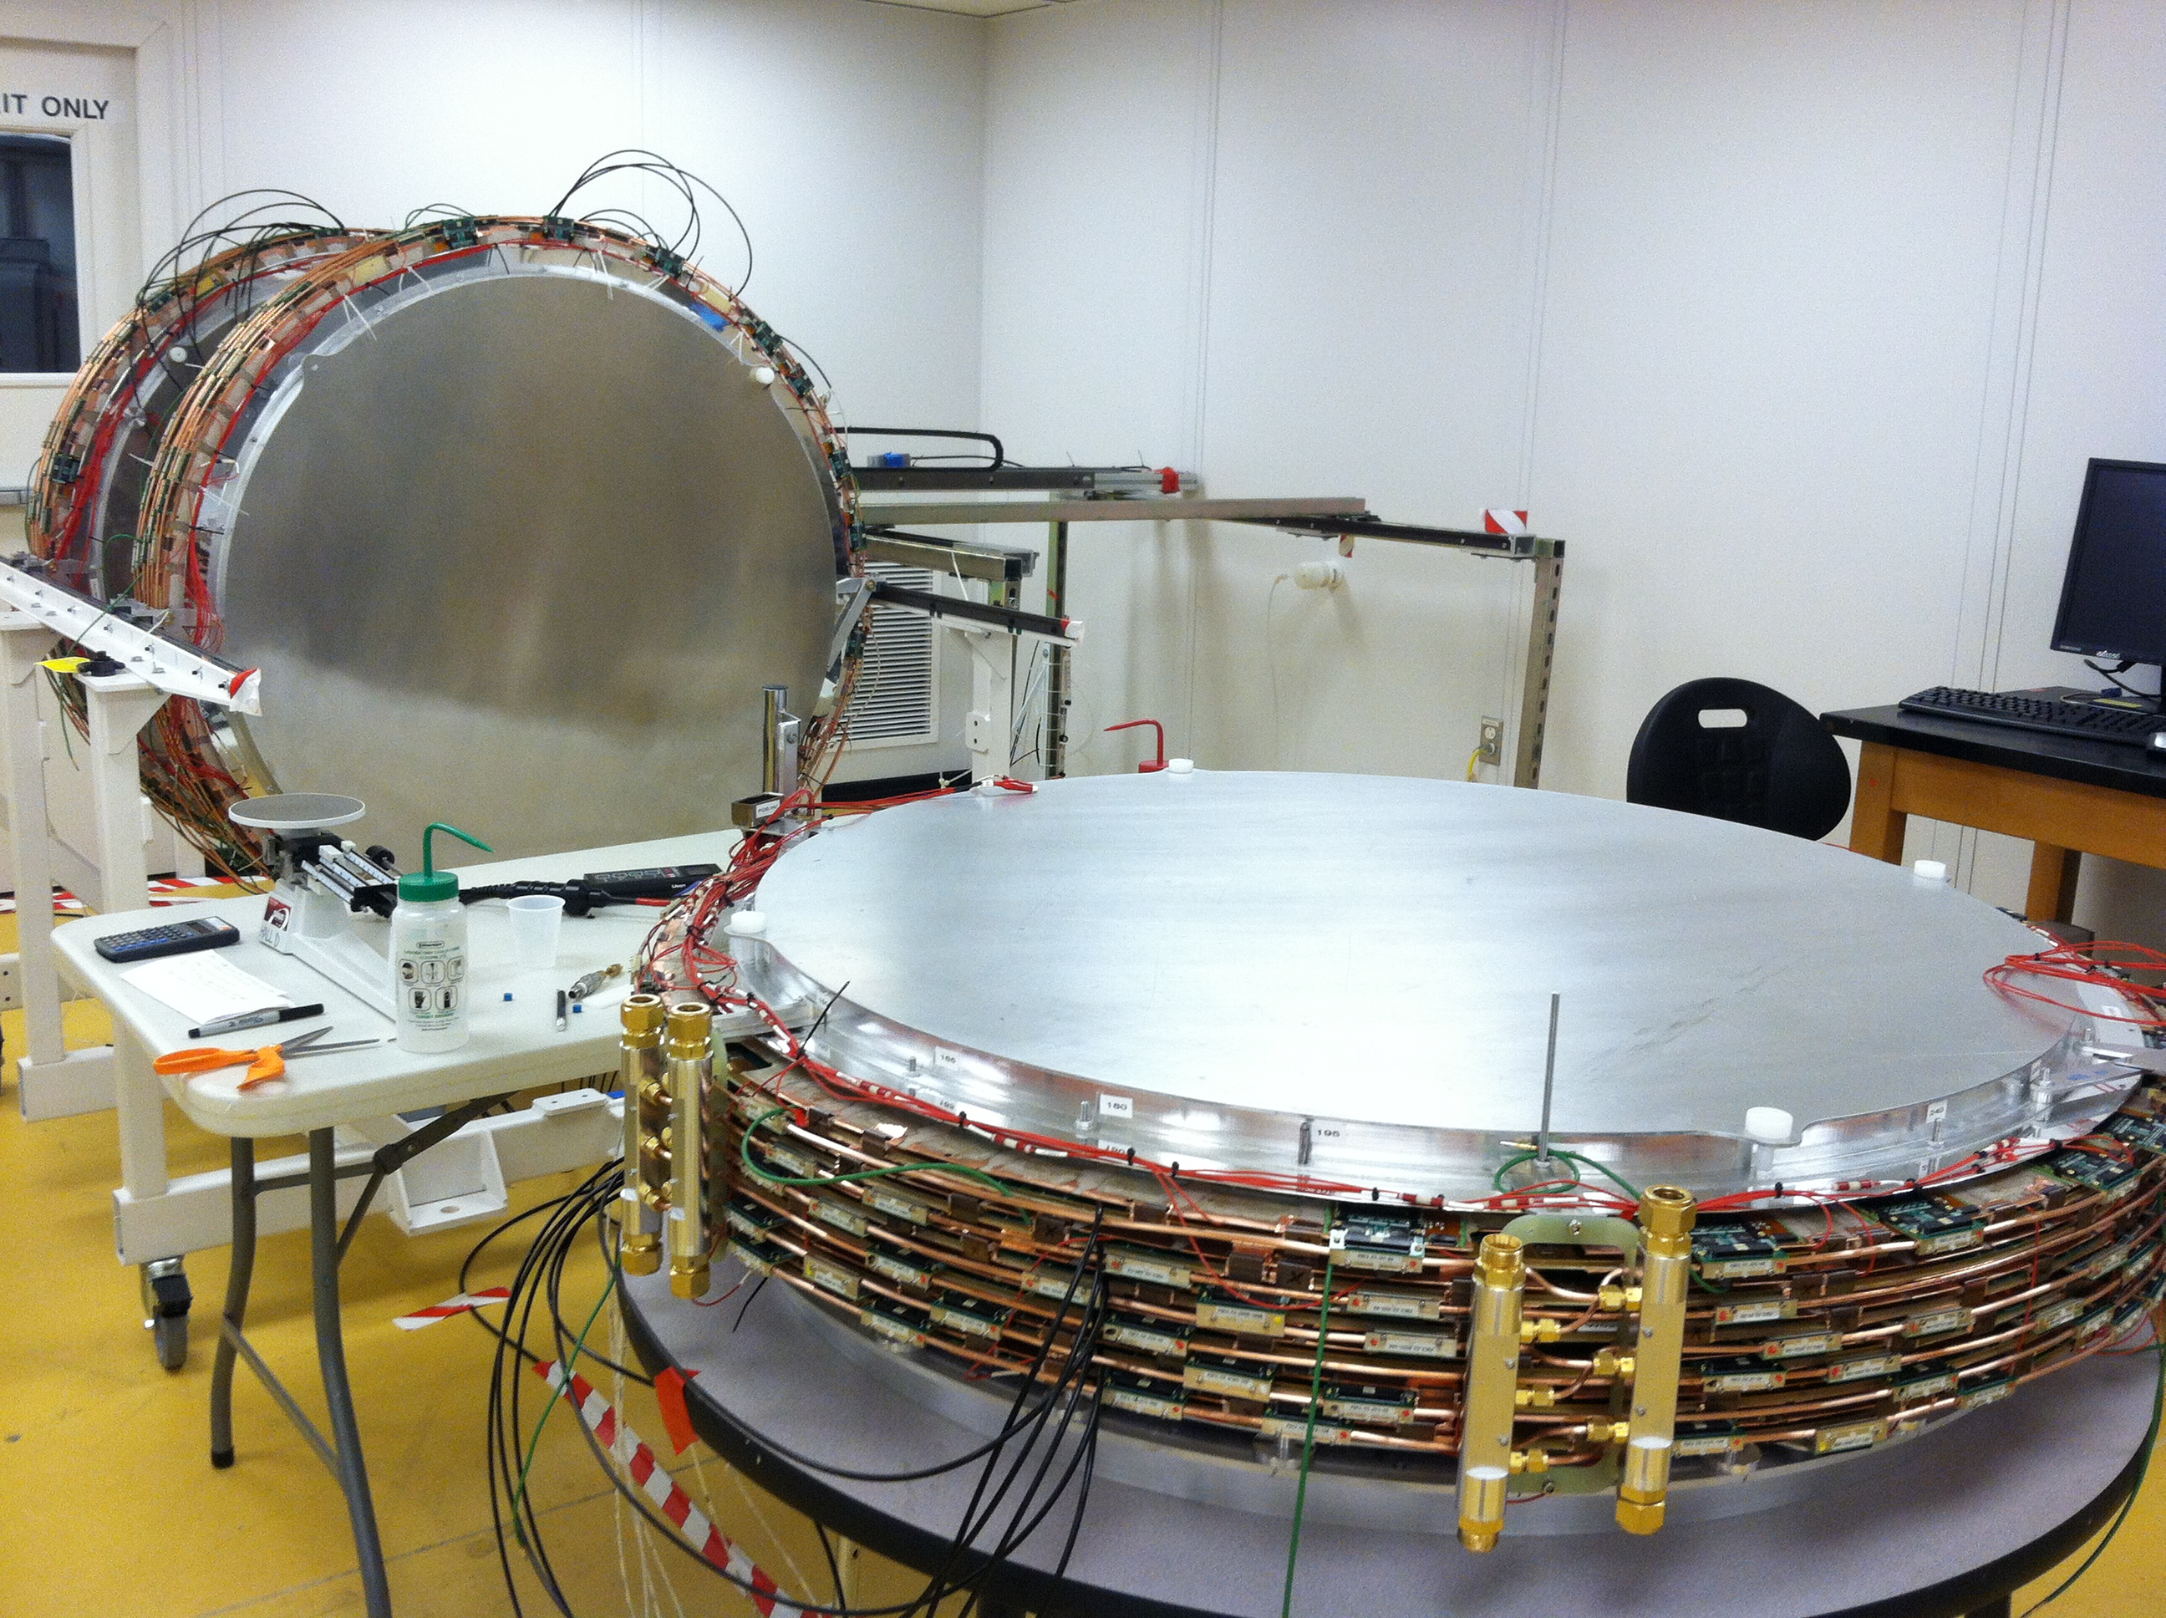
FDC UPDATE
GlueX Collaboration Meeting
June 3-5 2013, Jefferson Lab
Lubomir Pentchev
on behalf of the FDC group

Slide 2
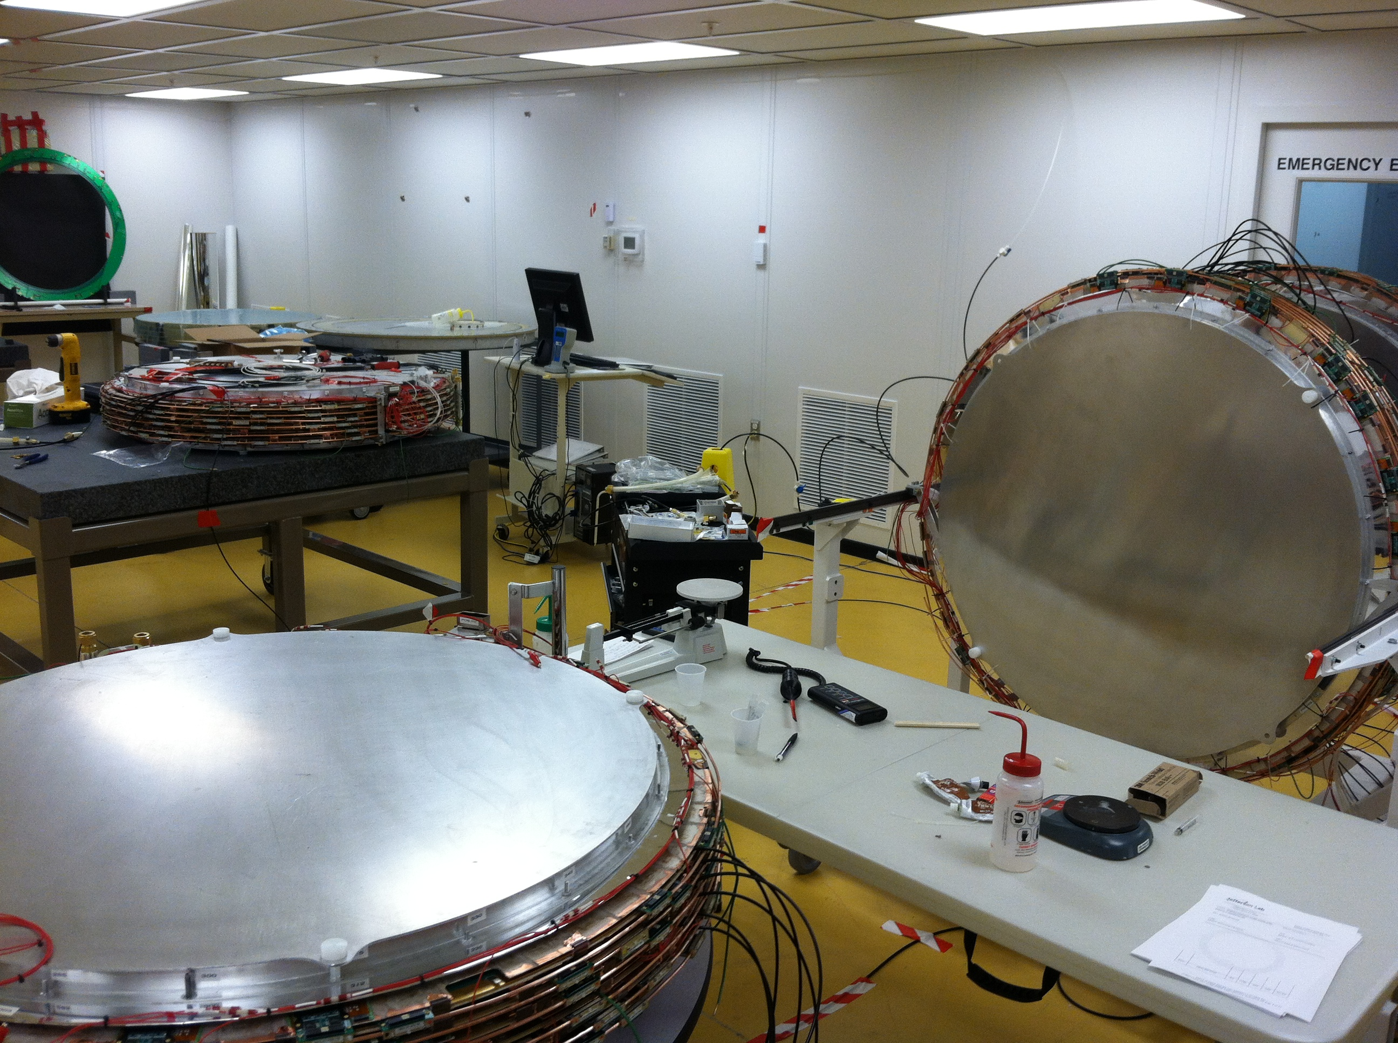
Production Packages
ALL PRODUCTION PACKAGES ARE READY AND TESTED WITH DAQ

Slide 3
Third Package Repair
Two AC units have been installed to lower the >80⁰F temperatures in EEL126
Package #1 is being tested now: all channels working OK
3

Slide 4
Spare Package
Package #2 was completely assembled, tested at Blue Crab
Subsystem installation: grounding finished, cooling tubes and HV wiring will be done by the end of the month
Will be moved for testing to EEL126 beginning of March
4

Slide 5
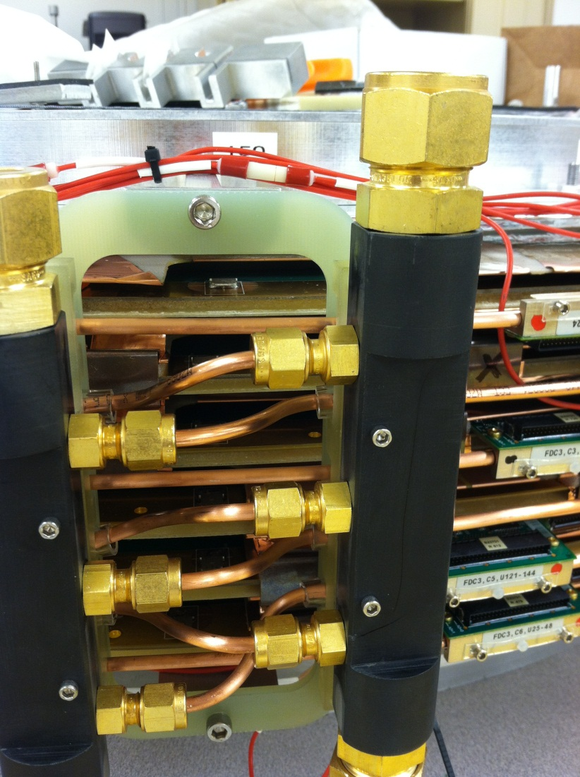
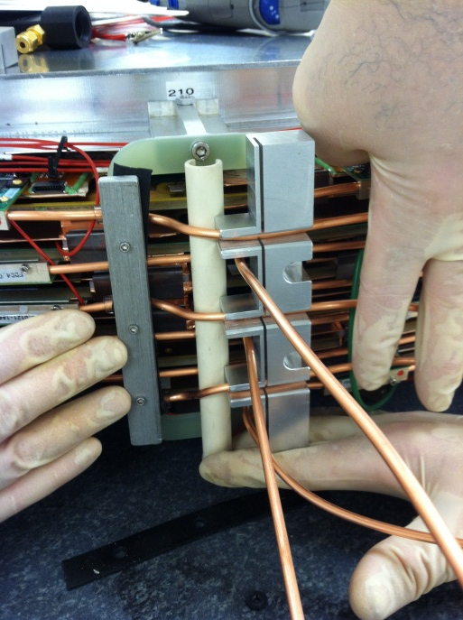
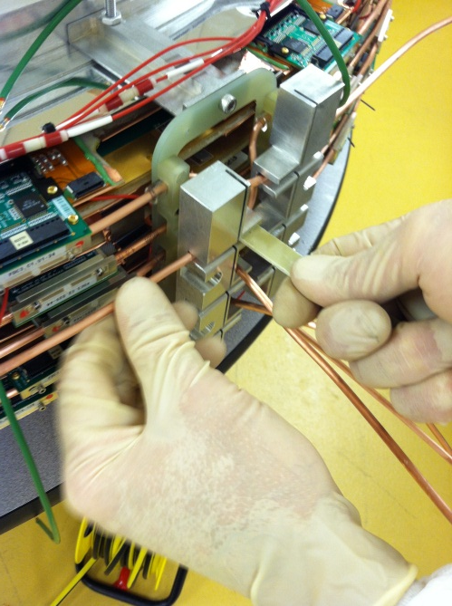
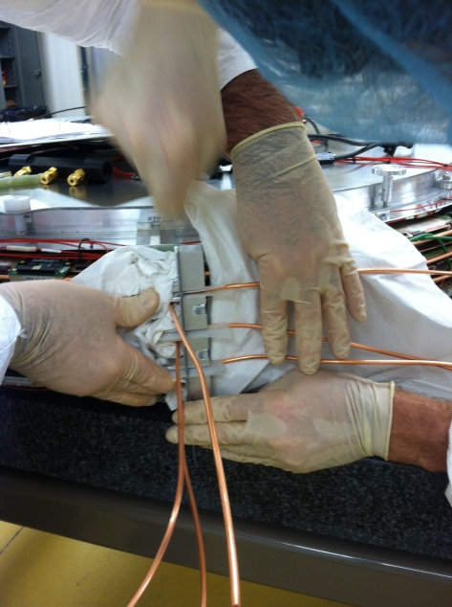
Cooling System
Decided to build one spare package: have the parts for six cells
NO electronics on the package, NO HV connections: don’t have extra electronics/HV cables
In case of emergency, production package can be replaced with this one using the old pre-amp cards and HV cables
Large size deadened area (7.8cm diameter) so that it can replace any of the original packages
5

Slide 6
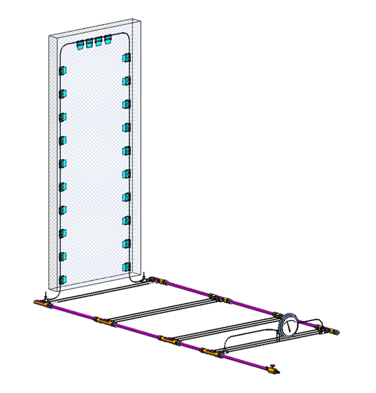
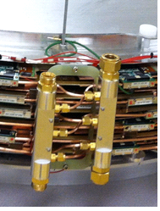
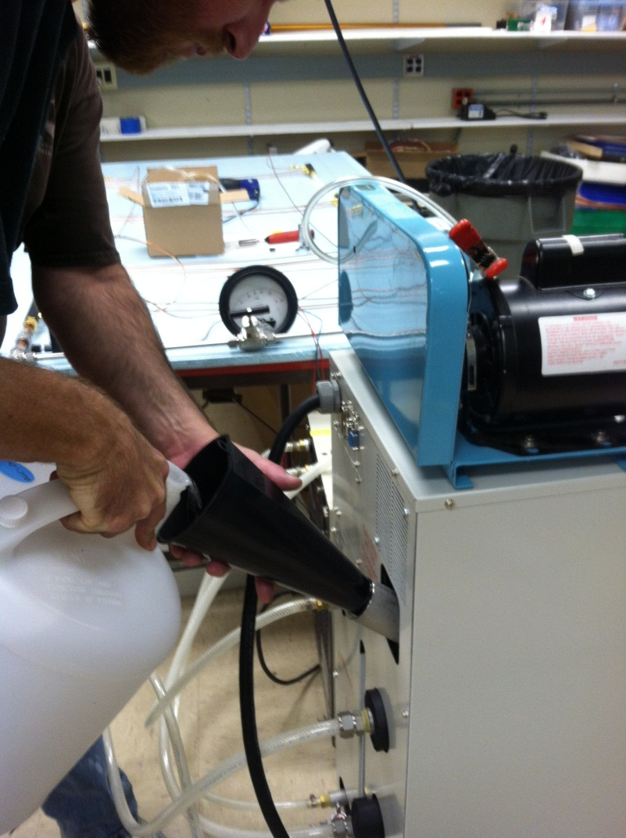
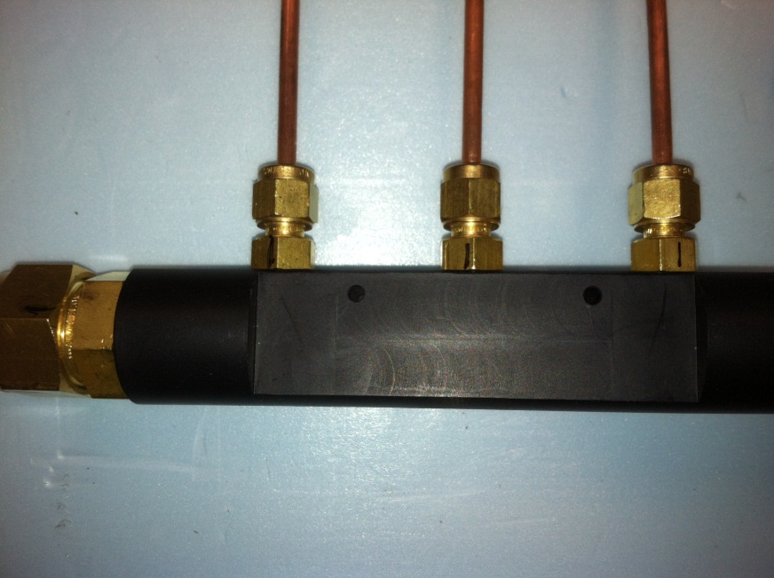
Cooling System Test
Decided to build one spare package: have the parts for six cells
NO electronics on the package, NO HV connections: don’t have extra electronics/HV cables
In case of emergency, production package can be replaced with this one using the old pre-amp cards and HV cables
Large size deadened area (7.8cm diameter) so that it can replace any of the original packages
6

Slide 7
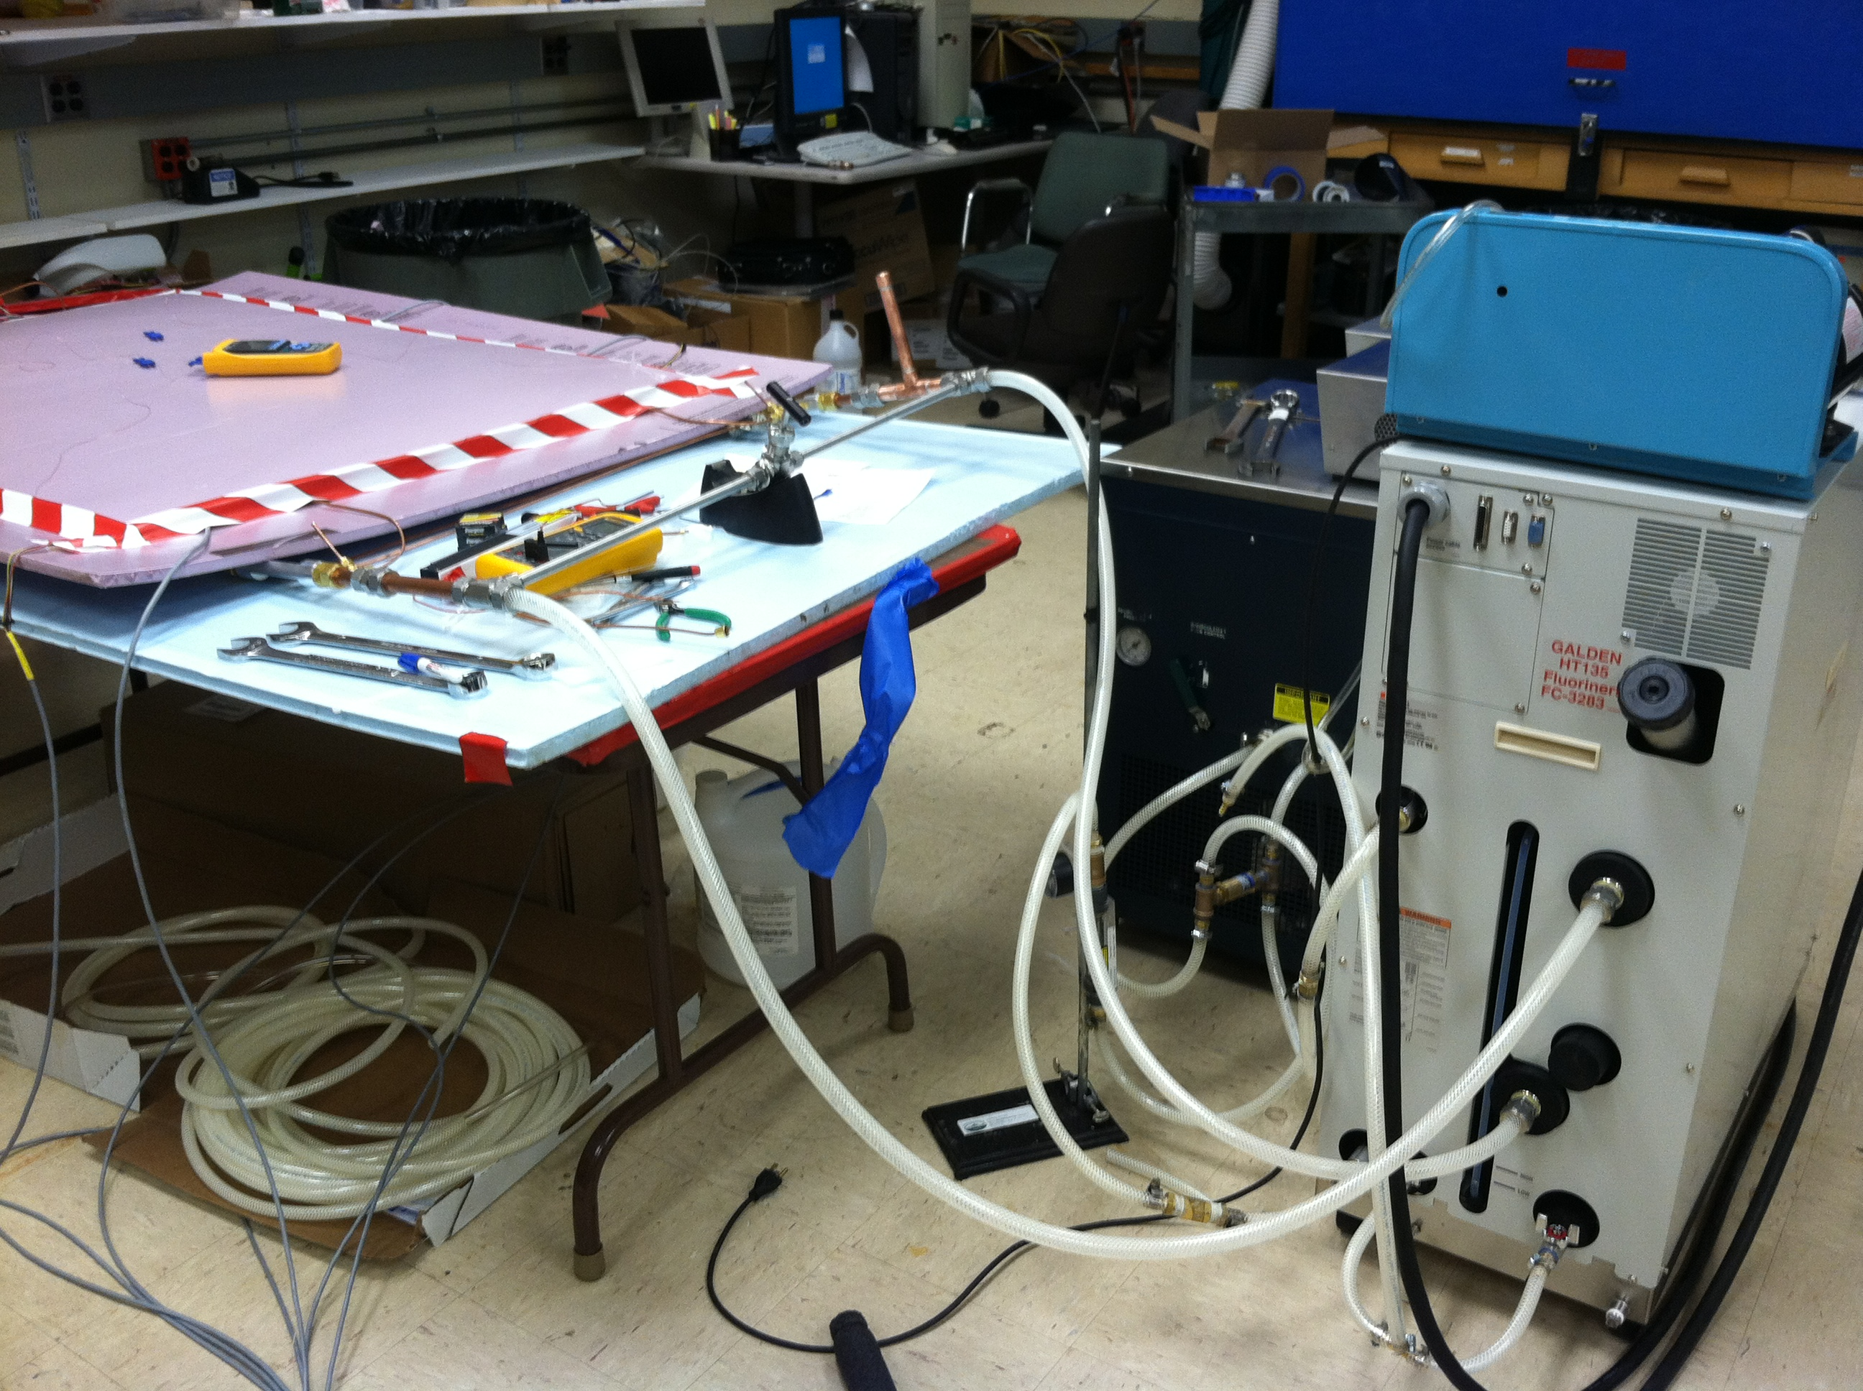
Cooling System Test
Decided to build one spare package: have the parts for six cells
NO electronics on the package, NO HV connections: don’t have extra electronics/HV cables
In case of emergency, production package can be replaced with this one using the old pre-amp cards and HV cables
Large size deadened area (7.8cm diameter) so that it can replace any of the original packages
7

Slide 8
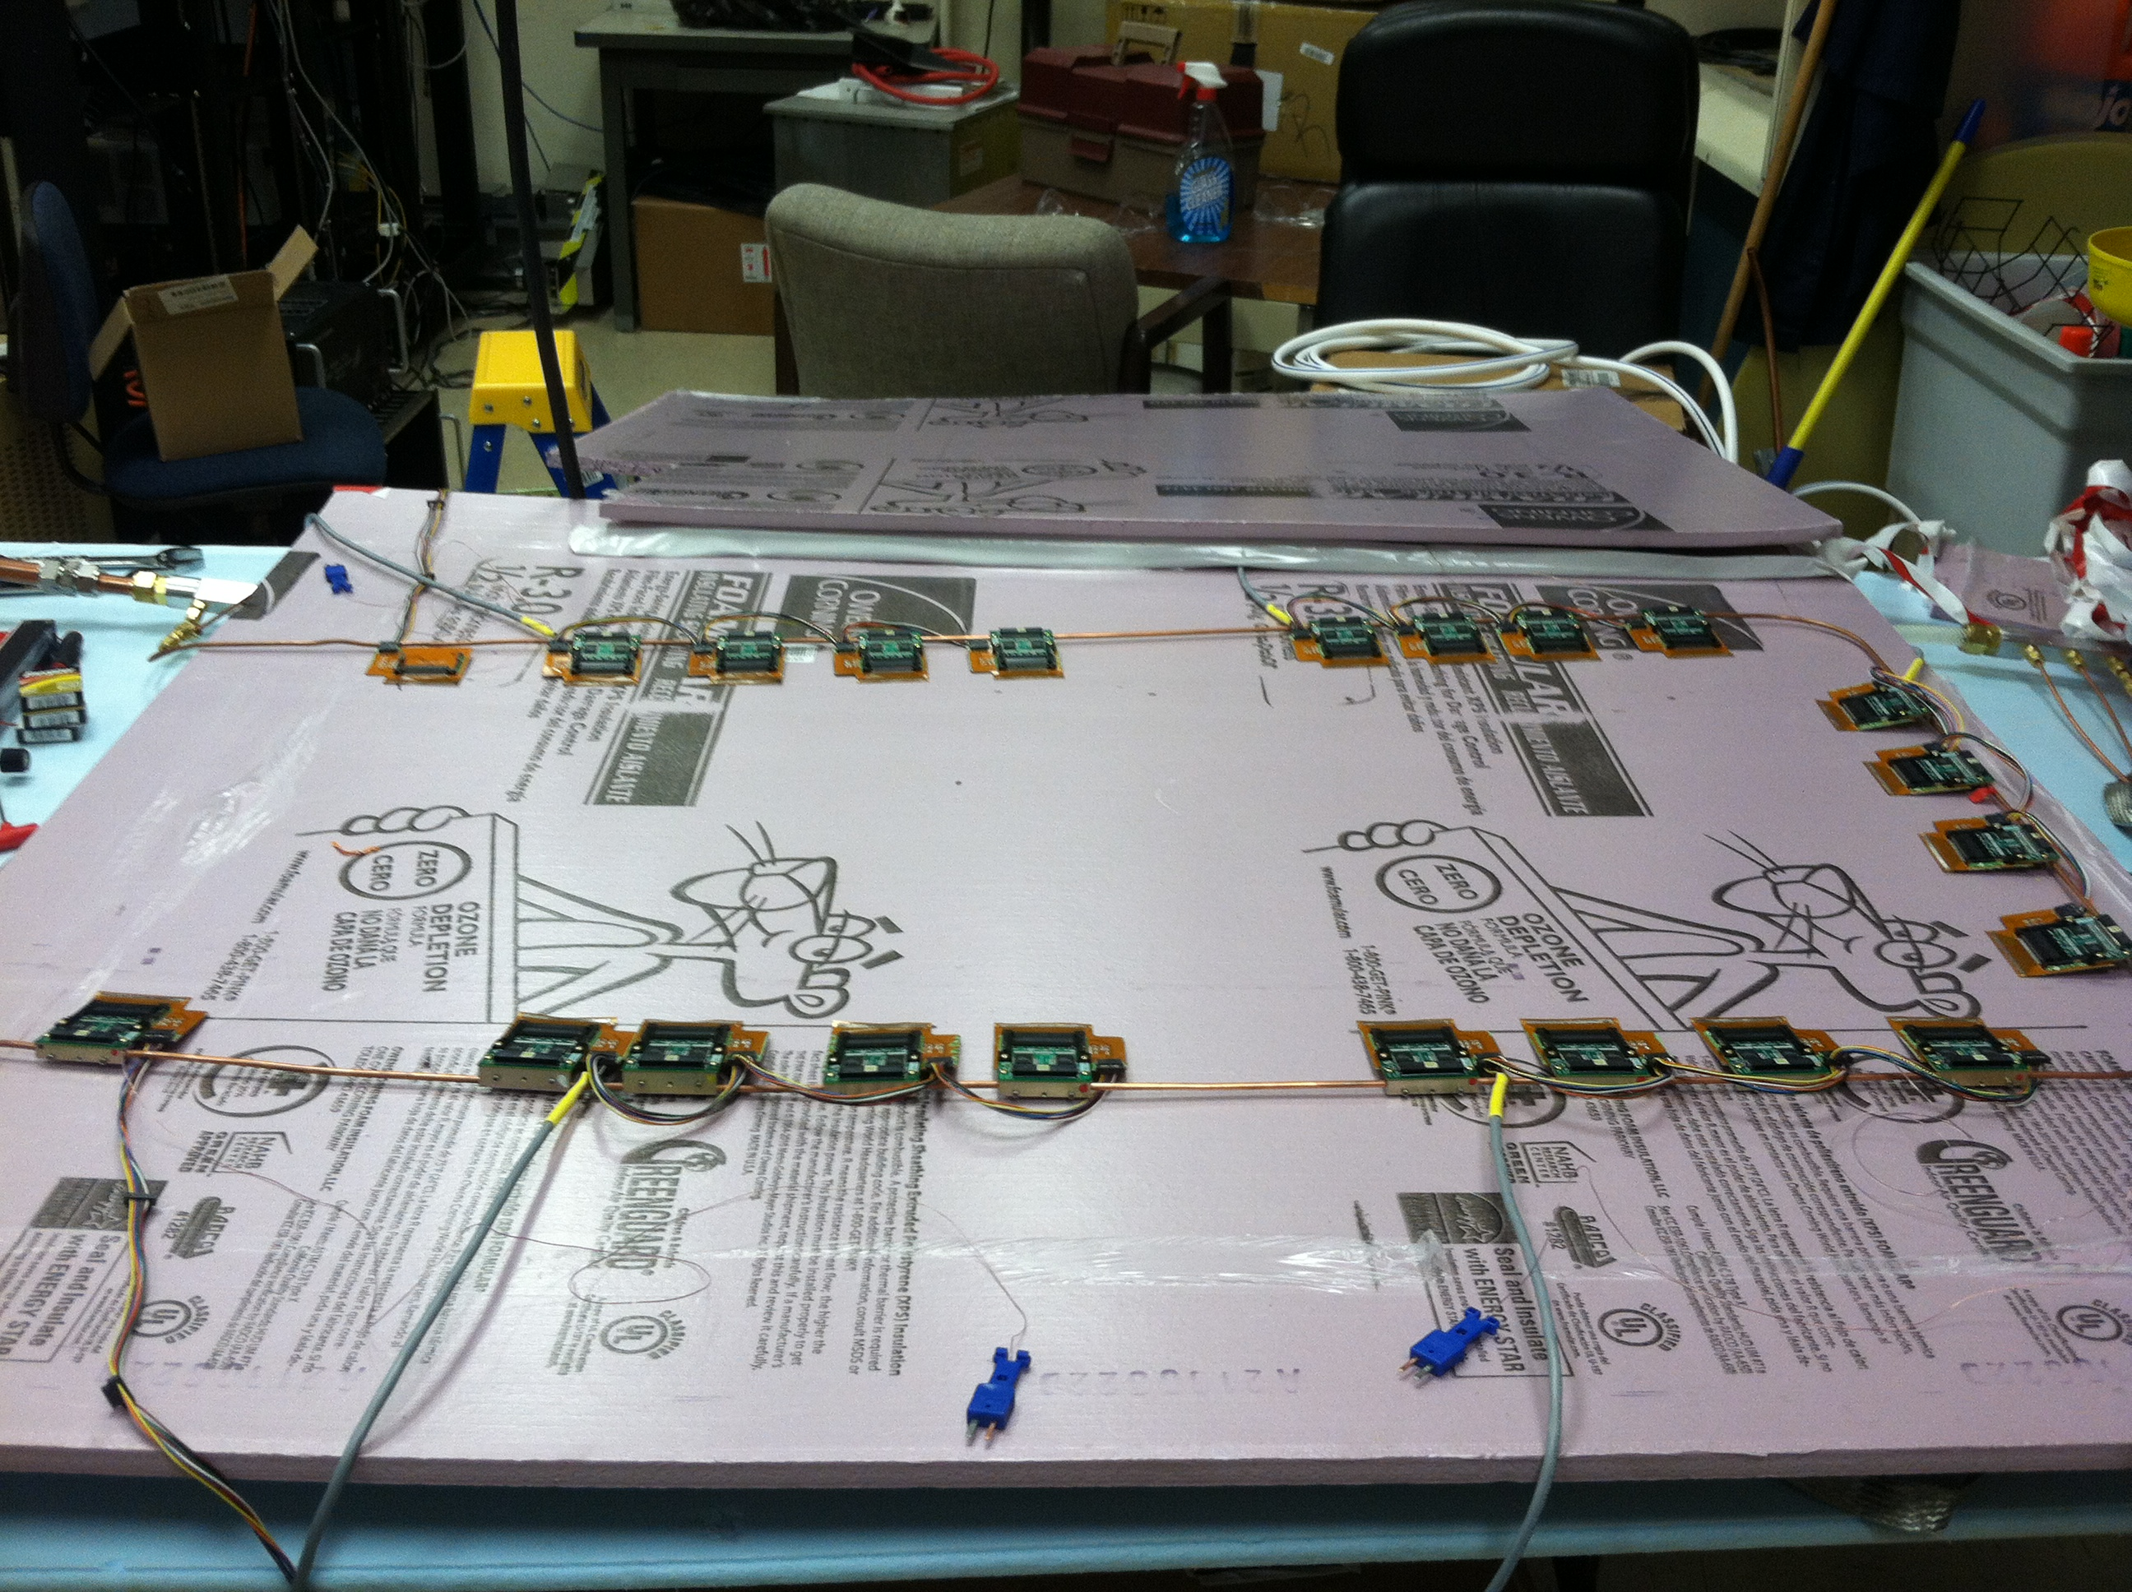
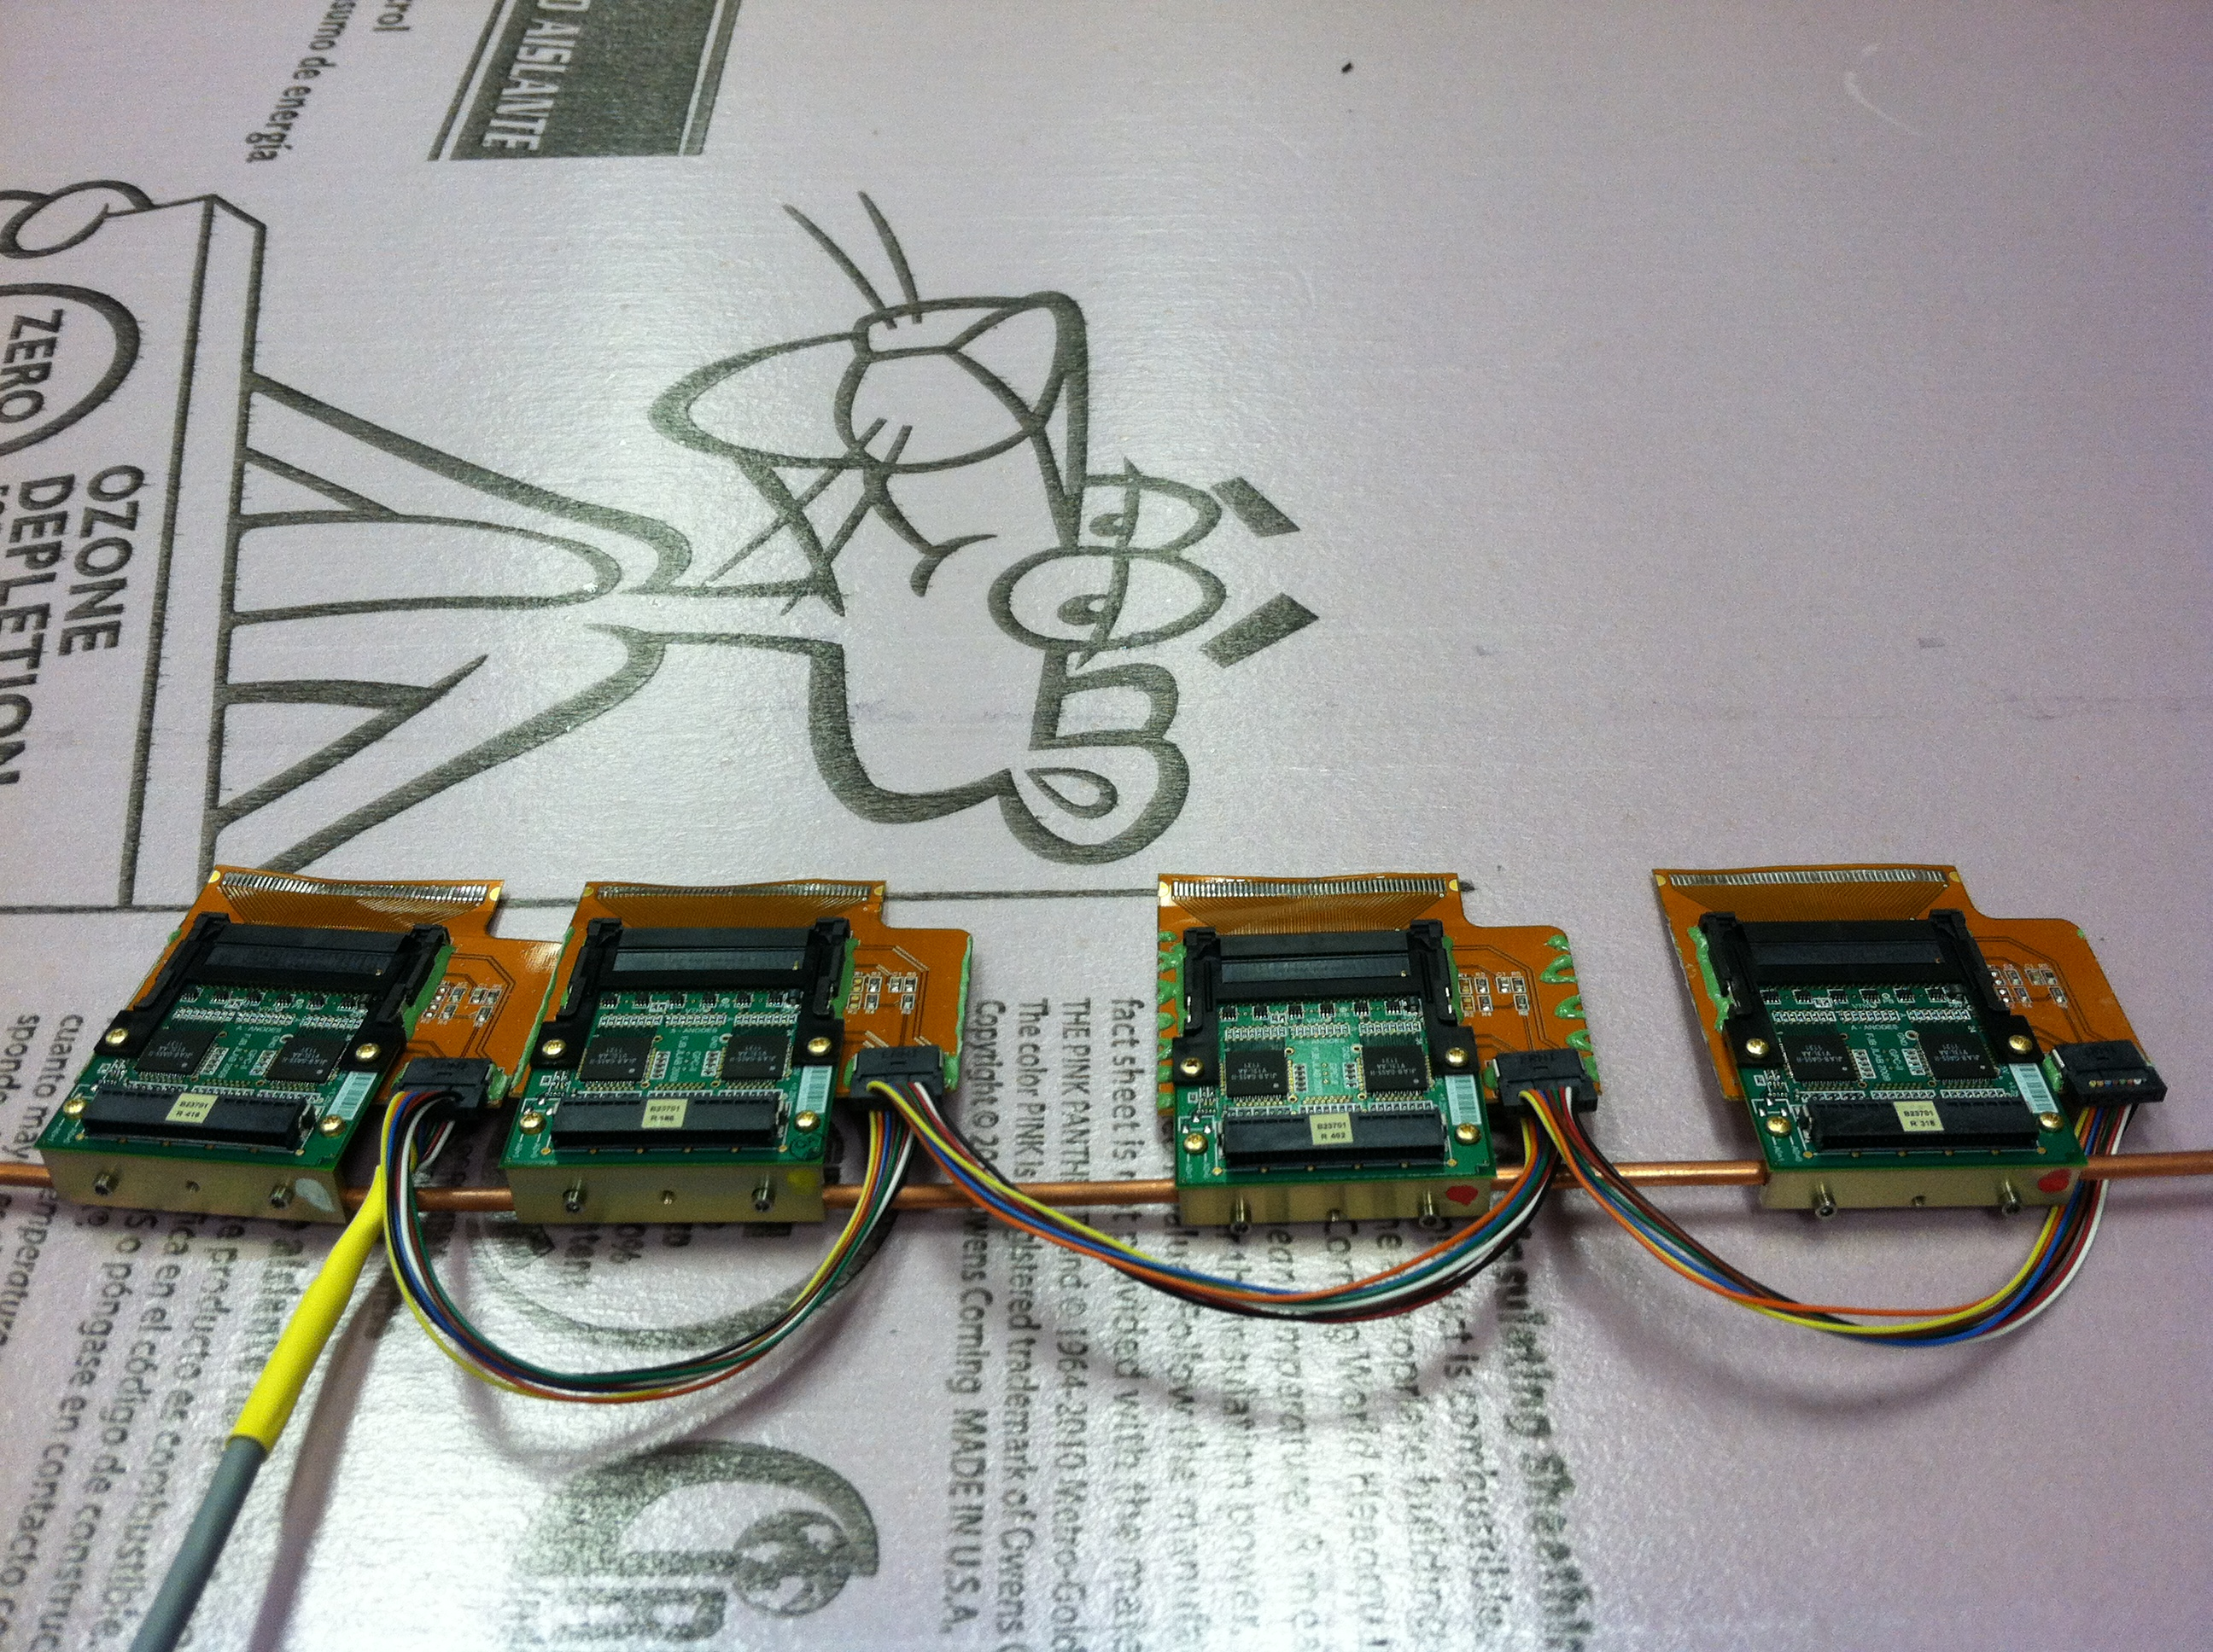
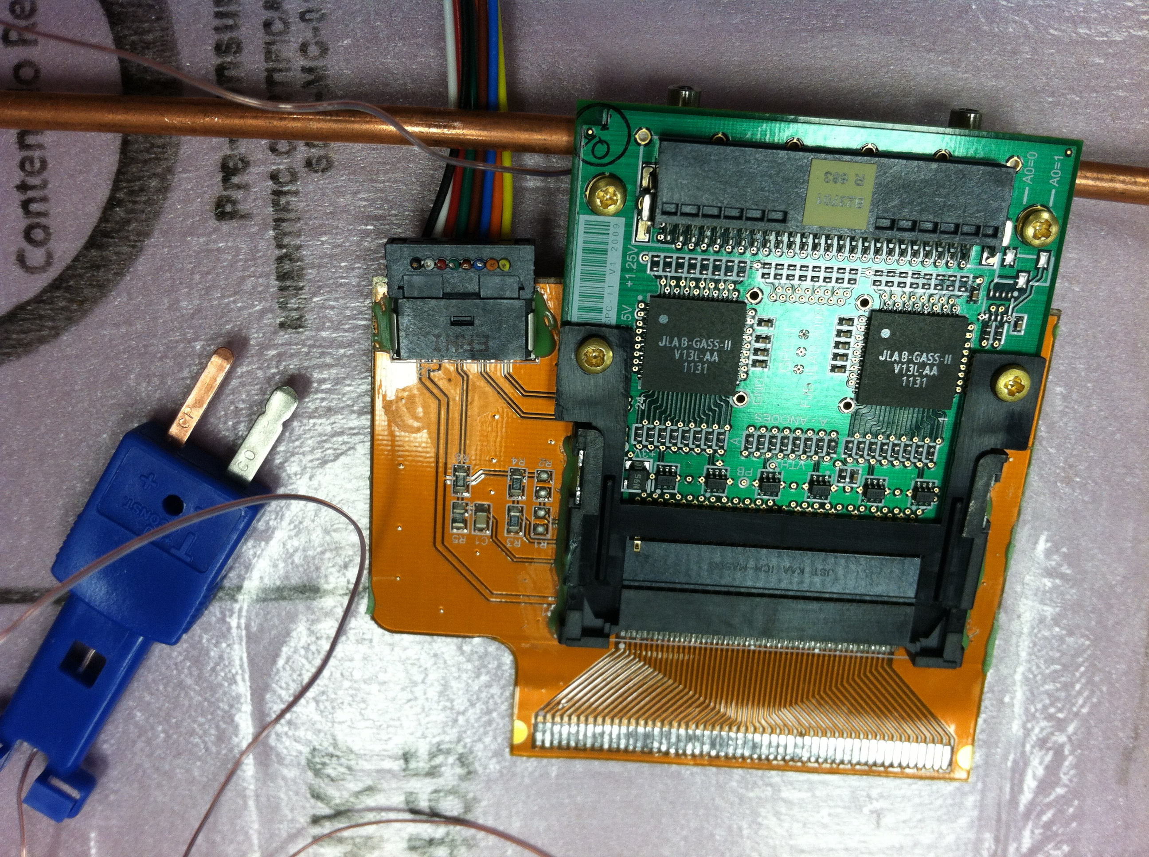
Cooling System Test
Decided to build one spare package: have the parts for six cells
NO electronics on the package, NO HV connections: don’t have extra electronics/HV cables
In case of emergency, production package can be replaced with this one using the old pre-amp cards and HV cables
Large size deadened area (7.8cm diameter) so that it can replace any of the original packages
8

Slide 9
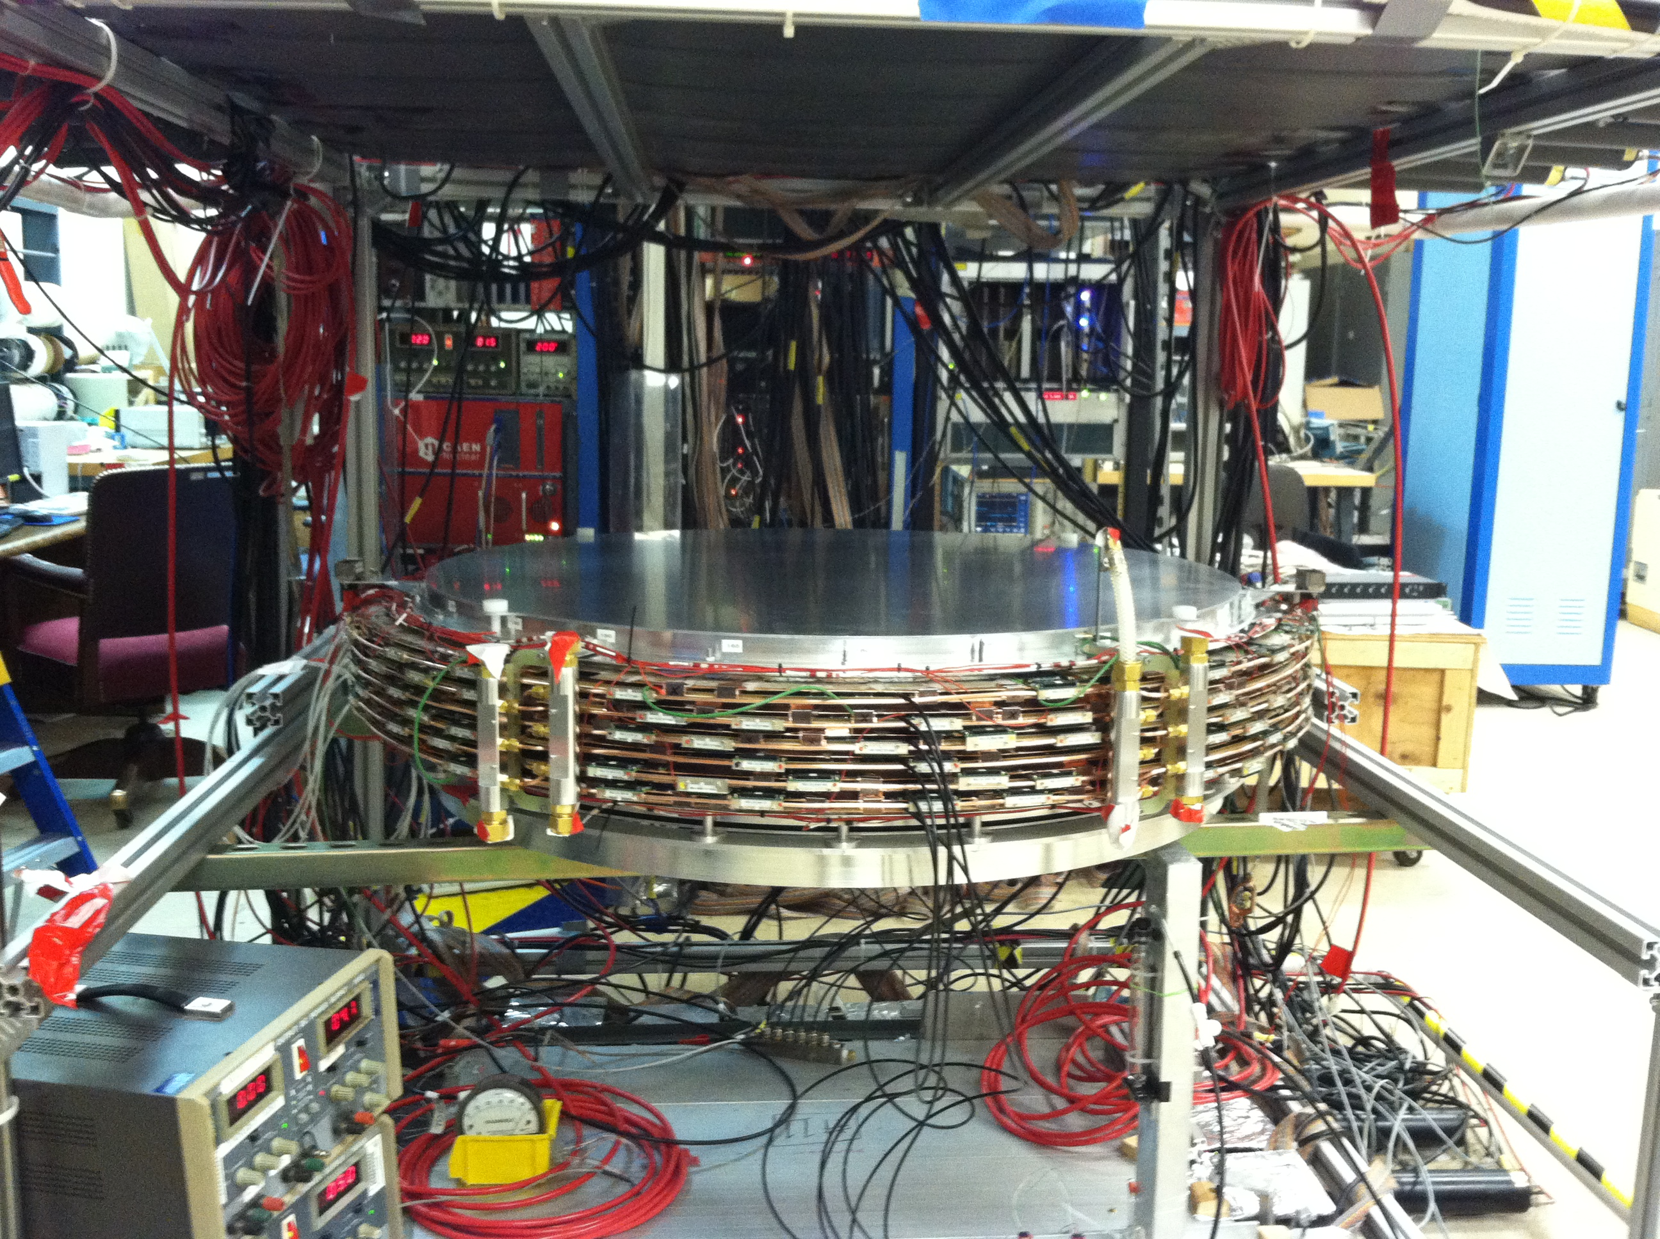
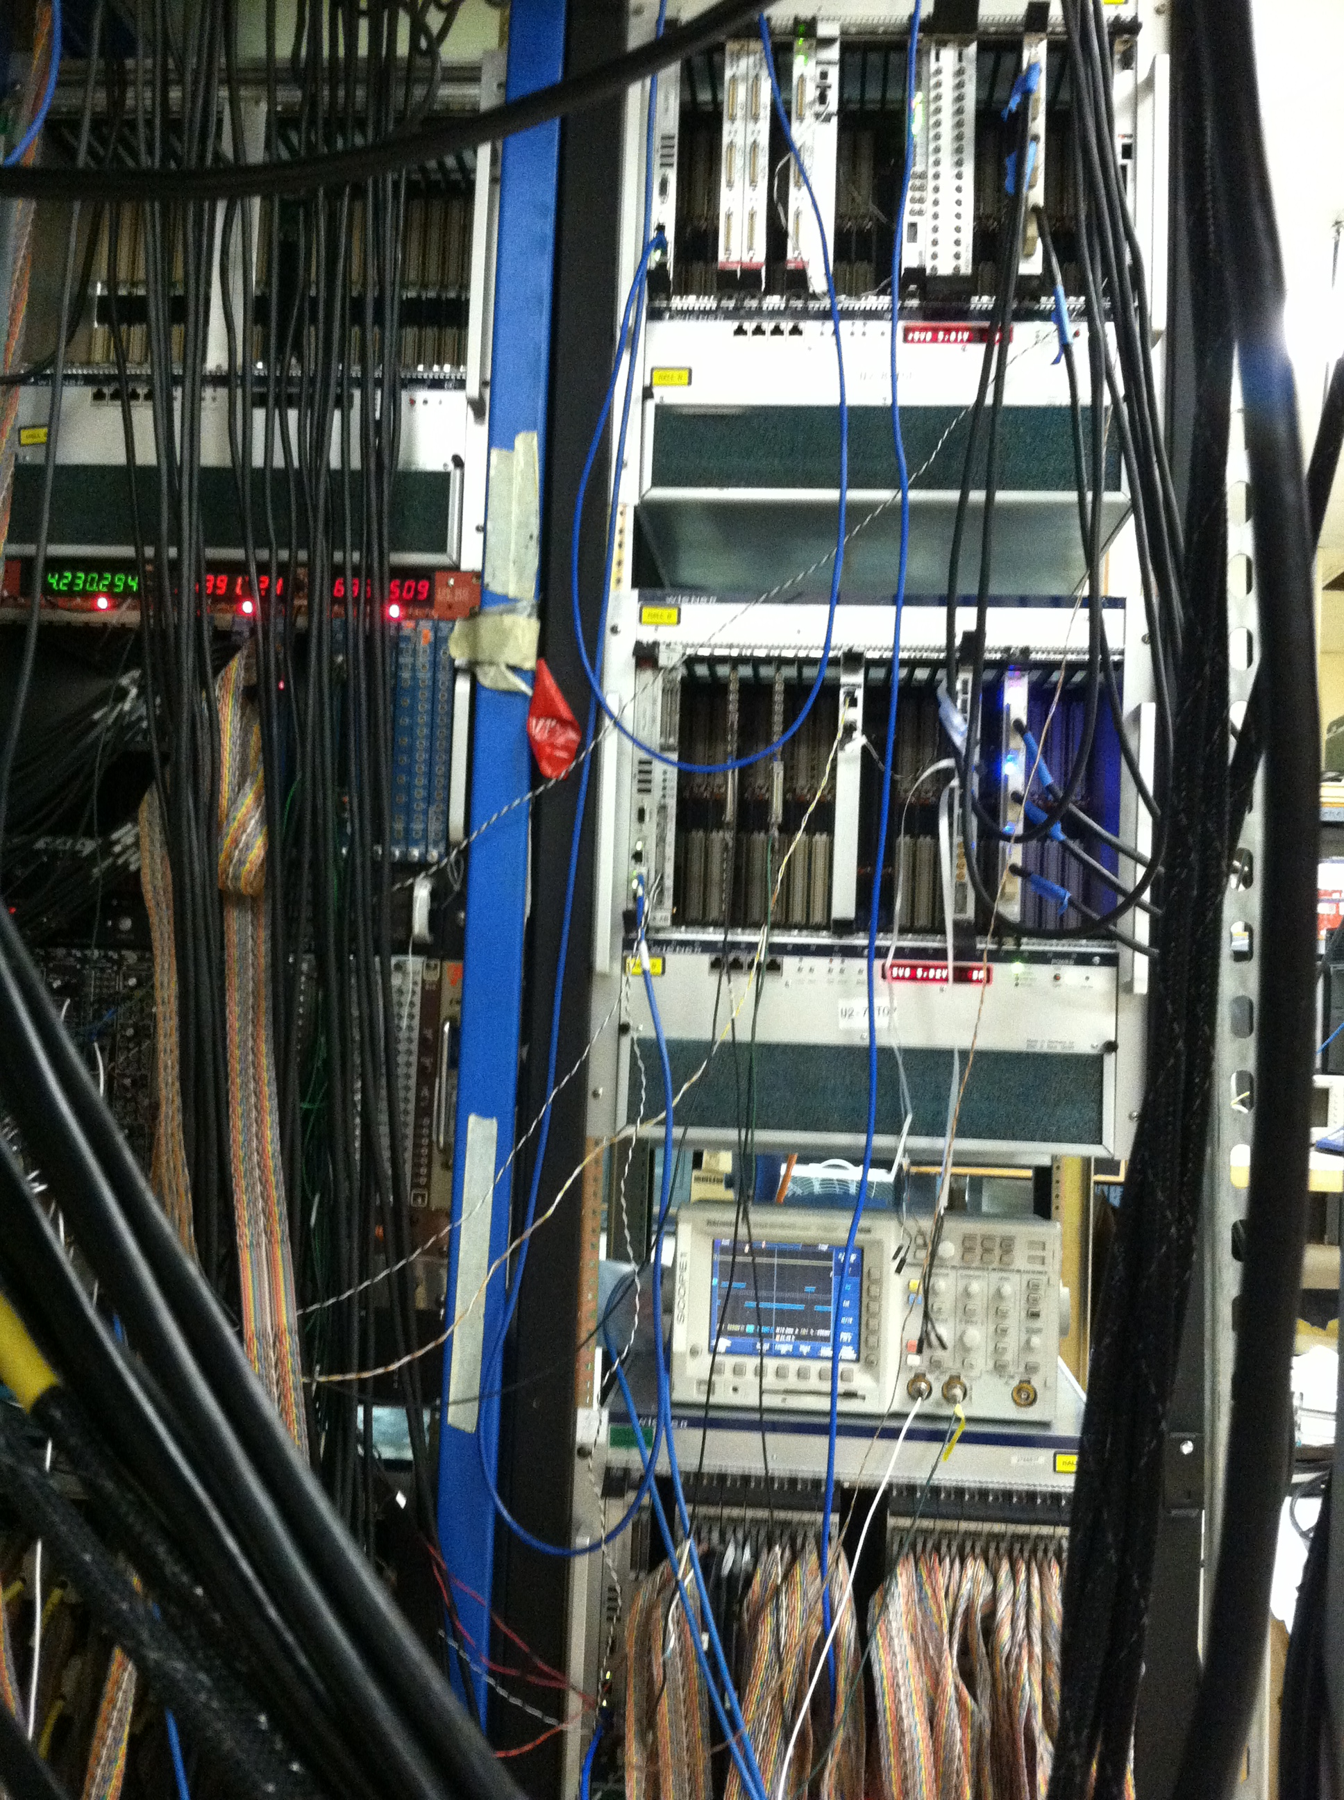
Test One Package with Full Electronics
We have to choose 6 wire planes out of 8 produced
#1 can’t be used
We already have 6 that can be used
After testing #6 we will decide if will put #2 with smaller deadened area into the package
9

Slide 10
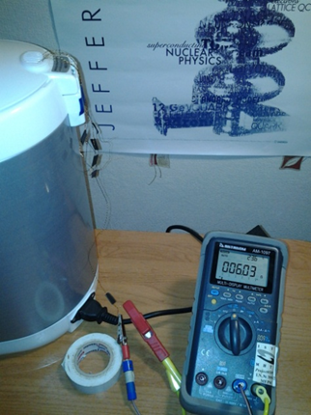
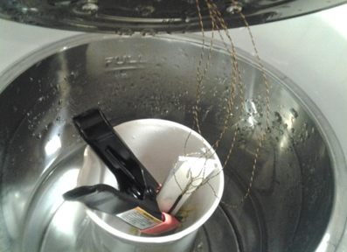
Corrosion Test
Environment | Temperature, K | O-ring | R curent (R first) | Days | Notes | Reason | Days, Ea=0.34eV | Days, Ea=0.39eV
experiment | 375 | EPDM | 2 MOhm(5 Ohm) | 1 | Failed after 24 hours | Corrosion | 13.95 | 20.56
over | 375 | EPDM | 2.5 MOhm(5 Ohm) | 1 | Failed after 6 hours | Corrosion | 13.95 | 20.56
Athmospheric | 375 | Viton | 6 Ohm(6 Ohm) | 70 | Failed | Other problem | 976.68 | 1439.07
100% | 375 | Viton | 5 Ohm(5 Ohm) | 70 |  |  | 976.68 | 1439.07
Humidity
 | 375 | Viton+Apiezon | 5 Ohm(5 Ohm) | 70 | Failed | Other problem | 976.68 | 1439.07
 | 375 | Viton+Apiezon | 5 Ohm(5 Ohm) | 70 | Failed | Other problem | 976.68 | 1439.07
Vladimir Berdnikov started a test at MePhi with air at 100% humidity (using water in a thermostat)
EPDM samples failed immediately (6-24h) after start of the test, while Viton samples are OK more than 3 weeks
10

Slide 11
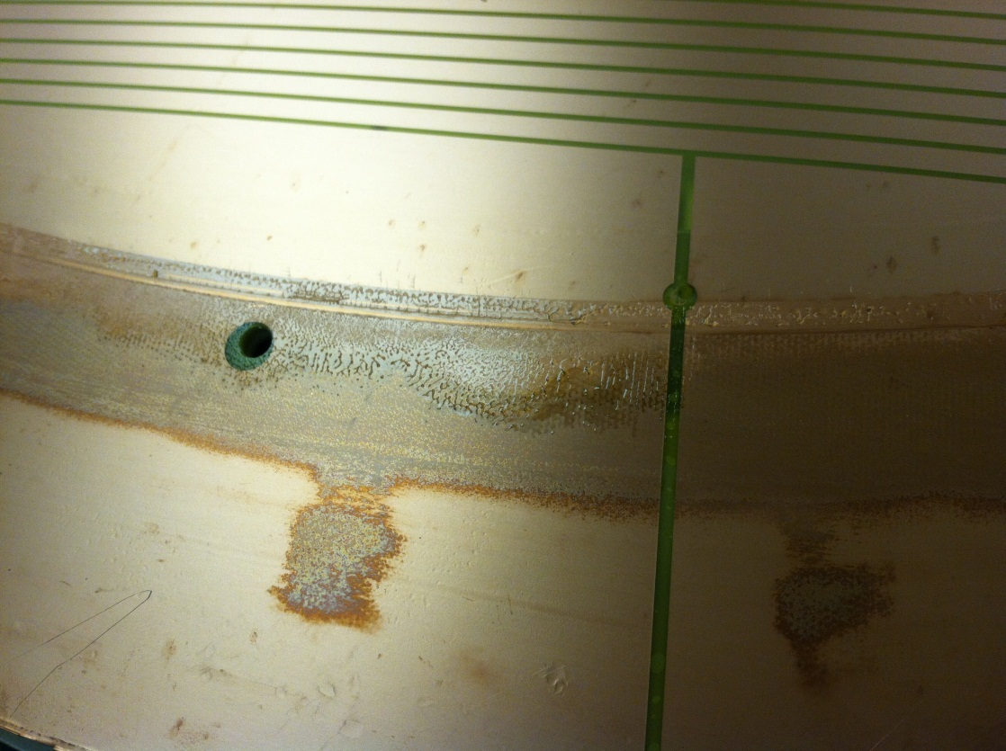
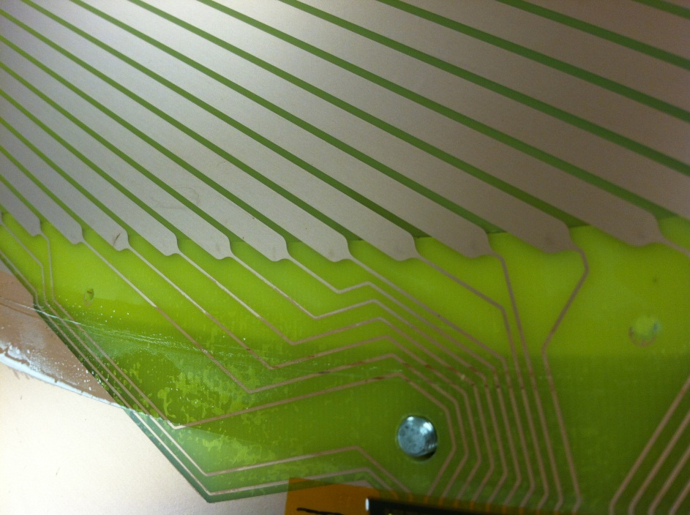
Corrosion
Vladimir Berdnikov started a test at MePhi with air at 100% humidity (using water in a thermostat)
EPDM samples failed immediately (6-24h) after start of the test, while Viton samples are OK more than 3 weeks
11

Slide 12
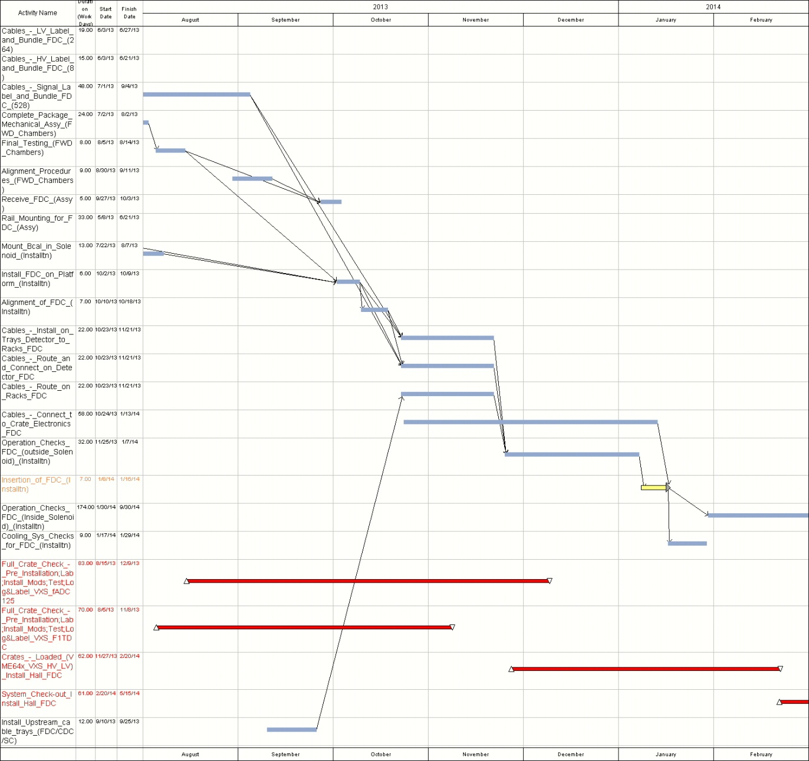
Installation
The rail deformation using the FDC mock-up loaded to 155kg (FDC+cables) has been tested (Bill and Casey) and found to be <0.1 mm
Survey/adjust the distances between the rails on all the installation carts (done for the main rails)
Before moving the FDC to the Hall, the packages will be surveyed as they are on the installation cart (July)
12

Slide 13
Installation
The rail deformation using the FDC mock-up loaded to 155kg (FDC+cables) has been tested (Bill and Casey) and found to be <0.1 mm
Survey/adjust the distances between the rails on all the installation carts (done for the main rails)
Before moving the FDC to the Hall, the packages will be surveyed as they are on the installation cart (July)
13

Slide 14
Installation
The rail deformation using the FDC mock-up loaded to 155kg (FDC+cables) has been tested (Bill and Casey) and found to be <0.1 mm
Survey/adjust the distances between the rails on all the installation carts (done for the main rails)
Before moving the FDC to the Hall, the packages will be surveyed as they are on the installation cart (July)
14

Slide 15
Installation
The rail deformation using the FDC mock-up loaded to 155kg (FDC+cables) has been tested (Bill and Casey) and found to be <0.1 mm
Survey/adjust the distances between the rails on all the installation carts (done for the main rails)
Before moving the FDC to the Hall, the packages will be surveyed as they are on the installation cart (July)
15

Slide 16
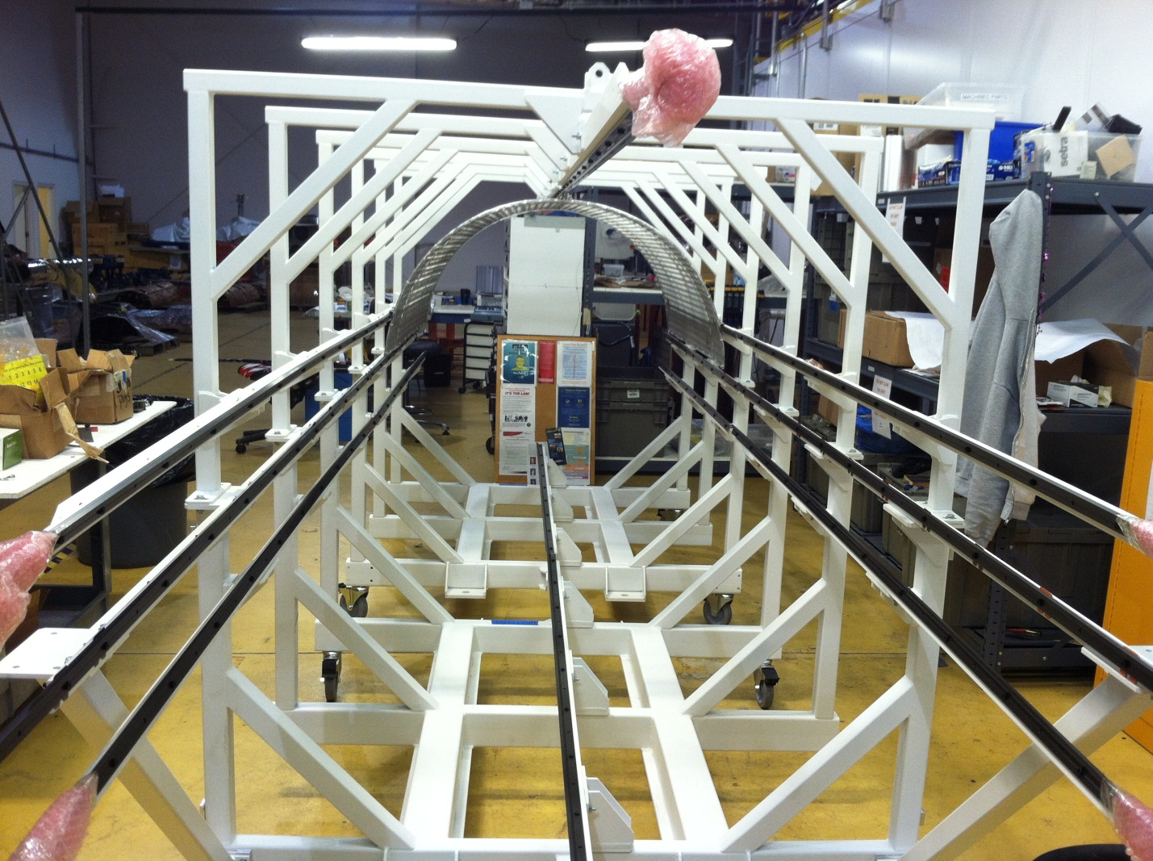
Installation
The rail deformation using the FDC mock-up loaded to 155kg (FDC+cables) has been tested (Bill and Casey) and found to be <0.1 mm
Survey/adjust the distances between the rails on all the installation carts (done for the main rails)
Before moving the FDC to the Hall, the packages will be surveyed as they are on the installation cart (July)
16

Slide 17
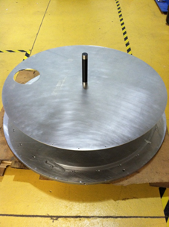
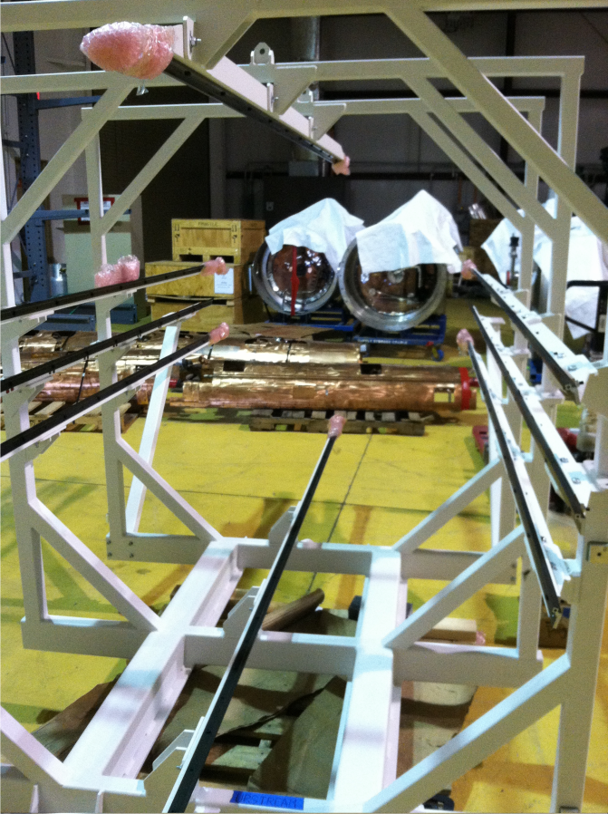
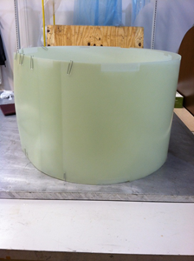
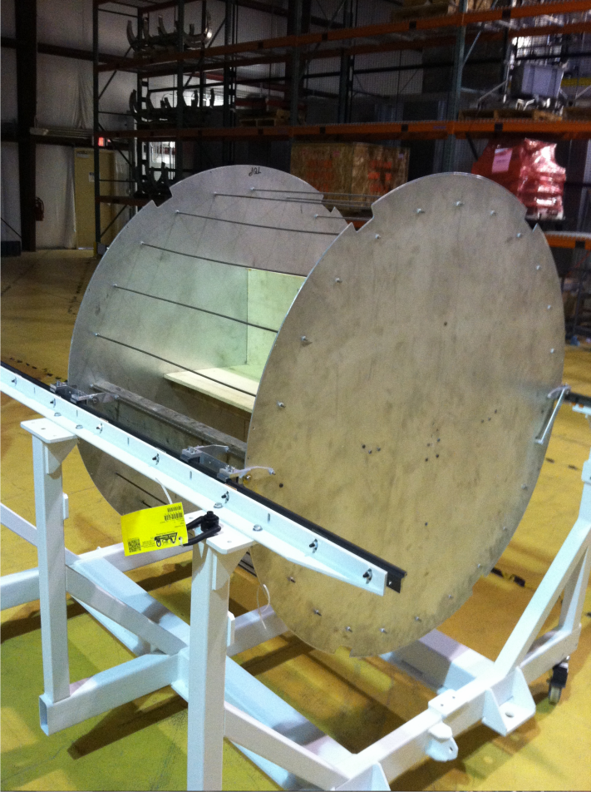
What’s next: installation cart survey, adjustment, tests
The rail deformation using the FDC mock-up loaded to 155kg (FDC+cables) has been tested (Bill and Casey) and found to be <0.1 mm
Survey/adjust the distances between the rails on all the installation carts (done for the main rails)
Before moving the FDC to the Hall, the packages will be surveyed as they are on the installation cart (July)
17

Slide 18
Outlook
The production of the four FDC packages is almost completed, the spare package will be ready by end of April.
The three packages tested so far showed very good performance and minor issues: out of 9,500 channels only one doesn’t work, 10 have connector/card problems, 20 field wires can’t be set to nominal HV.
Still, it is important to demonstrate this performance when all of the channels are connected to the electronics. Tests with full electronics on package #3 are planned for April-May.
All the four packages will be assembled together, tested (only applying HV) and surveyed at Blue Crab in June-July; ready to be moved to the Hall in August.
It is very important to synchronize all the activities related to the installation of the FDC. The installation of the FDC will require: space on the floor for cabling, cooling system, gas system, all the racks, electronics, LV and HV to be installed in advance, DAQ and trigger from FDC itself.
18

