Slide 1
Tracking working group - charges
The only work so far done by W&M: Amy Schertz and Justin Stevens for charged pions
Simon is studying proton efficiency with MC only
Some input from Bethe-Heitler and J/ψ efficiency studies but it is not only “tracking efficiency”

Slide 2
Studies with controlled sample of charged pions from ω decay (W&M group)
$ω→\left(π^{±}\right)π^{∓}π^{0}$
How to define cuts on the tracking quality, to be similar to the one of the tracks surviving certain reaction filter
Amy’s results

Slide 3
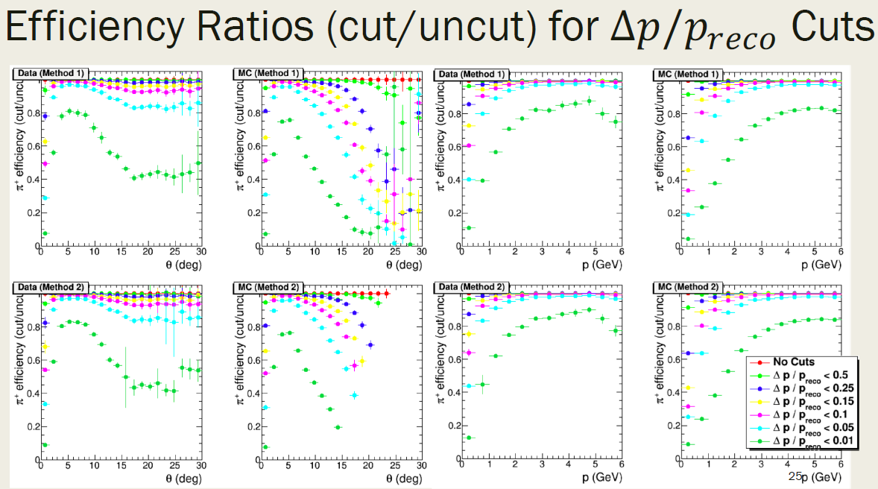
Studies with controlled sample of charged pions from ω decay (W&M group)
The method doesn’t work when applying cut on track resolution, due to bad reconstruction of missing momentum at big ω angles
Amy’s results

Slide 4
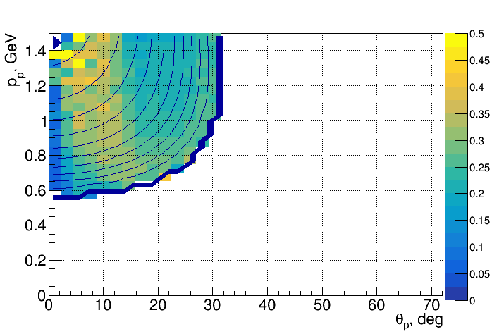
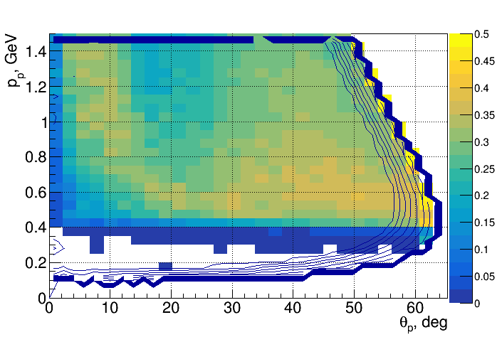
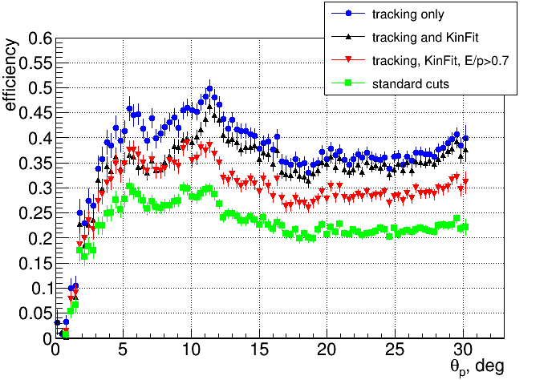
Bethe-Heitler and J/ψ efficiencies
J/ψ
BH M>1.5 GeV
Proton efficiency critical in comparing BH vs J/ψ
Can use BH at high M(e⁺e⁻) but very low statistics
Can we use pion tracking efficiency instead? (Simon’s studies)

Slide 5
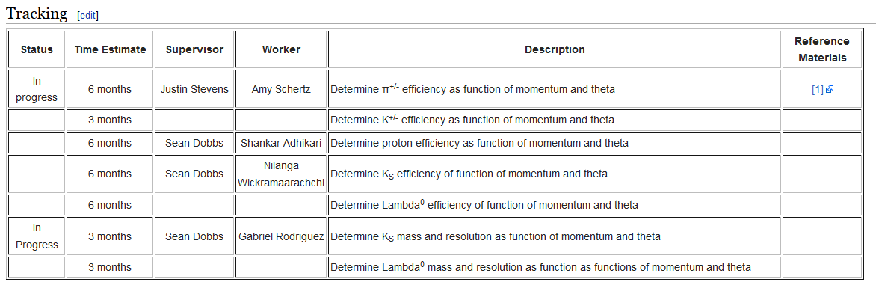
Tracking working group

Slide 6
Tracking - conclusions
The only work done so far by W&M – promising results with charged pions (data/MC agreement within 5%)
Difficulties with protons in covering forward angles
Deeper MC analysis needed to understand the tracking for pions and protons
Need studies with other reactions and more people actively working

