Slide 1
$π^{±}$ Tracking Efficiencies from $ω$ Production
GlueX Tracking Meeting – 02/07/2019
Amy M. Schertz

Slide 2
Previously…
Now…
Calculated $π^{±}$ efficiency as functions of $φ, θ, p$ from analysis of exclusive $ω→\left(π^{±}\right)π^{∓}π^{0}$ events
Summaries can be found at
https://halldweb.jlab.org/doc-private/DocDB/ShowDocument?docid=3801
https://halldweb.jlab.org/wiki/index.php/Meeting-1-24-2019
Added series of cuts on MM², $P(χ^{2})$ and $\left|Δp\right|/p_{reco}$
MM² cuts are useless, but $P(χ^{2})$ and $\left|Δp\right|/p_{reco}$ cuts show some promise
Still working with:
TTree files from ReactionFilter plugin pi0pimmisspip__B1_T1_U1_M7
Data: REST ver03, analysis launch ver23, runs 30274-30499 (~2B entries (before cuts))
MC: OSG generated: REQUESTED_MC/jz_omega_3pi_geant3_20181012035719pm (~70M entries (before cuts))

Slide 3
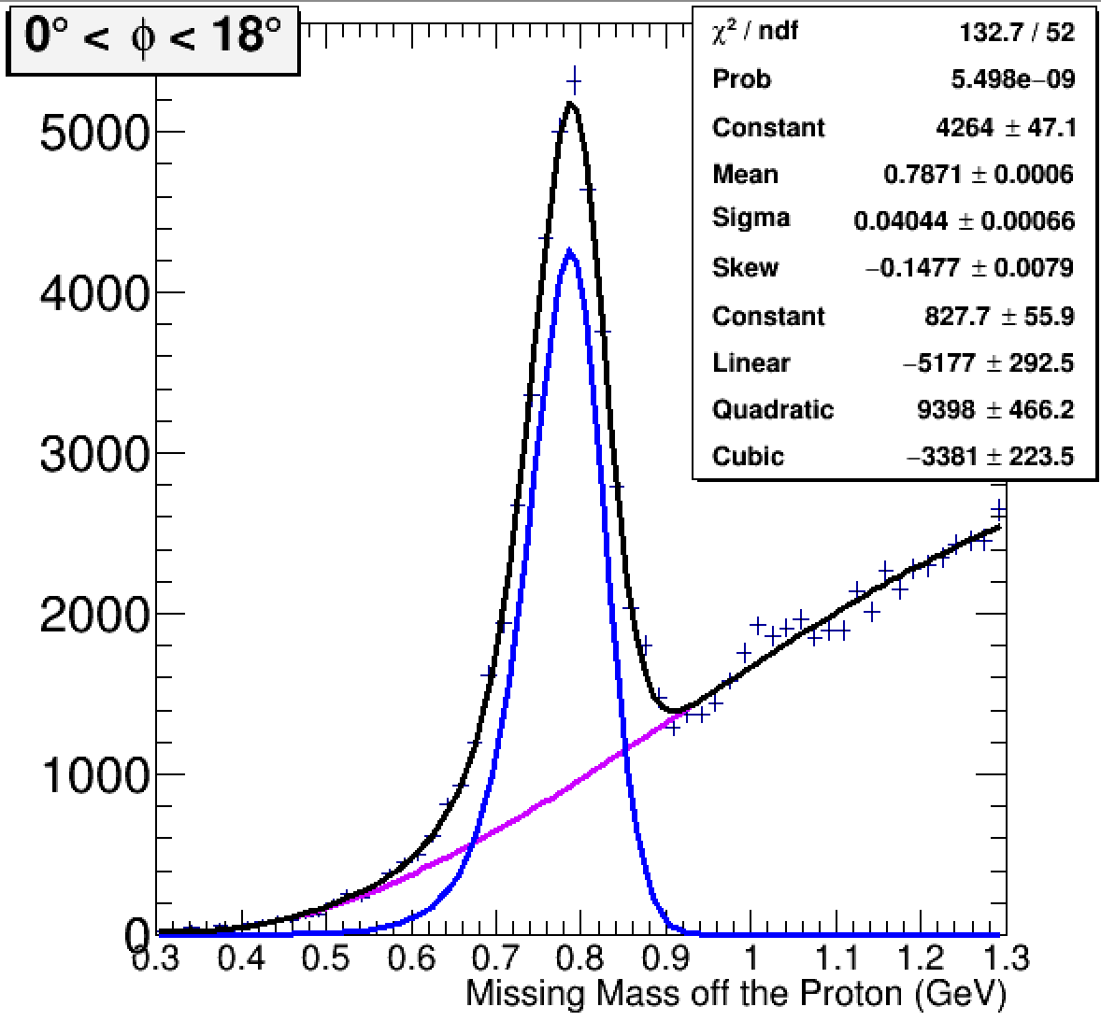
Procedure
After applying a series of cuts to data and MC, found $ω_{mmop}$ and $ω_{inv}$ yields by fitting mass distributions with Gaussian peaks and cubic polynomial background
Reminder: mmop stands for missing mass off the proton, aka recoil mass, and is defined in the DSelector as:
TLorentzVector locOmegaP4_mmop = locBeamP4_Measured + dTargetP4 - locProtonP4_Measured;
Used two methods to determine efficiency from $ω$ yields
$ε_{1}=\frac{ω_{mmop}|1 “good” track candidate}{ω_{mmop}|1 candidate + ω_{mmop}|0 candidates}$
$ε_{2}= \frac{ω_{inv}}{ω_{inv} + ω_{mmop}|0 candidates}$
Both methods show good agreement in the data and MC
$$ω_{mmop}$$

Slide 4
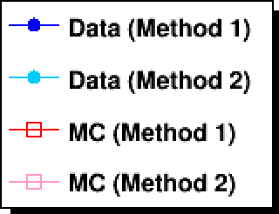
Efficiencies Before Analysis-Level Cuts

Slide 5
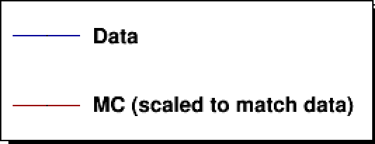
Missing Mass² Cuts
We initially tried placing cuts at $±$ 0.1 GeV². When this had almost no effect, we placed further cuts at $±$0.05, 0.02, 0.01, 0.0075, and 0.005 GeV².
The goal was to look for a visible change in the efficiency vs $θ$ distribution around $10$–${20}^{∘}$ associated with the FDC/CDC transition, which should indicate that our cuts are reducing efficiency for poorly reconstructed tracks.

Slide 6
Mass Correlation Plots with MM² Cuts
Data
MC

Slide 7
1D Mass Plots with MM² Cuts

Slide 8
Efficiencies with MM² Cuts

Slide 9
$P(χ^{2})$ Cuts
We placed a series of cuts on $P(χ^{2})$ > 0.000001, 0.00001, 0.0001, 0.001, 0.01, and 0.1.
These cuts turn out to have more of an effect than the MM² cuts.

Slide 10
Mass Correlation Plots with $P(χ^{2})$ Cuts
Data
MC

Slide 11
1D Mass Plots with $P\left(χ^{2}\right)$ Cuts

Slide 12
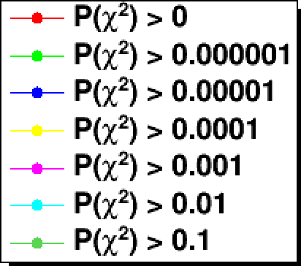
Efficiencies with $P\left(χ^{2}\right)$ Cuts

Slide 13
Efficiencies in theta, p (placeholder)

Slide 14
$Δp/p_{reco}$ Cuts
We placed a series of cuts at $Δp/p_{reco}$< 0.5, 0.25, 0.15, 0.1, 0.05, and 0.01.

Slide 15
Mass Correlation Plots with $Δp/p_{reco}$ Cuts
Data
MC

Slide 16
1D Mass Plots with $Δp/p_{reco}$ Cuts

Slide 17
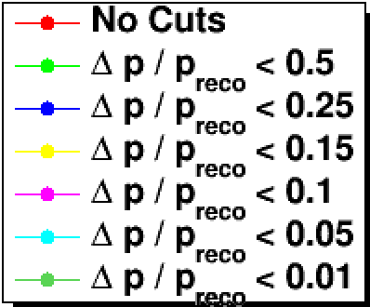
Efficiencies with $Δp/p_{reco}$ Cuts

Slide 18
Efficiencies in theta, p (placeholder)

Slide 19
Future Plans
Repeat for $π^{−}$
Investigate other analysis-level cuts similar to $J/ψ$ analysis
Write summary analysis note with event selection, procedure, and p and theta dependent efficiencies
Other suggestions?

