Slide 1
$π^{±}$ tracking efficiencies From $ω$ Production
GlueX Tracking Meeting – 01/24/2019
Amy M. Schertz

Slide 2
Previously…
Now…
Calculated $π^{+}$ efficiency as functions of $φ, θ, p$ from analysis of exclusive $ω→\left(π^{+}\right)π^{−}π^{0}$ events
Summary can be found at https://halldweb.jlab.org/doc-private/DocDB/ShowDocument?docid=3801
Applied same procedure to $π^{−}$
Binned efficiency in terms of $θ, p$
Added new cuts on ${MM}^{2}$ and missing energy to match those in analysis library
Currently working with:
TTree files from ReactionFilter plugin pi0pipmisspim__B1_T1_U1_M7
Data: REST ver03, analysis launch ver23, runs 30274-30499
MC: OSG generated: REQUESTED_MC/jz_omega_3pi_geant3_20181012035719pm

Slide 3
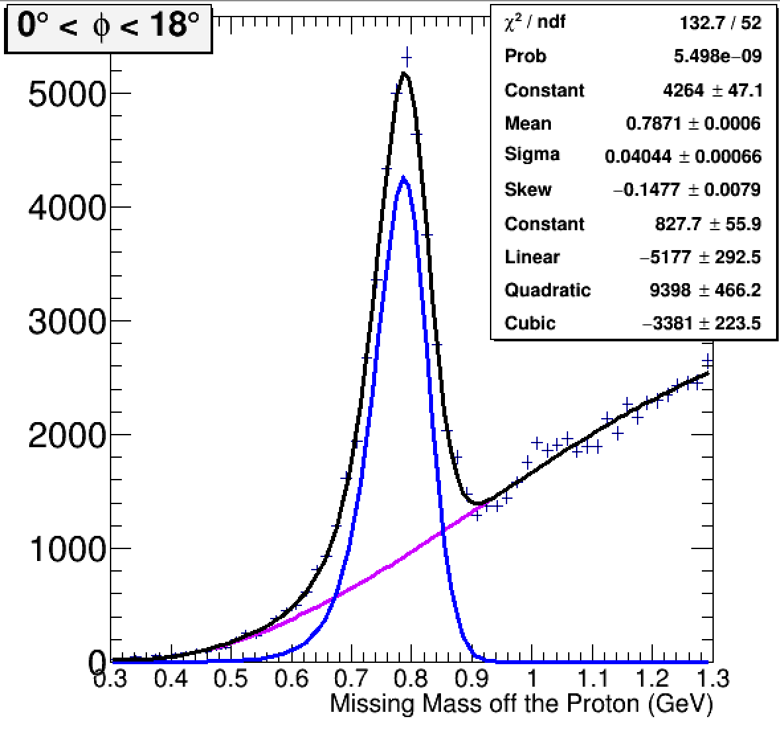
Procedure
After applying a series of cuts to data and MC, found $ω_{mmop}$ and $ω_{inv}$ yields by fitting mass distributions with Gaussian peaks and cubic polynomial background
Used two methods to determine efficiency from $ω$ yields
$ε_{1}=\frac{ω_{mmop}|1 candidate}{ω_{mmop}|1 candidate + ω_{mmop}|0 candidates}$
$ε_{2}= \frac{ω_{inv}}{ω_{inv} + ω_{mmop}|0 candidates}$
Both methods show good agreement in the data and MC
$$ω_{mmop}$$

Slide 4
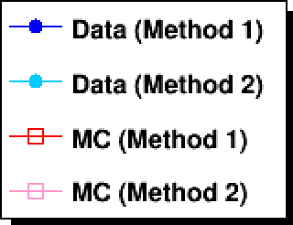
$π^{±}$ efficiencies as functions of $φ, θ, p$

Slide 5
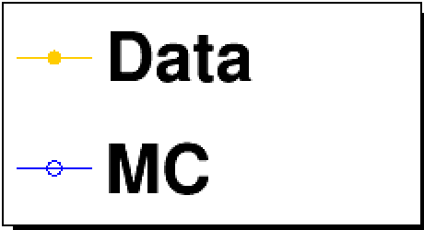
$π^{+}$ efficiencies binned in $θ, p$
Method 1
Method 2
$$ε_{1}= \frac{ω_{mmop}|1 candidate}{ω_{mmop}|1 candidate + ω_{mmop}|0 candidates}$$
$$ε_{2}= \frac{ω_{inv}}{ω_{inv} + ω_{mmop}|0 candidates}$$

Slide 6
$π^{−}$ efficiencies binned in $θ, p$
Method 1
Method 2
$$ε_{1}= \frac{ω_{mmop}|1 candidate}{ω_{mmop}|1 candidate + ω_{mmop}|0 candidates}$$
$$ε_{2}= \frac{ω_{inv}}{ω_{inv} + ω_{mmop}|0 candidates}$$

Slide 7
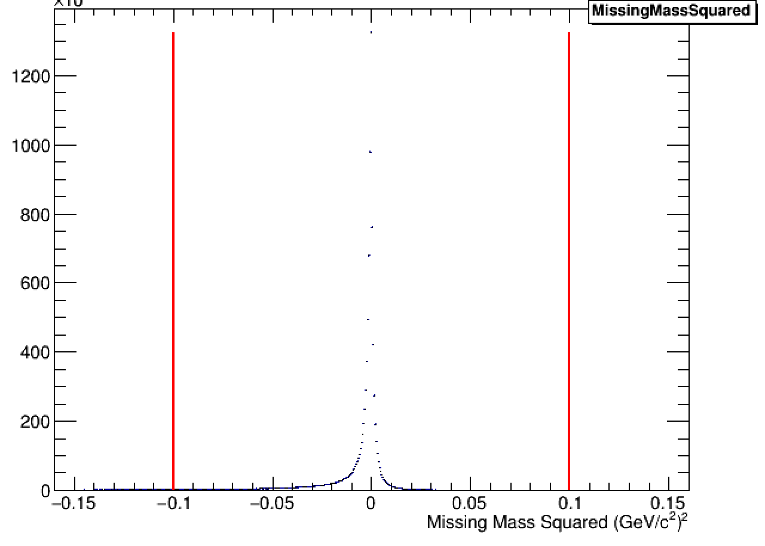
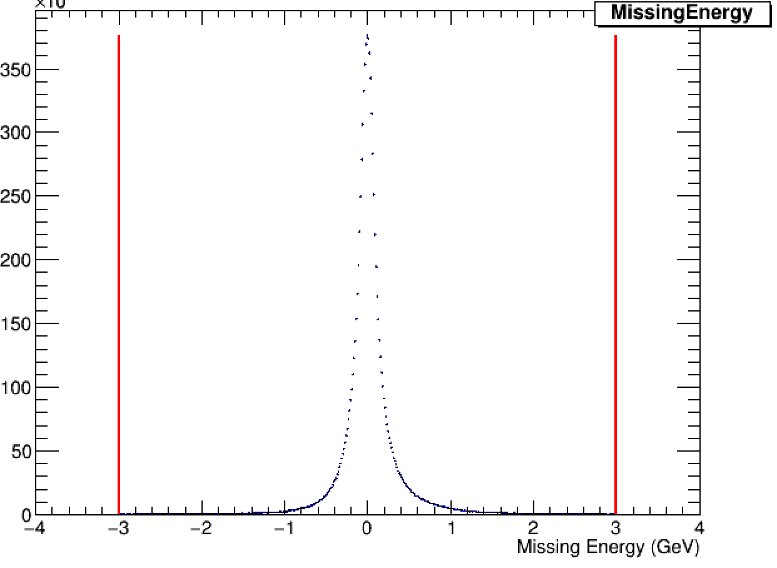
Missing Mass² and Energy cuts
Applied cuts on missing mass² and energy to match those in analysis library
$\left|MM^{2}\right|<0.1$ GeV²
$\left|E_{miss}\right|<3.0$ GeV
Example plots shown are from the missing pi+ distributions in data

Slide 8
$π^{+}$ efficiencies before and after cuts
Top: before cuts
Bottom: after
It takes fairly close examination to note that these are not the same set of plots

Slide 9
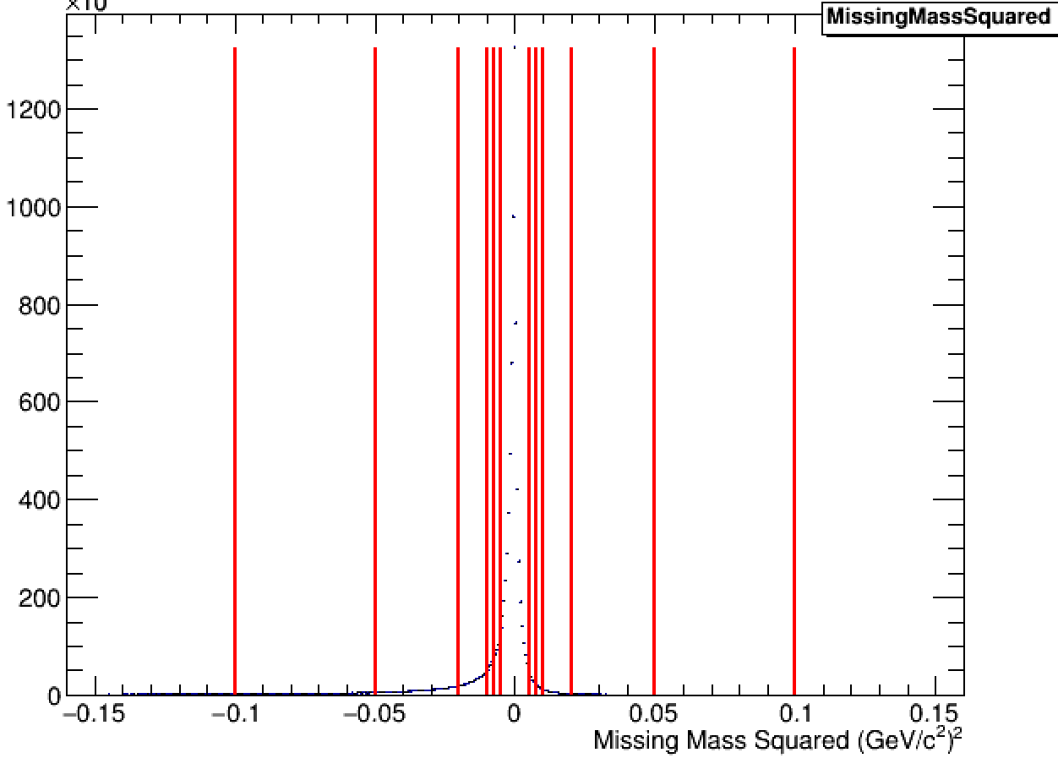
Future plans
Since the current missing mass² cut has almost no effect, we plan to adjust it, placing further cuts at $±$0.05, 0.02, 0.01, 0.0075, and 0.005 GeV²
We’ll be looking for a visible change in the efficiency vs $θ$ distribution around ${20}^{∘}$ associated with the FDC/CDC transition. This should be an indication that our cuts are reducing efficiency for poorly reconstructed tracks

