Slide 1
Charmonium Physics with GlueX
Lubomir Pentchev
JLab 12GeV accelerator has UNIQUE opportunity (high intensity, right energy) to study near threshold charmonium photo-production
Physics motivation
Heavy vs light quark hadrons
Study charmonium-nucleon interaction
LHCb pentaquarks
Other dielectron physics: TCS, rare leptonic decays
GlueX vs other Halls
maximum energy
full acceptance in both charge particles and photons
possibility to use linearly polarized beam
Possible GlueX modification for charmonium running
Trigger, detector modifications at high intensity
Electron/pion separation

Slide 2
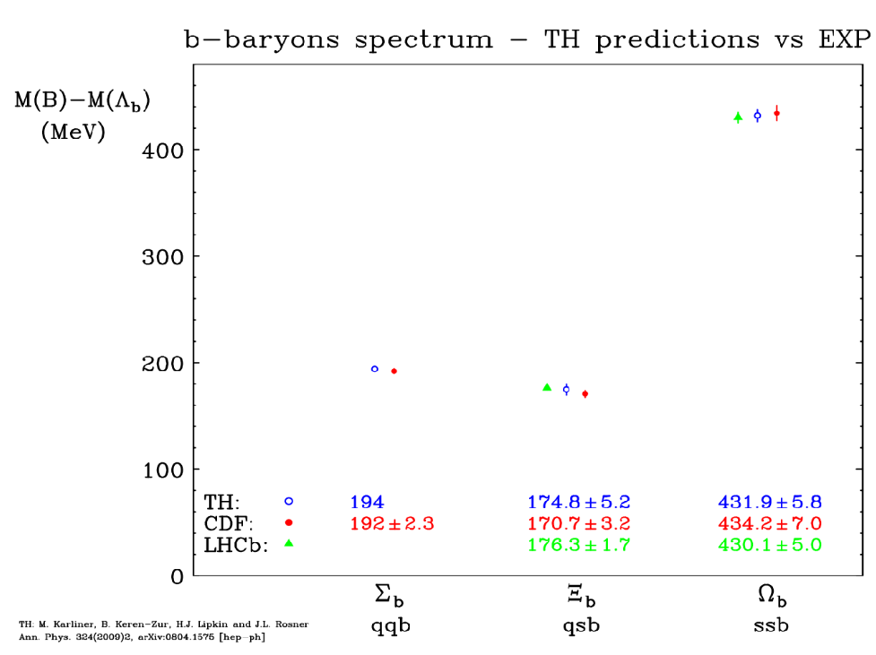
Why Heavy Quarks
Hadrons with heavy quarks are much simpler: quarks are almost static, spin-dependent interaction ~ 1/m_{Q}
Very accurate theoretical prediction for the heavy hadrons
Exotic states with heavy quarks: XYZ states, LHCb pentauqarks
Just an example:
Notes:
2
2

Slide 3
Charmonium-nucleon Interaction
Charmonium excellent probe to study gluonic content of nucleon
Using VMD (γ→J/ψ) one can study J/ψ p → J/ψ p
Heavy quark system interacts with light quark proton via gluon exchange
In analogy with the electro-magnetic Form Factor:

Slide 4
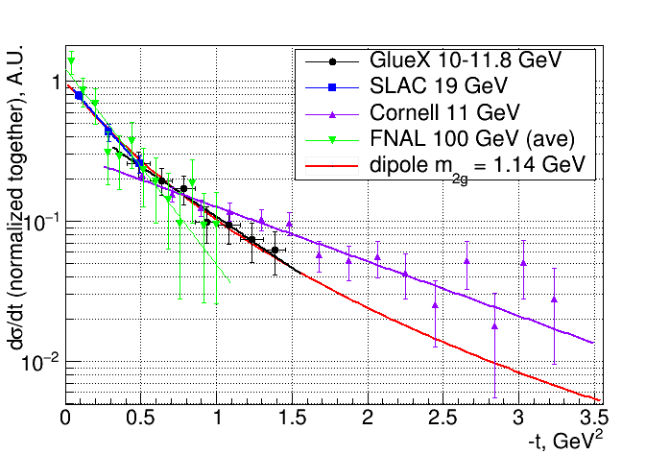
Proton Gluonic Form Factor
Frankfurt and Strikman PRD66 (2002) suggested t-dependence defined by the proton gluonic FF
Explains t-slope change with energy (due to t_{min} and t-range dependence) in wide energy range:
FNAL <E>=100 GeV
SLAC 19 GeV
Cornell 11 GeV
GlueX 10-11.8 GeV

Slide 5
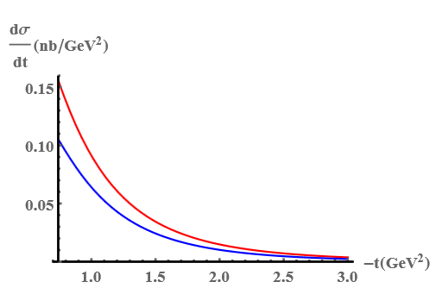
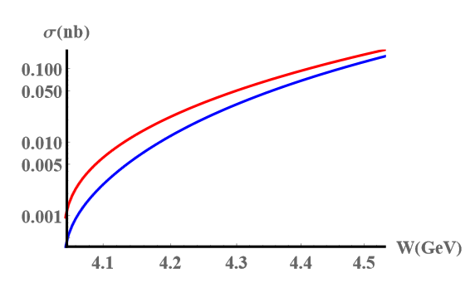
Proton Gluonic Form Factors: A,B,C
J/ψ p → J/ψ p:
Red – maximal trace anomaly term (related to fraction of nucleon mass arising from gluons)
Blue – no trace anomaly E_{γ} = 9.3 GeV
Yoshitaka Hatta and Di-Lun Yang
https://arxiv.org/pdf/1808.02163.pdf

Slide 6
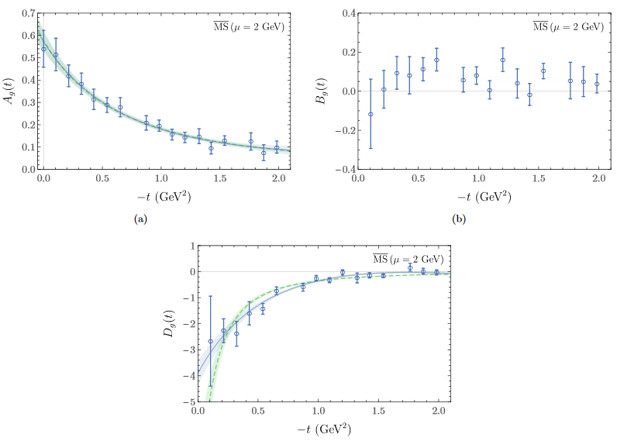
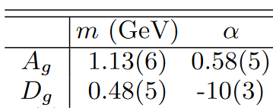
Proton Gluonic Form Factors: A,B,C (lattice calculations)
Fits in dipole form:
P. E. Shanahan and W. Detmold
https://arxiv.org/pdf/1810.04626.pdf

Slide 7
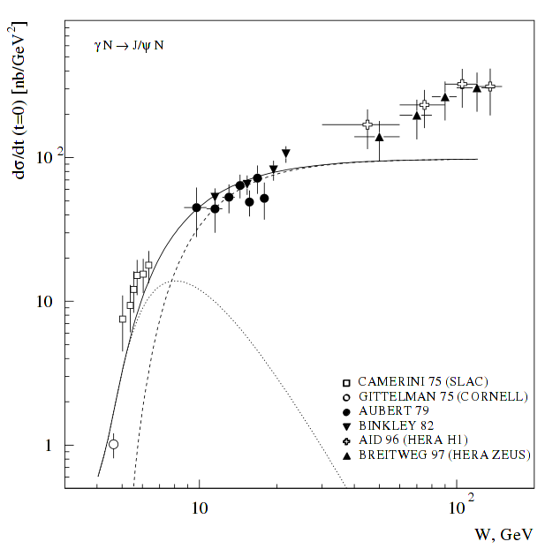
Why charmonium photoproduction NEAR THRESHOLD?
Kharzeev et al. Eur. Phys. C9 (1999) The real part of the amplitude (dominates at low energies) is critically important – contains the conformal (trace) anomaly, related to the fraction of the nucleon's mass arising from gluons.
Brodsky et al. PLB 498, (2001) Sensitive to proton gluonic content at high x. Energy dependence derived from dimensional scaling: hard 2-gluon or (near threshold) 3-gluon exchange.
Notes:
7
7

Slide 8
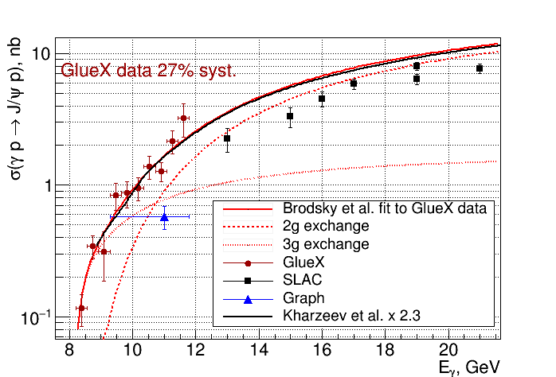
J/ψ photoproduction: comparison to data and theory
Brodsky at.al (2001)
fit of the GlueX data ONLY,
using F(t) as t-dependence
Kharzeev et al (1999)
absolute (factor 2-3 uncertainty) perturbative calculations using gluon PDFs - related to the gluonic contribution to the mass of the proton

Slide 9
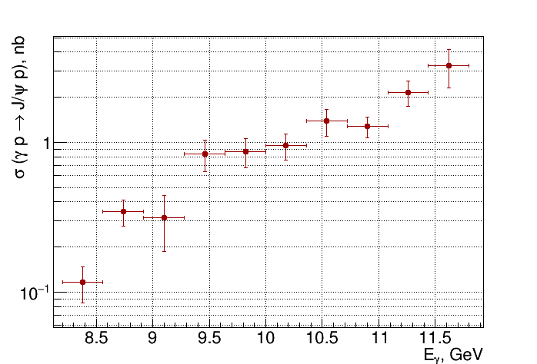
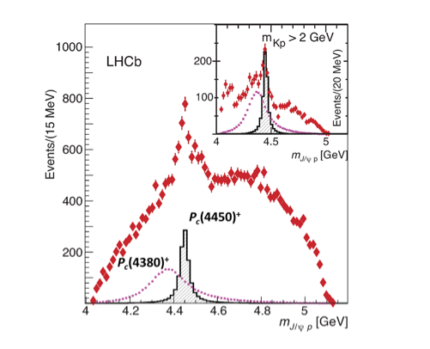
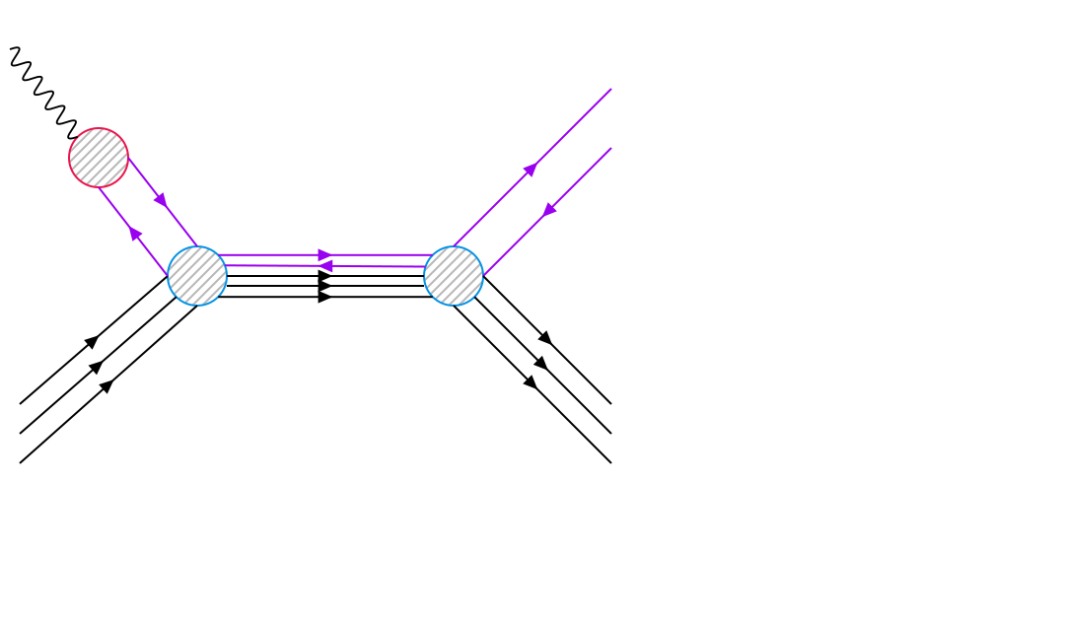
LHCb petaquarks in s-channel production
LHCb pentaquarks observed in Λ_{b} → K⁻(J/ψp) R.Aaji et.el PRL 115, (2015)
DIRECT relation – if they exist they should be seen in s-channel photoproduction:
γ
J/ψ
J/ψ
P_{c}
p
p
Direct relation
V.Kubarovsky and M.B.Voloshin, PRD 92.031502 (2015).
M.Karliner and J.Rosner, arXiv: PLB 752, 329 (2016).
A.Blin, C.Fernandez-Ramirez, A.Jackura, V.Mathieu, V.Mokeev, A.Pilloni, and A.Szczepaniak, PRD 94,034002 (2016).
P_{c}(4450)
Notes:
9
9

Slide 10
LHCb pentaquark: possible explanations
Liming Zhang’s slide
P_{c}(4450) - molecule
Narrow width despite big phase space indicates small overlap with J/ψp state
Pc(4380) much wider – has potential to be explained as tightly-bound system
If χ_{c1}p decay found then it is not a kinematic effect
Notes:
10
10

Slide 11
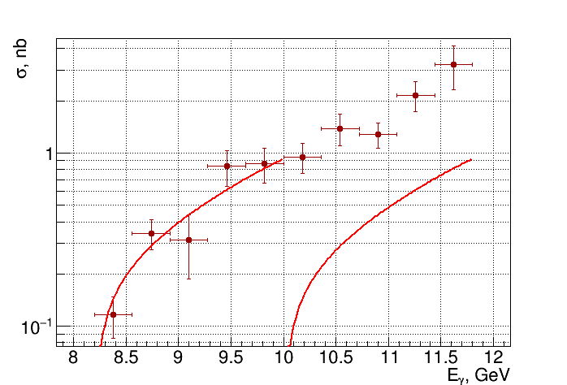
Photoproduction of χ_{c1}(3511) 1⁺⁺
γ p → χ_{c1} p→ J/ψ γ p→ e⁺ e⁻ γ p
J/ψ
χ_{c1}
N_{J/ψ}/Nχ_{c1} = 4.525 (σ) x 1.753 (flux) x 2.915 (χ_{c1} -> J/ψ γ 34.3%) = 23
Notes:
11
11

Slide 12
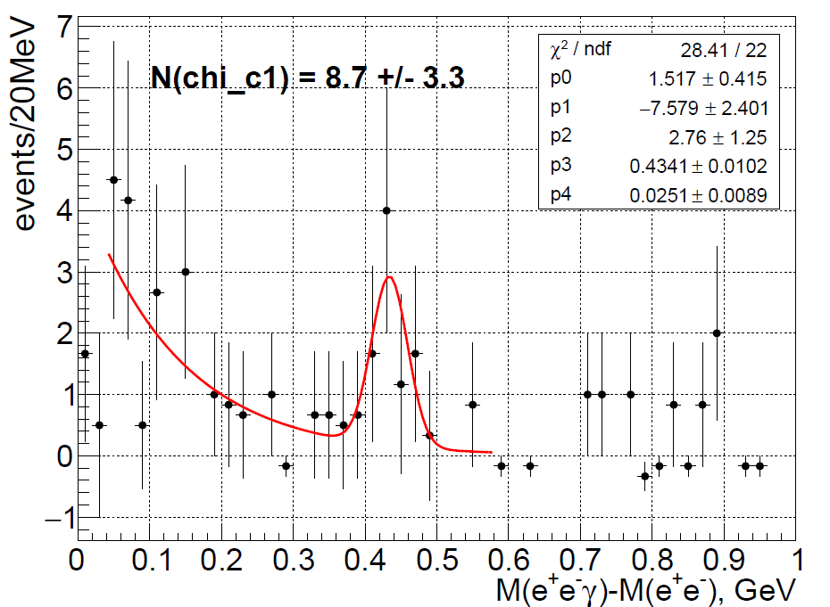
Photoproduction of χ_{c1}(3511)
γ p → χ_{c1} p→ J/ψ γ p→ e⁺ e⁻ γ p
2016 data only – expect ~11 events without efficiency corrections
Notes:
12
12

Slide 13
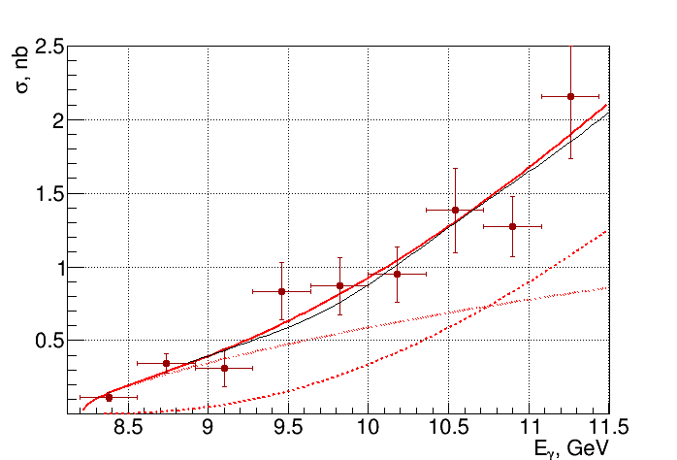
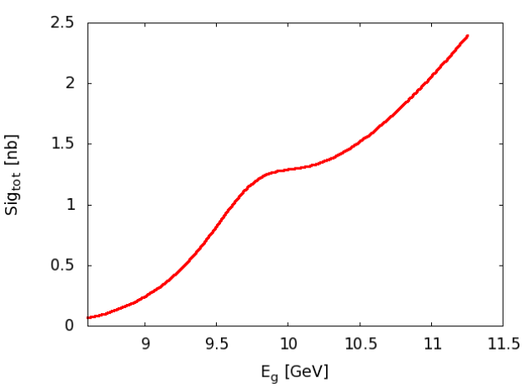
What can we say about Pc(4380)
JPAC model for Pc(4380) J=3/2 BR=1.5%
Cross-section experiments can’t separate t-channel from s-channel Pc(4380) production (too wide!)
Polarization experiments will be needed (using linearly polarized photons in GlueX?)
Expect results with higher statistics (x8) from LHCb
Notes:
13
13

Slide 14
GlueX vs other Halls
Full acceptance for charged and neutral particles
J/ψ photoproduction very close to the threshold (θ_{p}>1º)
t-dependence
γ p → χ_{c1} p→ J/ψ γ p→ e⁺ e⁻ γ p
γ p → J/ψ π p→ e⁺ e⁻ π p (target excitation - needed for inclusive experiments at other halls)
Maximal beam energy
Bridge to high energy measurements
γ p → χ_{c1} p→ J/ψ γ p→ e⁺ e⁻ γ p
Possibility to use linearly polarized beam
Pc(4380) polarization experiment
Other dielectron physics: TCS, rare leptonic decays requiring full acceptance
Notes:
14
14

Slide 15
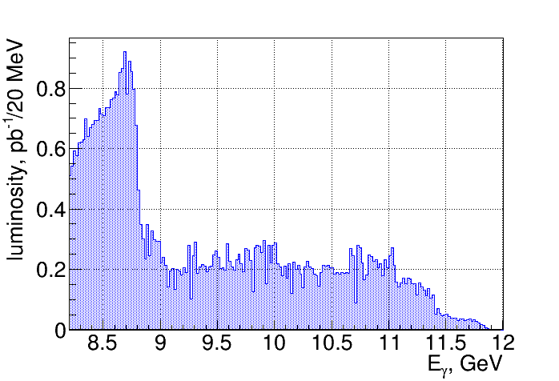
Possible GlueX modifications
Most likely scenario: opportunistic physics with GlueX data
Currently we have ~450 J/ψ’s using ~20% of statistics so far
With GlueX at high intensity expect ~10k in total
Depending on results from the other halls and LHCb we may decide to have special charmonium running at very high intensity with some (or all) of the modifications:
Trigger: high threshold on sum of two calorimeters
Keeping only high energy tagger counters
Turning off (or lower HV) the inner part of some detectors (CDC, FDC, TOF, FCAL)
Move coherent peak up to 10 GeV:
Notes:
15
15

Slide 16
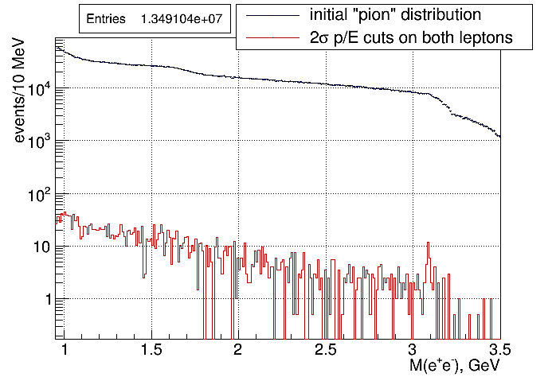
Possible GlueX modifications: e/π separation
~5,000 suppression
~5% of total statistics
Pions are 3 orders more numerous and GlueX detector doesn’t have enough power to suppress them
Suppression factor of ~5000 by E/p cuts (2σ) on both leptons using calorimeters

Slide 17
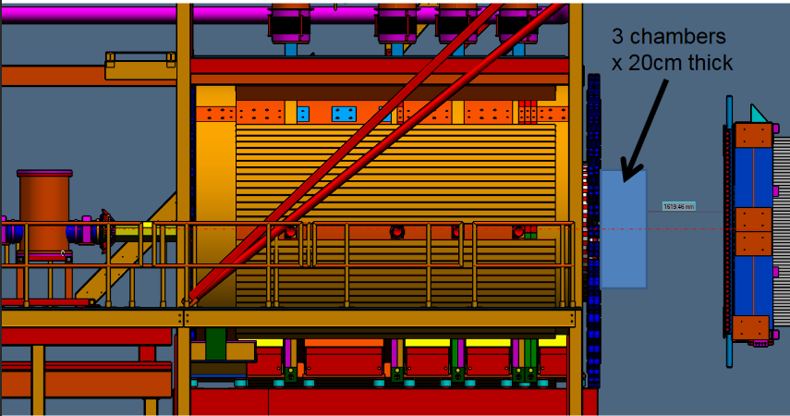
Possible GlueX modifications: e/π separation with TRD
TRD in forward direction: with 3 chambers expect suppression factor of ~20-50 at 90% efficiency
Notes:
17
17

Slide 18
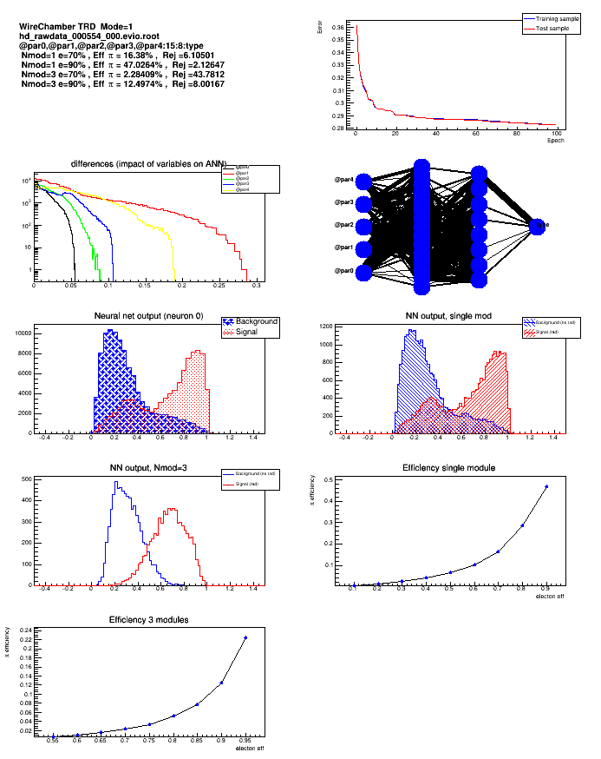
Possible GlueX modifications: WC-TRD prototype
Results with WC-TRD prototype
e/e with/without radiator – 1.9 suppression factor at 90% efficiency
Sergey Furletov reports these results on VCI 2019
Notes:
18
18

Slide 19
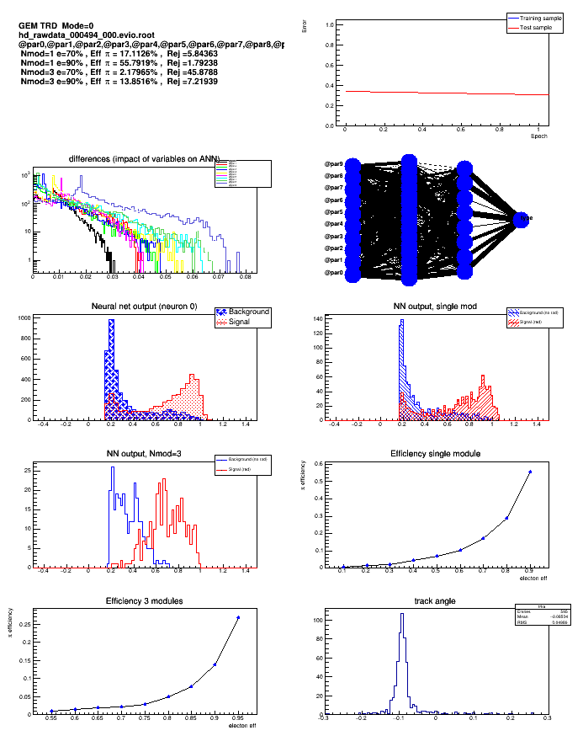
Possible GlueX modifications: GEM-TRD prototype
Results with GEM-TRD prototype
e/e with/without radiator – 1.9 suppression factor at 90% efficiency
Sergey Furletov reports these results on VCI 2019
Notes:
19
19

Slide 20
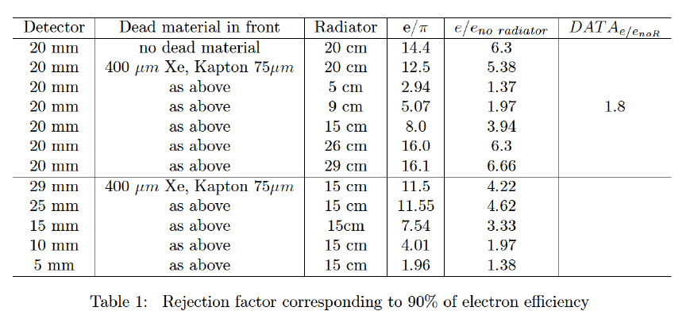
Possible GlueX modifications: extrapolation for e/π separation with TRD
Hadrons with heavy quarks are much simpler: quarks are almost static, spin-dependent interaction ~ 1/m_{Q}
Very accurate theoretical prediction for the b-baryons
Sergey Furletov reports these results on VCI 2019
Notes:
20
20

Slide 21
Summary (Q/A)
Why charmonium: heavy quark system can probe nucleon gluonic distribution
Why at threshold: anomaly terms coming from high twists (vanish at high energy)
Why at threshold: LHCb pentaquarks are there
Why with GlueX: highest energy (χ_{c1}), full coverage for charged and neutral particles (χ_{c1}, ΔJ/ψ final state), possibly using linear polarization (P_{c}(4380))
What is needed: nothing or higher luminosity (depending on results from other experimenst)
How: high threshold on calorimeter sum; turn off (lower HV) on inner detectors and low energy tagger hodoscopes
What is needed: electron/pion separation
How: TRD in forward direction
Notes:
21
21

