Slide 1
Threshold J/ψ production at GlueX
Lubomir Pentchev
for the GlueX collaboration

Slide 2
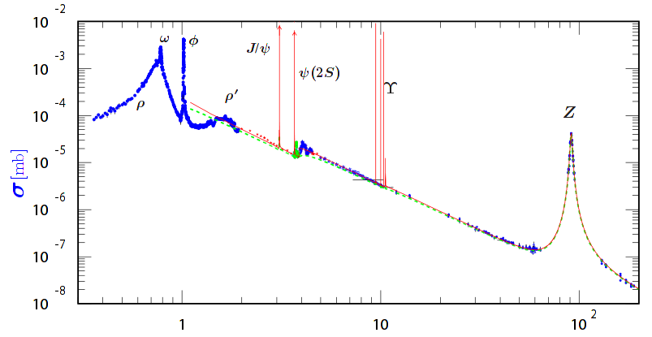
Di-lepton annihilation/production
PDG 2018

Slide 3
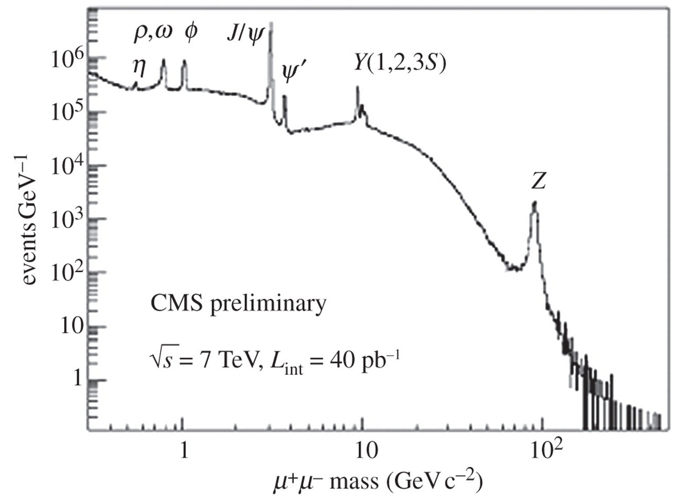
Di-lepton annihilation/production
PDG 2018

Slide 4
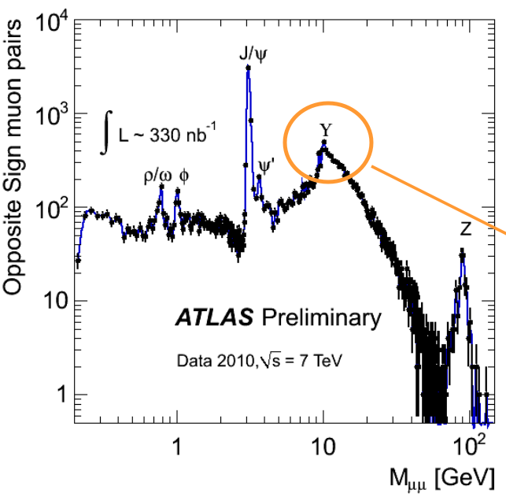
Di-lepton annihilation/production
PDG 2018

Slide 5
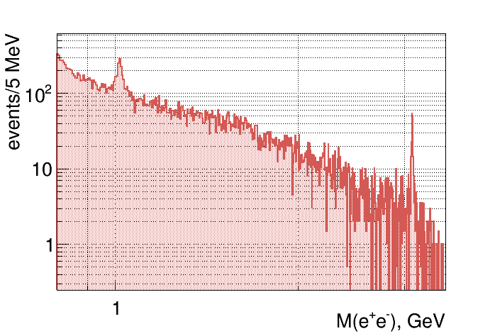
Di-lepton annihilation/production
φ
J/ψ
PDG 2018
at 12 GeV CEBAF

Slide 6
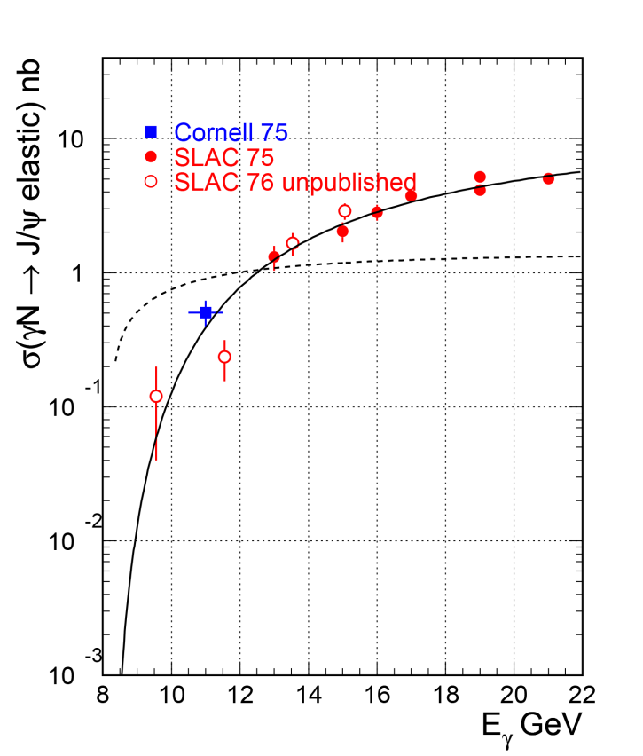
Why study J/ψ near threshold photo-production
JLab 12GeV accelerator has UNIQUE opportunity (high intensity, correct energy, polarized beam) to study J/ψ photo-production right above the threshold (E_{γ}=8.2 GeV) up to 12 GeV – poorly (If at all) covered by previous old measurements
Look for threshold enhancement: sensitive to proton gluonic content (high x); other interesting effects expected near threshold
Hall D is the only hall that can have E_{γ}>11 GeV – needed to allow continuity from the high energy data; so far only in 2016 we had data >11.5 GeV – when will be the next time we can have 12 GeV?
GlueX coherent peak right above the threshold – improved statistics at the very important point
GlueX
dashed line: three-gluon exchange
solid line: two-gluon exchange
6
Notes:
6
6

Slide 7
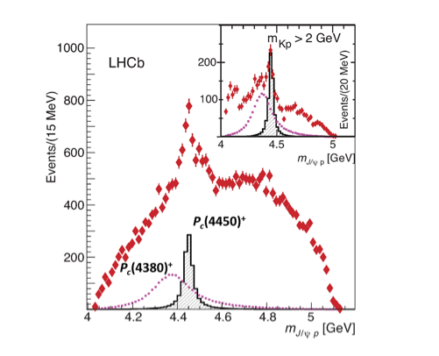
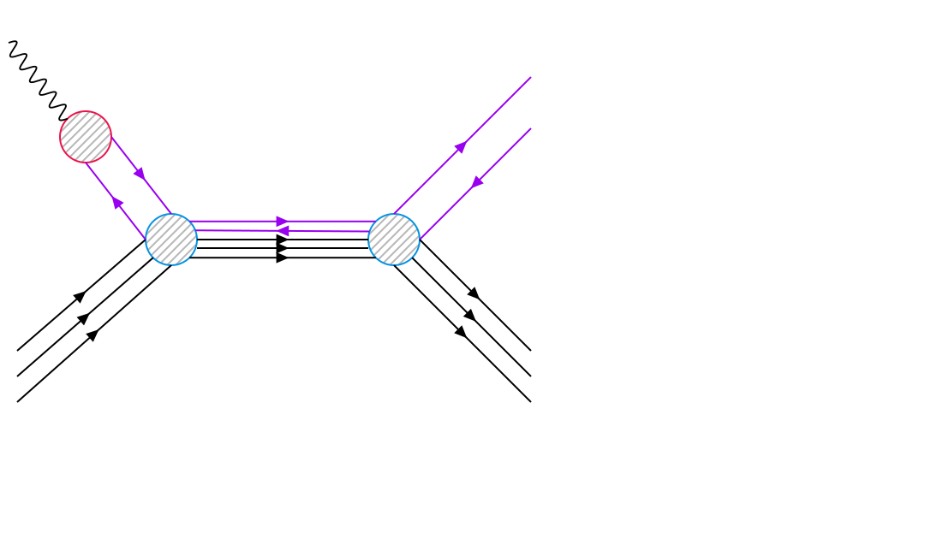
Why study J/ψ near threshold photo-production
Also because of the LHCb pentaquarks - DIRECT relation – if they exist they should be seen in s-channel photoproduction:
~ BW(Γ_{Pc},M_{Pc})*BR(P_{c}->γp)*BR(P_{c}->J/ψp)
BR(P_{c}->γp) ~ Γ(J/ψ -> l⁺l⁻)*BR(P_{c}->J/ψp) (VMD)
GlueX
γ
J/ψ
J/ψ
dashed line: three-gluon exchange
P_{c}
solid line: two-gluon exchange
p
p
Direct relation
7
Notes:
7
7

Slide 8
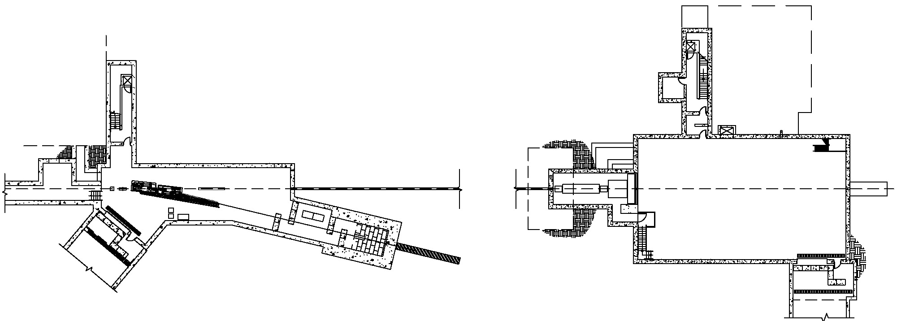
Hall D layout
Tagger Hall: magnet, radiator,
tagger hodoscope
Counting
House
Coherent Bremsstrahlung
photon beam
Top View
Pair
Spectrometer
Photon
Beam dump
Solenoid-
Based detector
Electron dump
Collimator
Photon energy tagged by scattered electron ~ 0.1% resolution
Photon beam collimated at 75m, <25 mrad
Intensity: now ~ 2 10⁷ - 5 10⁷ γ/sec above J/ψ threshold (8.2 GeV) – total 50 pb⁻¹ in 2016-2017 runs

Slide 9
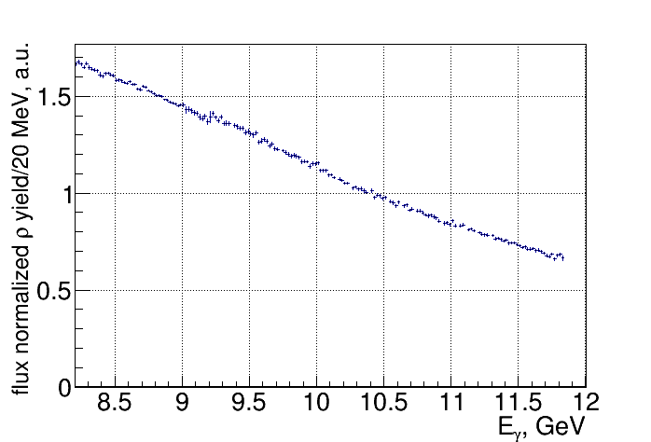
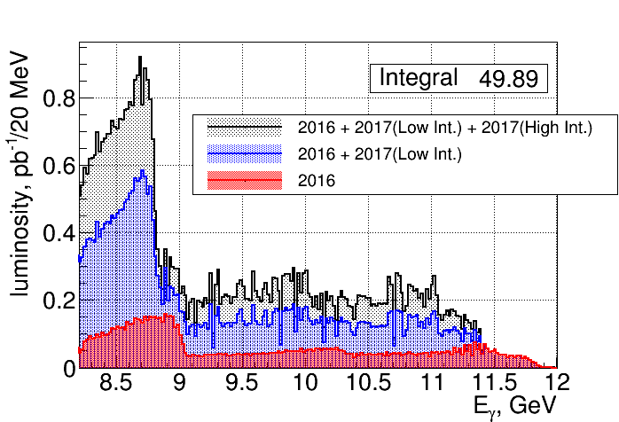
Tagged fluxes

Slide 10
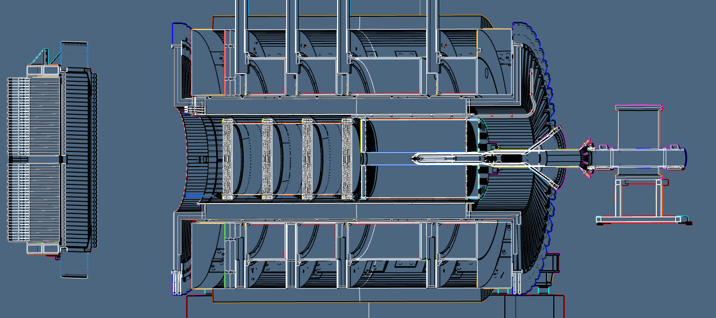
GlueX detector
2T-solenoid based, hermetic detector, LH target
Tracking (FDC,CDC) , Calorimetry (BCAL,FCAL) , Timing (TOF,SC)
FCAL
CDC
FDC
SC
TOF
BCAL

Slide 11
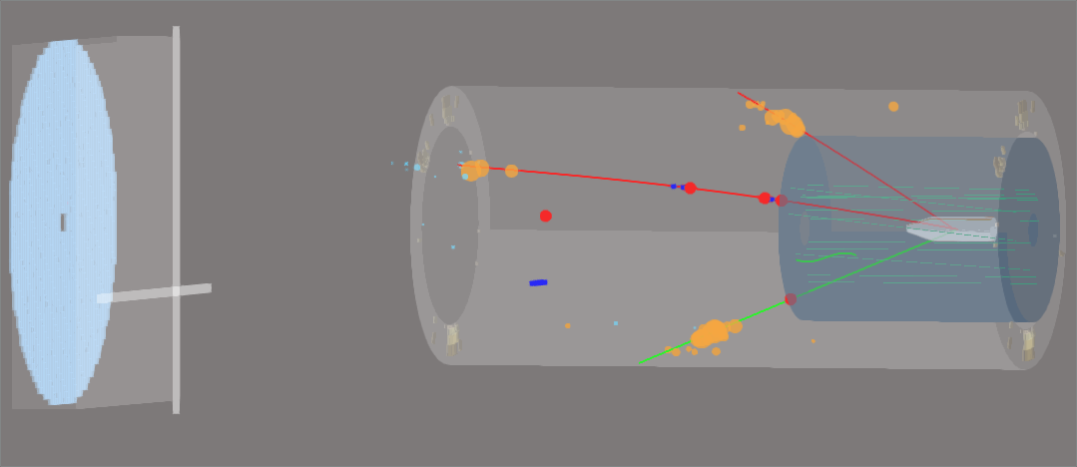
J/ψ event

Slide 12
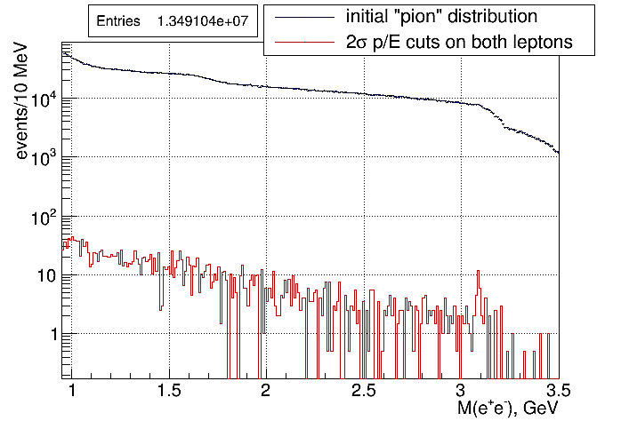
Electron/proton separation using p(tracking)/E(calorimetry)
~5000 suppression
~5% of total statistics
Suppression factor of ~5000 by p/E cuts
Difficult to be done with muons

Slide 13
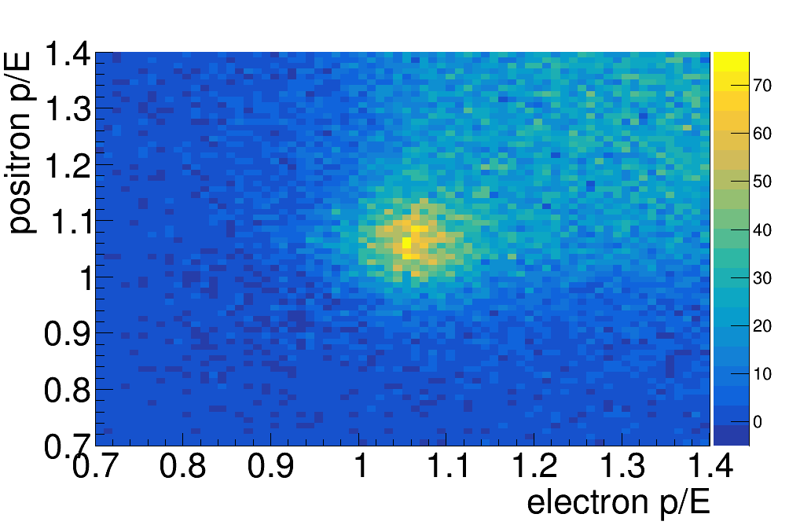
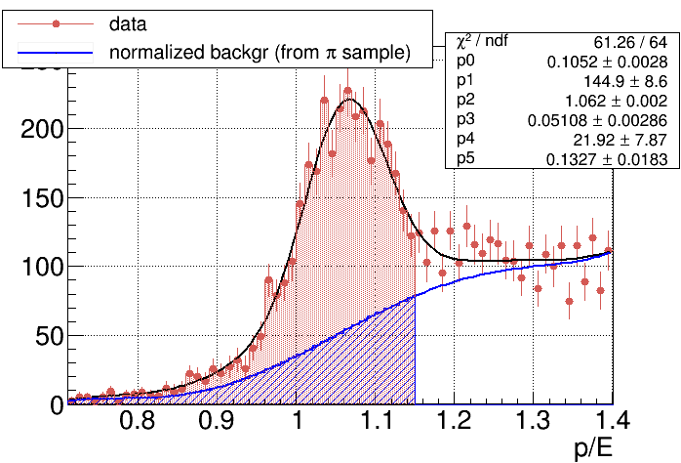
Electron/proton separation using p(tracking)/E(calorimetry)
36±1.2% π contamination in 1.5-2.5 GeV M(e⁺e⁻) region with 2σ cut on electrons
BH yields corrected in bins of energy
Background shape from pion sample (p/E anti-cuts)

Slide 14
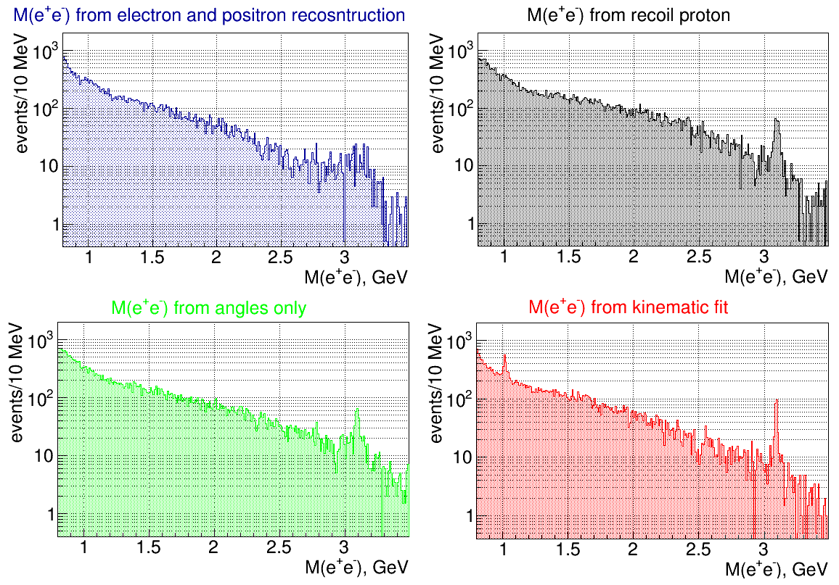
γp → J/ψp → e⁺e⁻p reconstruction methods
σ = 18.1 MeV
σ = 83.8 MeV
σ = 7.5 MeV
σ = 12.8 MeV

Slide 15
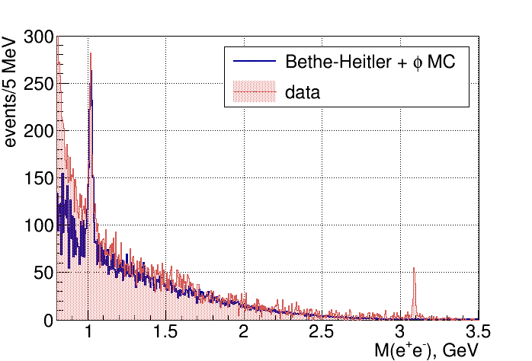
M(e⁺e⁻) spectrum
BH simulations from R.Paremuzyan, based on:
Berger, E., Diehl, M. & Pire, B. Eur. Phys. J. C (2002) 23: 675.

Slide 16
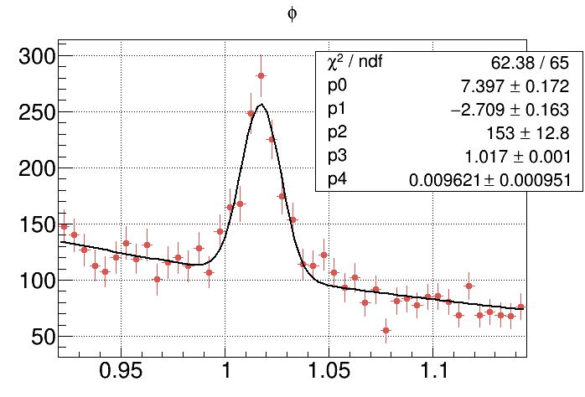
M(e⁺e⁻) spectrum - φ
736 ± 58 φ’s
σ = 9.6 MeV

Slide 17
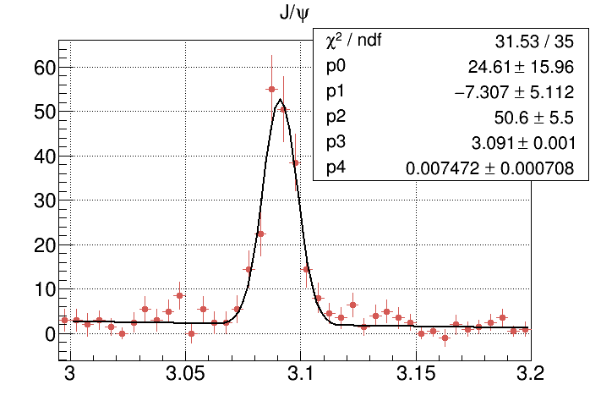
M(e⁺e⁻) spectrum – J/ψ
189 ± 16 J/ψ’s
σ = 7.5 MeV

Slide 18
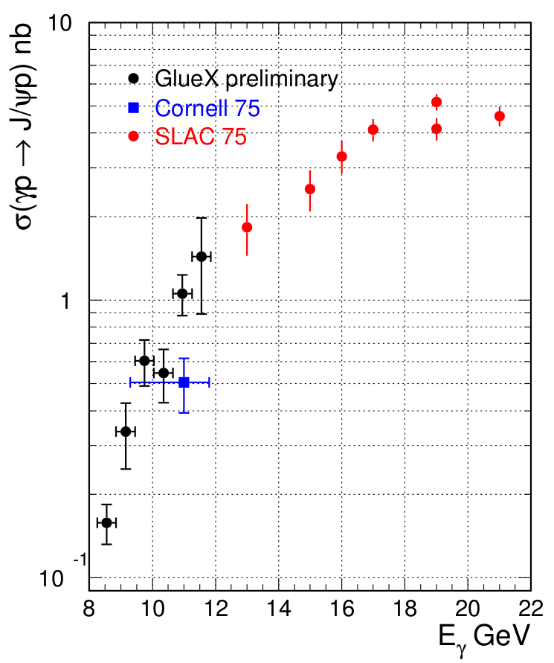
J/ψ cross-section – preliminary results
GlueX data
~30% syst. uncertainty

Slide 19
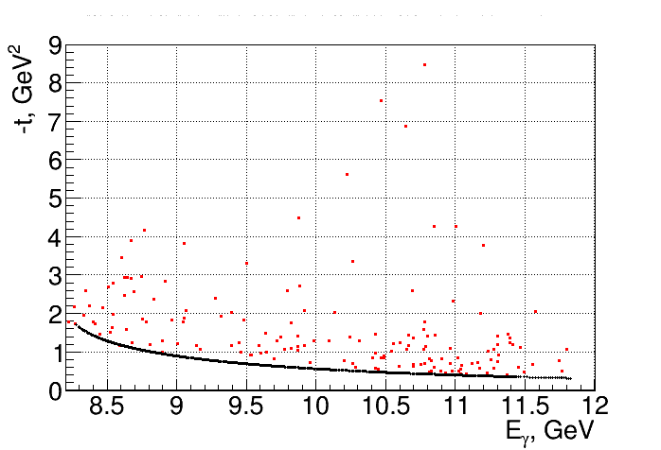
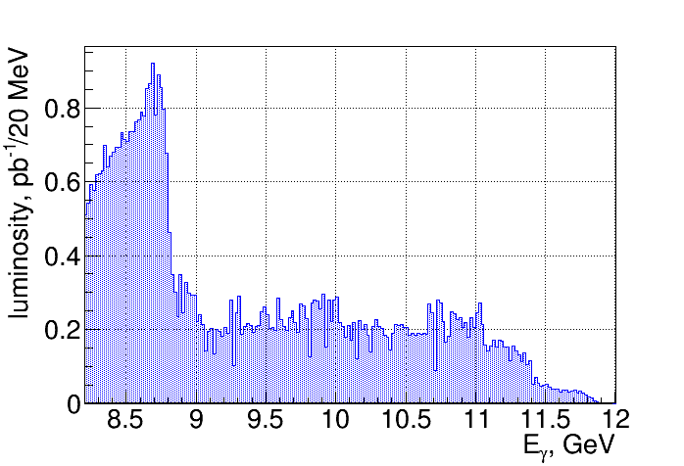
J/ψ t vs Eγ distribution – preliminary results
t_{min}

Slide 20
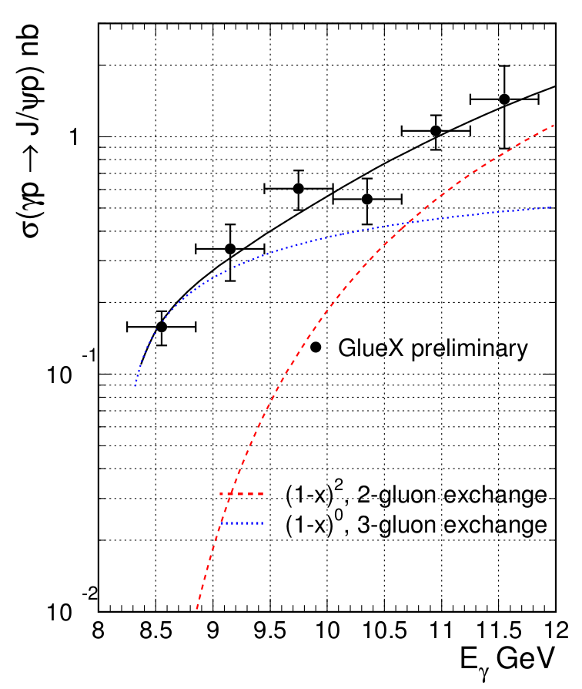
J/ψ cross-section – preliminary results
~30% syst. uncertainty

Slide 21
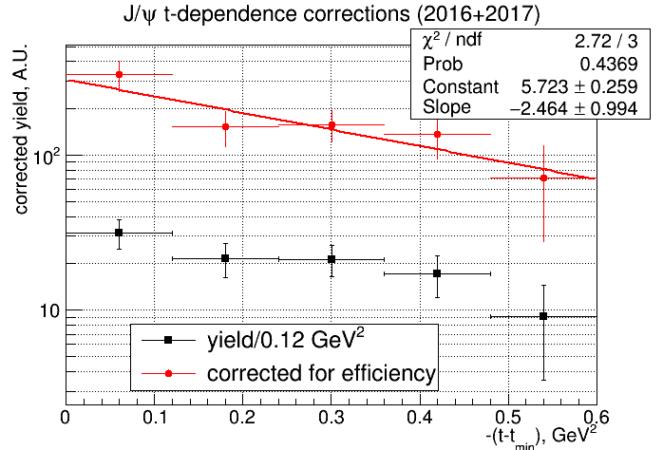
J/ψ analysis in bins of t-t_{min}
Cornell: 1.25 +/- 0.2 GeV⁻² at E_{γ} = 11 GeV
SLAC: 2.9 at E_{γ} = 19 GeV
21
Notes:
21
21

Slide 22
LHCb Pentaquarks
Λ_{b} -> K⁻(J/ψ p)
Pc(4380): Γ=205 MeV J^{P}=3/2⁺⁽⁻⁾
Pc(4450): Γ=39 MeV J^{P}=5/2⁻⁽⁺⁾
Interpretations:
- (charmed baryon) – (anti-charmed meson) molecule ($\overline{D}$*Σ_{c})
- Resonance in terms of quark degrees of freedom
- Kinematic effects: threshold effect (χ_{c1} p) , ATS
22
Notes:
22
22

Slide 23
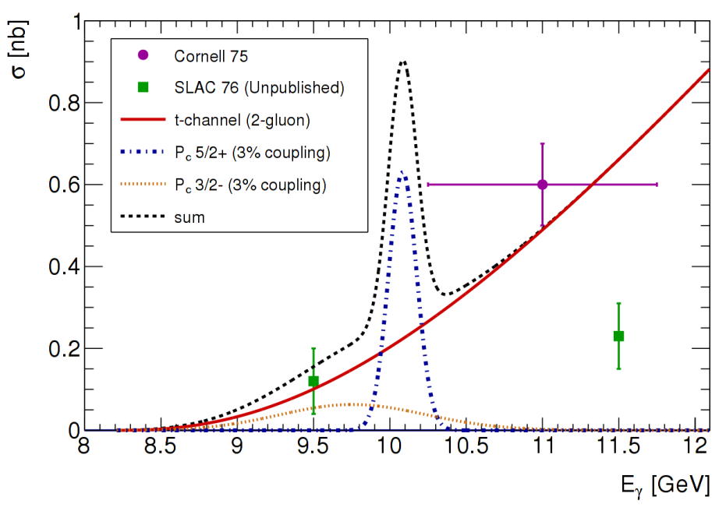
Phtotoproduction of LHCb Pentaquarks
γ
J/ψ
~ BW(Γ_{Pc},M_{Pc})*BR(P_{c}->γp)*BR(P_{c}->J/ψp)
BR(Pc->γp) ~ Γ(J/ψ -> l⁺l⁻)*BR(P_{c}->J/ψp) (VMD)
σ ~ BR²(P_{c}->J/ψp)
J/ψ
P_{c}
p
p
1)V.Kubarovsky and M.B.Voloshin, arXiv: 1508.00888.
2)M.Karliner and J.Rosner, arXiv: 1508.01496.
3)A.Blin, C.Fernandez-Ramirez, A.Jackura, V.Mathieu, V.Mokeev, A.Pilloni, and A.Szczepaniak,arXiv: 1606.08912
all three papers σ^{max} ~ 10 μb for P_{c}(5/2+) 100% BR
1)Q.Wang, X.Liu, and Q.Zhao,arXiv: 1508.00339
σ^{max} ~ 0.7 μb for P_{c}(5/2+) 100% BR
Hall C 5q-proposal (E12-16-007)
23
Notes:
23
23

