Slide 1
J/ψ skimmed event comparison
 | v1 (very old) | V2 (old) | work fest | July 9 version
2016 golden | 56 | 33 | 43 | 50
2017 20files/run | 32 | 33 | 32 | 36 (expected 45)
total | 88 | 66 | 75 | 86
Total of 121 skimmed J/ψ events – an “or” of v1 and v2
Recovered most of the events from 2016 (6 more needed)
Gained 4 events from 2017
Based on the fluxes, shape of the x-section and 2016 yields, we expect 45 events from 2017

Slide 2
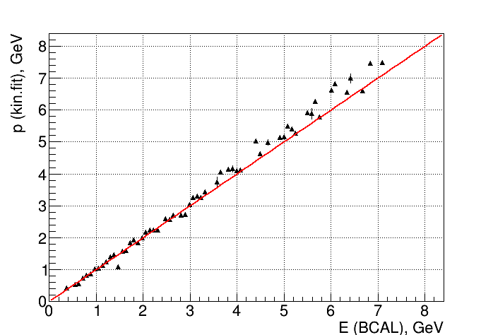
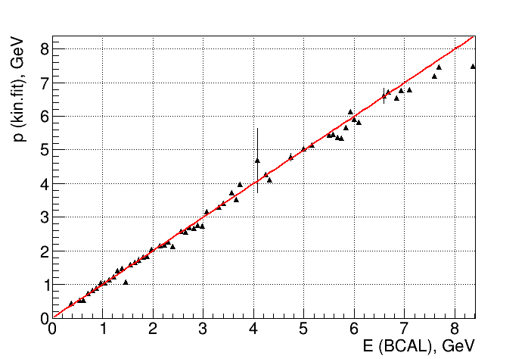
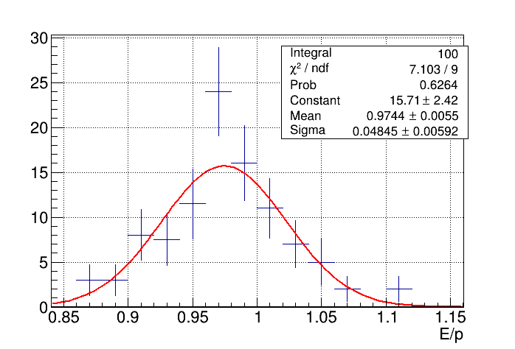
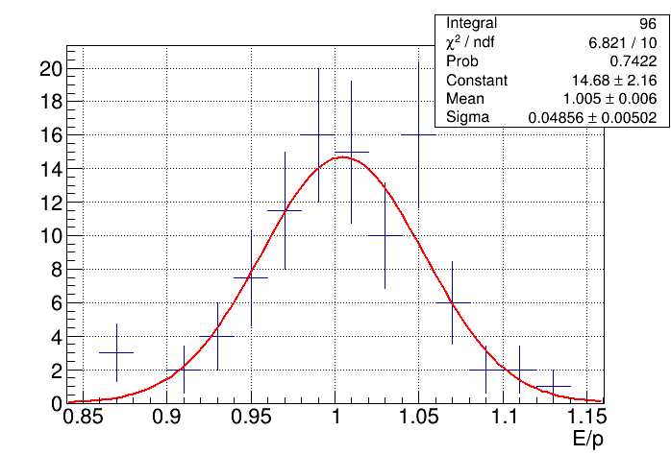
BCAL E/p with SiPM correction for J/ψ skimmed events
No SiPM correction With SiPM correction

