Slide 1
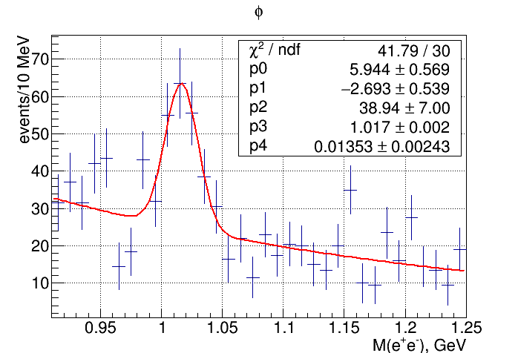
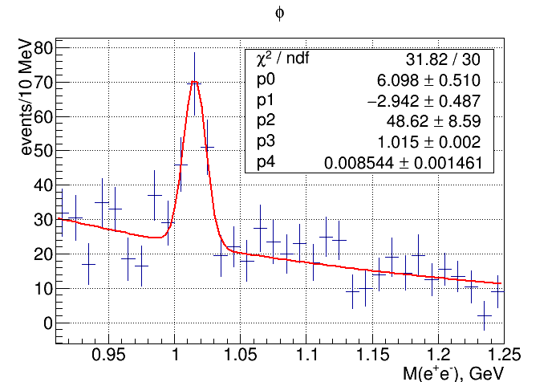
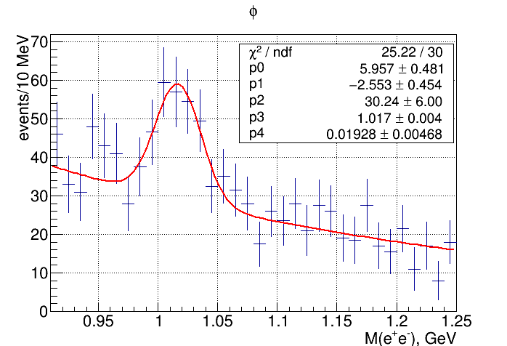
2016 golden runs - version comparison: φ
v1 132±23 φ’s
v2 104±17 φ’s
v3 146±32 φ’s

Slide 2
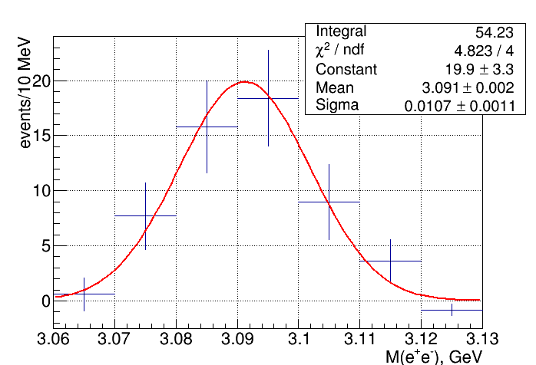
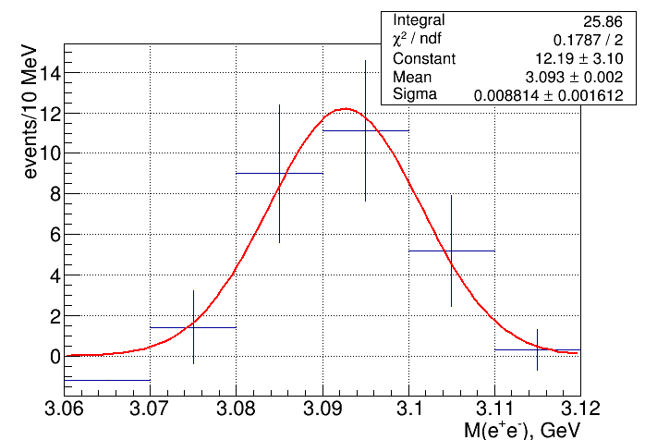
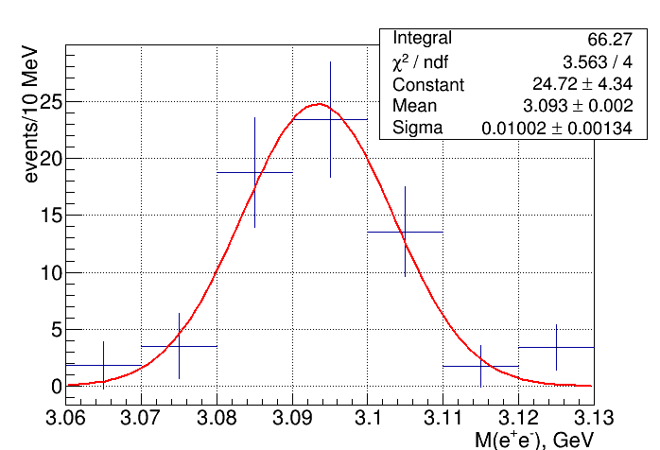
2016 golden runs - version comparison: J/ψ
v1 54 J/ψ’s
v2 26 J/ψ’s
v3 66 J/ψ’s

Slide 3
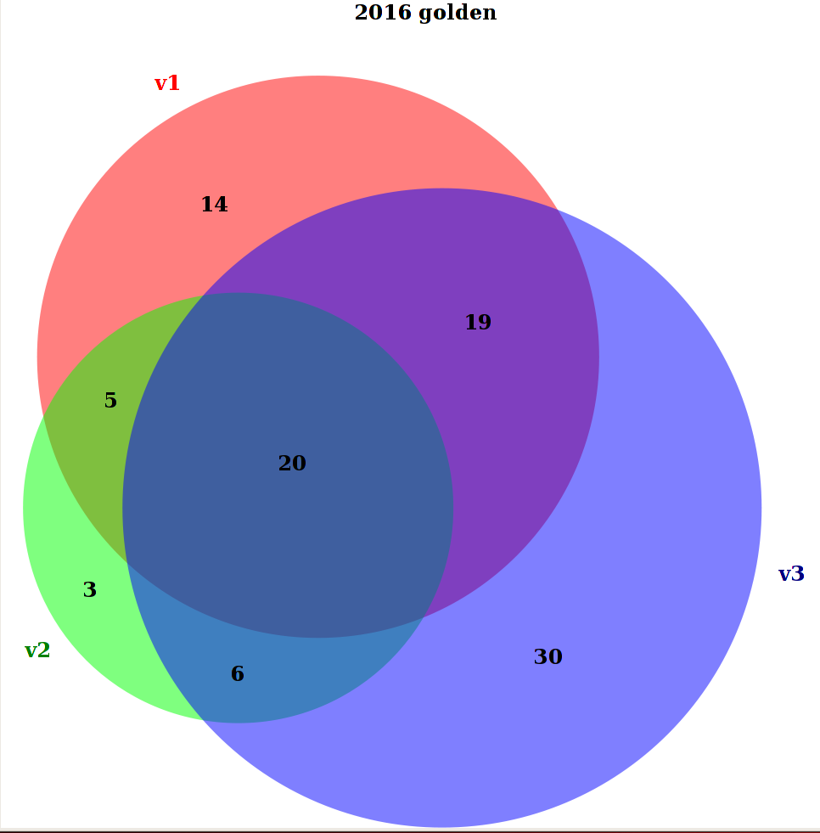
2016 golden runs - J/ψ event overlap: Venn diagrams

Slide 4
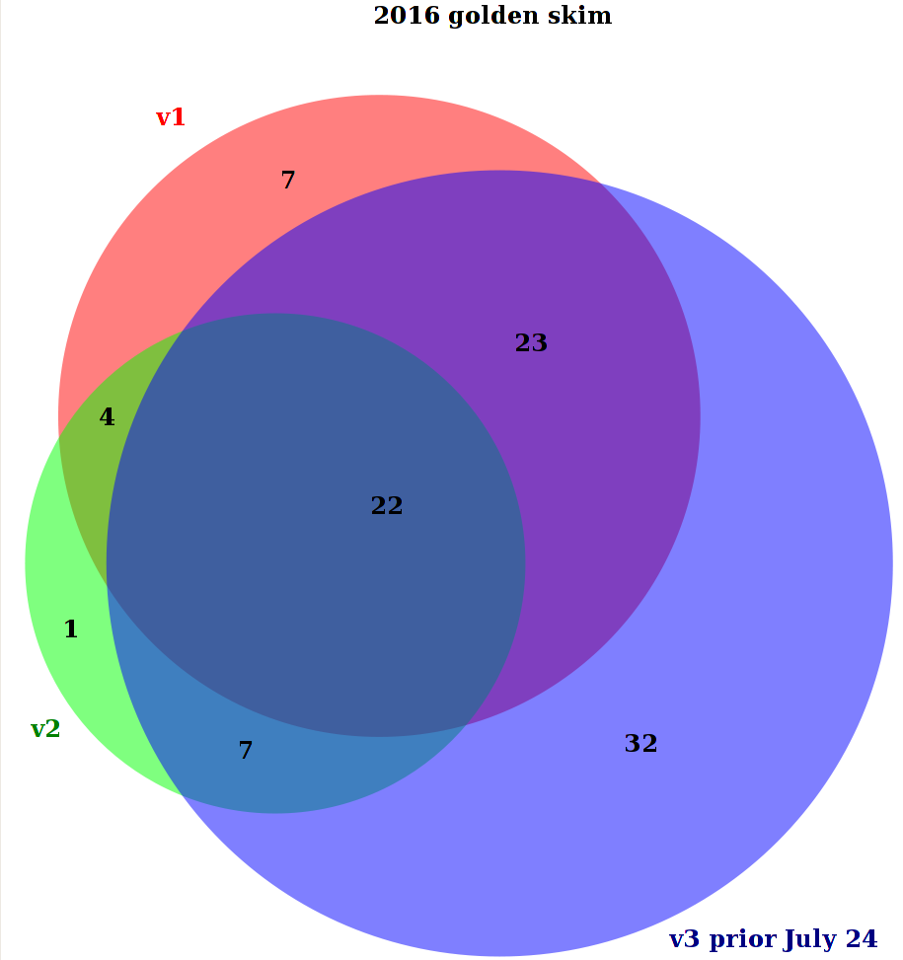
2016 golden runs - J/ψ event overlap: Venn diagrams
?

