Slide 1
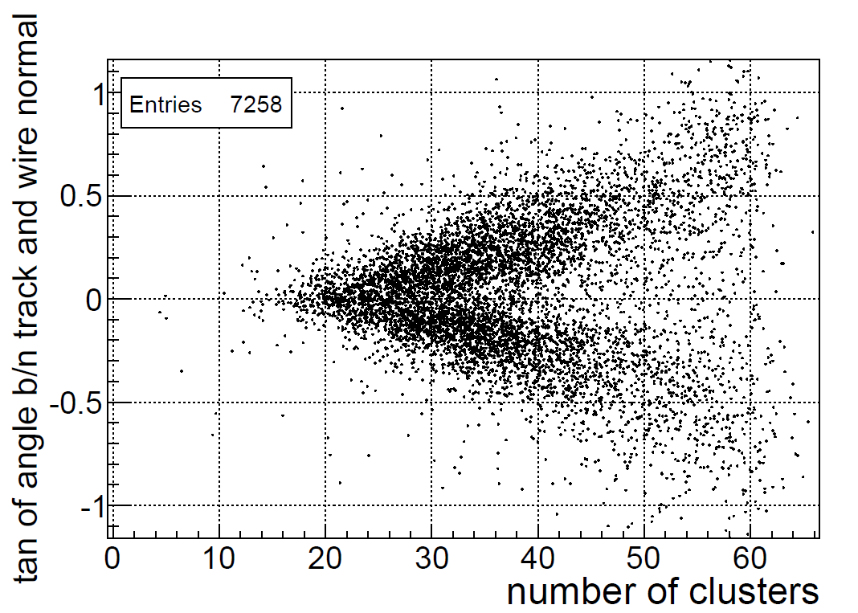
Number of clusters vs track angle in modified FDC

Slide 2
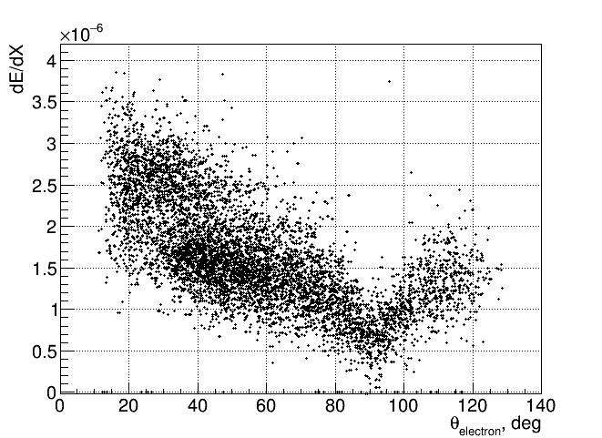
dE/dx vs track angle in CDC

Slide 3
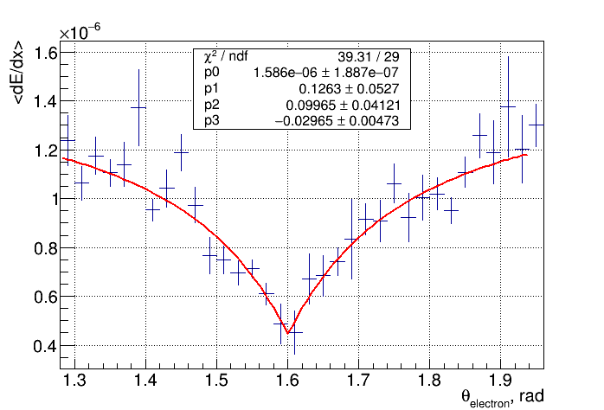
Space charge effects – when track perpendicular to the wire electrons drift to the same amplification region
p0 exp(- $\frac{p1}{abs(\cos\left(Θ−p3\right))+p2}$)

Slide 4
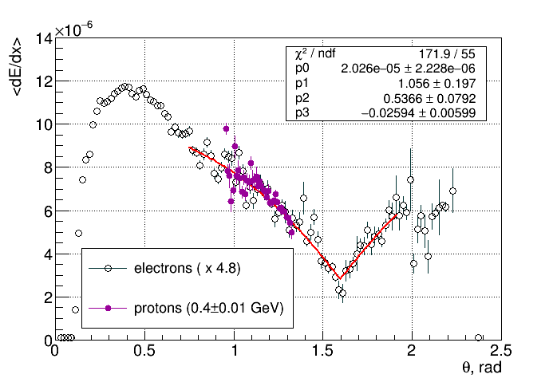
p0 exp(- $\frac{p1}{abs(\cos\left(Θ−p3\right))+p2}$)

