Slide 1
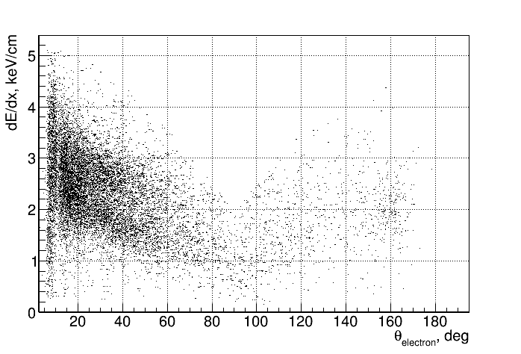
CDC dE/dx from e+/e- data (integral)
±

Slide 2
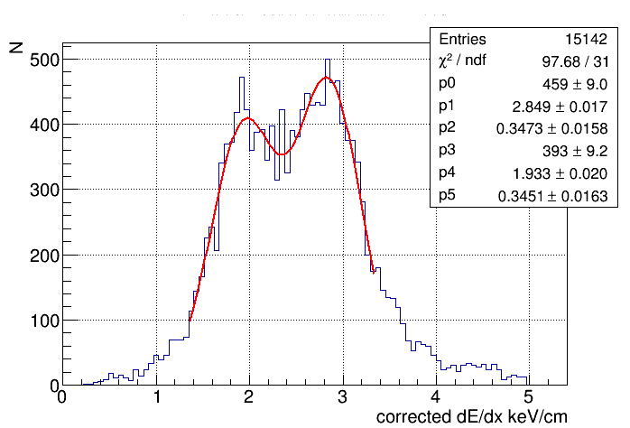
CDC dE/dx from e+/e- data (integral)

Slide 3
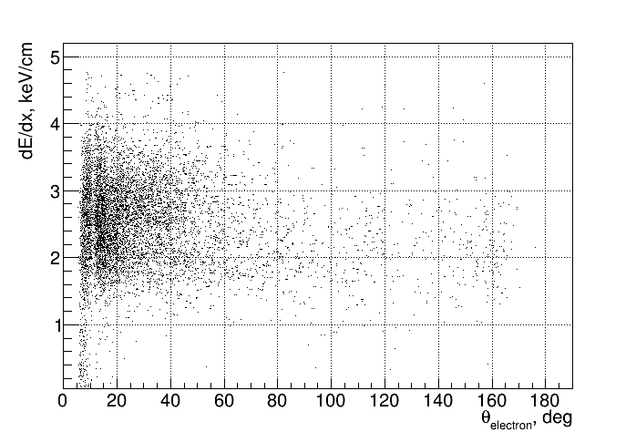
CDC dE/dx from e+/e- data (peak amplitude)
±

Slide 4
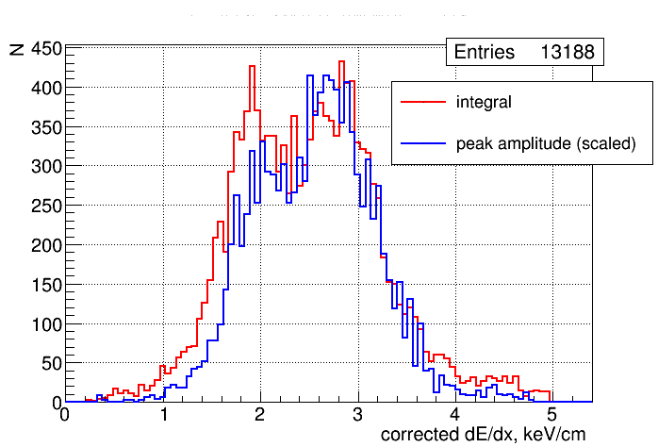
CDC dE/dx from e+/e- data (peak vs integral)
±

