Slide 1
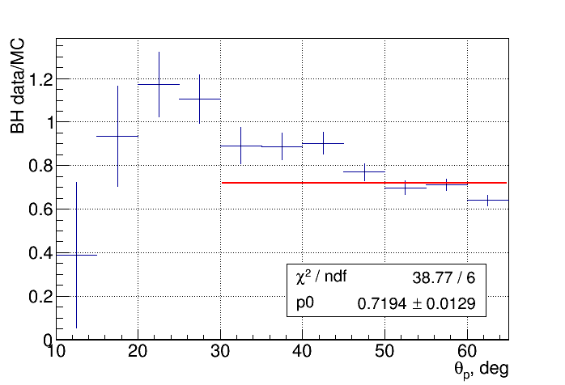
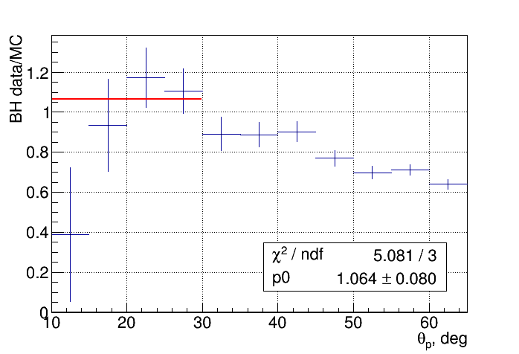
First look at spring 2018 data: systematics
Notes:
1
1

Slide 2
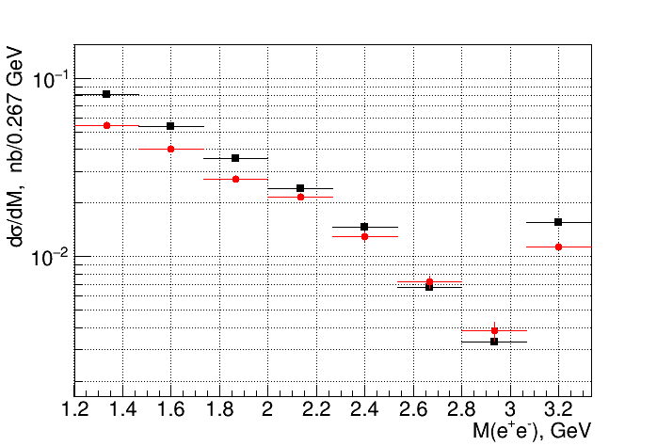
First look at spring 2018 data: systematics
BH MC vs data
Notes:
2
2

Slide 3
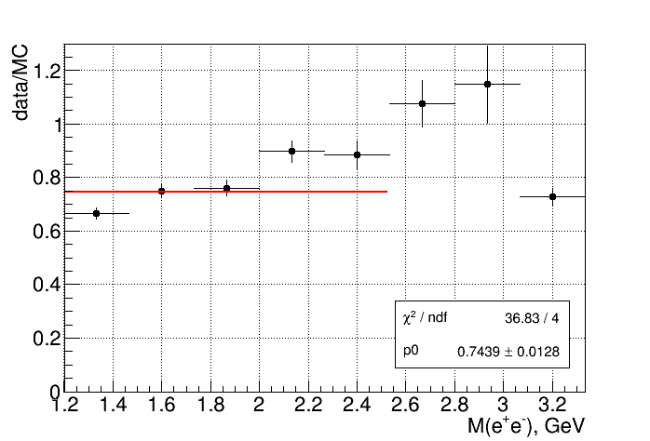
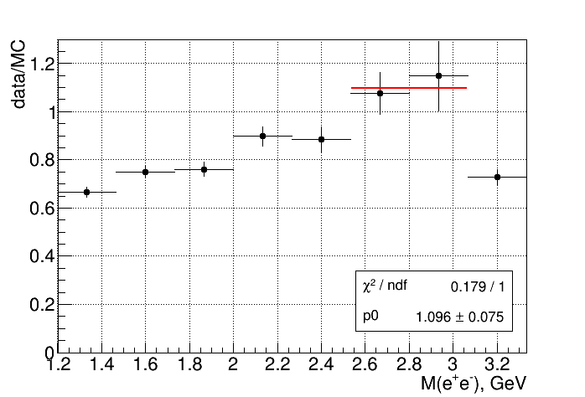
First look at spring 2018 data: systematics
Notes:
3
3

Slide 4
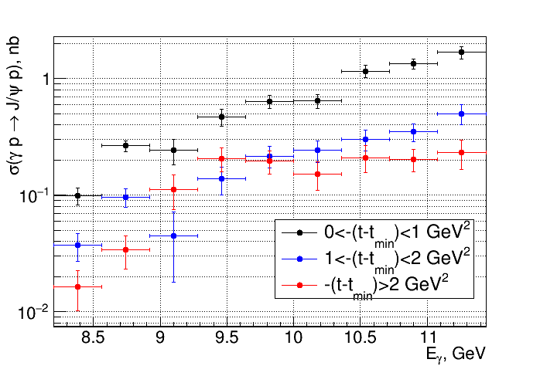
First look at spring 2018 data: x-sec in t ranges
Notes:
4
4

Slide 5
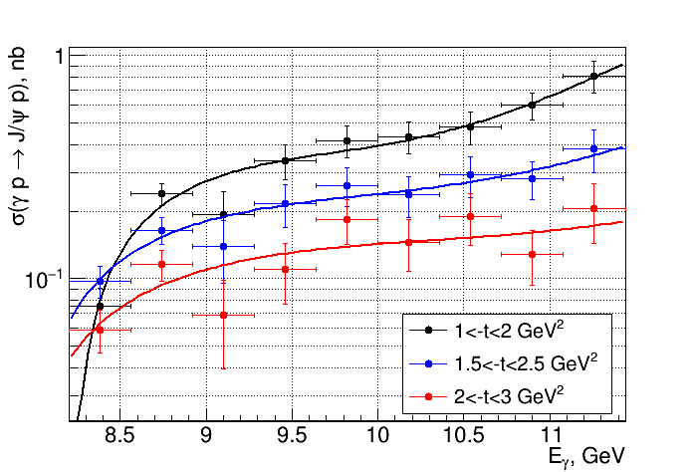
First look at spring 2018 data: x-sec in t ranges
Notes:
5
5

