Slide 1
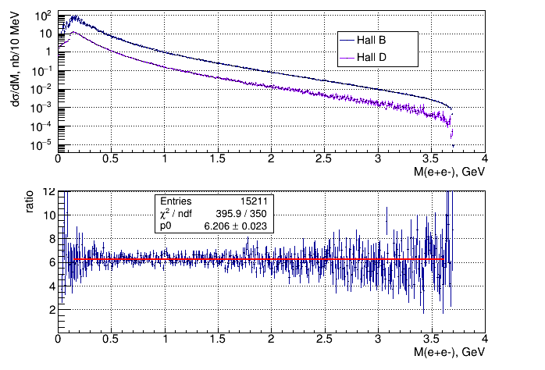
Hall B vs Hall D generator
E_{γ} = 11 GeV no proton FFs

Slide 2
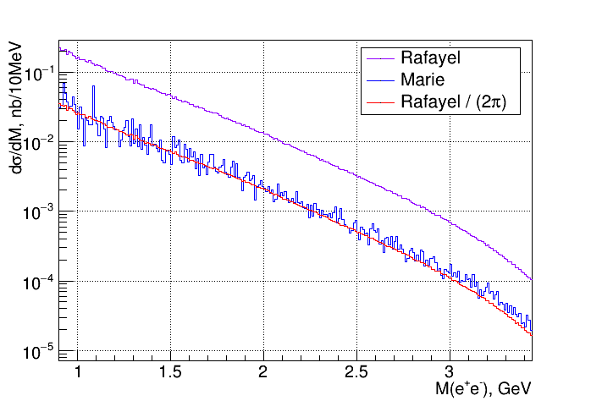
Hall B vs Marie’s generator
E_{γ} = 11 GeV 40<θ<140 0.04<|t|<3.5 GeV²

Slide 3
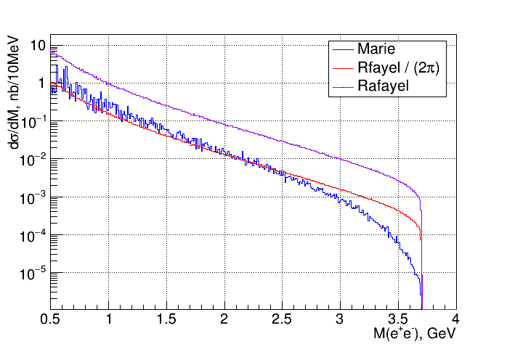
Hall B vs Marie’s generator
E_{γ} = 11 GeV 0<θ<180 0<|t|<3.5 GeV²

Slide 4
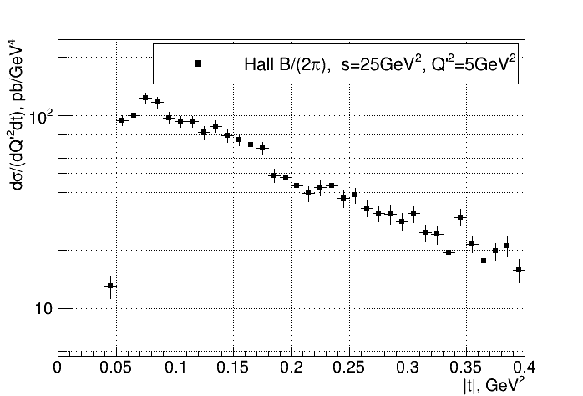
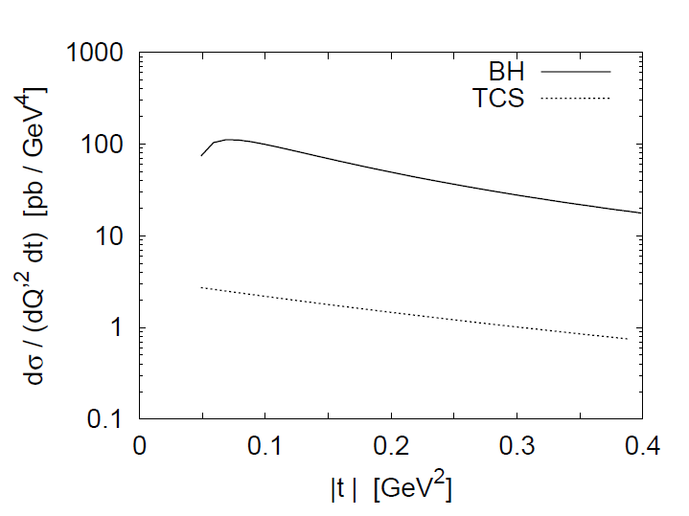
Hall B vs Berger et.al paper
s = 25 GeV² Q’2 = 5 GeV²

Slide 5
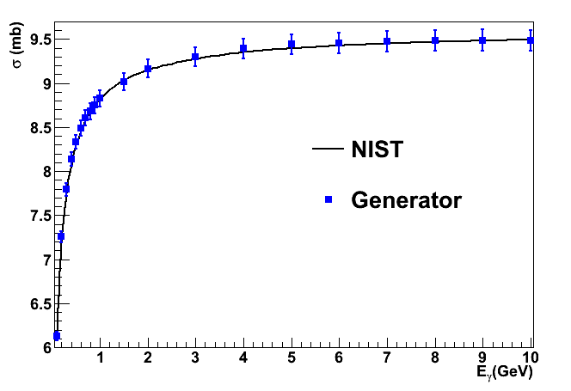
Hall D vs NIST

Slide 6
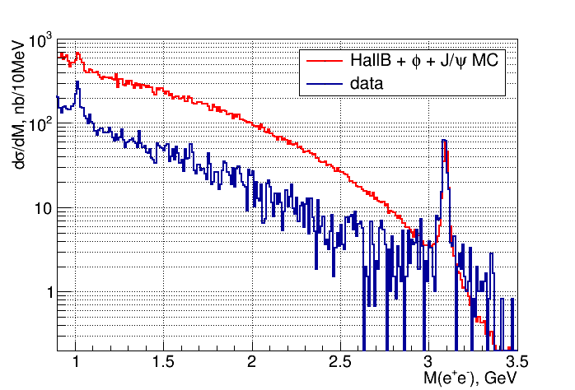
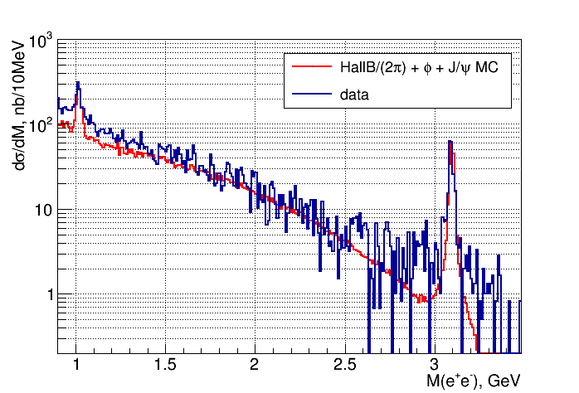
Hall B vs data

Slide 7
Conclusions
Misinterpretation of Berger et.al formula in the Hall B generator, resulting in double-counting trivial φ_{LAB} integration – easy fix: divide by 2π
Difference between Hall D and Hall B/Marie’s generator coming from the proton form-factors – very important to implement proton FFs into the Hall D generator
Limitations (t, θ_{CM}) in the Hall B and Marie’s generator have to be understood
Adapt Marie’s generator into the Hall D framework

