Slide 1
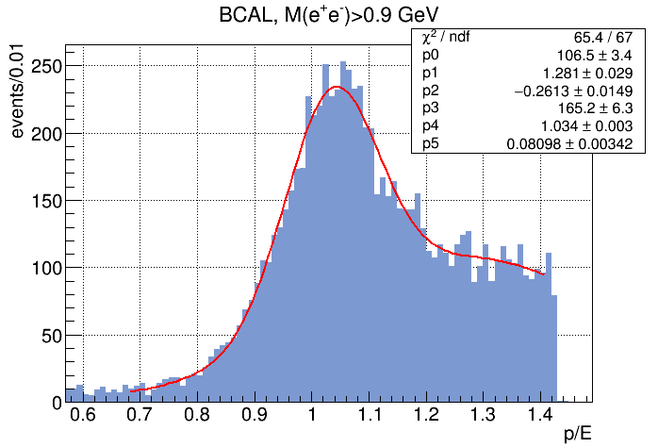
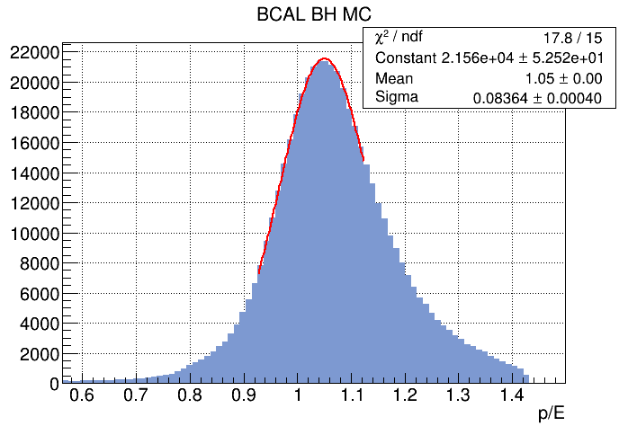
New analysis for 2017 (both LI and HI)
BH MC includes random hits run-by-run

Slide 2
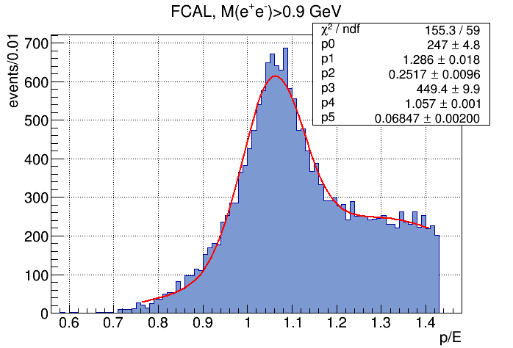
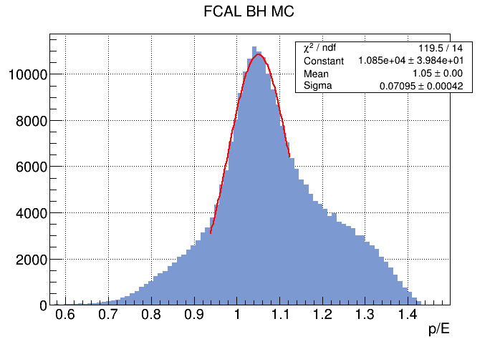
New analysis for 2017 (both LI and HI)
BH MC includes random hits run-by-run

Slide 3
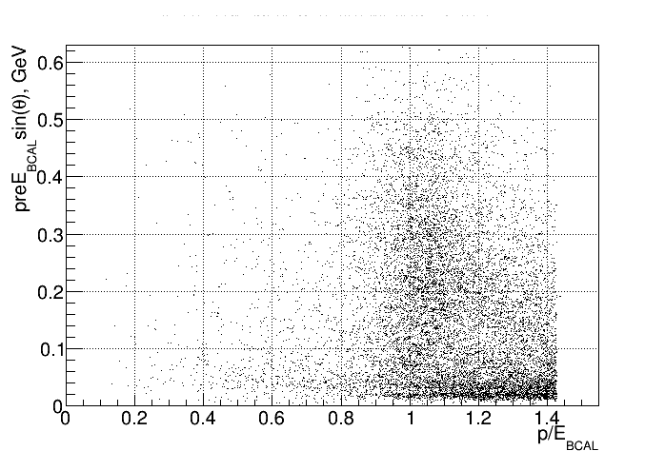
New analysis for 2017 (both LI and HI)
BCAL pre-shower; cut at 0.03

Slide 4
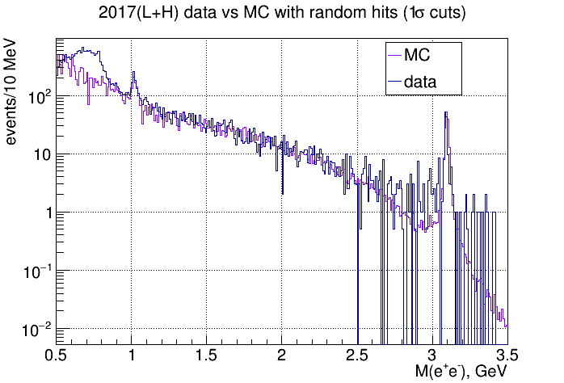
140 J/ψ events in 2017(L+H) with 1σ cuts

Slide 5
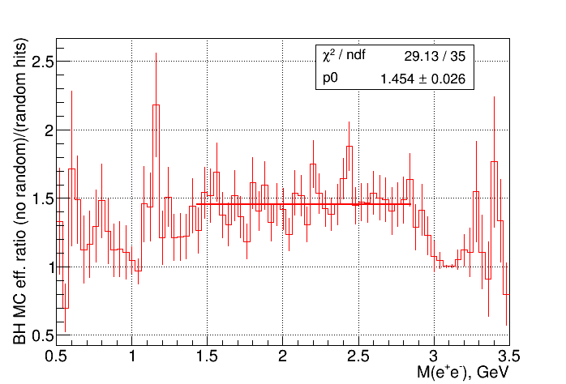
BH MC without/with random hits

