Slide 1
 | rest | anal | sim-recon | date
20f/run 2017 | offline mon. | v13 | 2.13 | April 24/2017
2016 | v4 | v6 | 2.14 | May 24/2017
2017 | v1 | v1 | 2.15 | June 27/2017
2017 | v2 | v9 | 2.20.1 | Dec. 4/2017
2016 | v5 | v11 | 2.20.1 | Dec. 4/2017

Slide 2
 | 2016 | (golden) | 2017 | 20files/run | 2017 | all
 | φ | J/ψ | φ | J/ψ | φ | J/ψ
old rec. old anal. | (130±23.0) 275 ± 36 | (56.5±8.3) 121±12.7 | 80.1 ± 19.0 | 32.0 ± 4.8
old rec. new anal. |  |  | 46.7 ± 14.0 | 23.8 ± 5.6
old rec. new anal. loose cuts |  |  | 65.9 ± 16.6 | 30.2 ± 6.5
new rec. old anal.
new rec. new anal. | (104±17.5) 250 ± 29 | (28.8±6.2) 62.5±9.2 | 78.8 ± 31.0 ? | 33.2 ± 6.8 ? | 483.8± 52.2 | 133.0± 12.8
new rec. new anal. loose cuts | 268±30 | 70.8±10.1 |  |  | 467.7±55.8 | 137.1±13.5
lumi, pb-1 | 10.895 |  | 5.804 |  | 46.138
norm. yield | 25.24±3.3 22.95±2.7 | 11.1±1.2 5.74±0.8 | 13.80±3.27 | 5.51±0.83 | 10.49±1.13 | 2.88±0.28

Slide 3
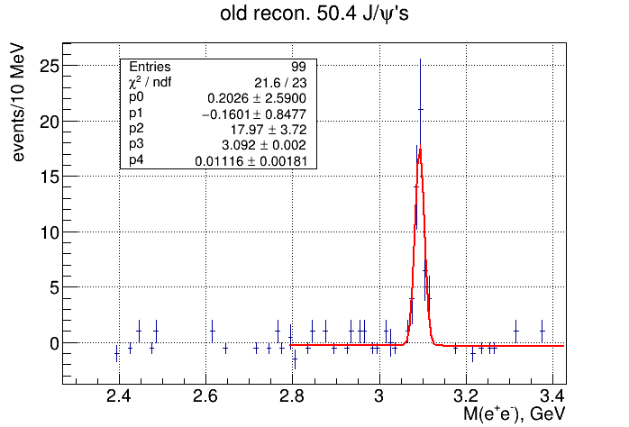
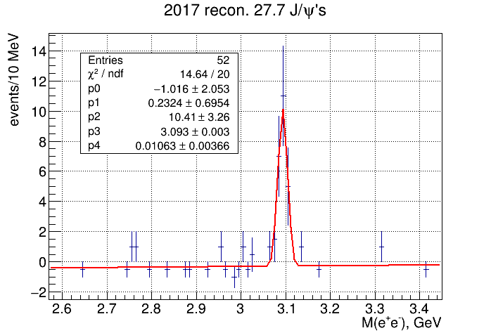
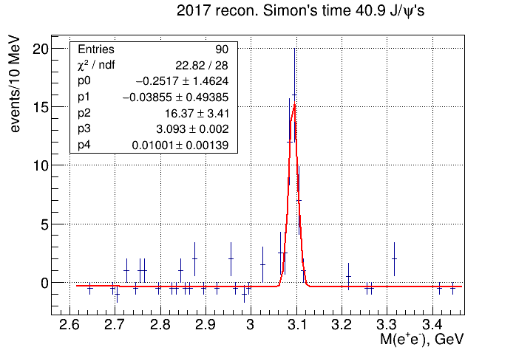
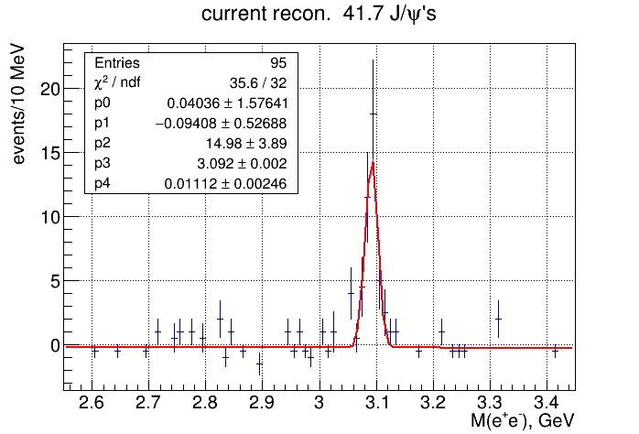
J/ψ event-by-event comparison (over 67 skims from 2016)
±

Slide 4
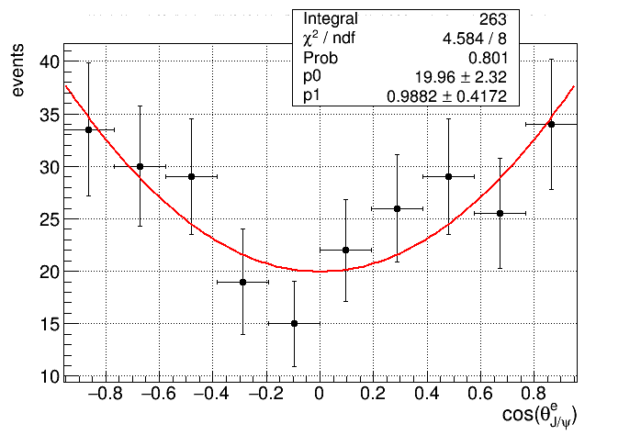
J/ψ photoproduction helicity conservation
Fit with p0(1+p1∙cos²θ)
±

Slide 5
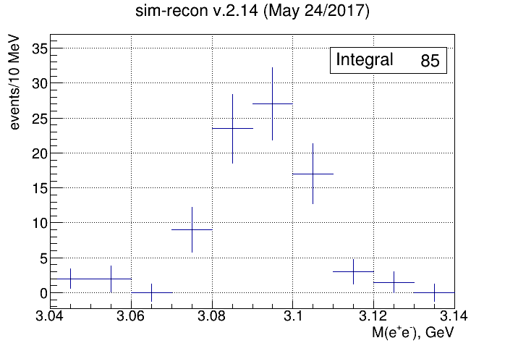
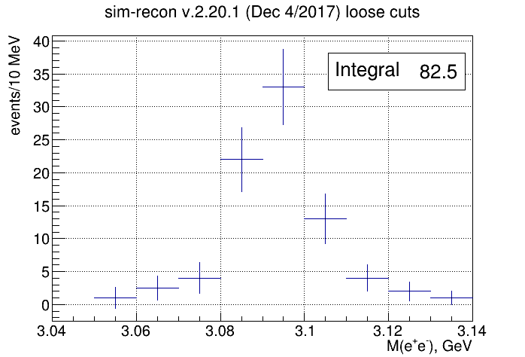
J/ψ event-by-event comparison (over 121 skims from 2016/2017)

Slide 6
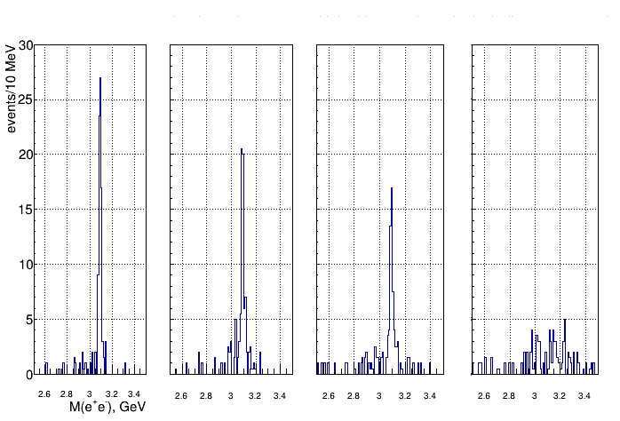
J/ψ reconstruction methods (over 121 skims from 2016/2017)
kinematic fit recoil proton angles only electron, positron

Slide 7
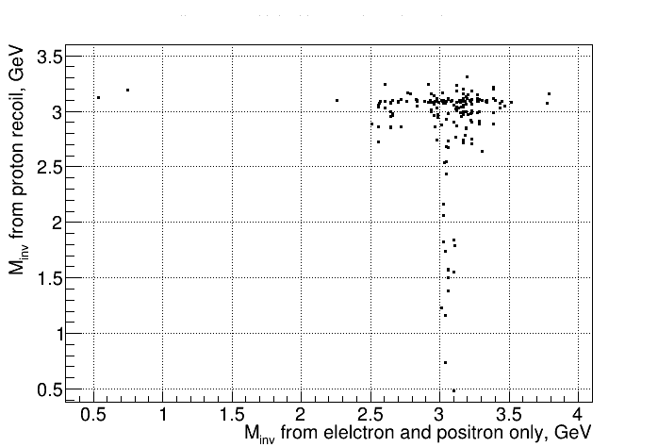
J/ψ reconstruction methods (over 121 skims from 2016/2017)
recoil proton vs electron, positron

