Slide 1
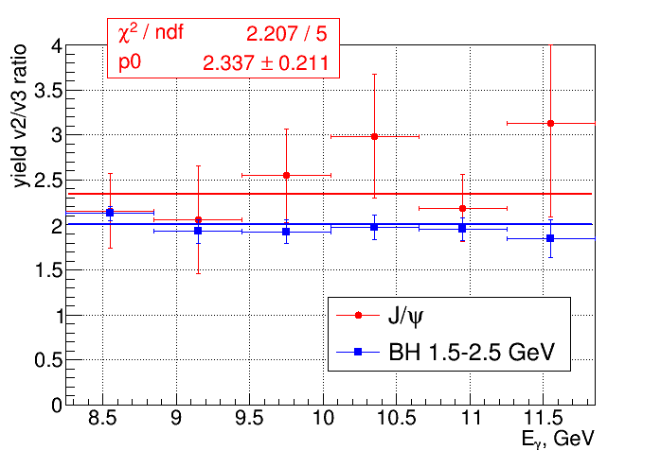
Latest reconstruction/analysis results -yields

Slide 2
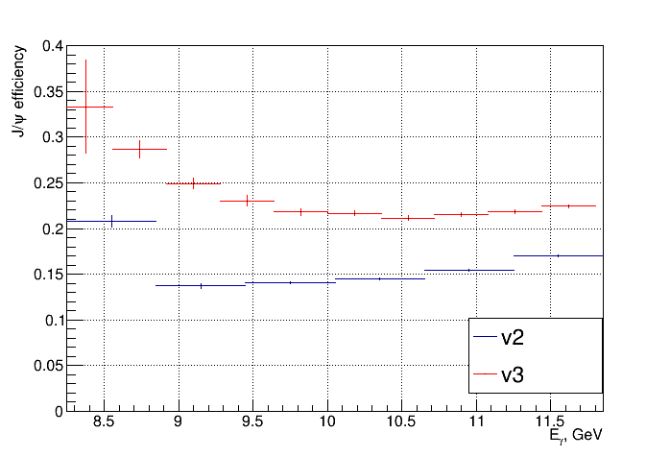
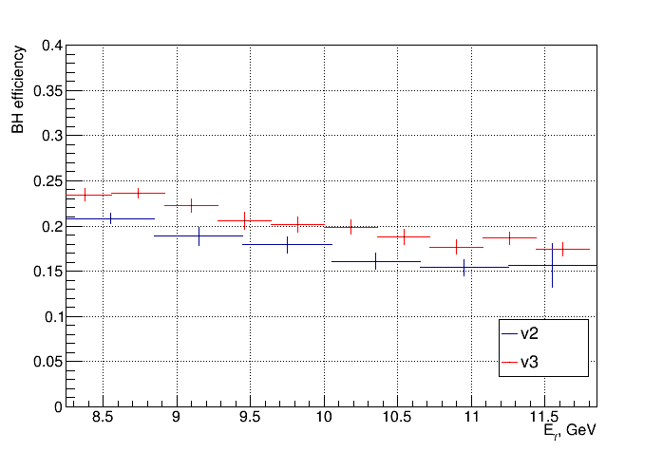
Latest reconstruction/analysis results - efficiencies

Slide 3
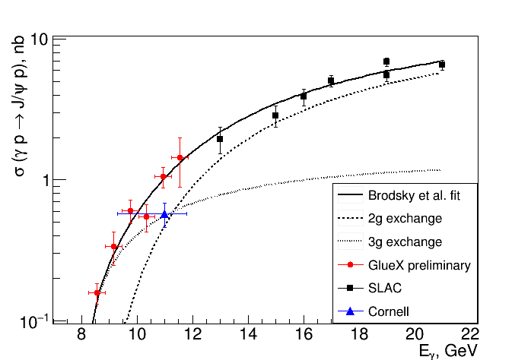
Comparison to theory

Slide 4
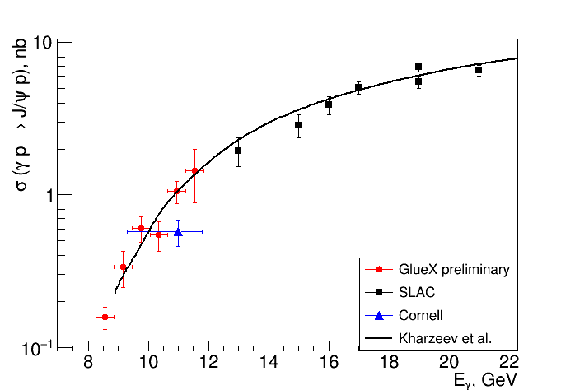
Comparison to theory

