Slide 1
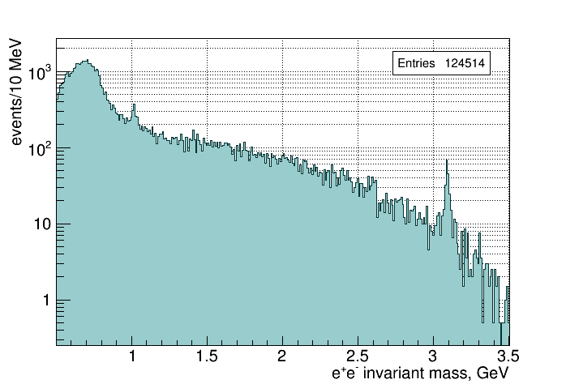
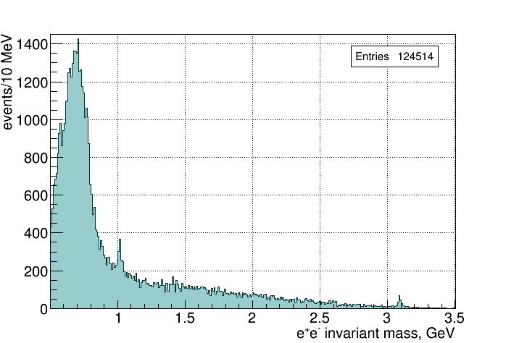
2016 + 20 files per run from 2017 data
Require kin.fit converges and θ_{e} > 1⁰
1
Notes:
1
1

Slide 2
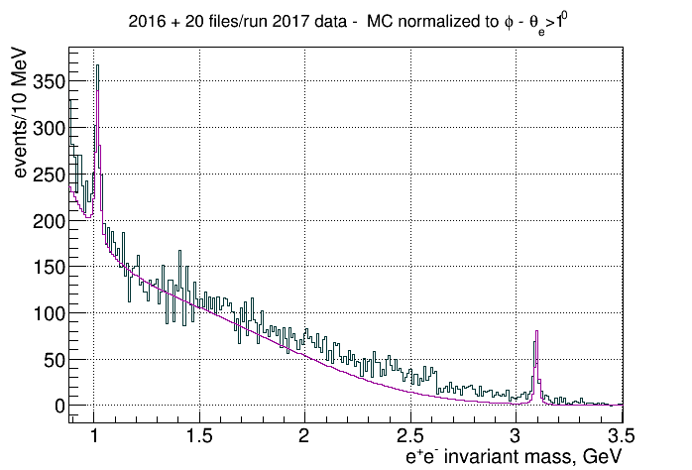
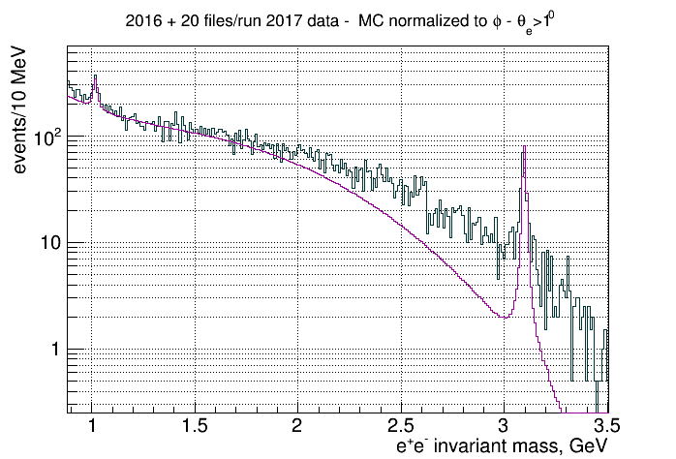
2016 + 20 files per run from 2017 data
Require kin.fit converges and θ_{e} > 1⁰
2
Notes:
2
2

Slide 3
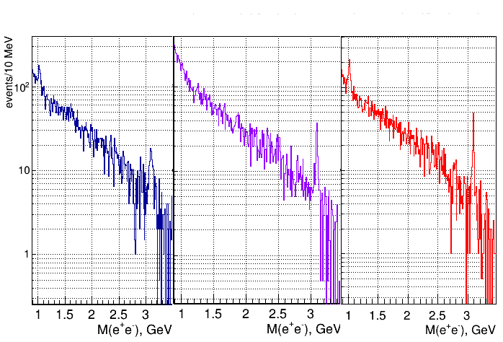
Reconstructing p, e⁺, e⁻ momenta from angles (2016 data)
angles only
γp -> pX missing mass
kinematic fit
3
Notes:
3
3

Slide 4
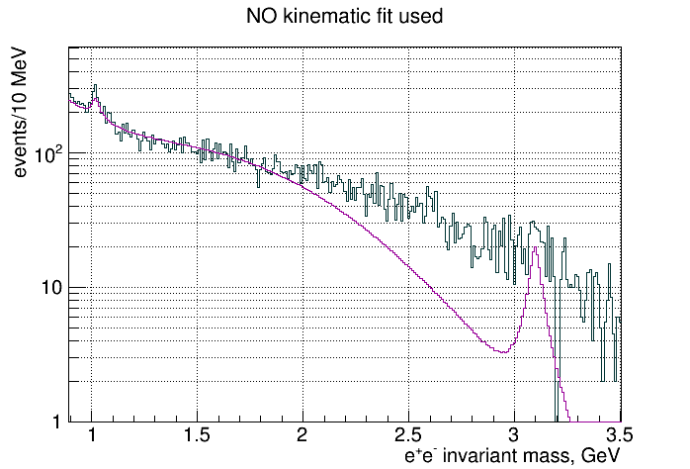
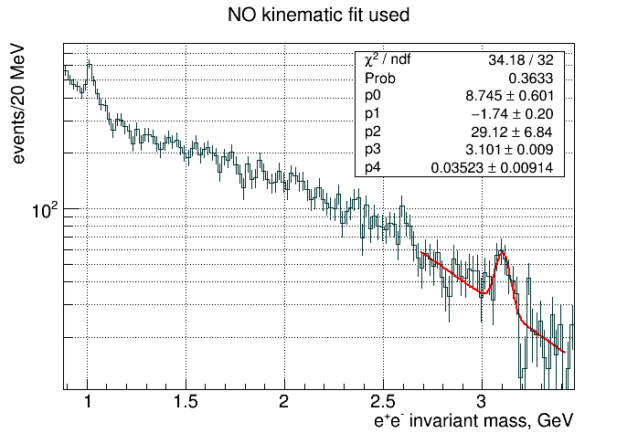
Reconstructing p, e⁺, e⁻ momenta from angles (2016 data)
Momenta calculated from angles
Require energy conservation to +/- 200 MeV and Δr(vertex) < 4 cm
4
Notes:
4
4

Slide 5
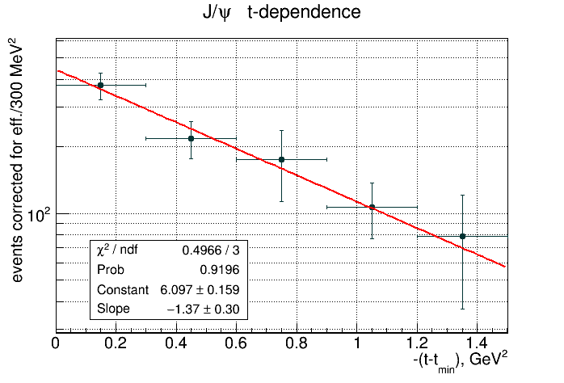
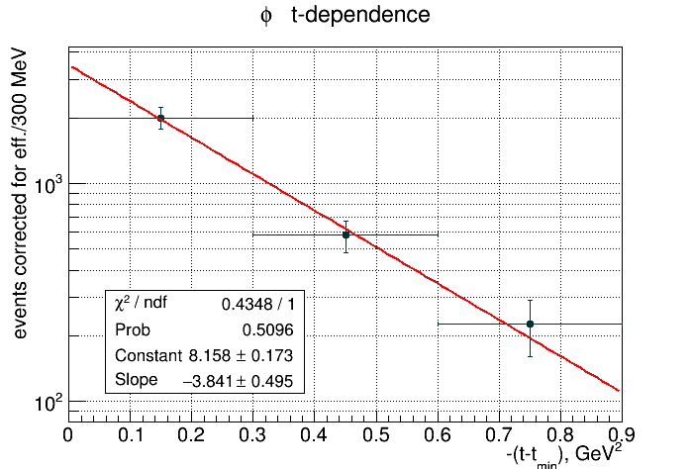
Analysis in bins of t
t-slope of Cornell data 1.2 GeV⁻² at E_{γ} = 11 GeV
t-slope of old data ~3.5 GeV⁻²
5
Notes:
5
5

Slide 6
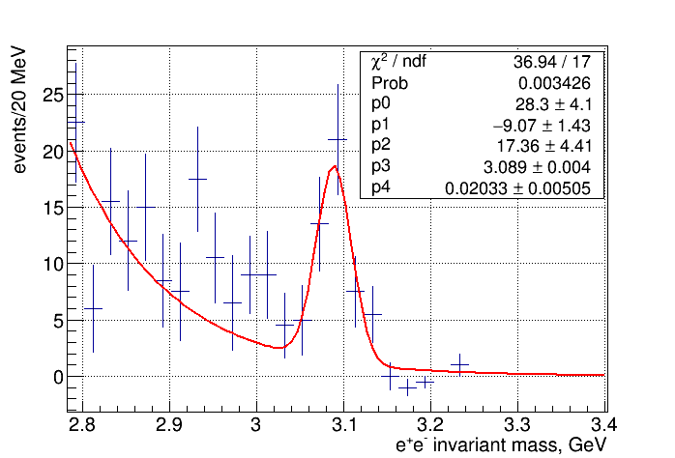
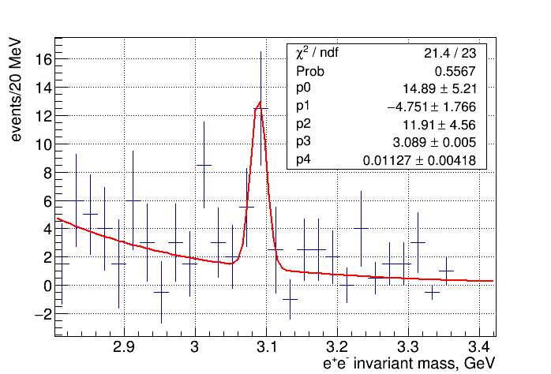
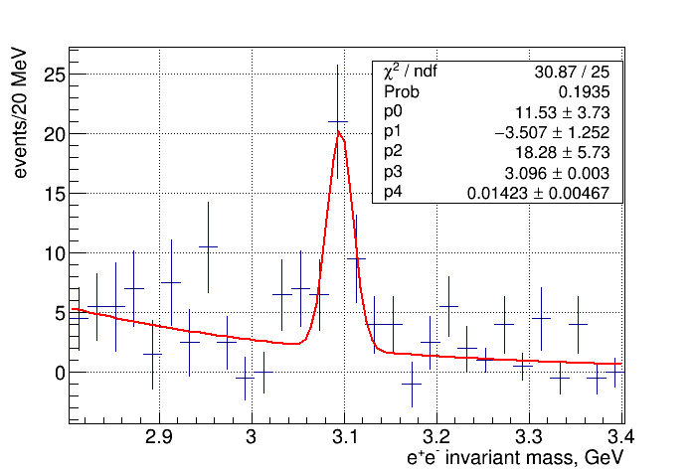
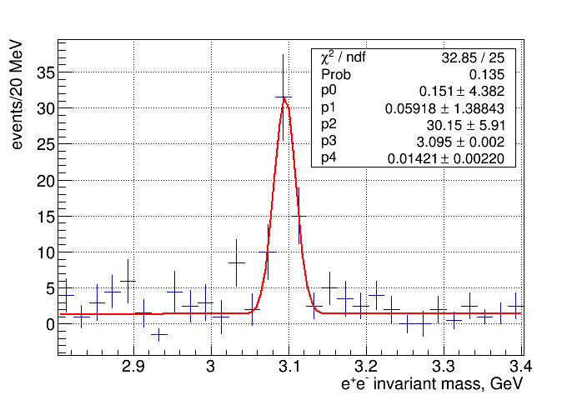
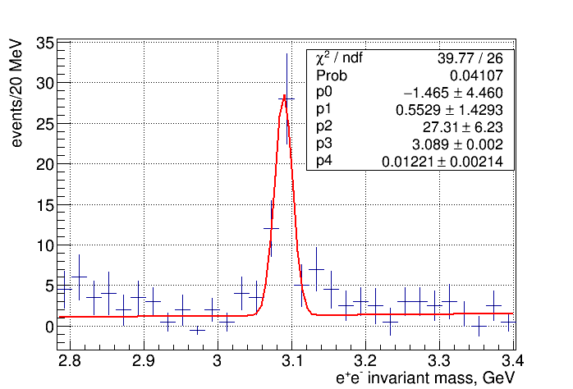
Analysis in bins of energy
6
Notes:
6
6

Slide 7
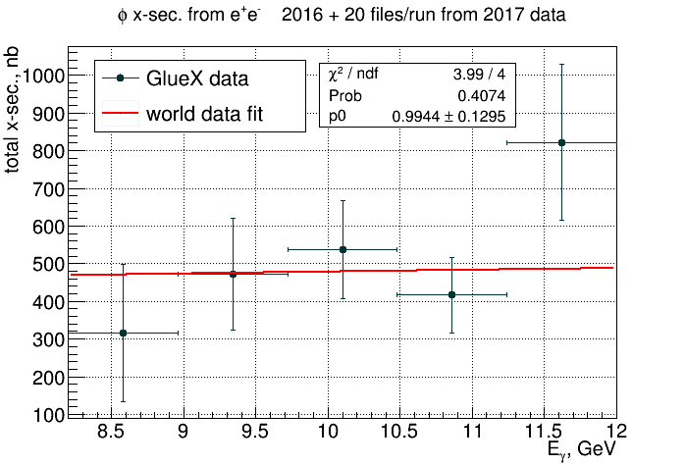
φ x-sec. vs beam energy
GlueX data normalized to world data fit - gives estimate of (luminosity) * (efficiency)
7
Notes:
7
7

Slide 8
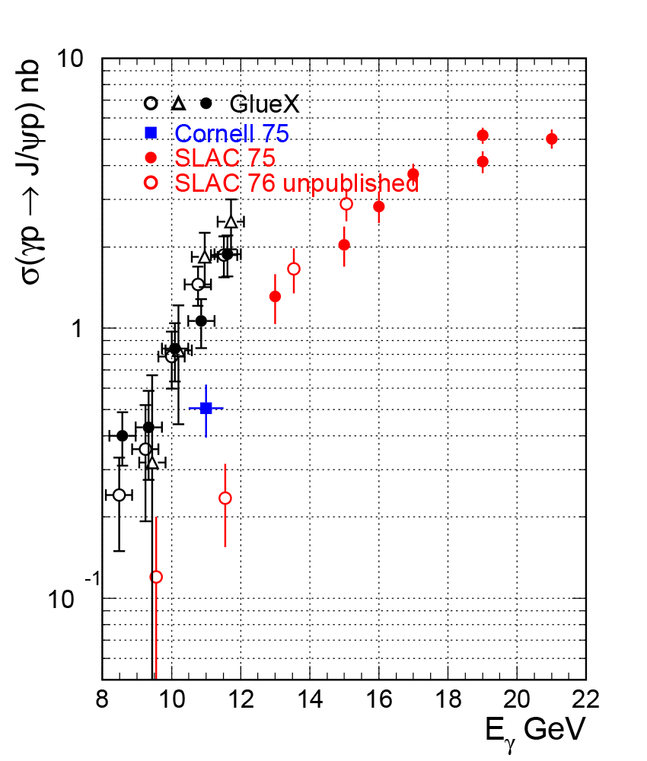
J/ψ x-sec. vs beam energy
● Fits in slices of energy
○ Using kin. fit (global fit with flat background)
∆ No kin.fit (global fit with flat background)
t-slope of SLAC data 2.9 GeV⁻²
t-slope of Cornell data 1.2 GeV⁻²
8
Notes:
8
8

Slide 9
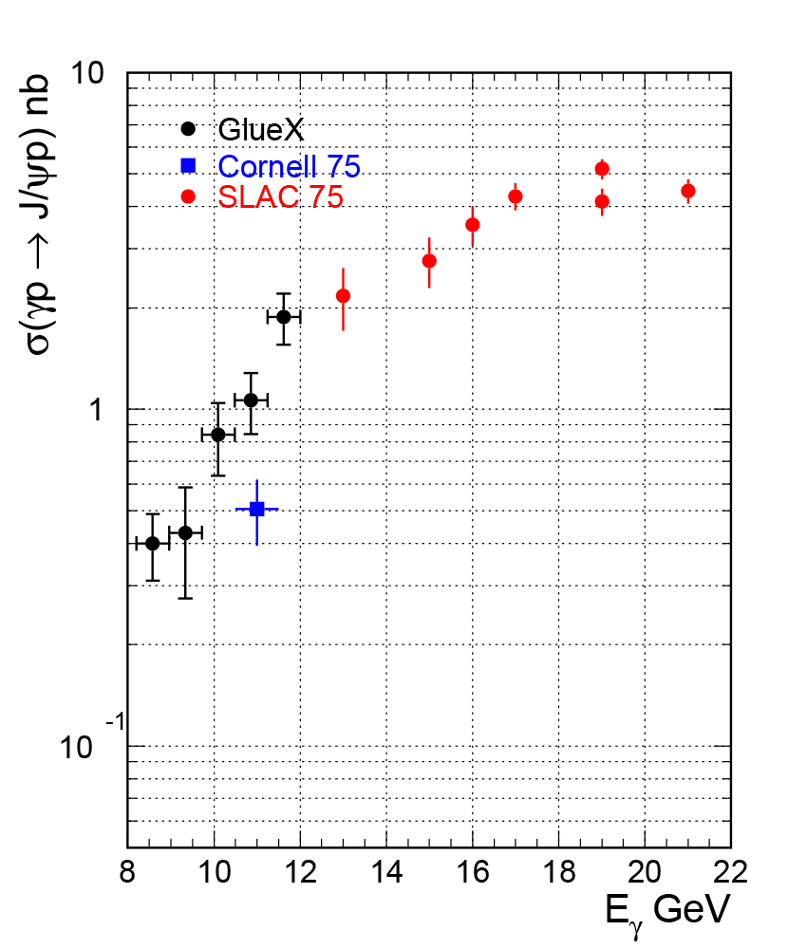
J/ψ x-sec. vs beam energy
● Fits in slices of energy
t-slope of SLAC data 1.39 - 2.9 GeV⁻² (13-21 GeV)
t-slope of Cornell data 1.2 GeV⁻²
9
Notes:
9
9

Slide 10
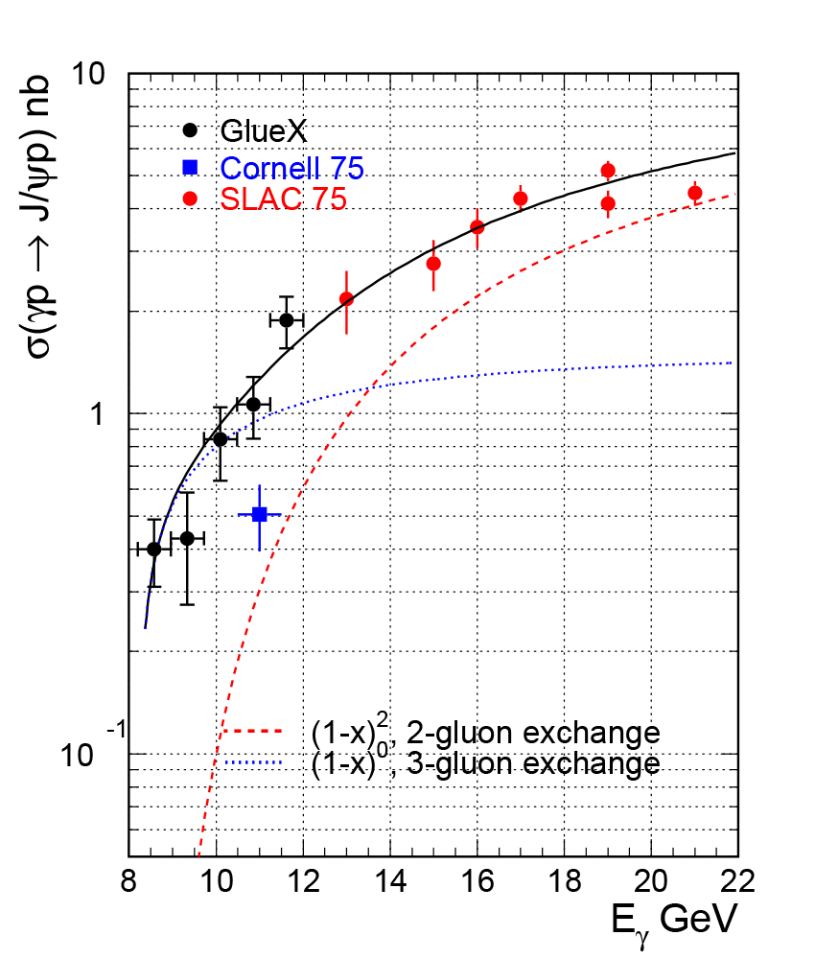
J/ψ x-sec. vs beam energy
● Fits in slices of energy
Cornell data excluded from fit
t-slope of SLAC data 1.39 - 2.9 GeV⁻² (13-21 GeV)
t-slope of Cornell data 1.2 GeV⁻²
10
Notes:
10
10

Slide 11
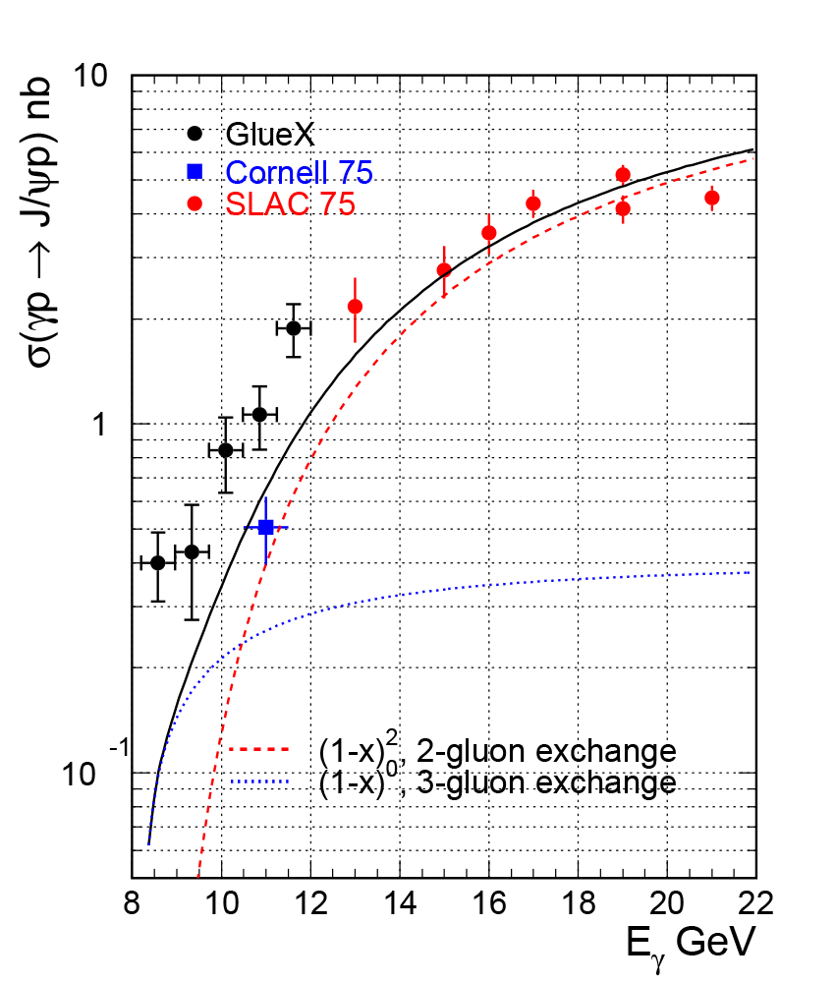
J/ψ x-sec. vs beam energy
● Fits in slices of energy
GlueX data excluded from fit
t-slope of SLAC data 1.39 - 2.9 GeV⁻² (13-21 GeV)
t-slope of Cornell data 1.2 GeV⁻²
11
Notes:
11
11

Slide 12
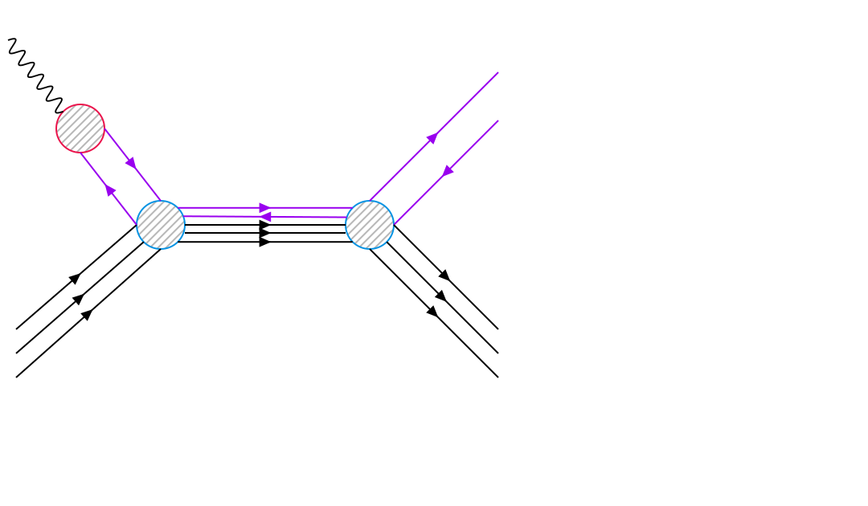
J/ψ x-sec. vs beam energy
● Fits in slices of energy
GlueX data excluded from fit
t-slope of SLAC data 1.39 - 2.9 GeV⁻² (13-21 GeV)
t-slope of Cornell data 1.2 GeV⁻²
12
Notes:
12
12

