Slide 1
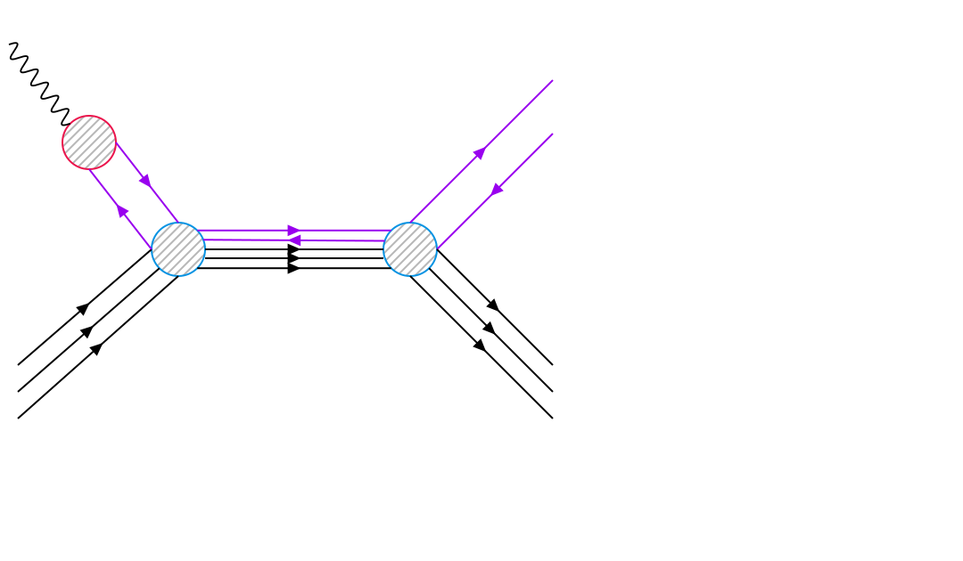
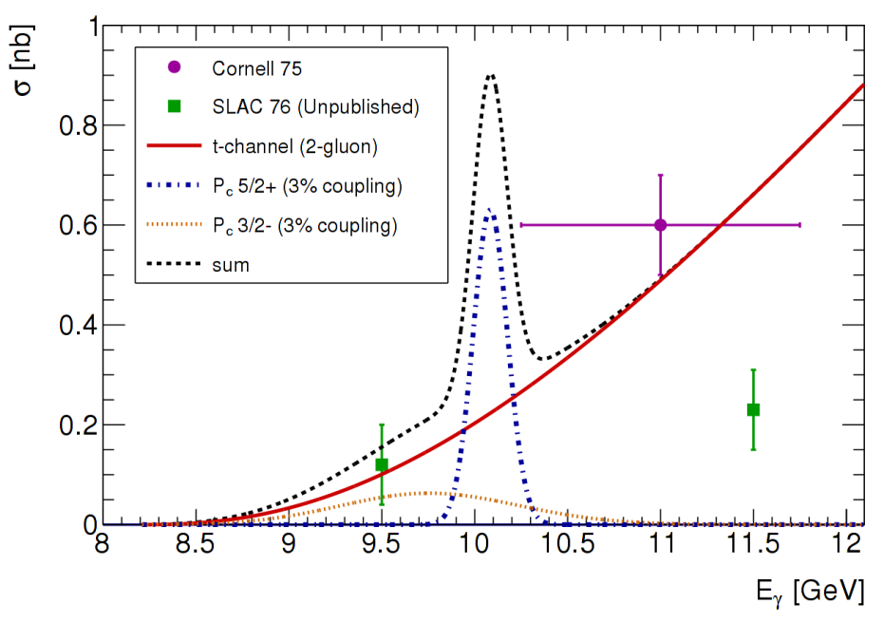
Phtotoproduction of LHCb Pentaquarks
~ BW(Γ_{Pc},M_{Pc})*BR(P_{c}->γp)*BR(P_{c}->J/ψp)
BR(Pc->γp) ~ Γ(J/ψ -> l⁺l⁻)*BR(P_{c}->J/ψp) (VMD)
σ ~ BR²(P_{c}->J/ψp)
1)V.Kubarovsky and M.B.Voloshin, arXiv: 1508.00888.
2)M.Karliner and J.Rosner, arXiv: 1508.01496.
3)A.Blin, C.Fernandez-Ramirez, A.Jackura, V.Mathieu, V.Mokeev, A.Pilloni, and A.Szczepaniak,arXiv: 1606.08912
all three papers σ^{max} ~ 10 μb for P_{c}(5/2+) 100% BR
1)Q.Wang, X.Liu, and Q.Zhao,arXiv: 1508.00339
σ^{max} ~ 0.7 μb for P_{c}(5/2+) 100% BR
1
Notes:
1
1

Slide 2
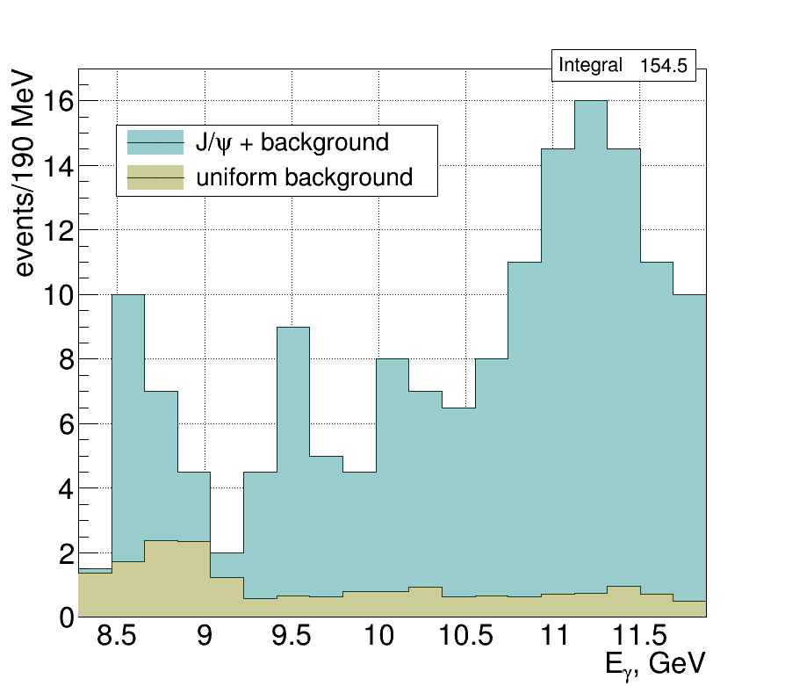
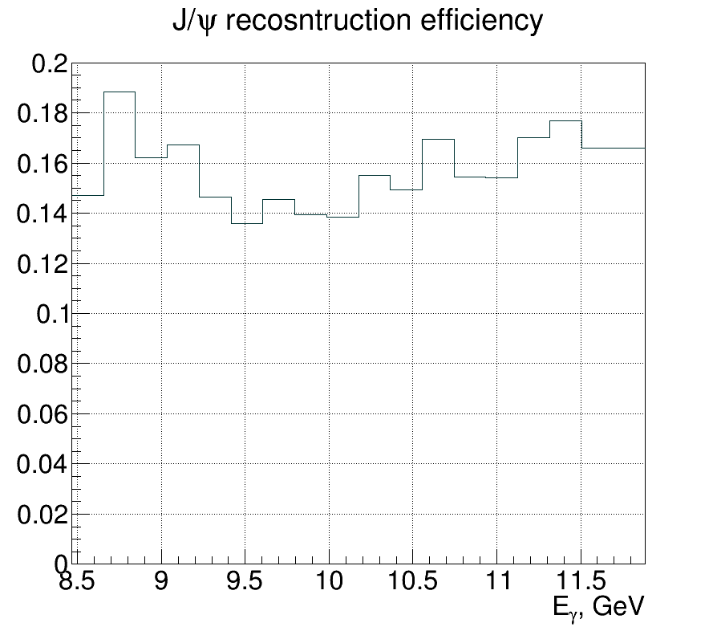
J/ψ x-section in finer bins of beam energy
2
Notes:
2
2

Slide 3
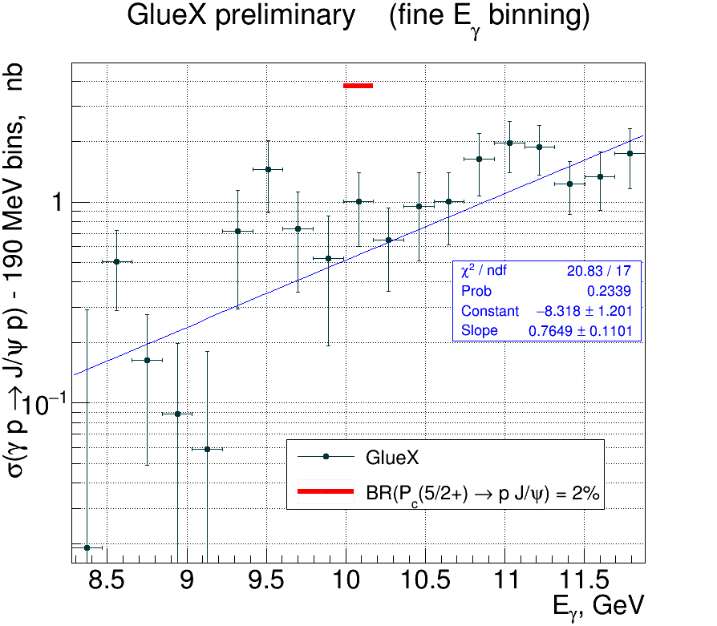
Upper limit for BR(P_{c} → p J/ψ)
3
Notes:
3
3

