Slide 1
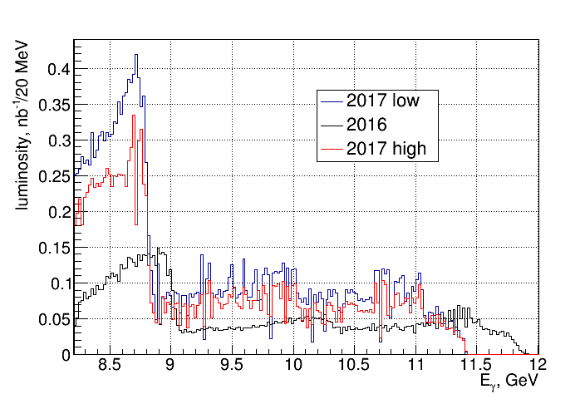

Slide 2
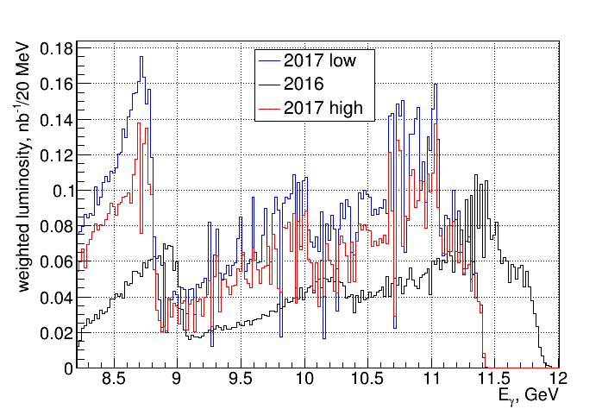

Slide 3
8.2 < E_{γ} <12 GeV 3σ cuts
 | L phi | phi | L J/psi | J/psi
2016 | 10.27 | 468+/-87 | 8.21 | 147+/-14
2017low | 20.37 | 462+/-65 | 13.47 | 122+/-14
2017high | 15.95 | 302+/-83 | 10.70 | 70+/-12
2017low/2016 | 1.98 | 0.99+/-0.15 | 1.64 | 0.83+/-0.09
2017high/2016 | 1.55 | 0.65+/-0.18 | 1.30 | 0.48+/-0.08

Slide 4
8.2 < E_{γ} <11 GeV 3σ cuts
 | L phi | phi | L J/psi | J/psi
2016 | 8.50 | 397+/-84 | 7.18 | 88+/-12
2017low | 19.15 | 438+/-65 | 15.54 | 106+/-13
2017high | 14.94 | 313+/-84 | 12.26 | 55+/-11
2017low/2016 | 2.25 | 1.10+/-0.15 | 2.16 | 1.20+/-0.16
2017high/2016 | 1.76 | 0.65+/-0.18 | 1.71 | 0.63+/-0.13

Slide 5
8.2 < E_{γ} <11 GeV 5σ E/p cuts and all cuts very loose
 | L phi | phi | L J/psi | J/psi
2016 | 8.50 | 341+/-144 | 7.18 | 100+/-16
2017low | 19.15 | 320+/-65 | 15.54 | 117+/-32
2017high | 14.94 | 313+/-84 | 12.26 | 55+/-11
2017low/2016 | 2.25 | 1.10+/-0.15 | 2.16 | 1.20+/-0.16
2017high/2016 | 1.76 | 0.65+/-0.18 | 1.71 | 0.63+/-0.13

