Slide 3
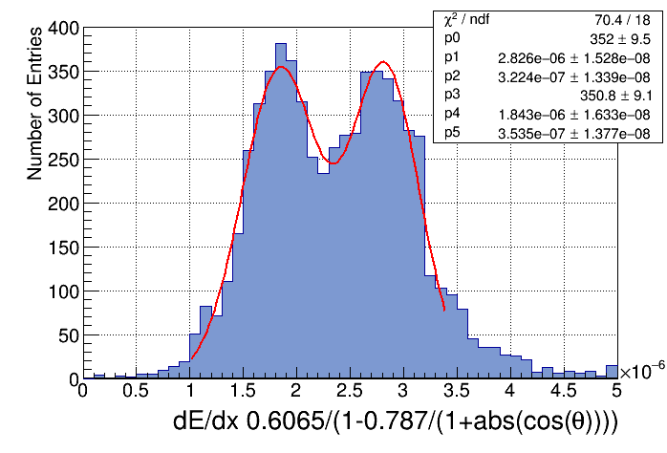
projection for θ>30deg

