Slide 1
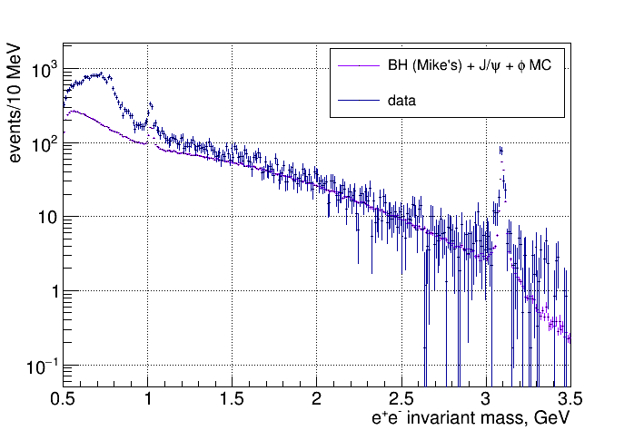
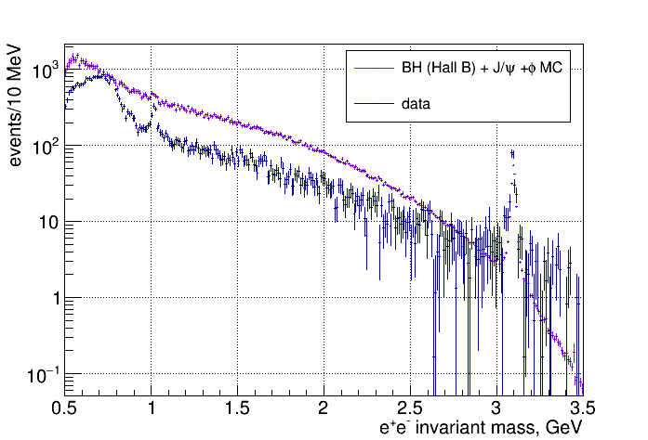
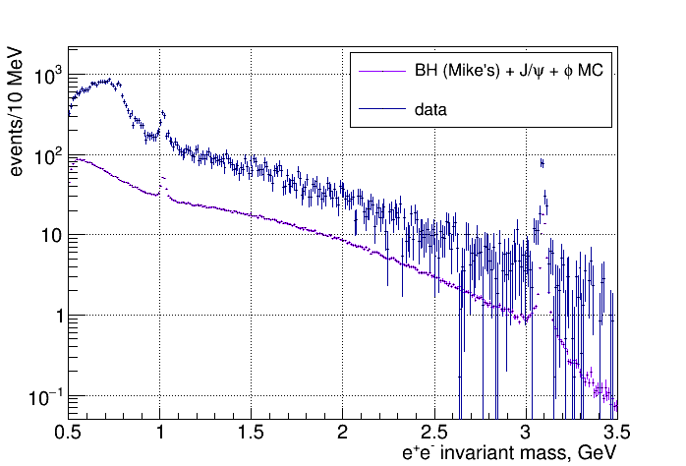
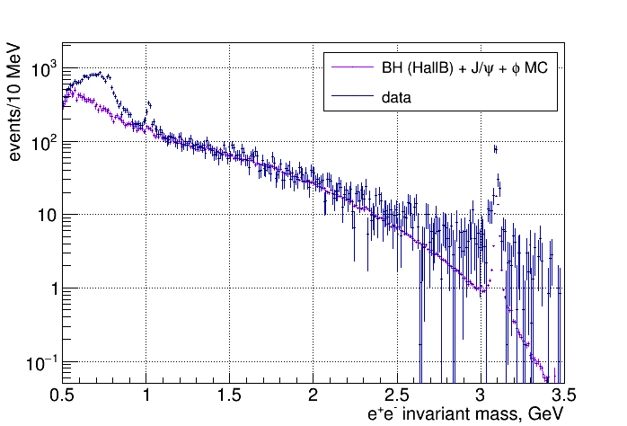
Hall D fit to data in 1.5 – 2.9 GeV
Hall B fit to data in 1.5 – 2.9 GeV

Slide 2
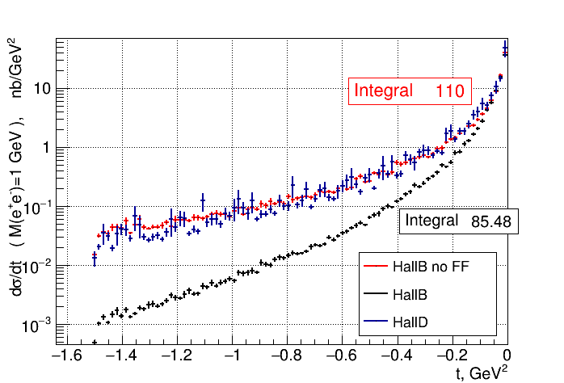
Invariant mass of lepton pair fixed at 1 GeV
Using flat phase space in both MC
Setting F1p=1 and F2p=0 for “Hall B no FF”
Hall B 10 times higher statistics

