Slide 1
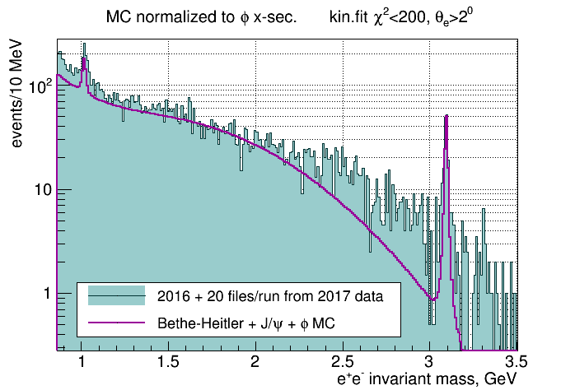
J/ψ update
Using full 2016 statistics and 20 files per run from 2017
2017 data about 20% of data set presented here
10% (high intensity runs) – not well calibrated (S.Dobbs)
Require kin.fit converges with χ²<200, and θ_{e} > 2⁰
Using 2016 flux, corrected for the different endpoint for 2017 data
Absolute flux not used, instead normalization to φ x-section
1
Notes:
1
1

Slide 2
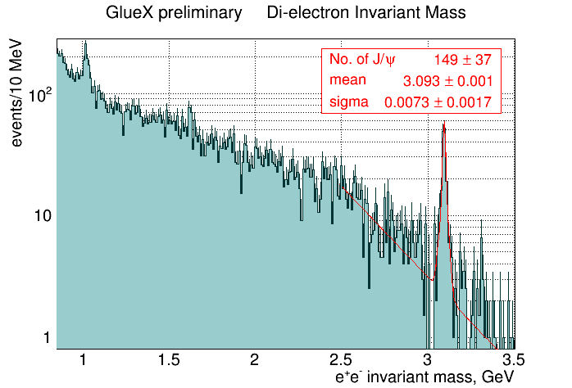
2016 + 20 files per run from 2017 data
Combined statistics allowed for mass peak fitting in bins of energy and t
Require kin.fit converges and θ_{e} > 2⁰
2
Notes:
2
2

Slide 3
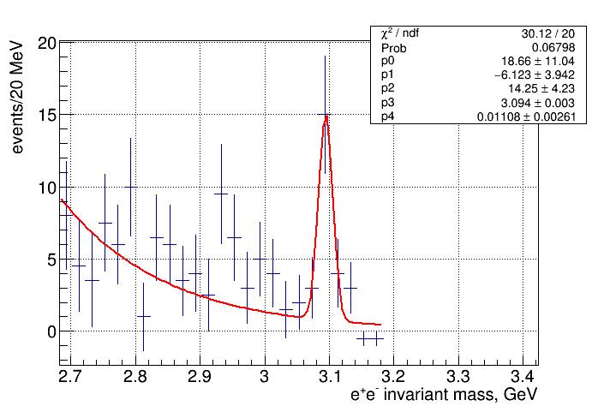
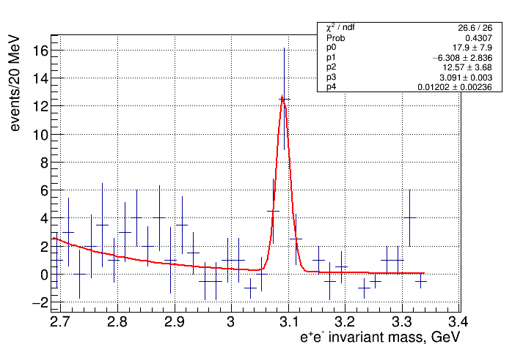
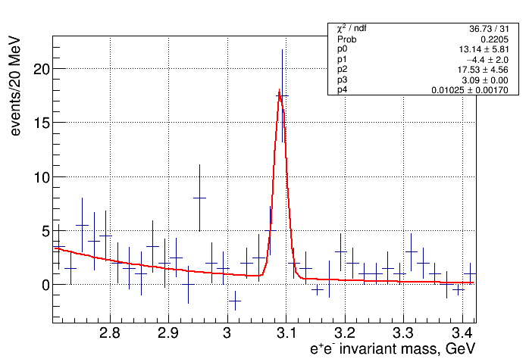
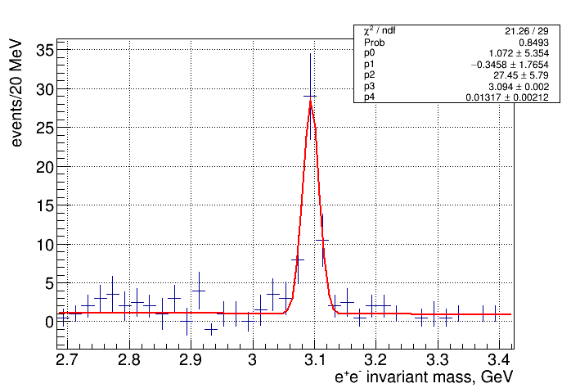
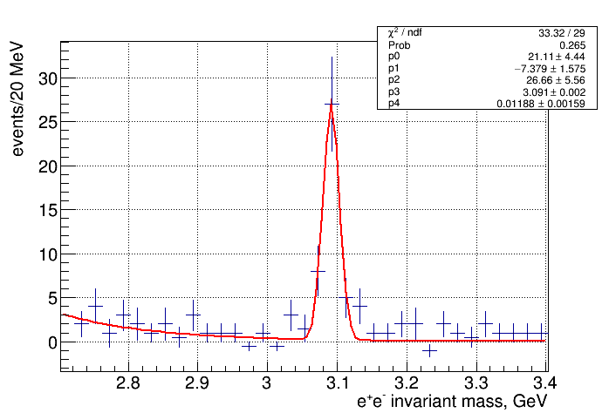
J/ψ mass fits in bins of energy
8.2 – 8.96 GeV
8.96 – 9.72 GeV
9.72 – 10.48 GeV
10.48 – 11.24 GeV
11.24 – 12 GeV
3
Notes:
3
3

Slide 4
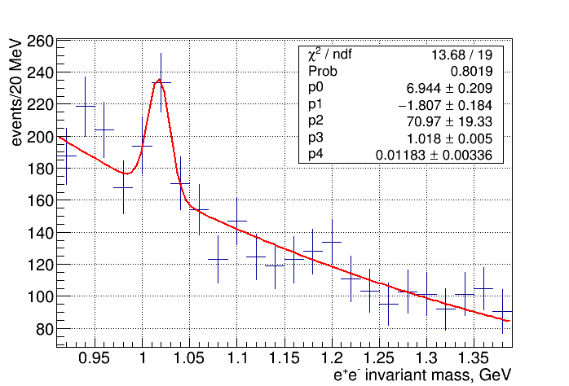
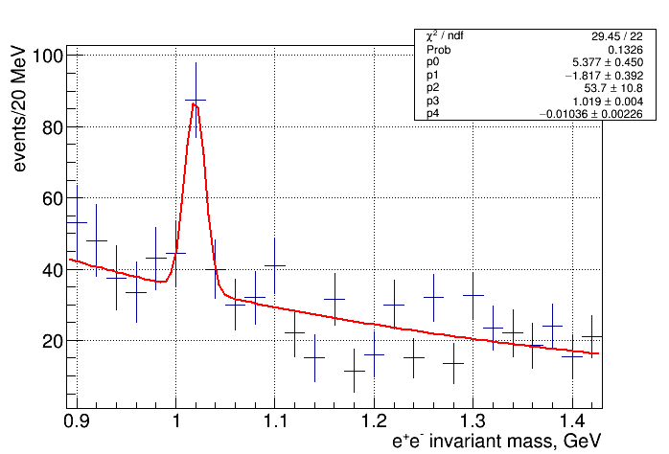
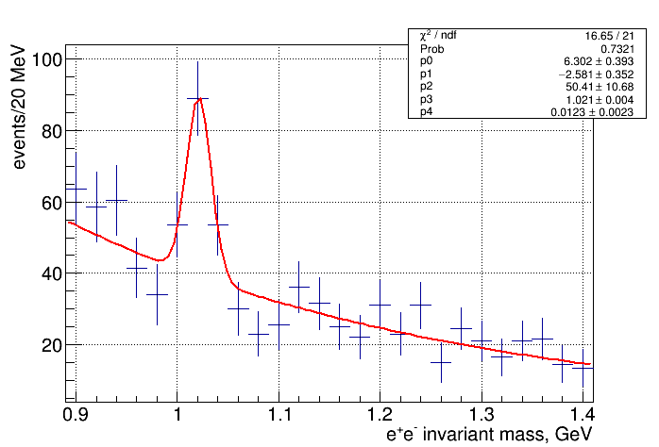
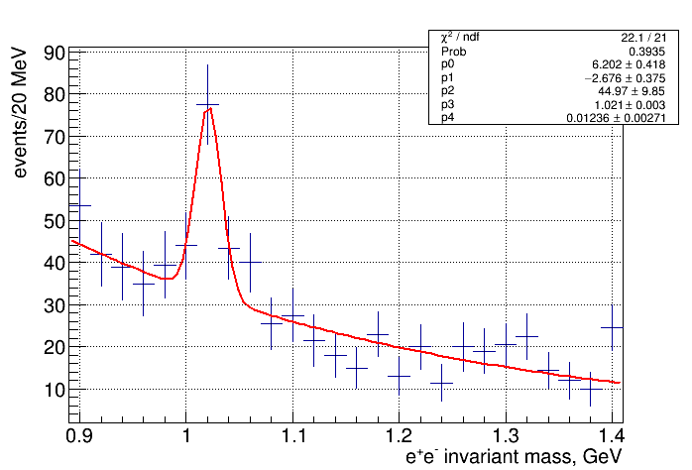
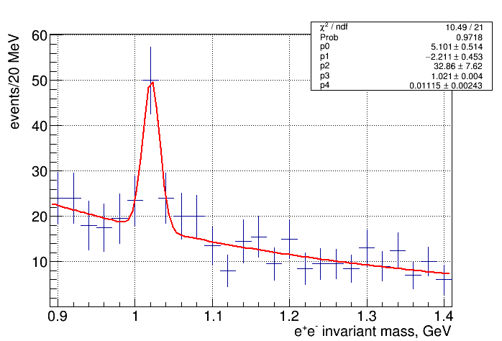
φ mass fits in bins of energy
8.2 – 8.96 GeV
8.96 – 9.72 GeV
9.72 – 10.48 GeV
10.48 – 11.24 GeV
11.24 – 12 GeV
4
Notes:
4
4

Slide 5
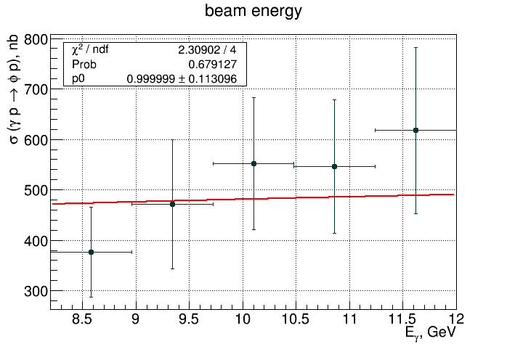
φ x-sec. vs beam energy
GlueX data normalized to world data fit (red line) - gives estimate of the luminosity, that is used for the x-section calculation
5
Notes:
5
5

Slide 6
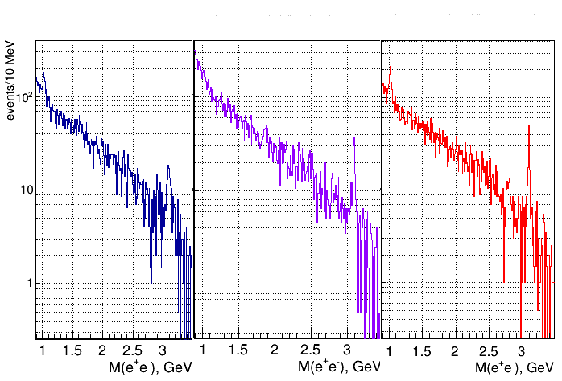
Reconstructing p, e⁺, e⁻ momenta from angles (2016 data)
angles only
γp -> pX missing mass
kinematic fit
6
Notes:
6
6

Slide 7
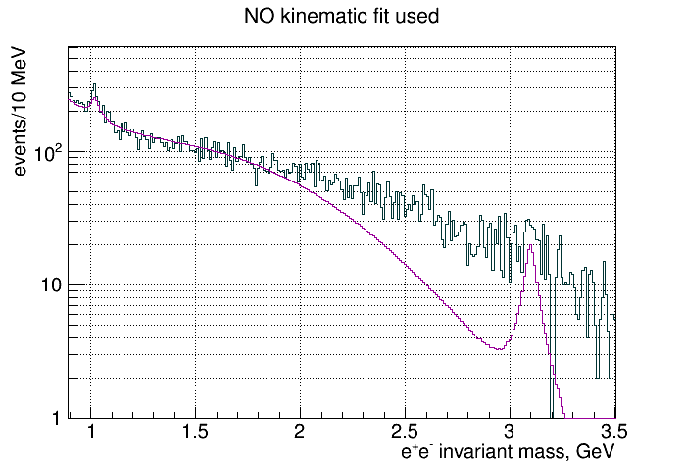
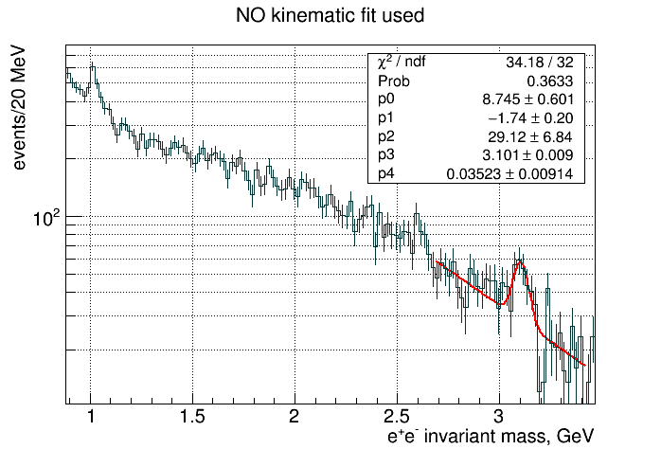
Reconstructing p, e⁺, e⁻ momenta from angles
Momenta calculated from angles
Require energy conservation to +/- 200 MeV and Δr(vertex) < 4 cm
7
Notes:
7
7

Slide 8
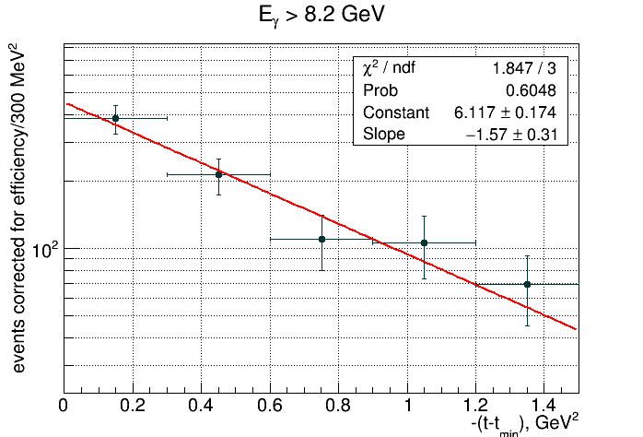
J/ψ analysis in bins of t
t-slope of Cornell data 1.25 +/- 0.2 GeV⁻² at E_{γ} = 11 GeV
GlueX result (total): 1.57 +/- 0.31 GeV⁻²
GlueX result for E_{γ} > 9.7 GeV: 1.73 +/- 0.30 GeV⁻²
8
Notes:
8
8

Slide 9
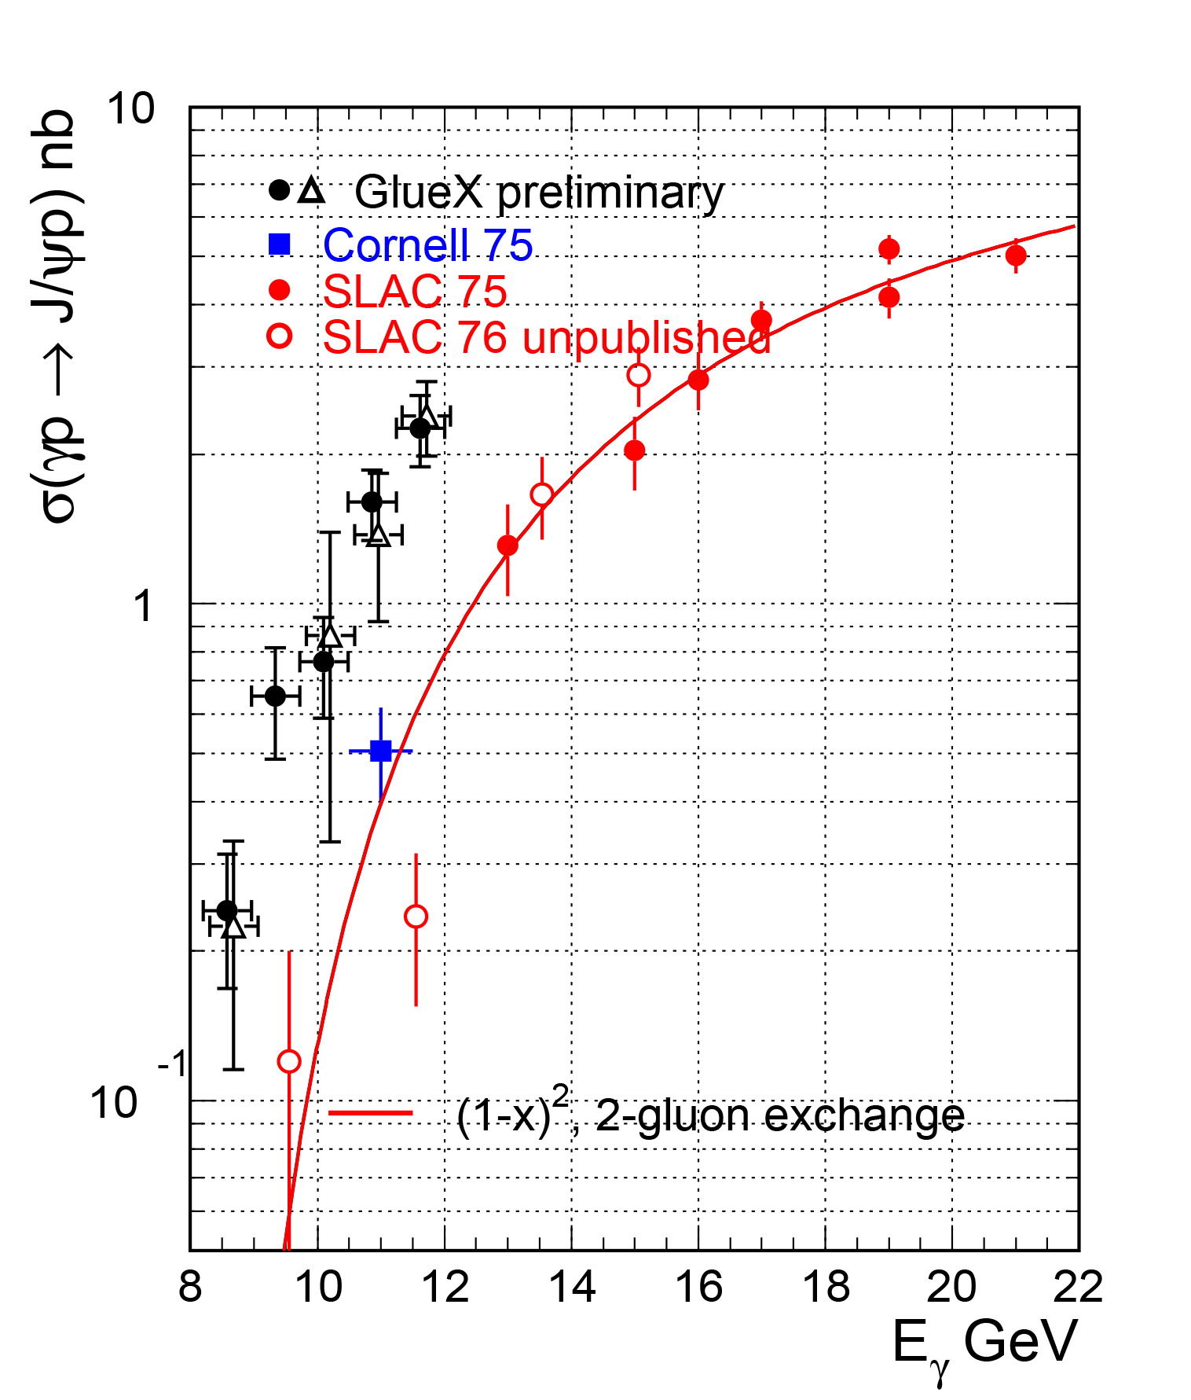
J/ψ x-sec. vs beam energy
SLAC results calculated from dσ/dt(t=t_{min}) using t-slope
t-slope of SLAC data 2.9 GeV⁻² (measured at 19 GeV)
t-slope of Cornell data 1.25 GeV⁻²
● Using kinematic fit
∆ No kinematic fit
9
Notes:
9
9

Slide 10
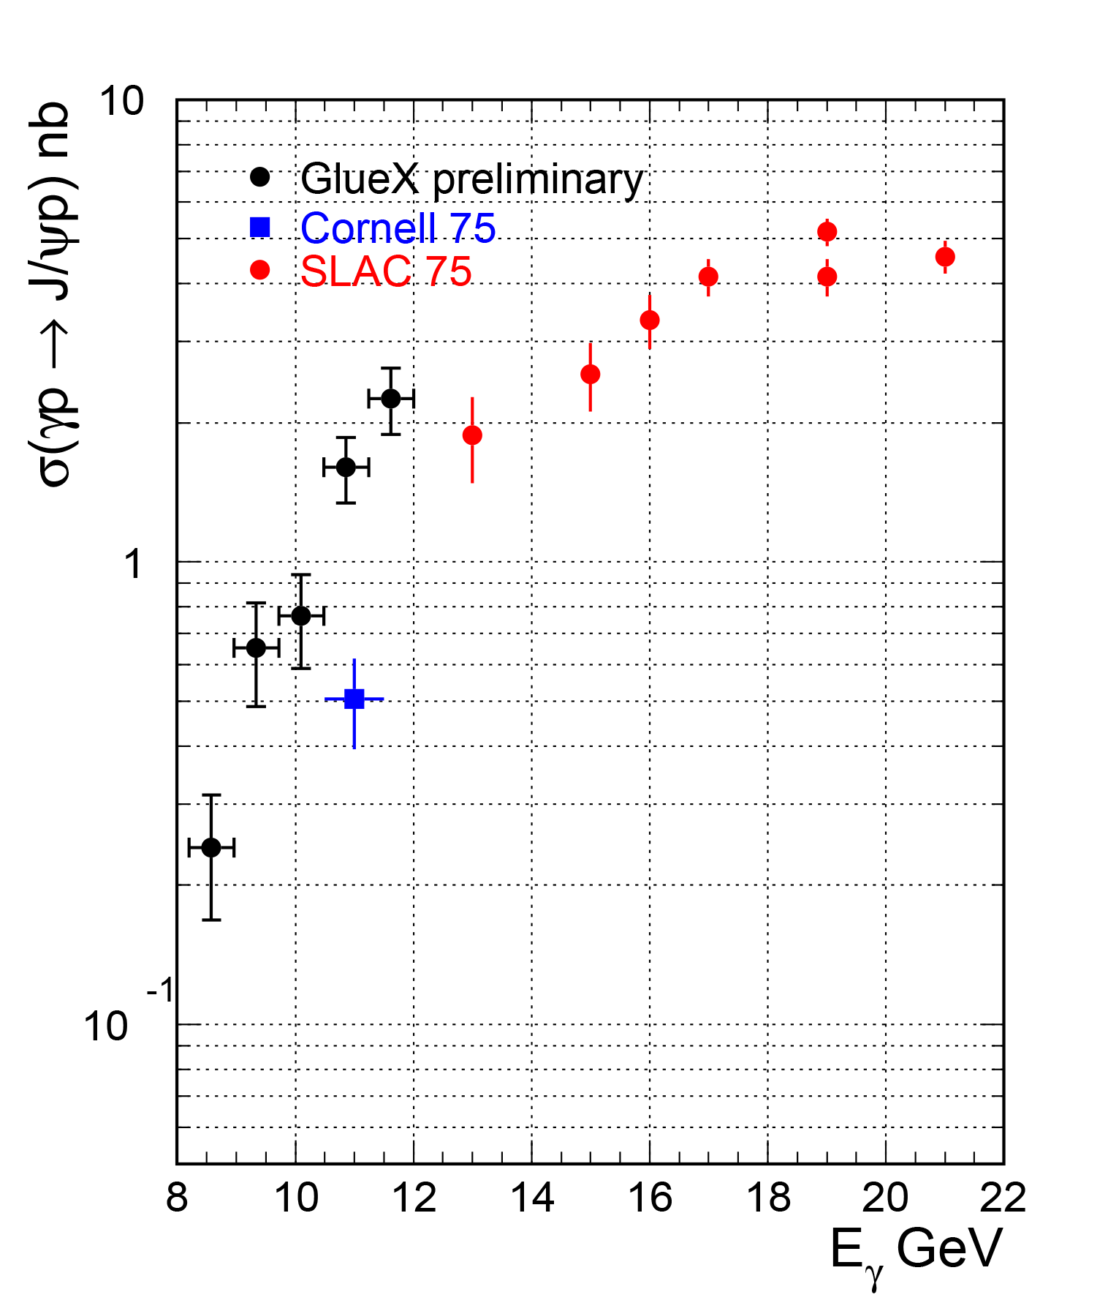
J/ψ x-sec. vs beam energy
t-slope of SLAC data 1.73 - 2.9 GeV⁻² (11-19 GeV)
t-slope of Cornell data 1.25 GeV⁻²
10
Notes:
10
10

Slide 11
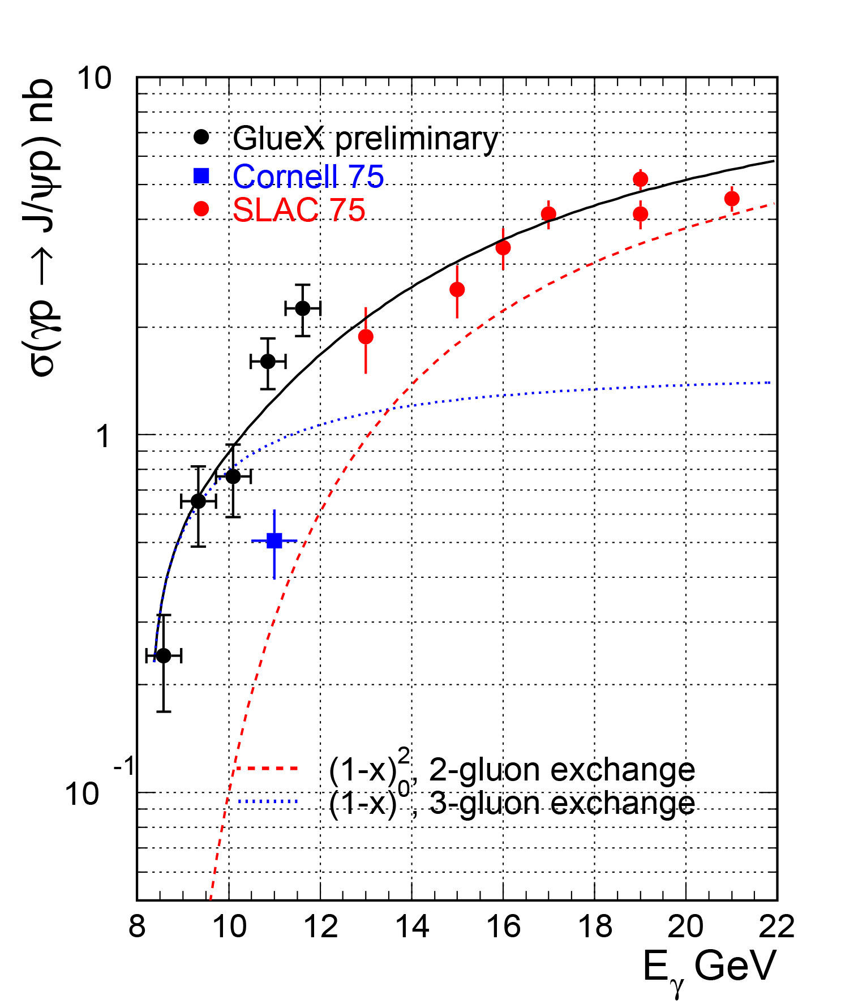
J/ψ x-sec. vs beam energy
t-slope of SLAC data 1.73 - 2.9 GeV⁻² (11-21 GeV)
t-slope of Cornell data 1.25 GeV⁻²
Three-gluon exchange dominates
Cornell data excluded from fit
— Brodsky et al. [PLB 498, 23 (2001)]
11
Notes:
11
11

Slide 12
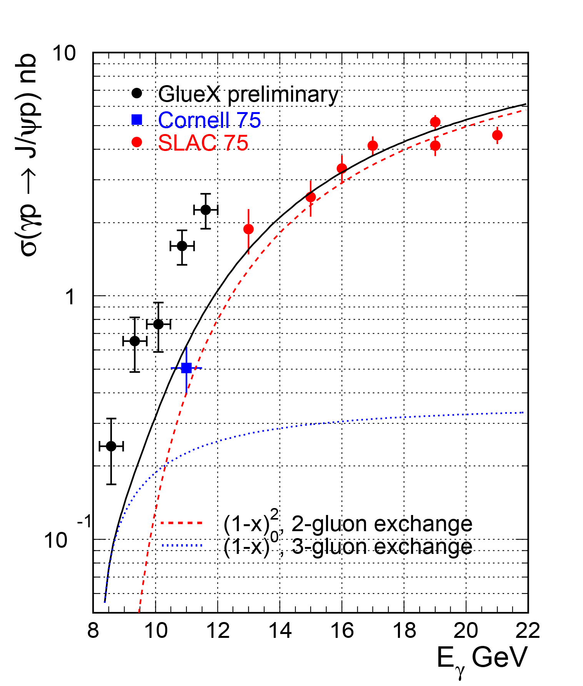
J/ψ x-sec. vs beam energy
t-slope of SLAC data 1.73 - 2.9 GeV⁻² (11-21 GeV)
t-slope of Cornell data 1.25 GeV⁻²
GlueX data excluded from fit
Two-gluon exchange dominates
— Brodsky et al. [PLB 498, 23 (2001)]
12
Notes:
12
12

Slide 13
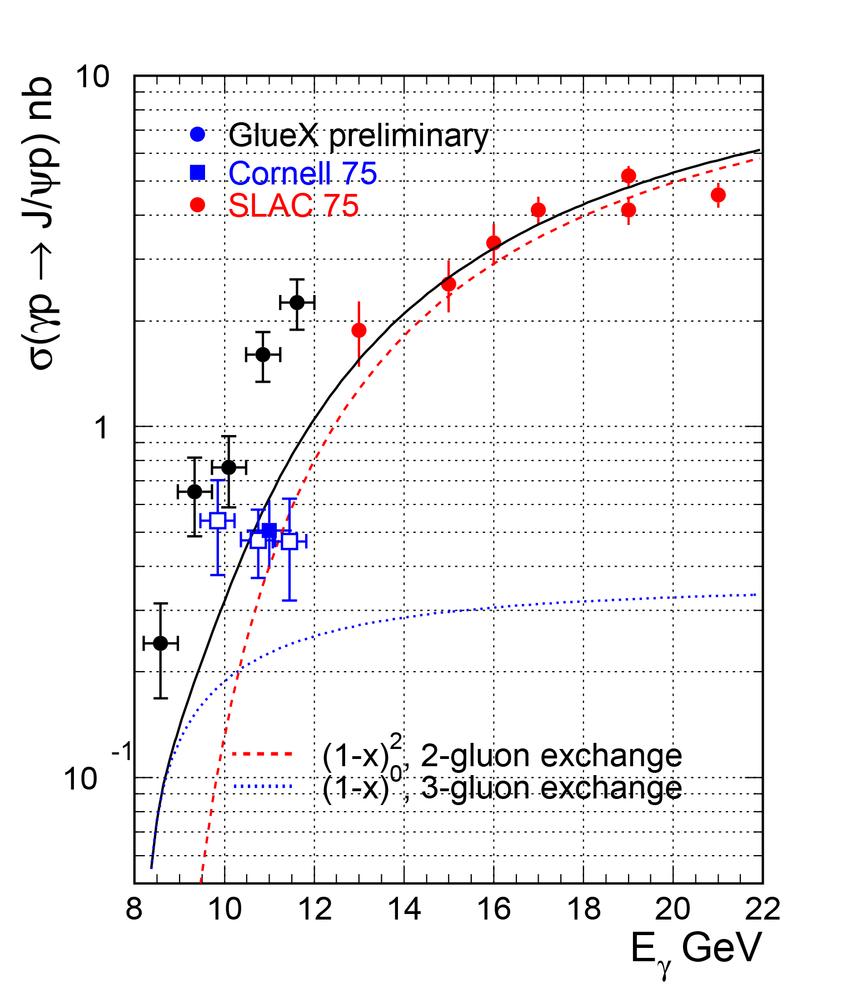
Cornell results
γ Be -> e⁺e⁻ X
Bad mass resolution (~100 MeV)
Beam energy calculated from e⁺e⁻ assuming elastic reaction – can explain the no-energy-dependence of the cross-section?
t-slope of SLAC data 1.73 - 2.9 GeV⁻² (11-21 GeV)
t-slope of Cornell data 1.25 GeV⁻²
GlueX data excluded from fit
— Brodsky et al. [PLB 498, 23 (2001)]
13
Notes:
13
13

Slide 14
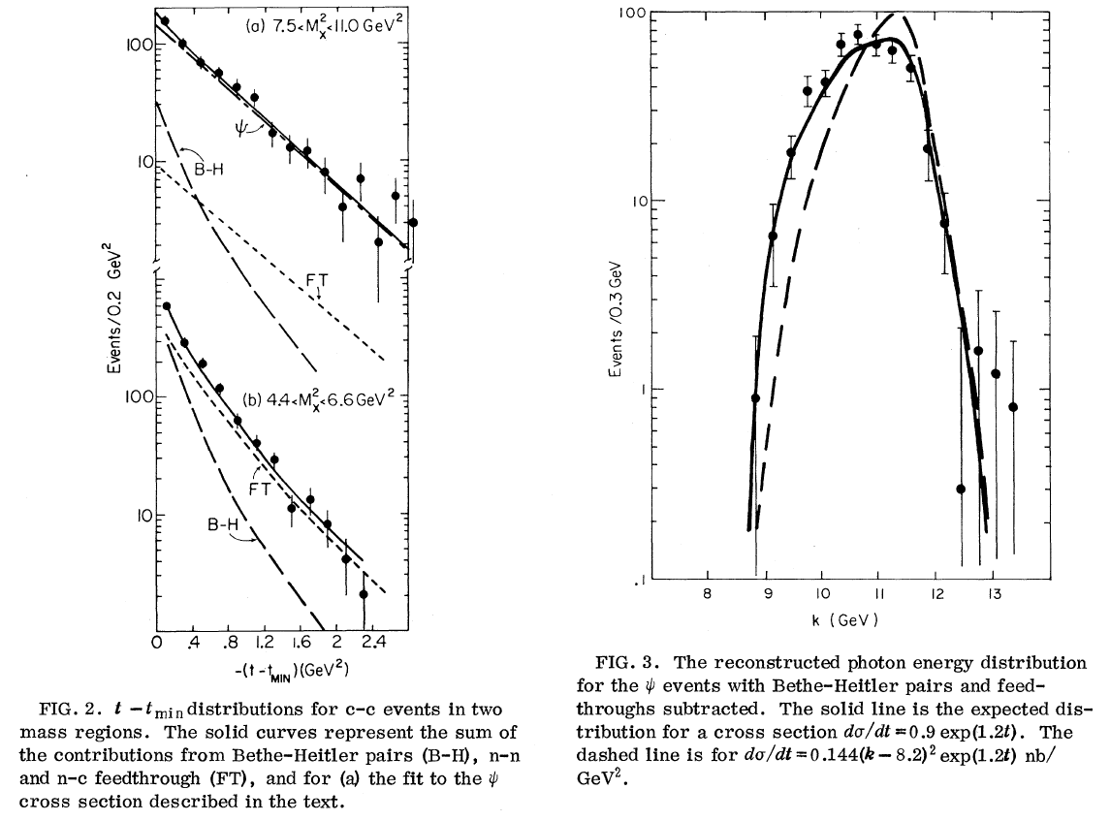
Cornell results
~1.65 GeV⁻²
Steep acceptance with the beam energy
t-slope from the plot (~1.65) contradicts the value in the paper (1.25 GeV⁻²)
14
Notes:
14
14

Slide 15
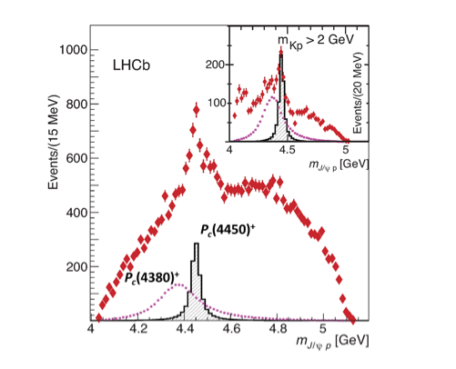
LHCb Pentaquarks
Λ_{b} -> K⁻(J/ψ p)
Pc(4380): Γ=205 MeV J^{P}=3/2⁺⁽⁻⁾
Pc(4450): Γ=39 MeV J^{P}=5/2⁻⁽⁺⁾
Interpretations:
- (charmed baryon) – (anti-charmed meson) molecule ($\overline{D}$*Σ_{c})
- Resonance in terms of quark degrees of freedom
- Kinematic effects: threshold effect (χ_{c1} p) , ATS
15
Notes:
15
15

Slide 16
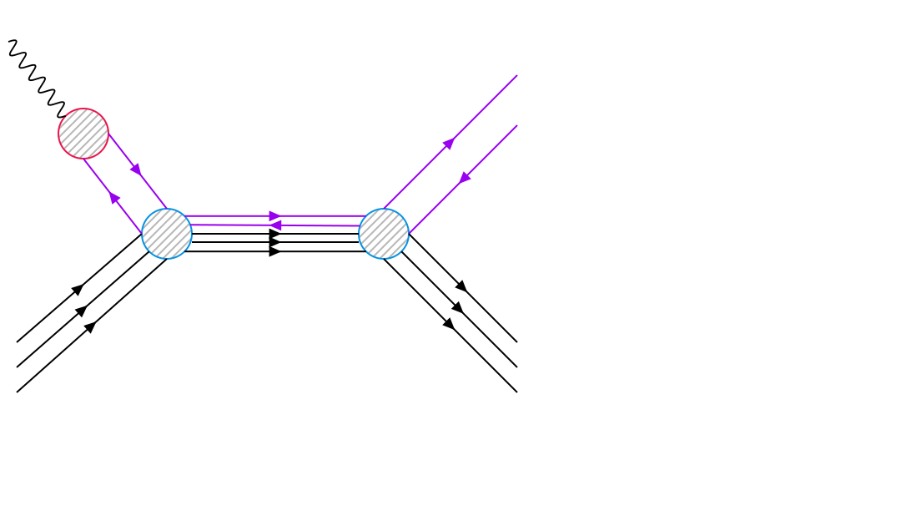
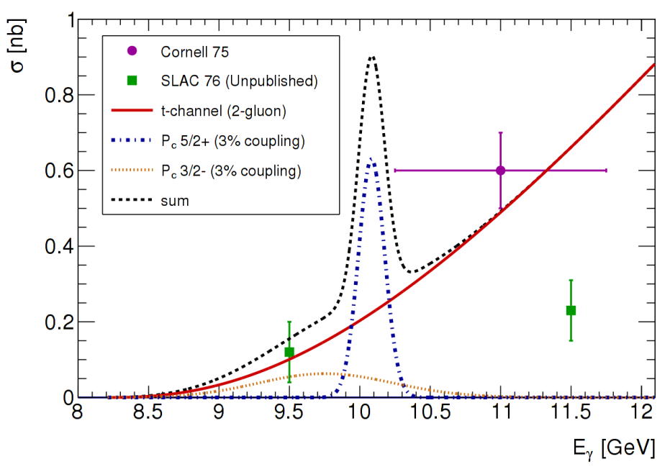
Phtotoproduction of LHCb Pentaquarks
γ
J/ψ
~ BW(Γ_{Pc},M_{Pc})*BR(P_{c}->γp)*BR(P_{c}->J/ψp)
BR(Pc->γp) ~ Γ(J/ψ -> l⁺l⁻)*BR(P_{c}->J/ψp) (VMD)
σ ~ BR²(P_{c}->J/ψp)
J/ψ
P_{c}
p
p
1)V.Kubarovsky and M.B.Voloshin, arXiv: 1508.00888.
2)M.Karliner and J.Rosner, arXiv: 1508.01496.
3)A.Blin, C.Fernandez-Ramirez, A.Jackura, V.Mathieu, V.Mokeev, A.Pilloni, and A.Szczepaniak,arXiv: 1606.08912
all three papers σ^{max} ~ 10 μb for P_{c}(5/2+) 100% BR
1)Q.Wang, X.Liu, and Q.Zhao,arXiv: 1508.00339
σ^{max} ~ 0.7 μb for P_{c}(5/2+) 100% BR
Hall C 5q-proposal (E12-16-007)
16
Notes:
16
16

Slide 17
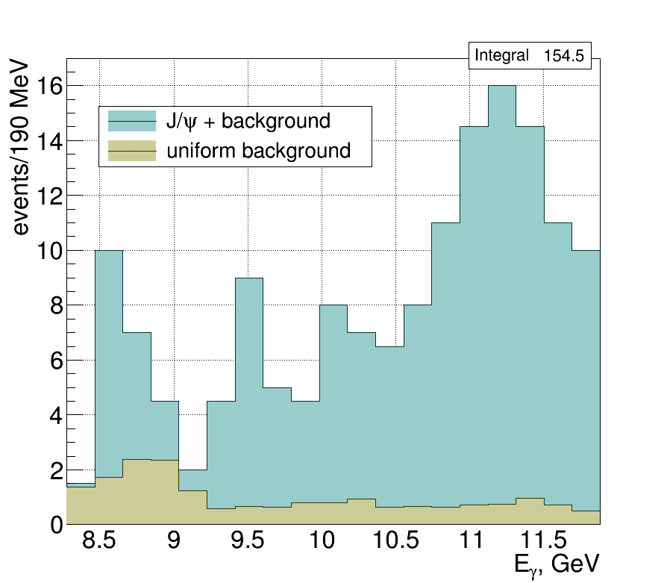
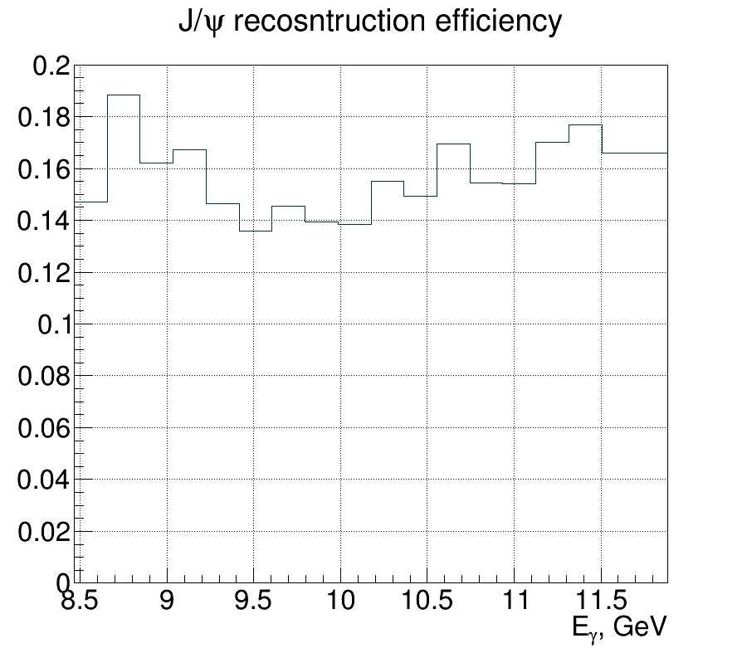
J/ψ x-section in finer bins of beam energy
Fine bins in E_{γ}: 190 MeV corresponds to 39 MeV in W, the P_{c}(4450) width
Background subtracted assuming uniform (with energy) distribution normalized to the total background events
17
Notes:
17
17

Slide 18
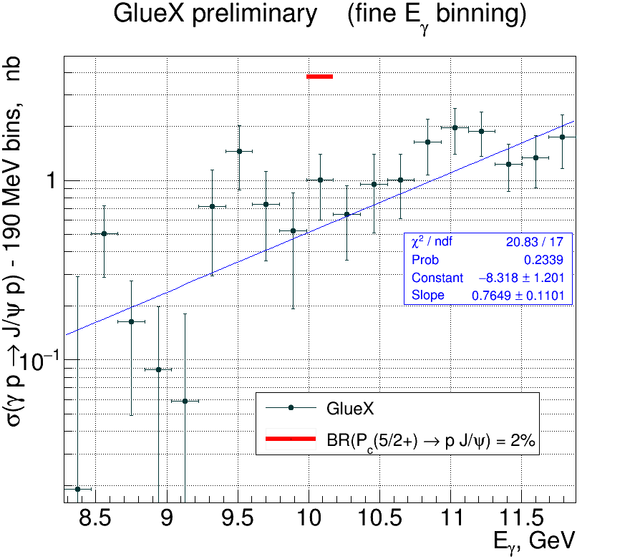
Upper limit for BR(P_{c} → p J/ψ)
If preliminary results hold (~ factor of 2) we can put upper limit of BR(P_{c}->J/ψp) < 2% or less
What about lower limit?
LHCb has measured:
BR(Λ_{b} -> K⁻J/ψ p) = 3.2 10⁻⁴
BR(Λ_{b} -> K⁻P_{c})*BR(P_{c}->J/ψ p) = 1.3 10⁻⁵
If BR(P_{c}->J/ψ p) too small then
BR(Λ_{b} -> K⁻ + J/ψ p) << BR(Λ_{b} -> K⁻ +!(J/ψ p) )
(M.Karliner and J.Rosner, PRL 115 122001)
18
Notes:
18
18

Slide 19
Conclusions
Despite analyses are preliminary, using ~35-40% of the total statistics, very unlikely these conclusions will change: the effects we observe are much bigger than the expected systematics:
GlueX cross-section is much higher than old data/fits with theoretical curve
GlueX and Cornell results can’t be reconcile and they result in different predictions for the reaction mechanism near threshold
We can set upper limit for the pentaquark BR(P_{c}(4450)->p J/ψ) at level of 1-2%
19
Notes:
19
19

Slide 20
Plans for analysis/publication by the end of the year
Due to the expected high impact of the results:
Requirements:
Need total flux and agreement with φ->K⁺K⁻ and φ−>π⁺π⁻π⁰
Need agreement with Bethe-Heitler (two MC models simulated by Sean)
Need some confidence in efficiency simulations (like comparing MC vs data with different cuts, studying electron/proton tracking efficiencies, etc.)
Need to improve FCAL and BCAL resolution at high electron energies
Need to analyze both the whole spring 2016 and spring 2017 data with the same reconstruction software version before final analyses
Writing analysis paper (simultaneously)
Organization:
Forming two independent groups using different analysis codes (above some level)?
Blind data in the energy range around pentaquark? (Mark D.)
20
Notes:
20
20

