Slide 1
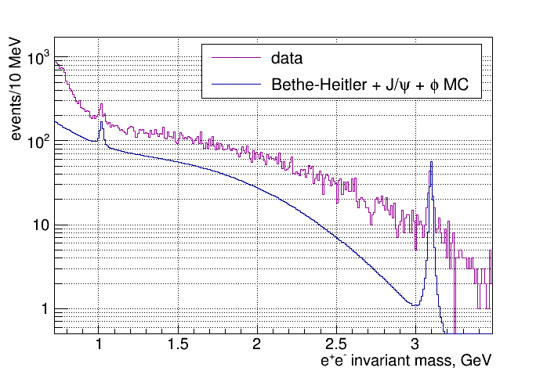
Di-electron Spectrum – comparison to MC
Calorimeter cuts only:
1
Notes:
1
1

Slide 2
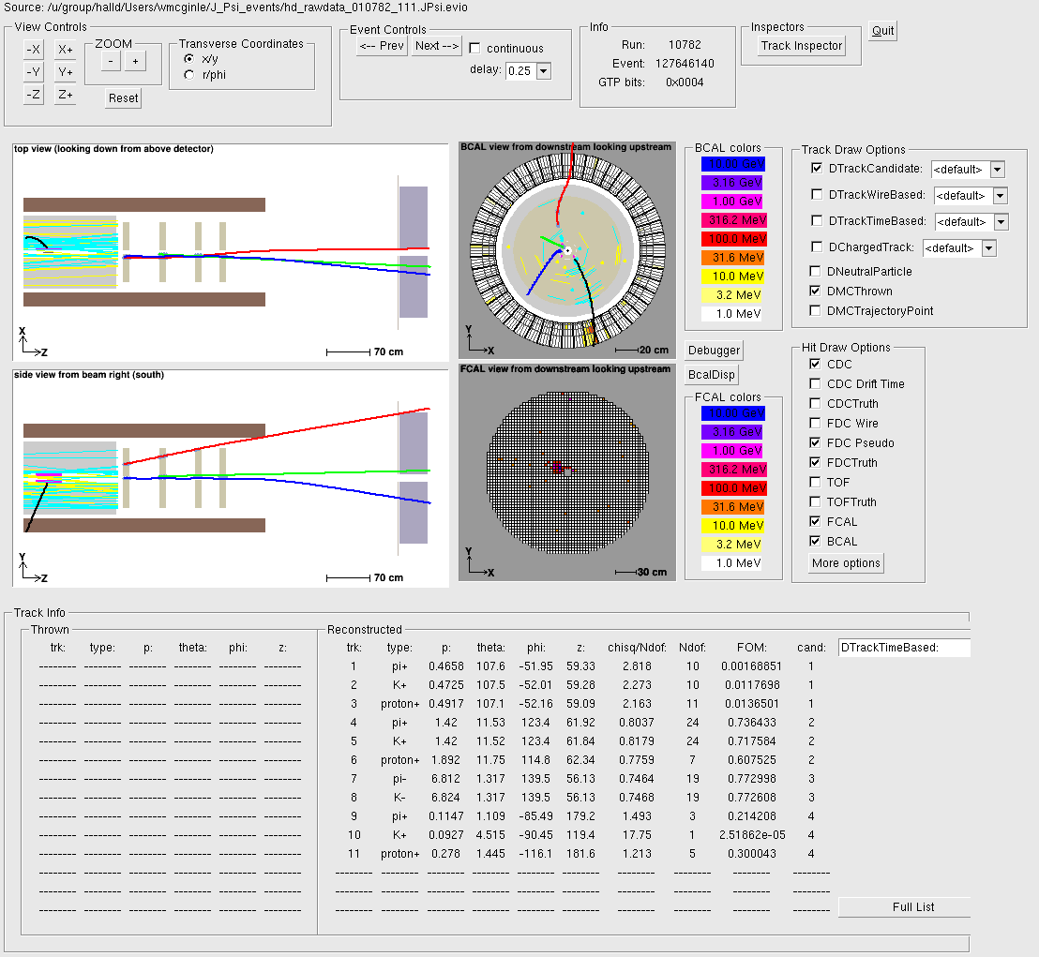
Small angle background
“good” J/ψ event
2
Notes:
2
2

Slide 3
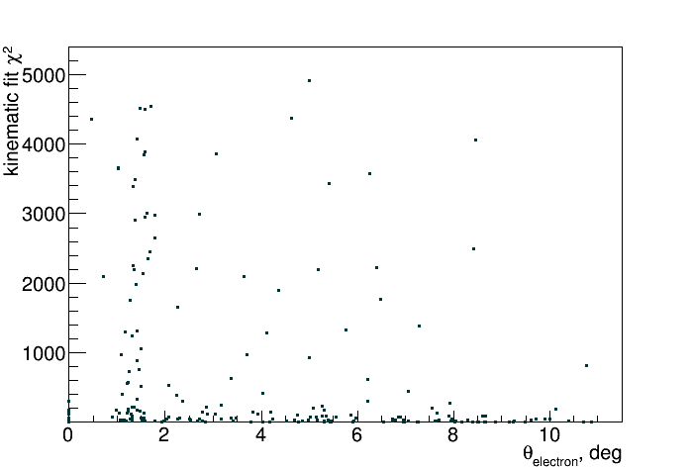
Small angle background
J/ψ data events:
3
Notes:
3
3

Slide 4
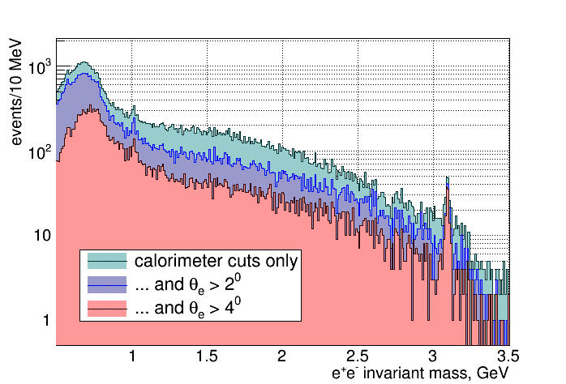
Di-electron Spectrum – angle cuts
4
Notes:
4
4

Slide 5
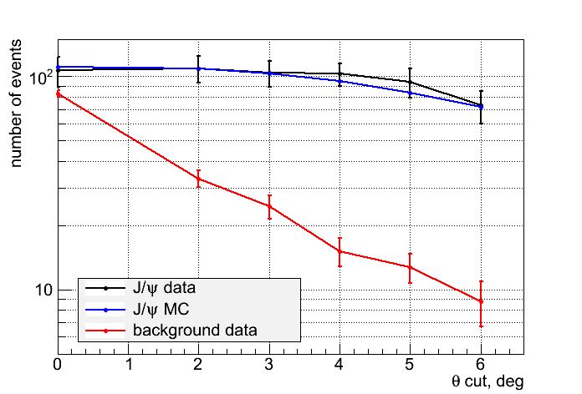
J/ψ vs background – angle cuts
5
Notes:
5
5

Slide 6
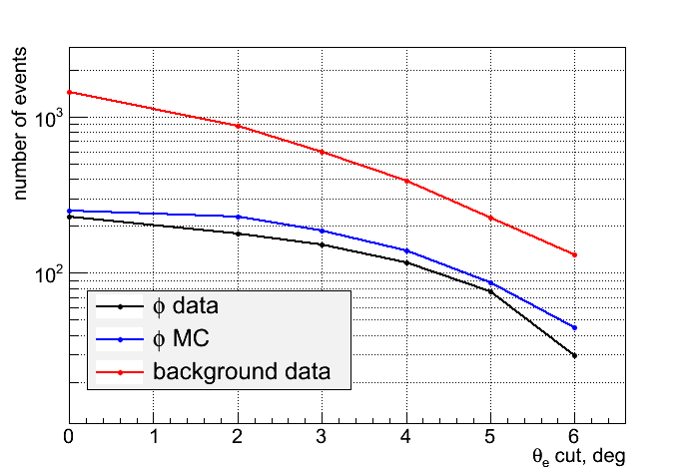
φ vs background – angle cuts
6
Notes:
6
6

Slide 7
Di-electron Spectrum – comparison to MC
Calorimeter cuts only:
7
Notes:
7
7

Slide 8
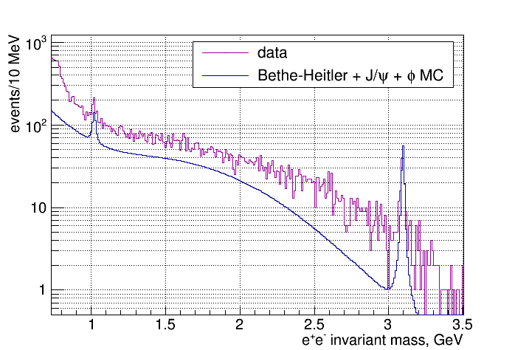
Di-electron Spectrum – comparison to MC
Calorimeter cuts and θ_{e} > 2⁰:
8
Notes:
8
8

Slide 9
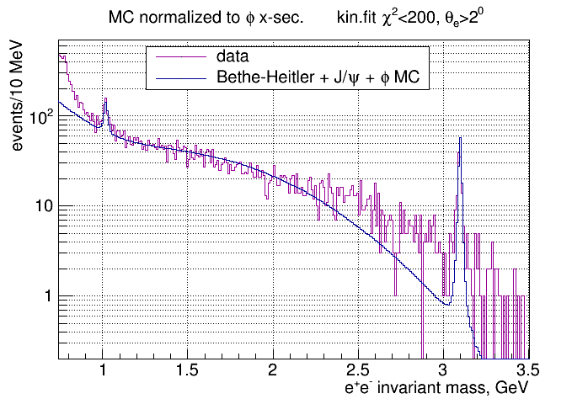
Di-electron Spectrum – comparison to MC
9
Notes:
9
9

Slide 10
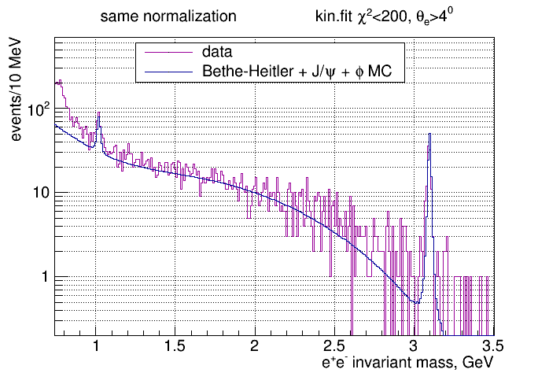
Di-electron Spectrum – comparison to MC
10
Notes:
10
10

Slide 11
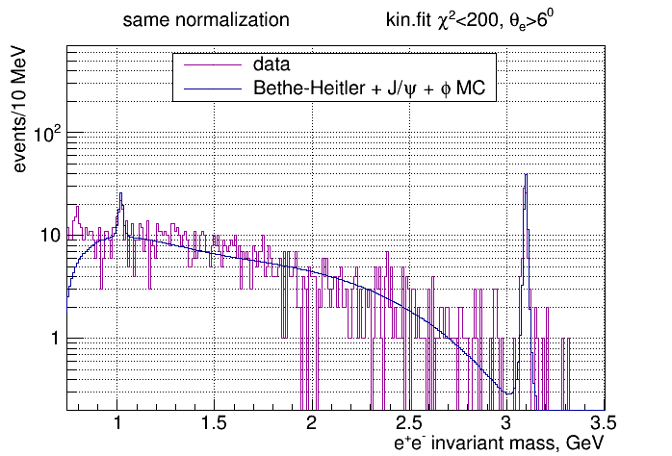
Di-electron Spectrum – comparison to MC
11
Notes:
11
11

Slide 12
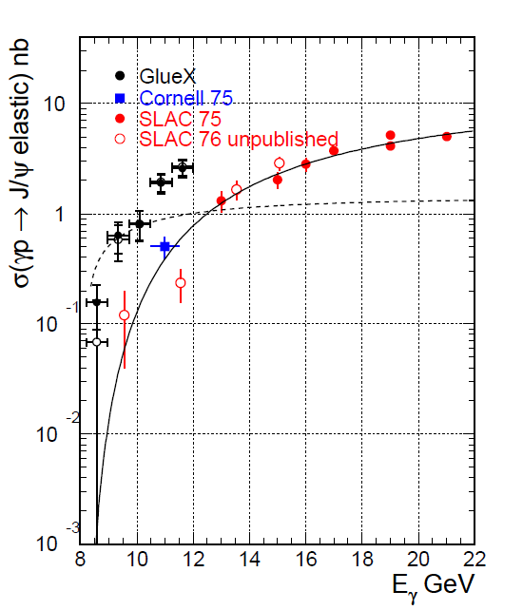
X-section updated
12
Notes:
12
12

