Slide 1
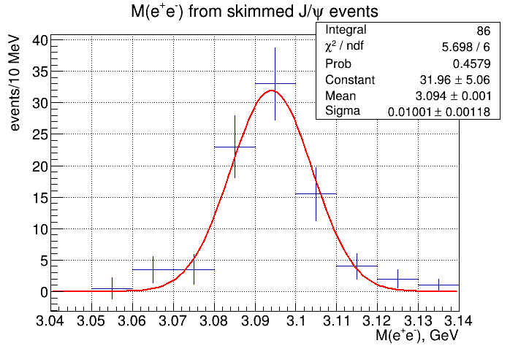
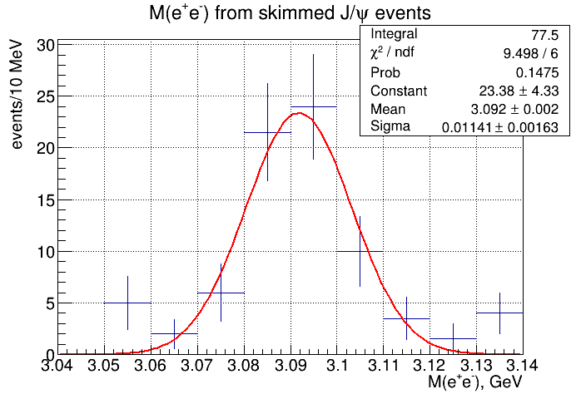
J/ψ yield from skimmed events
Recon. Ver2
Current sim-recon

