Slide 1
Threshold J/ψ production at GlueX
Lubomir Pentchev
for the GlueX collaboration

Slide 2
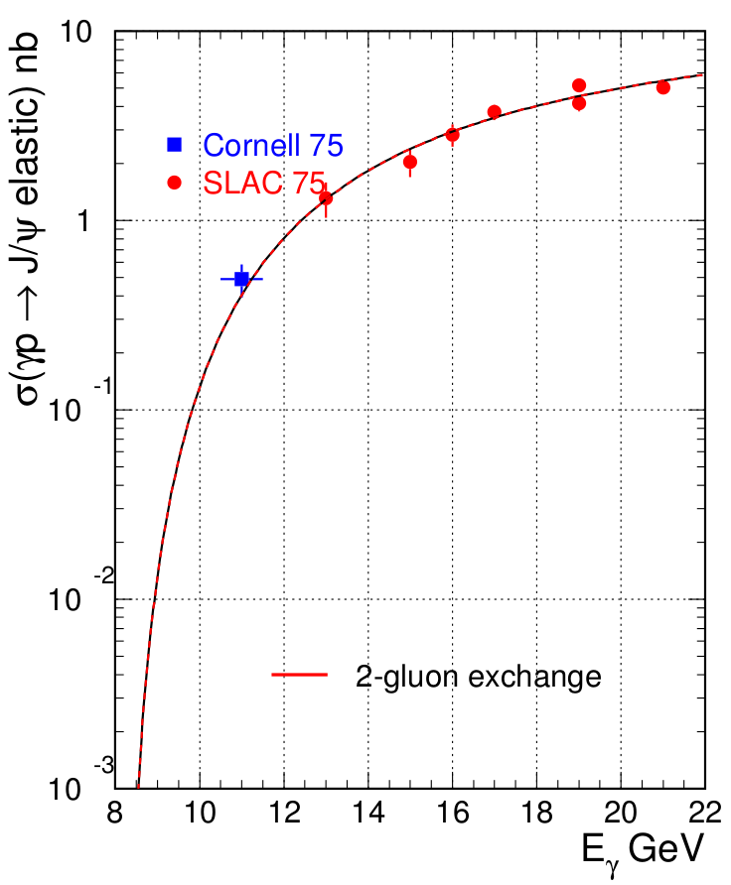
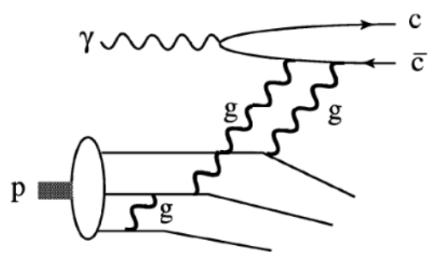
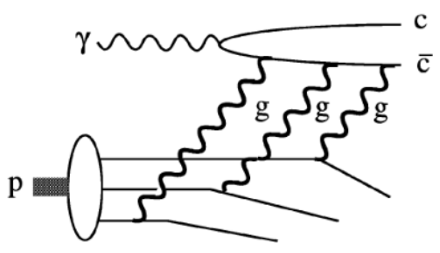
Why study J/ψ near threshold photo-production
GlueX
J/ψ photo-production near threshold poorly covered by previous old measurement
Look for threshold enhancement: sensitive to proton gluonic content (high x); other interesting effects expected near threshold
Hall D is the only hall with E_{γ}>11 GeV – needed to allow continuity from the high energy data; only in 2016 we had >11.5 GeV
GlueX coherent peak right above the threshold – improved statistics at the very important point
two-gluon exchange
three-gluon exchange
Brodsky et al. PLB 498, 23 (2001)
Notes:
2
2

Slide 3
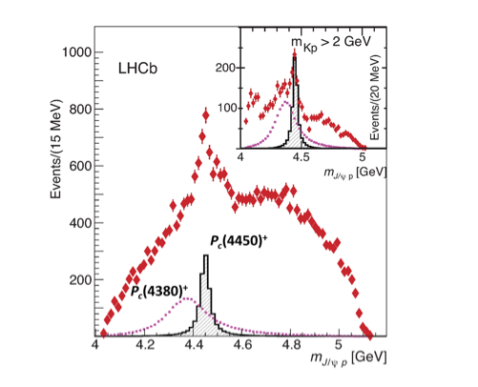
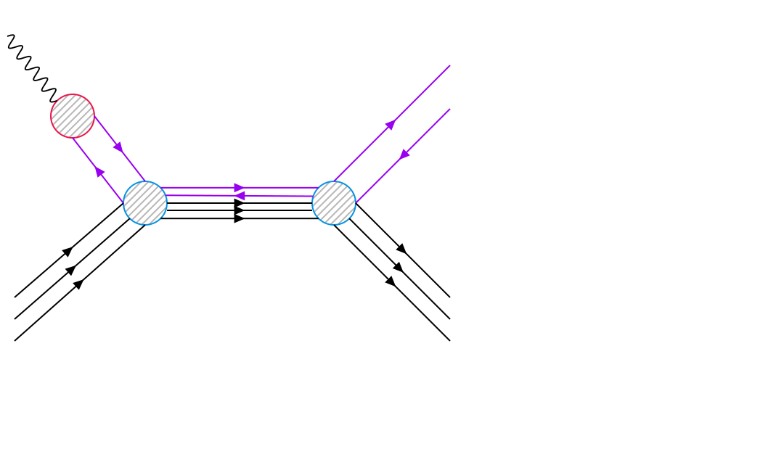
Why study J/ψ near threshold photo-production
Also because of the LHCb pentaquarks - DIRECT relation – if they exist they should be seen in s-channel photoproduction:
GlueX
γ
J/ψ
J/ψ
P_{c}
p
p
Direct relation
P_{c}(4450)
V.Kubarovsky and M.B.Voloshin, PRD 92.031502 (2015).
M.Karliner and J.Rosner, arXiv: PLB 752, 329 (2016).
A.Blin, C.Fernandez-Ramirez, A.Jackura, V.Mathieu, V.Mokeev, A.Pilloni, and A.Szczepaniak, PRD 94,034002 (2016).
Notes:
3
3

Slide 4
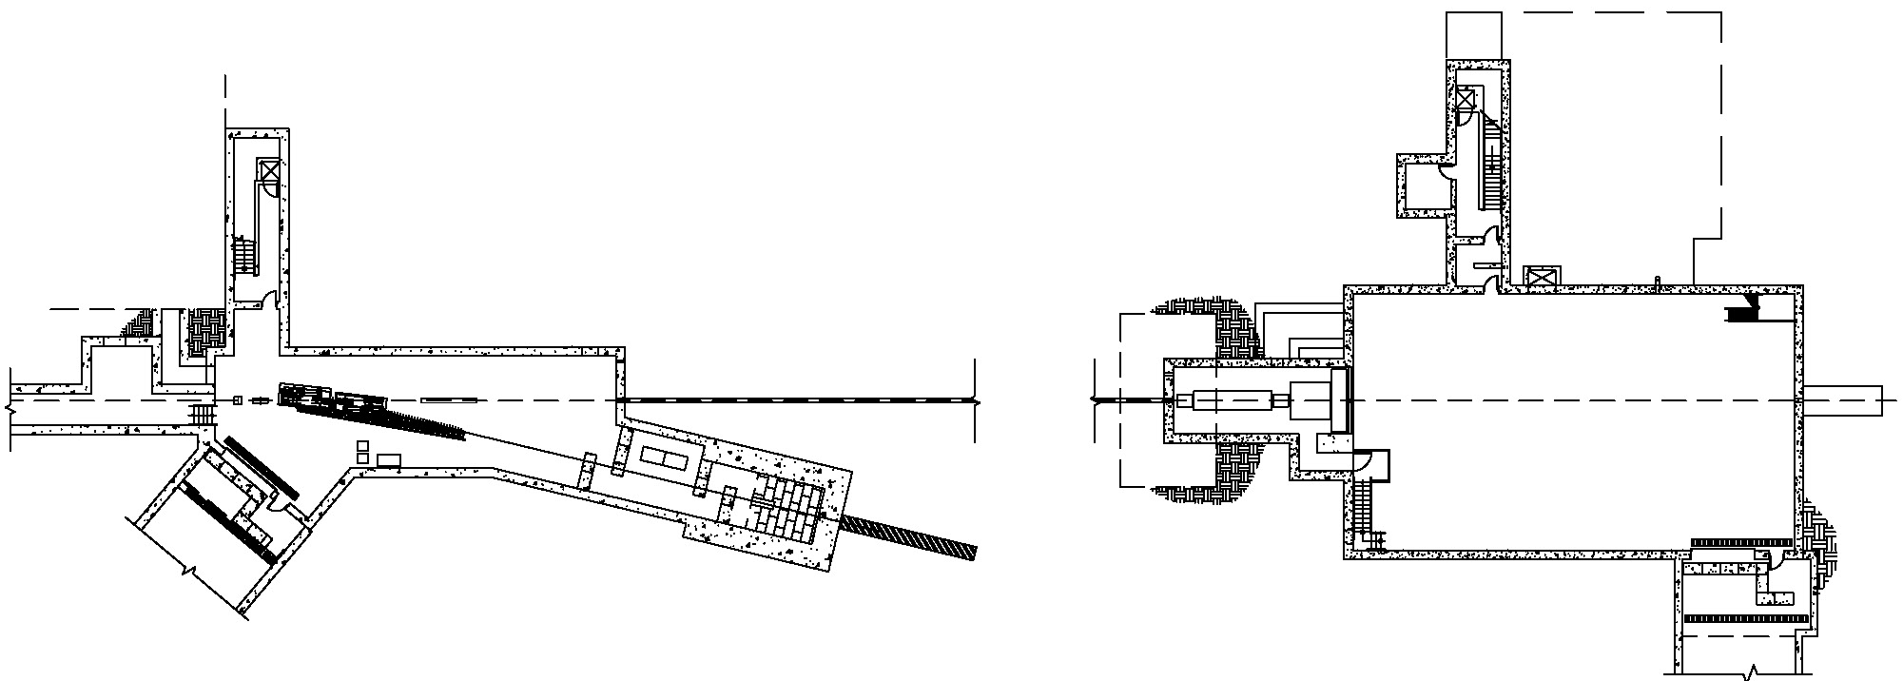
Hall D layout
Counting
House
Tagger Hall: magnet, radiator,
tagger hodoscope
Coherent Bremsstrahlung
photon beam
Pair
Spectrometer
Photon
Beam dump
Solenoid-
Based detector
Electron dump
Collimator
Photon energy tagged by scattered electron ~ 0.1% resolution
Photon beam collimated at 75m, <25 μrad
Intensity: ~ 2 10⁷ - 5 10⁷ γ/sec above J/ψ threshold (8.2 GeV) – total ~50 pb⁻¹ in 2016-2017 runs

Slide 5
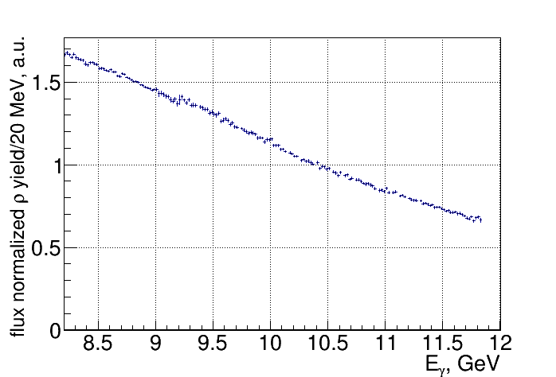
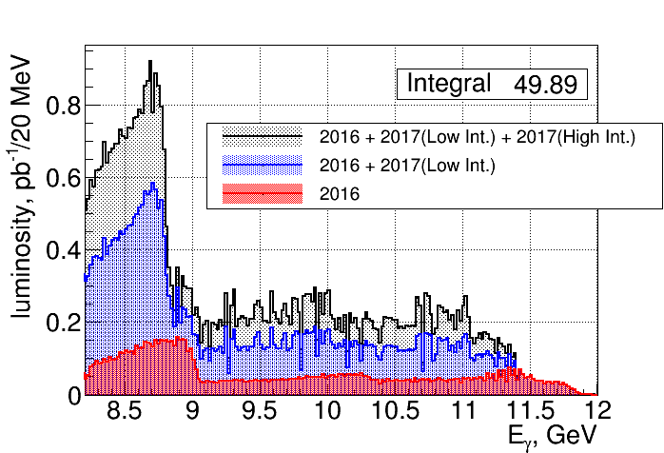
Tagged fluxes
γp → ρp
Fluctuations in flux coming from tagger efficiency, but canceled in normalized yields

Slide 6
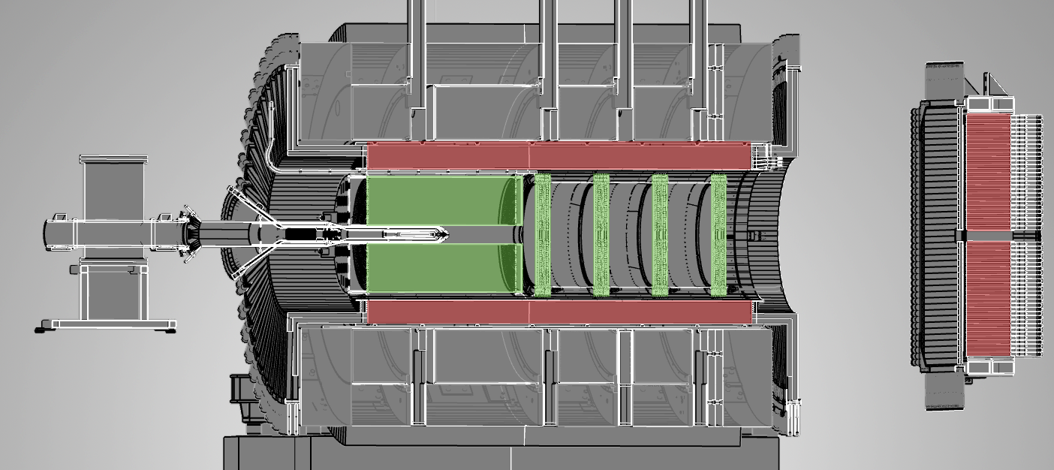
GlueX detector
2T-solenoid, LH target
Tracking (FDC,CDC) , Calorimetry (BCAL,FCAL) , Timing (TOF,SC)
FCAL
CDC
SC
FDC
BCAL
TOF
Hermetic detector: 1 – 120° polar and full azimuthal acceptance
Tracking: σ_{p}/p ~ 1 – 5%
Calorimetry: σ_{E}/E ~ 6%/√ E + 2%

Slide 7
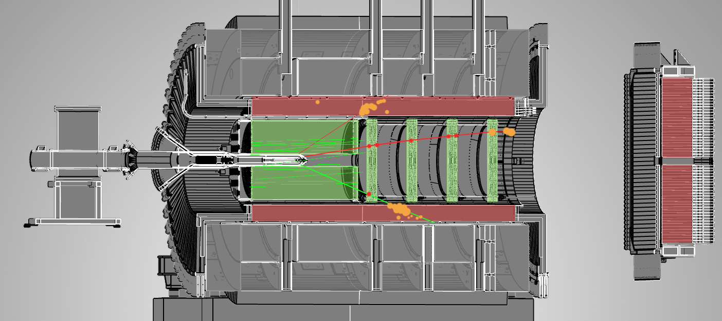
J/ψ event
Exclusive reaction γp → J/ψp → e⁺e⁻p
e⁺
p
e⁻

Slide 8
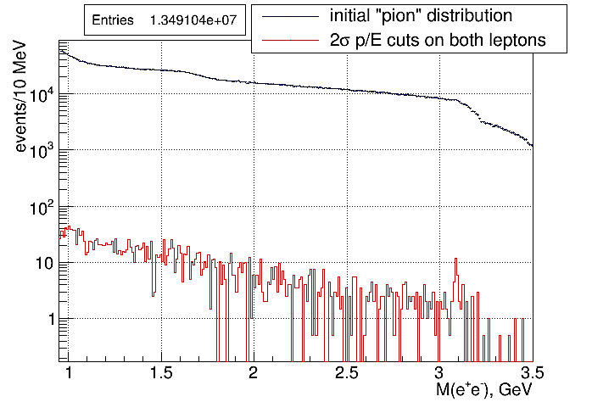
Electron/proton separation using E(calorimetry)/p(tracking)
~5,000 suppression
~5% of total statistics
Suppression factor of ~5000 by E/p cuts (2σ) on both leptons

Slide 9
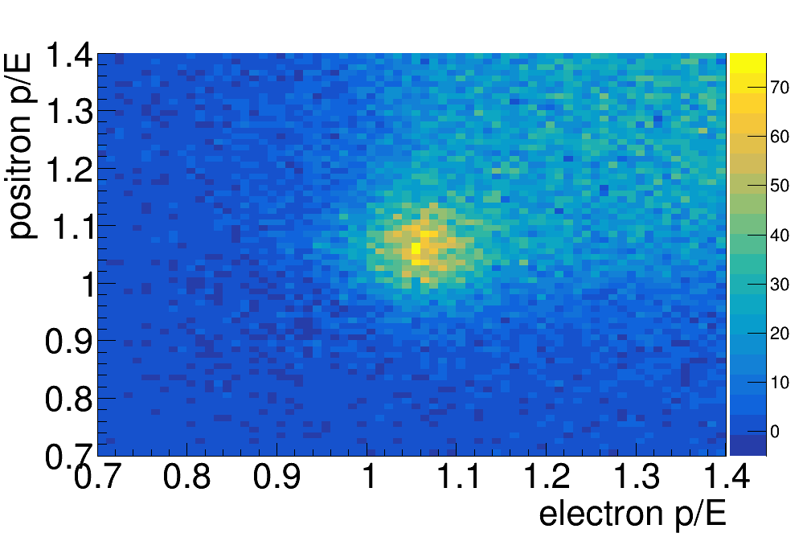
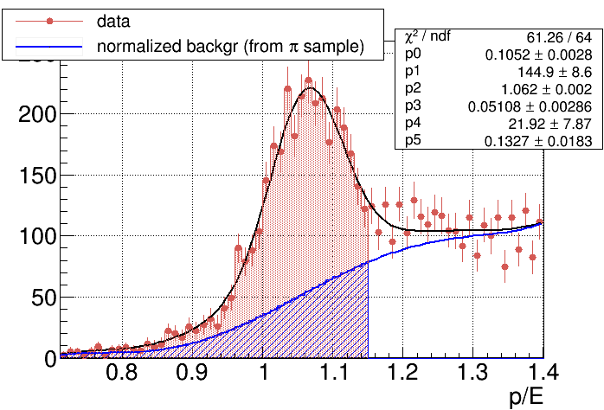
Electron/pion separation using E(calorimetry)/p(tracking)
← Note p/E on plots!
36±1.2% π contamination in 1.5-2.5 GeV M(e⁺e⁻) region with 2σ cut on electrons
BH yields corrected in bins of energy
Background shape from pion sample (E /p anti-lepton cuts)

Slide 10
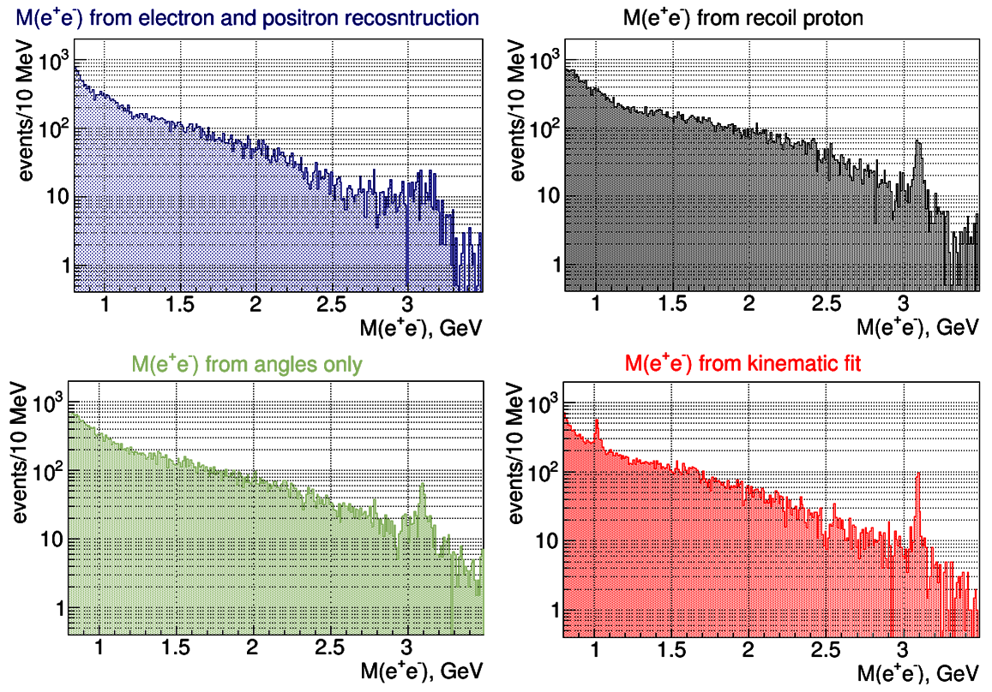
γp → J/ψp → e⁺e⁻p reconstruction methods (leptons tagged)
reconstruction
γp → pM_{x}
σ = 18.1 MeV
σ = 83.8 MeV
σ = 7.5 MeV
σ = 12.8 MeV

Slide 11
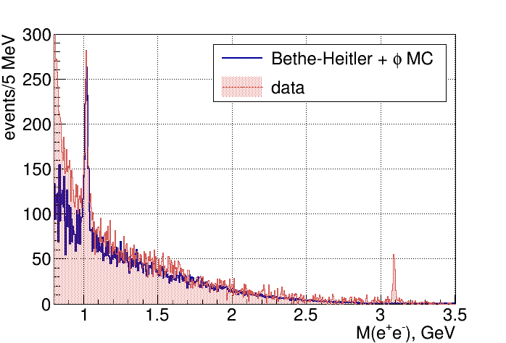
M(e⁺e⁻) spectrum
Shown actual yields and MC - NO normalization applied
BH simulations from R.Paremuzyan, based on:
Berger, E., Diehl, M. & Pire, B. Eur. Phys. J. C (2002) 23: 675.
BH continuum 1.5-2.5 GeV used for normalization

Slide 12
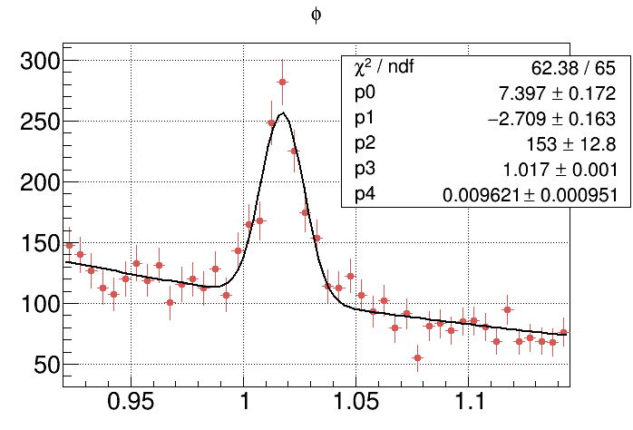
M(e⁺e⁻) spectrum - φ
736 ± 58 φ’s
σ = 9.6 MeV

Slide 13
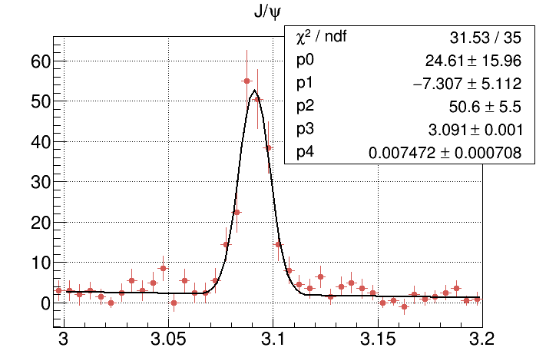
M(e⁺e⁻) spectrum – J/ψ
189 ± 16 J/ψ’s
σ = 7.5 MeV

Slide 14
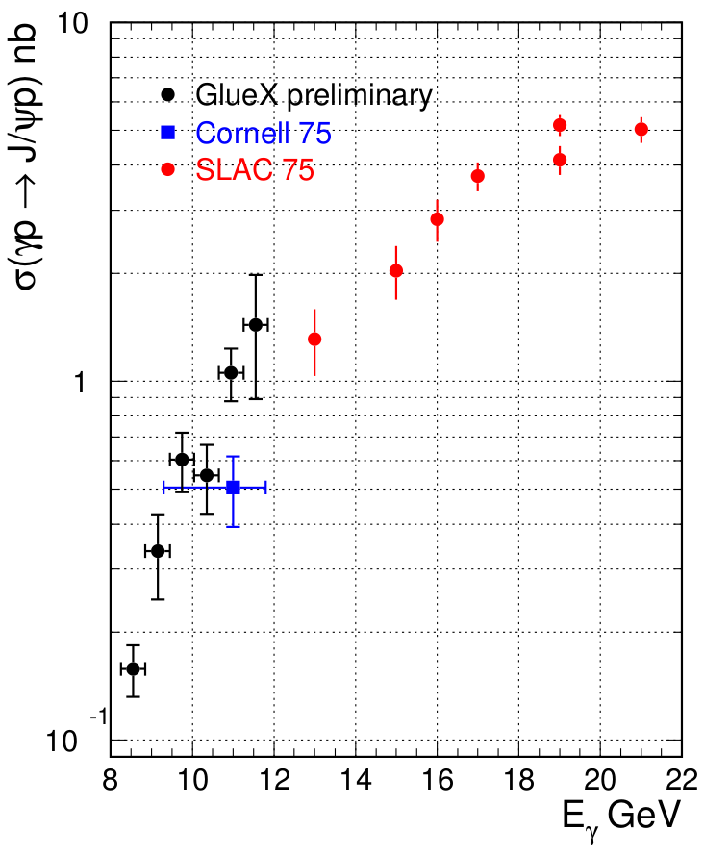
J/ψ cross-section – preliminary results
SLAC results calculated from dσ/dt(t=t_{min}) using
t-slope of 2.9±0.3 GeV⁻² (measured at 19 GeV)
Cornell data:
t-slope 1.25±0.2 GeV⁻²
horizontal errors represent acceptance
GlueX data
30% syst. uncertainty

Slide 15
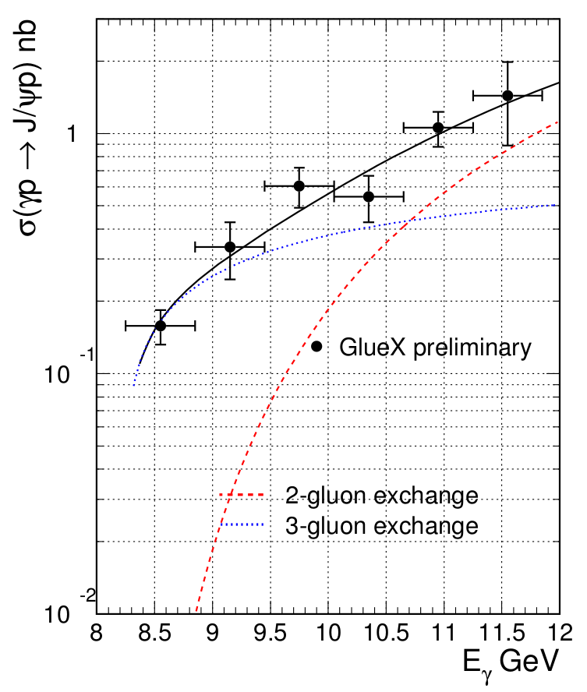
J/ψ cross-section – preliminary results
30% syst. uncertainty
Theory gives only shapes of the curves
Fit to the data with two parameters - the amplitudes of 2- and 3-gluon exchange
Data near threshold consistent with 3-gluon exchange
— Fit to the data
Brodsky et al.
PLB 498, 23 (2001):

Slide 16
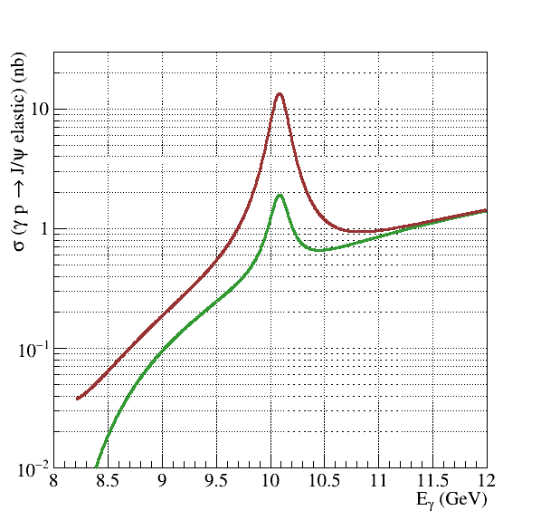
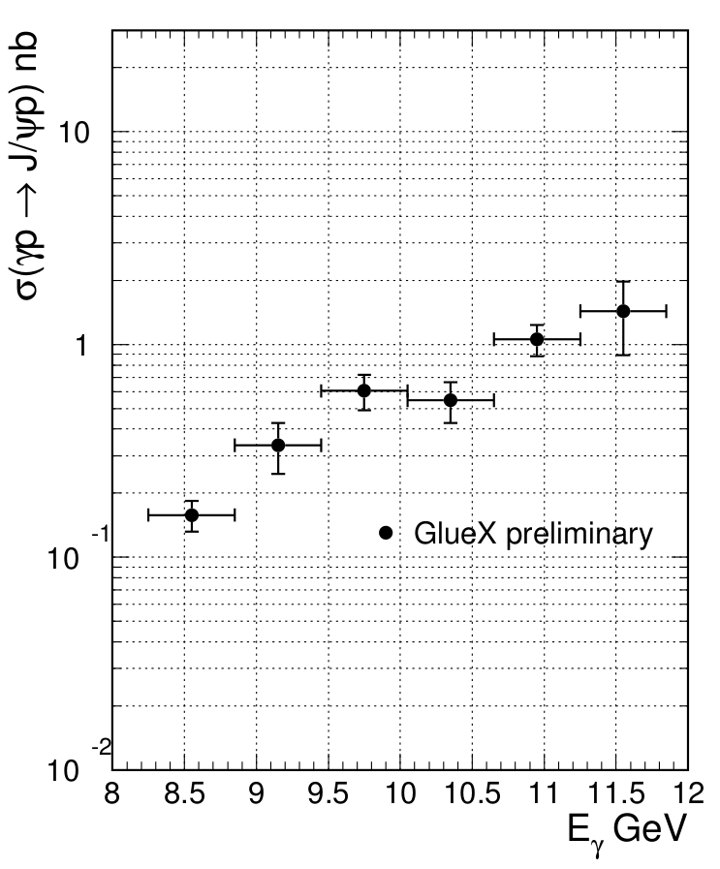
J/ψ cross-section and pentaquark predictions
σ(γp→J/ψp) nb
30% syst. uncertainty
3%BR P_{c}(4450) 5/2+
3%BR P_{c}(4450) 3/2-
P_{c}(4450)
A.Blin, C.Fernandez-Ramirez, A.Jackura, V.Mathieu, V.Mokeev, A.Pilloni, and A.Szczepaniak, PRD 94,034002 (2016).

Slide 17
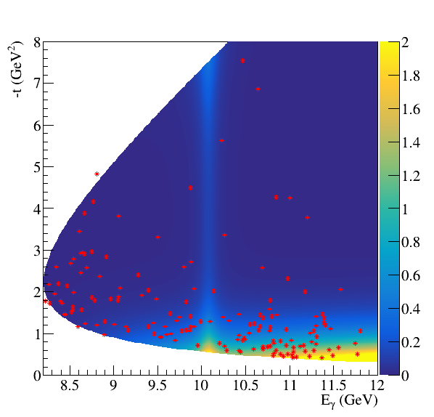
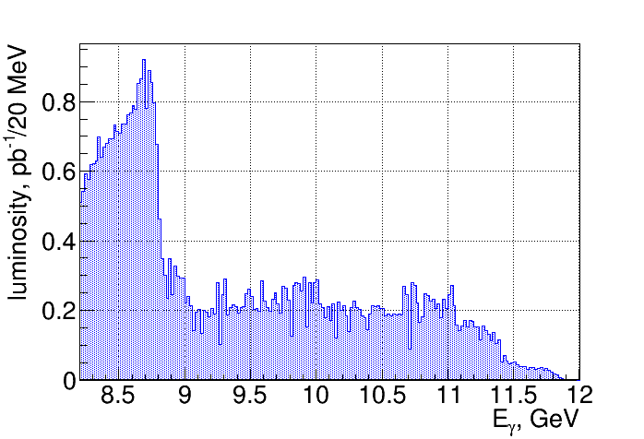
t vs Eγ unbinned distribution for J/ψ events
A.U.
dots – GlueX data
color – model prediction from JPAC for 3%BR P_{c}(4450) 5/2⁺
A.Blin, C.Fernandez-Ramirez, A.Jackura, V.Mathieu, V.Mokeev, A.Pilloni, and A.Szczepaniak, PRD 94,034002 (2016).
Density of data points proportional to flux and efficiency
No significant variations of flux (E_{γ}>9 GeV) and efficiency

Slide 18
My messages to the user’s community
JLab 12GeV accelerator has UNIQUE opportunity (high intensity, correct energy, polarized beam) to study J/ψ photo-production right above the threshold (E_{γ}=8.2 GeV) up to 12 GeV
Reaching the MAXIMUM BEAM ENERGY is very important to ensure consistency with the measurements in the high energy region.
Pion background requires at least 10³ suppression and much more to study BH continuum
Preliminary GlueX cross-sections near thresholds are higher than expected from the two-gluon exchange extrapolation of old data
The results show domination of the t-channel and no evidence for the LHCb pentaquark. Can set a limit for Pc(4450)→J/ψp BR at a several percent level
Notes:
18
18

Slide 19
Back-ups
Notes:
19
19

Slide 20
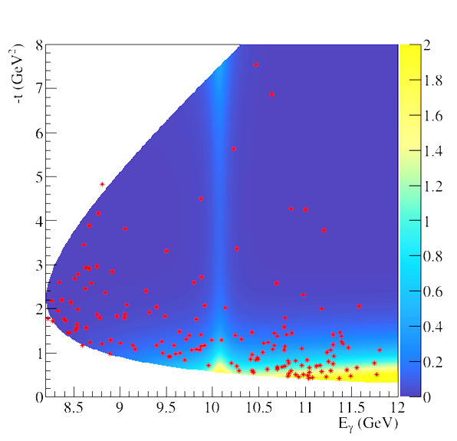
t vs Eγ unbinned distribution for J/ψ events
A.U.
dots – GlueX data
color – model prediction from JPAC for 3%BR P_{c}(4450) 5/2⁺
A.Blin, C.Fernandez-Ramirez, A.Jackura, V.Mathieu, V.Mokeev, A.Pilloni, and A.Szczepaniak, PRD 94,034002 (2016).
Density of data points proportional to flux and efficiency
No significant variations of flux (E_{γ}>9 GeV) and efficiency

Slide 21
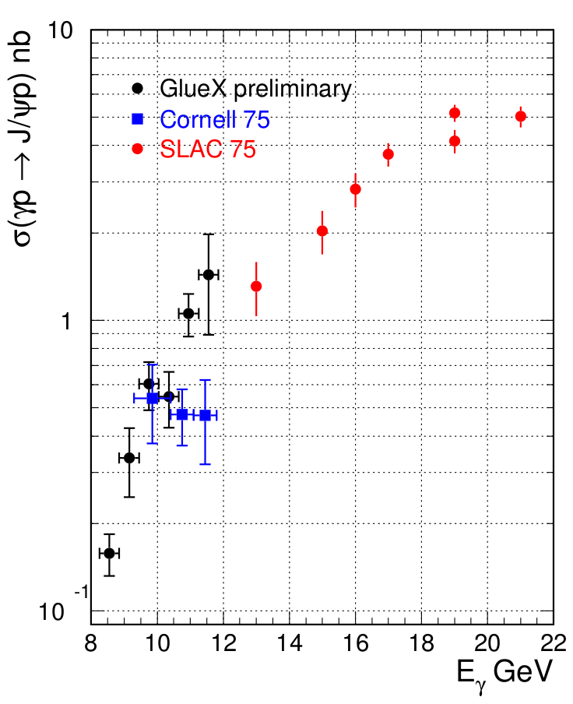
J/ψ cross-section – preliminary results
GlueX data
30% syst. uncertainty

Slide 22
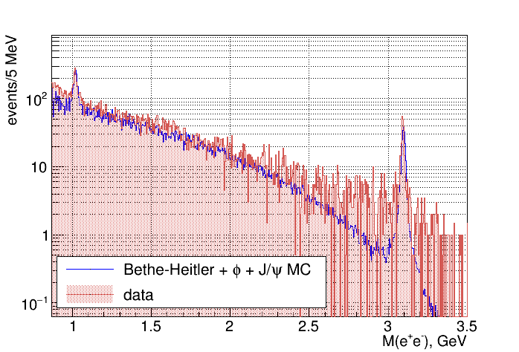
M(e⁺e⁻) spectrum

