Slide 1
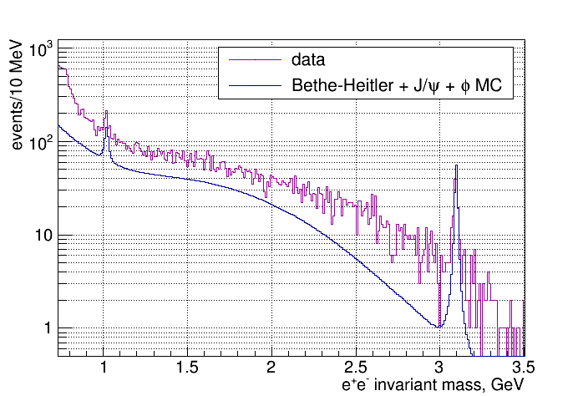
Di-electron Spectrum – comparison to MC
No kinematic fit χ2 cut θ_{e} > 2⁰
1
Notes:
1
1

Slide 2
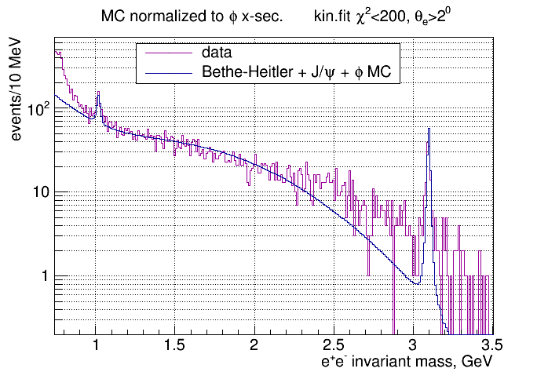
Di-electron Spectrum – comparison to MC
2
Notes:
2
2

Slide 3
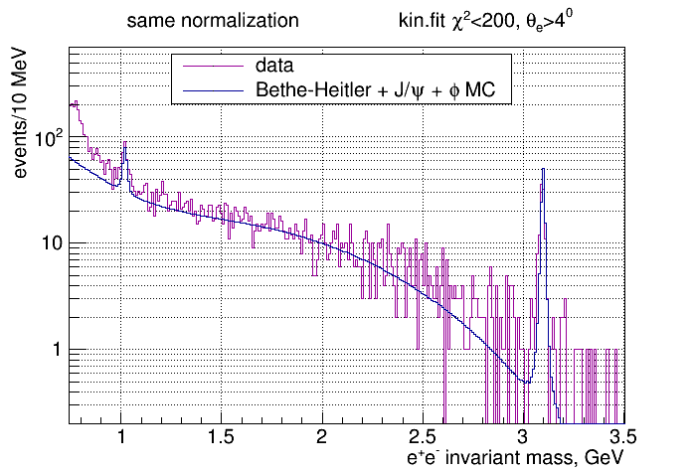
Di-electron Spectrum – comparison to MC
3
Notes:
3
3

Slide 4
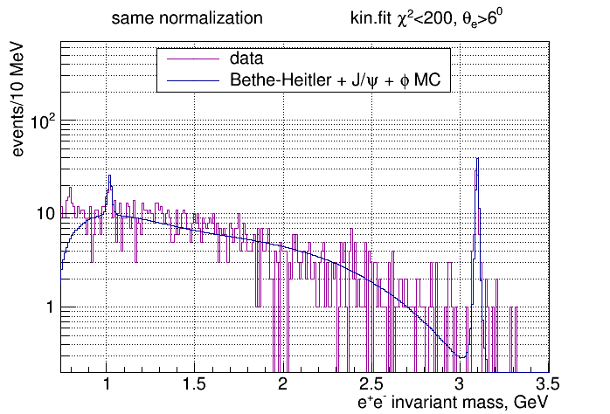
Di-electron Spectrum – comparison to MC
4
Notes:
4
4

Slide 5
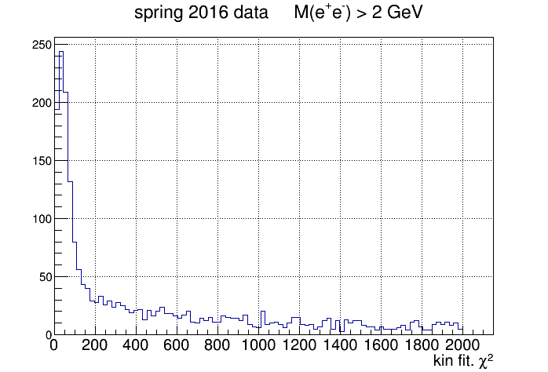
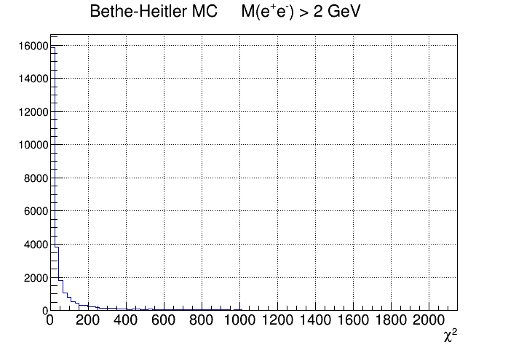
Di-electron Spectrum – kinematic fit χ²
5
Notes:
5
5

Slide 6
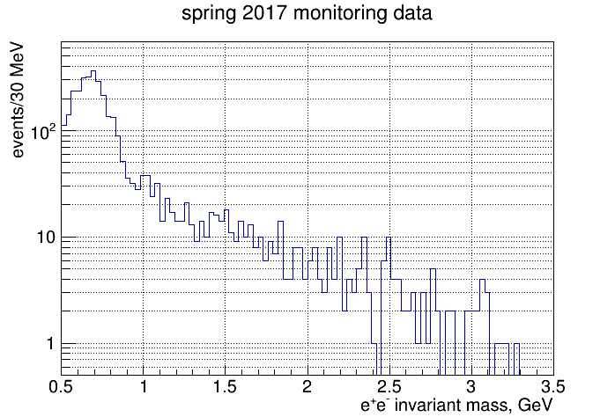
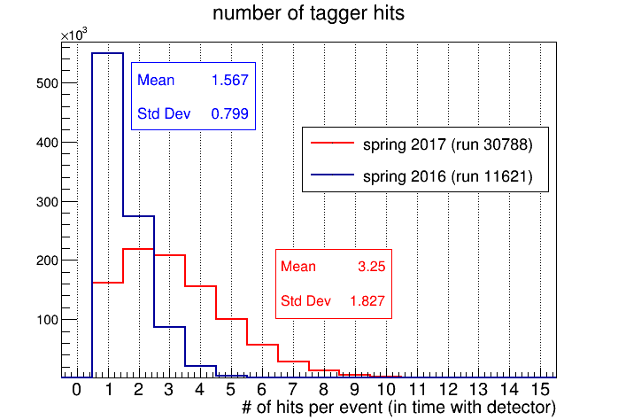
2017 data analysis – tagger multiplicity issue
6
Notes:
6
6

