Slide 1
TRD: status and future plans
Short update from the latest TRD tests
Why do we need TRD?
  Pion suppression with calorimeters
  Including dE/dx from CDC
  Complications in J/ψ analysis
Possible physics
Other advantages
Possible configuration
Cost estimates

Slide 2
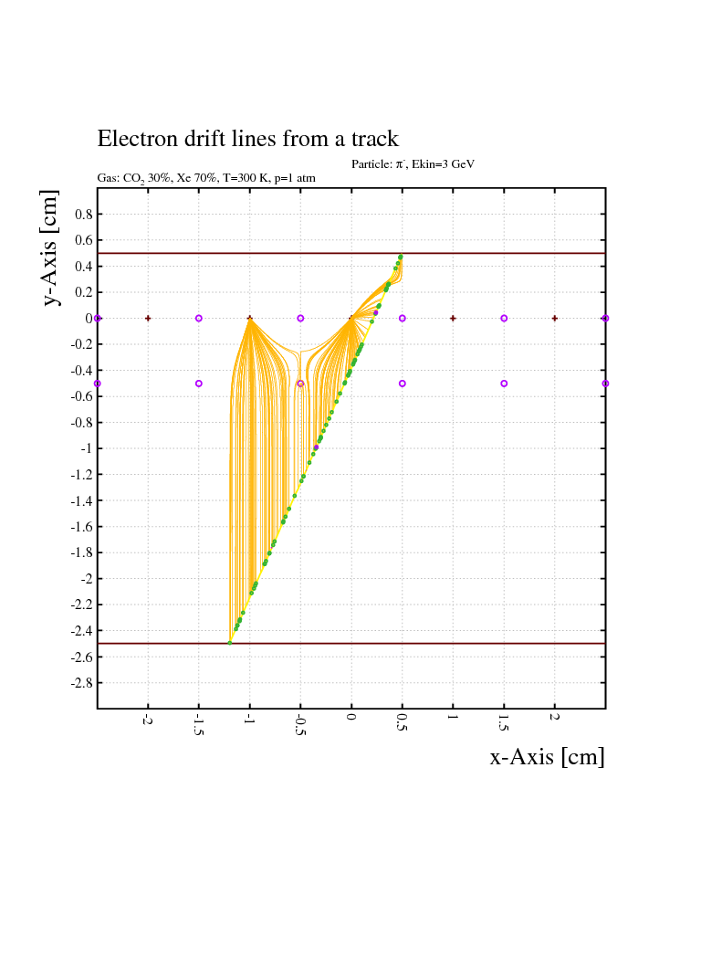
Spring 2018 tests – two modifications
Drift distance increased from 2cm to 3cm – more TR photons will interact
Entrance cathode foil replaced: Aluminized (3μ Al) Kapton → Chromium (0.1μ)

Slide 3
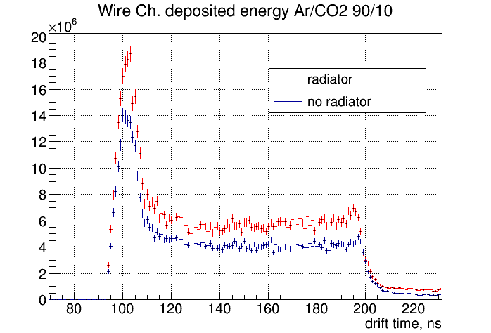
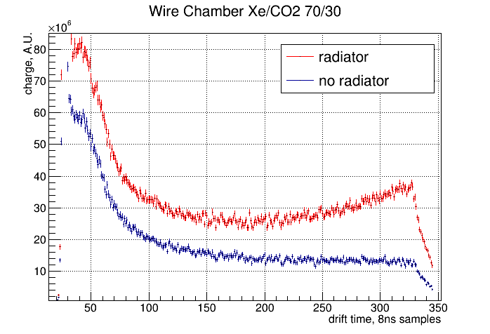
TRD prototyping: spring 2018 tests
Drift time, 8ns samples
Drift time, 8ns samples
Best results so far – flat distr. with Ar and enhancement with Xe
Need little more work with field wire HV (will do it during next run)

Slide 4
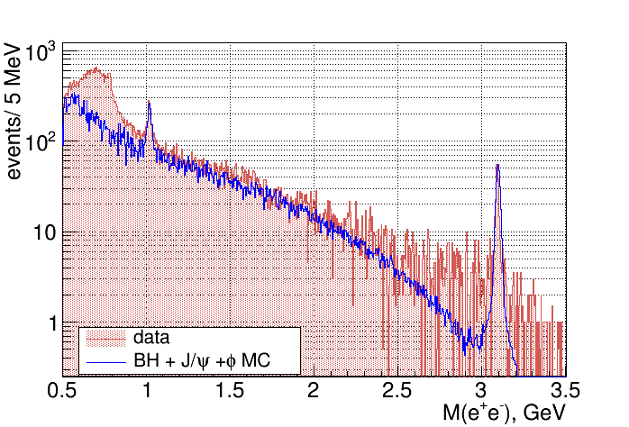
Pion background with the current detectors
Currently 36% π contamination in 1.5<M(e⁺e⁻)<2.5 GeV
Using all available cuts, except dE/dx from CDC

Slide 5
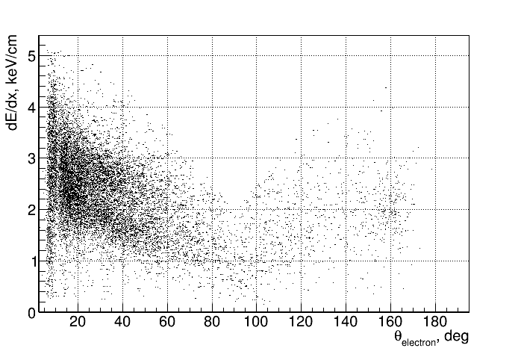
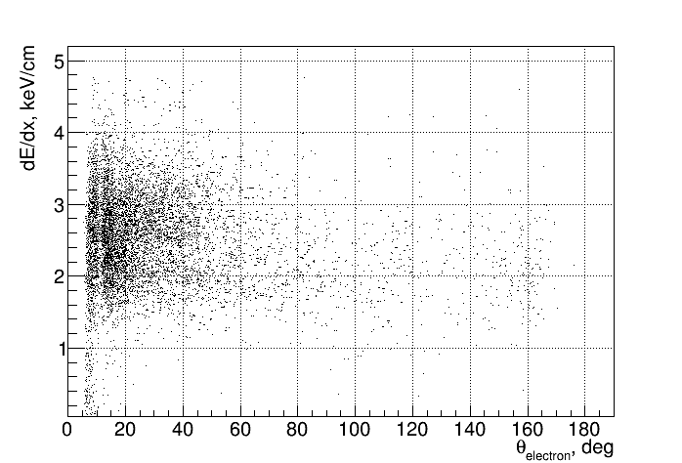
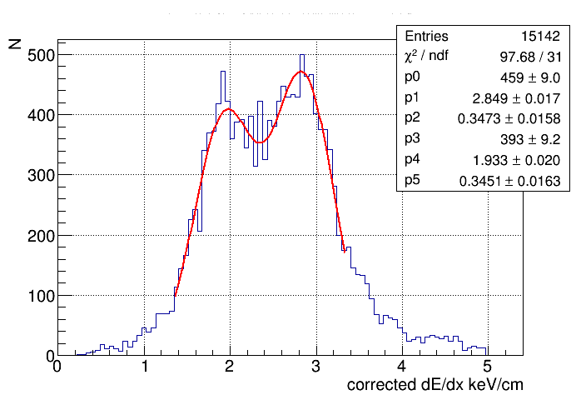
Pion background estimation – using dE/dx from CDC
π
e

Slide 6
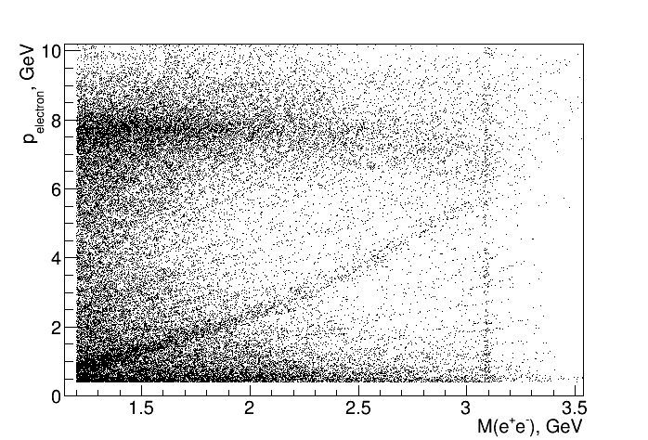
Pion background estimation – using dE/dx from CDC
p vs M(e+e-) distribution - all events with E/p cut and p>0.4GeV and θ>2deg

Slide 7
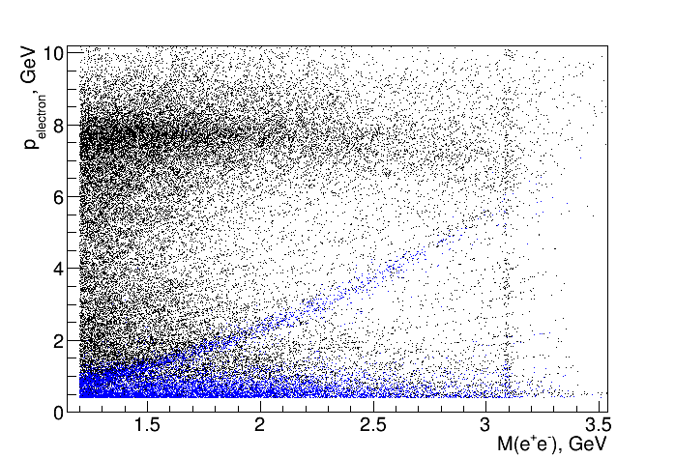
Pion background estimation – using dE/dx from CDC
p vs M(e+e-) distribution 1.132< M(pπ)<1.332

Slide 8
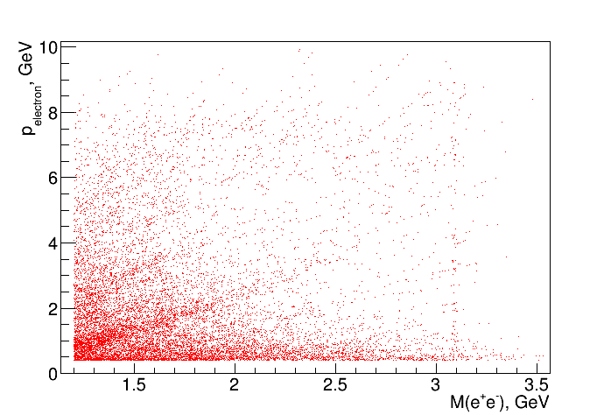
Pion background estimation – using dE/dx from CDC
p vs M(e+e-) distribution – 0<dE/dx<2.4 keV/cm (pions in CDC )
and p>0.4GeV and θ>2deg

Slide 9
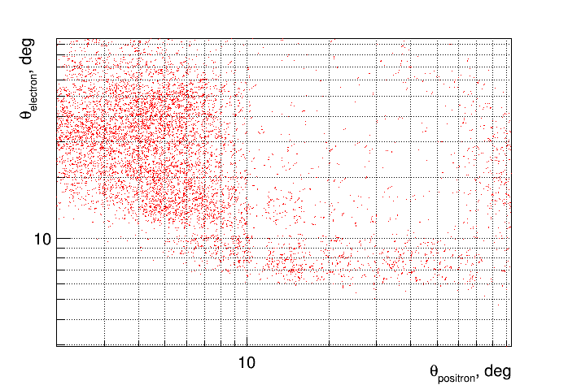
Pion background estimation – using dE/dx from CDC
Where is the other “electron”? – 90% in forward direction

Slide 10
Why pion contamination is bad for J/ψ analysis
36% contamination in BH resulting in some systematic effect that depends on BCAL, FCAL resolution (not dominating now but in the future we may want to improve it)
Requires cuts on momentum and angle that limit the acceptance and makes it more difficult to simulate
More background in the J/ψ mass region makes it more difficult to do event-by-event analysis
With additional PID detector one can study the calorimeter efficiency of the E/p cut

Slide 11
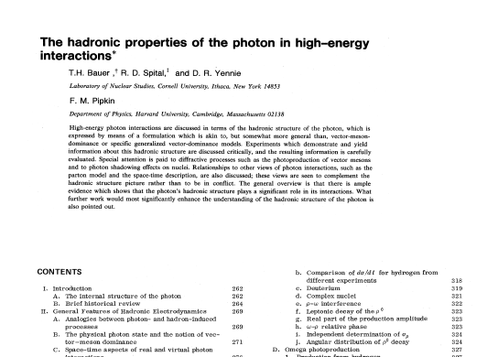
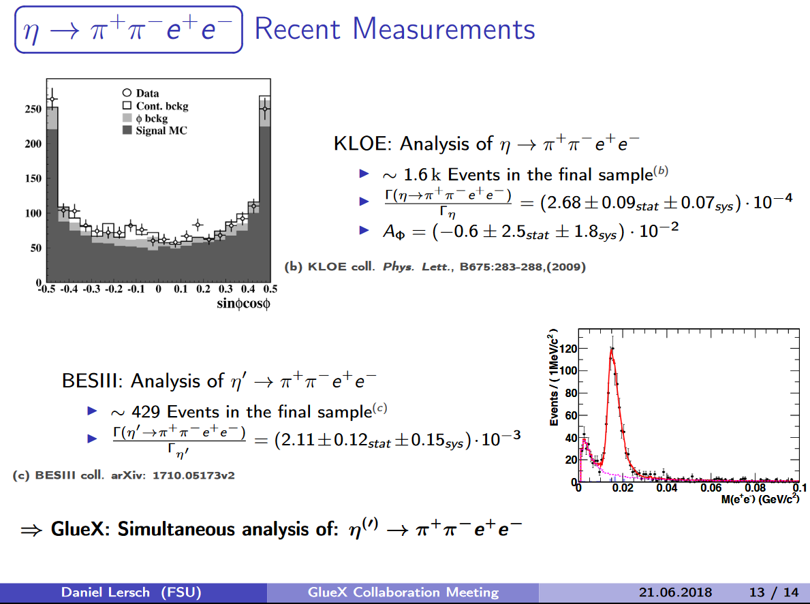
Possible physics with TRD and other advantages
Further studies of J/ψ
TCS – few percent effects require additional suppression of ~10-20
Rare di-electron decays, CP-violation,…(see Daniel’s report)
φ – BH interference
……
Other advantages:
Better tracking
Will help DIRC
Can be used to estimate e/π suppression in FCAL
….

Slide 12
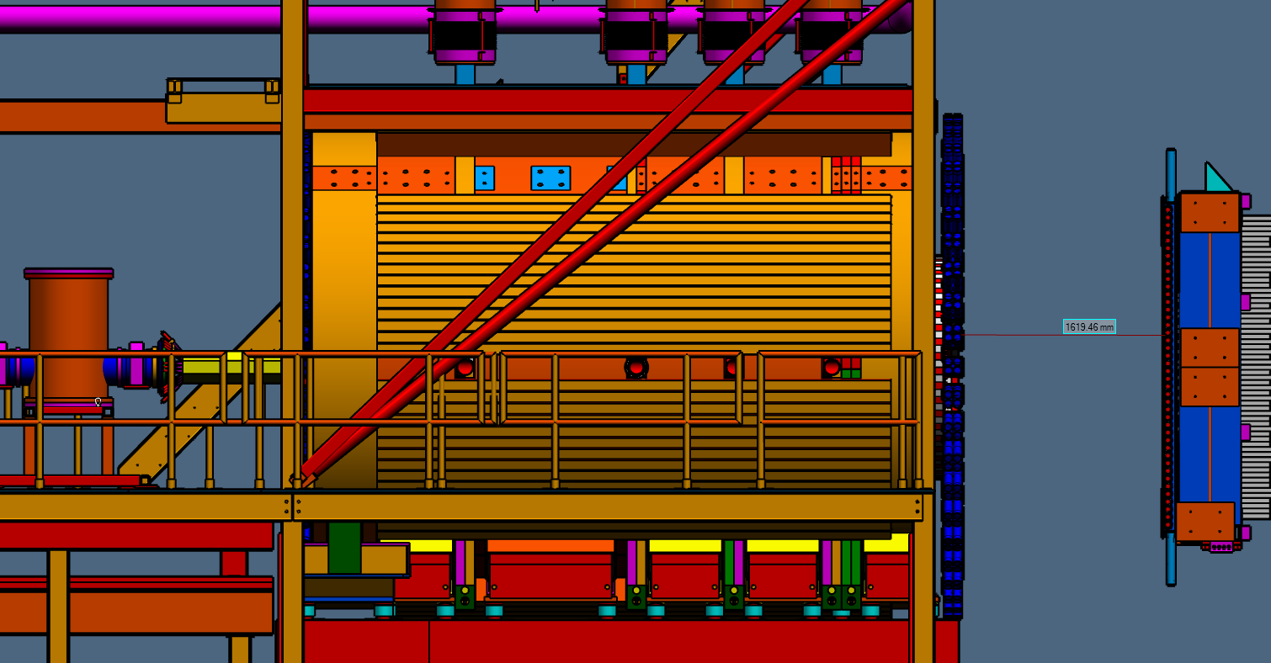
Approximate location/sizes
3 chambers
x 20cm thick

Slide 13
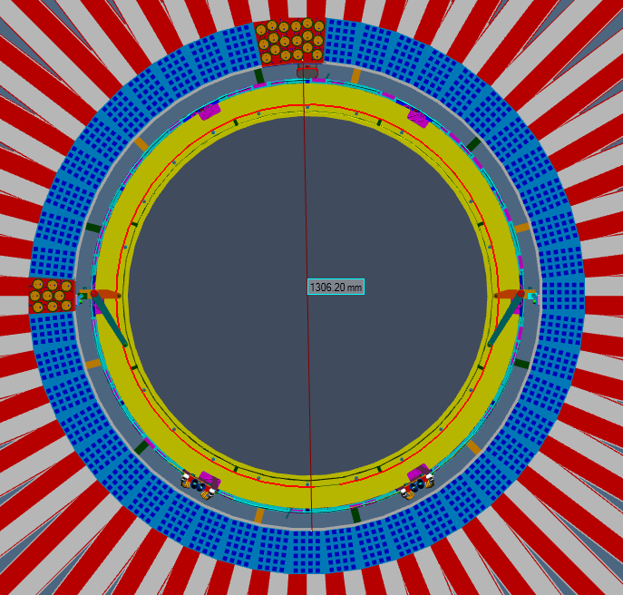
Approximate location/sizes
120x120 cm² sensitive area

Slide 14
Possible configuration and cost estimates
3 chambers (each factor 4-5 suppression at least)
Each chamber 120 wires and 240 strips
Total of 1,080 channels, 15 fADC125, 1 VXS crate
Gas system cost depend on requirements – will do studies with spare FDC package, need to evaluate minimal gas flow and possible contaminations
item | $k
Electronics $100/chan. ($55/ch for FDC) | 108
Materials for the detectors | 100
Gas system | 100-150
Total | 308-358

Slide 15
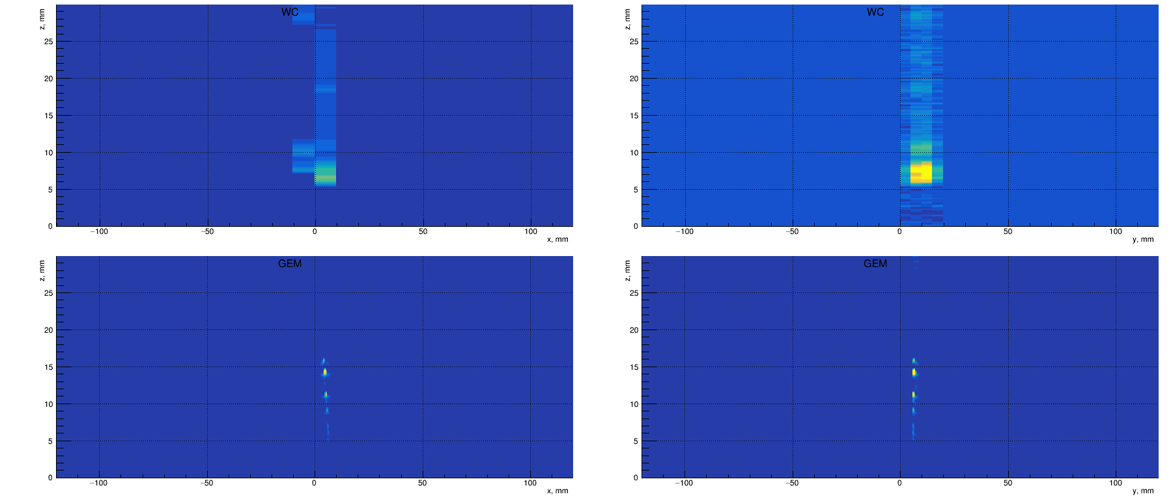

Slide 16
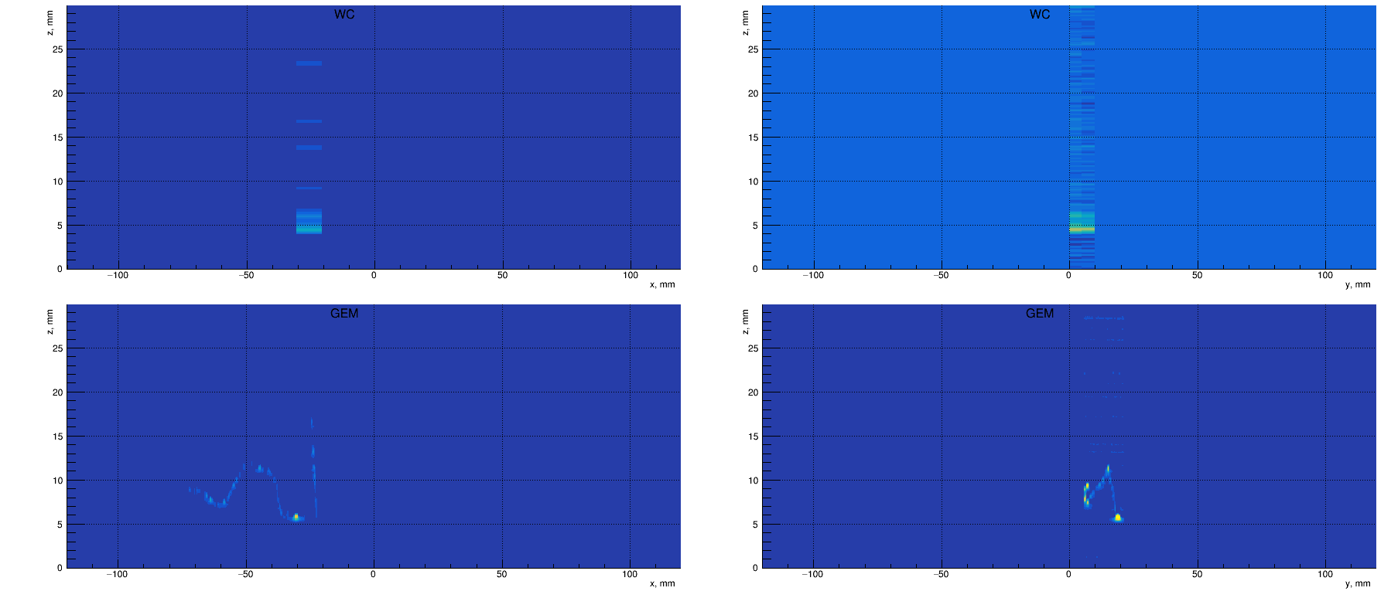

Slide 17
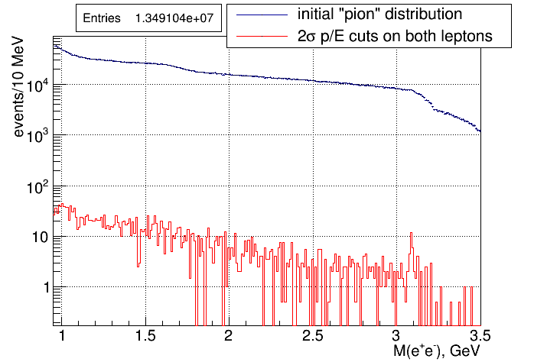
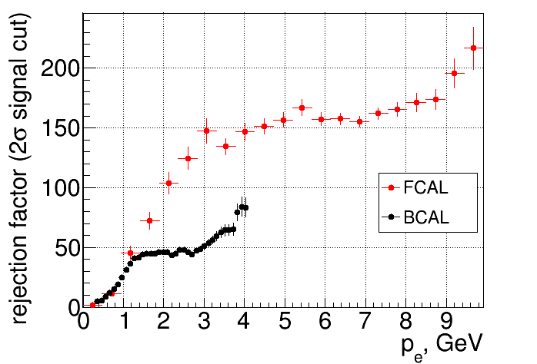
What we have now: e/π separation using p/E
~5000 suppression
~5% of total statistics
Suppression factor of ~5000 by p/E cuts only
Different for BCAL and FCAL; depends on energy
Still 36% π contamination in M(e⁺e⁻) > 1.5 GeV region

Slide 18
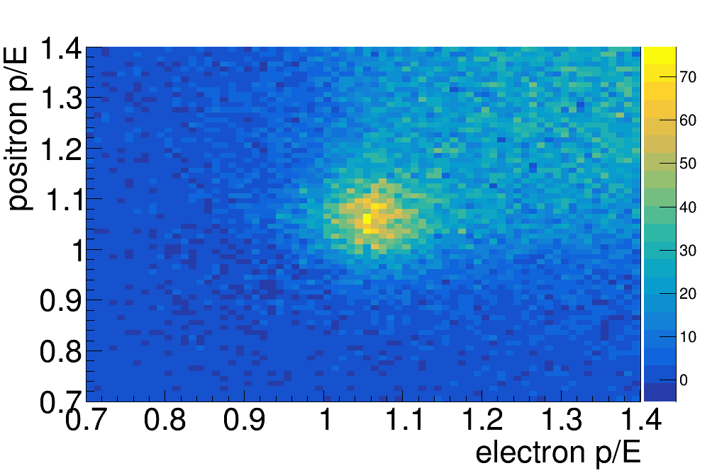
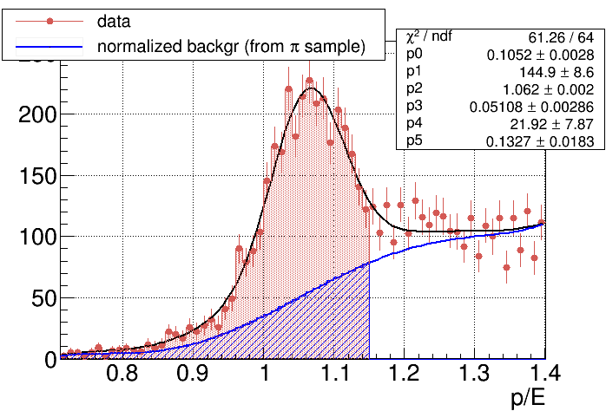
What we have now: e/π separation using p/E
36±1.2% contamination in 1.5-2.5 GeV M(e⁺e⁻) region with 2σ cut on electrons
BH yields corrected in bins of energy – percentage slightly varies with energy
Background shape from pion sample (p/E anti-cuts)

