Slide 1
Thickness tolerance issues with the FDC wireframes
Measured variation of the thickness of 31HF Rohacell sheet is on the order of 0.08mm. One sheet (hopefully not the norm) varied by .43mm. Note: manufacturer’s spec +/-0.5mm , +/-0.13 for additional fee. Evonik’s spec is +/-0.2mm, and they apparently also have tighter tolerances available.
The 110HF may be a little better- perhaps 0.05mm variation (not enough material to measure to say for sure)
Clamping a 31HF lamination for machining is tricky- the clamp pressure has to be well controlled- failure to do so resulted in variations on the order of 0.5mm. Even with better control, one lamination varied by the same 0.5mm. It is unknown whether this was a variation in glue layer thickness or a clamping issue (or both).
The pin jig plate used as a weight for laminating has flatness issues on the order of 0.1mm. This could be local surface defects, or be distributed across the plate.
Dimple extrusion due to clamping

Slide 2
Conclusions/Recommendations
The 31HF material seems to be to soft/springy to allow fabrication to the required tolerances. Even if this were not the case, bolt and O-ring forces would probably create local distortions affecting flatness (I have not as yet modeled this in FEA).
We could replace the 31HF with 110HF. The 110HF is 4.4 times as stiff, and 7.5 times as strong at compressive failure.
We could replace the back G10 skin and the Rohacell with a solid G10 ring. The variation in the height of G10 seems to be lower, between 0.025 and 0.05mm. Using the G10 ring would also require only one laminating process, and simplify clamping during machining. The added material could be minimized, as shown in the following slides:

Slide 3
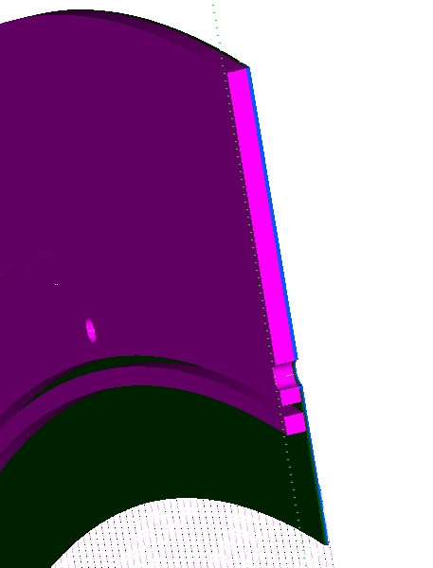
Solid G10 ring geometries

Slide 4
Controlling the thickness of the glue line
If the Jig plate is used as a clamping weight, and it isn’t flat, the resulting laminate will not be of uniform thickness! If we wish to use a plate, it would be better if the plate were slightly compliant, and we used hard stops to set the desired gap (5mm keyway stock is a standard item). In any case, I would suggest more force to extrude the excess glue.
The second option is to forget the plate, and use vacuum bagging to apply the force (46.5 times the force exerted by the plate). Alternatively, we could use vacuum bagging to apply the load to the plate, and use the hard stops.

Slide 5
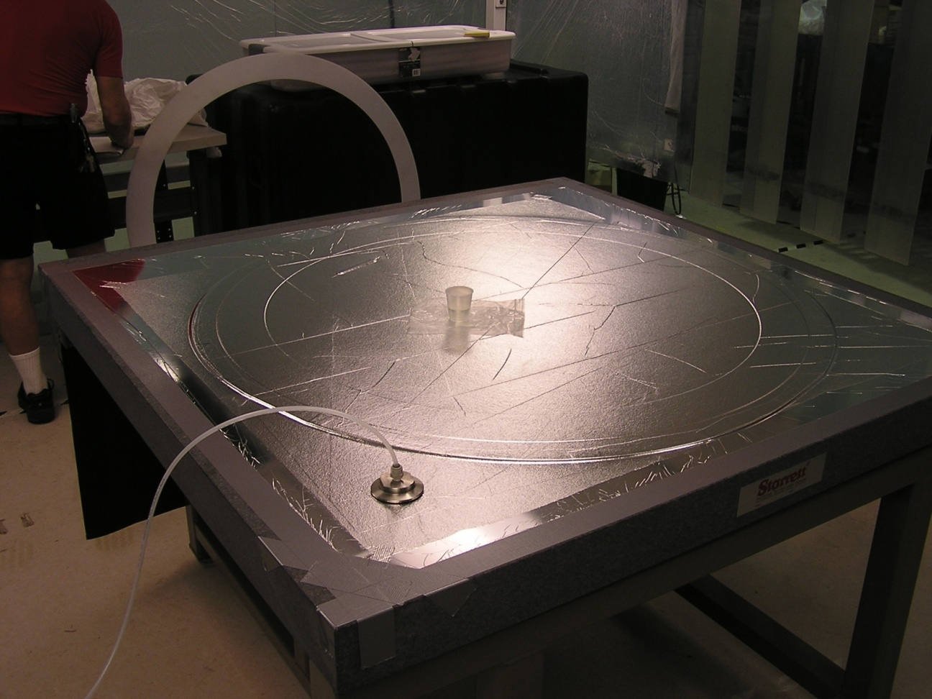
The 31HF lamination shown on the vacuum table was reduced in thickness by 0.2mm. It regained 0.1mm later that afternoon. 110HF would probably show no effects (4.4 times as stiff).

