Slide 1
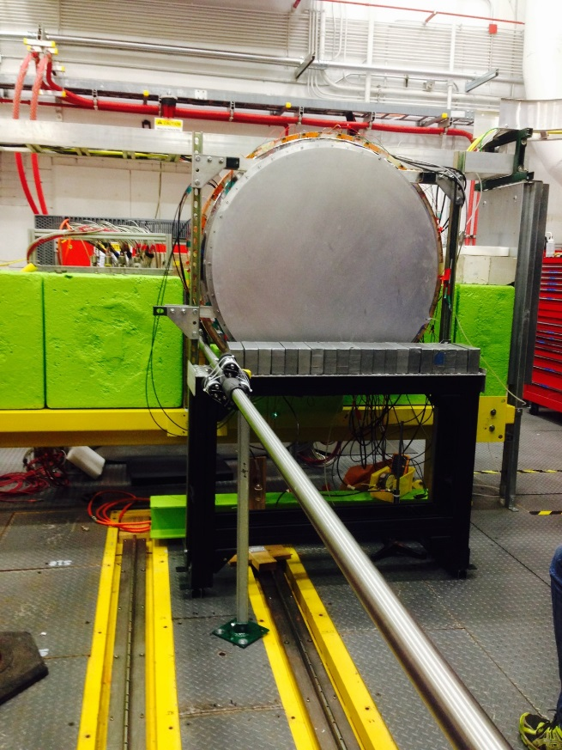
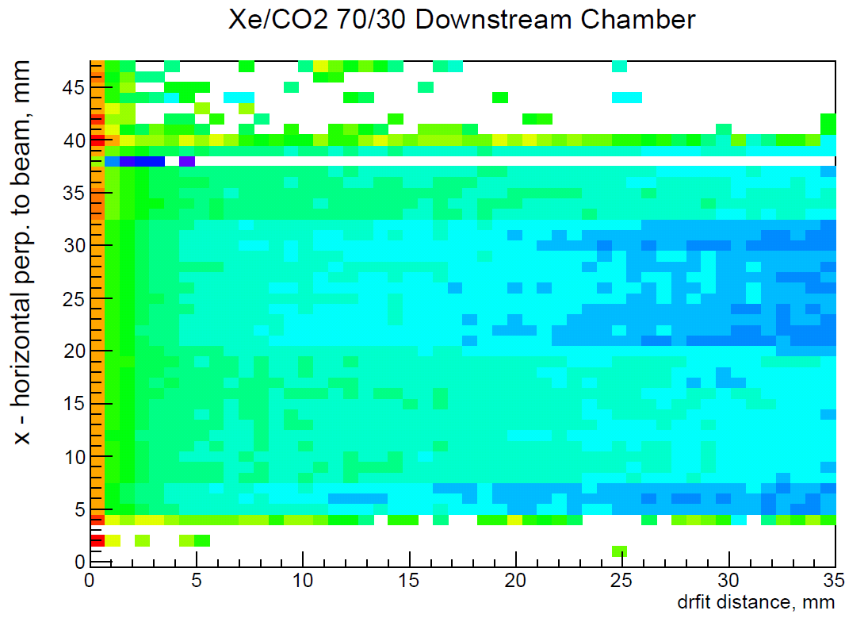
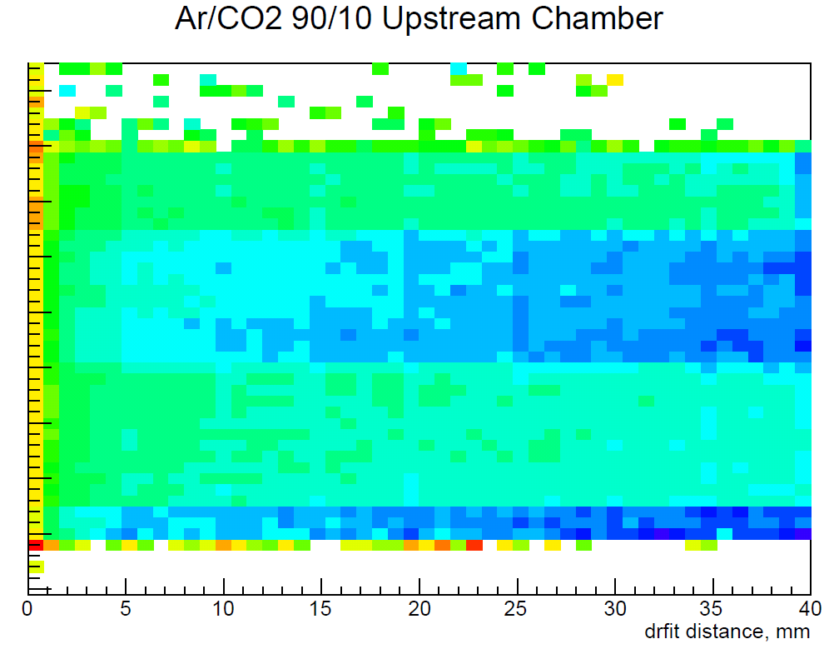
Transition Radiation Detector – R&D studies
e/π separation: for p>1.5 GeV, π suppression factor 100-1000 depending on # of chambers
Prototype tests done with Ar and Xe gas mixtures, using electrons with/without radiator
Chamber design similar to ALICE TRD:
e
e
e
Color represents the deposited charge per track
1
Notes:
1
1

Slide 2
Transition Radiation Detector - Prototype
2
Notes:
2
2

