Slide 1
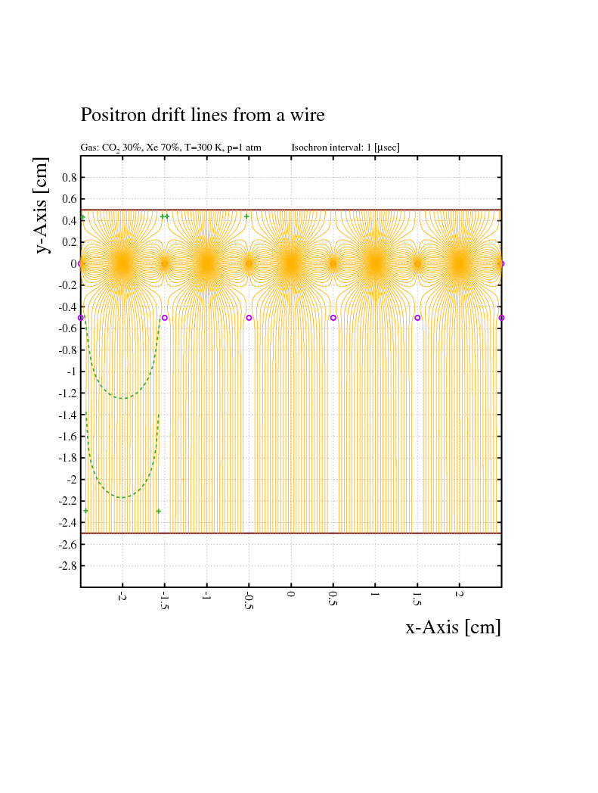
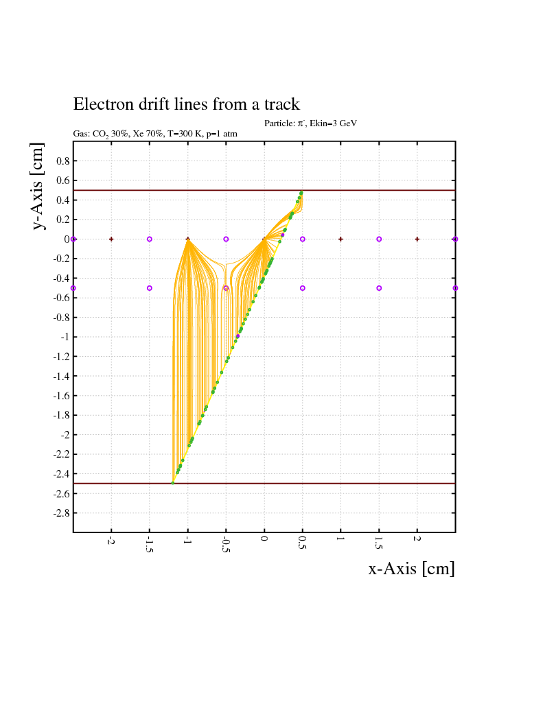
Transition Radiation Detector – New Field Configuration
0 V
+1950V
0 V
-2000V
1
Notes:
1
1

Slide 2
Transition Radiation Detector – Prototype Design
2
Notes:
2
2

Slide 3
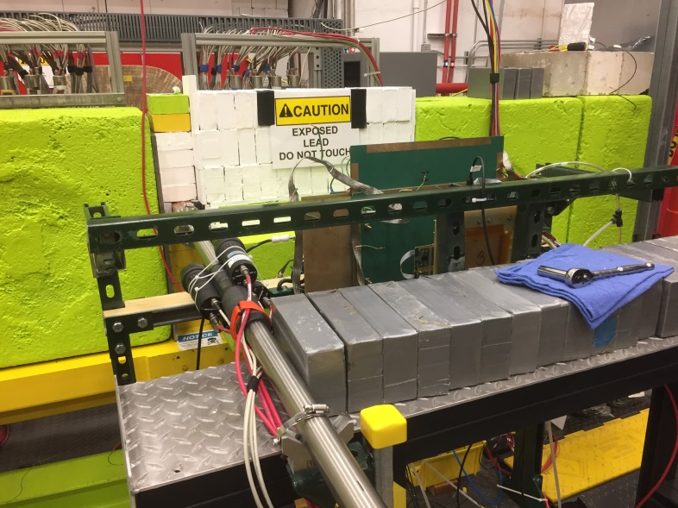
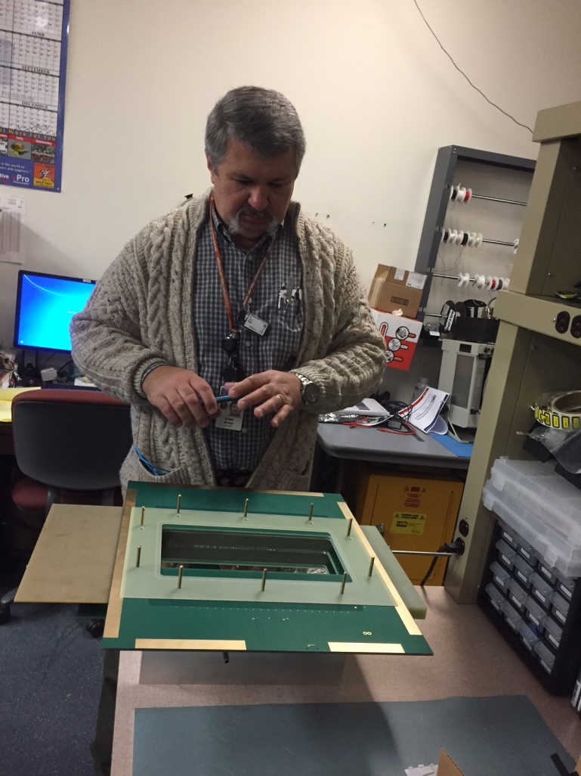
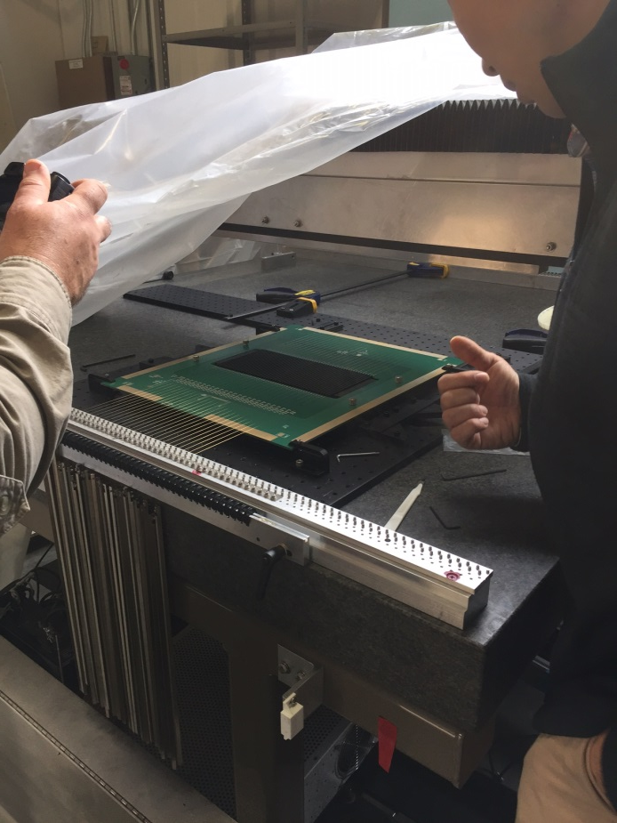
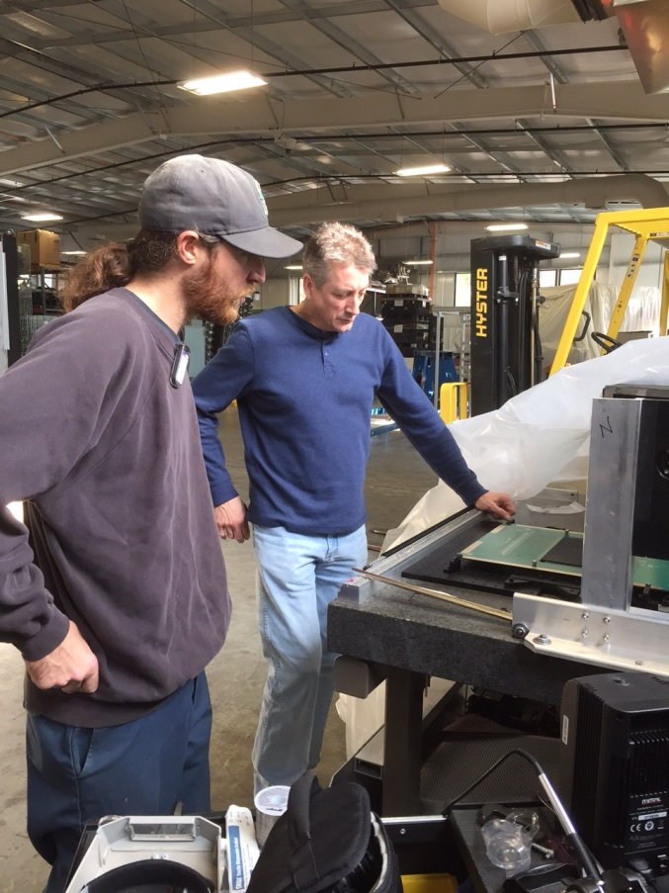
Transition Radiation Detector – Prototype Manufacturing
Detector group:
Brian Cross – design and assembly
Seung Joon Lee – tools for stringing
HallD electronics:
Fernando Barbosa – el. board design
Chris Stanislav – el. board assembly and stringing
Installed behind the left PS arm by our techs
Casey Heck – just watching
Using our FDC stringing table
3
Notes:
3
3

Slide 4
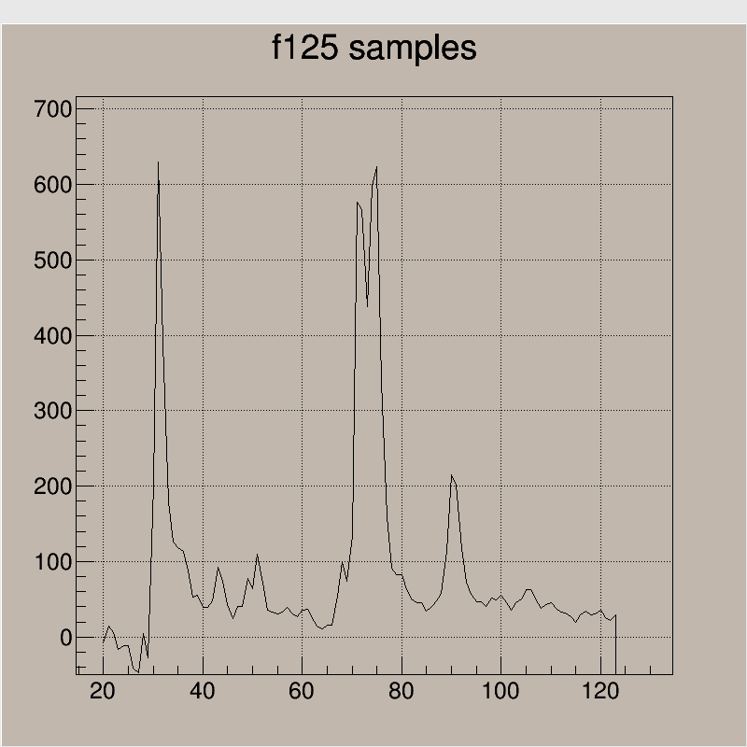
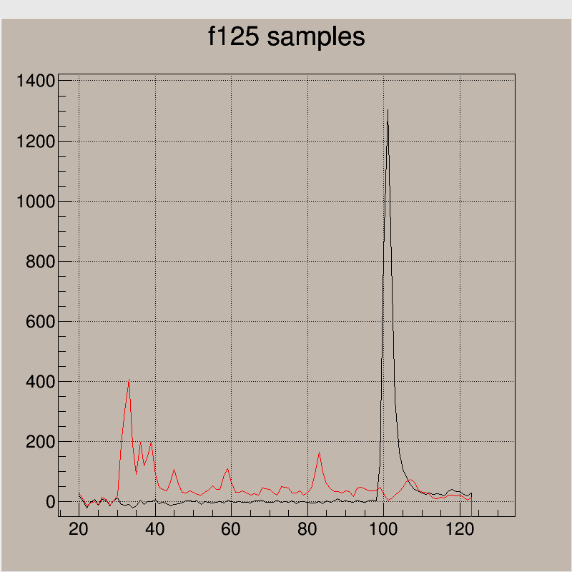
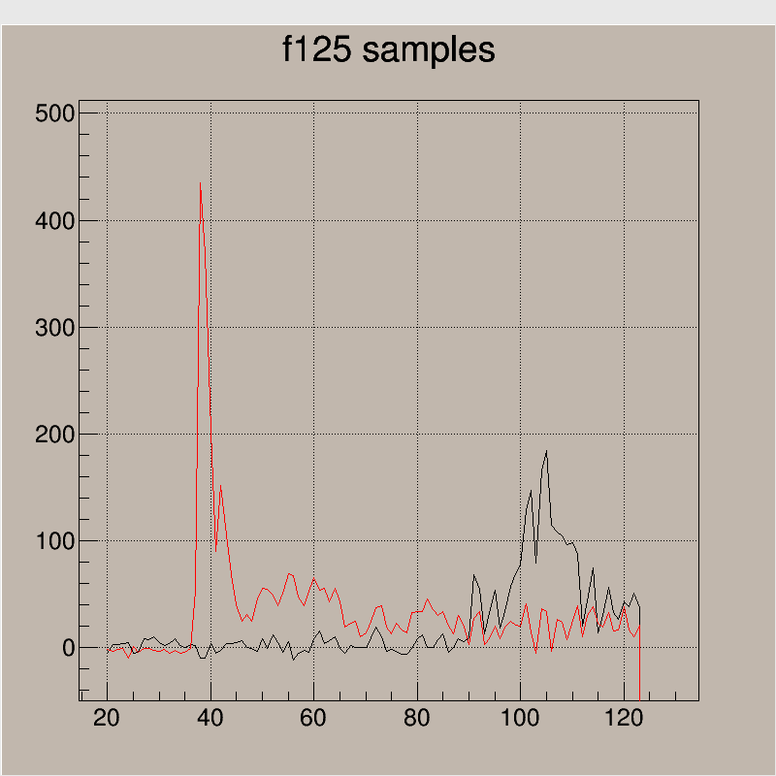
TRD – single event examples
f125 samples of 32ns – colors correspond to different wires
4
Notes:
4
4

Slide 5
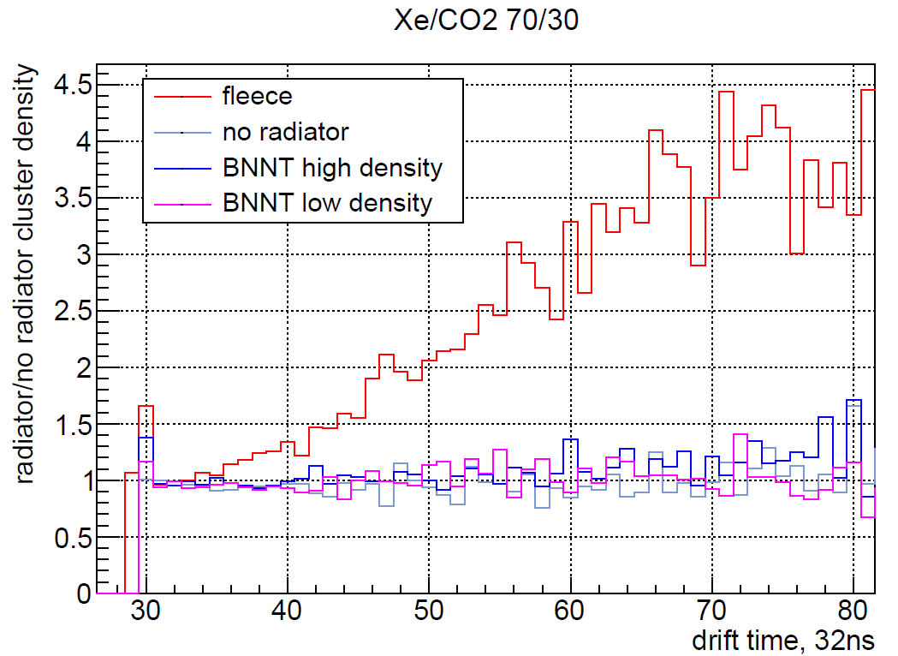
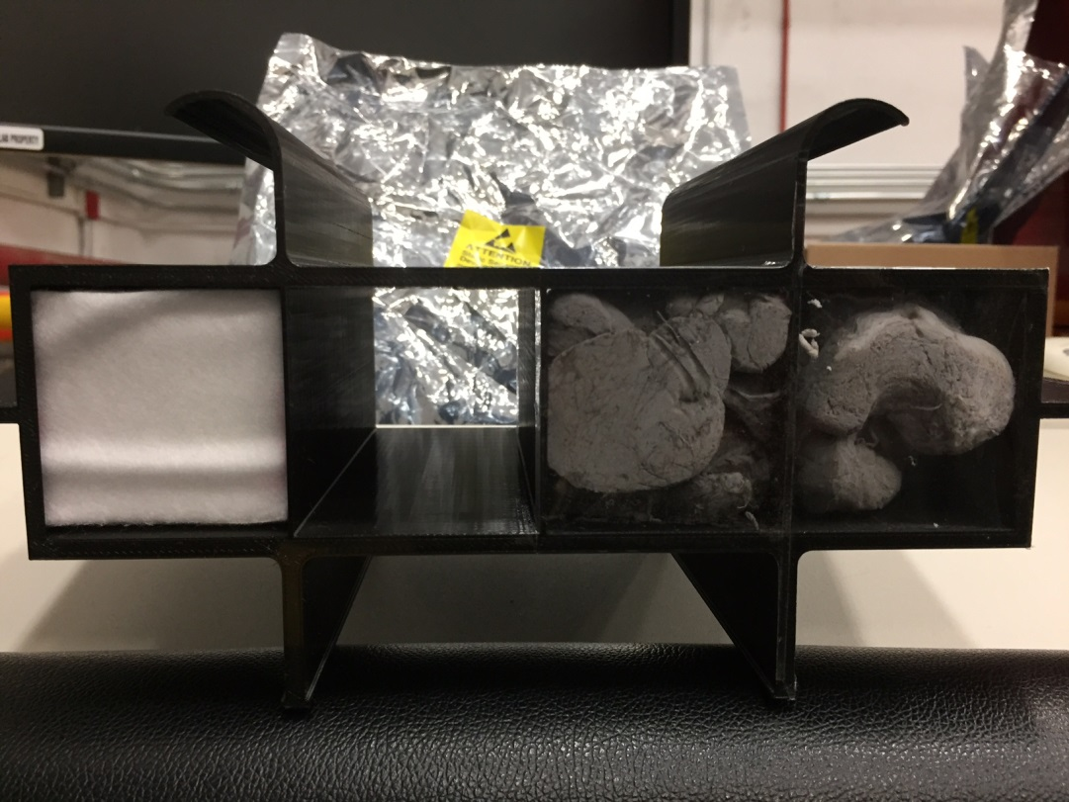
TRD results: nanotube vs fleece radiator
5
Notes:
5
5

Slide 6
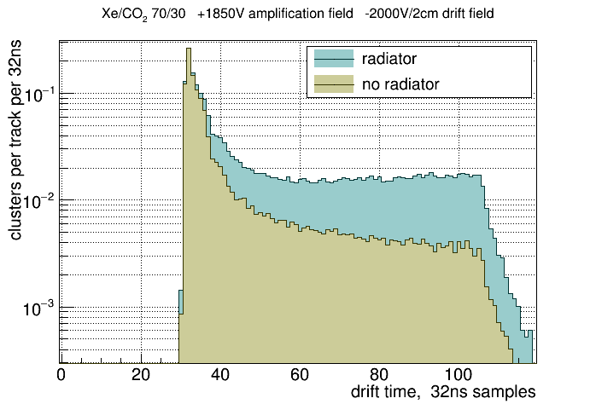
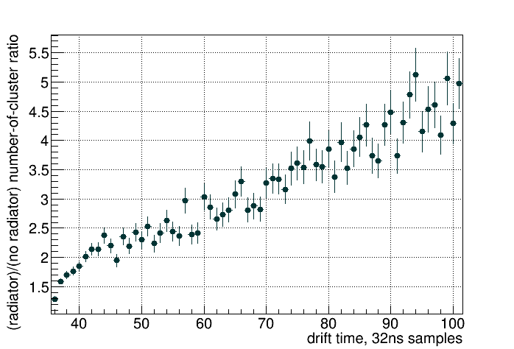
TRD results: averaged distributions
Threshold for cluster counting = 300 fADC units
6
Notes:
6
6

Slide 7
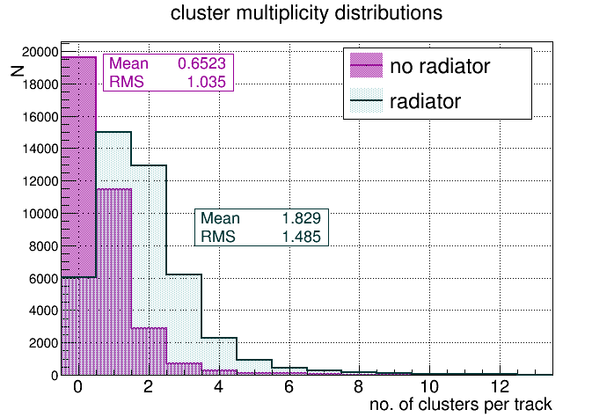
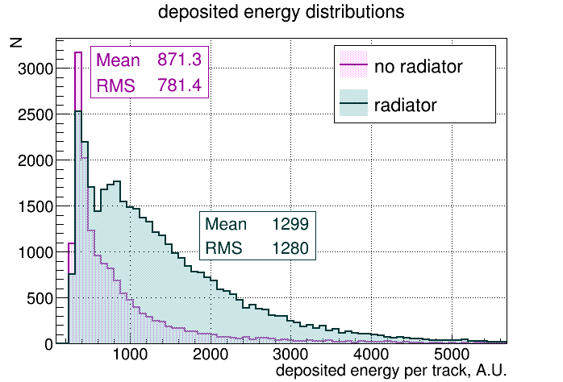
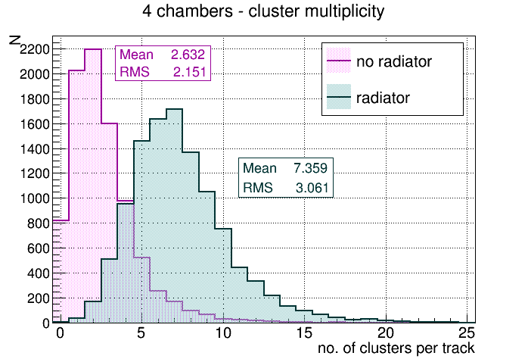
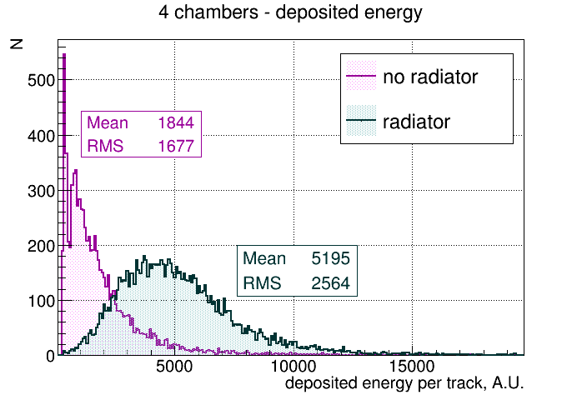
TRD results: event-by-event distributions
7
Notes:
7
7

