Slide 1

eRD22: GEM based Transition radiation detector/tracker for EIC
Yulia Furletova
on behalf of GEM-TRD/T working group
Presented (and slightly modified) by Lubomir Pentchev
Notes:
Title Page

Slide 2

eRD22 GEM-TRD/T
Goal: To develop a next generation of transition radiation detectors to improve electron identification (e/hadron separation) at EIC
TEAM
Jefferson Lab:
Howard Fenker
Yulia Furletova
Sergey Furletov
Lubomir Pentchev
Beni Zihlmann
Chris Stanislav
Fernando Barbosa
University of Virginia
Kondo Gnanvo
Nilanga K. Liyanage
Temple University
Matt Posik
Bernd Surrow
Critical issues/solutions of TRD operation:
Space charges suppress late signals; need cluster separation in time
  use GEM technology combined with fADC
Electron recombination in wide drift region
  use pure gases
Xe is expensive –
  recirculation
Low keV TR photons stop in entrance foil
  Optimize foil material/thickness, radiator
Example: Alice TRD
Notes:
Interior Page Design 2

Slide 3
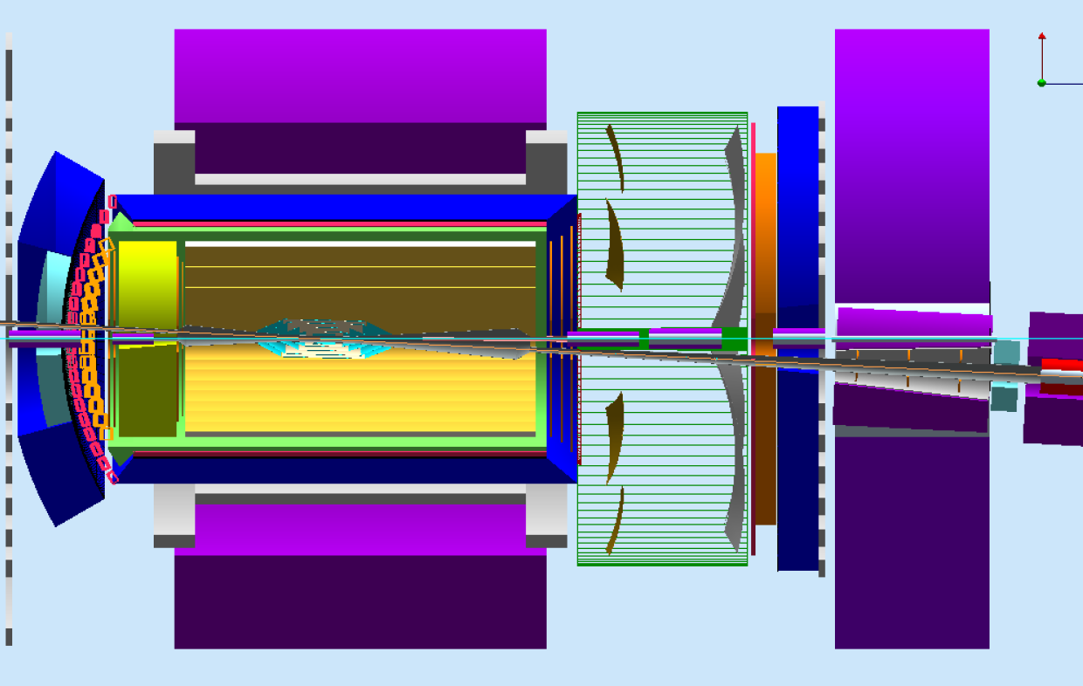
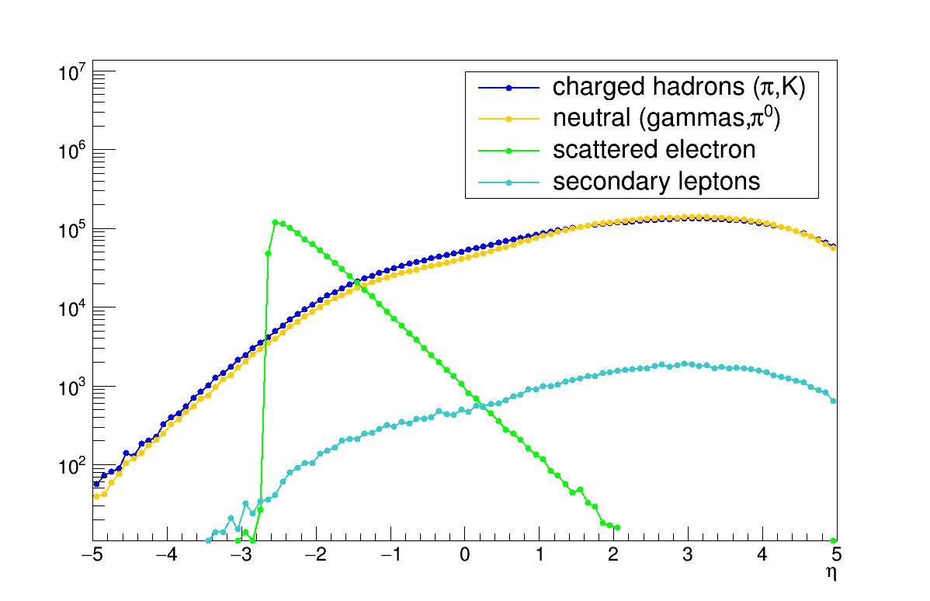
Hadron endcap
For EIC, the ideal place to install is at hadron endcap, where we expect a high hadron flux.
GEM-TRD/T
JLEIC design
High hadron background
Secondary electrons
Notes:
Interior Page Design 2

Slide 4
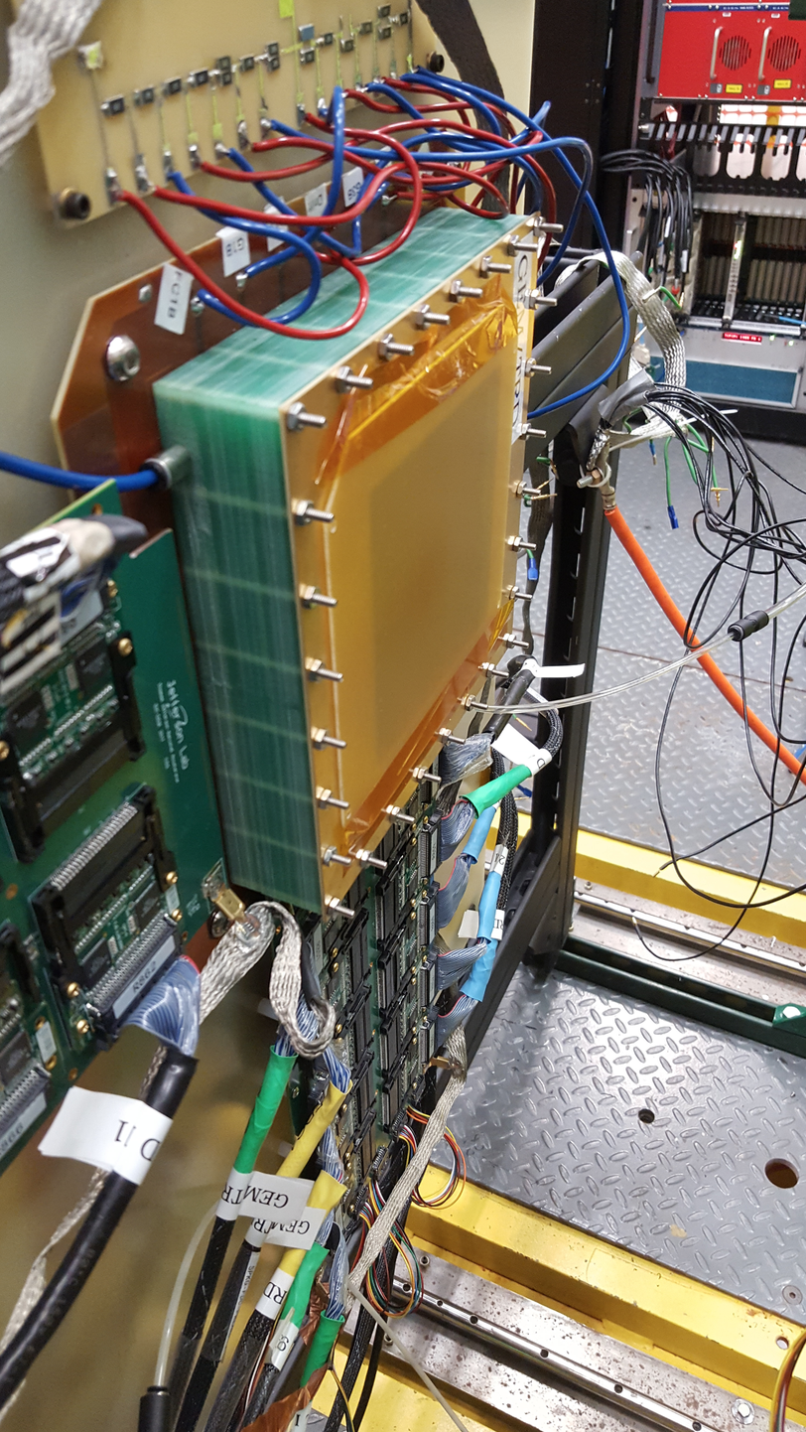

Test Setup at JLAB HALL-D
Pair spectrometer
e+
gamma
HALL -D
Beamline
Electrons
3-6 GeV
Hall-D
FDC
Radiator
$$γ$$
GEM
Radiator
EIC
$$γ$$
e-
3-6 GeV electrons in Hall-D from pair spectrometer
Tests in collaboration with Hall-D TRD prototype (wire-based) sharing same gas system, electronics (GASII pre-amps, flashADC125), DAQ, analysis software
Comparing radiator/no radiator effects
Notes:
Interior Page Design 2

Slide 5
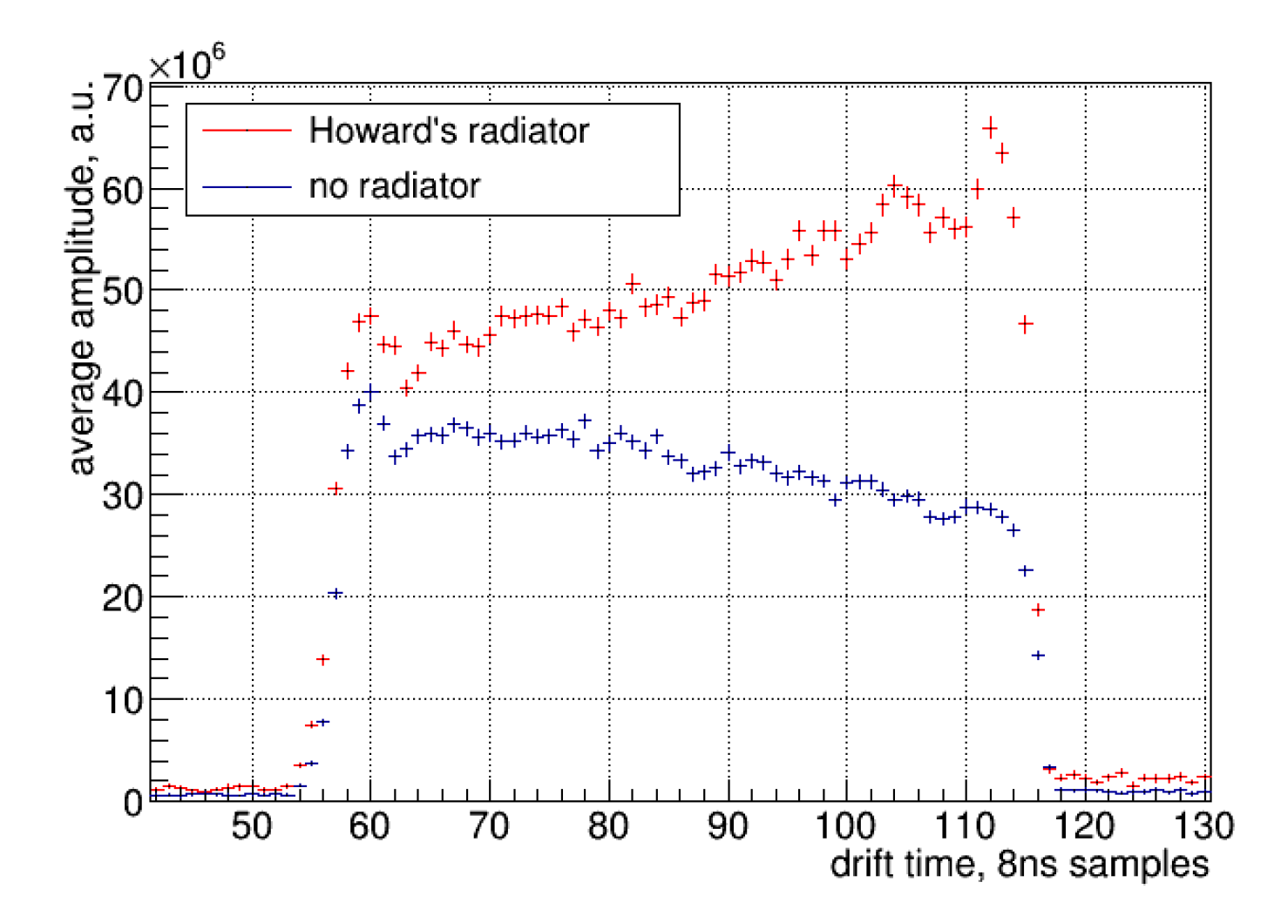
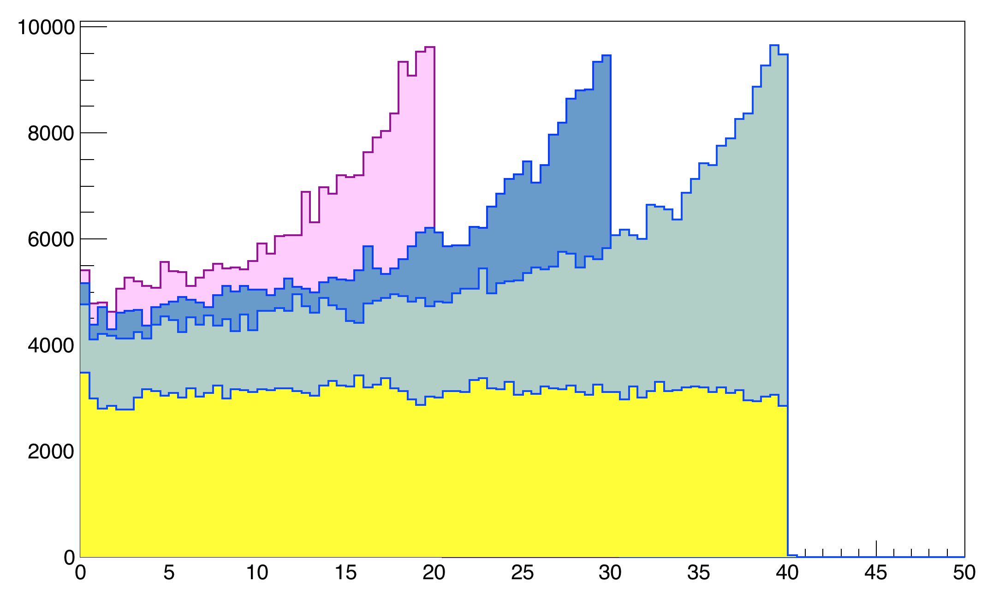
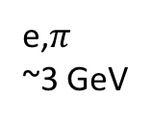
Energy deposition (dE/dx + TR) vs distance
GEANT4 simulation
Measured data
dE/dx + TR for electrons
Clearly see TR-photons (2cm drift)
R:5cm,
D: 2,3,4cm
Xe/CO₂ (80/20)
Reg. follies radiator
e,$π$
~3 GeV
dE/dx for Pions
Distance in gas [mm]
Very preliminary rejection, single module (likelihood method)
 | 90% eff | 70% eff
2cm Xe | 2.5 | 12
4cm Xe | 4.5 | 17
Slope in dE/dx indicates presence of gas contamination
Notes:
Interior Page Design 2

Slide 6
eRD22 GEM-TRD/T
Achievements:
We performed a GEANT4 simulation of TRD setup with GEM detector (gas and radiator volumes) for a single layer operation and estimated e/π rejection factor.
We built and tested a new GEM based TRD prototype and optimized its performance (new HV divider, different drift filed voltages, gas gain, etc)
Front-end electronic / DAQ :
  Test DAQ with Flash ADCs
Using the existing facility at JLAB Hall-D perform a test with different TR-radiators
New gas-mixing system is ready to use.
Notes:
Interior Page Design 2

Slide 7
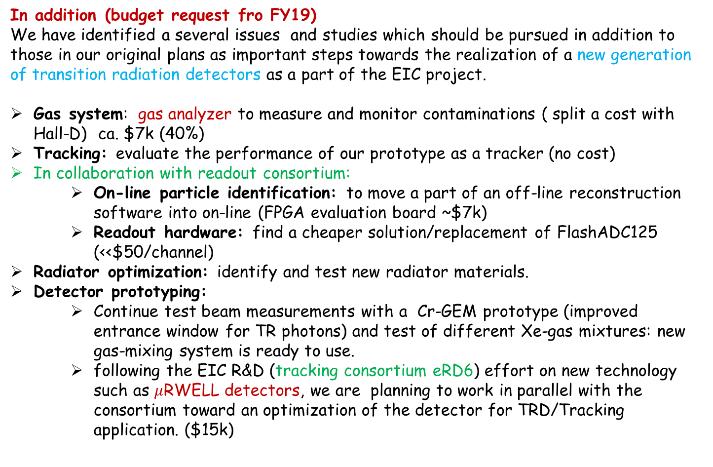
Proposal for FY19
In addition (budget request fro FY19)
We have identified a several issues and studies which should be pursued in addition to those in our original plans as important steps towards the realization of a new generation of transition radiation detectors as a part of the EIC project.
Gas system: gas analyzer to measure and monitor contaminations ( split a cost with Hall-D) ca. $7k (40%)
Tracking: evaluate the performance of our prototype as a tracker (no cost)
In collaboration with readout consortium:
  On-line particle identification: to move a part of an off-line reconstruction software into on-line (FPGA evaluation board ~$7k)
  Readout hardware: find a cheaper solution/replacement of FlashADC125 (<<$50/channel)
Radiator optimization: identify and test new radiator materials.
Detector prototyping:
  Continue test beam measurements with a Cr-GEM prototype (improved entrance window for TR photons) and test of different Xe-gas mixtures: new gas-mixing system is ready to use.
  following the EIC R&D (tracking consortium eRD6) effort on new technology such as $μ$RWELL detectors, we are planning to work in parallel with the consortium toward an optimization of the detector for TRD/Tracking application. ($15k)
Notes:
Interior Page Design 2

Slide 8
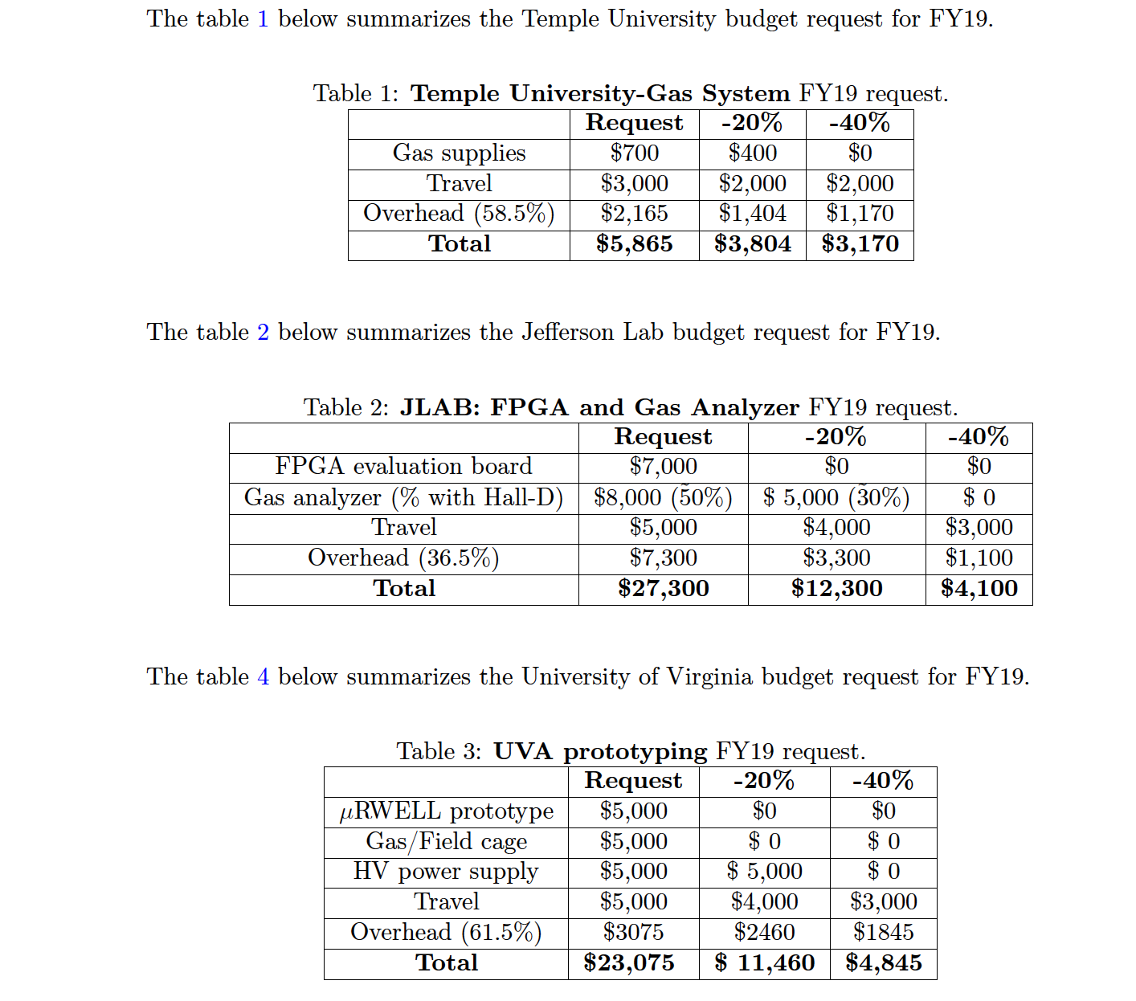
Notes:
Interior Page Design 2

Slide 9
BACKUP
Notes:
Interior Page Design 2

Slide 10
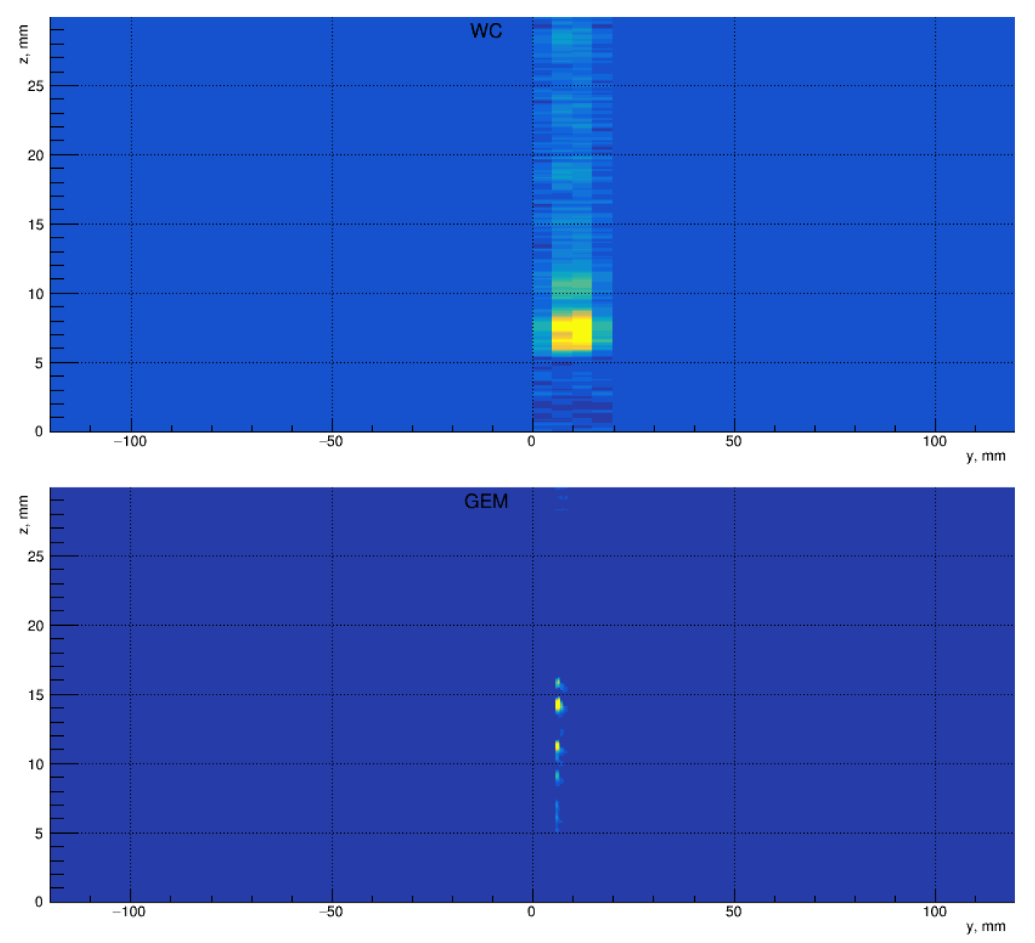
Electron, few GeV
Electron beam
few GeV
Multi-wire drift chamber
MW
3cm
GEM
2cm
GEM drift chamber
10
Notes:
Interior Page Design 2

Slide 11
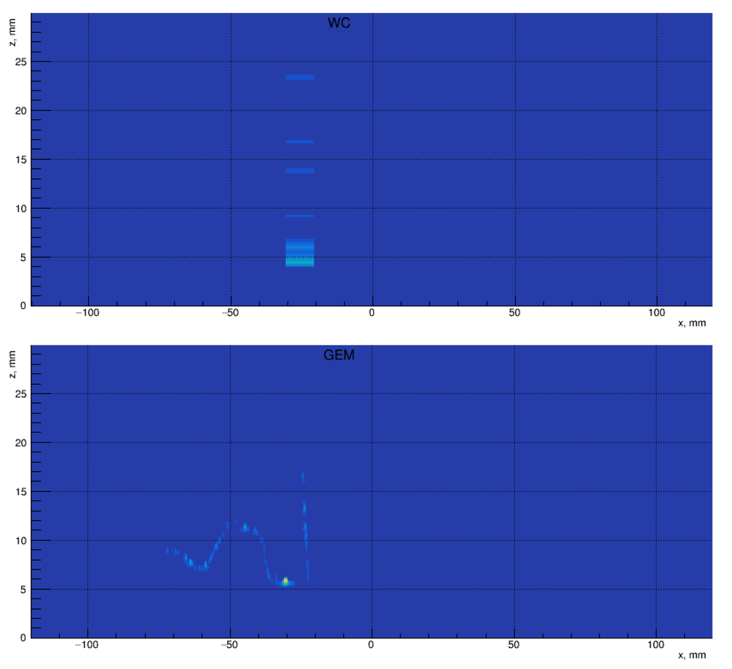
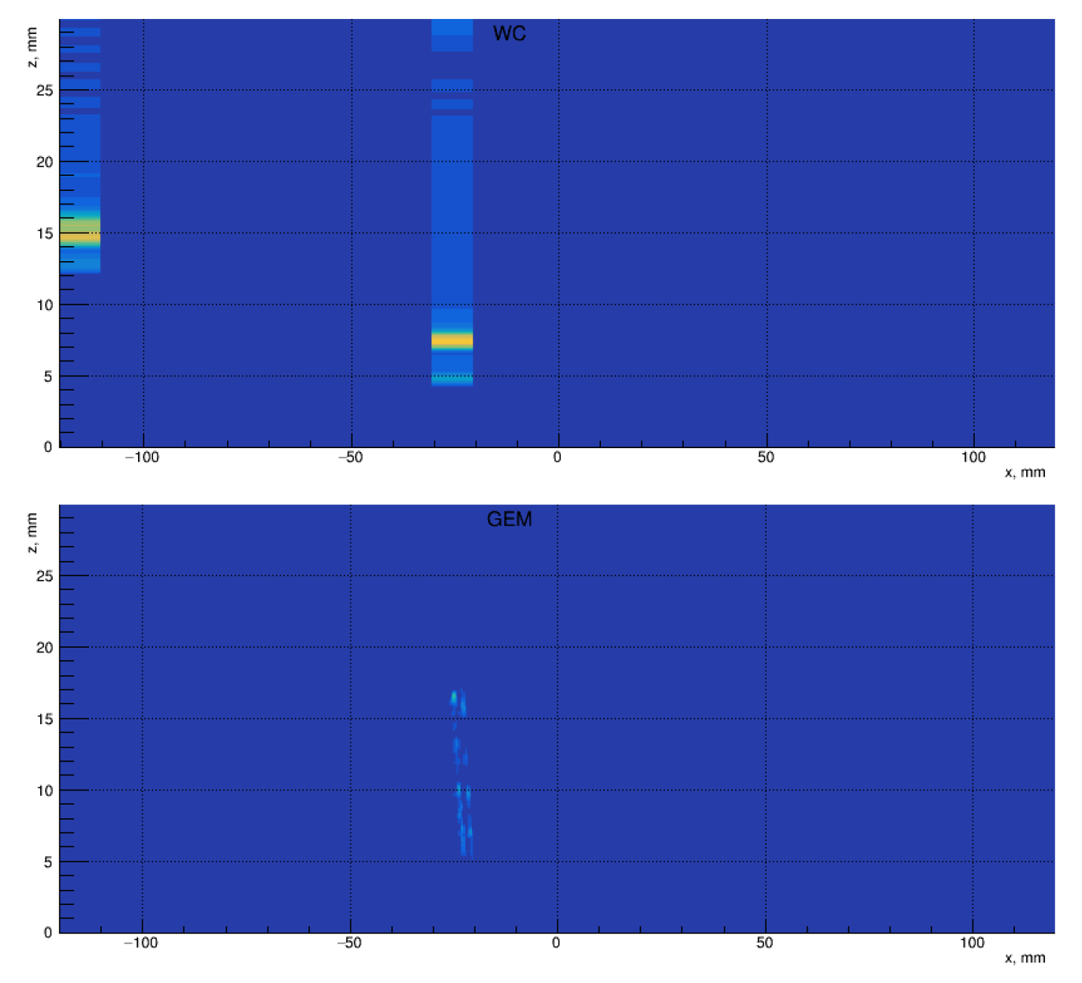
Multi-wire drift chamber
GEM drift chamber
Notes:
Interior Page Design 2

Slide 12
Notes:
Interior Page Design 2

Slide 13
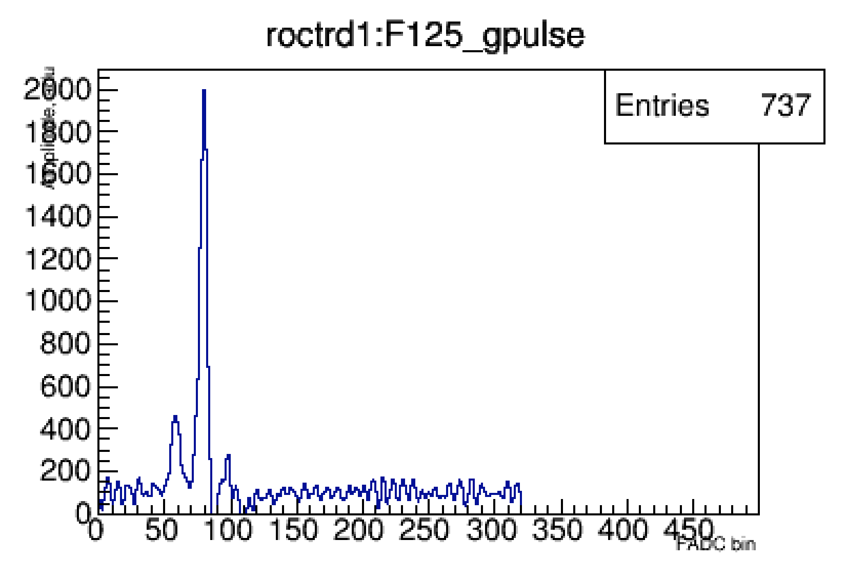
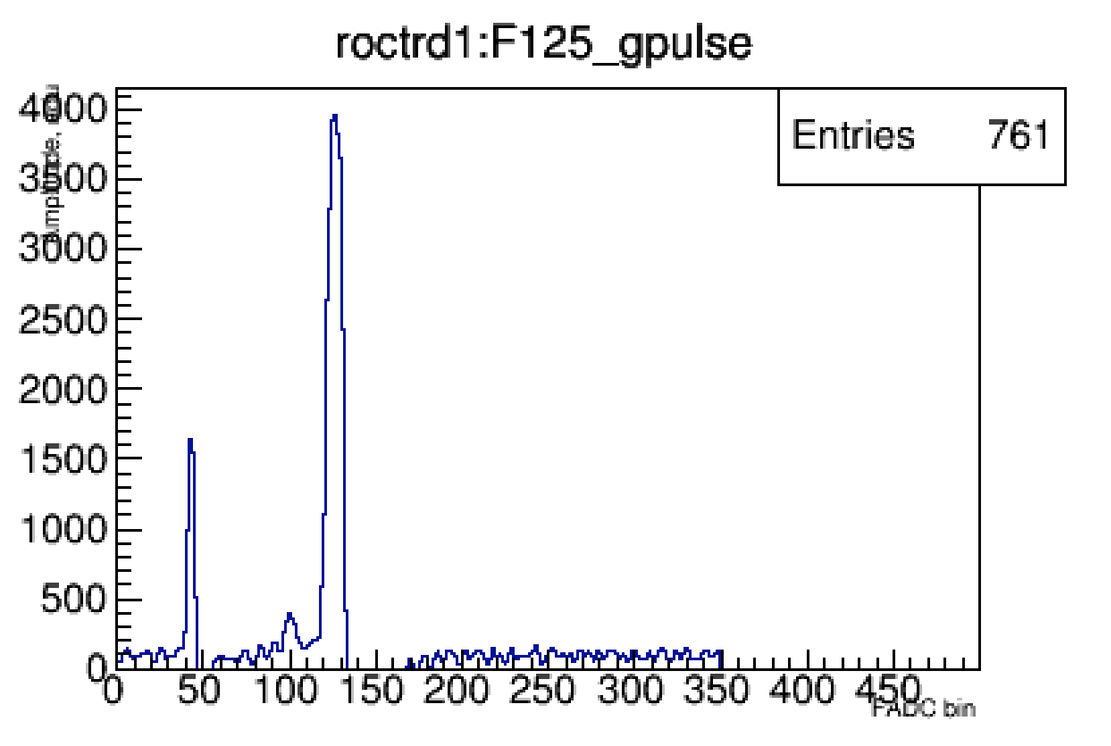
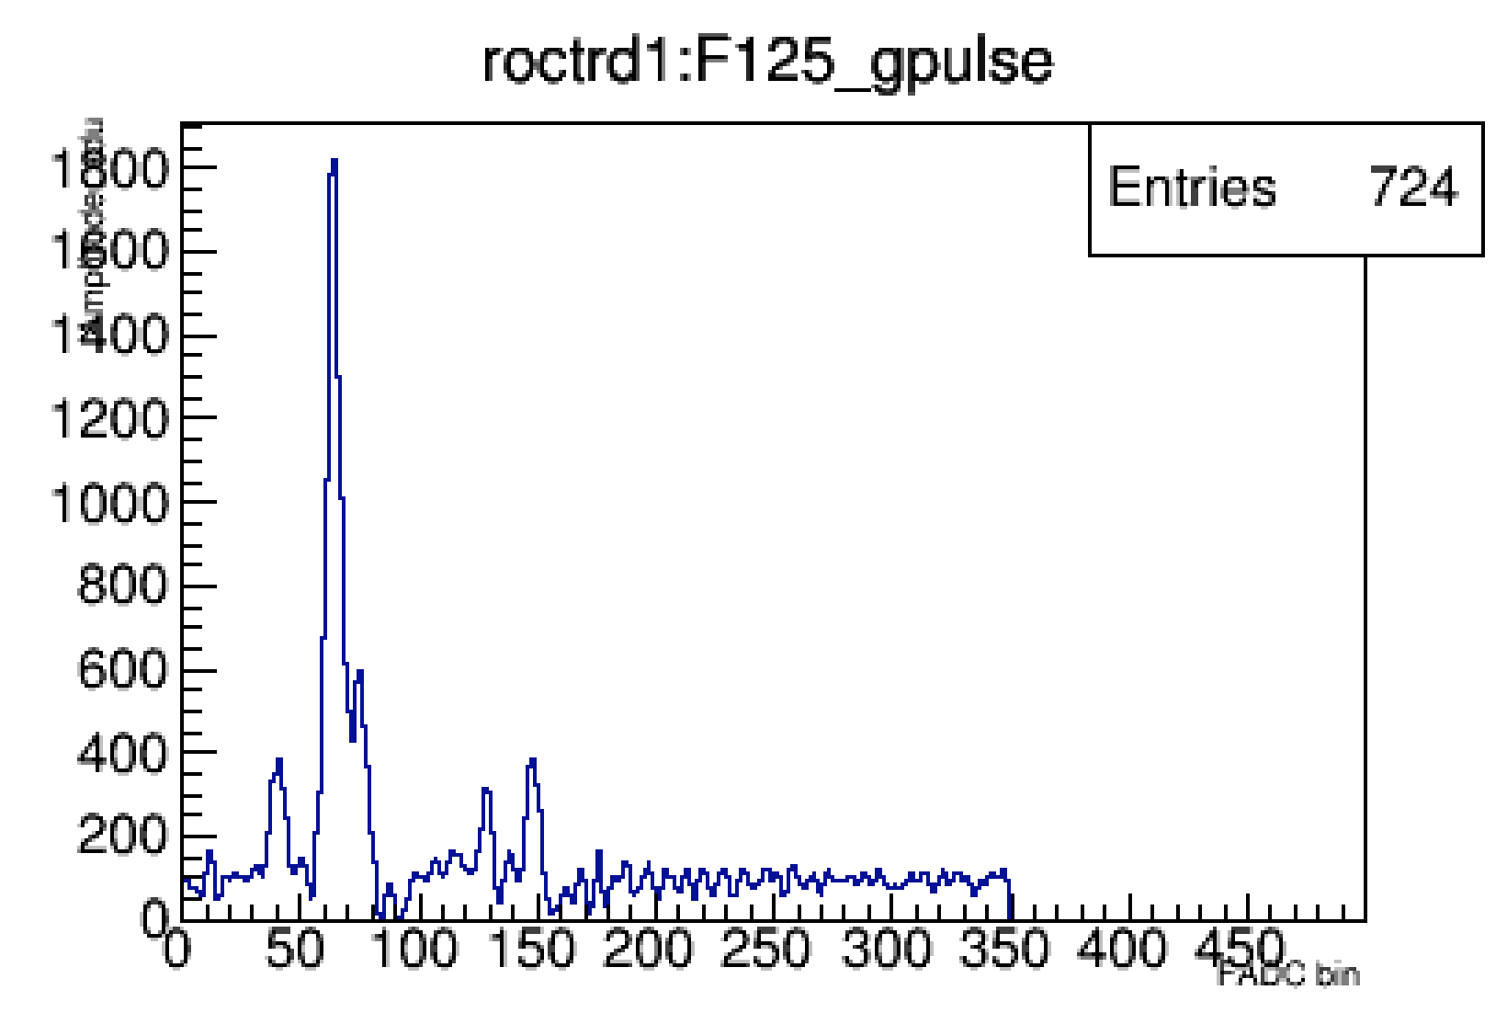
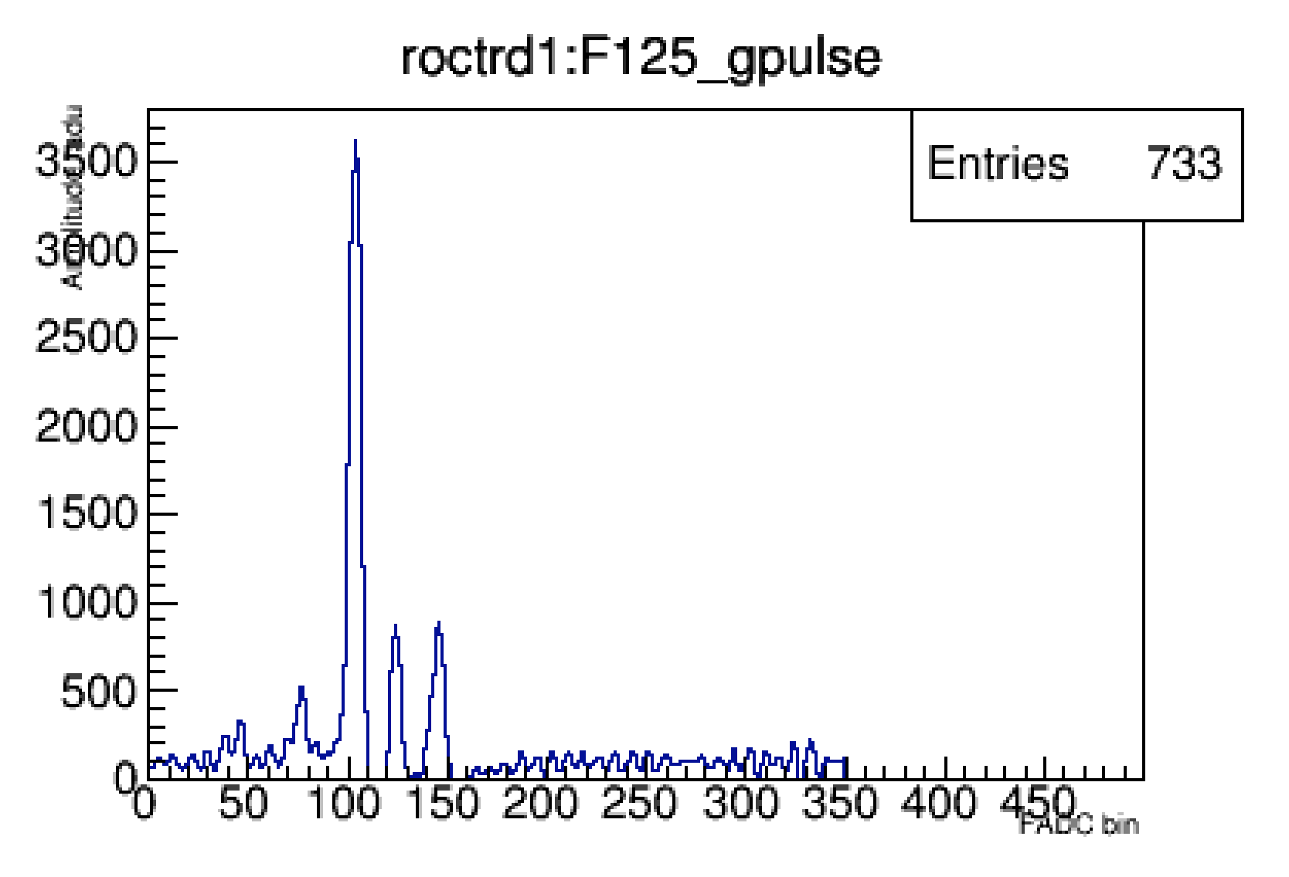
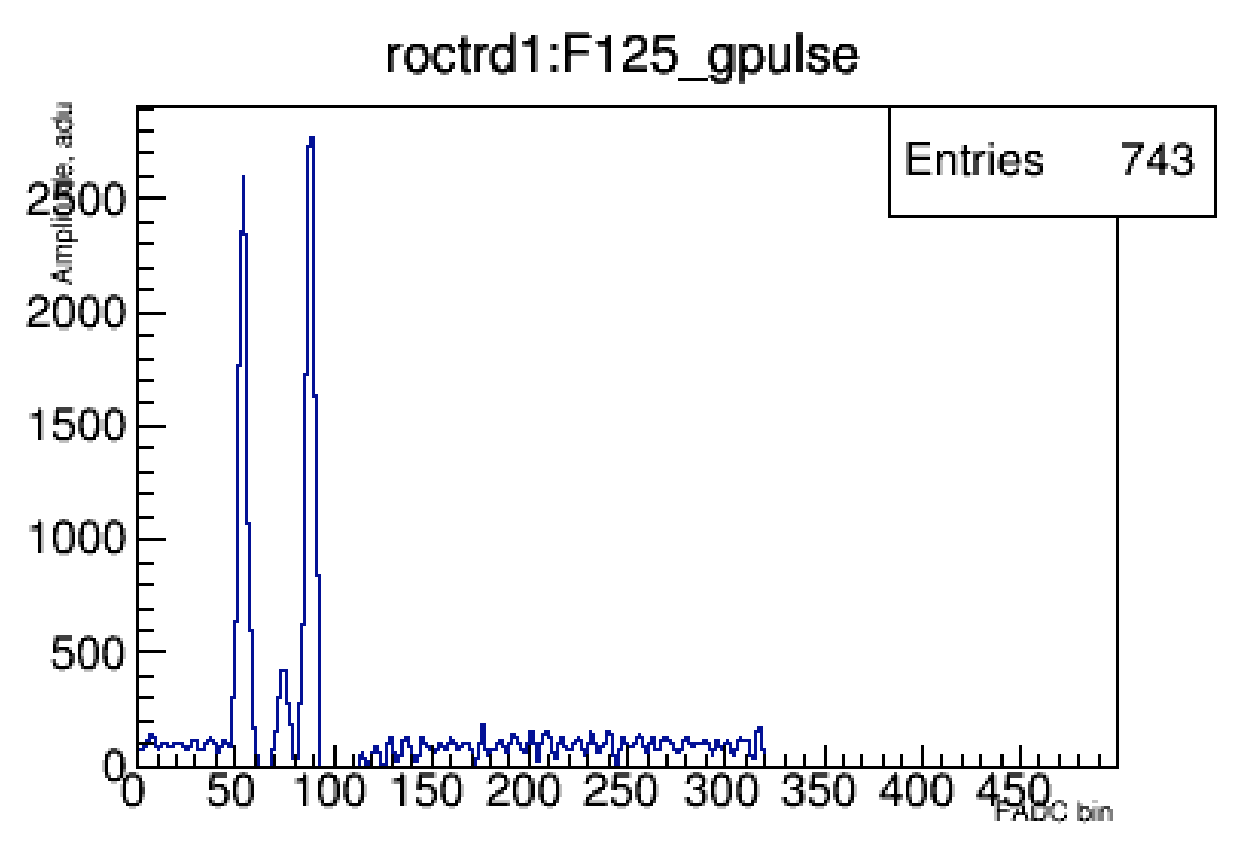
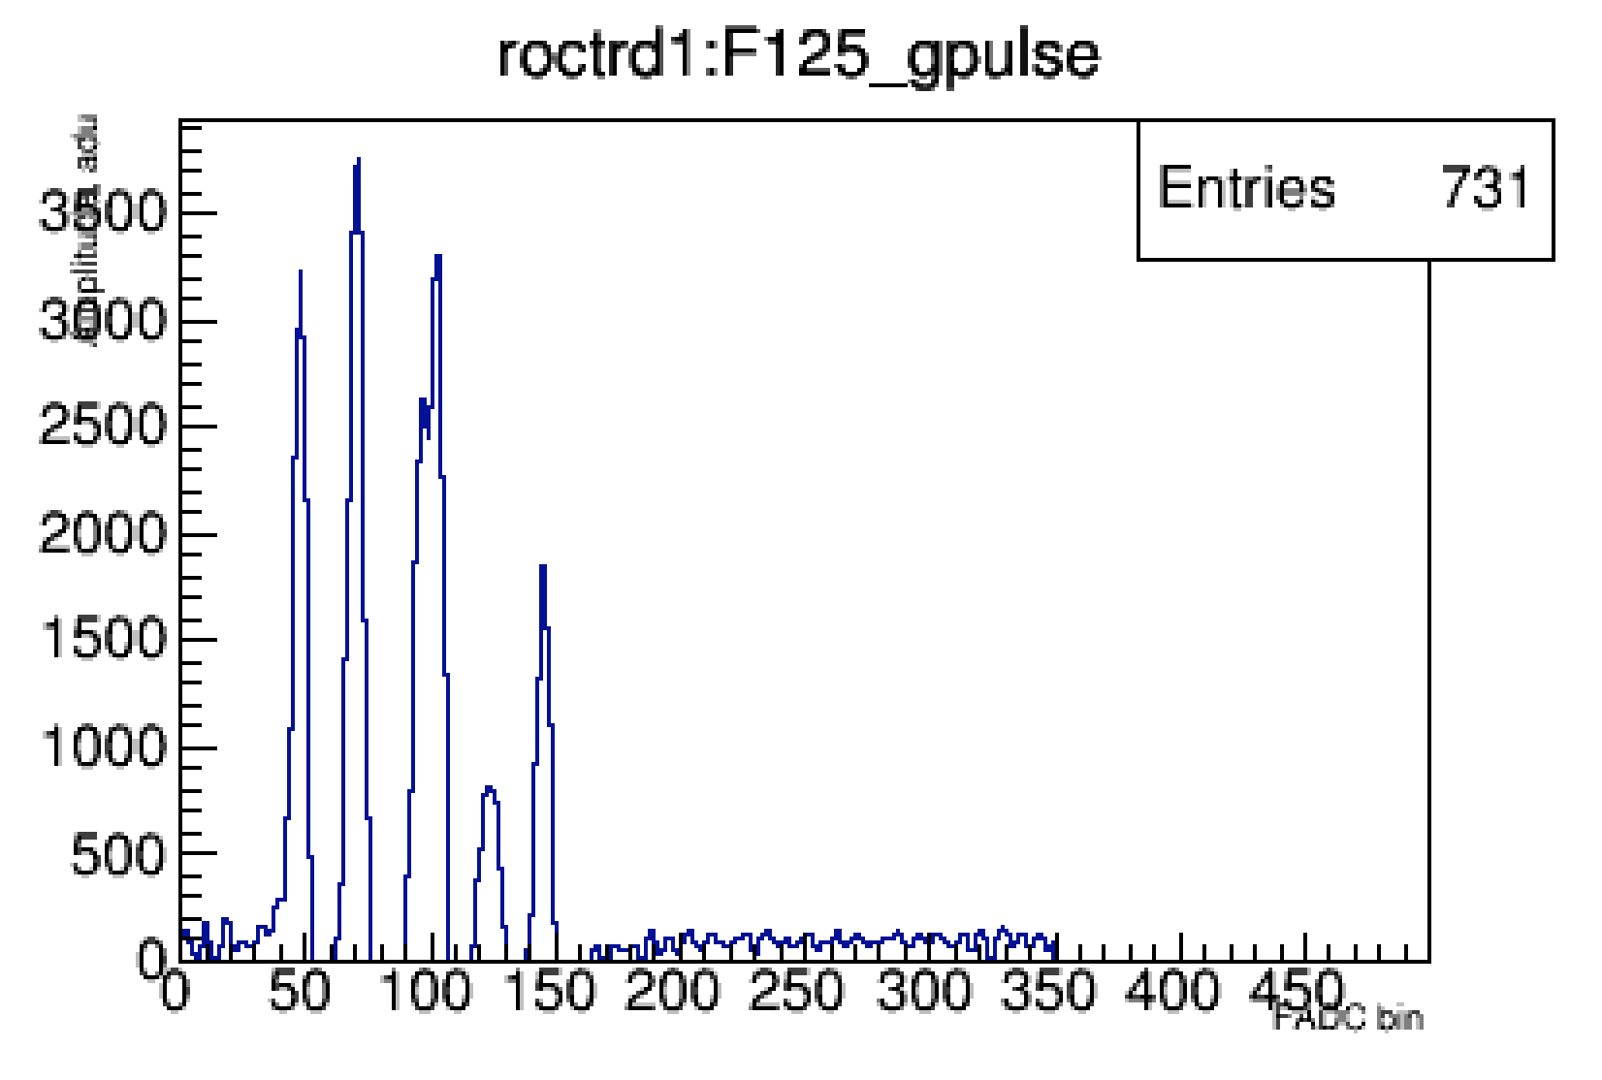
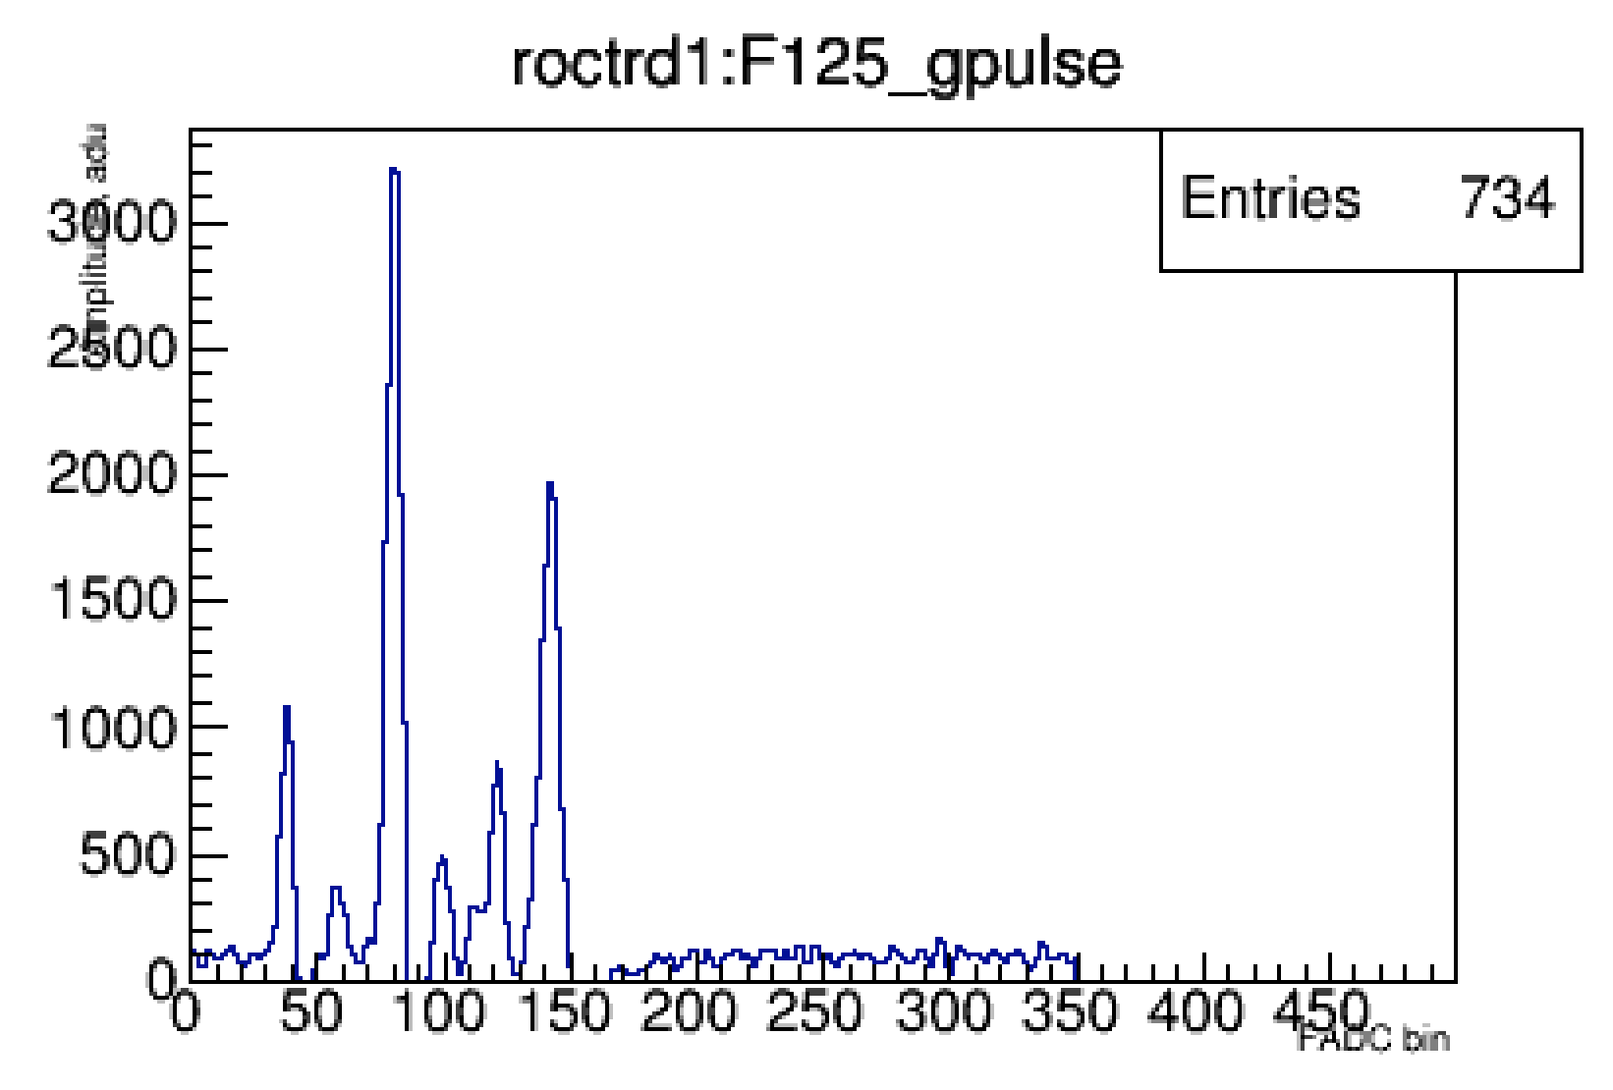
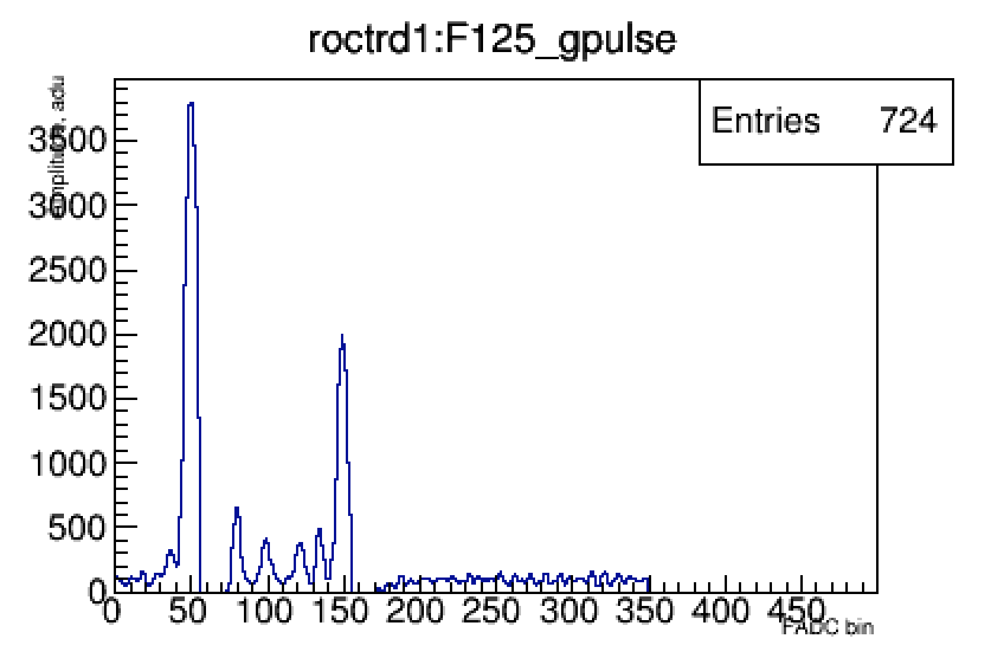
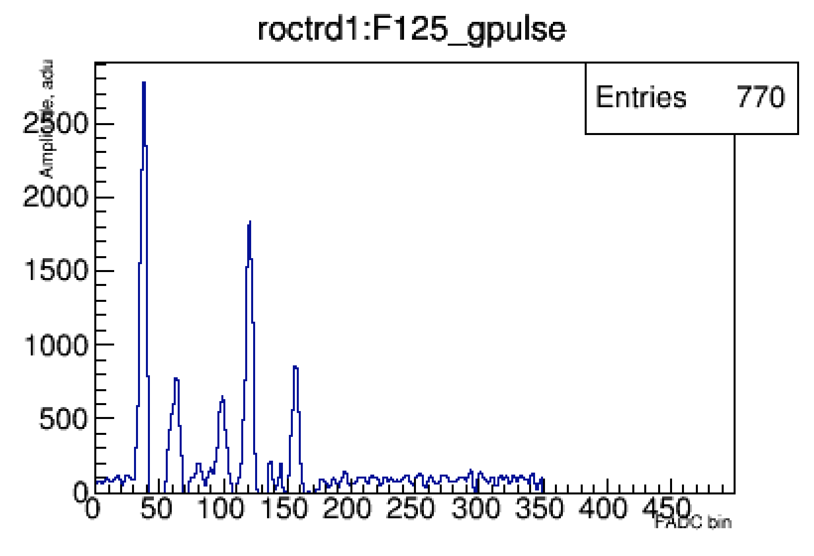
GEMTRD signals
13
13
Yulia Furletova
Yulia Furletova
Notes:
Interior Page Design 2

Slide 14
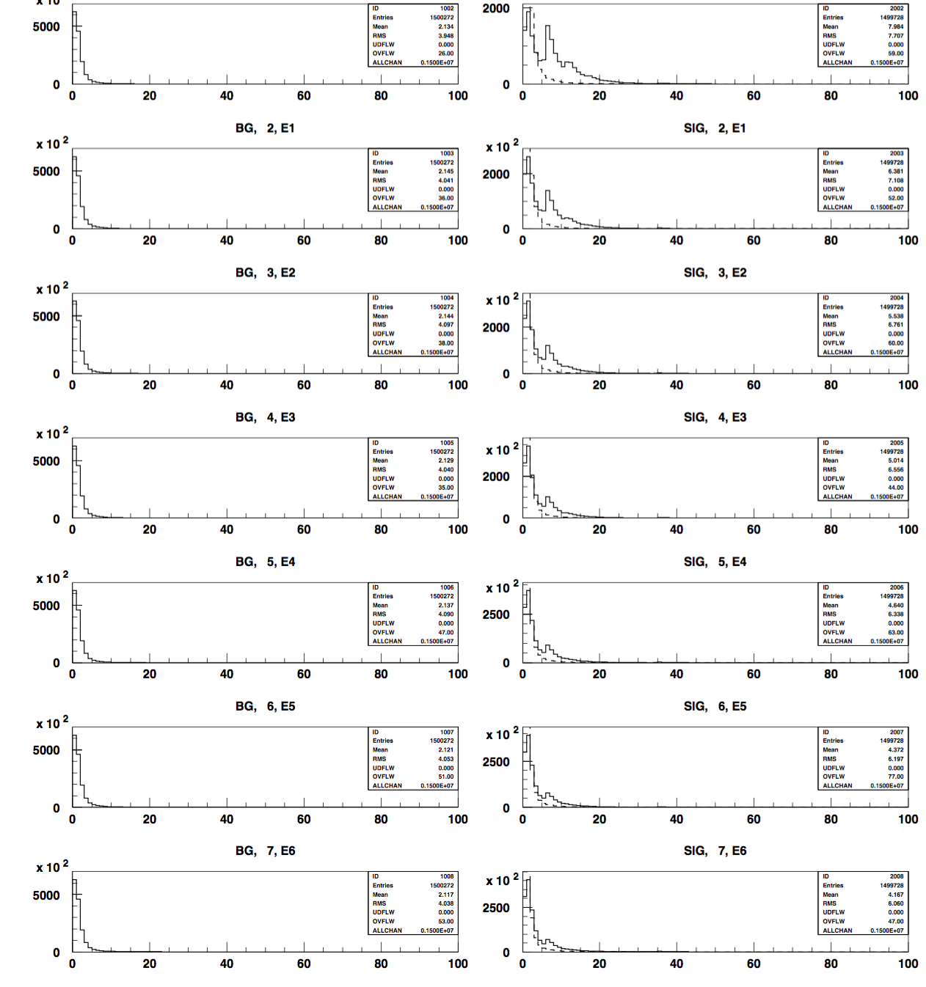




TR identification: Artificial Neural Network
Input variables:
Total or per slice or per cluster (we use ca 30var)
<dE/dx>
Number of clusters
Timing
Etc.
background
signal
electrons +TR
$$γTR$$
e
$$γTR$$
Drift time
electrons +TR
e
$$γTR$$
pions
$$π$$
14
14
Yulia Furletova
Yulia Furletova
Notes:
Interior Page Design 2

Slide 15
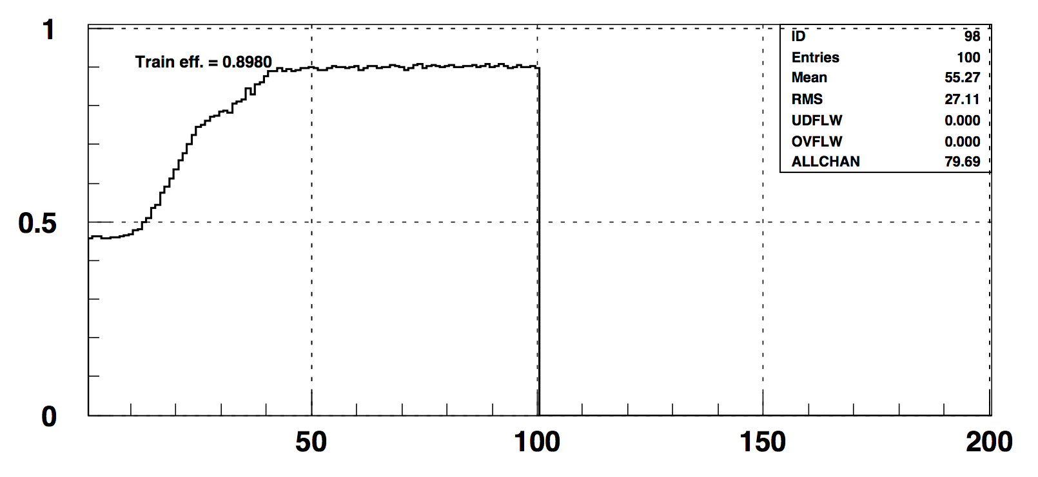
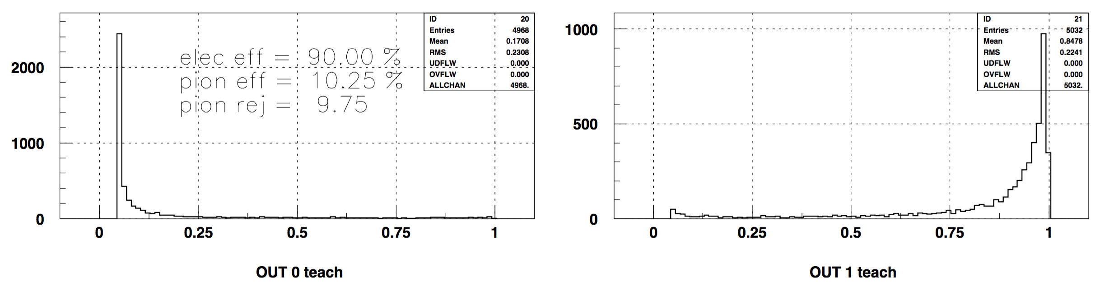
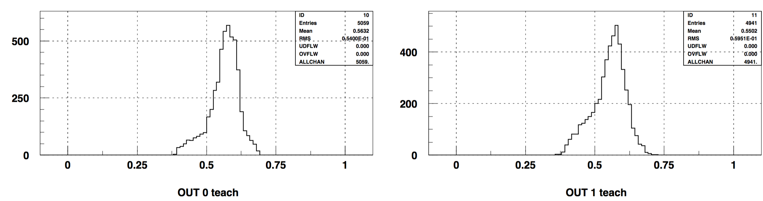
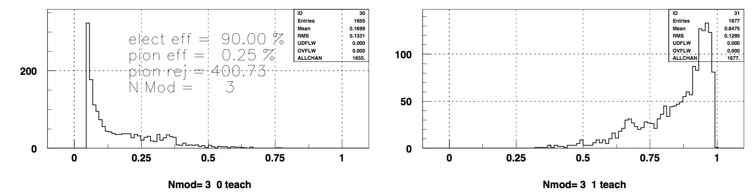
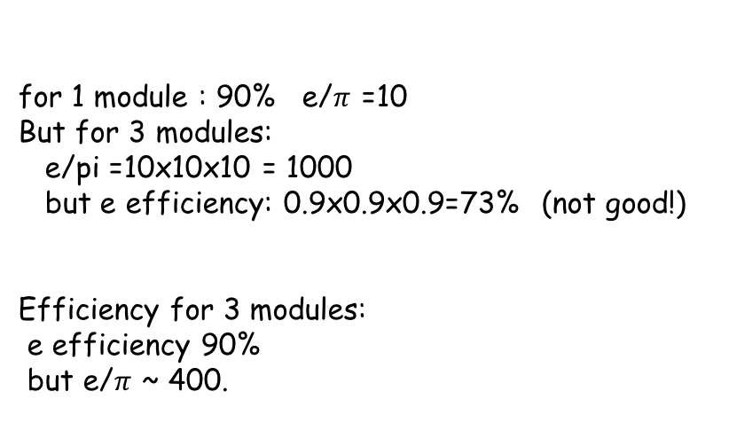
TR identification: Neural Network
Training efficiency
efficiency for 1 module
90% e eff
85% e eff
10% pi cont
5% pi cont
for 1 module : 90% e/$π$ =10
But for 3 modules:
e/pi =10x10x10 = 1000
but e efficiency: 0.9x0.9x0.9=73% (not good!)
Efficiency for 3 modules:
e efficiency 90%
but e/$π$ ~ 400.
efficiency for 3 (N) modules
Notes:
Interior Page Design 2

