Slide 1
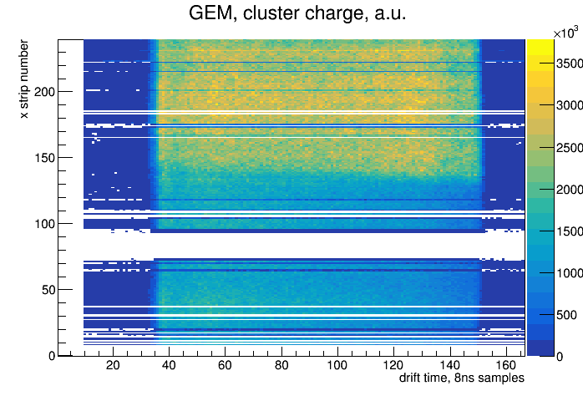
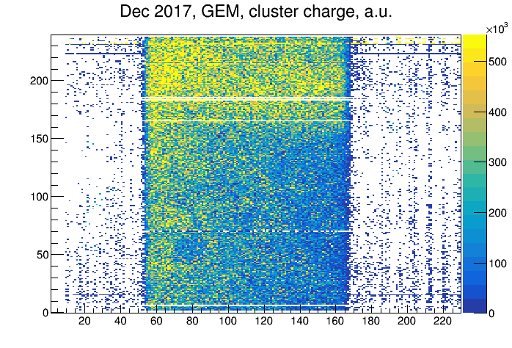
Latest results (Feb 2018) with the GEM TRD with Ar and Xe
GEM at ~10deg w.r.t. beam
Tripled the flow rate
Temperature in the gas room >23deg C for several days
Many bad channels/pre-amps (compare to Dec 2017):
Feb 2018 Dec 2017

Slide 2
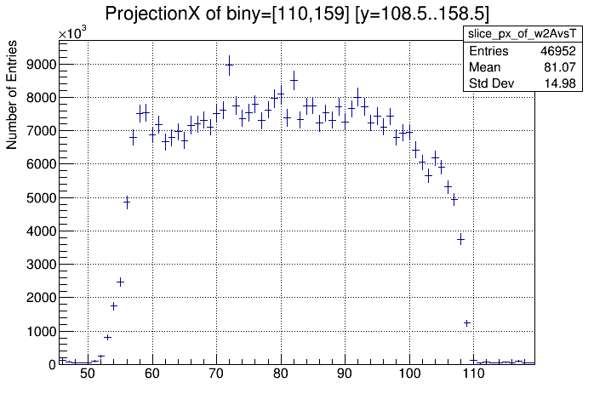
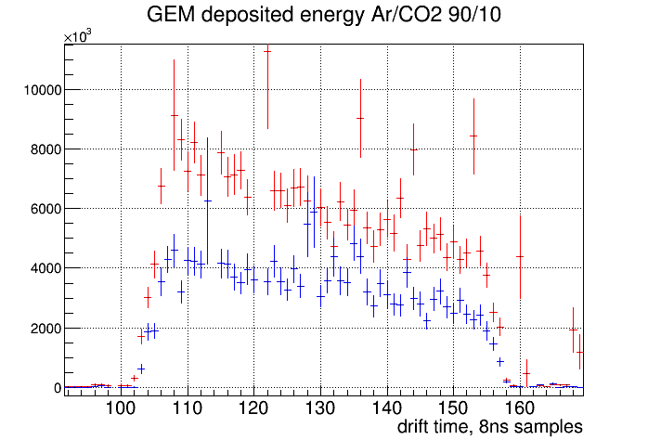
Latest results (Feb 2018) with the GEM TRD with Ar
Flatter distribution of charge vs drift time:
Feb 2018 Dec 2017

Slide 3
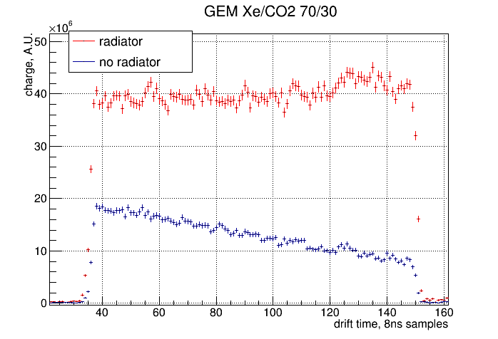
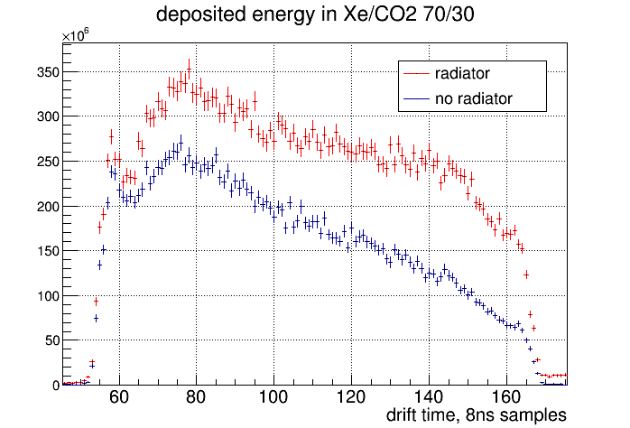
Latest results (Feb 2018) with the GEM TRD with Xe
Much better distribution of charge vs drift time
Feb 2018 Dec 2017

Slide 4
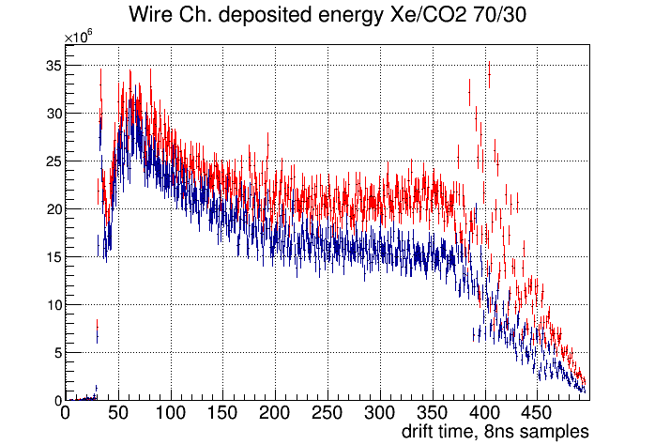
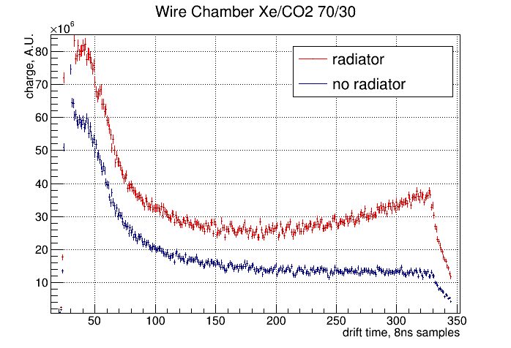
Latest results (Feb 2018) with the Wire Chamber TRD with Xe:
Feb 2018 Dec 2017

Slide 5
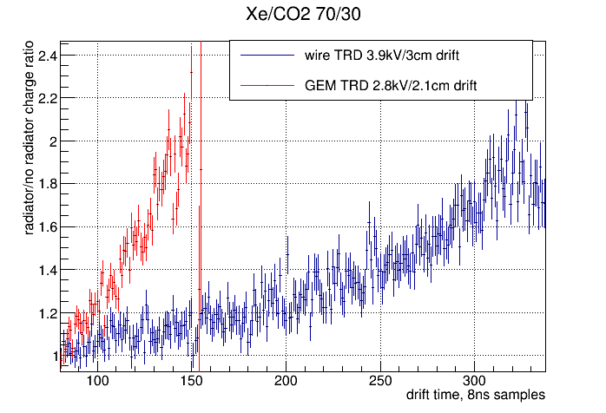
Latest results (Feb 2018) with Xe
Radiator/no radiator ratios for WC and GEM TRD:

