Slide 1
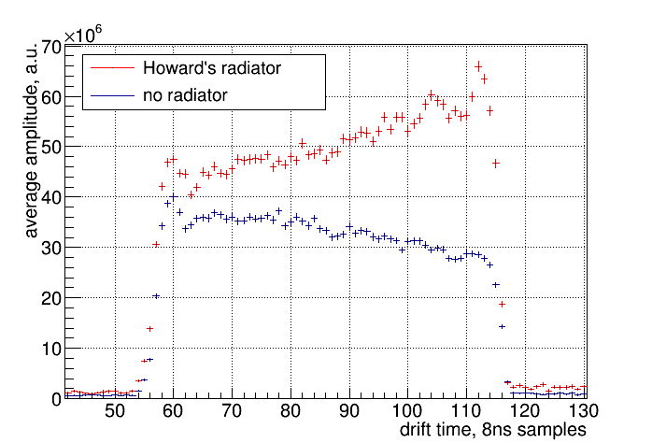
Latest results (Apr 2018) with Xe, 2kV/cm drift field
Howard’s radiator/no radiator comparison GEM TRD:

Slide 2
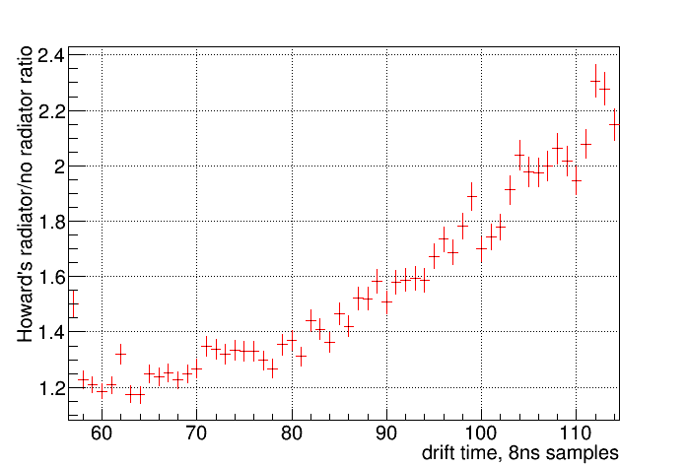
Latest results (Apr 2018) with Xe, 2kV/cm drift field
Howard’s radiator/no radiator comparison GEM TRD:

Slide 3
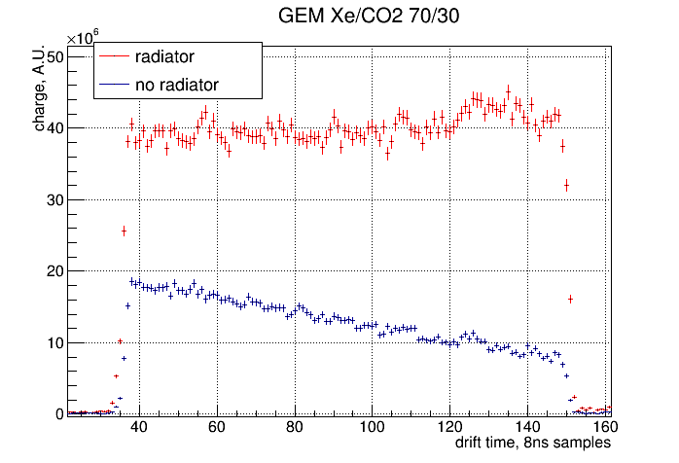
Latest results (Feb 2018) with Xe, 1.33kV/cm drift field
Radiator/no radiator ratios for WC and GEM TRD:

Slide 4
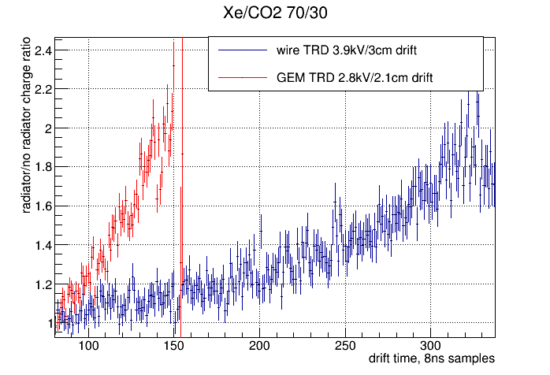
Latest results (Feb 2018) with Xe
Radiator/no radiator ratios for WC and GEM TRD:

Slide 5
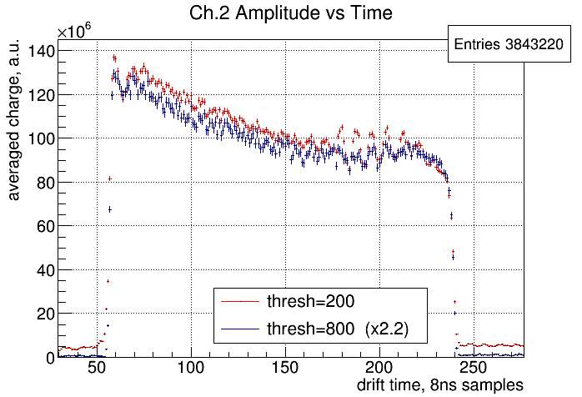
Latest results (Apr 2018) with Xe
Effect of the threshold on averaged charge:

