Slide 1
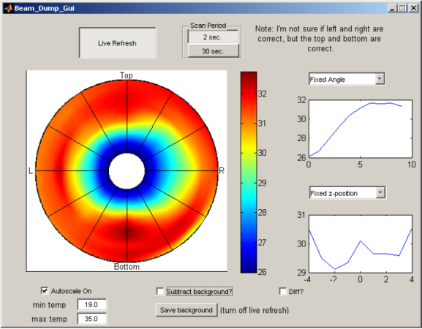
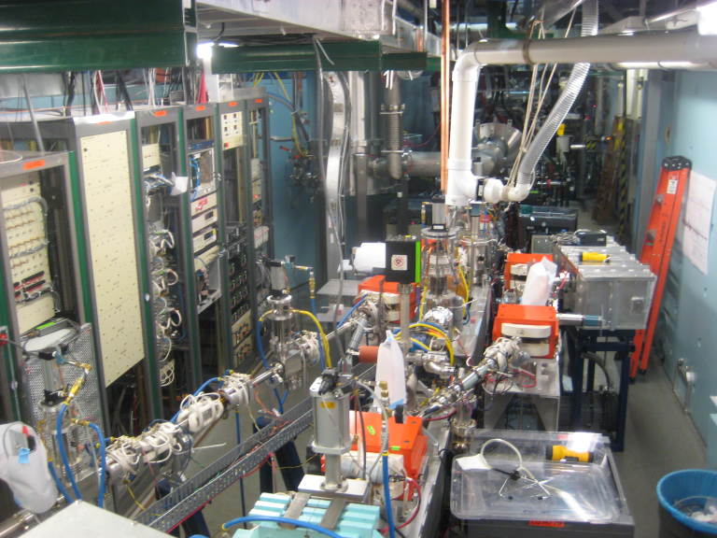
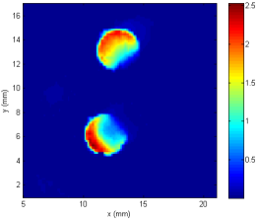
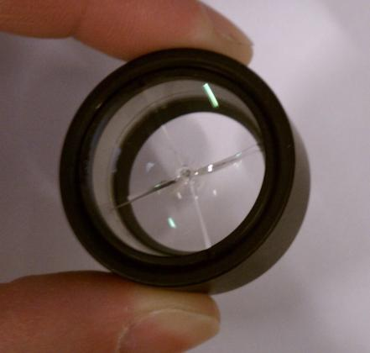
Cornell Laboratory for Accelerator-based ScienceS and Education (CLASSE)
Overview of Photoinjectors for Future Light Sources
Ivan Bazarov
Cornell University
Main dump T-map during 35 mA high current running
GaAs QE(%) map after 50 mA run
damaged optics after 10’s W of laser power
world‘s highest avg brightness & current photoinjector at Cornell

Slide 2
Today’s talk
Needs for linac-based light sources
Different approaches, same goals
Recent progress (incomplete survey)
Moving beyond the state-of-the-art

Slide 3
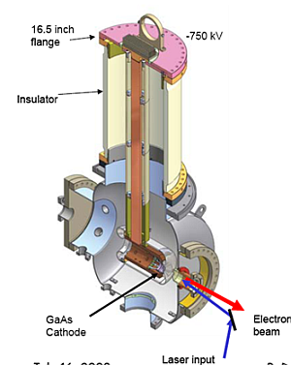
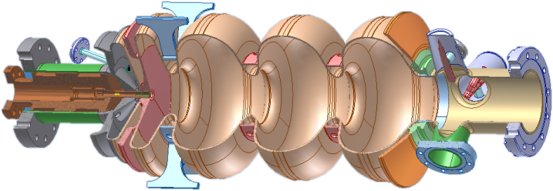
DC, RF, SRF guns
NCRF
SRF
plus variants…
Pulsed machines (FELs): NCRF a success story
  can always improve emittance → lower machine energy
CW operation: cathode fields reduced (DC ≤10 MV/m), NCRF (≤ 20 MV/m), best promise for SRF (≤ 30 MV/m)
  Main push is for increased avg current (ERLs), emittance desired several 0.1 um rms normalized range for ~100 pC
DC
½ cell
Tuner
RF / HOM ports
Cathode
stock
Choke filter
3 full cells
LANL RF gun
Cornell gun
ELBE SRF gun

Slide 4
Physics of high brightness photoguns made simple
Given a laser, photocathode cathode, and accelerating gradient → max brightness is set
Each electron bunch assumes a “pan-cake” shape near the photocathode for short (~10ps) laser pulses, max charge density determined by the electric field
dq/dA = ε₀ E_{cath}
Angular spread or transverse momentum footprint is set by intrinsic momentum spread of photoelectrons leaving the photocathode (MTE = mean transverse energy), Δp⊥ ~ (m×MTE)^{1/2}
Combining these two yields the maximum (normalized) beam brightness achievable from a photoinjector – defined by only two key parameters: cathode field E_{cath} and MTE of photoelectrons
v
B_{n}
ε₀mc²
E_{cath}
achievable brightness:
=
f
_{max}
2π
MTE

Slide 5
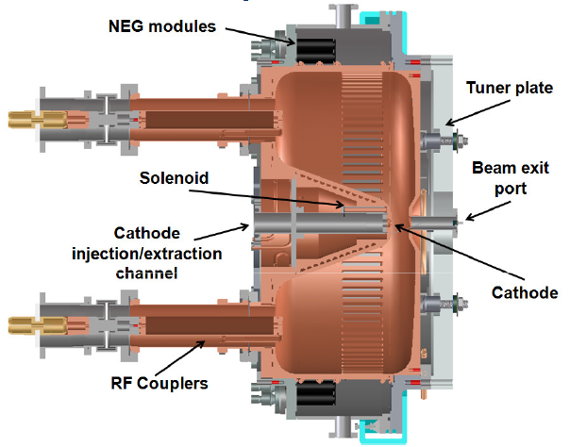
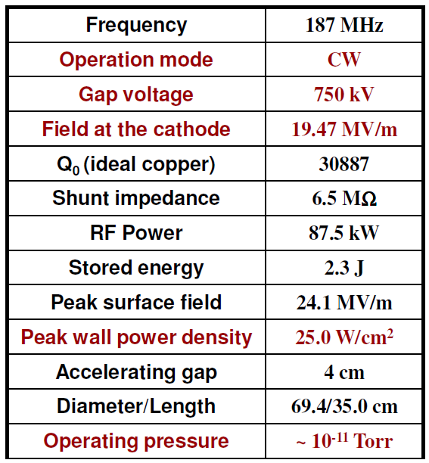
RF guns
No ceramic to worry about, no cryoplant
BUT huge losses for CW operation, questionable vacuum
  BOEING RF gun & renewed LANL effort: it can be made to work!
VHF gun (LBNL): reduce operating frequency, increase cooling area, introduce plenty of pumping slots
  nice solution when << GHz rep rate is acceptable
VHF LBNL gun

Slide 6
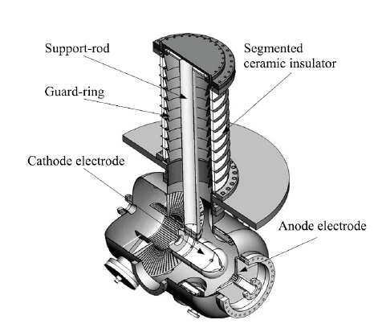
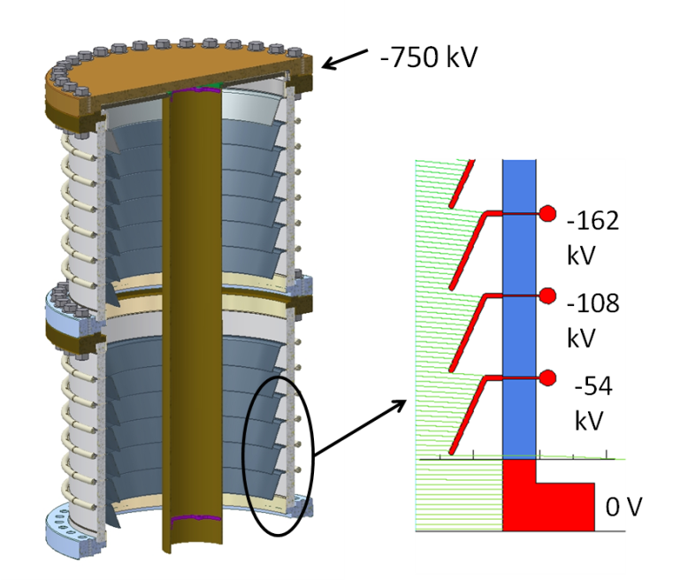
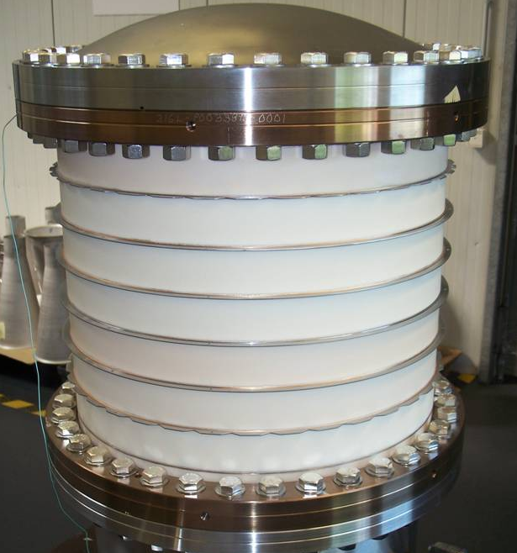
DC guns
Highest average current (50mA) operation today of the 3 choices
Very high voltages (≥ 500kV) are still difficult, despite DC guns being around for a while
New generation of guns to resolve ceramic puncture problems
JAEA/KEK gun with shielded ceramic
Cornell ceramic design & photo

Slide 7
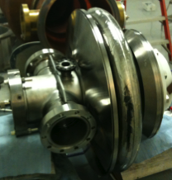
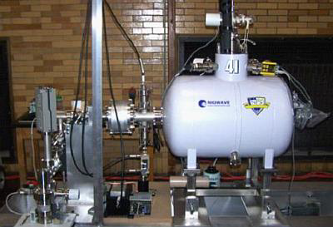
SRF guns
A lot of R&D in the community
  Great promise, lots of issues
Elliptical cavities and quarter wave resonator (QWR) structures
  Elliptical cavities ≥ 700 MHz
  QWR ≤ 500 MHz (operates as a quasi-DC gap, similar to VHF NC gun)
Best result so far: ELBE ~18MV/m pk with 1% Ce₂Te for > 1000h
700MHz BNL/AES/JLAB
NPS & Niowave QWR gun

Slide 8
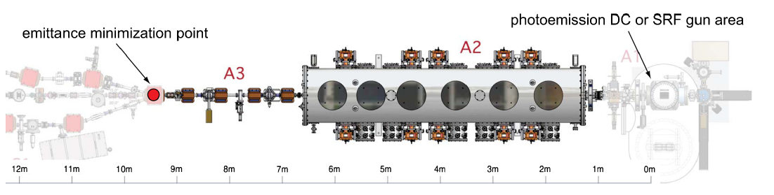
Example of one detailed comparison: DC vs SRF
GOAL: using multiobjective genetic algorithms compare two technologies
Use Cornell injector beamline as a basis
Realistically constrained DC gun voltages, SRF gun fields
Vary gun geometries, laser, beam optics
IVB et al., PRST-AB 14 (2011) 072001

Slide 9
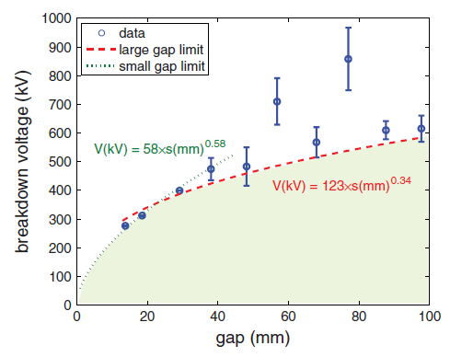
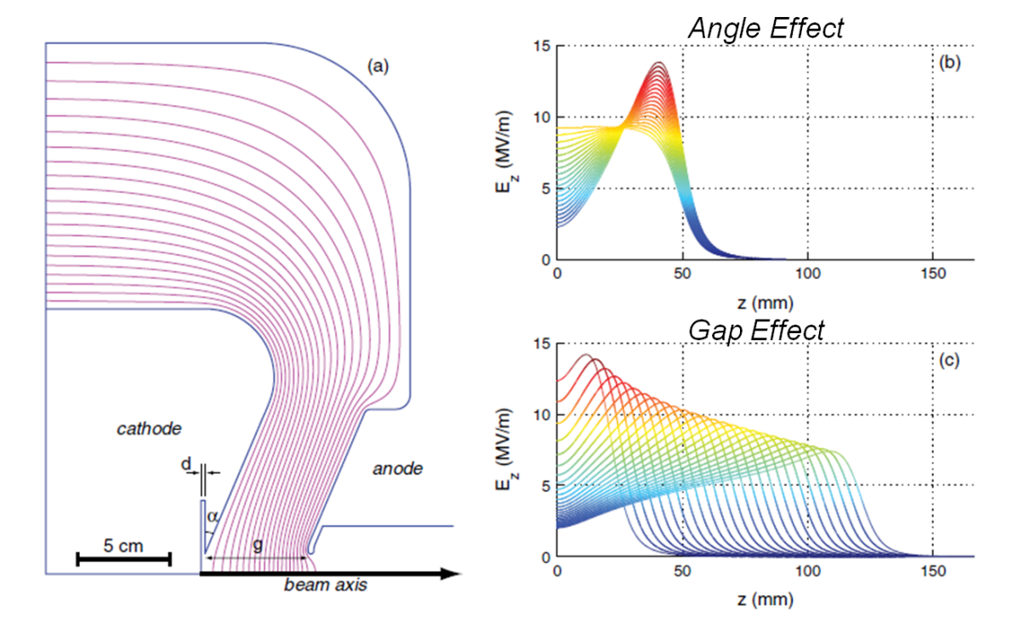
DC gun geometry & field constraints
Use empirical data for voltage breakdown
Vary gun geometry while constraining the voltage
breakdown voltage vs gap
3 geometry parameters: gap, cathode angle & recess
keep surface fields ≤ 10 MV/m

Slide 10
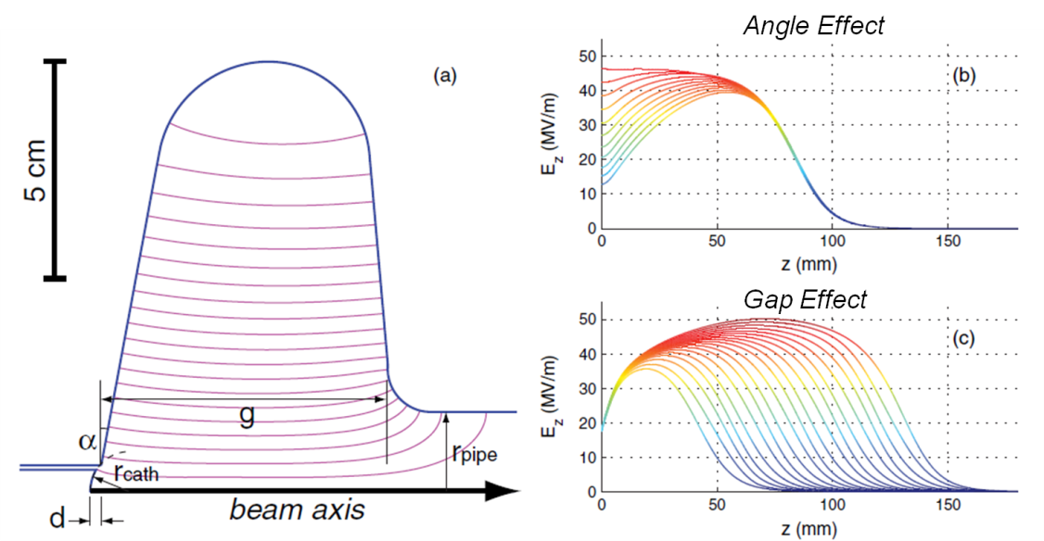
SRF gun geometry & field constraints
Equator radius used for frequency tuning
1.3 GHz 0.5-cell elliptical cavity
Constrained surface fields according to TESLA spec
  E_{acc} ≤ 25 MV/m
  E_{pk}/E_{acc} ≤ 2
  H_{pk}/E_{acc} ≤ 4.26 mT/(MV/m)
Vary beam current 0-200 mA
Final bunch length ≤ 3 ps rms
4 parameters: gap, cathode angle & recess, pipe dia
Most solutions E_{pk} ≤ 50 MV/m

Slide 11
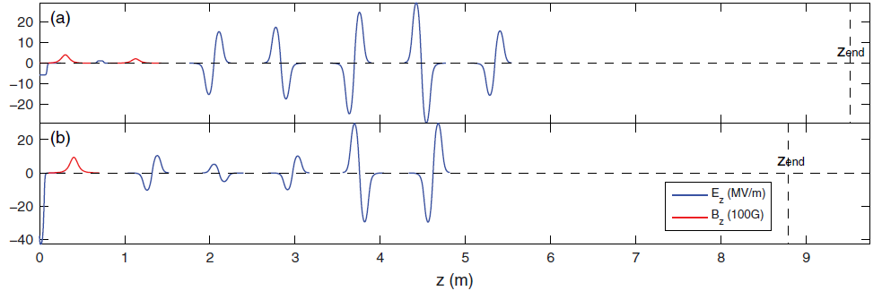
Beamline parameters
DC Gun
SRF Gun
SRF Linac
Solenoids
Buncher
The SRF beamline is simplified:
  NC buncher cavity is ineffective at high beam energy
  Only one solenoid included

Slide 12
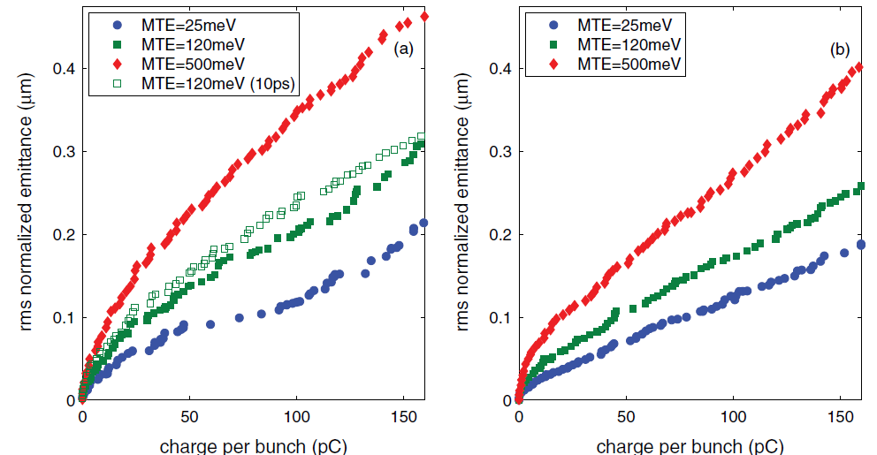
Emittance Performance
DC Gun
SRF Gun

Slide 13
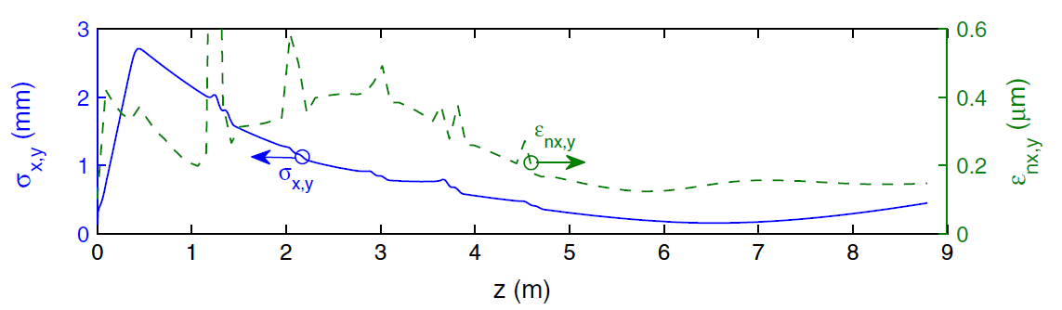
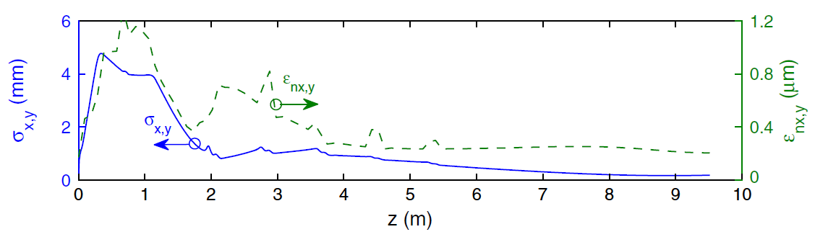
A closer look at 80pC case
SRF Gun
X2-3 larger peak emittance!
but final is very close
DC Gun

Slide 14
Comparison results recap
The two technologies did not show much difference in the final 100% rms emittance in these simulations despite > x3 larger field at the cathode for SRF case (the beam core must be brighter for SRF)
DC gun case requires more cancellations to get to small emittances at the end – how well can it be done in real life?
Space charge energy chirp after the gun:
  leaves a nasty chromatic aberration through the solenoids!
  Far more prominent in DC case. Must anti-chirp with buncher!
Perhaps cathodes (MTE) are more important than the field (beyond a certain point)!
Recent alignment & emittance run @ Cornel ERL injector:
  Measured: 1.3-1.4 x model (so far)

Slide 15
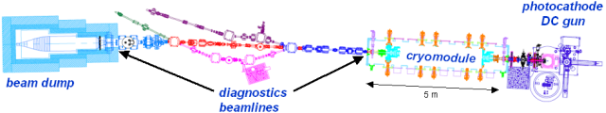
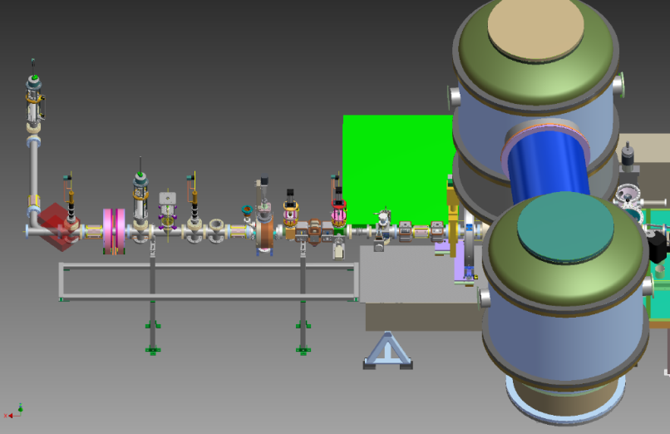
Photoemission source development @ Cornell
Two accelerator facilities @Cornell to push photoinjector state-of-the-art: NSF supported 100mA 5-15 MeV photoinjector;
New 500kV photoemission gun & diagnostics beamline (under construction): shoot to have HV by this summer
~3m

Slide 16
Cornell ERL photoinjector highlights
Over the last year:
  Maximum average current of 52 mA from a photoinjector demonstrated
  Demonstrated feasibility of high current operation (~ kiloCoulomb extracted with no noticeable QE at the laser spot)
  Original emittance spec achieved: now getting x1.8 the thermal emittance values, close to simulations (Sept 2011)

Slide 17
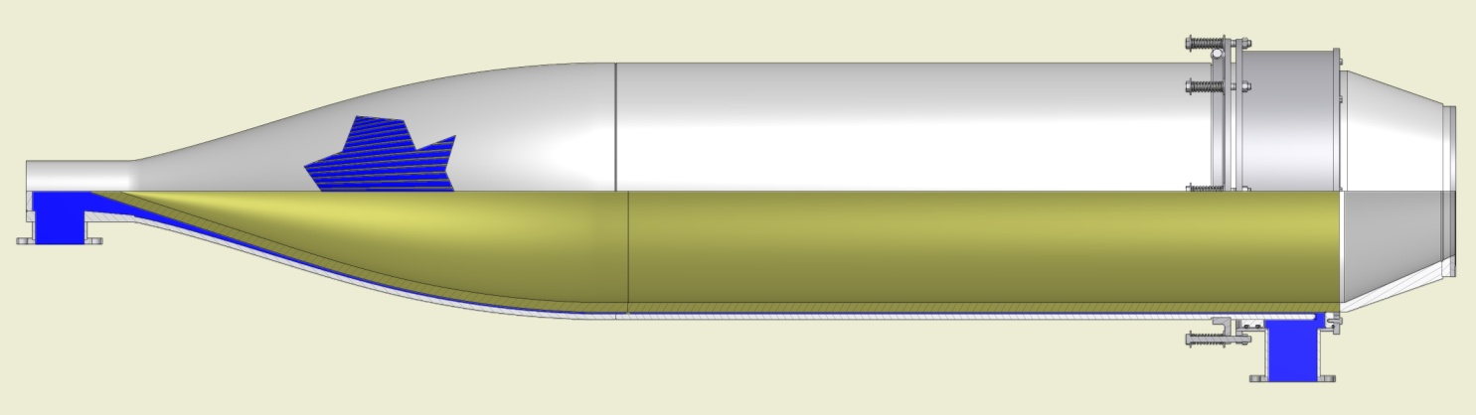
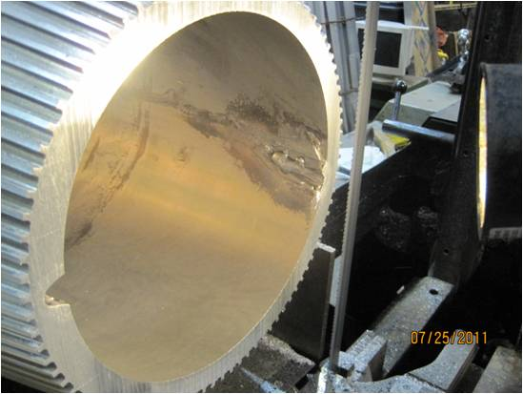
*it happens…
spring’11: opened leak in the beam dump at 25mA
Designed for 600 kW average power
Now 80 thermocouples monitor the repaired dump temperature over its entire surface
‘Dramatic accelerator physics’ – drilled a hole in the dump (1” Al) with electron beam!
Raster/quad system wired/set incorrectly

Slide 18
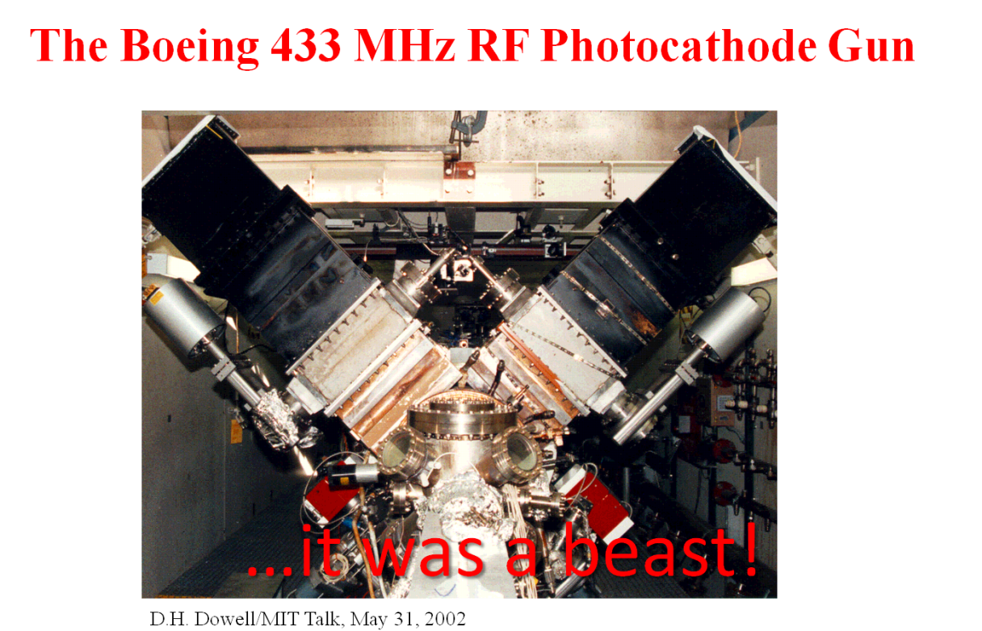
BOEING gun tribute
New current record is 52 mA (Feb 9, 2012) at Cornell using GaAs!!
  beats Dave Dowell’s 32 mA record of 20 years!
Cornell photoinjector: 52 mA (Feb 9, 2012)

Slide 19
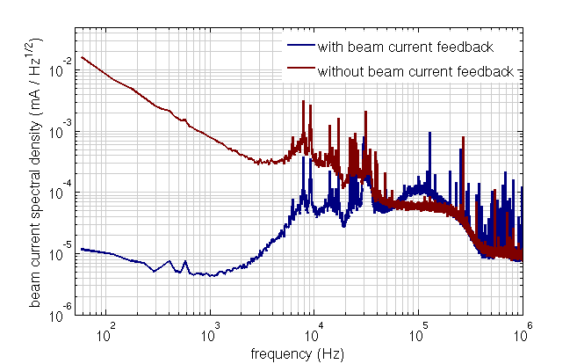
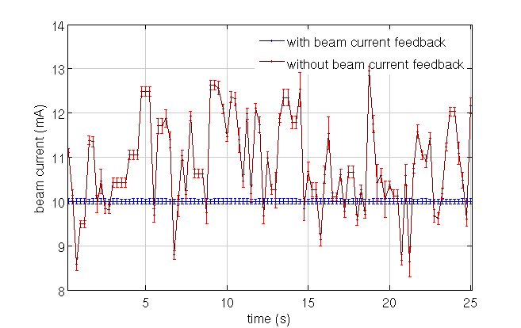
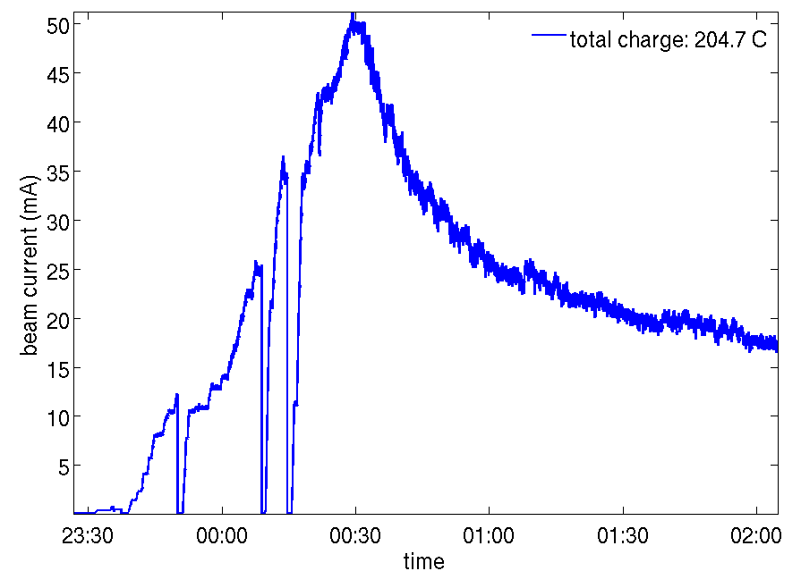
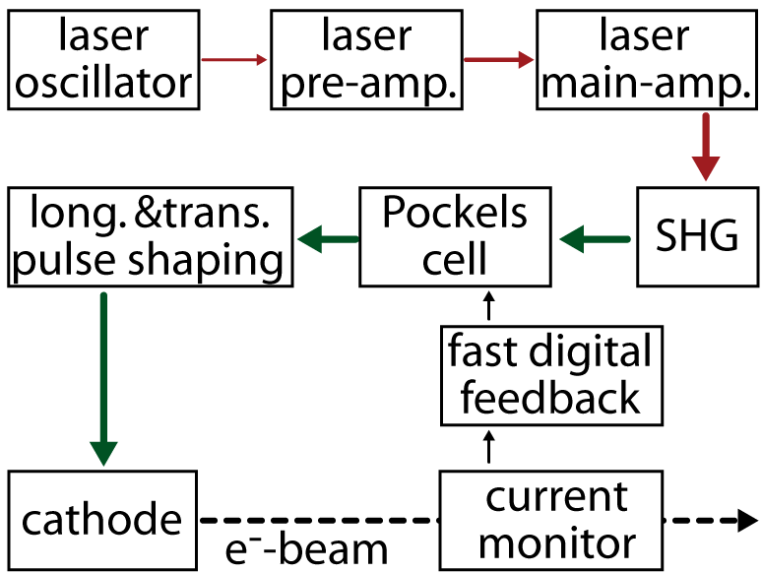
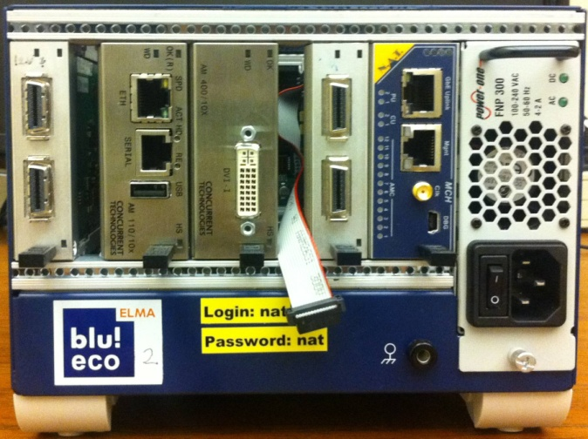
Pushing for high current
Key developments:
  Expertise in several different photocathodes (both NEA and antimonides)
  Improvements to the laser (higher power)
  Feedback system on the laser
  Minimization of RF trips (mainly couplers)
  Minimizing radiation losses
Feb 9, 2012
first 50mA!!
GaAs
Laser intensity feedback system (developed by F. Loehl)

Slide 20
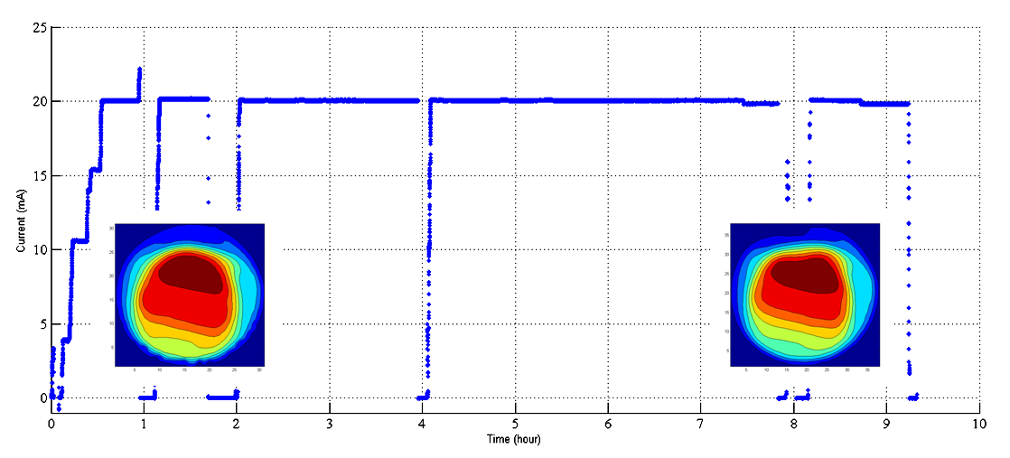
High current operation
(offset CsKSb gives excellent lifetime)
~600 Coulombs delivered (same spot)
active area
QE before
QE after
6AM: sleepy operator
L. Cultrera, et al., PRST-AB 14 (2011) 120101

Slide 21
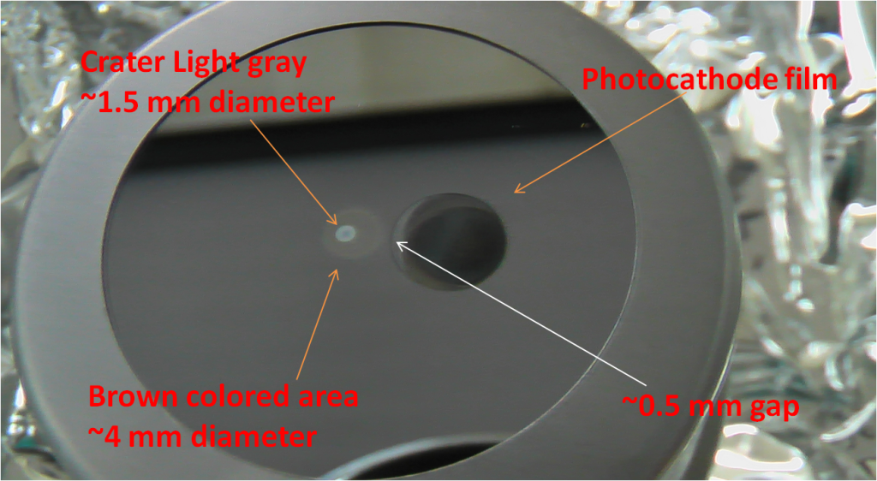
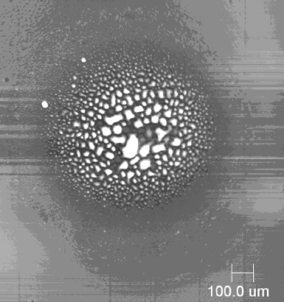
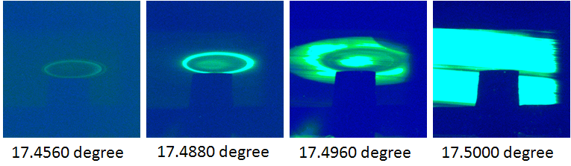
Real-life accelerator testing for photocathodes: high average current
Main message: moving off-axis gives many kiloCoulombs 1/e lifetime from K2CsSb or Cs3Sb (same spot)
Now understand that pits in EC are the result of machine trips
cathode after 20mA 8hour run
SEM close-up
X-ray topography showing rings of ion back-bombardment damage

Slide 22
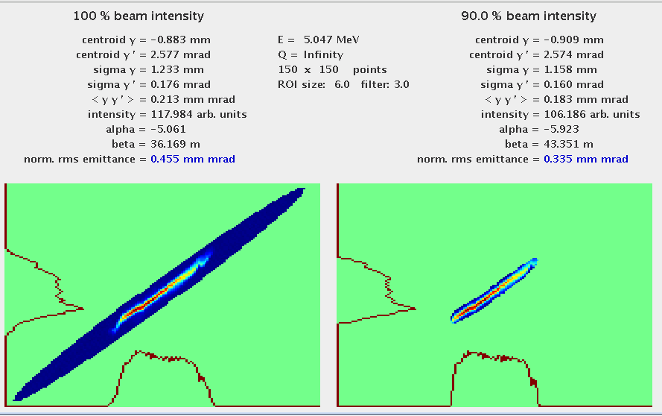
Laser off-center
Laser Off-center
Good news: running 5 mm off-center on the photocathode
gives the same emittance (20pC/bunch) due to
intrinsically low geometric aberrations in the DC gun
This is very important, as we know that we cannot run with the laser at the center of the cathode due to cathode damage issues.

Slide 23
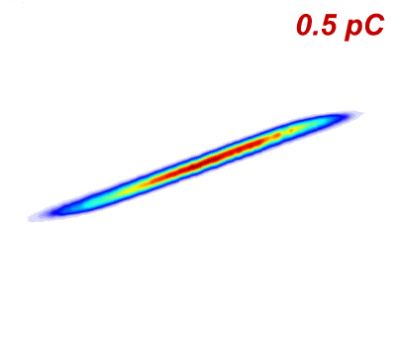
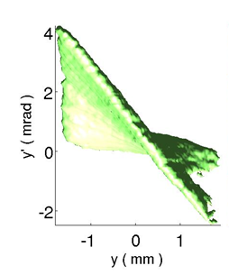
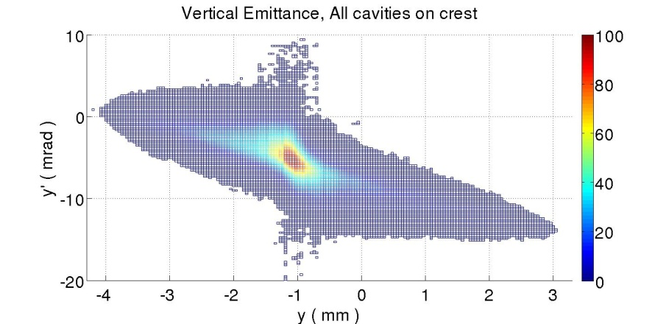
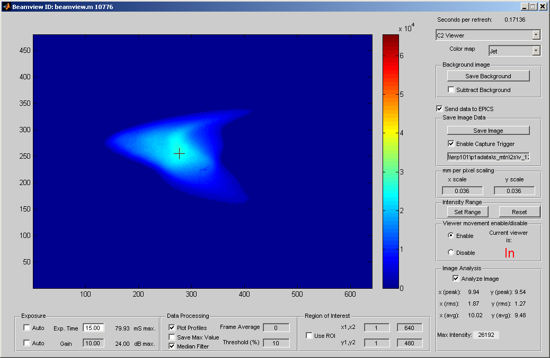
6D beam diagnostics: key to low emittance
transverse phase space (animation)
slice emittance with resolution of few 0.1ps
p_{y}
So far the smallest emittance 0.7 mm-mrad at 80 pC/bunch (rms, 100%)
p_{y}
y
t
projected emittance
y
t
E
longitudinal phase space

Slide 24
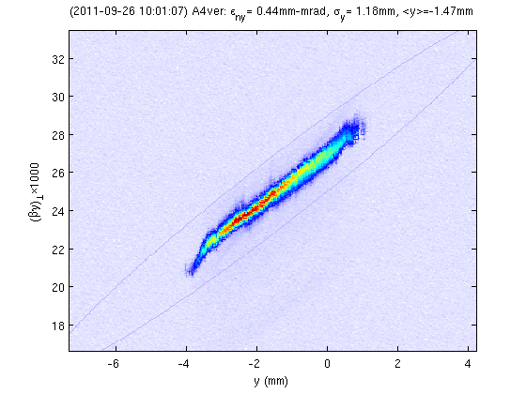
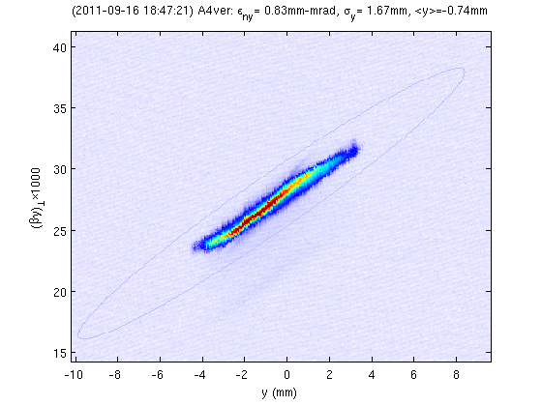
Sept 2011: initial emittance spec achieved!
Keys to the result
  Beam-based alignment (took us a couple of months)
  Working diagnostics
  Fight jitters in the injector
x1.8-2.0 thermal emittance! x1.4 simulated emittance
correct scaling with bunch charge
ε_{ny}(100%) = 0.4 um @ 20pC/bunch
ε_{ny}(100%) = 0.8 um @ 80pC/bunch

Slide 25
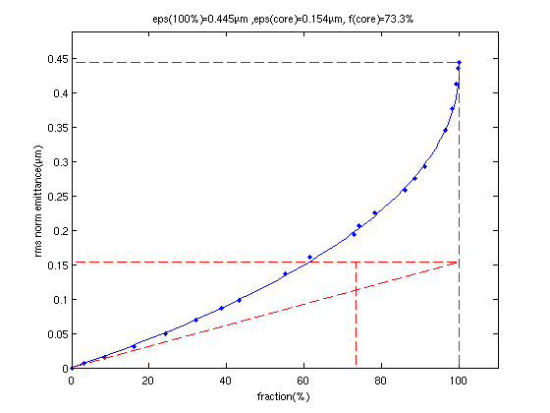
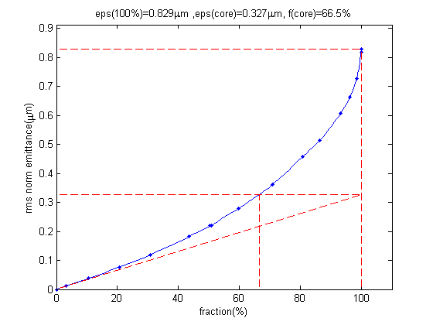
Some proselytizing: which emittance is right to quote
Single RMS emittance definition is inadequate for linacs
  Beams are not Gaussian
  Various groups report 95% emittance or 90% emittance (or don’t specify what exactly they report)
The right approach
  Measure the entire phase space, then obtain emittance of the beam vs. fraction (0 to 100%)
20pC/bunch ε_{core} = 0.15 um f_{core} = 73%
80pC/bunch ε_{core} = 0.3 um f_{core} = 67%

Slide 26
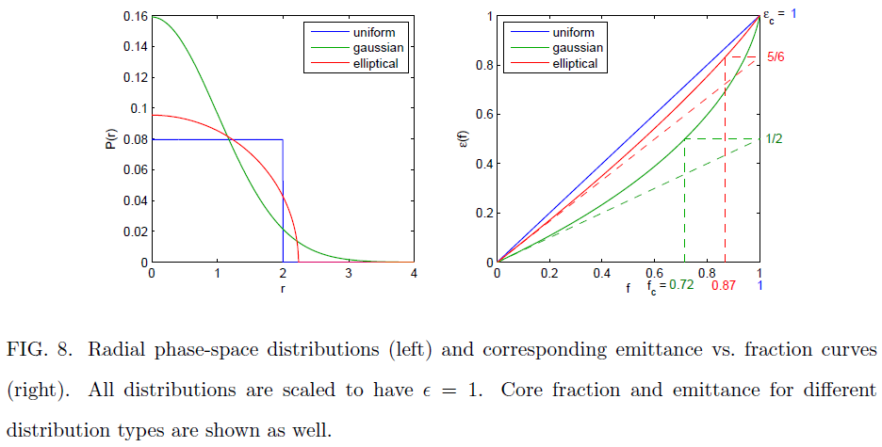
Single rms emittance is inadequate for comparisons
Better to quote 3 numbers
  100% rms emittance (or 95% or 90%)
  core emittance (essentially peak brightness)
  core fraction

Slide 27
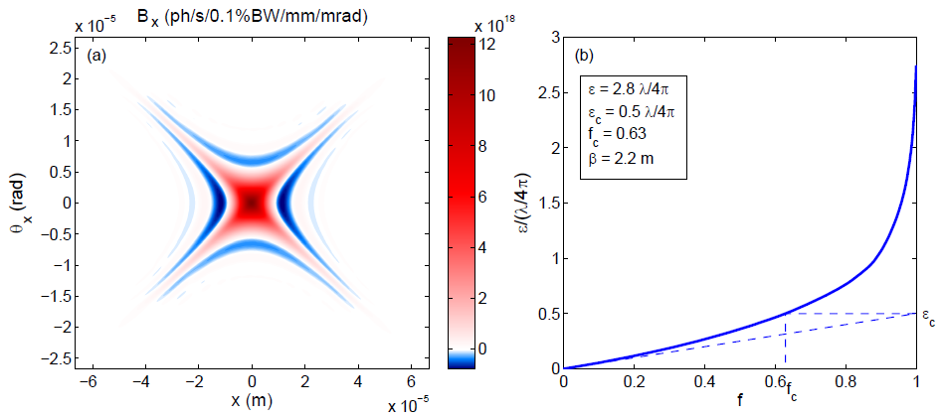
Emittance vs. fraction for light
Wigner distribution = phase space density
phase space of undulator radiation
emittance vs. fraction of light
There are fewer Gaussians around than one might think
More about it in my afternoon talk in joined SR&ERL WG
IVB, arXiV 1112.4047 (2011)

Slide 28
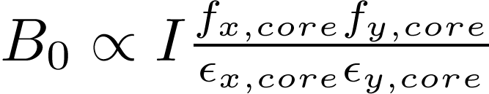
Measured beam brightness so far…
Effective brightness (for comparison)
E.g. demonstrated at 20mA ERL injector beam, if accelerated to 5GeV, is as bright as 100mA 50 × 50 pm-rad Gaussian beam!
The result can only improve!

Slide 29
Lasers & cathodes
Laser/gun/cathode is really one package
New guns = load lock chamber (a must for high current operation, debugging)
Great interest in cathodes & developing new materials
  Mirror success of polarized photocathodes: started with <50% polarization from strained GaAs, now >90% polarization is routine
  Need more material science experts
  Fertile research area = better cathodes immediately translate into better photoinjectors
  Several proposals for ultracold photoelectrons

Slide 30
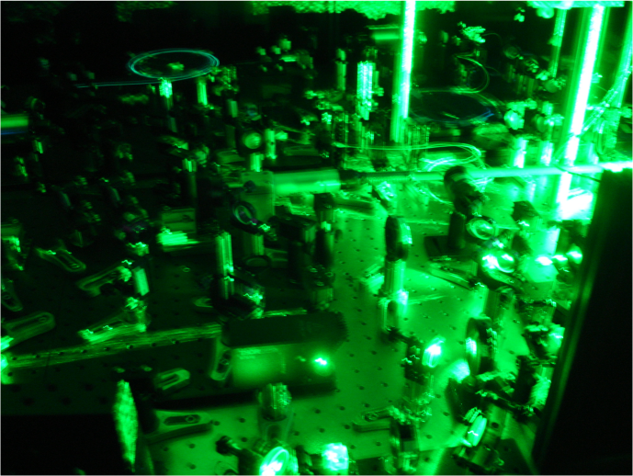
Lasers
Z. Zhou et al., Opt. Express 20 (2012) 4850
Plenty of laser power when coupled with good cathodes
Next steps:
  better 3D shaping
  engineering and integration into the machine via stabilization loops (all degrees of freedom)
Practical shaping techniques
  Temporal stacking (uniform)
  Transverse clipping (truncated Gaussian)
  Blowout regime if E_{cath} is high enough
1.3GHz laser at 65W
  better than “beer-can”; only ≤ 20% emittance increase compared to highly optimized shapes

Slide 31
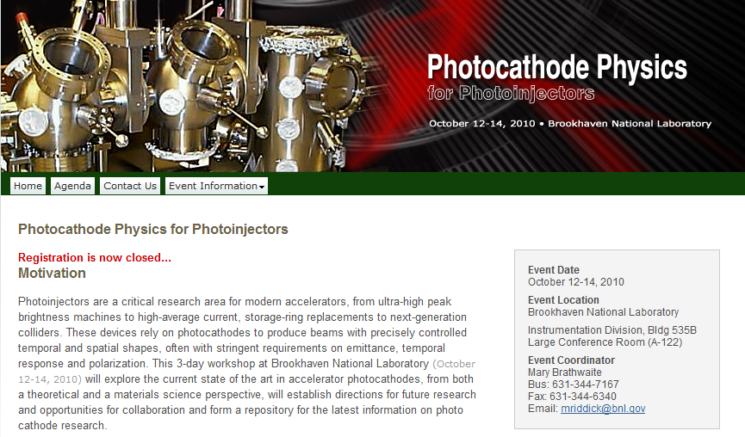

Building collaboration on photocathodes for accelerators
Collaboration with
    ANL, BNL, JLAB
    Cornell, SLAC
    Berkeley, more…
Excitement and momentum in the community;
Cathode workshops at BNL in 2010; in Europe 2011; coming up at Cornell in 2012
1st workshop
2nd workshop
http://www.bnl.gov/pppworkshop/
http://photocathodes2011.eurofel.eu
http://www.lepp.cornell.edu/Events/Photocathode2012

Slide 32
Conclusions
Accelerator community investing into photoinjector R&D
Dividends will follow (already happening)
Much remains to be done with conventional approaches (no emittance exchange tricks, field emission tips to enhance field, etc.), but there is always room for brand new ideas
Practical (turn-key) photoinjectors with greatly improved parameters becoming a reality

Slide 33
Acknowledgements
(for the Cornell team)
Photoinjector team:
  John Barley, Adam Bartnik, Joe Conway, Luca Cultrera, John Dobbins, Bruce Dunham, Colwyn Gulliford, Siddharth Karkare, Xianhong Liu, Yulin Li, Heng Li, Florian Loehl, Roger Kaplan, Val Kostroun, Tobey Moore, Vadim Vescherevich, Peter Quigley, John Reilly, Karl Smolenski, Charlie Strohman, Zhi Zhou, and more.
Main support NSF DMR-0807731 for ERL R&D
  also DOE DE-SC0003965 CAREER grant

Slide 34
END

Slide 35
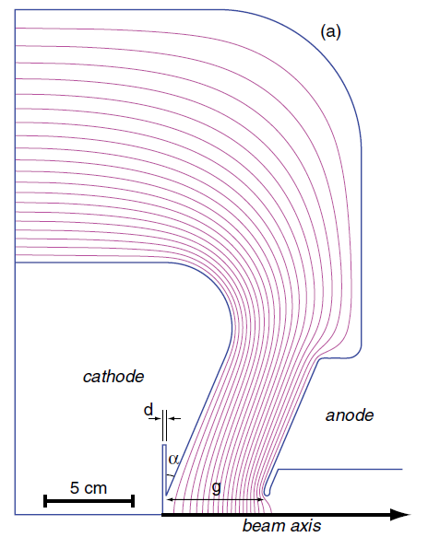



Optimal Gun Geometry:
DC Gun:
  $α≈0 , g=9$ cm, V=470 kV
  Pushed for max field over focusing.
  Cathode recess unimportant.
SRF gun:
  $α=2.3 , g=4.4$ cm
  $r_{pipe}=0.9$cm, $r_{cath}=0.4$ cm
  $r_{pipe}$ and cathode recess seemed unimportant.

Slide 36

Beamline Specifics

Slide 37



3D laser shaping for space charge control
Optimal 3D laser shape: practical solutions identified
>50% of light gets through, emittance (sims) ~20% higher than the optimal
temporal – birefringent crystal pulse stacking
temporal profile
transverse – truncated Gaussian
transverse profile
PRSTAB 11 (2008) 040702
Appl. Opt. 46 (2011) 8488

