Slide 1

NGLS DESIGN STUDY
AND
ACCELERATOR R&D
John Corlett for the NGLS Team
March 5, 2012

Slide 2



Motivation
Coherent X-rays with high repetition rate, unprecedented average brightness, and ultrafast pulses
Today’s storage ring x-ray sources
Weak pulses at
high rep rate
~ nanoseconds
~nanojoule
~ picoseconds
Today’s x-ray laser sources
~ milliseconds
Intense pulses at
low rep rate
…
~millijoule
…
~ femtoseconds
Tomorrow’s x-ray laser sources
~ microseconds
Intense pulses at high rep rate
~0.1 millijoule
~ attoseconds to femtoseconds
Notes:
Storage rings and FELs provide beamlines with about 1 Watt average power (0.1% BW)
Next generation superconducting-linac-driven FELs can provide hundreds of Watts, and with flexibility in X-ray pulse characteristics
Orders of magnitude more average power in coherent beams, with many (10) orders of magnitude greater peak brightness than storage rings

Slide 3
Approach
High average power electron beam distributed to an array of FELs from high rep-rate injector and CW SCRF linac
Beam spreader
High-brightness, high rep-rate gun and injector
CW superconducting linac,
laser heater, bunch compressor
Array of independent FELs
X-ray beamlines and endstations

Slide 4
Capabilities
High repetition rate soft X-ray laser array
  Up to 10⁶ pulses per second
  Average coherent power up to ~100 W
Spatially and temporally coherent X-rays (seeded)
  Ultrashort pulses from 250 as – 250 fs
  Narrow energy bandwidth to 50 meV
Tunable X-rays
  Adjustable photon energy from 280 eV – 1.2 keV
    higher energies in the 3rd and 5th harmonics
  Polarization control
  Moderate to high flux with 10⁸ – 10¹² photons/pulse
Expandable
  Capability
  Capacity
More photons per unit bandwidth
More photons per second
Shorter pulses
Controlled trade-off between time and energy resolution

Slide 5
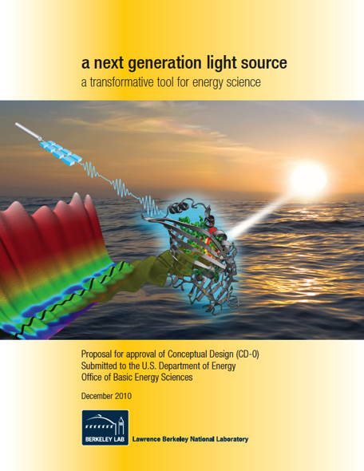
Science requirements drive machine design
Tuning range
Maximum photon energy
Peak flux
Average Flux
Repetition rate
Two-color capability
Pulse duration
Bandwidth
Accuracy
Stability
Synchronization
Contrast ratio

Slide 6
Accelerator Systems R&D priorities
High repetition rate
  Injector “APEX”
  Beam spreader
Advanced FEL operation
  Modeling and optimization
  Seeding approaches
  Seed lasers
  Superconducting undulators
Developing partnerships
SCRF
RF power
Notes:
High repetition rate
Injector (APEX)
Spreader
Advanced FEL operation
Seeding
Lasers
Undulators
Instrumentation & diagnostics
Timing & synchronization
High average power
Beam dumps
Superconducting accelerator developments
High Q_{o}
Higher order mode power
Field emission
Harmonic cavity

Slide 7
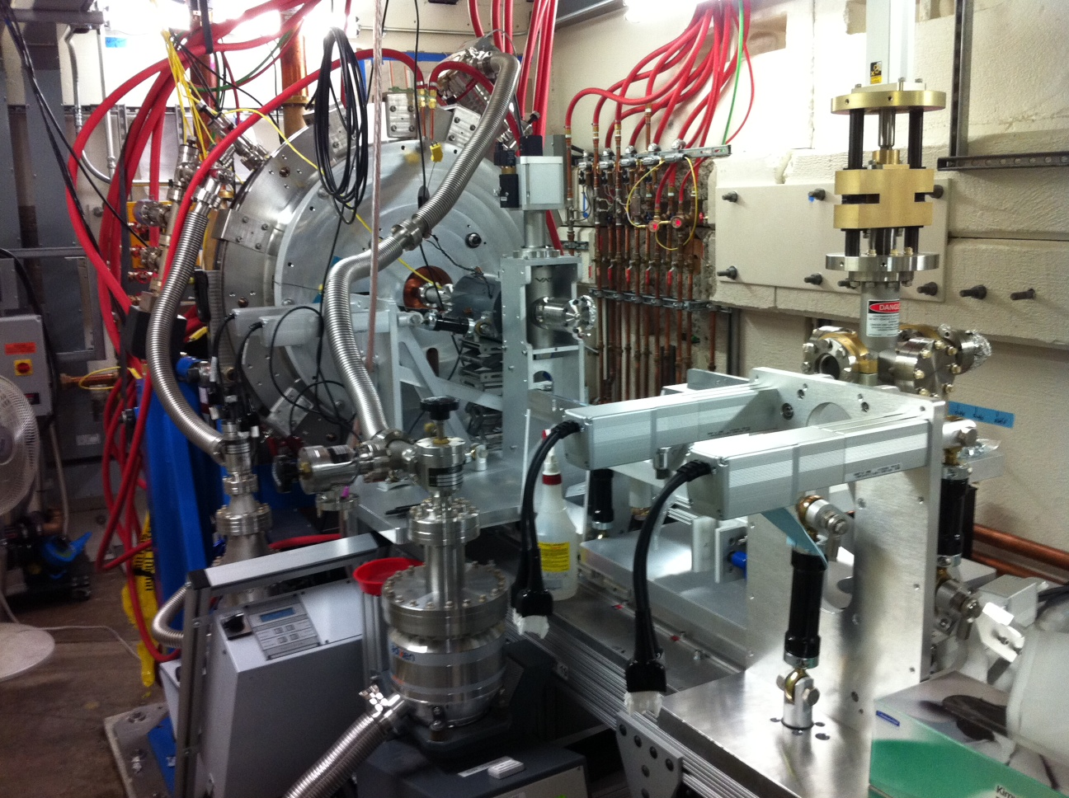
APEX gun: high-brightness MHz electron source
APEX cavity is successfully RF conditioned
Notes:
Repetition rate 1 MHz
Charge per bunch from ~10 pC to ~1 nC
Emittance <10⁻⁶ mm-mrad (normalized)
Electric field at the cathode ≥~10 MV/m (space charge emission limit)
Beam energy at the gun exit ≥~500 keV (space charge control)
Bunch length ~100 fs to ~10 ps for handling space charge effects, and for allowing different modes of operation
Compatible with magnetic field control within the gun (emittance exchange and compensation)
10⁻¹¹ Torr vacuum capability (cathode lifetime)
Accommodates a variety of cathode materials

Slide 8
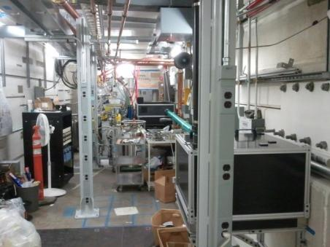
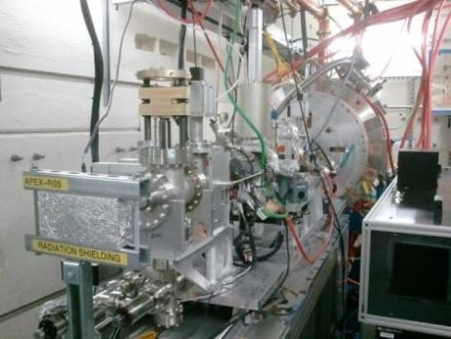
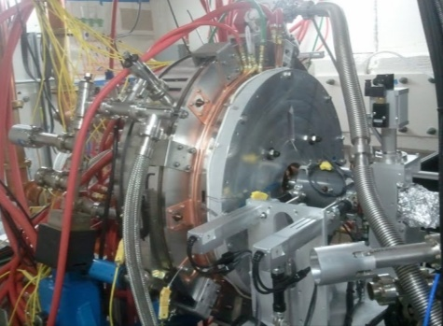
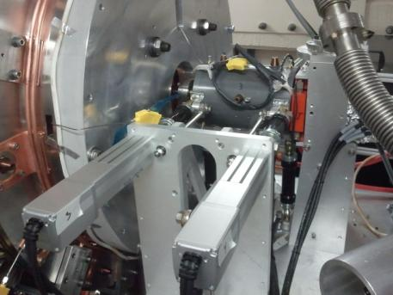
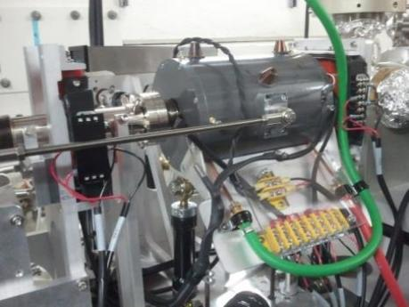
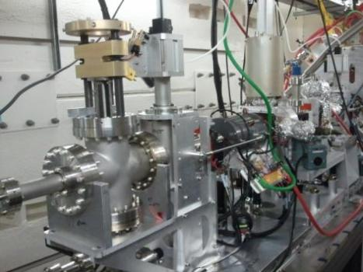
APEX in the Beam Test Facility
Notes:
Installation almost complete
Laser beam on cathode plug
Photoemission test about to start

Slide 9
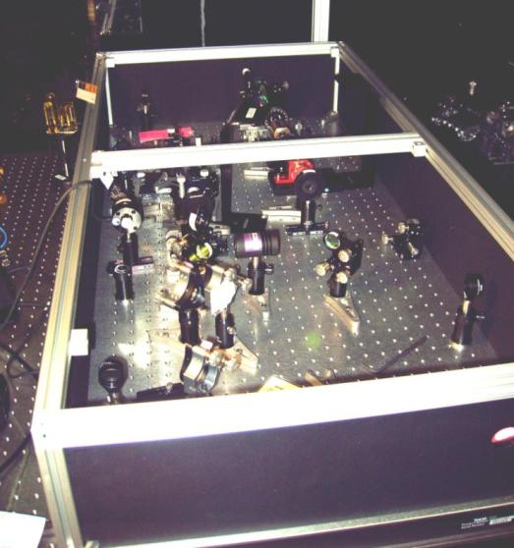
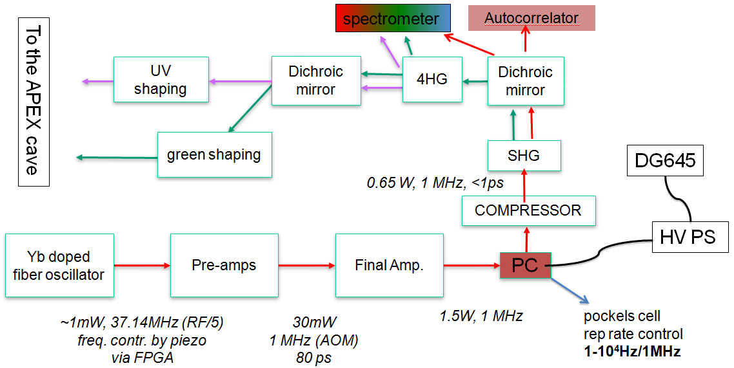
APEX Activity and Plans
F. Sannibale
Yb fiber photocathode drive laser
1 MHz reprate Yb fiber laser
  LLNL/UCB/LBNL collaboration
Notes:
0.7 W @ 1052 nm (systems being optimized)
240 mW @ 526 nm
~ 1.5 nC, 1 MHz CsK₂Sb
55 mW @ 263 nm
~ 190 pC, 1 MHz Cs₂Te
Other lasers available for future use
1 MHz, 2 W, 1052 nm (Calmar)
1 MHz, >100 W,1064 nm, cryo-cooled Yb:YAG (Qpeak Inc., STTR)

Slide 10
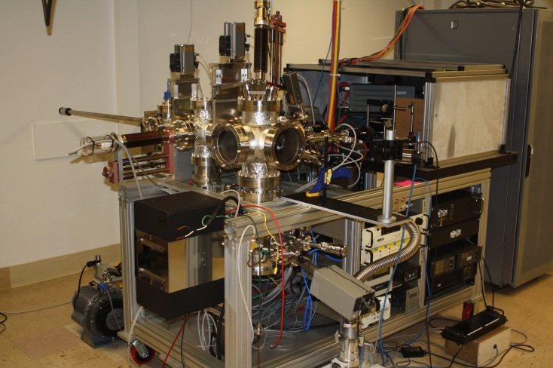
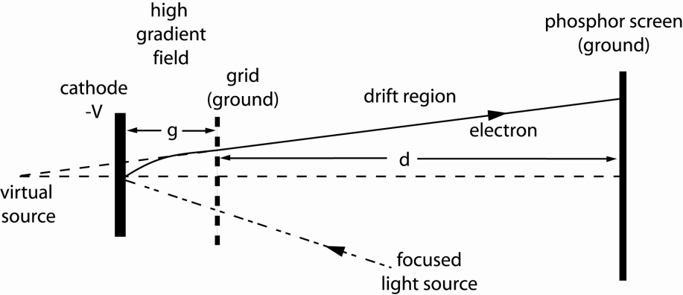
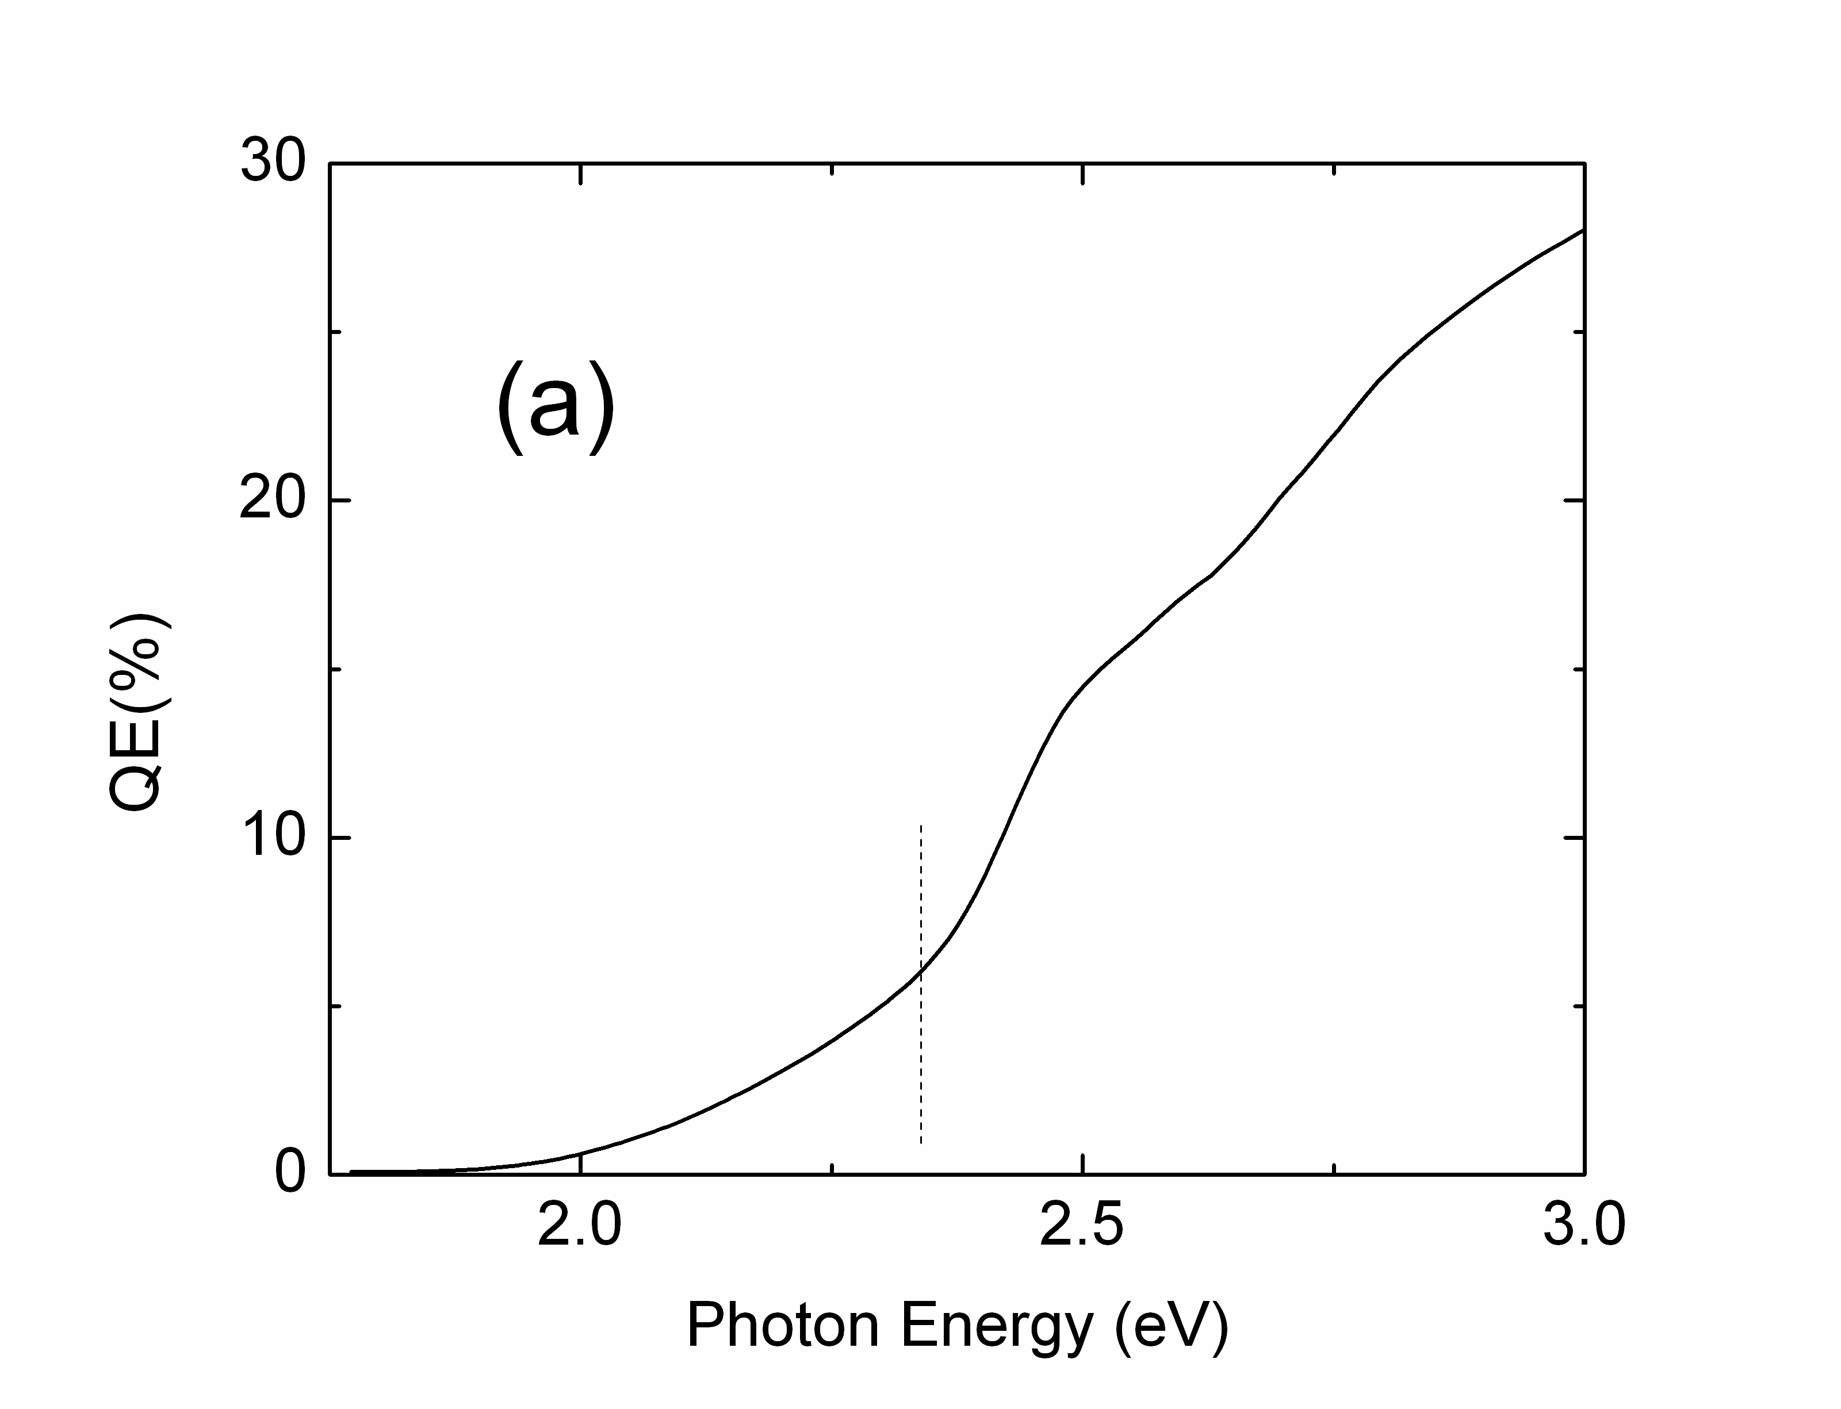
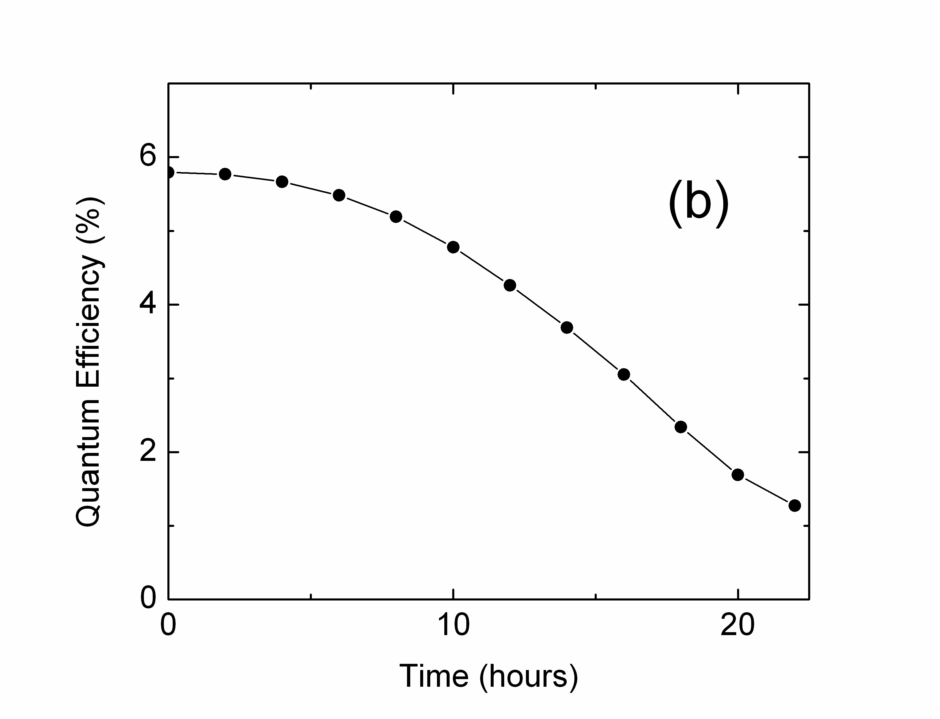
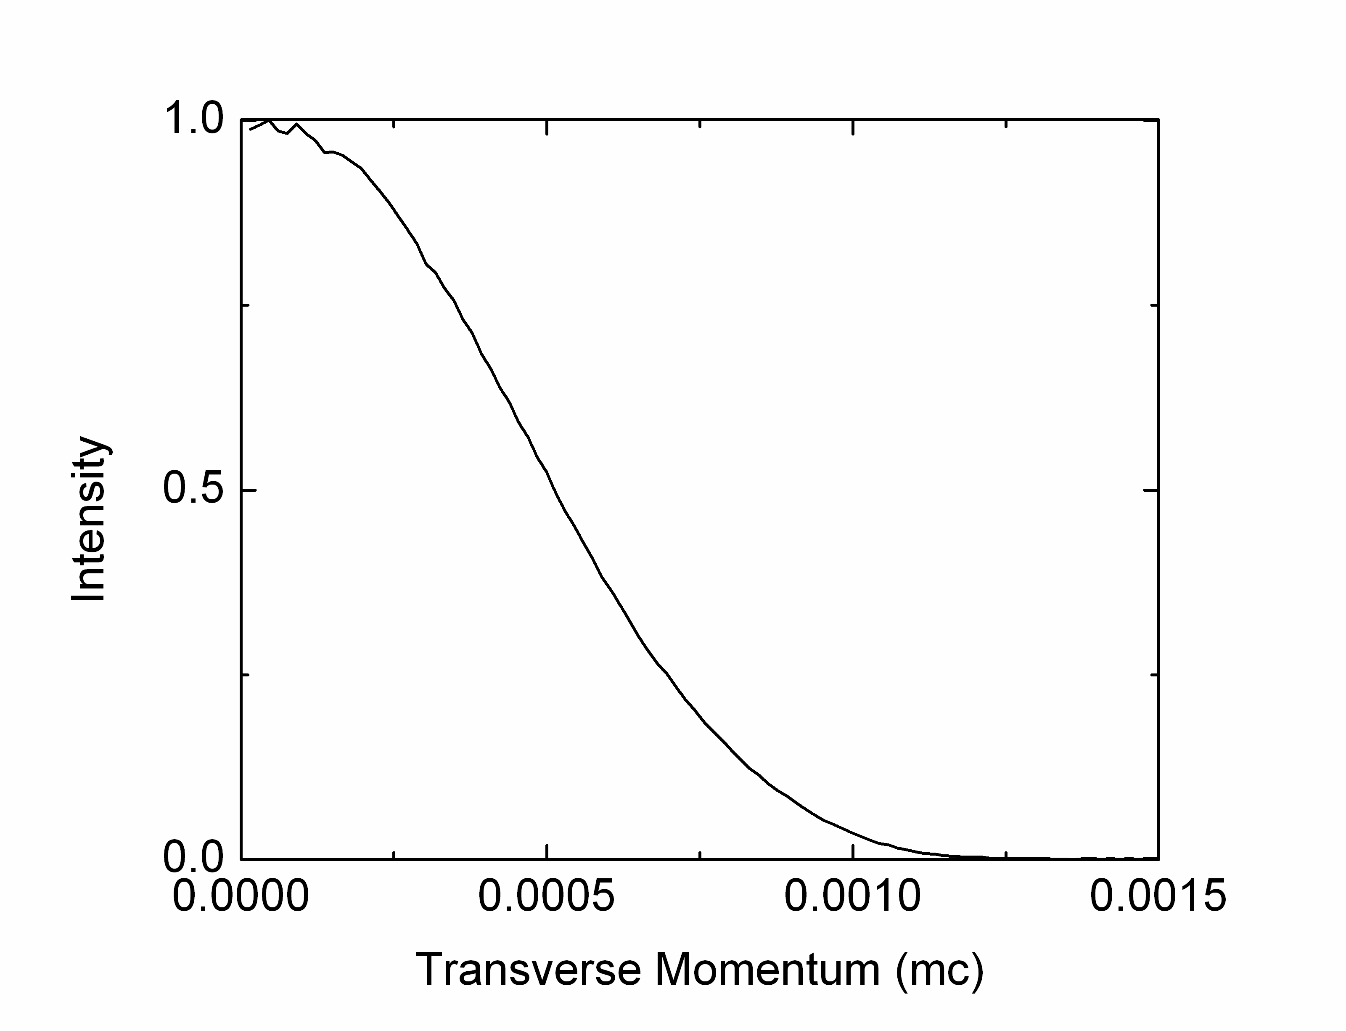
Photocathode materials R&D
K₂CsSb:
6% QE at 532 nm
0.36 microns / mm rms ε_{n}
>> 1 week lifetime
Good lifetime at
10⁻⁹ mBar
Low transverse
momentum
High QE
Notes:
Padmore leads
ALS, surface & materials science expertise

Slide 11
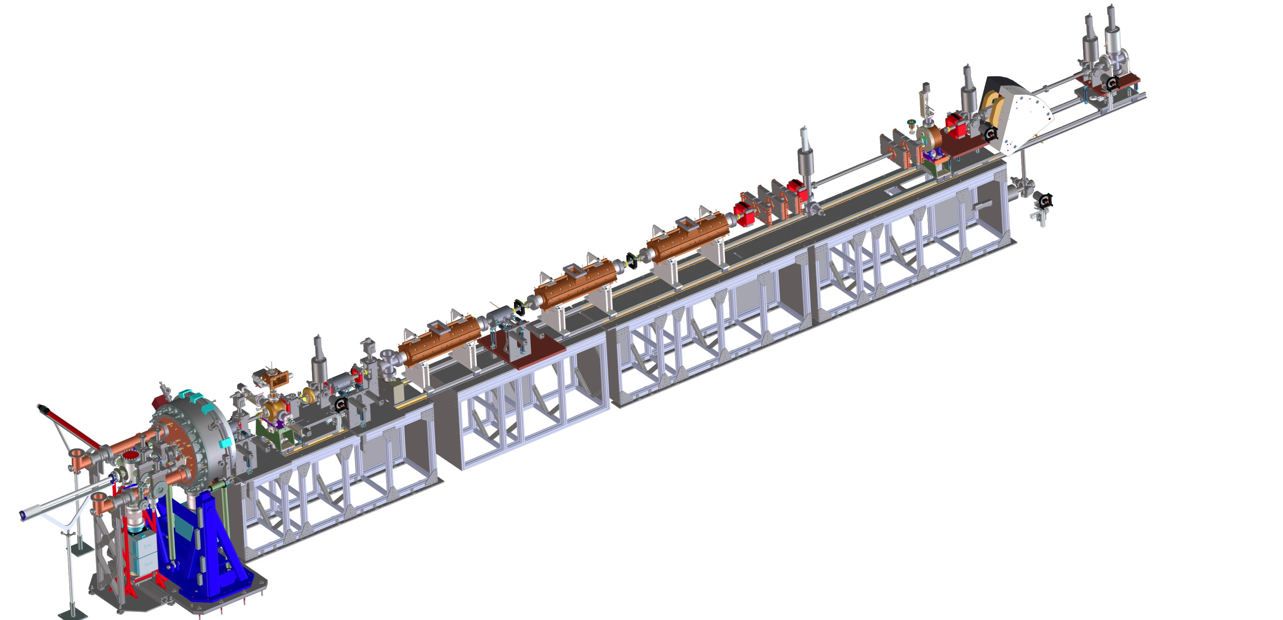


APEX stages
Phase-II:
Beam characterization at 15–30 MeV
6-D brightness measurements
Phase I:
Beam characterization at gun energy (750 keV)
Phase 0:
Gun and photocathode tests
Diagnostics systems in collaboration with Cornell CLASSSE
Accelerating cavities in collaboration with ANL AWA
Planning for final installation in 2013
Notes:
Phase 0 (1 MHz)
Photocathode tests
QE Vs time
QE maps
Cathode emittance
High current cathode performance (~mA)
Energy measurement with correcting coil
Phase 1 (1 MHz)
Beam characterization at the gun energy (750 kV)
Space charge emittance
Time and energy resolved measurements
Phase II (10 Hz)
Beam characterization at the injector exit (15-30 MeV)
6D brightness measurement
Jitter measurements
Review held November 28
Chair I. Bazarov (Cornell)

Slide 12
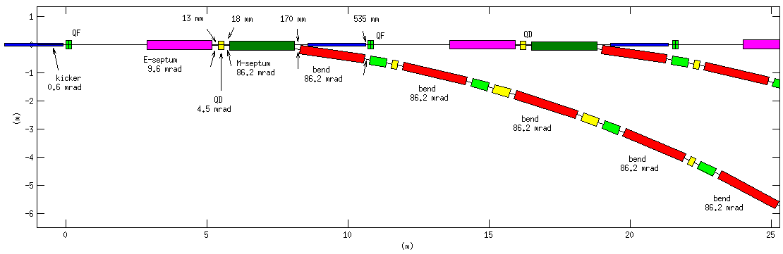
Optimizing the beam spreader
Electrostatic
septum
Kicker
(0.6 mrad –
was 3 mrad)
Magnetic
Septum
DC Bends
Electrostatic allows 5x weaker kickers (1/5 stability tolerance)
Footprint reduced ~1/3
Notes:
Further optimization under way (CSR, impedance, footprint, diagnostics)

Slide 13
Optimizing the beam spreader
Electrostatic Septum
2.0 m, 9.6 mrad
Magnetic Septum
1 m, 45 mrad
Pulsed Kicker
1 m, 0.6 mrad
x
z
Linac line
D
F
D
ARC
D
Electrostatic allows 5x weaker kickers (1/5 stability tolerance)
Footprint reduced ~1/3
Notes:
Further optimization under way (CSR, impedance, footprint, diagnostics)

Slide 14
Linac developments – “10/25/11” layout
Laser heater
Linearizer cryomodules
Accelerating cryomodules
Injector
Spreader
CM1
CM2
HL
CM3
CM9
CM10
CM30
Bunch compressor 1
Bunch compressor 2
Accelerating cryomodules
GUN
1 MeV
Heater
70 MeV
BC1
168 MeV
BC2
640 MeV
SPRDR
2.4 GeV
~670 m
Notes:
Balancing demands on systems
Using common components
Next steps:
Integrate spreader kicker and septa with transport lattice
Work with partner Lab to improve SCRF linac performance
Increase gradient from 13 MV/m to 16+ MV/m
Increase Q_{o} from 1x10¹⁰ to 2x10¹⁰

Slide 15
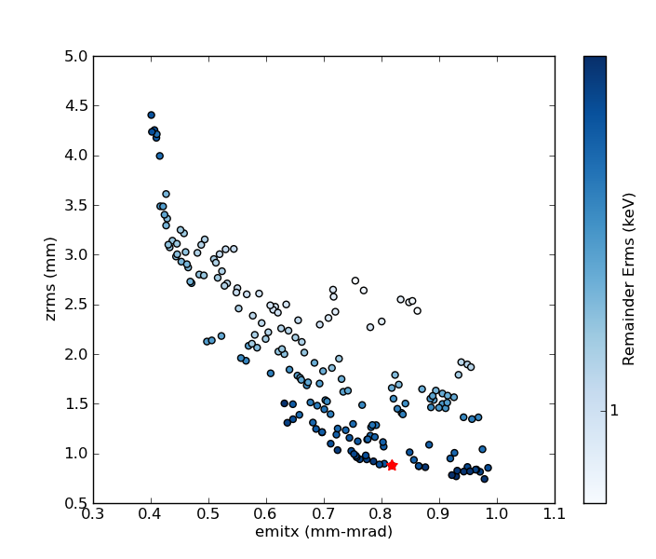
Injector optimization
Buncher
Gun
5 keV
Pareto front of genetic optimization
300 pC, ~70 MeV design point
Delivers required beam brightness
RMS energy spread
RMS bunch length (mm)
1 keV
Projected normalized emittance (m-rad, 100%)
Notes:
Uses main linac cryomodule
Genetic algorithm

Slide 16
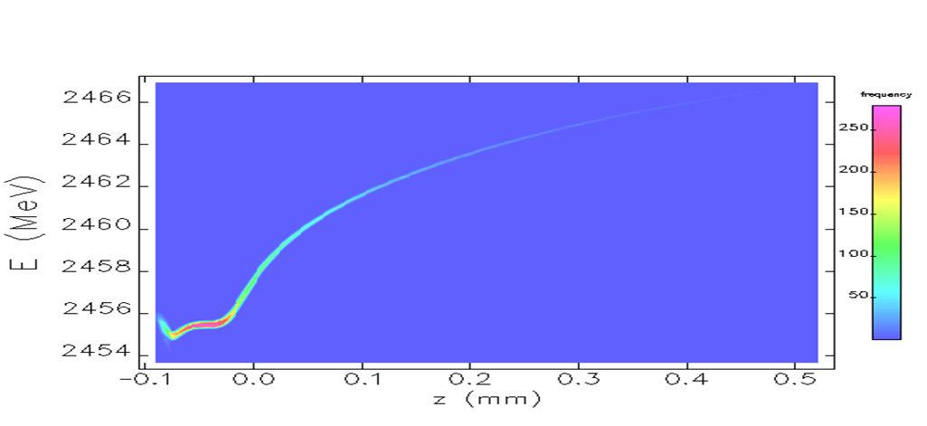
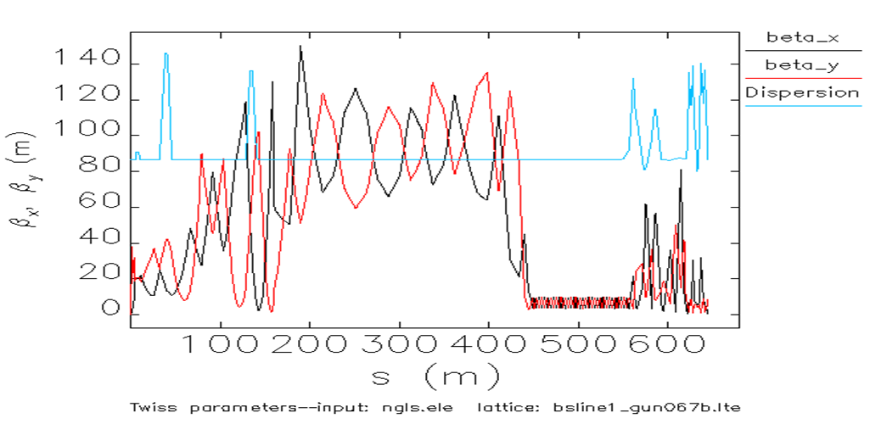
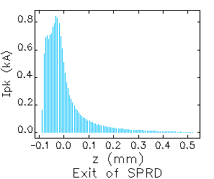
Beam dynamics modeling through linac
Two-stage compression
2.4 GeV
  APEX-gun generated beams (300pC)
  ≥ 600 A peak current and small residual energy chirp within usable beam core
  limited CSR-induced projected emittance growth
Longitudinal beam phase-space
at entrance of FEL beamlines*
Twiss functions through the Linac
Current profile
*’Elegant’ simulation through the linac starting from an ASTRA-simulated beam out of the APEX-gun based injector
Notes:
ASTRA
ELEGANT
IMPACT
<0.6 micron
<100 keV

Slide 17
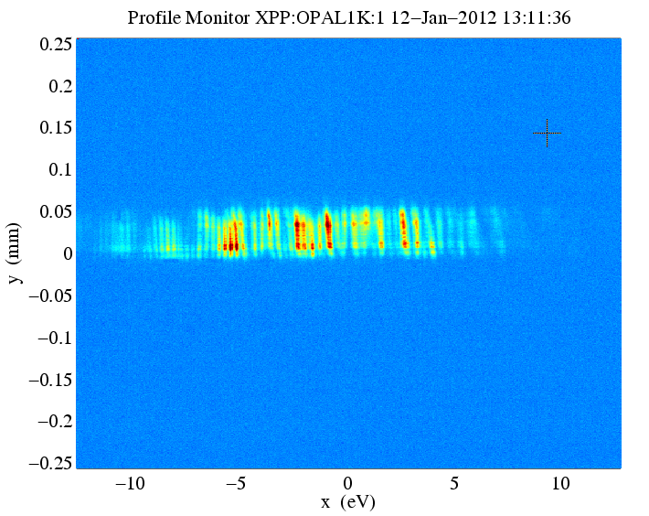
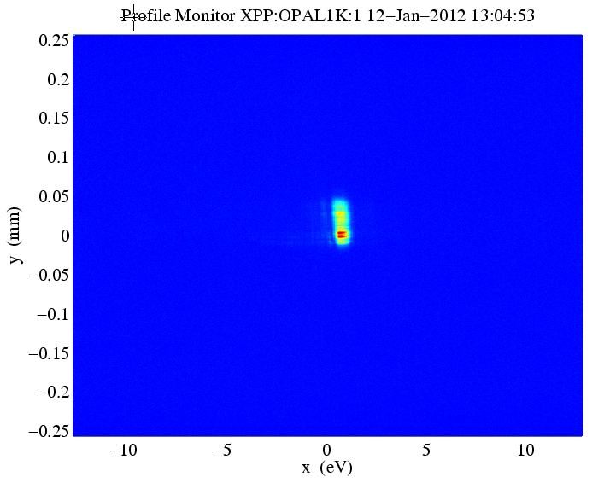

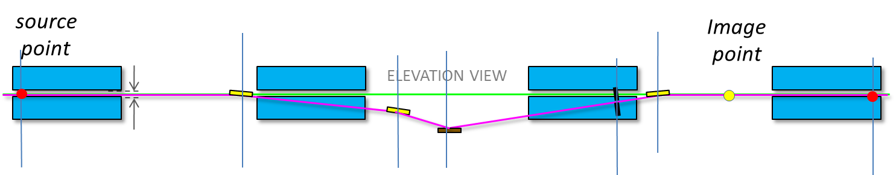
Self-seeded FELs
e⁻ chicane
1st undulator
2nd undulator with taper
SASE FEL
Single crystal: C(400)
Self-seeded FEL
SASE FEL spectrum
Seeded FEL spectrum
~ 20 eV
~ 0.5 eV
Near Fourier Transform limit
Initial results: 40x reduction in BW (40x increase in peak brightness)
LCLS Soft X-ray Self Seeding – in planning stages

Slide 18
Laser seeded FEL – ”ECHO”
Developing R&D plans
  Beam experiments
  Laser developments
EEHG
HHG
HGHG
Notes:
Our approach for a future machine is to use a range of FEL designs, including the ECHO technique under development
We will develop seeded FEL capabilities in an R&D program – Echo, HHG, self-seeding, oscillators, … etc
Need 10’s micro-Joule in UV (200 nm) – i.e. 10’sto 100 Watts in IR
Simulations use GENESIS and GINGER codes
Stupakov, G., Using the Beam-Echo Effect for Generation of Short-Wavelength Radiation, Physical Review Letters 102 (2009) 074801

Slide 19
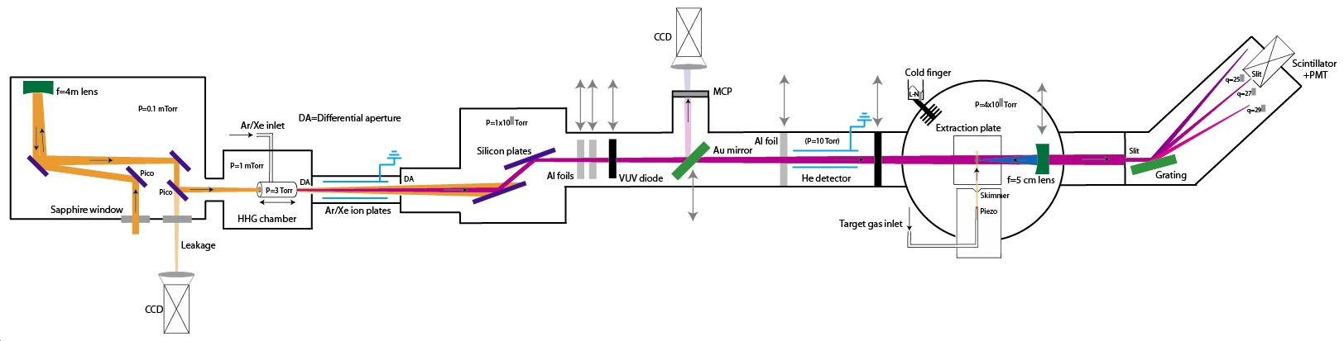
HHG seeded FEL R&D
HHG seeding at ~50–100 eV
HGHG to reach 1.2 keV
1 kHz, 40 mJ, HHG source for seeding R&D
Notes:
~100 kW (peak) seed power at ≤50 nm
~10’s nJ per pulse
Needs laser development for higher repetition rate
~kW average power @ ~4µm
Phase-matching in capillaries
Tunability
Development of long-pulse capability
Diagnostics, control, reliability

Slide 20

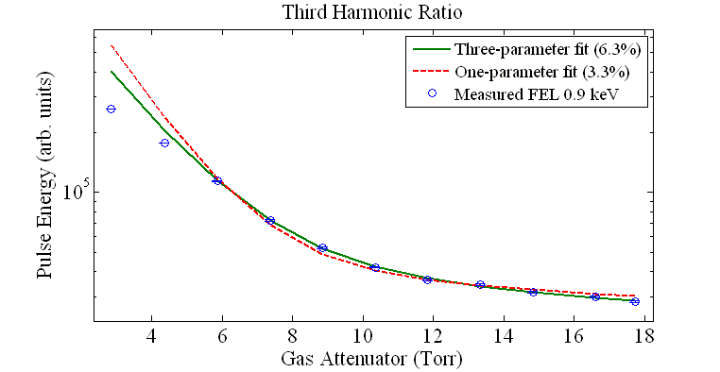
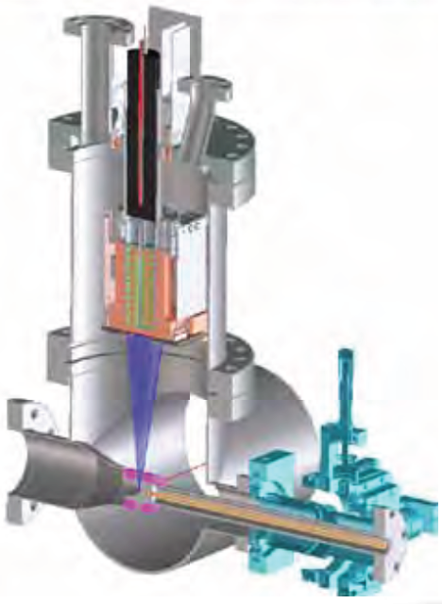
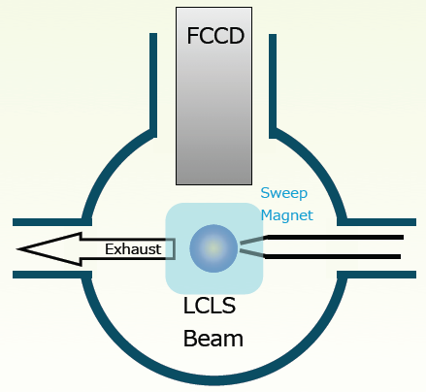
FEL harmonics measurements at LCLS
Now using filters
Daniel Ratner
Fit to detected signal level with attenuators
Future using spectroscopic fast CCD detector
  LBNL detector

Slide 21
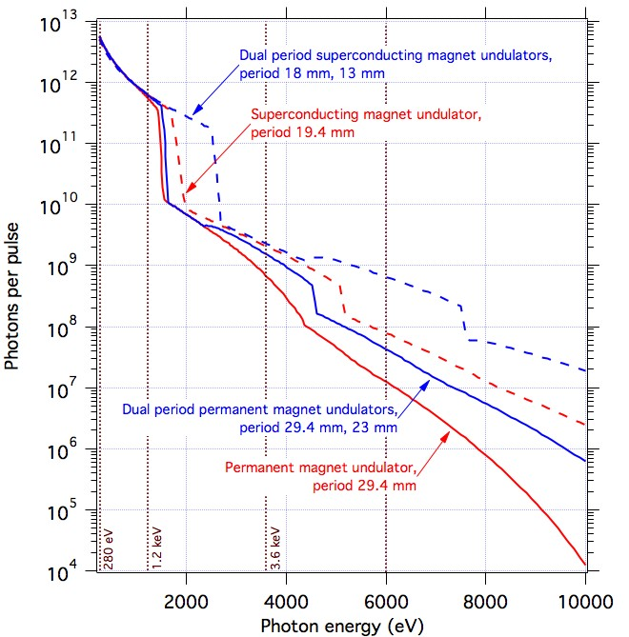
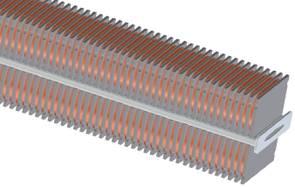
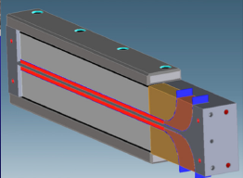
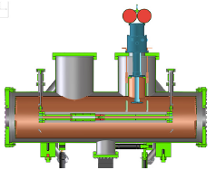
Superconducting undulator R&D
Planar Nb₃Sn undulator
HTS tape undulator
Cryostat for test and measurement
Notes:
Motivation
Reduce costs and enhance performance
Shorter FELs
Shorter, lower energy linac
Higher photon energy
Greater tuning range
Potential radiation damage resistance

Slide 22
Summary
DOE has approved Mission Need for a Next Generation Light Source
  LBNL led the effort
  We are:
    Developing science case and experimental requirements
    Evolving machine design to best meet science needs
    Executing and developing R&D plans
    Strengthening and building collaborations

