Slide 1
Soft X-ray Self-Seeding
Philip Heimann (SLAC)
Daniele Cocco, Juhao Wu, Jim Welch, Yiping Feng, John Amann, Zhirong Huang, Jerry Hastings (SLAC)
Paul Emma (LBNL)
SLAC/LBNL R&D project in Soft X-ray Self Seeding

Slide 2
Soft X-ray Self-Seeding Concept
SASE FEL x-rays are generated in a 1st undulator section.
A grating monochromator selects a narrow x-ray bandwidth.
The electron beam passes to the side in a chicane.
The x-rays from the monochromator seed the FEL x-ray generation in a 2nd undulator section.
Proposed by J. Feldhaus, E.L. Saldin, J.R. Schneider, E.A. Schneidmiller, M.V. Yurkov, Opt. Comm., V.140, p.341 (1997)
Not implemented at FLASH
e-beam
ξ/2
M₁
M₃
2nd undulator
1st undulator
η/2
Source
plane
γ’/2
M₂
Re-entrant
plane
S
G

Slide 3
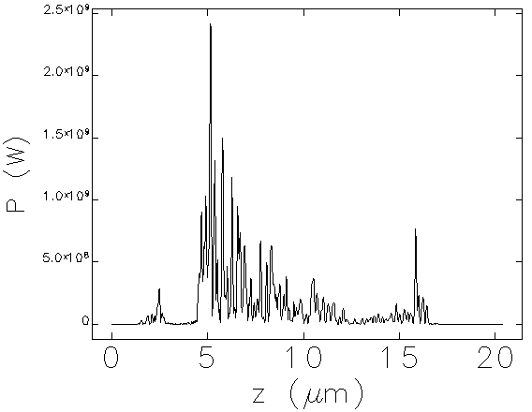
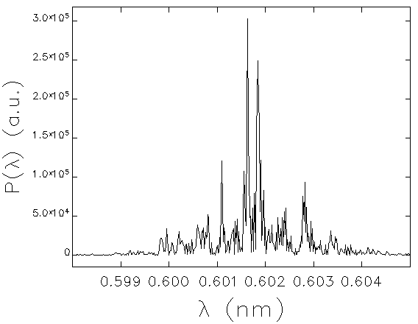
Motivation
SASE FEL pulse is longitudinally incoherent
Soft x-ray self-seeding
Reduce spectral bandwidth
Remove spectral jitter
Make a near-Gaussian pulse in time
SASE FEL longitudinal profile at 26 m
SASE FEL temporal profile

Slide 4
Symmetric Design (Toroidal grating)
1.2 m
0,0
1663, 0
60 max,3.85
1535,3.85
~1290 mm
1350,3.85
Fit within the length of one undulator module, 4.5 m.
Photon energy range 400 - 1000 eV.
X-ray and electron delay varies from 660 - 850 fs.

Slide 5
Beam Transverse position @ midpoint of chicane
3.85
0
16.1 - 19.9
8 mm
x-ray
electron
X-ray and electron deflections are in the horizontal plane.

Slide 6
Symmetric Design (Toroidal grating)
D. Cocco
Central groove density (l/mm) | 1123
D1 (l/mm2) | 1.60000
Radius of curvature (m) | 195
Diffraction order | 1
Fixed incidence angle (deg) | 89.0000
Sag Radius of curvature | 18 cm
Resolving power from 7800 (400 eV) to 4800 (1000 eV).

Slide 7
Pulse stretching vs resolving power
Grating x-ray pulse stretching Δt =N m λ / c.
The grating x-ray pulse stretching ≈1.7 times transform limit.
X-ray pulse will be longer than electron bunch.

Slide 8
Beam steering
M3 15 mrad
Incidence
+0.5 mm
plane
-0.5 mm
slit
spherical
M2 15 mrad
Incidence
Overlap of x-ray and electron beams made by translation or rotation of M2 and M3 mirror.

Slide 9
Overlap scheme
12 m
SXRSS
YAG
YAG
U8
U9
U10
U11
σ≈35μm
σ≈35μm
Use x-ray steering (x, x’, y, y’) to move x-ray spots on top of electron spots on both Ce-YAGscreens.

Slide 10
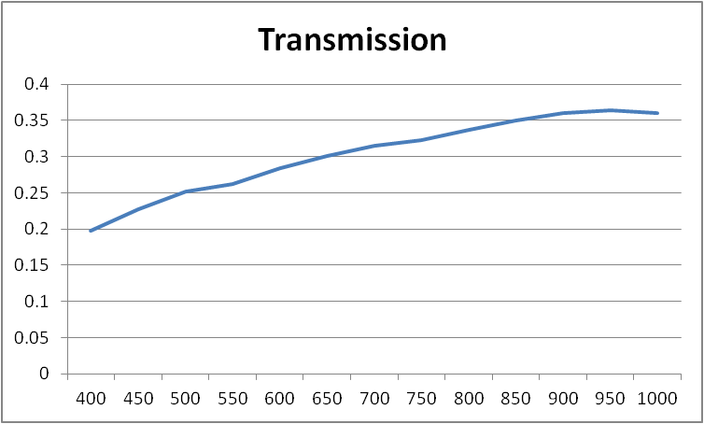
Transmission
Pt optical coatings
Including resolution and with 0.3% SASE bandwidth.
w
h
Laminar profile

Slide 11
Spot expected in the following undulators
Distance from M3 | Horizontal spot size (μm) at 400/1000 eV | Vertical spot size (μm) at 400/1000 eV
2 m | 67/66 | 40/32
Based on geometric ray tracing.
Future work coherent beam propagation.

Slide 12
Cases studied and results
undulator | 1.2 nm (1 keV) |  | 2.5 nm (500 eV)
 | 20 pC | 100 pC | 20 pC | 100 pC
LCLS | 0.77 | 1.18
LCLS-II | 0.94 | 0.98 | 1.69 | 1.48
Parameters and longitudinal phase space area after Gaussian fit to both temporal and spectrum distribution are summarized as follows (defined as σ_{t}σ_{ω})
Seems to be 2 ~ 3 times of transform limited

Slide 13
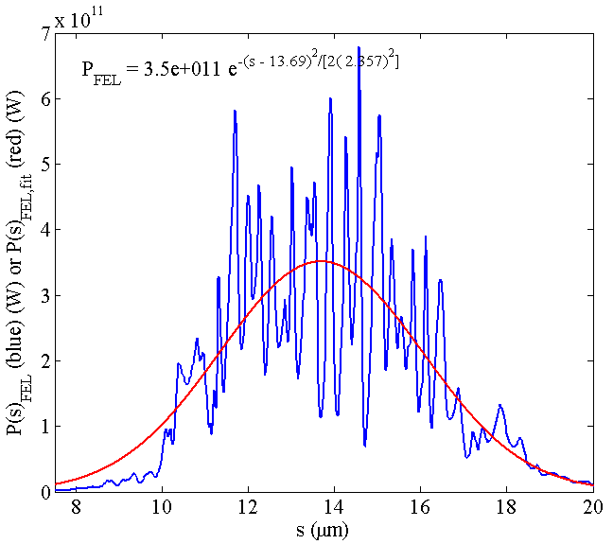
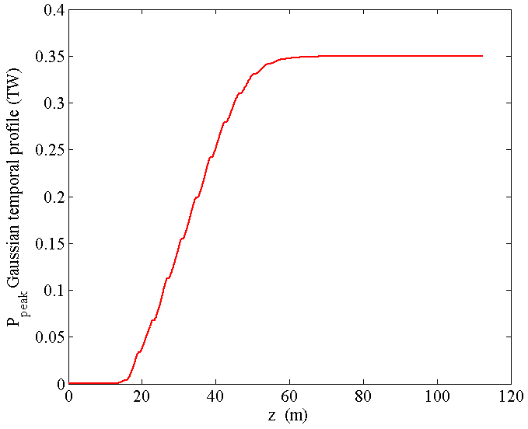
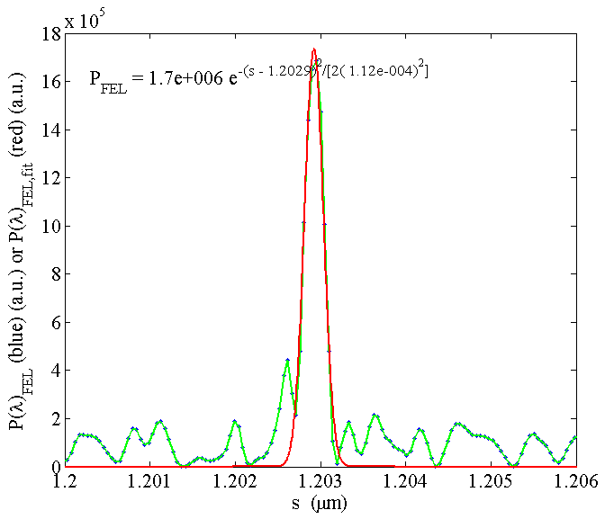
High peak power
1 keV Soft X-ray Self-seeding (10 kW after mono)+ Taper → 350 GW
~ 100 pC Gaussian temporal dist.
Longitudinal phase space: ~ 2 times of transform limited
@ 60 m
U33
Grating monochromator
@ 60 m
2.2 x 10⁻⁴
fwhm

Slide 14
Summary
At the LCLS soft x-ray self-seeding is possible in the length of one undulator module.
The optical-electron design is nearly complete.
This project is a collaboration between SLAC and LBNL.

