Slide 1

BERLinPro
BERLinPro
The Berlin Energy Recovery Linac Project
Why, How and Status
Andreas Jankowiak
on behalf of the BERLinPro project team
Institute for Accelerator Physics
Helmholtz-Zentrum Berlin
FLS Workshop
JLAB
5th March, 2012

Slide 2
The menu
Why BERLinPro
the beauty of ERLs
The project
basic layout, goals, timeline
Status
building, radiation protection, optics/theory, srf gun,
cold systems (srf), warm systems
Summary

Slide 3
Energy Recovery Linacs: The idea
high average („virtual“) beam power
(up to A, many GeV = GW class beams)
mature technology
“resonant” system
interaction experiment ↔ ring
beam parameter defined by equilibrium
outstanding beam parameter
single pass experiments
high flexibility
low number of user stations
limited average beam power (<<mA)
LINEAR ACCELERATOR
ID
X-Rays
STORAGE
Source
ID
RING
IP
IP
X-Rays
ENERGY RECOVERY LINAC
IP
ID
X-Rays
Main Linac
Source
Dump
high average beam power for single pass “experiments”
excellent beam parameters, high flexibility, multi user facility

Slide 4
Applications of ERL Technology:
High energy electron cooling of bunched proton/ion beams
Ultra high luminosity electron – ion collider (EIC, LHeC)
Compact radiation sources:
FELs, Compton sources,
next generation EUV lithography,
nuclear waste management, port security
Multi-User next generation light sources

Slide 5
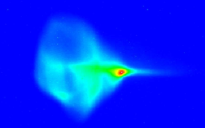
Still many open questions
Electron source:
high current , low emittance (100mA – A) cw / ε_{norm} < μm rad ) not yet demonstrated
(big step forward: Cornels 50mA)
Injector/Booster:
100mA @ 5 – 15MeV = 500 – 1500kW beam loading (coupler, HOM damper)
Main-Linac:
100mA recirculating beam → beam break up (BBU), higher order modes (HOM),
highest cw-gradients (>15MV/m) with quality factor > 10¹⁰ → reduce cryo costs
Beam dynamics / optics:
recirculation, flexible optics, bunch compression schemes = flexibility
Control of beam loss
unwanted beam = dark current (cathode, gun, srf), beam halo, collimation
Storage ring:
nearly Gaussian
~ pA losses typical
~ 10 nA maximum
ERL:
no dead mathematician
~ 100 μA losses possible
The “hummingbird”
P. Evtushenko, JLAB

Slide 6
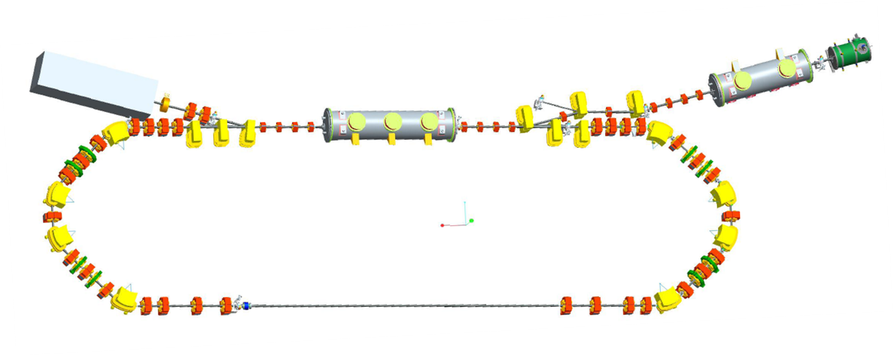
BERLinPro – Machine layout / parameters
BERLinPro = Berlin Energy Recovery Linac Project
100mA / low emittance technology demonstrator (covering key aspects of large scale ERL)
beam dump
7MeV, 100mA = 700kW
modified Cornell booster
3 x 2 cell srf cavities, 4.5MeV
linac module
3 x 7 cell srf cavities, 44MeV
srf-gun
1.5-2MeV,
single solenoid,
no buncher cavity
merger
dogleg
recirculation arc
 | Basic Parameter
max. beam energy | 50MeV
max. current | 100mA (77pC/bunch)
normalized emittance | 1 π mm mrad
bunch length (straight) | 2 ps or smaller
rep. rate | 1.3GHz
losses | < 10⁻⁵

Slide 7
BERLinPro – Project goals
Produce and accelerate an electron beam with
emittance: 1 π mm mrad (normalized)
current: 100mA cw
(1.3GHz, 77pC bunch charge)
pulse length: 2 ps
at reasonable energy (50MeV ) in „user quality“ (low losses in
recirculation) with stable and reliable operation
→ Facility for ERL beam tests and developments
- develop the required srf technology (gun/booster/linac)
- explore the parameter space of emittance, charge and pulse length
- understand to control “unwanted” beam(loss)
- educate accelerator physicists, engineers and technicians
- acquire expertise to be prepared for future large scale projects
- foster international collaboration on ERL technology

Slide 8








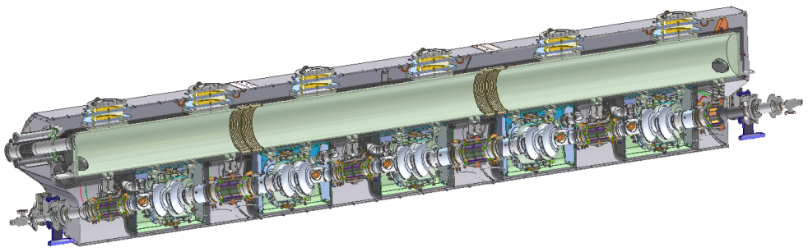
Challenges (i)
electron source with cathode and laser system
staged approach for development of srf photo electron source
Gun_0 → Gun_1 → Gun_2
already started, fully sc (Pb cathode film), first beam 21.04.11
demonstrator, beam dynamic
nc cathode, CsK₂Sb cathode
beam dynamic, emittance, cathode performance
lessons learned / high power
generate high power beam in booster
modified Cornell booster design , adapt to our needs
(only 3 cavities,
more power per
coupler – KEK design)

Slide 9
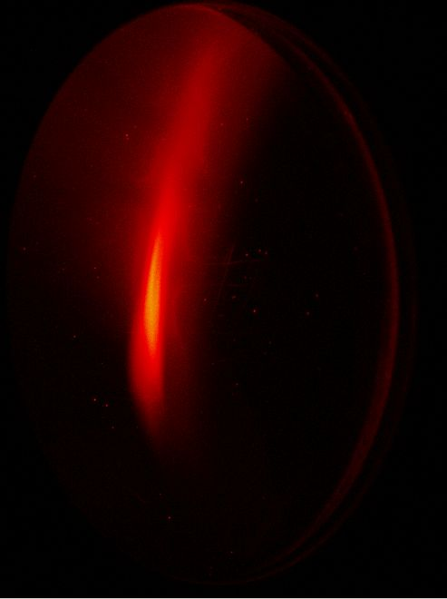
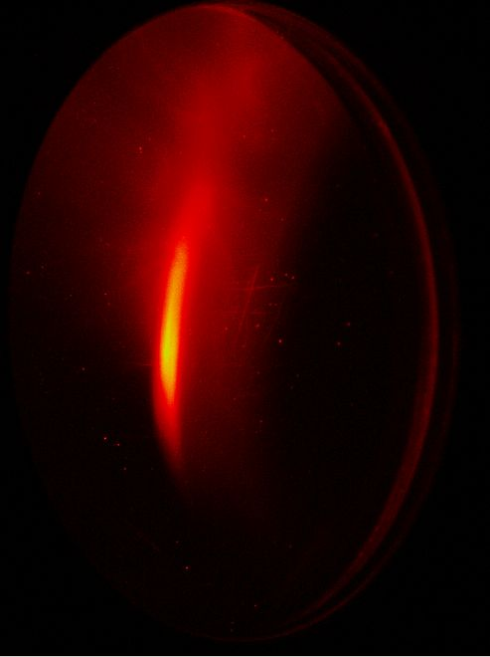
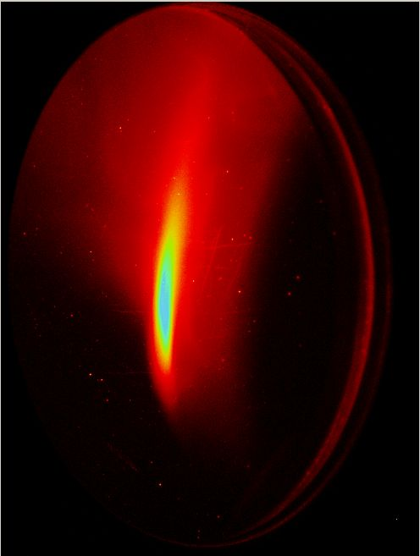
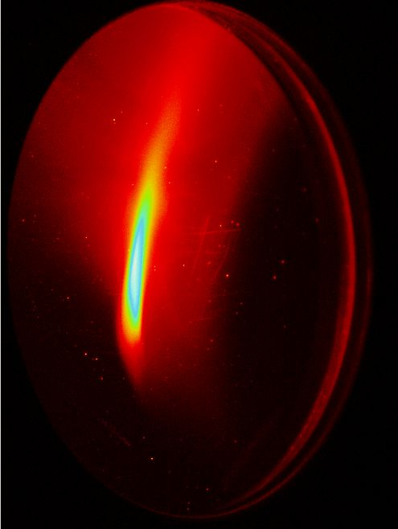
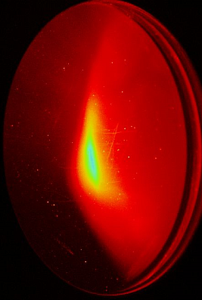
Challenges (ii)
emittance compensation and preservation
- merger design and operation
- 2d-emittance compensation scheme gun to end of linac
- control of CSR effects
linac cavities for high current (HOMs, BBU)
starting point JLAB 5 cell with waveguide damper
design started → looking for 7 cell design
control of beam losses
“ERL beams do not occur in distributions
named after dead mathematicians”
Pat O'Shea, Univ. Maryland
cited by D. Douglas, JLAB
- dark current from gun and cavities
- Halo from laser spot, non linear fields, bunch compression, CSR, ...
- collimation schemes (but where and how ????)

Slide 10

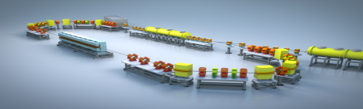
Challenges (iii)
high “virtual” beam power, very high loss rates possible
BESSY II: 200μC / a @ 1.7GeV typical
BERLinPro: some 100μC / 1s @ 50 MeV possible
(30kW linac RF-power)
new regime of operation (compared to storage ring)
→ radiation protection issues favor an underground bunker
3m
Ground level
3m
BERLinPro 50MeV

Slide 11
BERLinPro – Project timeline + budget
2008 10/2010 2011 2012 2013 2014 2015 2016 2017
Application
Approval
(25.8M€ over 5a)
CDR TDR
first
recirculation
Building
Project
start
- first MAC 05/2011
- re-scoping of the project
(100MeV = 50M€
→ 50MeV
following BERLinPro Mac recommendation)
- detailed time planning
- detailed costing
(50MeV = 36.2Mio€, need to stretch timeline)
still hiring additional personnel

Slide 12
Building + Infrastructure (i)
Criteria for the layout of building I
13m x 33m x 3m to host the machine
Close vicinity of the cryo-system and the machine for short cryogenic lines
Radiation protection of the cryogenic systems
Shielding to secure the annual dose limit at any accessible uncontrolled area
Compatibility with environmental contamination requirements (activation of ground water and air)
=> subterranean ~3m “bunker”, adjacent “gallery” with sufficient shielding to place SRF and laser systems
Subterraneous bunker, gallery and entrance ramp

Slide 13
Building + Infrastructure (ii)
Criteria for the layout of building II
1200m² to host equipment and laboratory space
=> industrial hall above surface for technical subsystems, laboratories and new conventional infrastructure
industrial hall for technical subsystems and laboratories and new conventional infrastructure

Slide 14
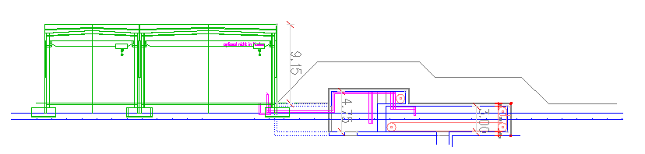
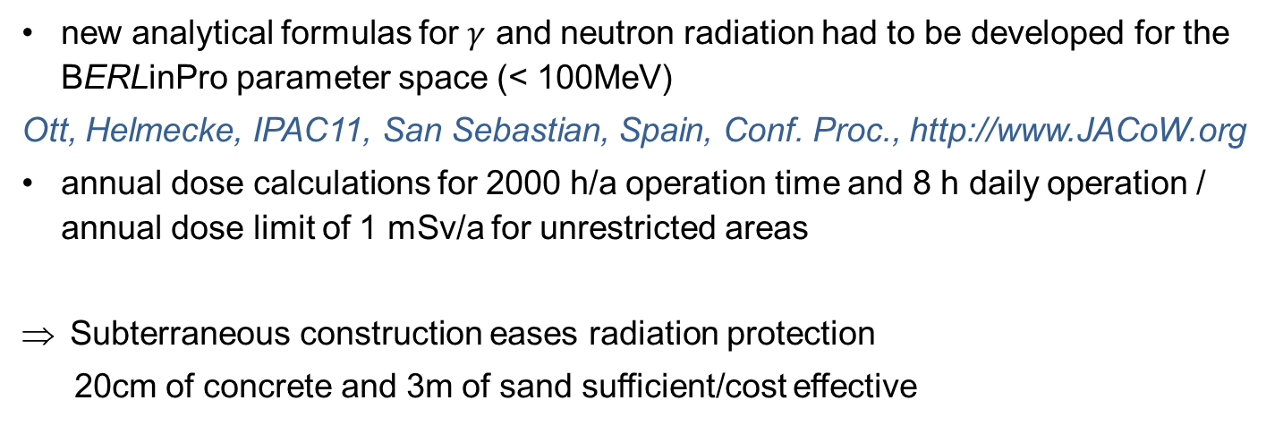
Radiation protection (i)
shielding
new analytical formulas for $γ$ and neutron radiation had to be developed for the BERLinPro parameter space (< 100MeV)
Ott, Helmecke, IPAC11, San Sebastian, Spain, Conf. Proc., http://www.JACoW.org
annual dose calculations for 2000 h/a operation time and 8 h daily operation / annual dose limit of 1 mSv/a for unrestricted areas
    Subterraneous construction eases radiation protection
20cm of concrete and 3m of sand sufficient/cost effective
3m covering with mould (sand)
laboratory space, controls,
technical infrastructure
technical galley + machine
(klystrons,
cold box, laser)
Vertical cut through bunker

Slide 15
Radiation protection (ii)
Beam power
650 kW beam power in injection/extraction line (regular operation)
first beam dump calculations => water cooled copper cone
electron losses in the recirculator ring are limited by the 30 kW of RF power of the linac (unwanted beam loss)
first thoughts on Machine Protection Systems are under way
(local losses (not at collimators ☺), will be limited to < 5μA)
Detector development
detectors for high energy neutron:
use standard neutron detector with 1 cm of lead cover of modulator
due to a (n, 2n) nuclear reaction in the lead the complete neutron spectrum can be measured
calibration at CERN in 2012

Slide 16

Optics and theory – Injector / merger (i)
Layout / Optics
Injector layout of BERLinPro
  merger decision: dogleg
    geometry more comfortable
    second order dispersion acceptable (quads in dispersive region)
  reduction of number of booster cavities (5 -> 3)
    stronger RF focusing
  space requirements for HOM couplers behind gun
    longer bunches / compression in merger necessary
    reduced solenoid field less favorable for emittance
  use of Gaussian laser pulses (see talk T. Quast)
    risk of over compression of low charge slices
  => standard mode optics developed to achieve design goals

Slide 17
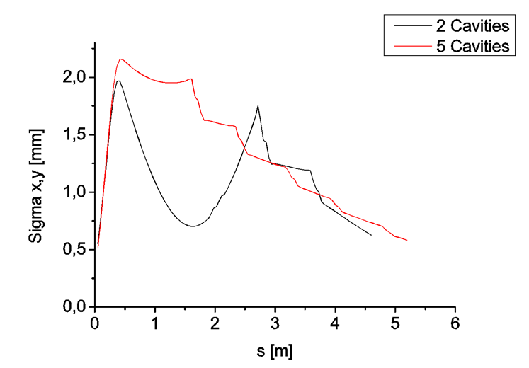
Optics and theory – Injector / merger (ii)
Longitudinal phase space behind booster
First cavity will have 9kV transmitter only
Field without beam loading
enough to energy chirp the bunch
Bunch length behind booster : 0.3 – 5mm
Beam size development in injector for 2 and 5 cavities
2 cavities
5 cavities
Standard mode parameters behind booster
Emittance [mm mrad] | 0.9
Bunch length [mm] | 1.8

Slide 18
Optics and theory – Beam dynamics gun to linac
77pC bunch charge
gun
booster
merger
linac
gun
booster
merger
linac

Slide 19
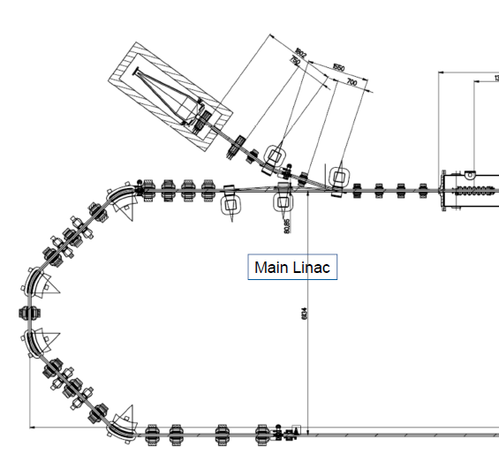
Optics and theory – Layout of arcs (i)
4 dipoles (45°)
7 quadrupoles
4 sextupoles
High transmission: moderate β-functions and dispersion
Variable R₅₆: ‑0.25 m < R₅₆ < 0.25 m
Adjustable betatron phase advance: increase BBU current threshold
Sextupoles: control non-linear beam transport
First arc with beam dump

Slide 20
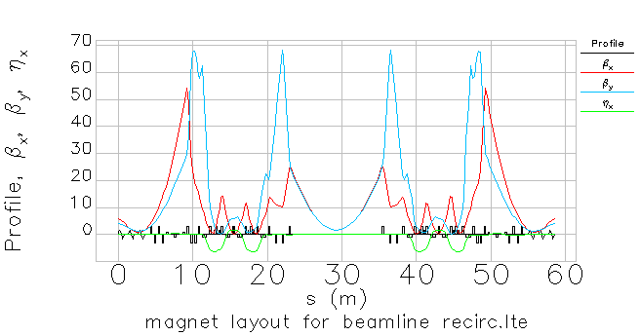
Optics and theory – Layout of arcs (ii)
Recirculator lattice:
R₅₆ = 0.0 m

Slide 21
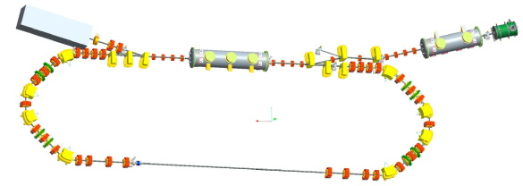
SRF gun development – Staging
High current injector development in three stages
see talk:
T. Kamps, “BERLinPro injector”
Current focus
 | HoBiCaT Injector 0 | Injector 1 | Injector 2
Goal | Beam Demonstrator | Brightness R&D Injector | High-current injector
Electron energy | ≥ 1.5 MeV
RF frequency | 1.3 GHz
Design peak field | ≤ 50 MV/m
Operation launch field | ≥ 10 MV/m
Bunch charge | ≤ 77 pC
Repetition rate | 30 kHz | 54 MHz / 25 Hz | 1.3 GHz
Cathode material | Pb | CsK₂Sb | CsK₂Sb
Cathode QE | 10⁻⁴ at 258 nm | 10% at 532 nm | 10% at 532 nm
Laser wavelength | 258 nm | 532 nm | 532 nm
Laser pulse energy | 0.15 µJ | 1.8 nJ | 1.8 nJ
Laser pulse shape | Gaussian | Gaussian/Flat-top | Gaussian/Flat-top
Laser pulse length | 2.5 ps FWHM | ≤ 20 ps | 20 ps
Average current | 0.5 µA | ≤ 10 mA / 0.1 mA | 100 mA

Slide 22
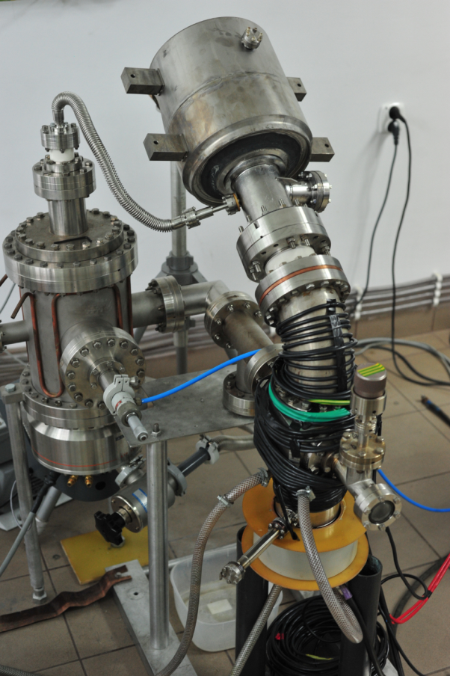
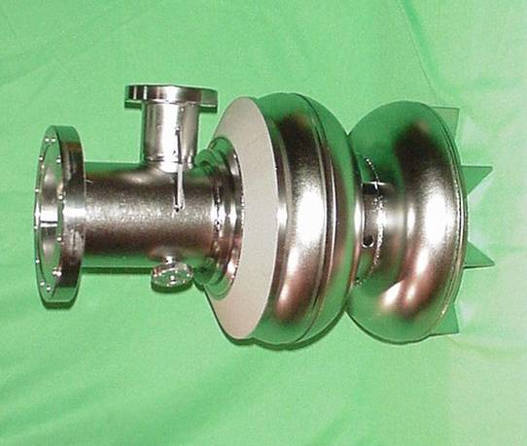




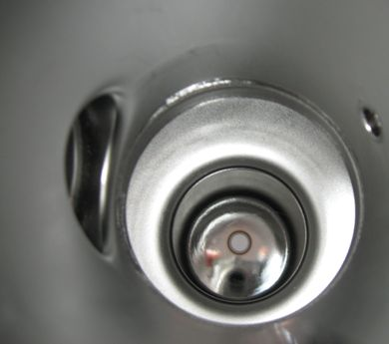
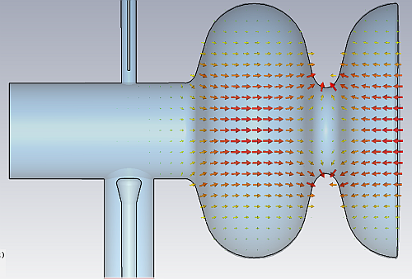



SRF gun development – HoBiCaT / fully sc gun with lead cathode
Plasma arc
depositon setup
at Swierk
Cavity production at JLAB
P. Kneisel
Pb cathode film (few 100 nm)
J. Sekutowicz, DESY
R. Nietubyc, Soltan Inst.

Slide 23
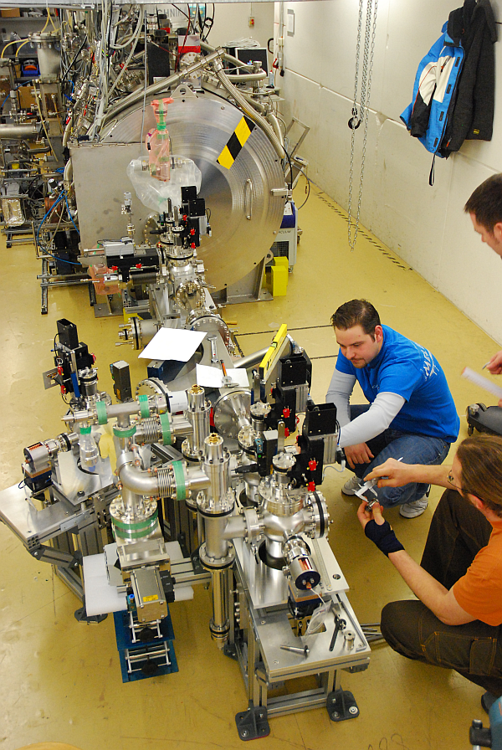
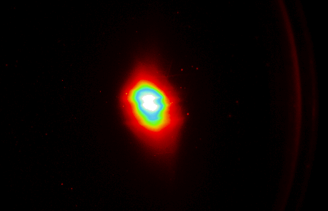
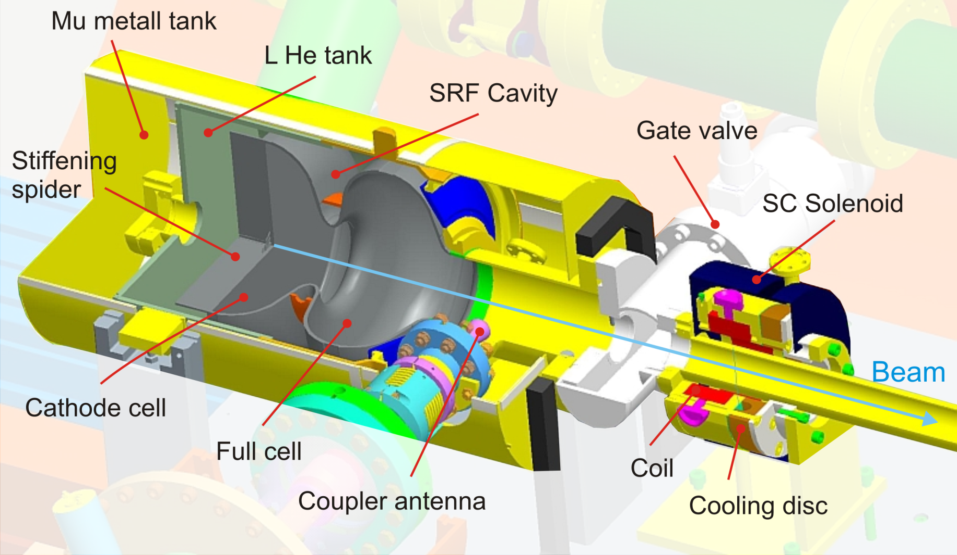
SRF gun development – HoBiCaT / fully sc gun with lead cathode
Project Start:
May 2009
1.8MeV
6pC bunch charge
8kHz (~50nA)
3ps rms
2 mm mrad (~ 5 mm mrad / mm)
First beam
21st April 2011
- important milestone,
demonstrating our capabilities
- great interest in community
- basis for further collaborative
effort
In 2012 test of new fully sc 1.6 cell gun
(with Pb cathod plug)

Slide 24
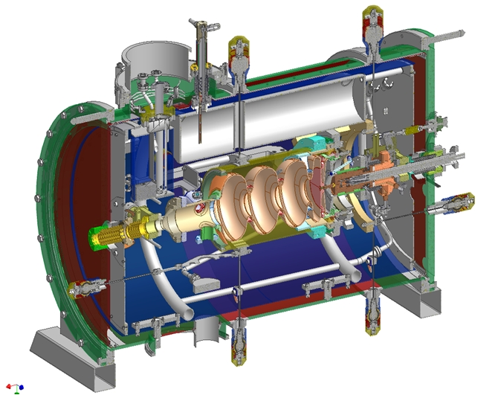
SRF gun development – Gun Lab cryo module gun_1 / 2
Gun1: Plan cryomodule.
Needs to be ready to take cold mass in summer 2014
Design based on 2nd gen gun cryomodule design of the HZDR/ELBE SRF gun.
P. Murcek (HZDR) incorporated already some BERLinPro design requirements in the current version.
Detailed design depends on cavity unit, RF coupler, cavity tuner, HOM load, solenoid.
Need to fix soon interfaces with big items with long lead/development time like RF coupler, tuner, solenoid mover.
Courtesy: P. Murcek

Slide 25
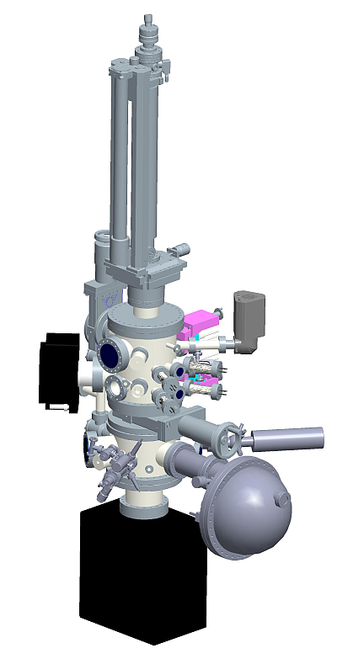
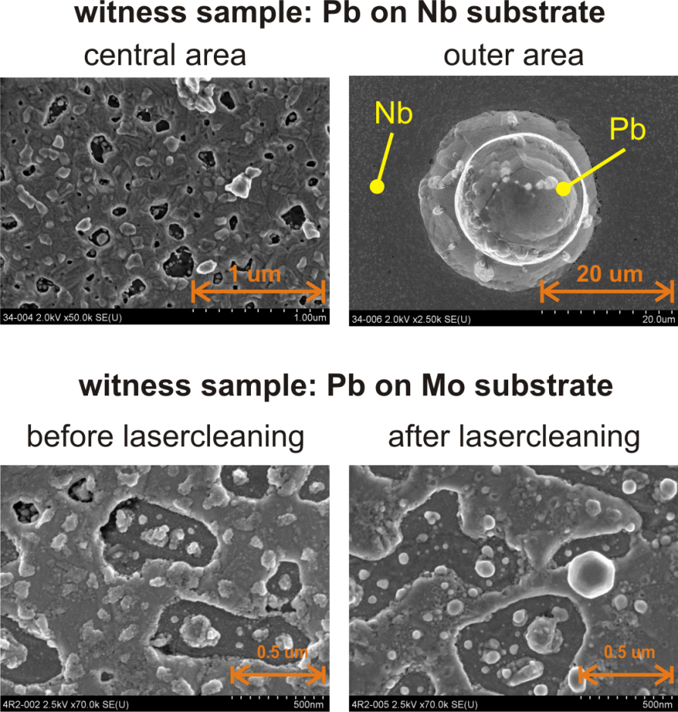

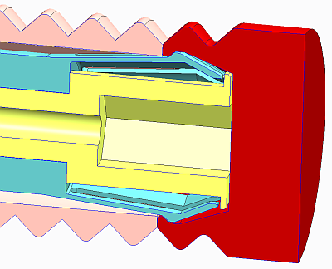
SRF gun development – Gun Lab cathode preparation
Gun1: Setup for CsK₂Sb cathode preparation.
Start preparation of cathodes in summer 2012
Order of parts completed.
Next steps: Detailed design of evaporators and cap holder, engineering design of transport vessel, engineering of support base, and location of suitable lab area.
S. Schubert, D. Böhlick
Transfer and
transportation
Evaporation
sources
Mass spectrometer
X-ray tube
Ion gun
Ion and electron
Energy analyser
R. Barday
S. Schubert

Slide 26
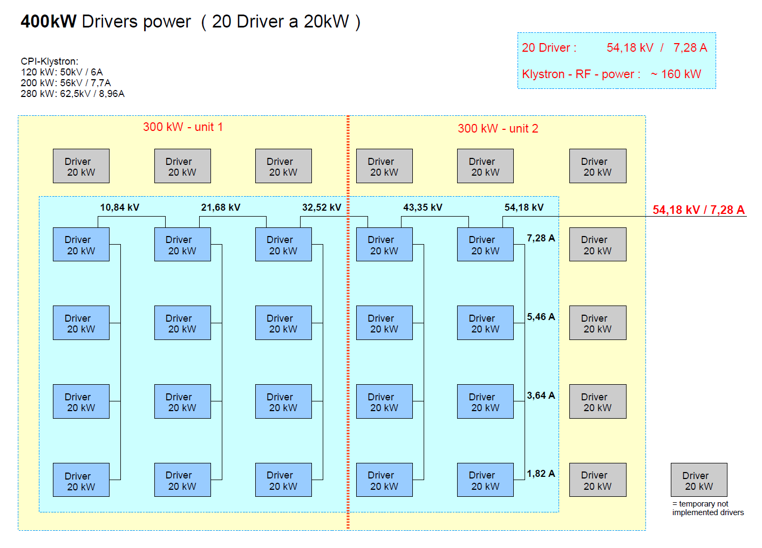
Cold systems – RF systems
Two types of transmitters:
High beam loading in injector path 1 MeV 100 mA ➔ 100 kW
Klystron based 270 kW transmitters
Build in two stages 160 kW (~50 mA beam)→ 270 kW (~100 mA beam)
Klystrons, circulator, transmitter-status: ordered
Low beam loading in main linac (energy recovery)
15 kW solid state transmitters
 | base design |  | upgrade option
 | stage 1 (50 mA) | stage 2 (100 mA)
 | transmitter power
Gun cavity | 160 kW | 270 kW | 270 kW
Booster Cavity 1 | 15 kW | 15 kW | 80 kW
Booster Cavity 2 | 160 kW | 270 kW | 270 kW
Booster Cavity 3 | 160 kW | 270 kW | 270 kW
Linac | 3x15 kW | 3x15 kW | 3x15 kW
Collector power supply of klystron transmitter: first stage (blue) 160 kW_{RF}, full 270 kW_{RF}
Overview of BERLinPro transmitters

Slide 27
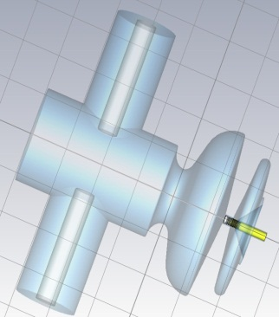
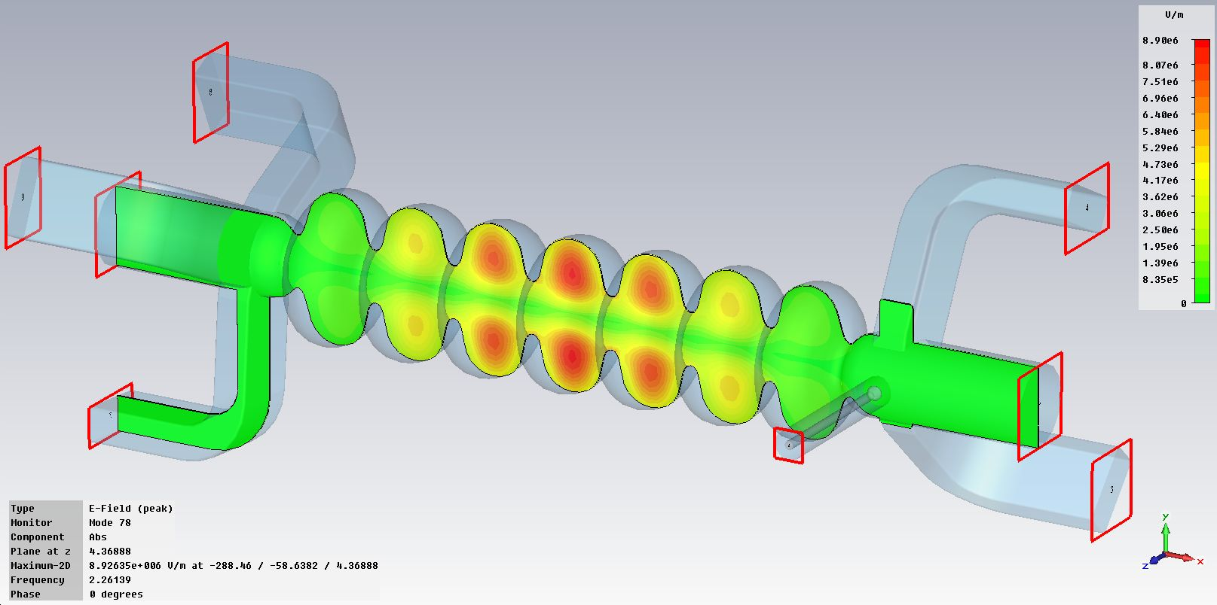
Cold systems – Cryo modules
Three cryo modules at BERLinPro
Gun module and booster module in construction phase
Linac module construction will start 2013
Model of 7-cell cavity with waveguide HOM dampers
0.6-cell gun cavity with choke cell
 | Number of cavities / cells | HOM damping | Accelerating field gradient | Fundamental power coupler | Maximal power at coupler | Tuner
Gun module | 1 x 0.6/1.4- cell | Beam pipe ferrite | ~ 20 MV/m | 2x KEK type | 115 kW | Blade
Booster module | 3 x 2-cell Cornell-type | Beam pipe ferrite | < 10 MV/m | 2x KEK type each cavity | 115 kW | Blade
Main linac module | 3 x 7-cell | Wave guide | 18.3 MV/m | BESSY (TTF3) type | 10 kW | Blade
The availability of high current cw srf technology
opens up new possibilities
e.g. BESSY^{VSR}
“overvoltage cavities”
(see Gode Wüstefelds talk)
BESSY^{VSR}

Slide 28
Cold systems – Cryogenics (i)
Cryogenics at BERLinPro is at three temperature levels
1.8 K for cooling of the cavities. High dynamic load due to cw operation
4.5 K for thermal intercepts
80 K for shield cooling and HOM beam pipe ferrites
 | 1.8 K |  | 4.5 K |  | 80 K
 | Static load | Dynamic load | Static load | Dynamic load | Static load | Dynamic load
Photoinjector module | 7 W | 16 W | 34 W | 8 W | 130 W | 75 W
Booster module | 11W | 39 W | 62 W | 24 W | 180 W | 270 W
Linac module | 21 W | 79 W | 59 W | 6 W | 203 W | 30 W
Subtotal | 39 W | 134 W | 155 W | 38 W | 513 W | 375 W
Cryo Distribution | 3 W | -- | 45 W | -- | 550 W | --
Total | 42 W | 134 W | 200 W | 38 W | 1063 W | 375 W
Cryogenic loads at BERLinPro

Slide 29
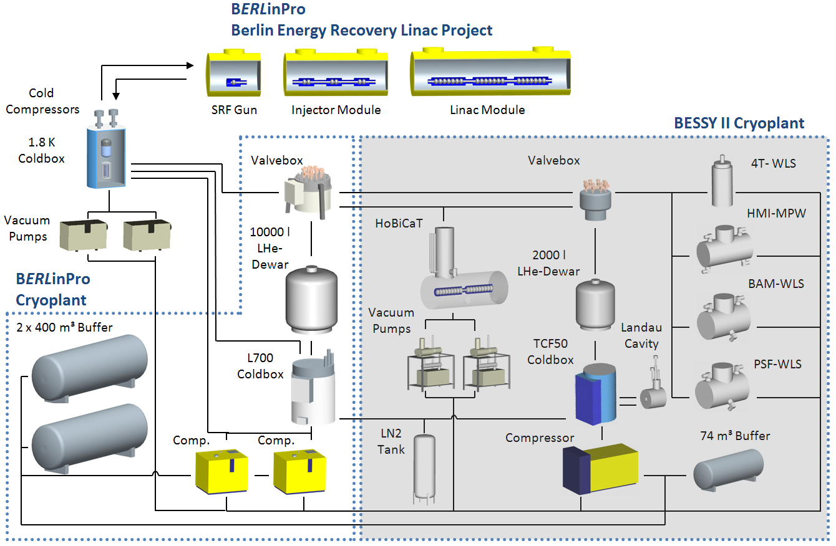
Cold systems – Cryogenics (ii)
Existing cryogenic infrastructure with two operating cryo plants:
TCF 50 liquefaction rate: 180 l/h
L700 liquefaction rate: 700 l/h
New: Cold compressor box needed for BERLinPro

Slide 30
Summary
BERLinPro is a technology demonstrator for “generic ERL research”
(50MeV, 100mA, 1 π mm mrad, srf gun)
Project started 2011, first beam through booster envisaged 2015
Makes efficient use of existing resources at HZB (Matrix org.)
(Institute for Accelerator Physics, Institute for SRF Science, Department
for Accelerator operation, Young Investigator Group)
Well embedded in the Accelerator Research and Development
Initiative of Germanys Helmholtz-Foundation
Very attractive for students (education) from Berlin Universities
and abroad

Slide 31
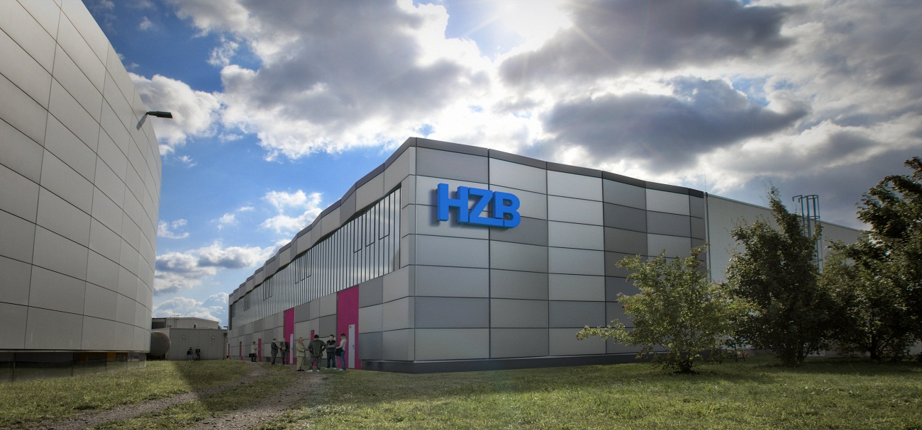

From virtual reality to virtual beam power
We are right on the way!

Slide 32
Thanks to the BERLinPro Team
T. Atkinson, R. Barday, A. Bondarenko, S. Schubert, Y. Petenev, J. Rudolph, J. Völker

