Slide 1









Status of the ERL Project in Japan
Shogo Sakanaka
for the ERL development team
High Energy Accelerator Research Organization (KEK)
Presentation at FLS2012, March 5-9, 2012, at Jefferson Lab.
v1

Slide 2





Acknowledgment to Staff and Collaborators
High Energy Accelerator Research Organization (KEK)
M. Akemoto, T. Aoto, D. Arakawa, S. Asaoka, K. Endo, A. Enomoto, S. Fukuda, K. Furukawa,
T. Furuya, K. Haga, K. Hara, K. Harada, T. Honda, Y. Honda, T. Honma, T. Honma, K. Hosoyama,
M. Isawa, E. Kako, T. Kasuga, H. Katagiri, H. Kawata, Y. Kobayashi, Y. Kojima, T. Matsumoto,
H. Matsumura, S. Michizono, T. Mitsuhashi, T. Miura, T. Miyajima, H. Miyauchi, N. Nakamura,
S. Nagahashi, H. Nakai, H. Nakajima, E. Nakamura, K. Nakanishi, K. Nakao, T. Nogami, S. Noguchi,
S. Nozawa, T. Obina, S. Ohsawa, T. Ozaki, C. Pak, H. Sakai, S. Sakanaka, H. Sasaki, S. Sasaki,
Y. Sato, K. Satoh, M. Satoh, T. Shidara, K. Shinoe, M. Shimada, T. Shioya, T. Shishido, T. Takahashi, R. Takai, T. Takenaka, Y. Tanimoto, M. Tobiyama, K. Tsuchiya, T. Uchiyama, A. Ueda, K. Umemori,
K. Watanabe, M. Yamamoto, Y. Yamamoto, S. Yamamoto, Y. Yano, M. Yoshida
Japan Atomic Energy Agency (JAEA)
R. Hajima, R. Nagai, N. Nishimori, M. Sawamura, T. Shizuma
Institute for Solid State Physics (ISSP), University of Tokyo
I. Ito, H. Kudoh, T. Shibuya, H. Takaki
UVSOR, Institute for Molecular Science
M. Katoh, M. Adachi
Hiroshima University
M. Kuriki, H. Iijima, S. Matsuba
Nagoya University
Y. Takeda, Xiuguang Jin, T. Nakanishi, M. Kuwahara, T. Ujihara, M. Okumi
National Institute of Advanced Industrial Science and Technology (AIST)
D. Yoshitomi, K. Torizuka
JASRI/SPring-8
H. Hanaki
Yamaguchi University
H. Kurisu
2

Slide 3
Outline
Outline of the ERL plan in Japan
Design of the Compact ERL (cERL)
Status of R&D and Construction
Summary

Slide 4
Outline of the ERL plan in Japan

Slide 5
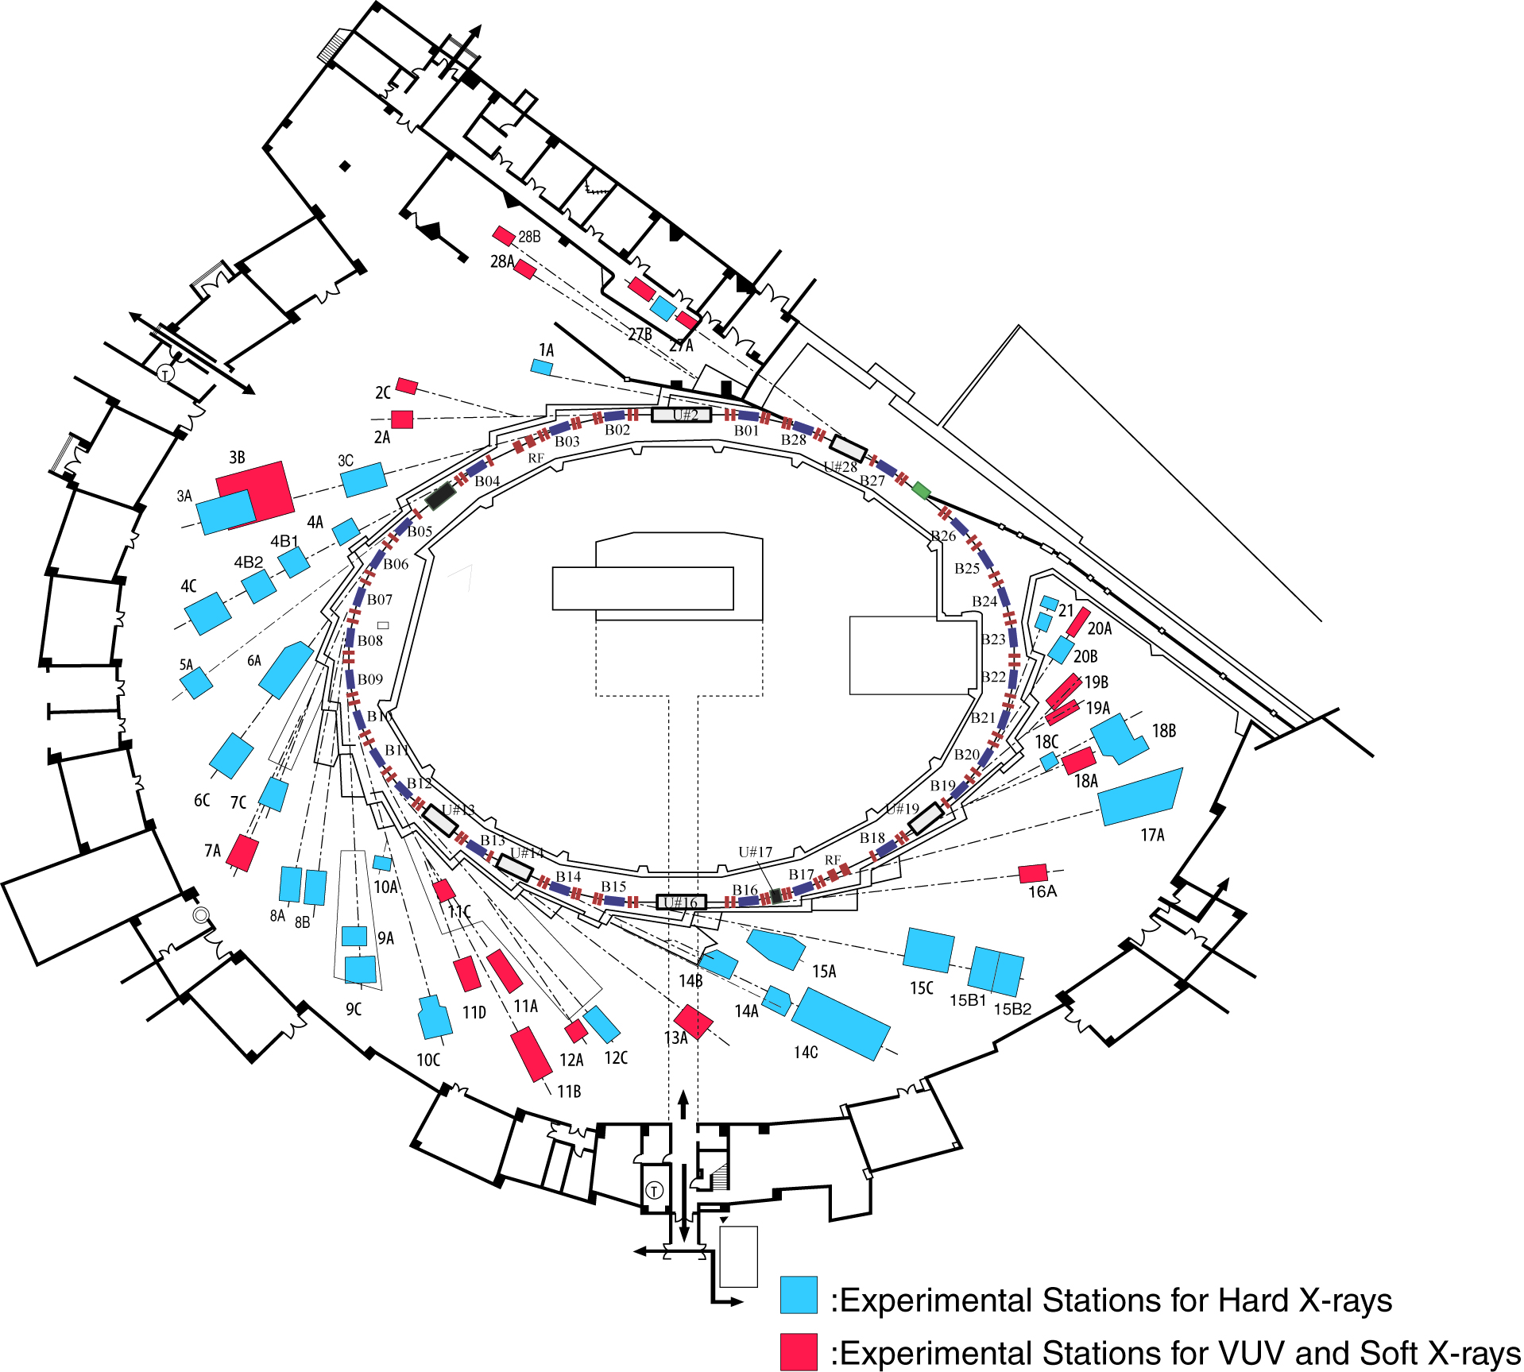
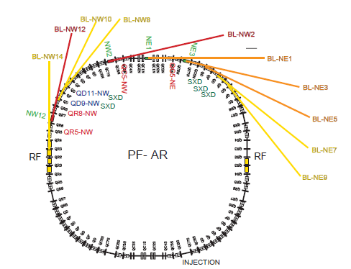
KEK Photon Factory (at present)
PF ring (2.5 GeV)
PF-AR (6.5 GeV)
E = 6.5 GeV (injection: 3 GeV),
C = 377 m, (I₀)_{max}=60 mA
Beam emittance: 293 nm·rad
Single bunch operation (full time)
8 beamlines, 10 experimental stations
  In-vacuum X-ray undulators: 5
  Multi-pole wiggler : 1
Since 1987
E = 2.5 GeV, C = 187 m
Beam emittance : 34.6 nm rad
Top-up operation, I₀ = 450 mA
10 insertion devices
  In-vacuum X-ray undulators: 3
  VUV/SX undulators: 5
22 beamlines, 60 experimental stations
Since 1982

Slide 6
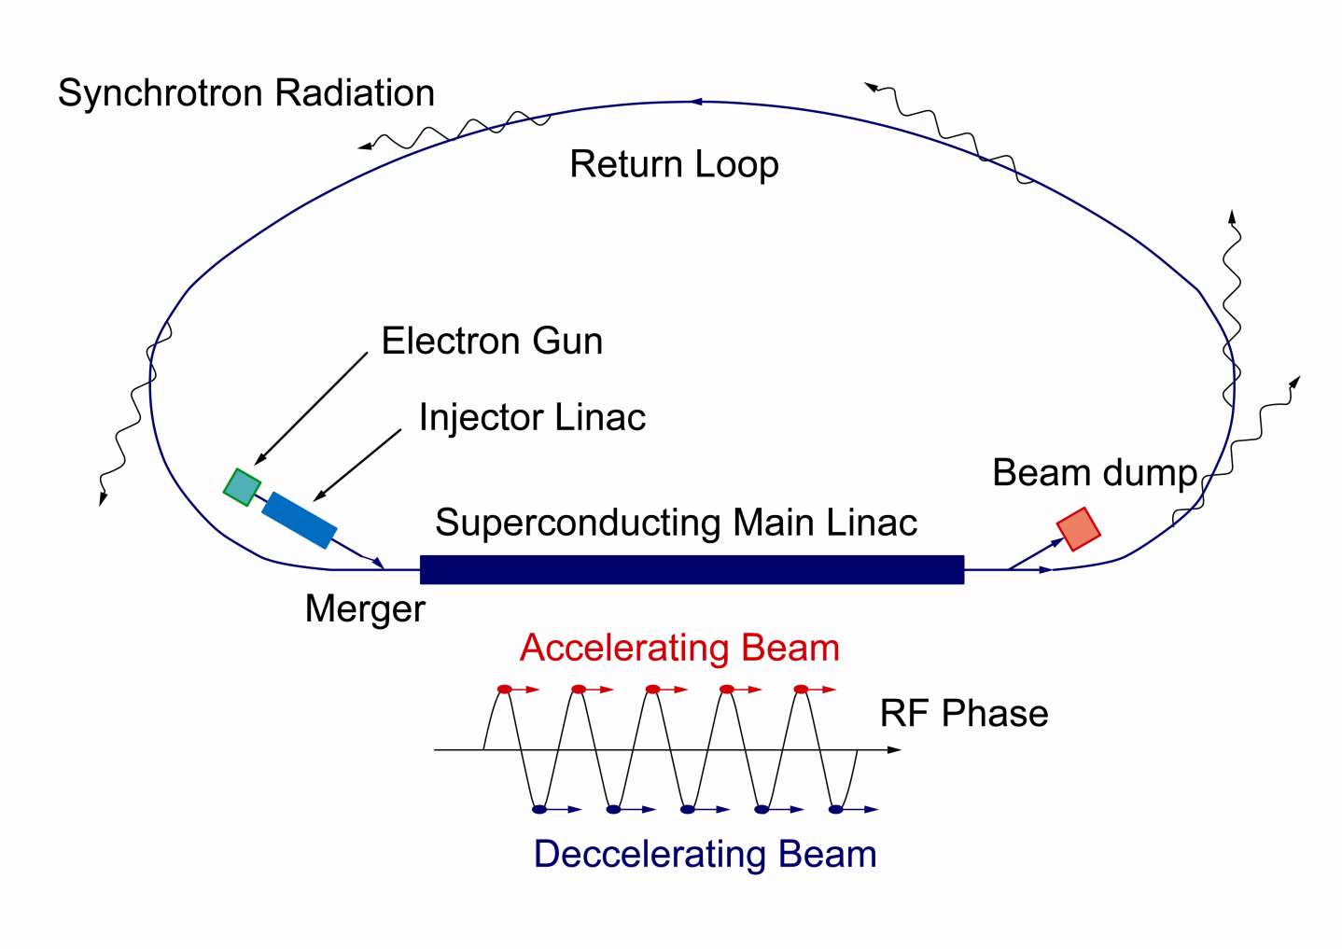
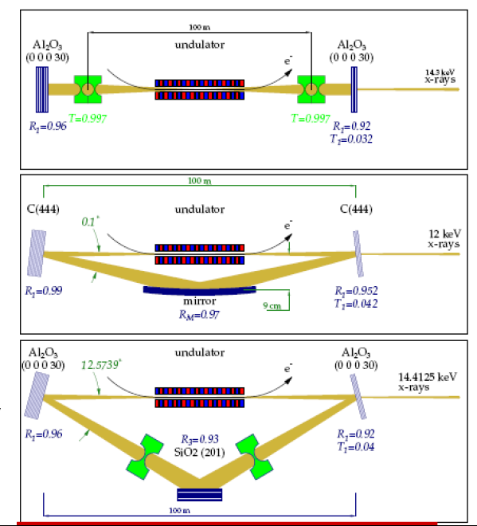
3GeV ERL Light Source Plan at KEK
Needs for future light source at KEK
Driving cutting-edge science
Succeeding research at the Photon Factory (2.5 GeV and 6.5 GeV rings)
3-GeV ERL that is upgradable
to an XFEL oscillator
Layout and beam optics
are under design.
λ_{rf}/2 path-length
changer
6 (7) GeV
3GeV ERL
in the first stage
XFEL-O in 2nd stage

Slide 7
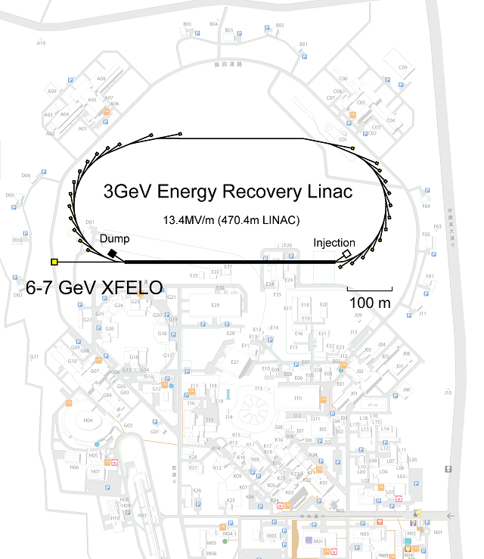
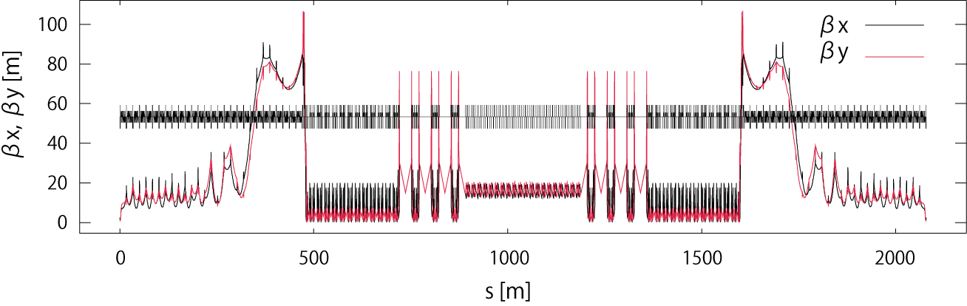
Tentative Layout of 3-GeV ERL at KEK
Courtesy: N. Nakamura, M. Shimada, Y. Kobayashi
Beam energy
  Full energy: 3 GeV
  Injection and dump :10 MeV
Geometry
  From the injection merger to the dump line : ~ 2000 m
  Linac length : 470 m
Straight sections for ID’s
  22 x 6 m short straight
  6 x 30 m long straight
Overall beam optics (merger → dump)
Acceleration
Deceleration
Notes:
7

Slide 8
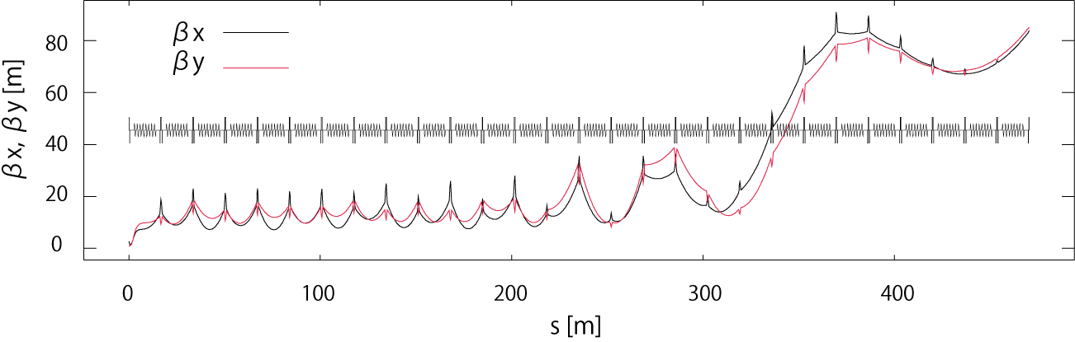
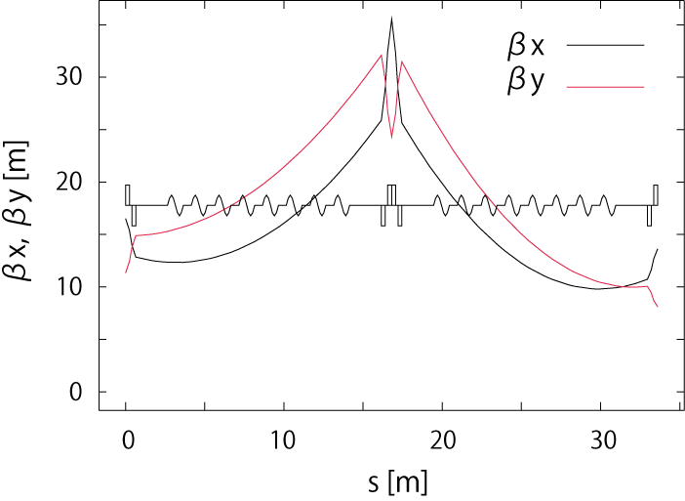
Beam Optics in 3-GeV Linac
Courtesy: N. Nakamura, M. Shimada, Y. Kobayashi
Cavities
  Eight 9-cell cavities in a cryomodule.
  28 cryomodules (252 cavities).
  Field gradient: 13.4 MV/m
Layout
  Focusing by triplets.
  Gradient averaged over the linac is 6.4 MV/m
Optics
  Minimization of beta functions to suppress the HOM BBU (optimized with SAD code)
  Body and edge focusing effects of the cavities are included with elegant code
  Deceleration is symmetric to the acceleration.
triplet
8

Slide 9
Target Parameters for Typical Operational Modes
High-brilliance light source
XFEL-O
 | High coherence (HC) mode | High flux (HF) mode | Ultimate mode (future goal) | XFEL-O
Beam energy | 3 GeV |  |  | 7 (6) GeV¹⁾
Beam current | 10 mA | 100 mA | 100 mA | 20 μA
Charge/bunch | 7.7 pC | 77 pC | 77 pC | 20 pC
Bunch repetition rate | 1.3 GHz | 1.3 GHz | 1.3 GHz | 1 MHz
Normalized beam emittance (in x and y) | 0.1 mm·mrad | 1 mm·mrad | 0.1 mm·mrad | 0.2 mm·mrad
Beam energy spread (rms) | 2×10⁻⁴ | 2×10⁻⁴ | 2×10⁻⁴ | 2×10⁻⁴
Bunch length (rms) | 2 ps | 2 ps | 2 ps | 1 ps
1) Parameters were estimated at 7 GeV. We are interested in 6-GeV operation.

Slide 10
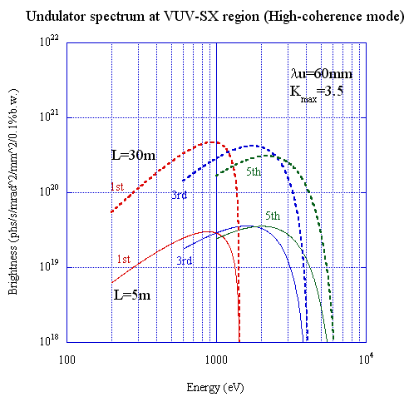
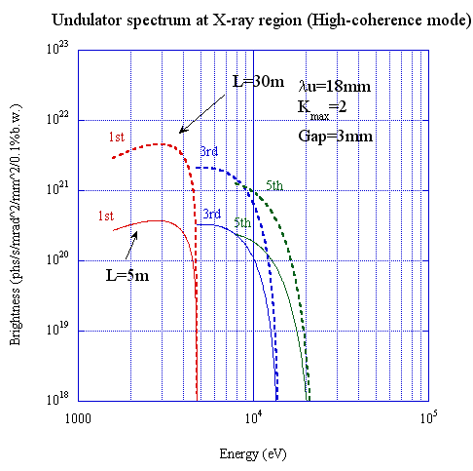
Spectral Brightness (high-coherence mode)
Courtesy: K. Tsuchiya
VUV-SX undulator
X-ray undulator

Slide 11
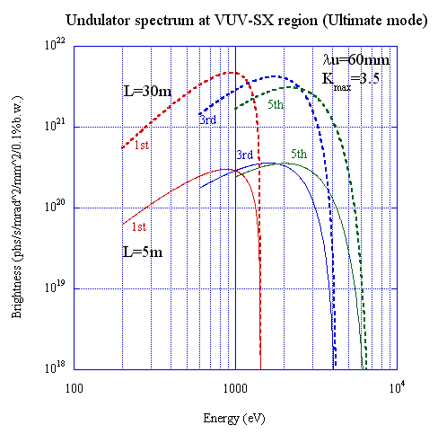
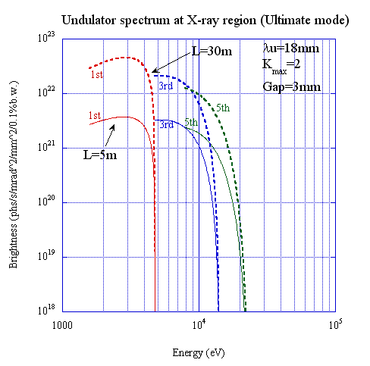
Spectral Brightness (ultimate mode)
Courtesy: K. Tsuchiya
VUV-SX undulator
X-ray undulator

Slide 12
(cf.) Assumed Parameters of Undulators
Courtesy: K. Tsuchiya
VUV-SX undulator
X-ray undulator
 | Parameter
Length of period λ_{u} | 60 mm
Number of periods N_{u} | 83 (L_{u} = 5 m) 500 (L_{u} = 30 m)
Maximum K-value K_{max} | 3.5
Maximum magnetic field B_{max} | 0.525 T
Optical functions at undulator | β_{x} = β_{y} = 10 m α_{x} = α_{y} = 0 η = η’ = 0
 | Parameter
Length of period λ_{u} | 18 mm
Number of periods N_{u} | 277 (L_{u} = 5 m) 1666 (L_{u} = 30 m)
Maximum K-value K_{max} | 2
Maximum magnetic field B_{max} | 1.19 T
Optical functions at undulator | β_{x} = β_{y} = 10 m α_{x} = α_{y} = 0 η = η’ = 0

Slide 13
Target: spectral brightness
Targets for ERL
XFEL-O
ERL
Figures are cited from: R. Hettel, “Performance Metrics of Future Light 13 Sources”, FLS2010, SLAC, March 1, 2010.

Slide 14
2. Design of the Compact ERL (cERL)

Slide 15
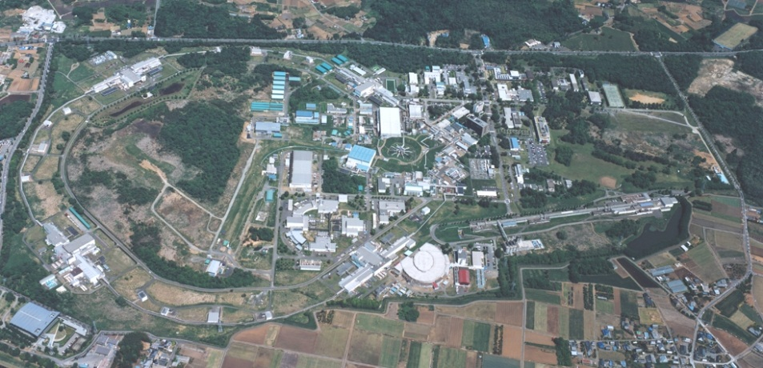
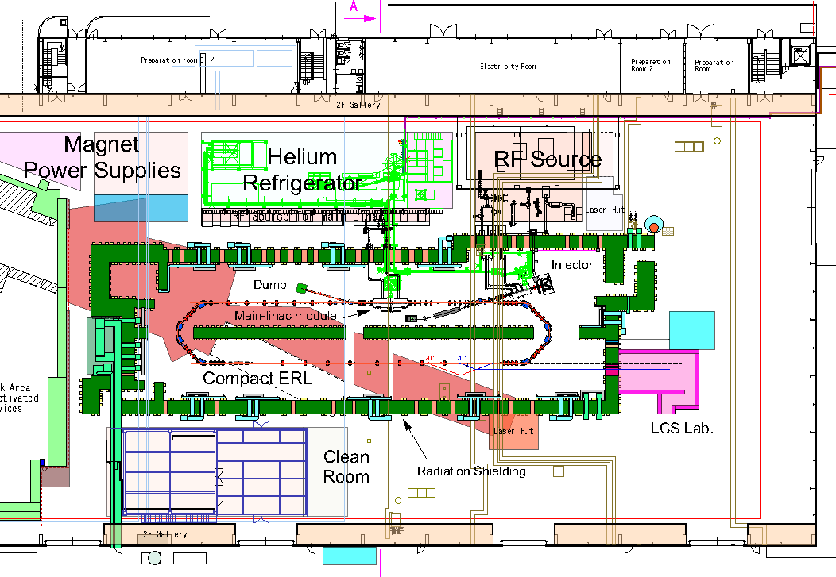
The Compact ERL for demonstrating our ERL technologies
Goals of the compact ERL
Demonstrating reliable operations of our R&D products (guns, SC-cavities, ...)
Demonstrating the generation and recirculation of ultra-low emittance beams
ERL development building
Parameters of the Compact ERL
70 m
 | Parameters
Beam energy (upgradability) | 35 MeV 125 MeV (single loop) 245 MeV (double loops)
Injection energy | 5 MeV
Average current | 10 mA (100 mA in future)
Acc. gradient (main linac) | 15 MV/m
Normalized emittance | 0.1 mm·mrad (7.7 pC) 1 mm·mrad (77 pC)
Bunch length (rms) | 1 - 3 ps (usual) ~ 100 fs (with B.C.)
RF frequency | 1.3 GHz

Slide 16
Layout of the Compact ERL (single-loop version)

Slide 17
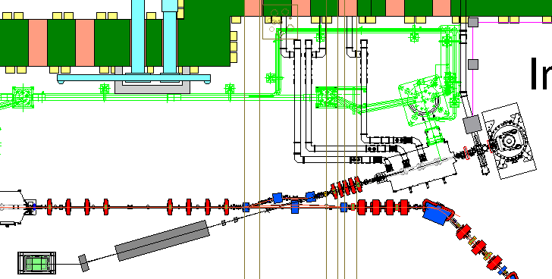
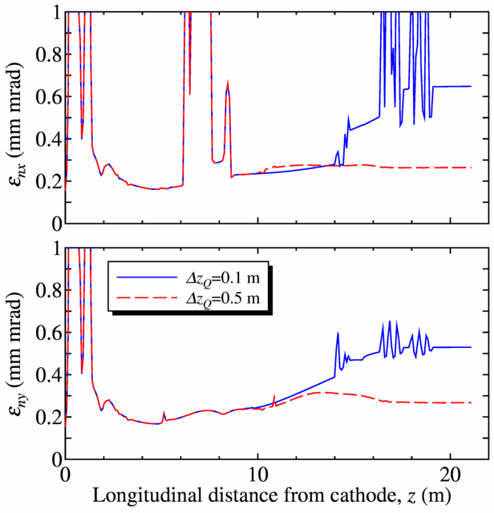
Optimized Design of Injector (for commissioning)
Courtesy: T. Miyajima
Point C
0.69 mm mrad
After optimization
0.26 mm mrad
Point A
Buncher
Merger
Injector Cryomodule
500kV DC gun
Diagnostic beamline
for Injector
Design layout of cERL injector.
Example of parameters.
After optimization
Parameter | Value
Gun DC voltage | 500 kV
Beam energy of injector | 5 MeV
Charge/bunch | 7.7 pC
Full width of laser pulse | 16 ps
Spot diameter of laser | 0.38 mm
Magnetic fields of solenoids #1, #2 | 0.0326, 0.0318 T
Voltage of buncher cavity | 90.6 kV
Eacc of 1st, 2nd, and 3rd SC cavity | 6.46, 7.52, 6.84 MV/m
Offset phase of 1st, 2nd, and 3rd cavity | 13.6, 4.8, 10.0 degrees
Example of beam envelopes from the gun to
a matching point.
(T. Miyajima, presentation at ERL11)

Slide 18
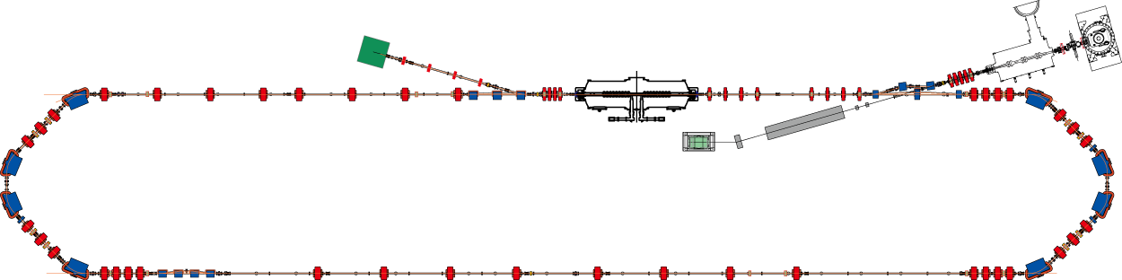
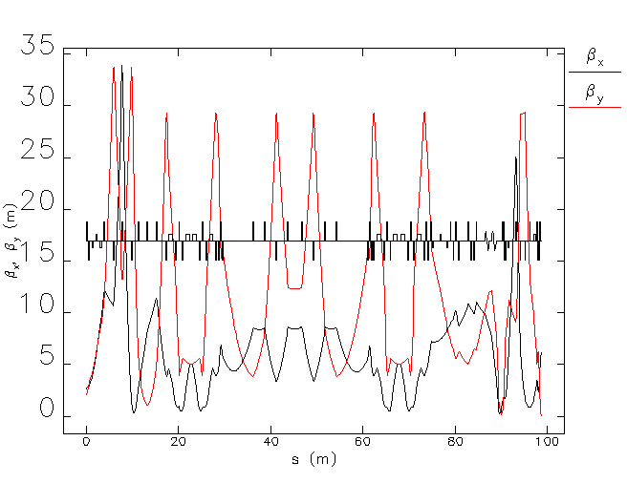
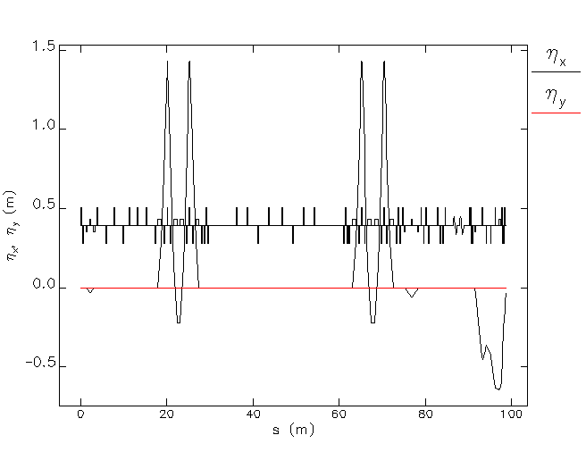
Lattice and Optics Design of cERL
Courtesy: M. Shimada
and N. Nakamura
Injector SCC
cryomodule
Beam dump
Main SCC
cryomodule
Arc #1
(TBA)
Three-dipole
merger
Photocathode
DC gun
Bump magnets
Bump magnets
The Compact ERL
35 MeV, 10 mA version
Diagnostic beamline
for Injector
Injection energy: 5 MeV
Arc #2
(TBA)
Chicane for orbit-length adjustment
Aperture: 35 mm in arc
Energy acceptance: ±2%
Betatron functions in the return loop.
Dispersion functions in the return loop.

Slide 19
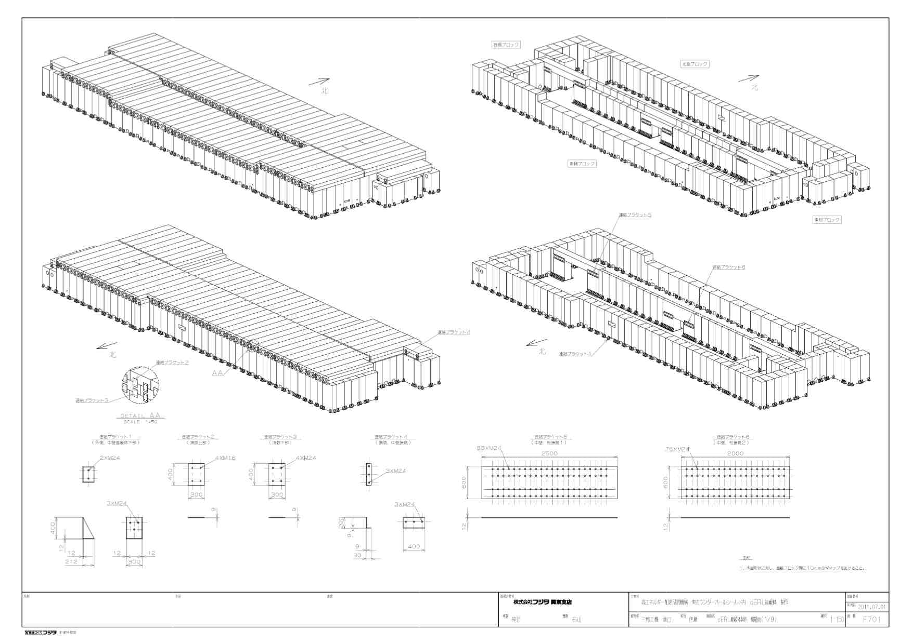
Design of Radiation Shield
Courtesy: K. Haga
Roof: 1-m thick
Side wall: 1.5-m thick
Japan is an earthquake-prone area.
This shield can withstand both horizontal and vertical accelerations (earthquake) of up to 0.5 G.

Slide 20
3. Status of R&D and Construction

Slide 21
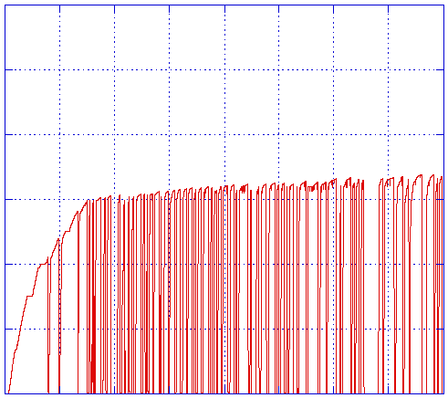
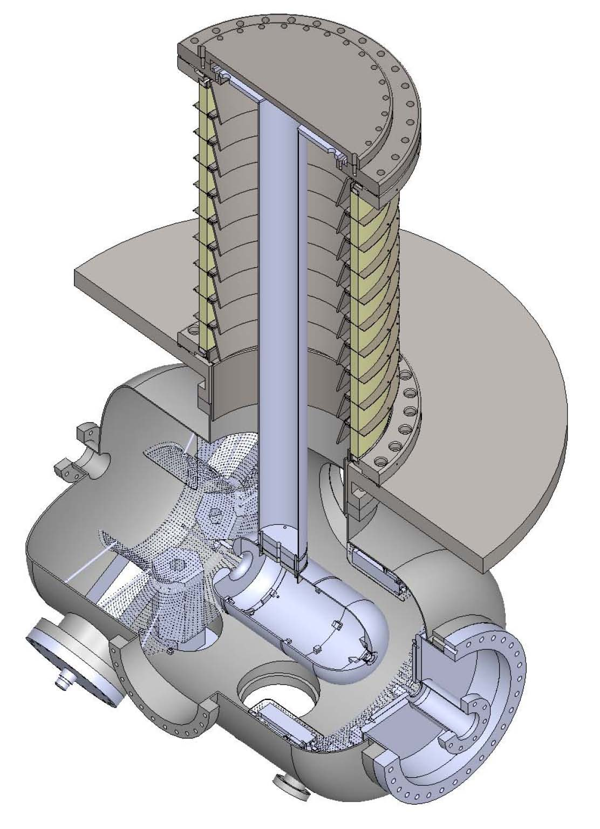
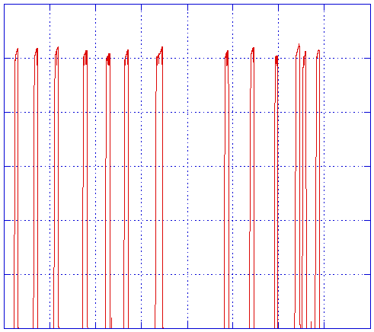
HV processing of JAEA-gun with electrode in place
Development of Photocathode DC Gun #1 at JAEA
Courtesy: N. Nishimori
  HV processing up to 526 kV
  Local radiation problem needs to be solved
600
High voltage
400
HV(kV)
200
0
0
4
8
time(hrs.)
600
526kV
400
HV(kV)
200
0
112
116
120
time(hrs.)
N. Nishimori et al., Presentation at ERL2011.
Notes:
The next step is to repeat the same HV processing with electrodes and NEG pumps in place. We tried to design the electrodes for its maximum surface electric field to be less than 10 MV/m for 500 kV. The maximum electric field is 10.3 MV/m. The gap between cathode and anode electrodes is 100 mm. The electric field on the cathode is 6.7 MV/m.
We installed electrodes and NEG pumps in the HV chamber and performed HV processing up to 526kV, but we have not reached 550 kV yet because of local radiation problem, which appears suddenly after a discharge. This local radiation disappears by hand wiping after nitrogen exposure of the HV chamber. The source of radiation will be dust inside of the chamber.
Very recently we found a certain amount of polishing powder were left in holes of NEG holder parts. It is likely those powders fell on the cathode electrode during the processing. We will perform supersonic wave cleaning of NEG holders with organic solvents and try HV processing again.
21

Slide 22
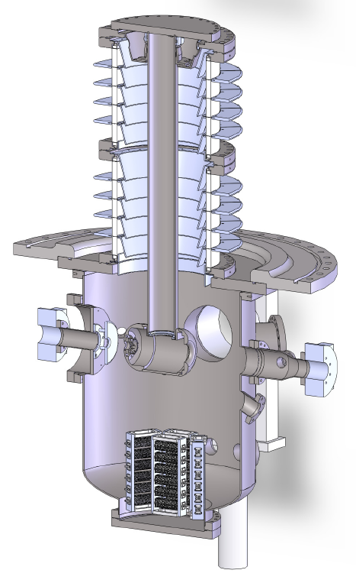
Development of Photocathode DC Gun #2 at KEK
Aiming at Achieving Extreme High Vacuum
Courtesy: M. Yamamoto
High voltage insulator
  Inner diameter of φ=360 mm
  Segmented structure
Low outgassing material
  Large titanium vacuum chamber
  (ID~φ630 mm)
  Titanium electrode, guard rings
Main vacuum pump system
  Bakeable cryopump
  NEG pump (> 1x10⁴ L/s, for hydrogen)
Large rough pumping system
  1000 L/s TMP & ICF253 Gate valve
e⁻ beam
Anode
(0V)
Cathode
(-500kV)
Goal
Ultimate pressure : 1x10⁻¹⁰ Pa
(during the gun operation)
IPAC2011 Spain
22
6th,Sept,2011

Slide 23
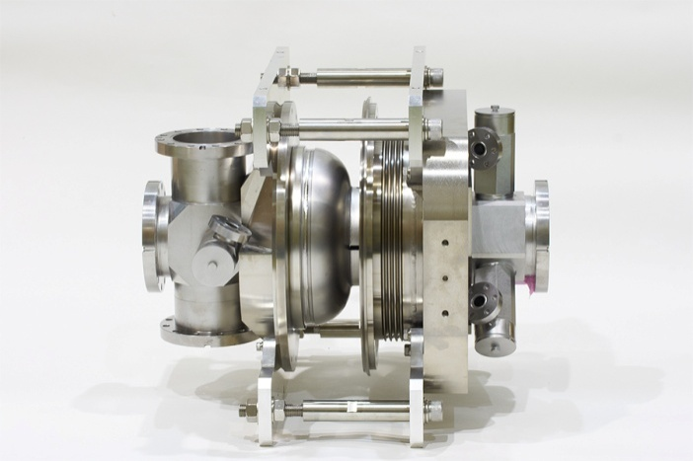
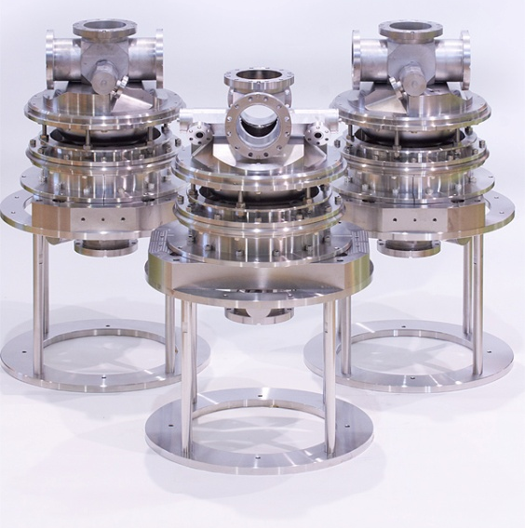
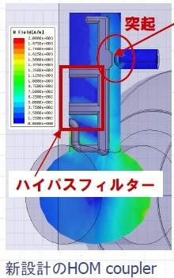
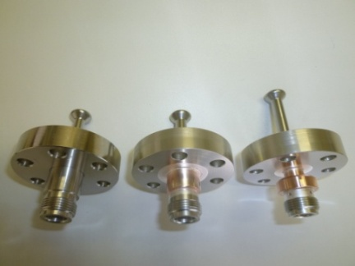
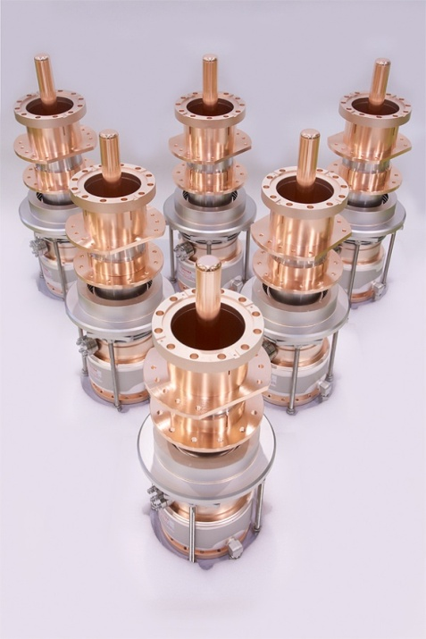
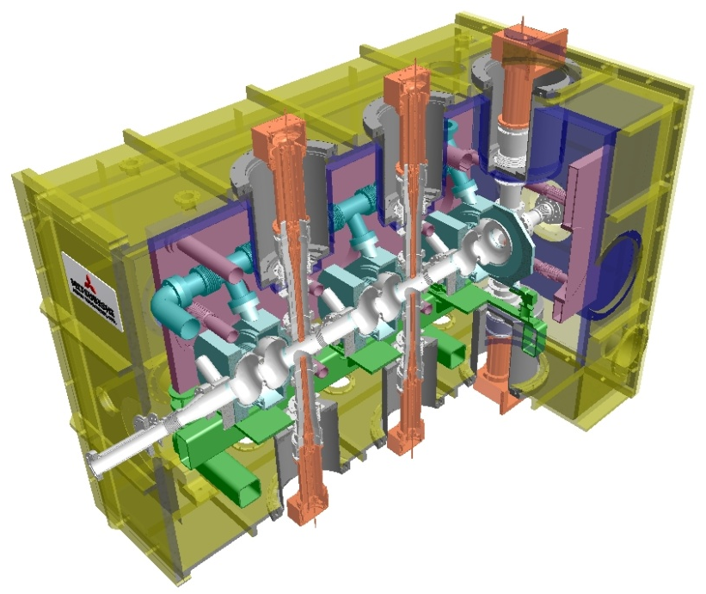
Superconducting Cavities for Injector
Courtesy: E. Kako,
K. Watanabe
All of five HOM couplers
are loop-type
High-pass filter
Prototype 2-cell cavity #2
2-cell cavities for cryomodule
New HOM-coupler design
Fabricated input couplers
23
Cryomodule design (3D view)
Notes:
1) Loop-type HOM couplers were adopted for all 5 HOM-couplers because they strongly couple to monopole modes such as TM011.

Slide 24
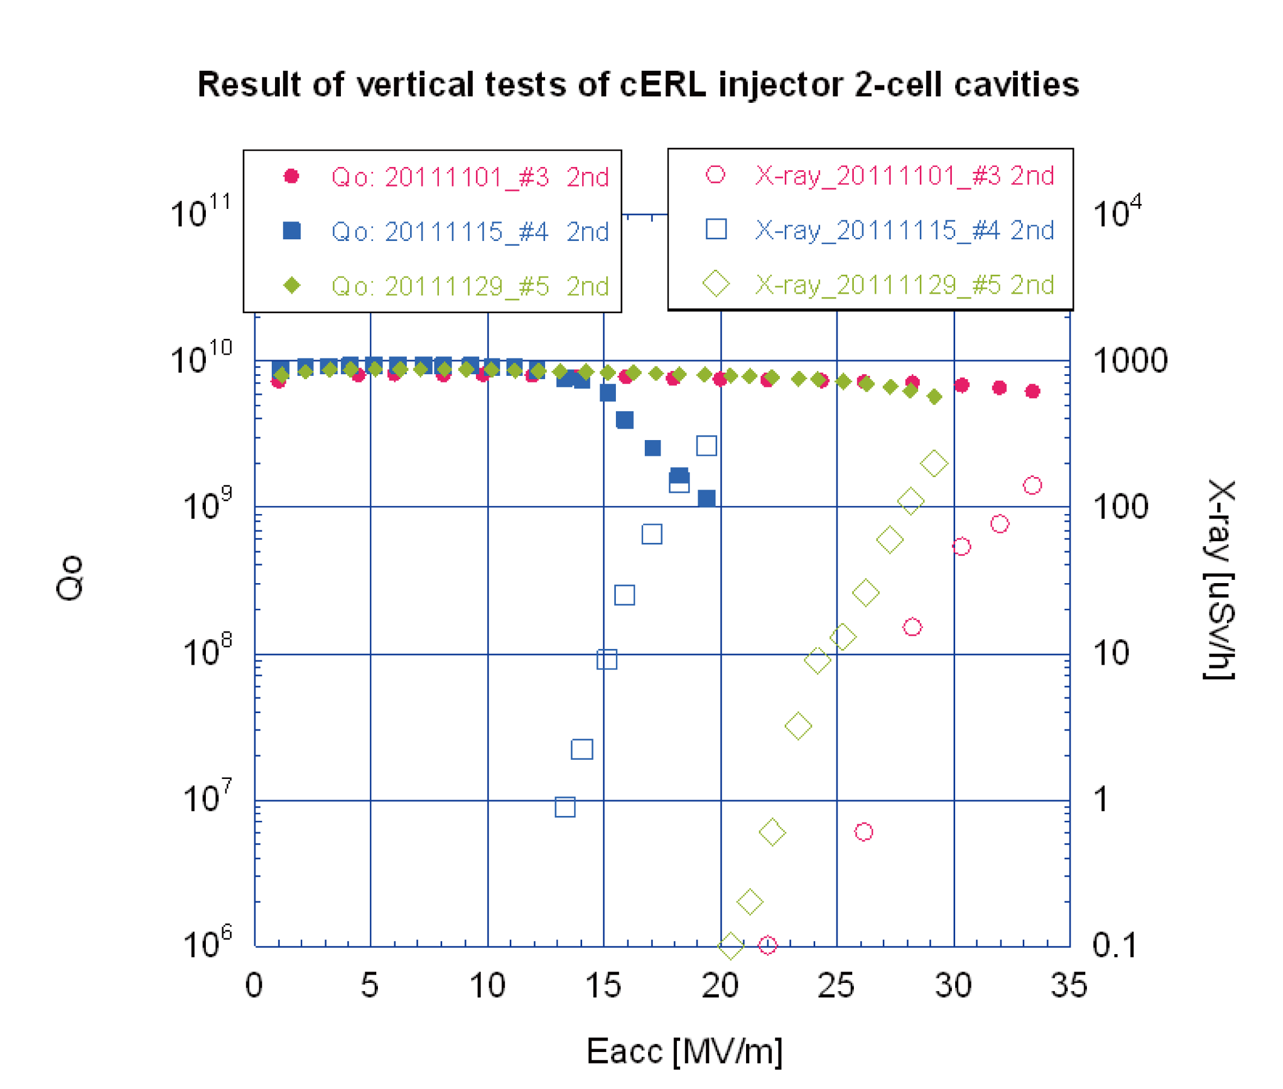
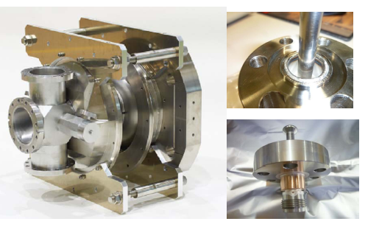
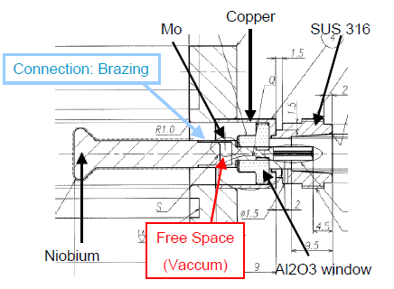
Recent Vertical Test of the Injector Cavities
Courtesy: E. Kako
K. Watanabe
Improved cooling in HOM couplers resulted in higher sustainable field-gradient.
We could keep high field-gradient of more than 20 MV/m (for cavities #3 and #5) for long time even when the HOM couplers were out of liquid Helium.
¹⁾
He <2K
Improved feedthrough
for HOM couplers
1) These Q₀-E_{acc} curves were measured when whole cavities were located in the liquid Helium. However, even when the upper HOM couplers were out of liquid Helium of 2K, we could maintain high field-gradient of 30 MV/m (cavities #3 and #5).
Notes:
2) These Q0-Eacc curves were measured when whole cavities were located in the liquid Helium. However, even when the upper HOM couplers were out of liquid Helium of 2K, we could keep high field gradient of 30 MV/m (cavities #3 and #5).

Slide 25
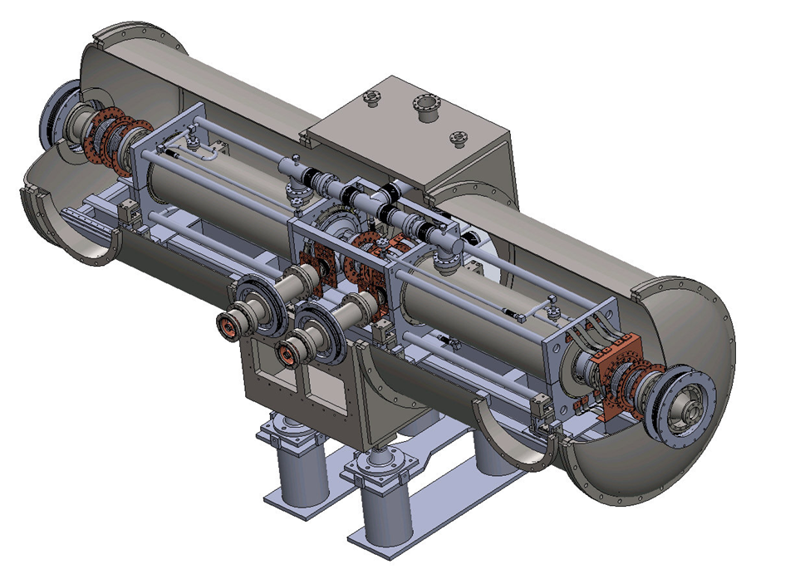
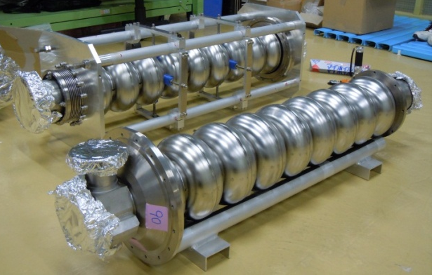
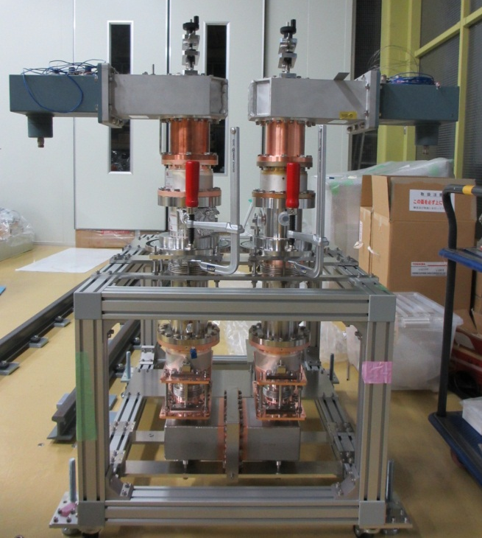
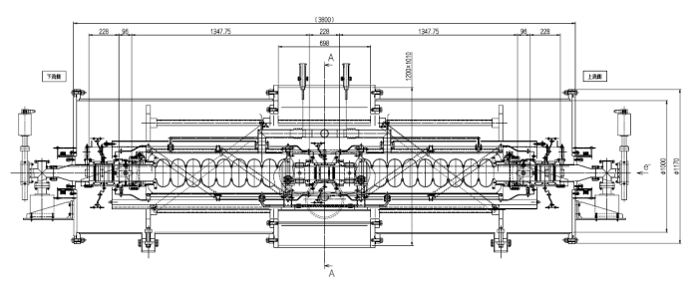
Superconducting Cavities for the Main Linac
Courtesy: K. Umemori
HOM
absorber
Input couplers
9-cell Cavities
HOM Absorber
Assembly of two 9-cell cavities
Cryomodule design
Input coupler
25
Cryomodule design (side view)

Slide 26
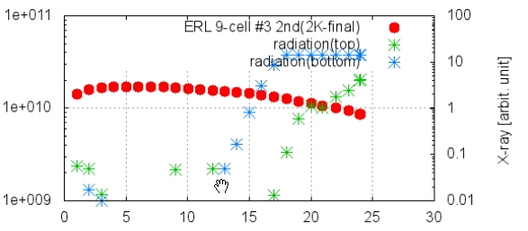
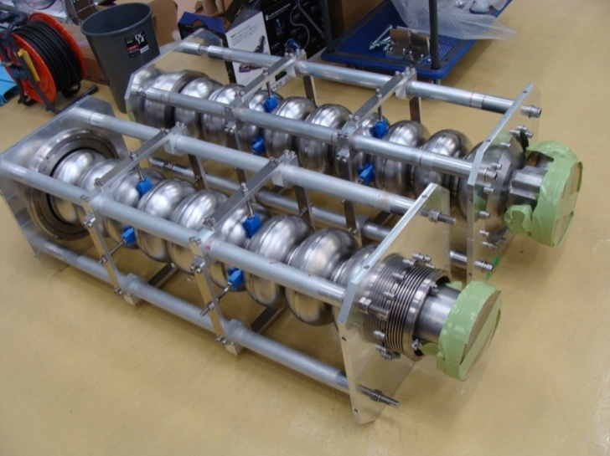
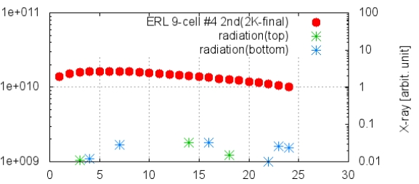
Vertical Test Results (of cavities #3 & #4 for the cERL cryomodule)
Courtesy: K. Umemori
E_{acc} of higher than 25 MV/m could be achieved in both cavities.
Q₀ > 10¹⁰ at 15 MV/m
Satisfied cERL specification
Onsets of X-ray were 14 MV/m and 22 MV/m for the cavities #3 and #4, respectively.
#3
Q₀
Q₀ vs E_{acc}
E_{acc} (MV/m)
#4
Q₀
Q₀ vs E_{acc}
Cavities are waiting for Helium-jacket welding and will be installed into cryomodule.
E_{acc} (MV/m)
26

Slide 27
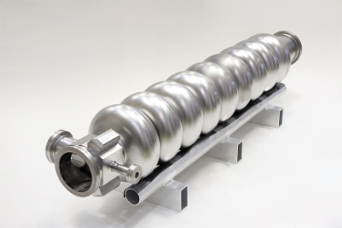
RF System for the cERL
Courtesy: T. Miura
Main Linac
Injector
9-cell Cavity
300kW
Klystron
30kW
klystron
30kW IOT
20kW IOT
Gun
Dump
Buncher
Two 9-cell Cavities
2-cell Cavities
Double input
couplers/cavity
Parameters of RF System for the cERL (35 MeV, 10 mA version)
Item | Unit | Buncher | Inj-1 | Inj-2 | Inj-3 | ML-1 | ML-2
Structure |  | NC | SC | SC | SC | SC | SC
Gradient | MV | 0.14 | 1 | 2 | 2 | 15 | 15
Q_{L} |  |  | 5 × 10⁵ | 2 × 10⁵ | 2 × 10⁵ | 2 × 10⁷ | 2 × 10⁷
Beam Phase | degree | −90 | −15 to −30 | −10 | −10 | 0 | 0
Power Required | kW | 4.5 | 10 | 37 | 37 | 11 | 11
Power Output | kW | 6.2 | 17 | 122 |  | 30
RF Source |  | IOT | Klystron | Klystron |  | IOT
Power Available | kW | 20 | 30 | 300 |  | 30
27

Slide 28
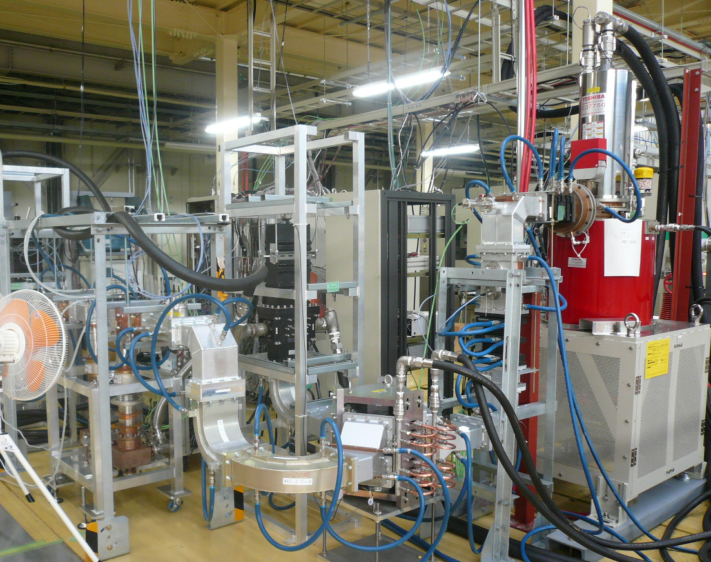
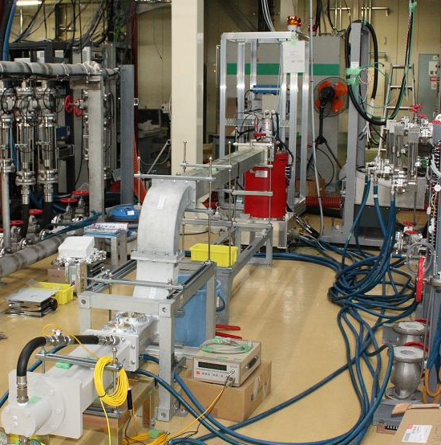
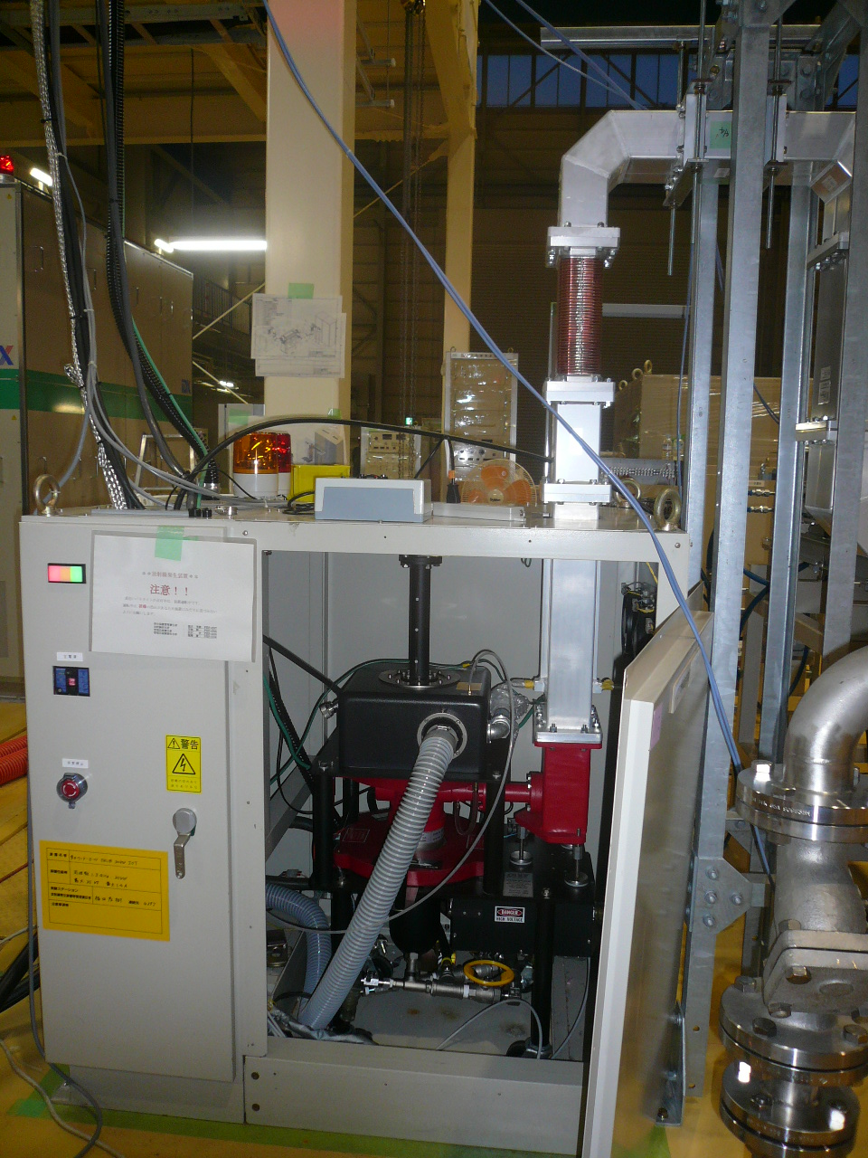
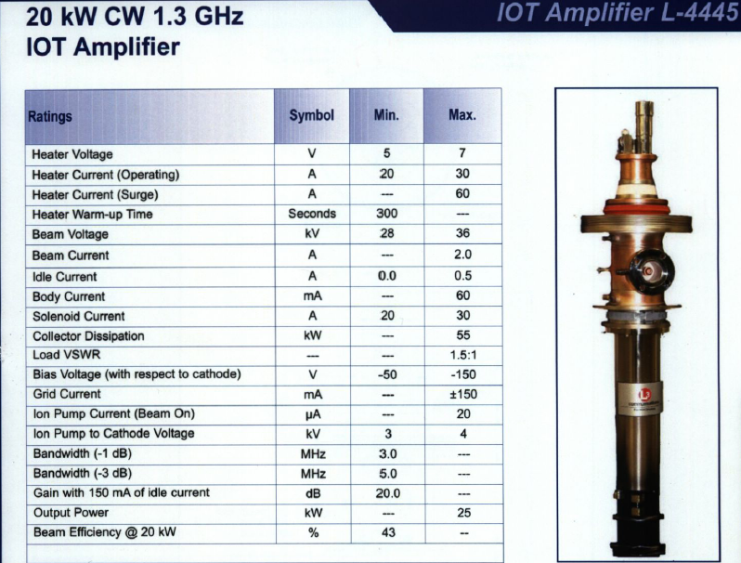
1.3 GHz CW RF Sources at KEK
Courtesy: T. Miura
300kW CW Klystron
30kW CW Klystron
30kW CW IOT
20kW CW IOT
-> to be delivered at the end of FY2011
28

Slide 29
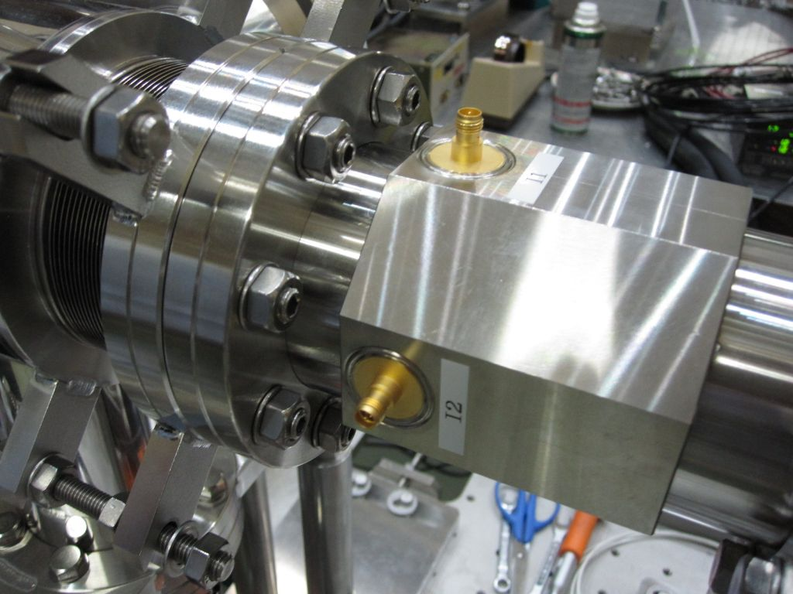
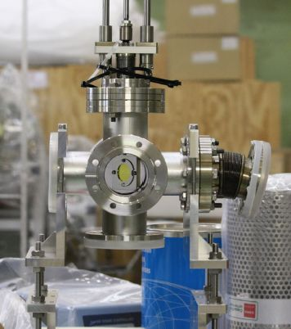
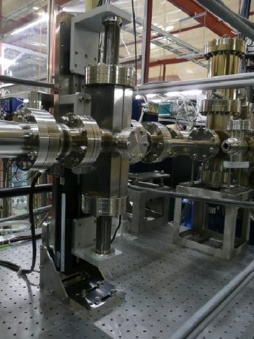
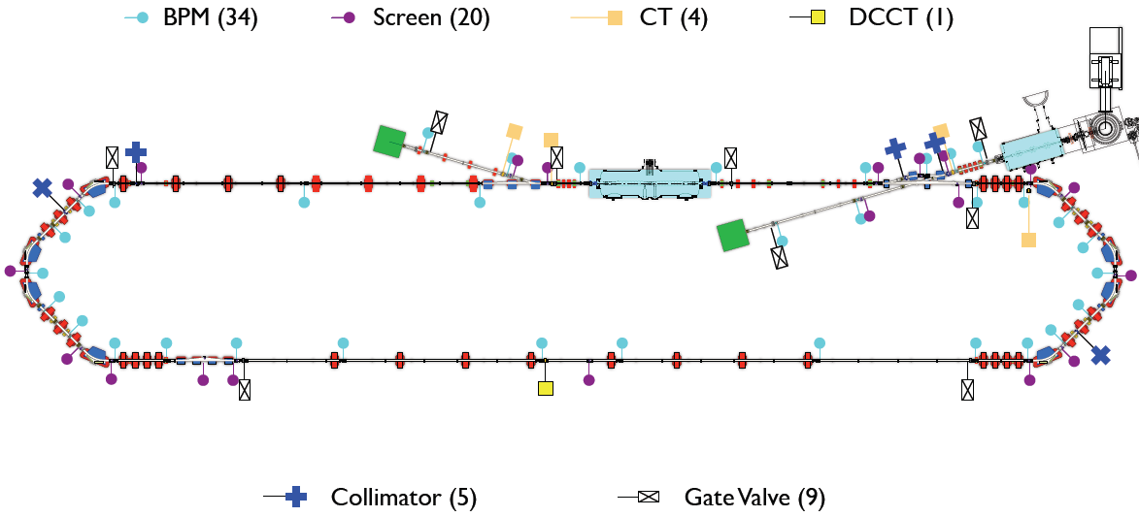
Beam Instrumentations for cERL
Courtesy: Y. Honda, T. Obina, R. Takai
Stripline BPM with glass-type feedthrough
Screen monitor
Slit for emittance measurement
Two beam is running here: 2.6GHz rep rate

Slide 30
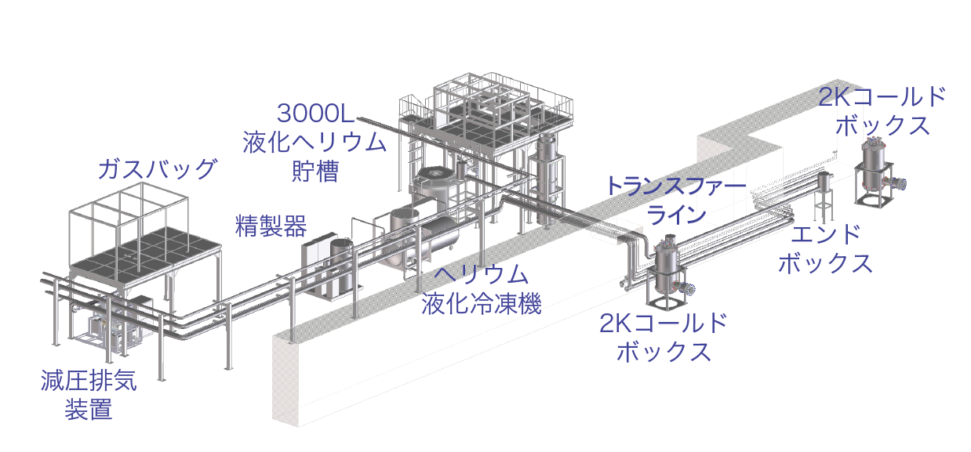




Liquid-Helium Refrigerator for cERL
Courtesy: H. Nakai
Overview of the system
2K cold box
Gas bag
Purifier
End box
Liquefier/
refrigerator
2K cold box
Pumping
unit
Cooling capacity: 600 W (at 4K) or 250 L/h
3000L liquefied helium
storage vessel
2K cold box and end box
TCF200 helium liquefier/refrigerator

Slide 31

ERL Development Building for cERL

Slide 32



Application of cERL:
Plan of Laser Compton Scattering Experiment by JAEA
3-year R&D program was funded from MEXT (2011-2013)
Nondestructive measurement of
isotopes by LCS γ-rays,
which is applicable to nuclear security
and safeguards purposes.
Installation of a LCS chamber
Generation of LCS gamma-rays
Demo-Experiment of NRF measurement
(NRF: Nuclear Resonance Fluorescence)
Courtesy: R. Hajima
electron gun
superconducting
accelerator
LCS gamma-rays
LCS chamber
Electron beam = 35 MeV, 10 mA
LCS photon flux = 5x10¹¹ ph/s @22keV
possible upgrade in future
Electron beam = 245 MeV, 10 mA
LCS photon flux = 1x10¹³ ph/s @1.1MeV
32
Notes:
This viewgraph shows the principle nuclear material detection by laser Compton gamma-rays.
Laser Compton scattering is a scheme to generate monochromatic gamma-rays by collision of a high-energy electron beam and a laser beam. The gamma-ray energy can be easily tunable by changing electron energy or laser wavelength.
If we irradiate a gamma-ray beam tuned at an energy specific to Pu 239, 2143 keV, nucleus of Pu-239 is excited by gamma-ray absorption and re-emitt another gamma-ray instantaneously. Observing this re-emitted gamma-ray, we can detect Pu-239.
This is nuclear resonance fluorescence.
The combination of laser Compton gamma-ray and nuclear resonance fluorescence has several advantages. First, nondestructive detection of radioactive and stable nuclides is possible. Second, We have excellent signal-to-noise ratio in the energy resolved gamma-ray detection. Third, detecting many kind of nuclides by scanning gamma-ray energy is also available. Fourth, we can detect materials through a thick shield. Finally, this is full utilization of high-power lasers and high-brightness electron beams, which show tremendous progress continuously.

Slide 33
Road Map of ERL
Courtesy: H. Kawata
Japanese Fiscal Year (from April to March)
2008 | 2009 | 2010 | 2011 | 2012 | 2013 | 2014 | 2015 | 2016 | 2017 | 2018 | 2019 | 2020
R&D of ERL key elements
Prep of ERL Test Facility
cERL construction
Beam test and test experiments
Improvements towards 3GeV class ERL
Construction of
3GeV ERL
User
run
Present time
33

Slide 34
4. Summary
Future light source plan at KEK
3-GeV ERL with single return-loop
6-7 GeV XFEL-O is considered in the second stage
R&D in progress
High-brightness photocathode DC guns: 500kV, 10mA (100mA in future)
Drive laser for the gun (520 nm, ~1.5 W for cERL)
SC cavities for both injector and main linacs
RF sources (300 kW CW klystron, etc.)
Compact ERL
First stage: 5 MeV injector, 35 MeV (single) return loop. 10 mA.
Upgradable: rooms for additional cryomodules and for double loops
Liquid-helium refrigerator is working well.
Construction of radiation shielding has been started.
We plan to commission cERL, hopefully, in March, 2013.

