Slide 1
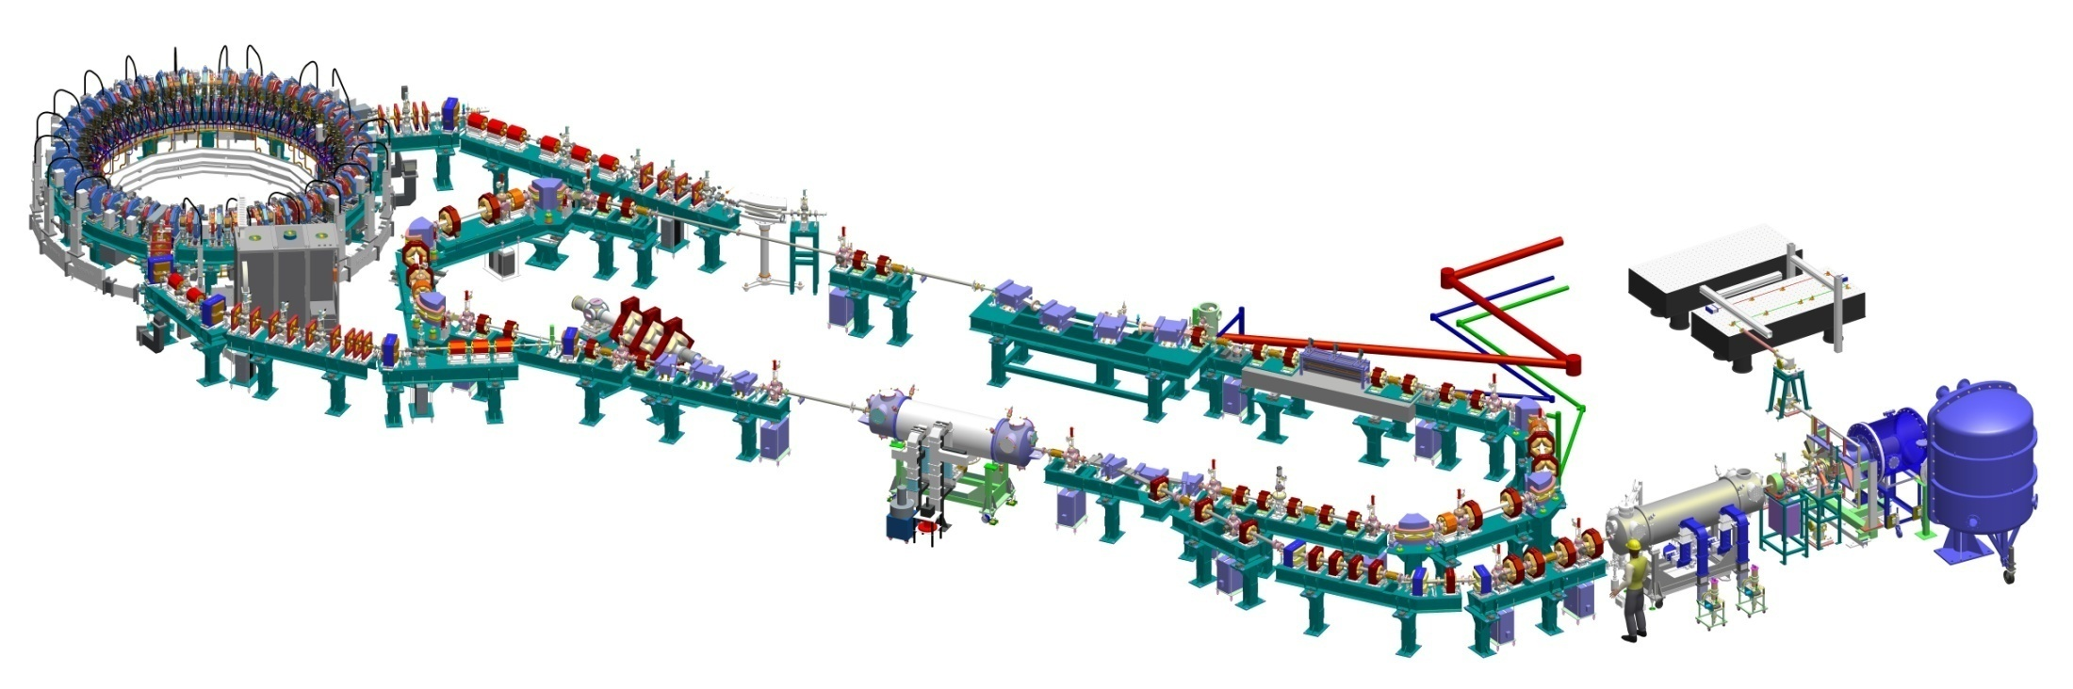
ALICE Status and News
Electron Model for Many Applications
Susan Smith
Director of ASTeC, STFC
Notes:
Introduce you to the two unique R&D facilities that were are developing at Daresbury
The first is the Energy recovery linac prototype R&D testbed ALICE
And the second is an accelerator demonstrator, the world’s first non scaling FFAG; EMMA

Slide 2
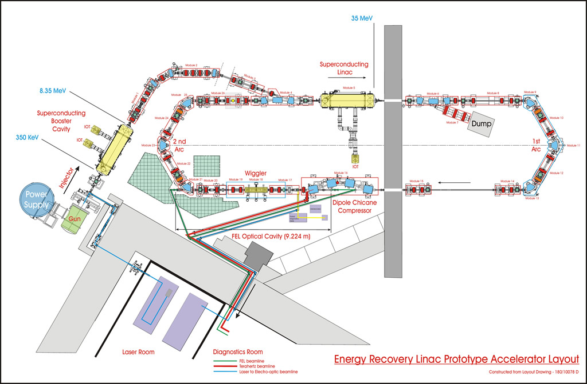
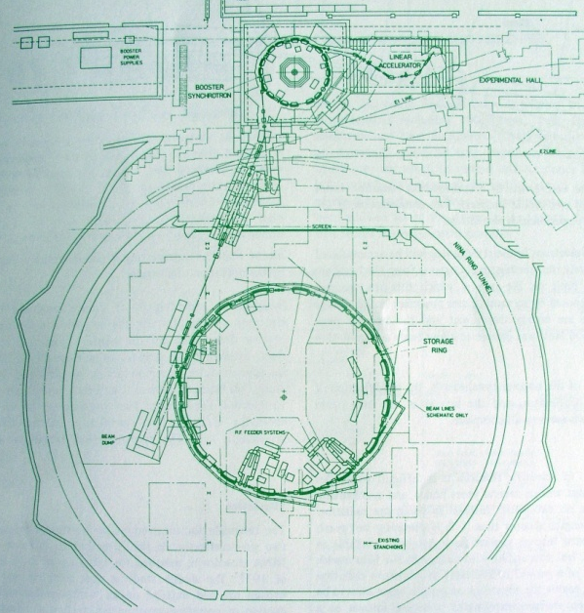

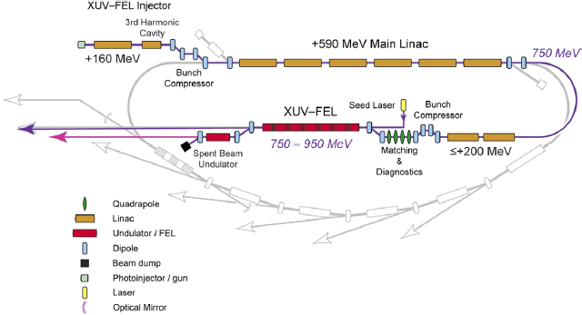
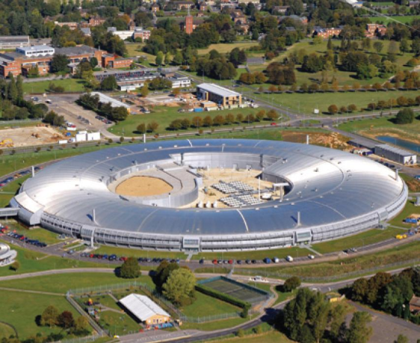

... how all this started
ERLP
SRS
.... Oh yes !
We get there ...
.... Hmmmm
Not quite ....
... to greener
pastures
DIAMOND
4GLS

Slide 3
ERLP: test bed and a learning tool
New accelerator technologies for the UK
First SCRF linac operating in the UK
First DC photoinjector gun in the UK
First ERL in Europe
First IR-FEL driven by energy recovery accelerator in Europe
... lots of help from all around the world
... BIG THANKS to all and , especially, to colleagues from JLab !!

Slide 4
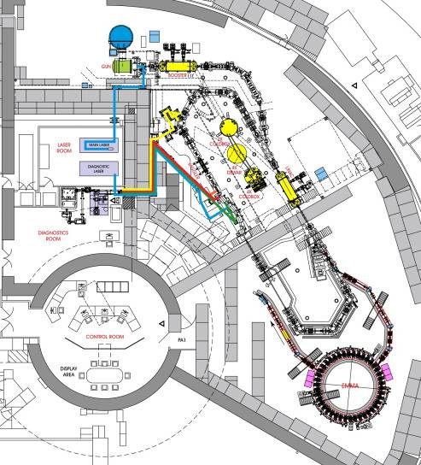
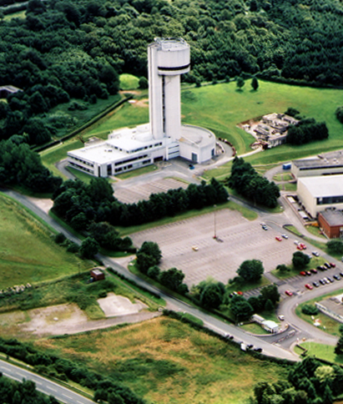
The ALICE (ERLP) Facility @ Daresbury Laboratory
Tower or lab picture
Notes:
This is the footprint of the machine and its location at daresbury laboratory.
It was built in an already existing building which used to be an van der graaf accelerator for nuclear phycics
The SRS which was at Daresbury for over 20 years is just off the side.
4

Slide 5

The ALICE Facility @ Daresbury Laboratory
Accelerators and Lasers In Combined Experiments
An accelerator R&D facility based on a superconducting energy recovery linac
photoinjector
laser
Free Electron Laser
EMMA
superconducting linac
DC gun
superconducting
booster
Notes:
-ALICE stand for Accelerators …
-It is based on an energy recovery linac prototype and used to be known as ERLP.
-Originally it’s main puropse was as a small scale version of the type of light source the UK might build in future.
-But also a testbed for new concepts (guns, SCRF, lasers) beyond the main UK experience which was 3rd generations synchrotron light sources.
-The main highlights of this talk will be the lasing of the FEL which was achieved last october.

Slide 6
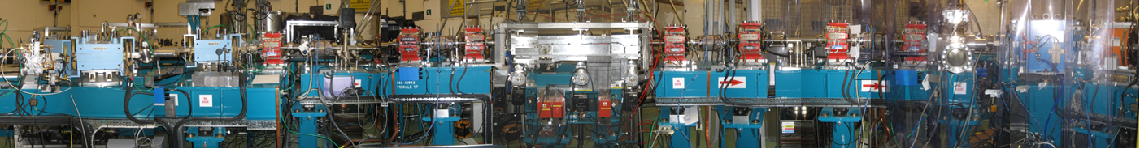
ALICE accelerator
Accelerators and Lasers In Combined Experiments
1st arc: TBA on translation stage
THz beamline
Bunch compression chicane
FEL beamline
FEL optical
cavity
PI laser
6.5MeV
dump
Buncher cavity
2nd arc
Linac: 2 9-cell SC L-band cavities >27.5MeV, ER
230 kV DC GaAs cathode gun
Booster: 2 9-cell SC L-band cavities >6.5MeV
Upstream mirror
Downstream mirror
Undulator
Electron path

Slide 7
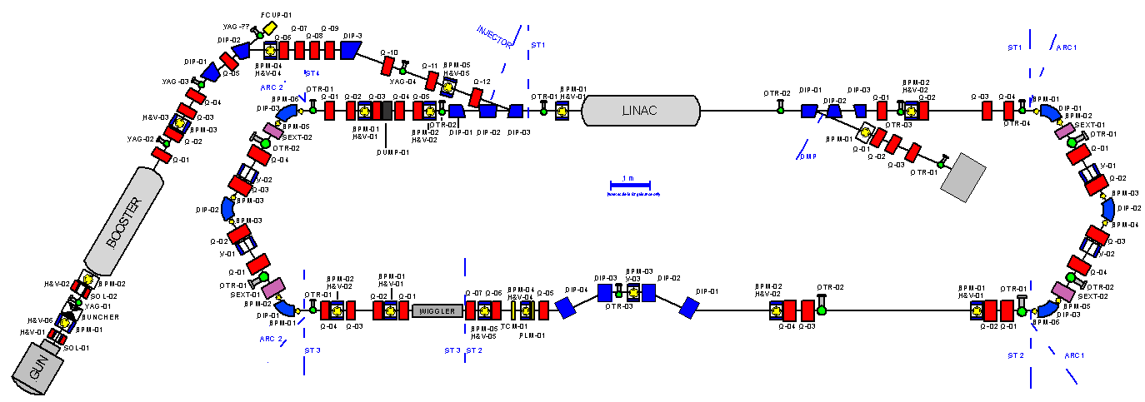
ALICE Machine Description
RF System
Superconducting booster + linac
9-cell cavities. 1.3 GHz, ~10 MV/m.
Pulsed up to 10 Hz, 100 μS bunch trains
Beam transport system.
Triple bend achromatic arcs.
First arc isochronous
Bunch compression chicane R₅₆ = 28 cm
Undulator
Oscillator type FEL.
Variable gap
Diagnostics
YAG/OTR screens + stripline BPMs
Electro-optic bunch profile monitor
TW laser
For Compton Backscattering
and EO
~70 fS duration, 10 Hz
Ti Sapphire
DC Gun + Photo Injector Laser
230 kV
GaAs cathode
Up to 100 pC bunch charge
Up to 81.25 MHz rep rate

Slide 8
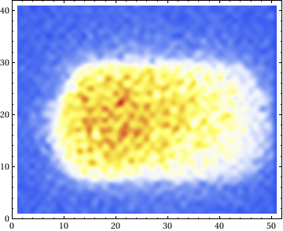
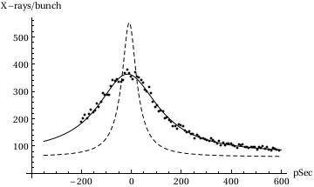
2009: CBS exp.
Compton backscattering demonstrated on ALICE: November 2009
... Just two days before the start of the shutdown !!!
Prediction assuming no offset
X-ray picture
X-rays
Binned pixels
Scintillator
Be window
Measured data
Laser beam
~6 mm
Camera:
Pixelfly QE
Interaction region
Electron beam
Binned pixels

Slide 9
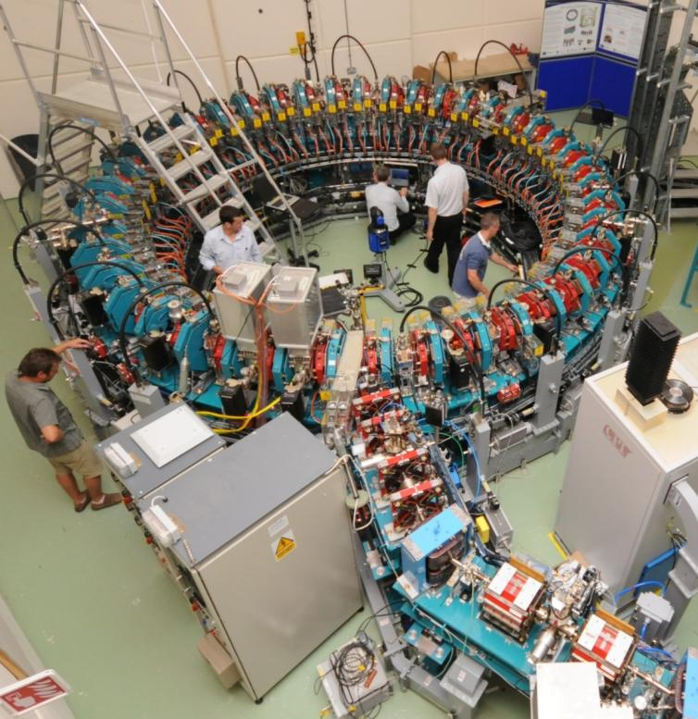
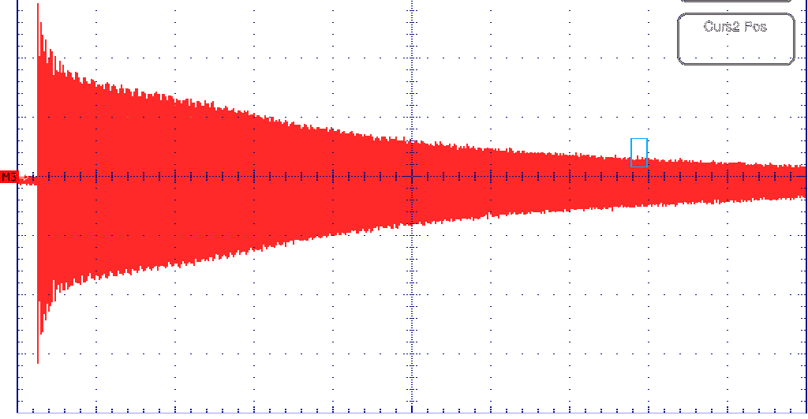
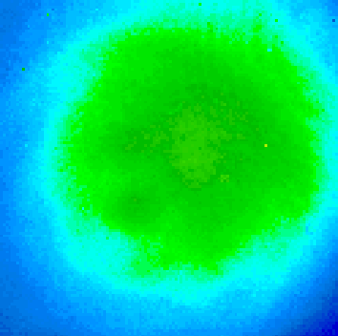
2010: “accelerating”
Helium processing of linac cavities
(March)
PI laser burst generator
allows < 81MHz operation
enables Q=60pC as standard
THz cells exposures started in April
(in an incubator located in
the accelerator hall)
EMMA ring completed and commissioned
... many-many turns (August)
IR FEL : first lasing !! (October)
He processing by ASTeC RF + cryogenic groups with assistance from T. Powers (Jlab)

Slide 10
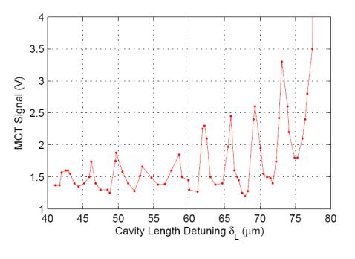
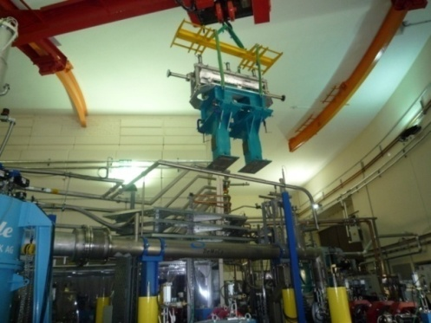
FEL Commissioning Timeline
November 2009 - Undulator installation.
January 2010 - Cavity mirrors installed and aligned, all hardware in place.
  Limited to 40pC bunch charge due to beam loading in the booster.
  Throughout 2010 the FEL programme proceeded in parallel with installation of EMMA leaving one shift per day for commissioning. ~15% of ALICE beam time was dedicated to the FEL programme (approximately 5-6 weeks integrated time).
February 2010 - First observation of undulator spontaneous emission. Radiation was stored in the cavity immediately, indicating the transverse pre-alignment was reasonable.
May/June 2010 - Spectrometer installed and tested. Analysis of spontaneous emission used to optimise electron beam steering and focussing.
June 2010 - Strong coherent emission with dependence on cavity length but no lasing.
Undulator installation
Spontaneous spectra used to set steering
Intracavity Interference

Slide 11
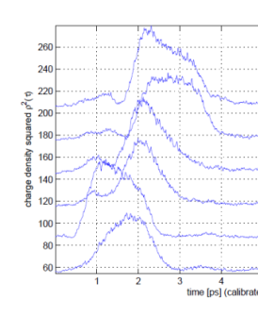
Modifications for Lasing
July 2010 - Changed outcoupling mirror from 1.5mm radius hole to 0.75mm to reduce losses.
Installed an encoder to get a reliable relative cavity length measurement.
Optical cavity mirror radius of curvature was tested - matched specification.
EO measurements indicated correct bunch compression.
17th October: installed a Burst Generator to reduce the photo-injector laser repetition rate by a factor of 5, from 81.25MHz to 16.25MHz. This enabled us to avoid beam loading and increase the bunch charge from 40pC up to 80pC (the original ERLP specification)
→ resulted in lasing within a few shifts.
1ps
EO measurements of electron bunch profile

Slide 12
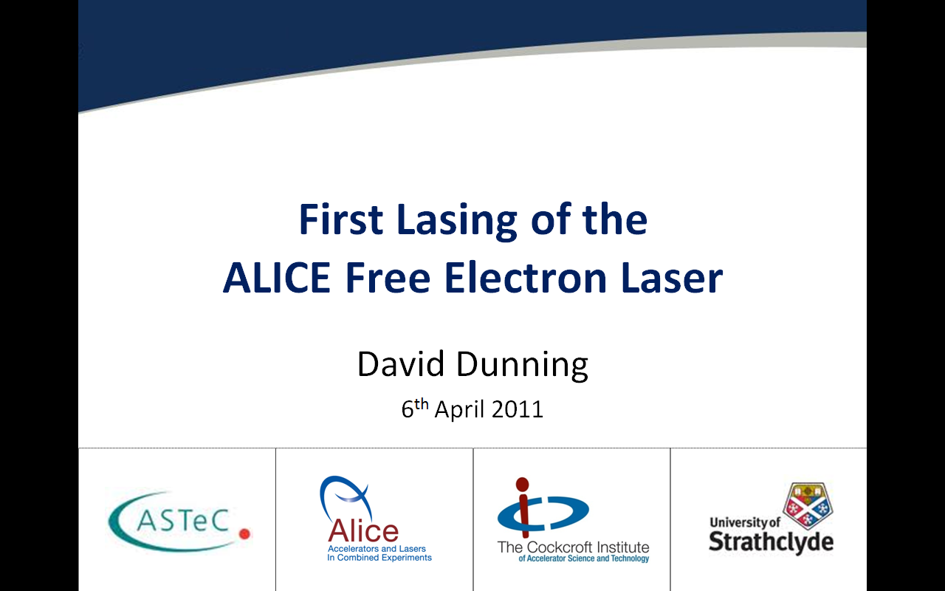
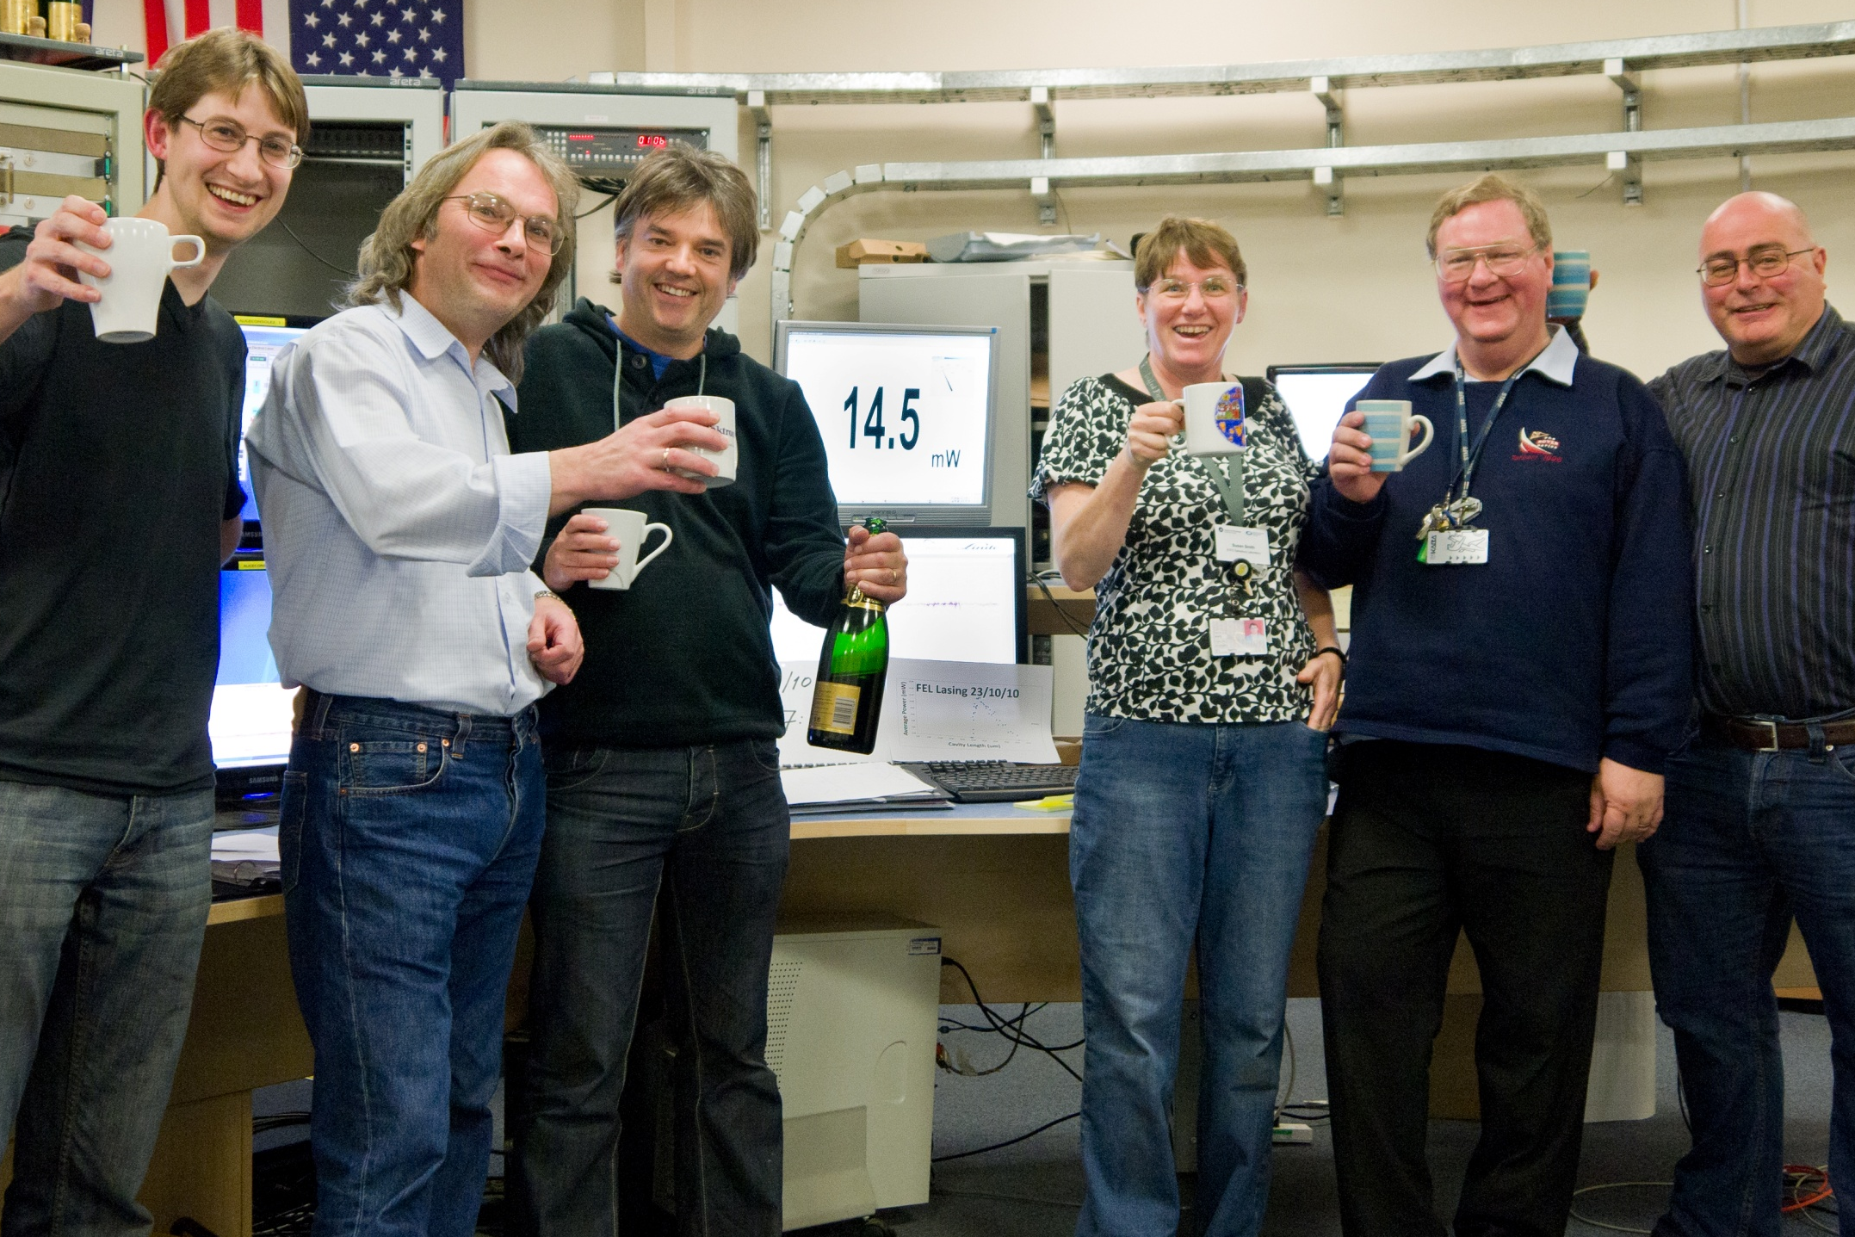
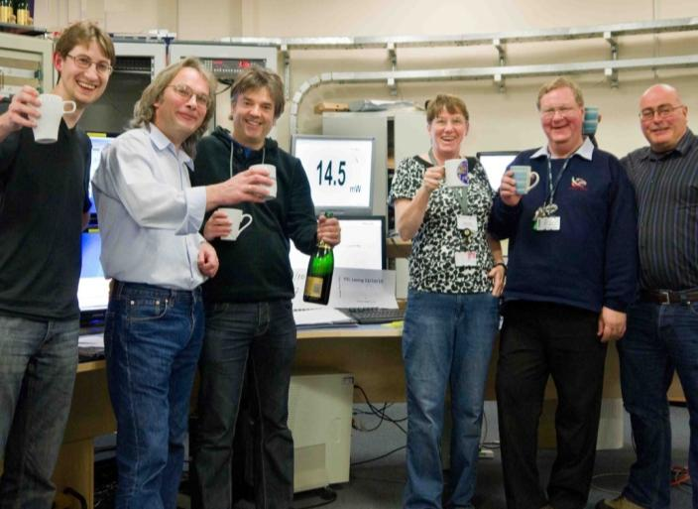
23 October 2010: First Lasing!
First Lasing Data: 23/10/10
Simulation (FELO code)

Slide 13
23rd October 2010: ALICE FEL First Lasing
Lasing
100-40 pC @
16.25 MHz
The peak power ~3 MW
Single pass gain ~20 %
First Lasing Data: 23/10/10
Continuous tuning 5.7-8.0 µm, varying undulator gap.

Slide 14
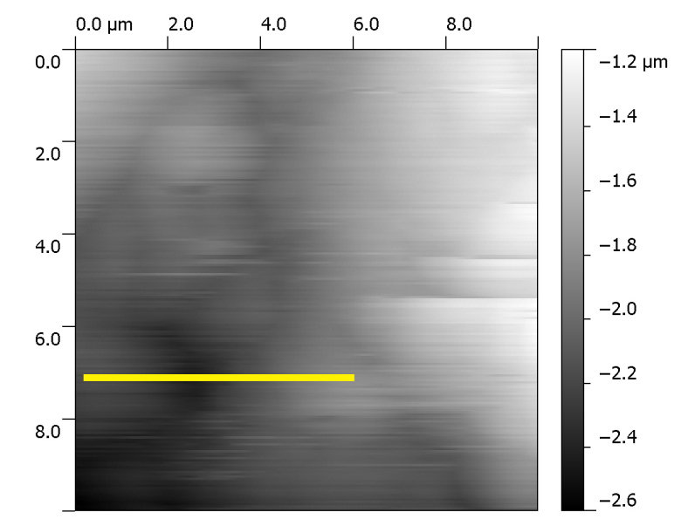
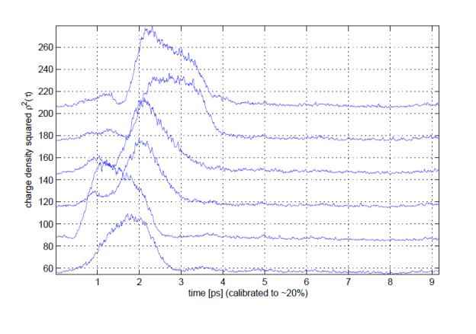
2011: FEL and FELIS
FEL beam transported to the Diagnostic room (March)
Scanning Near-field Optical Microscope (SNOM) installed
received from Vanderbuilt Uni.
Free Electron Laser integration with
Scanning Near-field Optical Microscope →FELIS
First SNOM image (September)
Short e-bunch characterisation with EO diagnostic
Electro-optic bunch profile measurement (ZnTe crystal probed by Ti Sapphire laser)

Slide 15
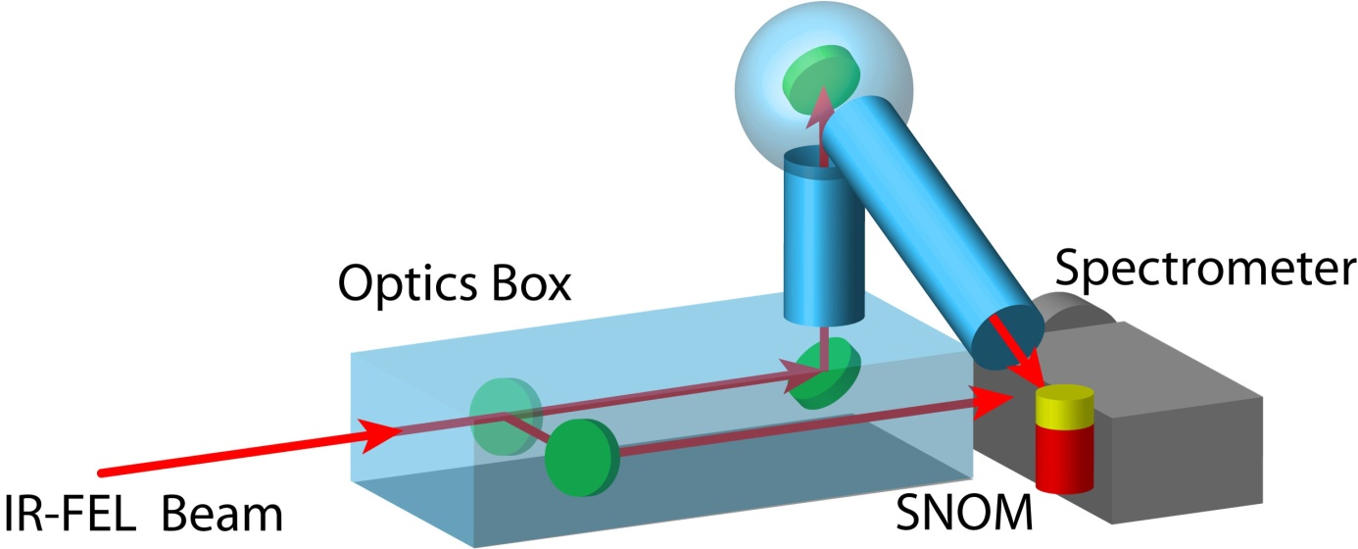
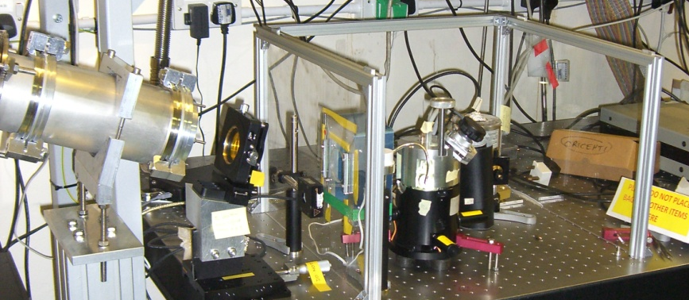
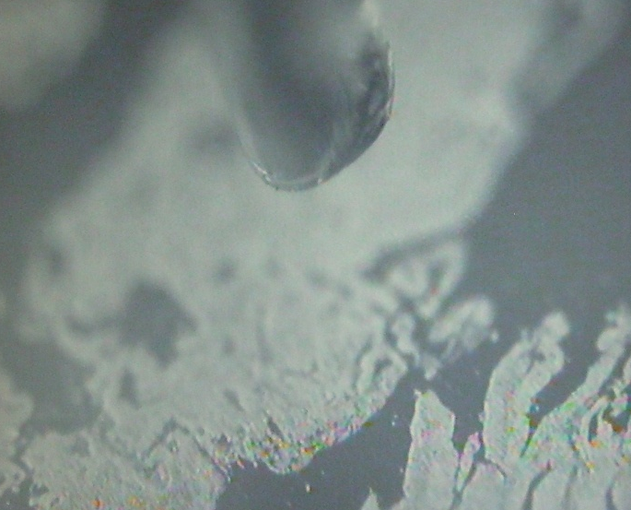
SNOM: Scanning Near-Field Optical Microscopy in the IR
Spatial resolution beats diffraction limit
Spectral resolution to locate distribution of proteins, lipids and DNA (IR signatures)
Proof-of-principle experiments
An example of some meaningful Science that can now be done with the ALICE FEL

Slide 16
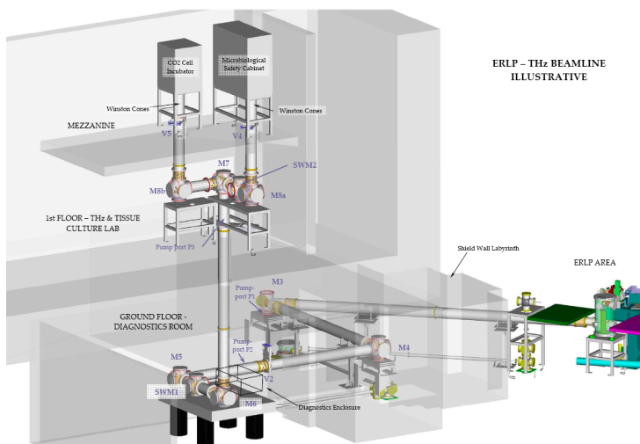
2011: THz for biology
ALICE :
a source of high power broadband coherently enhanced THz radiation
THz beam transported to the TCL (Tissue Culture Lab)
that’s ~ 30m away from chicane
Biological experiments in TCL started (June)
Estimate > 10 KW in single THz pulse
with ~ 20% transport efficiency to TCL
Research program to determine safe limits of exposure of human cells to THz and effect of THz on differentiation of stem cells

Slide 17
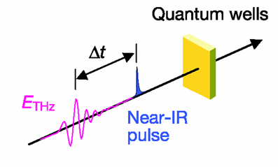
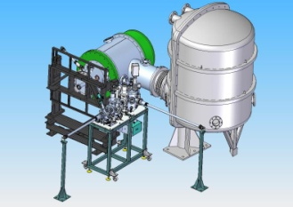
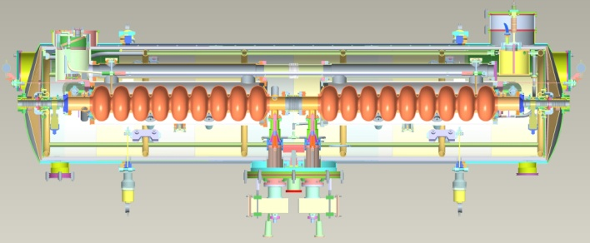
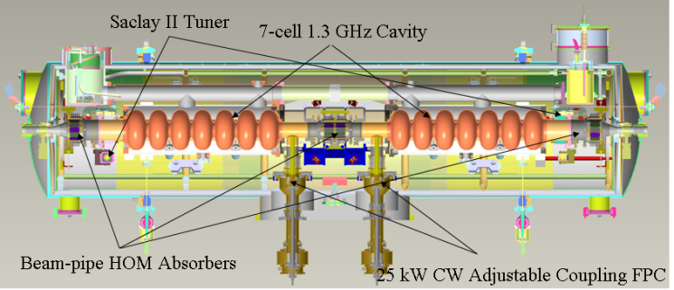






2011: Other developments
Quantum dots studies for novel solar cells (with Manchester Uni.)
- employs high power THz from ALICE
Timing and synchronisation experiments
- fibre-ring-laser-based system;
- aims for sub-10fs timing distribution for future light sources
Digital LLRF development
Experiments on interaction of short electron bunches with high power
electromagnetic radiation
Photocathode research
DICC: International collaboration on SC cryomodule development
sample
fs UV pulse

Slide 18




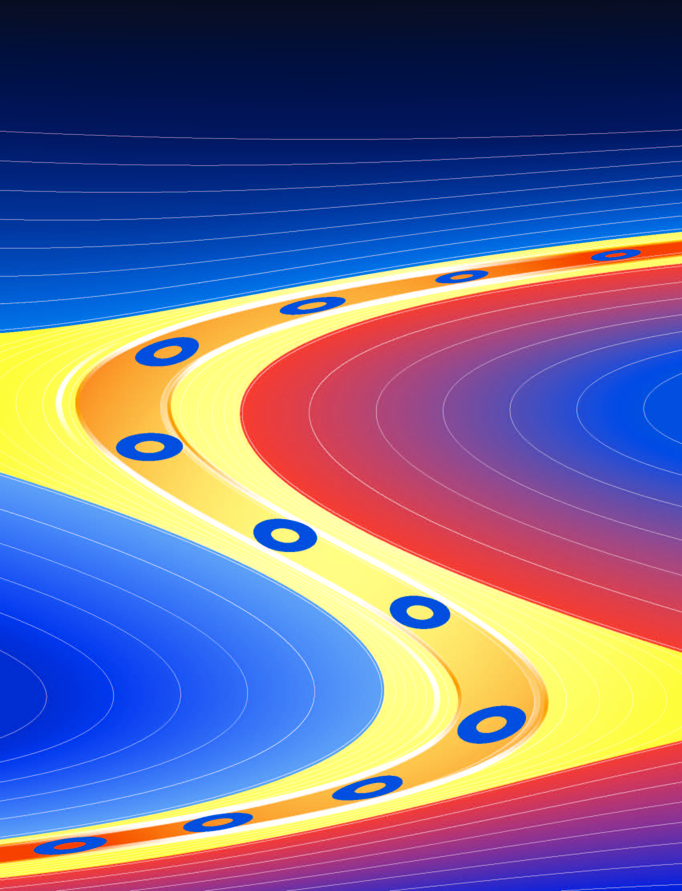
2011: EMMA
First extraction of beam from the ring (March)
First acceleration in EMMA (March)
Acceleration by EMMA : 12 → 21MeV (April)
Proof-of-principle demonstrated
Paper to Nature Physics
... to be continued
First NS FFAG “EMMA”:
Successful International
Collaboration
Nature Physics
March 2012

Slide 19
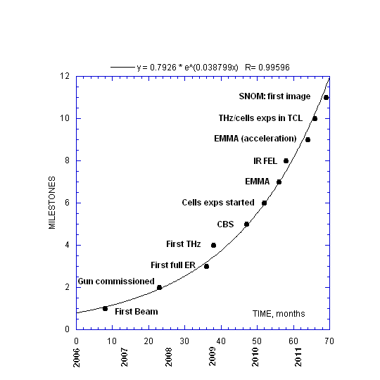
ALICE Milestones: still growing
.... exponentially

Slide 20
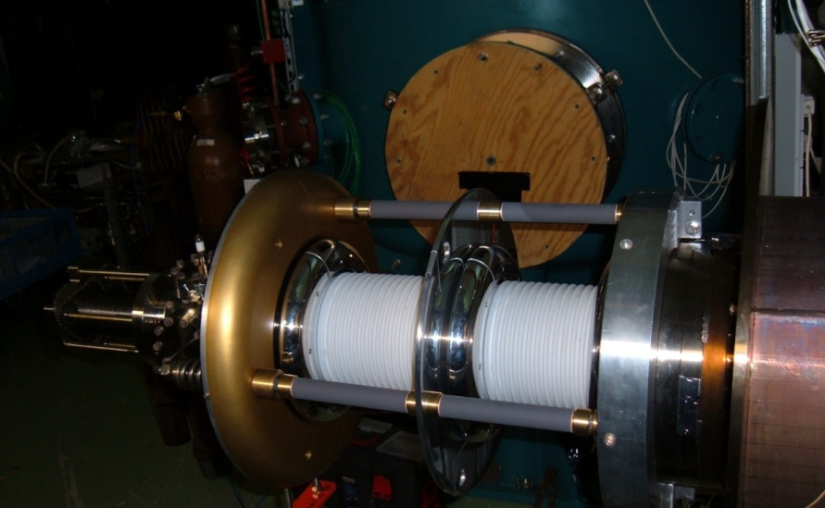
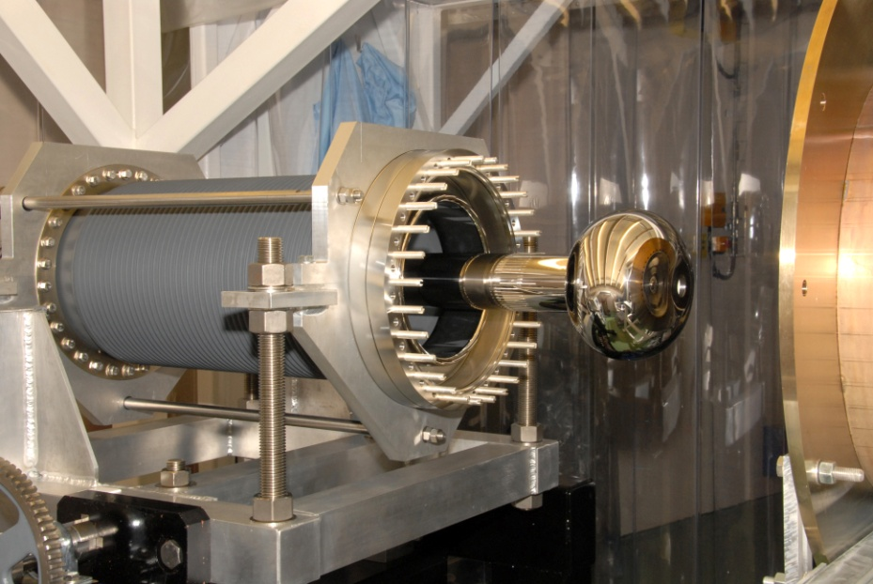
Gun Ceramic Change
Lower than nominal (230kV instead of 350kV) is due to
  Stanford ceramic
  Field emitter on the cathode
Both do not help emittance and injector set up
Feb 2012 Conditioned to 430 kV for 350kV operation no field emission evident so far
Stanford
Larger diameter single ceramic
Notes:
As we said we are running at 230 kV instead of 350 kV and a major issue in this is the gun ceramic.
We initially commissioned the injector successfully at 350 kV with a large bulk resistive ceramic
But we had 3 failures of the ceramic to metal flange braze over ~18 months
So last year we installed two Stanford uni gun ceramics which have a smaller diameter which means we reckon we can condition to around 350 kV and run approx 250 kV.

Slide 21
Gun conditioning
2007
2012

Slide 22
ALICE 2012 (April-August)
Characterisation of EMMA Electron Model of Many Application
Transverse & longitudinal beam dynamics investigation
Free Electron Laser Studies
Alice Energy Modulation by Interaction with THz Radiation
A compact high-resolution terahertz upconversion detection scheme
Use of novel THz passive imaging instrument
Diagnostic for oesophageal cancer (SNOM)
Investigations of the mechanism of biological organisation.
THz pump-probe approach to accurately determine the low frequency response of biomolecules to high intensity THz
THz absorbance for probing protein folding
Spin dynamics in rock-salt crystal semiconductors

Slide 23
Next Steps
Sept – Dec: ALICE programme II
Dec – Jan: installation of Daresbury International Cry module
Feb – Mar: Characterisation of module and some limited science programme
The Future?
ALICE : A Photon Source for Science?

