Slide 1
Intro to WG, part II
T. Kamps, C. Hernandez-Garcia
FLS 2012 Workshop
05.03.2012 – 09.03.2012

Slide 2
Acknowledgements
John Lewellen, Siegfried Schreiber, Katja Honkavaara, Roland Müller, Michael Abo-Bakr, Wolfgang Anders, Roman Barday, Jochen Teichert, Dave Dowell for inspiration, material and discussions.
Meeting organizers.
You.

Slide 3










My bias: BERLinPro. Here the gun needs to deliver
100 mA, 1 mm mrad, short bunches
generate a low emittance (1mm mrad)
high current beam (100mA)
accelerate/ de-accelerate
to / from 100MeV
(energy recovery,
HOM losses, Beam Break Up)
accelerate the beam
up to 6.5MeV (handle 650MW)
beam dump
gun
booster
linear accelerator
transport through merger
without deterioration
of beam quality
manipulate the beam
(pulse compression)
recirculate the used beam (energy spread, emittance)
back to linac, control of beam loss
25m
max. beam energy | 50MeV
max. current | 100mA
nominal bunch charge | 77pC
max. rep. rate | 1.3GHz
normalized emittance | < 1mm mrad

Slide 4
Approach the goals for BERLinPro in stages, tackling issues concerning beam, brightness and current
 | Gun0 (HoBiCaT) | Gun1 | Gun2
Goal | Beam Demonstration (First beam April 2011) | High brightness R&D gun (2014) | High average current production gun (2015)
Cathode material | Pb (SC) | CsK₂Sb (NC)
Cathode QE_{max} | 1*10^-4@258 nm* | 1*10^-2@532 nm
Drive laser wavelength | 258 nm | 532 nm
Drive laser pulse length and shape | 2.5 ps fwhm Gaussian | ≤ 20 ps fwhm Gaussian | ≤ 20 ps fwhm Flat-top
Repetition rate | 8 kHz | 54 MHz/25 Hz | 1.3 GHz
Electric peak field in cavity | 20 MV/m* | ≥ 10 MV/m
Operation launch field on cathode | 5 MV/m* | ≥ 10 MV/m
Electron exit energy | 1.8 MeV* | ≥ 1.5 MeV
Bunch charge | 6 pC* | 77 pC
Electron pulse length | 2…4 ps rms^{*o} | ≤ 10 ps rms
Average current | 50 nA* | 4 mA/40 µA | 100 mA
Normalized emittance | 2 mm mrad* | 1 mm mrad
*Preliminary data / results,
º value represents emission time
T. Kamps et al, PRST-AB IPAC 2011 Edition, in preparation,
A. Neumann et al., PRST-AB IPAC 2011 Edition, in preparation
R. Barday et al., Proc. of PSTP 2011, in preparation
J. Völker, Master thesis, HU Berlin

Slide 5
This workshop
Here we deal with storage rings, ERLs, FELs, and compact sources as drivers for future light sources.
Compact sources usually bring their own electron source with them. Plasma accelerators. → We will learn during the workshop what is required from non-plasma CLS.
Storage rings are ususally served by long injector chain with booster rings → not source limited.
Concentrate here on ERLs and FELs, which are more source limited in their performance.

Slide 6
Some assumptions
ERLs can drive free electron laser (FEL) and storage ring replacement (SRR) type light sources.
FEL users expect slight shot-to-shot variations and look for peak brightness and pulse length.
SRR users expect storage ring like stability (top-up) and look for average brightness and pulse length. There is small subgroup of users demanding high flux.

Slide 7
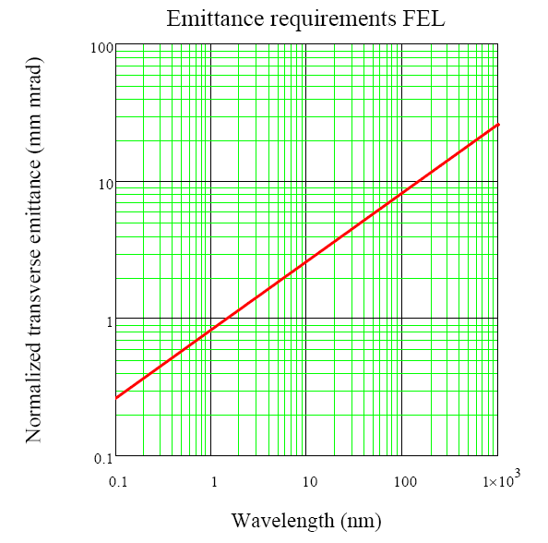
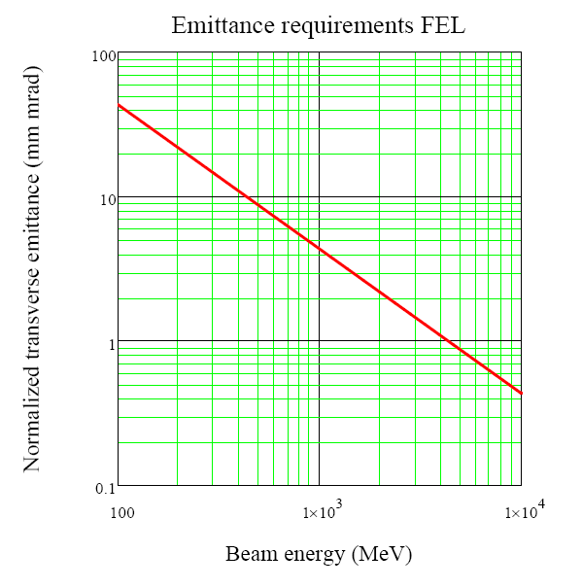

Transverse emittance (FEL)

Slide 8
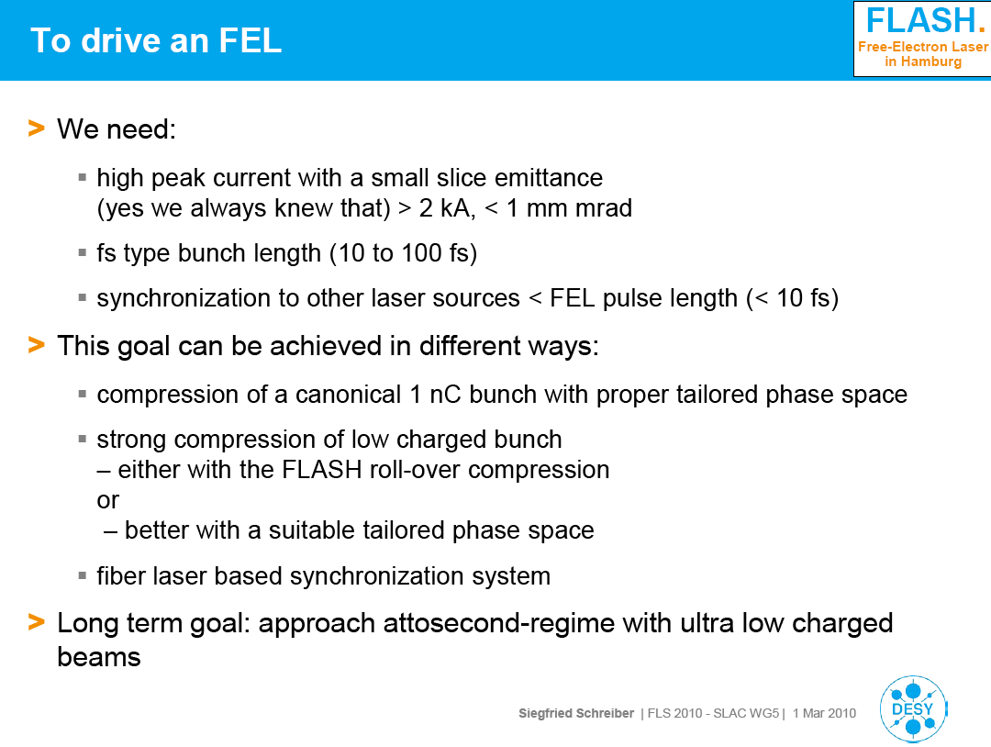
What do we need to drive a (soft) X-ray FEL?
S. Schreiber, FLS 2010

Slide 9
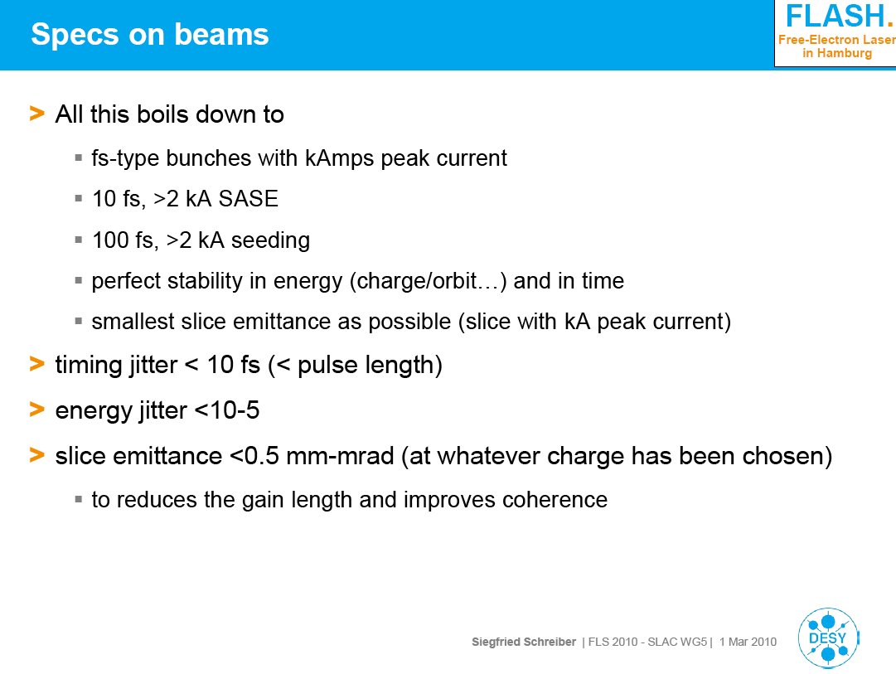
What do we need to drive a (soft) X-ray FEL?
S. Schreiber, FLS 2010

Slide 10
Transverse emittance (ERL as SRR)
Goal is to have peak brightness improvement by > 10^2 over exisiting storage rings and have < ps pulse duration
Source | Normalized transverse emittance (um) | Bunch charge (nC) | Bunch length (ps) | Peak Current (A) | Average current (mA) | Peak brightness | Average brightness
Bessy II at 1.7 GeV | 16.6 x 0.17* | 0.8 | 35 | 23 | 300 | 1 | 1
ERL 1 nm at 1.7 GeV | 0.1 x 0.1 | 0.1 | 0.1 | 100 | 100 | 147 | 6
APS at 7 GeV | 43 x 0.5 | 3 | 30 | 86 | 102 | 1 | 1
ERL 0.1 nm at 7 GeV | 0.1 x 0.1 | 0.1 | 0.1 | 100 | 100 | 93 | 46
*assumed coupling of 10% to match ε_{y} to λ_{rad} of 1 nm
X-ray data booklet, J. Lewellen at FLS 2010, M. Abo-Bakr

Slide 11
Photocathodes/Drive Lasers vs. Beam Current Goals
(FELs and ERLs as SRR)
Cathode material |  | QE | Operation λ_{L} | Required laser power at operation wavelength |  |  | Fundamental laser power* for 100 mA
 |  |  |  | 1 mA | 10 mA | 100 mA
Metal | Nb | 2*10^-5 | 250 nm | 248 W | 2.48 kW | 24.8 kW | 248 kW
 | Cu | 1*10^-4 | 250 nm | 50 W | 0.5 kW | 50 kW | 500 kW
 | Pb | 5*10^-3 | 200 nm | 1.2 W | 12.4 W | 124 W | 2.48 kW
PEA | Cs₂Te | 1*10^-1 | 250 nm | 0.05 W | 0.5 W | 5 W | 50 W
 | CsK₂Sb | 1*10^-2 | 500 nm | 0.25 W | 2.5 W | 25 W | 75 W
NEA | GaAs | 1*10^-1 | 500 nm | 0.025 W | 0.25 W | 2.5 W | 7.5 W
*assume conversion efficient 1st to 2nd of 1/3, 1st to 4th of 1/10, and 1st to 5th of 1/20
color code reflects risk (low, medium, high)
Cathode parameters from D. Dowell at al., NIM A 622 (2010)

Slide 12
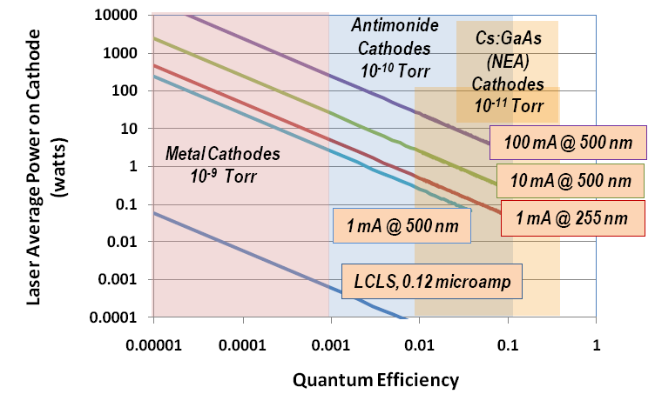
Photocathodes/Drive Lasers and Beam Current Goals
(FELs and ERLs as SRR)
different color code than previous slide
D. Dowell at al., NIM A 622 (2010)

Slide 13
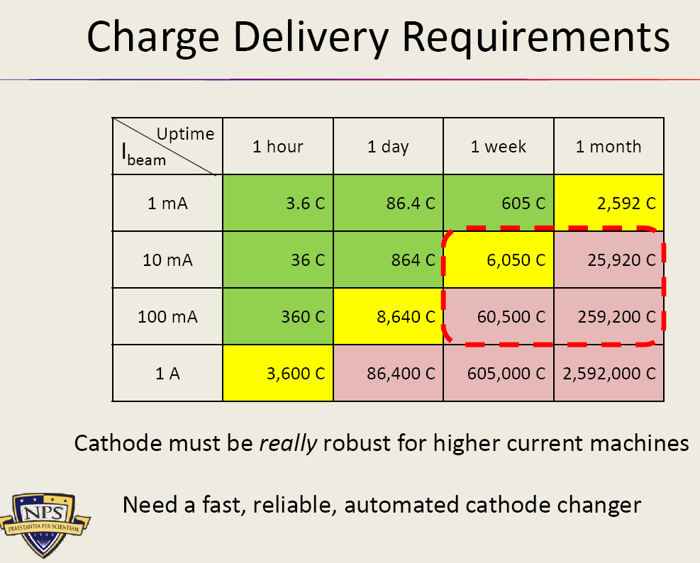
Integrated charge requirements: Cathode and drive laser must sustain delivery over long periods (ERLs)
J. Lewellen,
FLS 2010

Slide 14
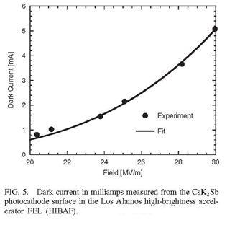
Control risk of dark current (FELs and ERLs)
*not for NEA like GaAs
ELBE FEL SRF Gun (J. Teichert, HZDR)
LANL FEL NCRF Gun (LANL)
Material | φ_{w} (eV)
Mo | 4.6
Nb | 4.3
Pb | 4.0
Cs₂Te | 3.6
CsK₂Sb | 1.9
Dark current can limit operation of gun.
Need to control the cathode workfunction, roughness and size of emissive area.

Slide 15
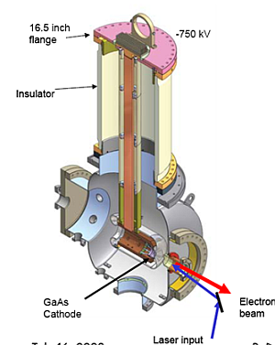
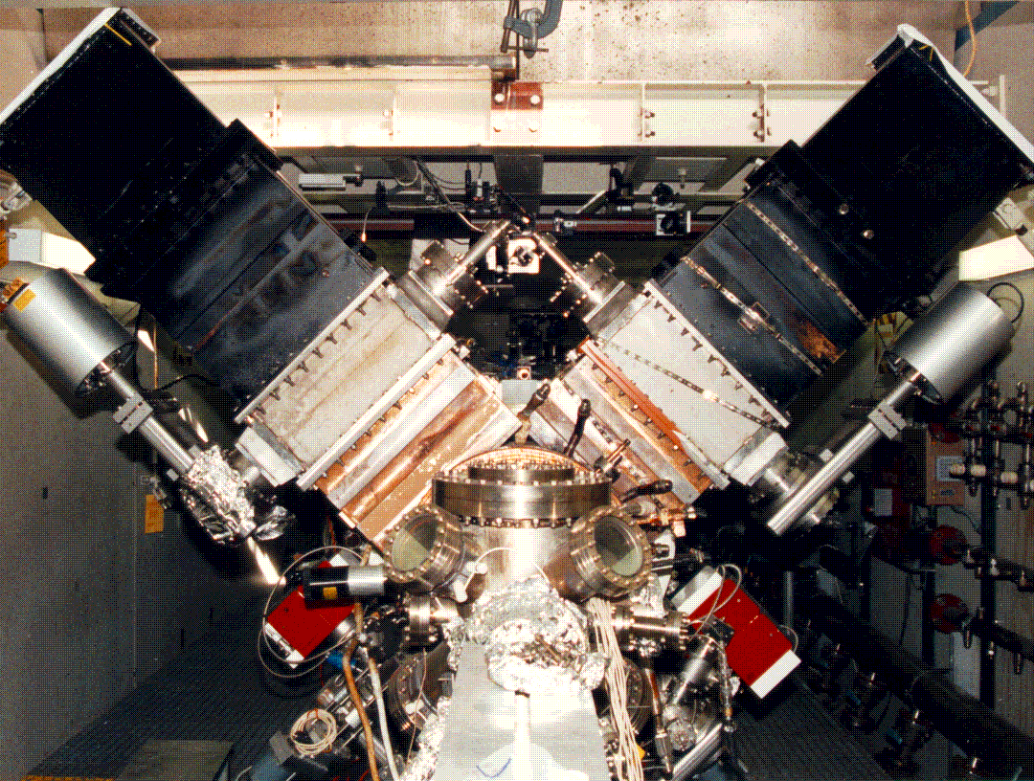
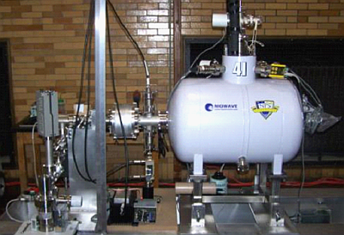
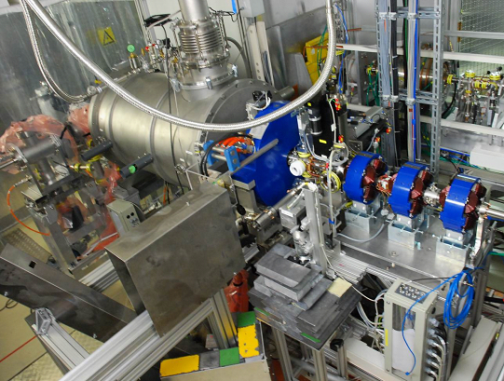
Acceleration: NCRF mature for FELs (FLASH, LCLS), NCRF (32 mA) and DC (50 mA) proved to be ERL compatible, SRF upcoming technology for FEL and ERL guns.
NCRF
Courtesy S. S. Kurennoy / LANL
DC
Courtesy D. Dowell / Boeing / SLAC
SRF
Courtesy B. Dunham / Cornell
Courtesy J. Lewellen / NPS
Courtesy J. Teichert / HZDR

Slide 16
Beam dynamics
Most guns operate
    with some form of emittance compensation mode,
    in a mode derived by multi-parameter optimization, or
    resulting from experimental optimization.
Interplay between space charge, accelerating fields and focusing with solenoid (or quadrupole)
Ideas:
    HOM inside SRF gun cavity,
    Emittance exchange.

Slide 17
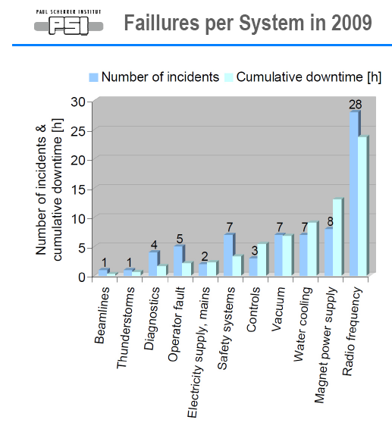
Reliability
FLASH 3rd user run in 2010/2011
Infrastructure failure, especially power cuts and disturbances of cooling water, air con and temp stabilization are main sources of downtime.
Of total downtime attributed to RF at 1.3 GHz is 9%, RF at 3.9 GHz is 5%.
S. Schreiber et al., FEL 2011
RF and power supplies,
(NC/S)RF and DC guns…
A. Stingelin, ESLS RF 2010

Slide 18
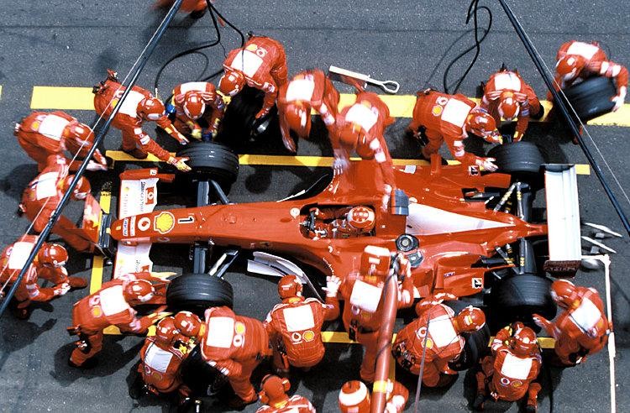
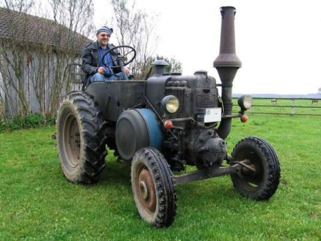
bleeding edge performance…
… solid, with low maintenance.

