Slide 1
What could a Compact X-ray Light Source at EMSL/PNNL do?
Theva Thevuthasan, Lou Terminello and Dave Koppenaal
IFCA Workshop
3/5/2012
Notes:
PowerPoint_Title_Master.jpg

Slide 2

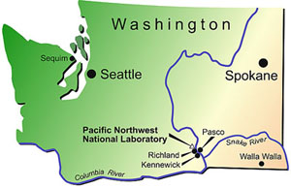
What is EMSL at PNNL?
William R. Wiley’s Vision:
An innovative multipurpose user facility providing “synergism between the physical, mathematical, and life sciences.”
Dr. William R. Wiley
PNNL Director
1984-1994
Mission
EMSL, a national scientific user facility at Pacific Northwest National Laboratory, provides integrated experimental and computational resources for discovery and technological innovation in the environmental molecular sciences to support the needs of DOE and the nation.
Funded by DOE Office of Science’s Office of Biological and Environmental Research

Slide 3
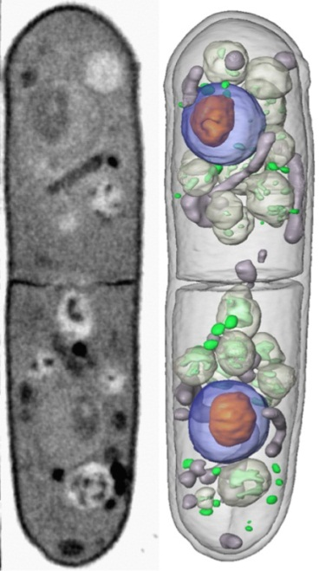
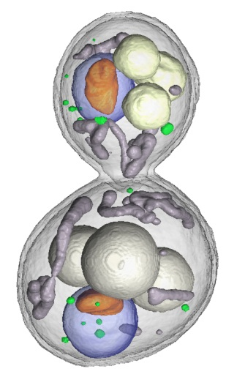

How does compact x-ray light source (CXLS) fit in EMSL/PNNL?
Multi-modality characterization
- Incorporation of EMSL’s capabilities with X-ray capabilities
- i.e., incorporating MS or dynamic TEM capability with x-rays
Controlled radiation damage
- Less intensity in comparison to 4th generation light sources
- Damage in biological materials can be controlled
Time resolved measurements
- Time structure of the pulse width will be in the order of 10-300 fs
- Time scales are consistent with many processes
Special Needs
- High level bio safety, classified work, etc.
Yeast organelle structure
C. Larabell, UCSF/LBNL
With permission.

Slide 4
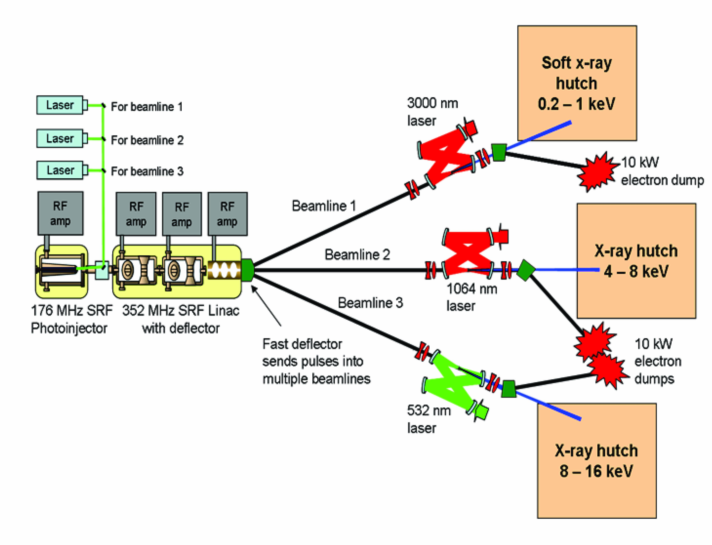
CXLS Workshop at EMSL/PNNL
Workshop was held in September 2011
- 2 days
- about 75 people participated
Biology
Biogeochemistry & Environmental Science
Catalysis
Material Science
Technology
One of the major outcomes is associated with multi-modality due to EMSL capabilities and CXLS

Slide 5
Bernd Kabius et. al , EMSL

Slide 6
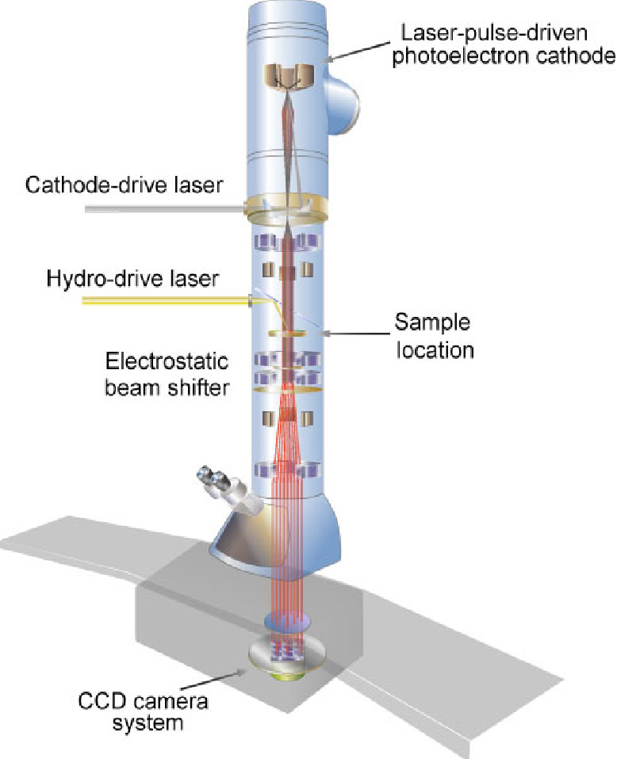
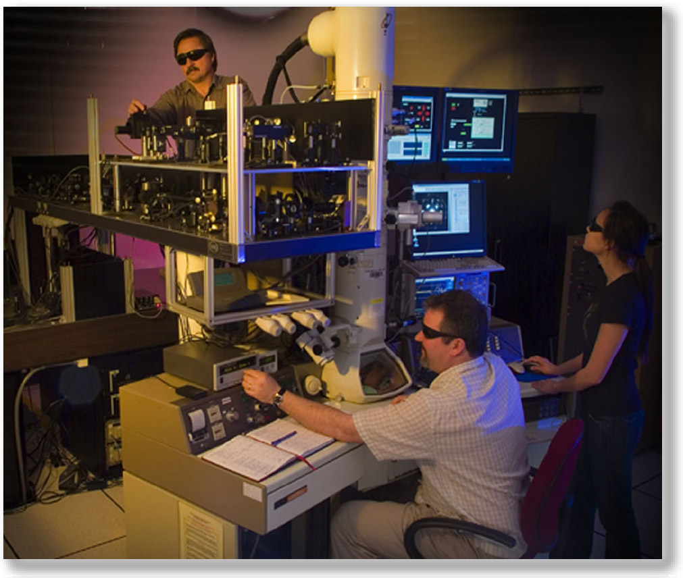
DTEM at LLNL

Slide 7

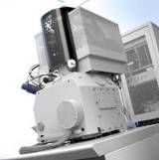
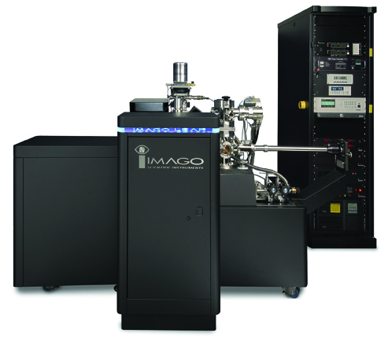
3D chemical imaging at EMSL
APT : Atom Probe Tomography
DB-FIB: Dual-beam Focused Ion Beam
TEM : Transmission Electron Microscopy
TEM
DB-FIB
APT
Ultimate Goal: Determine the
positions (in 3D) and chemical identity of individual atoms in any materials system
I. Arslan et al. / Ultramicroscopy 108 (2008) 1579–1585

Slide 8
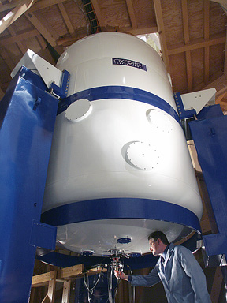
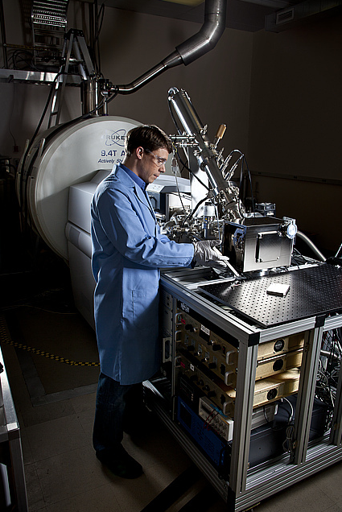

Slide 9
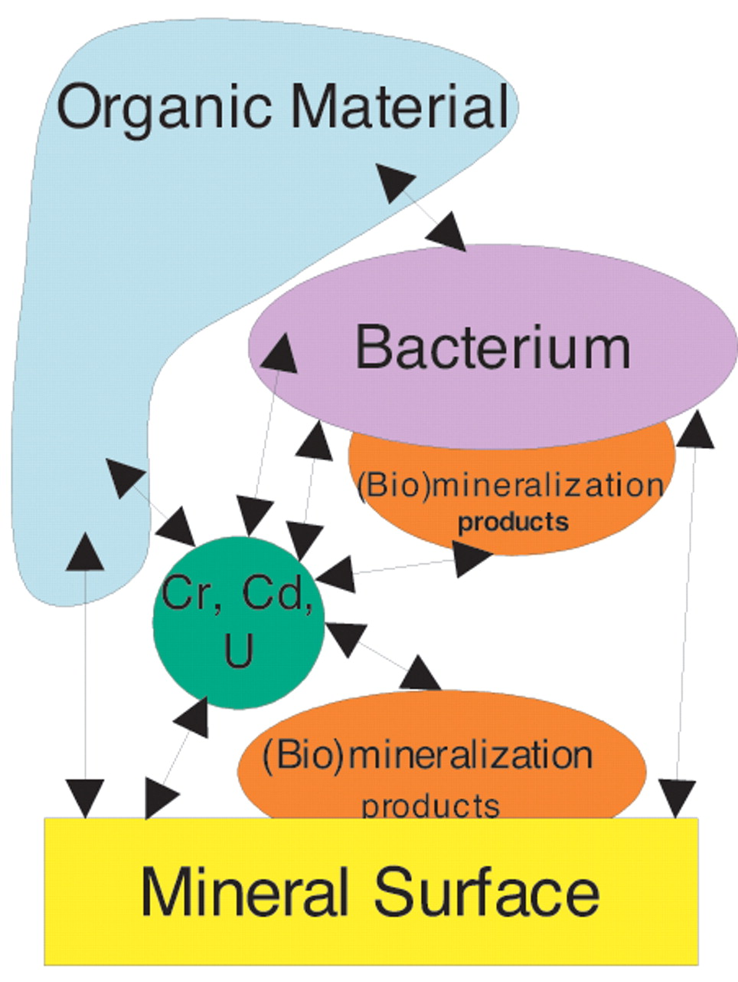





Transformations at the mineral-metal-microbe interface microenvironment
Microbes and redox active minerals have been shown to be capable of transforming contaminants
Characteristics of microenvironments, cell surfaces, subcellular components are important
The location/mechanism of contaminant sorption, reduction, and precipitation processes, relative to cells attached to mineral surfaces is not well understood
An understanding of the spatial distribution of contaminants and their chemistry within and near the mineral-microbe interface microenvironment is needed
Kemner, O’Loughlin, Kelly, Boyanov, “Synchrotron x-ray investigations of mineral-microbe-metal interactions,” Elements August 2005.

Slide 10
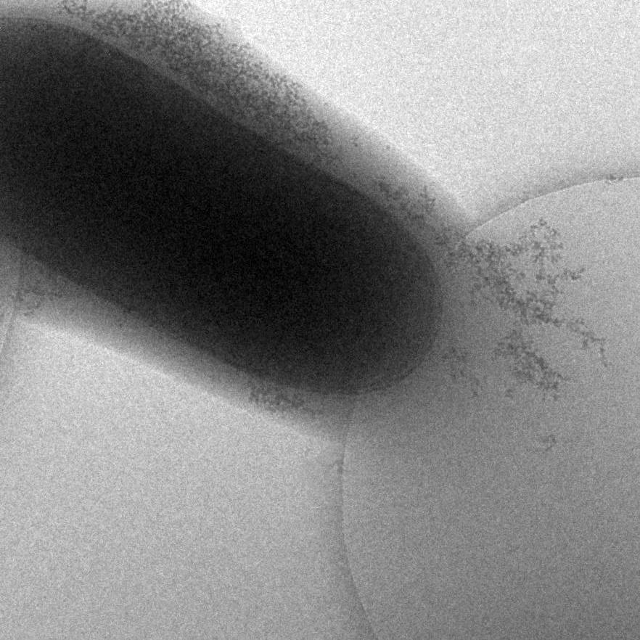
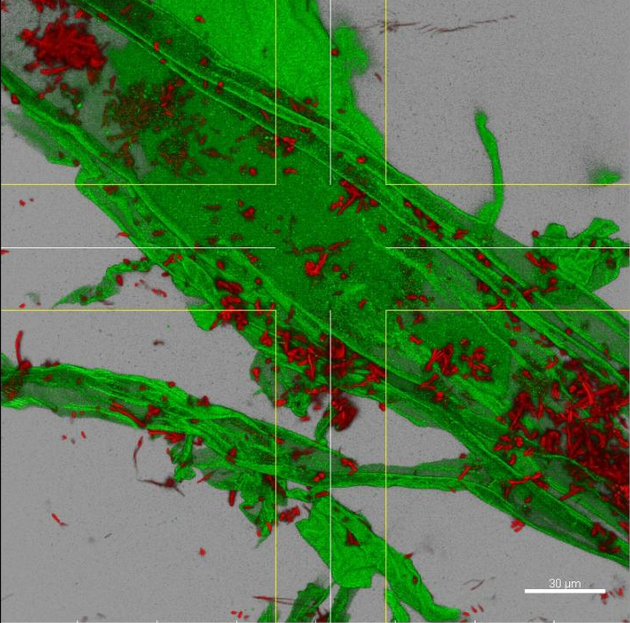
Microbe interactions
Need to understand the microbial interactions
- sub cellular level
- between the microbes
- microbes with the environment
- microbes as a community
- interactions with the mineral surfaces
- how does the extracellular polymeric substance (EPS) on the microbe surface play a roll?
- charge transfer mechanisms?
What is happening during cell division?
What kind of protein changes occur?
Cells
Interactions between them?
Interactions between them and the environment?
0.5 μm

Slide 11
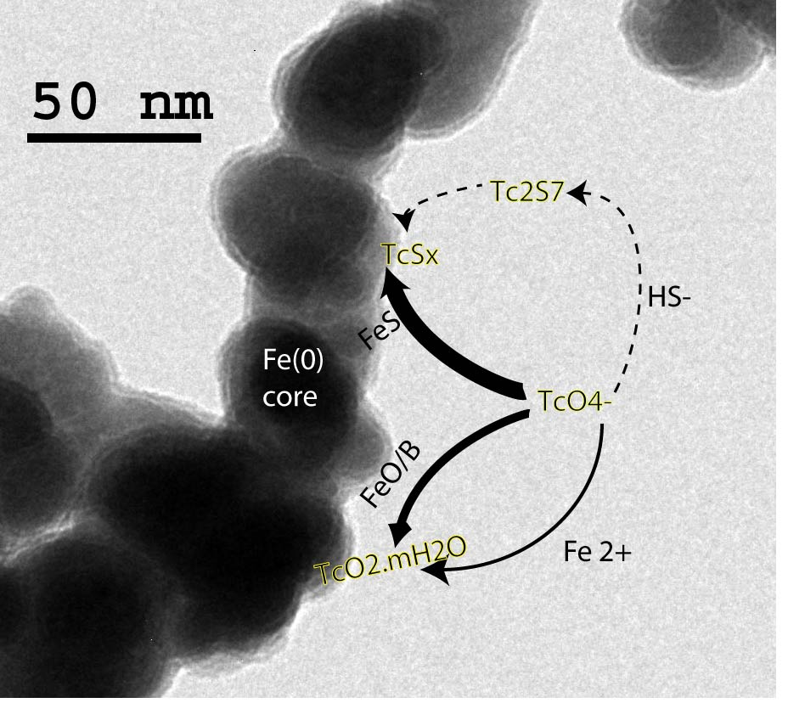
Tc sequestration under sulfidogenic conditions
nZVI
Nature of the reduced Tc solids?
Changes in the composition of the reduced Tc solids as the environment shifts from Fe rich to sulfide rich?
Is Tc structurally incorporated into FeS minerals?
Stability of Tc during re-oxidation?
C
D
B
SRBs
A
B
P.G. Tratnyek and D. Fan

Slide 12
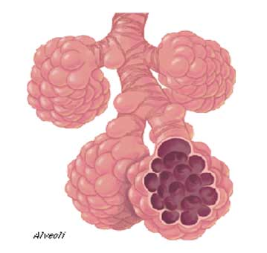
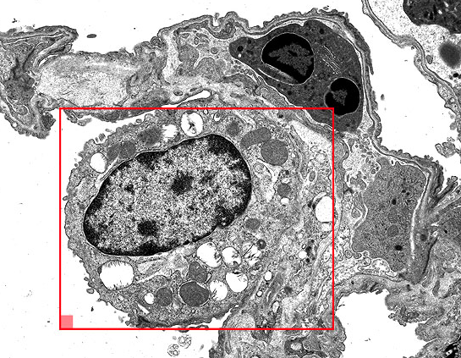
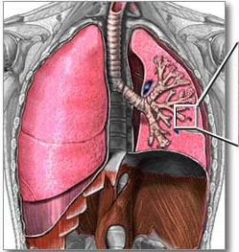
Response mechanisms: living cell to intended or unintended external perturbations – engineered nanomaterials
Can we combine 3D super-resolution fluorescence imaging and CXLS to provide the following:
Gain a molecular level insight into the spatiotemporal distribution of specific proteins and molecular complexes in their native cellular environment to better understand their behavior and function in cell response and survival
Study the response mechanisms of the living cell to external perturbations with a focus on engineered nanomaterials
G. Orr et. al

Slide 13
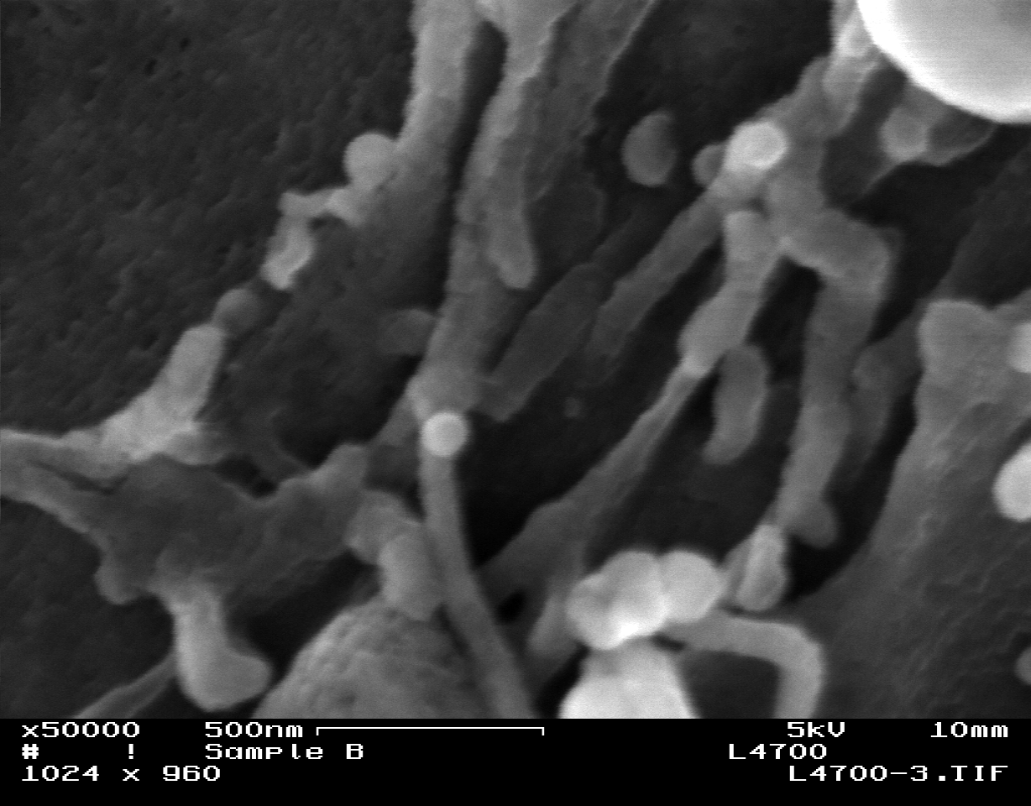
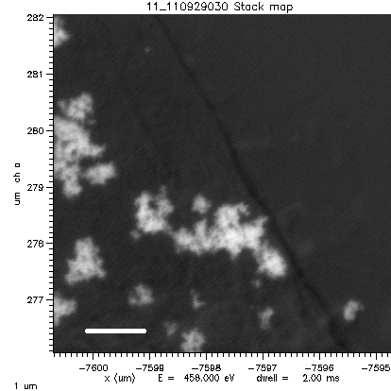
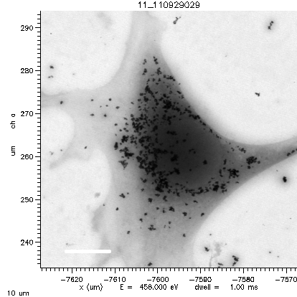
3D nano-scale imaging and chemical analysis
Imaging and chemical analysis of molecular complexes and individual proteins in their native cellular environment in response to highly defined and dynamically changing nanomaterials and other perturbations
Fluorescence in live cells
Develop 3D nano-scale fluorescence imaging combined with CXLS capabilities and cryo electron tomography for correlating spatial, temporal and chemical response patterns
Identify changes in physical and chemical properties of nanomaterials that occur within the cellular environment and correlate these to fate of the particle and the cellular responses
Enable unprecedented insights into the living cell’s responses to external perturbations, and ultimately new understanding of the cellular machinery
SEM
Ti elemental map – L edge
nucleus
10 µm

Slide 14
Probing the photoinduced charge transfer in semiconductor QDs-polymer hybrid solar cells
Operation of the cell
  Exciton formation following photon absorption and diffusion to the interface between π-conjugated polymer blends (P3HT) and nanoparticles (CdSe)
  Charge separation at the interface
  Hole transport through the polymer to the electrode
  Electrons hop between the QDs and reach the electrode
P.V. Kamat, J. Phys. Chem. C 112, 18737-18753 (2008); J.H. Bang and P.V. Kamat, NanoLetters 3, 1467-1476 (2009)

Slide 15
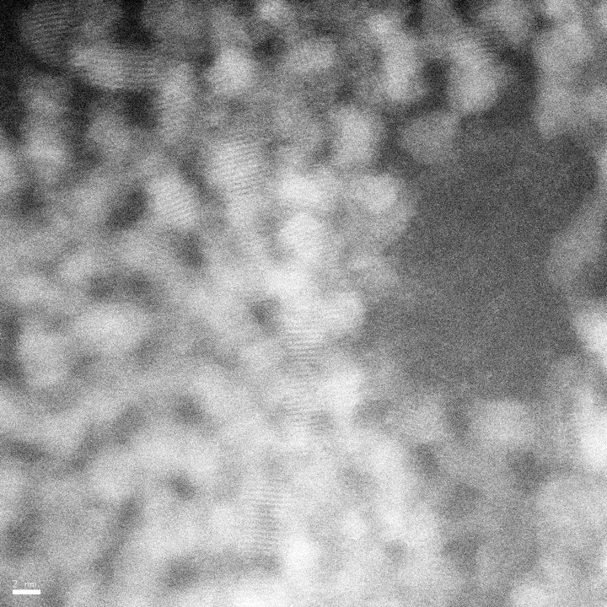
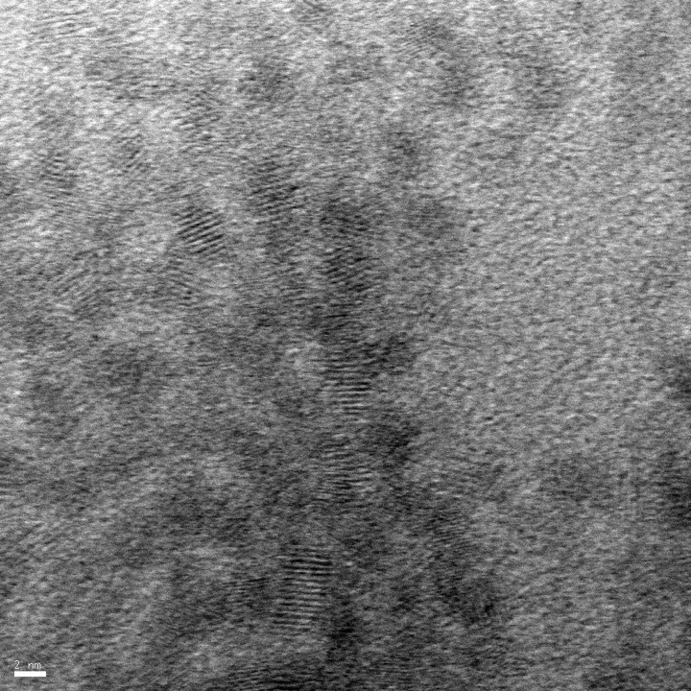
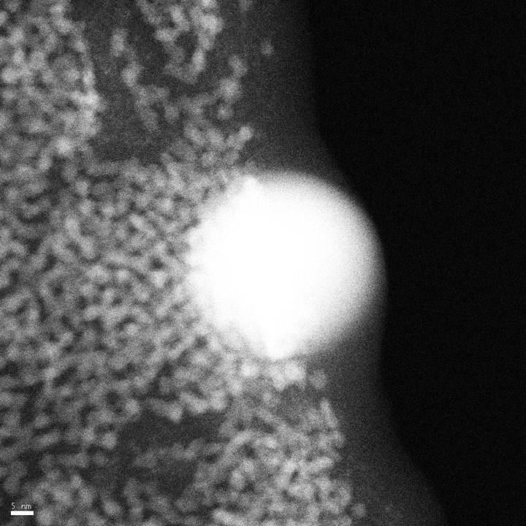
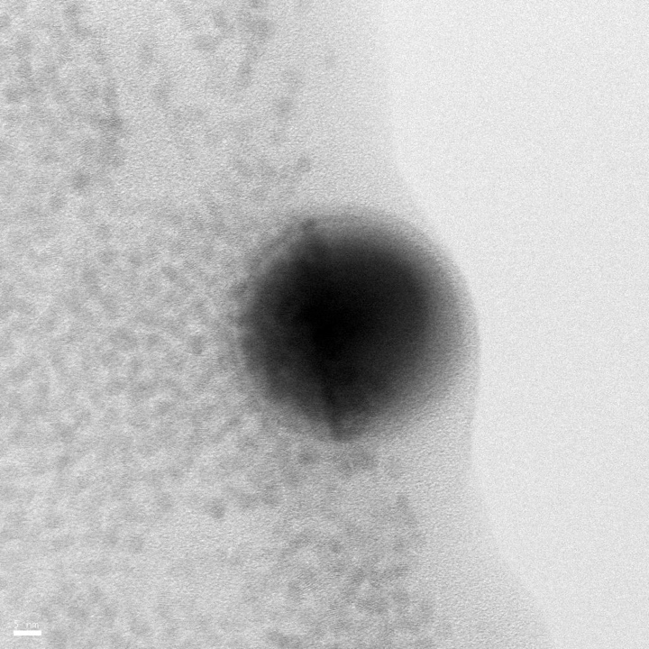
High resolution STEM imaging from CdSe QDs
Dark field
Bright field
High resolution TEM images obtained from 3.3nm quantum dots
Efforts underway to overcome the challenges associated with STEM imaging and image quantum dots in toluene and P3HT
Demonstrated size dependent non stoichiometry in CdSe quantum dots
Probed the environment induced phase transformation in CdSe quantum dots
DF
BF
DF
BF
A.S. karakoti et. al, J. Phys. Chem. Lett. 2011, 2 (22), pp 2925–2929

Slide 16
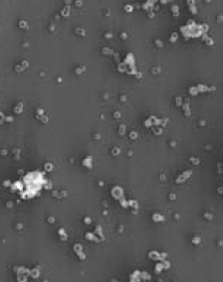
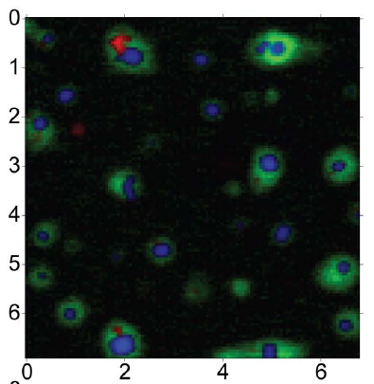
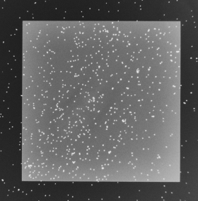
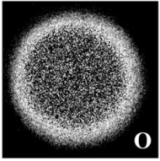

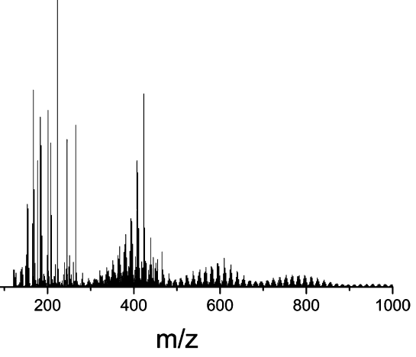
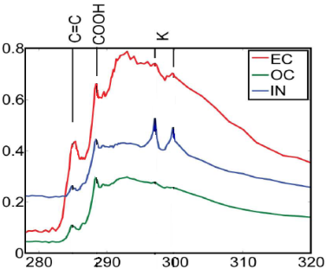
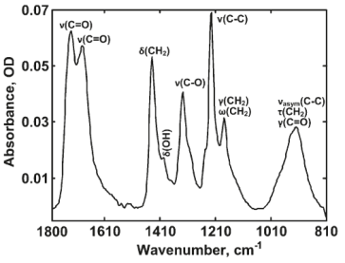
Atmospheric Aerosols
SEM-EDX, TEM/EELS
STXM-NEXAFS
Micro-FTIR
Nanospray DESI-MS
Microscopic Details
Molecular Characterization
Comprehensive Analysis Using Complementary Analytical Techniques is Needed!
Systematic Approach from “General” to “In-depth” Analysis
A. Laskin, A. I. Zelenyuk, et. al

Slide 17
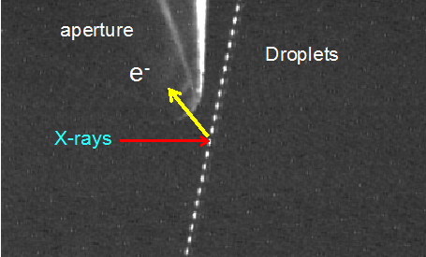
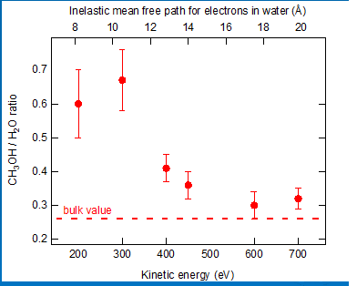
Aerosol Characterization
X-ray micro-spectroscopy experiments to understand chemical speciation of particle internal heterogeneity, in-situ studies of gas-particle reactions, liquid-particle interfaces
High pressure photoemission X-ray Microscope for Surface Reaction Dynamics at Environmental Interfaces - interfacial segregation in organic/inorganic aerosols particles, surface chemical reactions

Slide 18
Understanding Chemical and Structural Changes in Battery Materials
Challenges:
Discovering new materials with high capacity, high power, longer life, and safe operation
- Less volume expansion
- Chemical stability across different components
- Enhance charging and discharging rate
- Less irreversible microstructure formations
Approach:
- Combination of nanomaterials and in-situ structural and electrochemical measurements
- Combination of TEM, STEM and APT
- Integration of high energy resolution EELS measurements with CXLS capabilities such as STXM – chemical state charge transfer information
- Integration of experimental data with calculations (DFT and MD)
In-situ TEM set up and microstructure and chemistry of high capacity anode materials
C. M. Wang et. al

Slide 19
Recent progress and identification of critical paths for the success of the discovery of new battery materials
Key Progress:
Identified critical paths:
- Interface structure and stability in battery, i.e SEI - New chemistry, such as Li-Air and Li-S
- Lattice dynamic and phase stability: need both high spatial and high temporal resolution
- In-situ EELS and STXM to monitor chemical and electronic structure evolution
- Multi-scale predictive modeling: DFT, MD, phase field, continuum mechanics
  In-situ work on high capacity and longer cycle life Si-C nano composite
  Deep dive into the phase transformation mechanisms into Si-Li system, discovered for the first time the congruent phase transition from amorphous Li₁₅Si₄ to crystalline Li₁₅Si₄
  Integration of experimental observation with DFT-MD calculation
In-situ observation of structure and phase evolution of a-Si coated carbon fiber nanocomposite, and the DFT-MD calculation

Slide 20
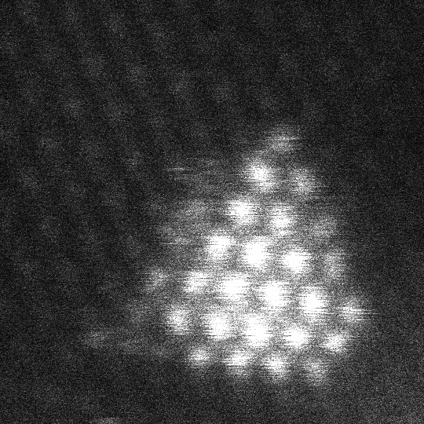
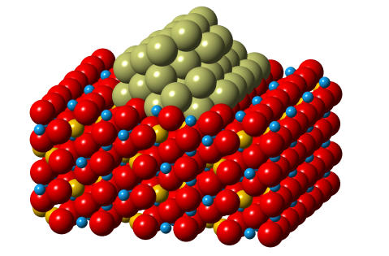



Atomic and Electronic Structure of Catalysts
Tomography reconstruction of γ-Al₂O₃ decorated with Pt
Challenges:
Oxide nanoclusters supported by gamma alumina
To determine physical structure and chemical state of catalytic particles and their interfaces under working environment (in-situ)
To establish electronic structure at the active sites
To correlate the structural and electronic characteristics with catalytic properties (the nature of the reactive sites)
Describe the mechanism of diffusion, coarsening poisoning and other degradation processes
Pt
porosity
Pt
20 nm
Image #12
1 nm

Slide 21
Atomic and Electronic Structure of Catalysts
Approach:
Class of TMO (e.g., WO₃, MO₃, V₂O₅) and TM (e.g., Pt, Cu) supported by γ-Al₂O₃ -> prominent heterogeneous catalytic systems for a number of reduction, oxidation and reforming reactions in automotive and petroleum industries.
In-situ aberration corrected TEM, STEM-HAADF imaging, EDS and EELS spectroscopy to establish structural nature of catalyst.
Integration of high energy resolution EELS measurements with light source XAS measurements to understand the electronic structure.
DTEM and time resolved XAS to study the structural transformations associated with catalytic processes (dehydroxylation, surface reconstruction, diffusion….)
Integration of experimental data with DFT calculations and correlation with catalytic performance.
0 sec.
85 sec.
170 sec.
255 sec.
340 sec.
5 nm
5 nm
5 nm
5 nm
5 nm
In situ study of Pt particles Oswald ripening @ 500°C
L. Kovarik, et. al

Slide 22
Thank you!

