Slide 1
Injection in Rings with Small Dynamic Aperture - Lessons Learned at BESSY II
A. Jankowiak, P. Kuske

Slide 2
Content
Some Facts about BESSY II
Introduction:
Conventional Injection Scheme
Example BESSY II – Technical Limitations
Critical Issues for Efficient Injection:
Transverse and Longitudinal Match
(Dynamic Aperture – Acceptance of the SR)
(Impact of IDs on Acceptance and Counter Measures)
Overcome Technical Limitations
Give up Symmetry for Higher Injection Efficiency
Limitations –Thickness of the Septum for Ultimate SR
Alternative Single Kicker Injection Schemes
BESSY II Approach
Pulsed Quadrupole or Sextupole KEK Approach
Spring8 Approach
Alternatives to Accumulation, Swap-Out Injection (a la Borland)
Summary

Slide 3
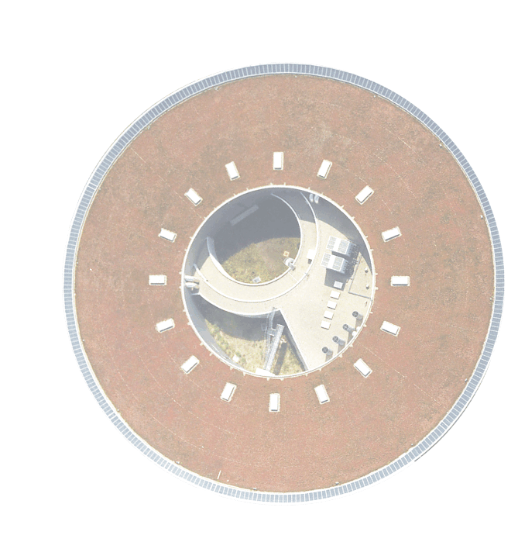
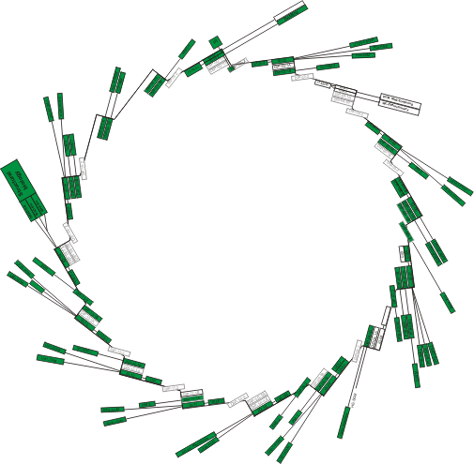
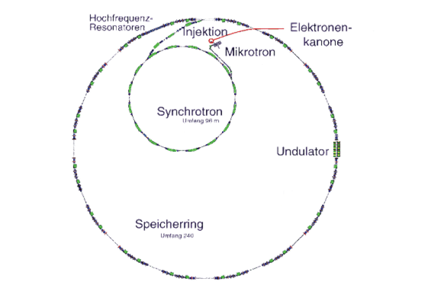
BESSY II – The Storage Ring
Energy/current 1.7GeV / 300mA
Emittance 6 nm rad 4 nm rad
Straight sections 16
Undulators / MPW+WLS 10 / 1+3
ID / dipole beam lines 32 / 20
end stations (fixed+var) 52
~ 5000 h/a user service
~ 2400 users / a
~ 1000 h/a beam test + commiss.
used for accelerator research
Running up-grades:
new injector linac, 30x higher charge in single bunch injection
(in user operation right now)
Fast Orbit Feedback, up to 100Hz
Top-Up
will start after summer
shutdown 08/2012

Slide 4
What‘s Next?
Some Facts about BESSY II
Introduction:
Conventional Injection Scheme
Example BESSY II – Technical Limitations
Critical Issues for Efficient Injection:
Transverse and Longitudinal Match
(Dynamic Aperture – Acceptance of the SR)
(Impact of IDs on Acceptance and Counter Measures)
Overcome Technical Limitations
Give up Symmetry for Higher Injection Efficiency
Limitations –Thickness of the Septum for Ultimate SR
Alternative Single Kicker Injection Schemes
BESSY II Approach
Pulsed Quadrupole or Sextupole KEK Approach
Spring8 Approach
Alternatives to Accumulation, Swap-Out Injection (a la Borland)
Summary

Slide 5
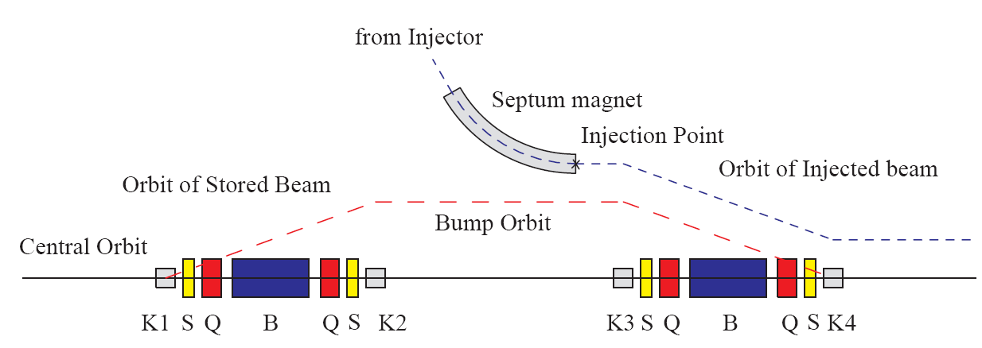
Conventional Injection Scheme
taken from K. Harada, et al., PAC 2005
Targets – in view of top-up operation:
Injection as efficient as possible
Stored beam as quiet as possible

Slide 6
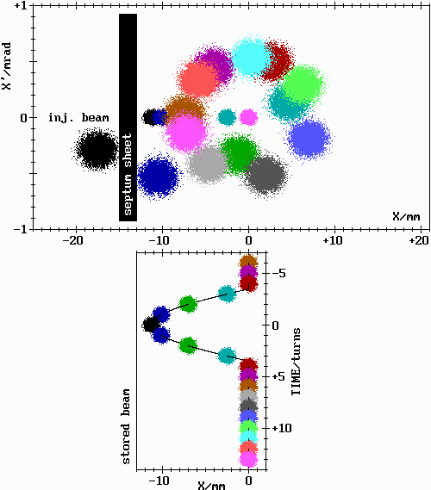
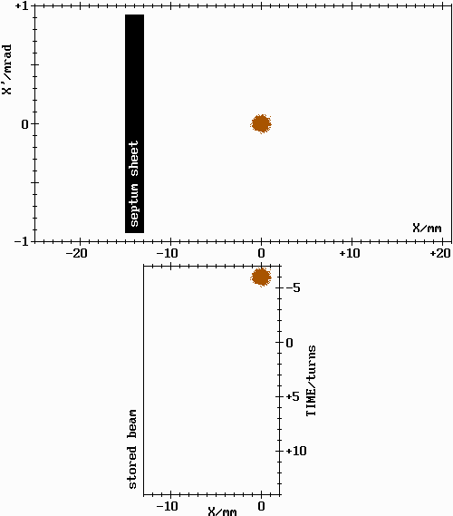
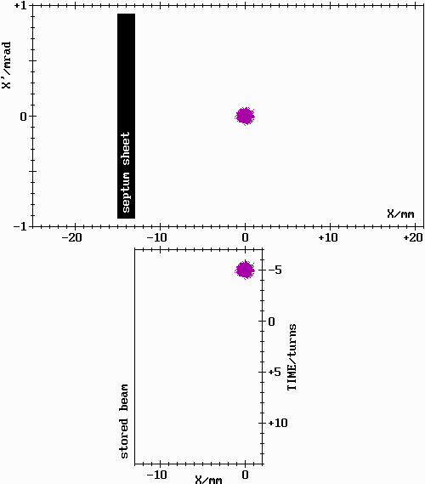
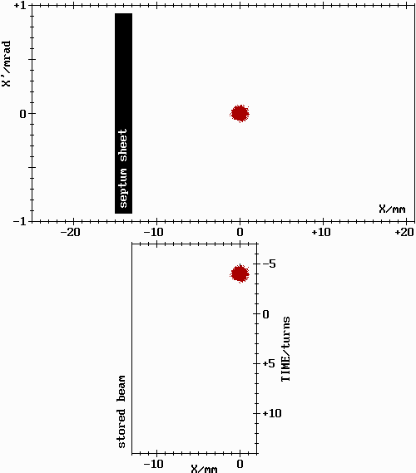
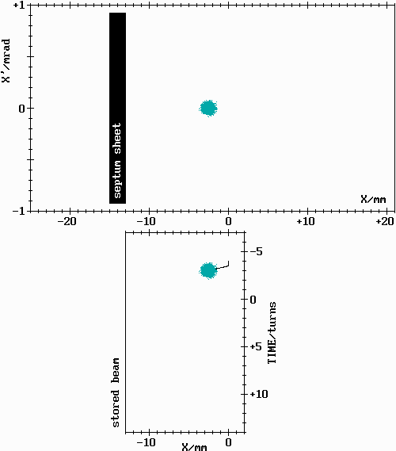
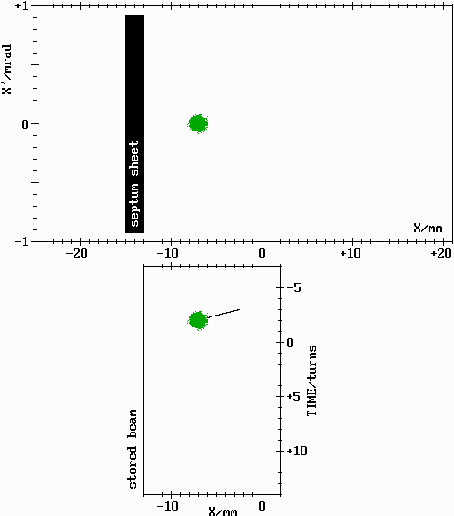
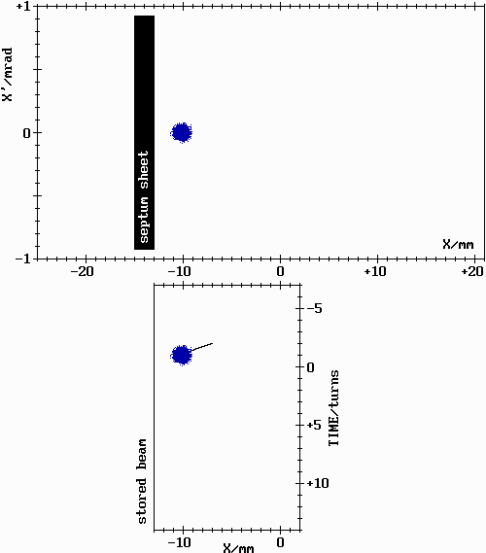
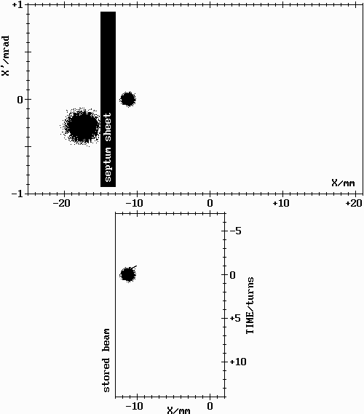
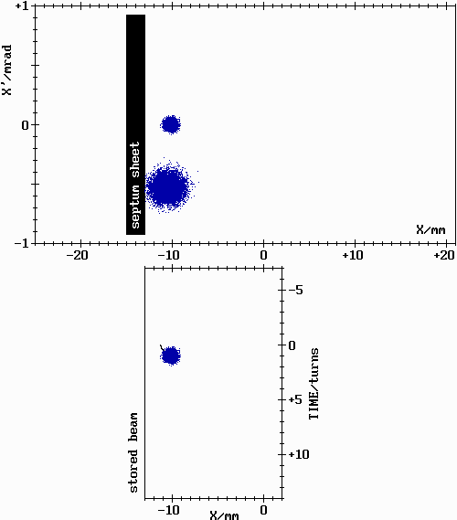
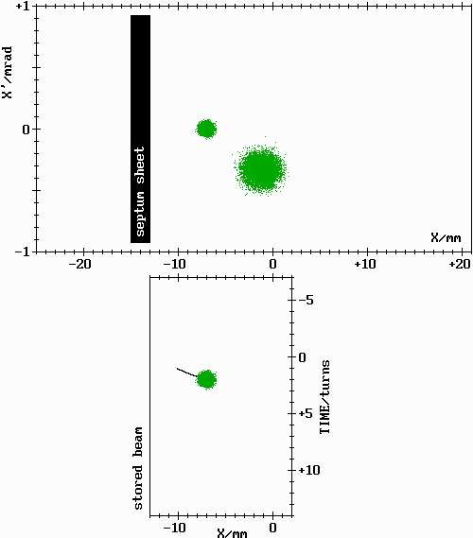
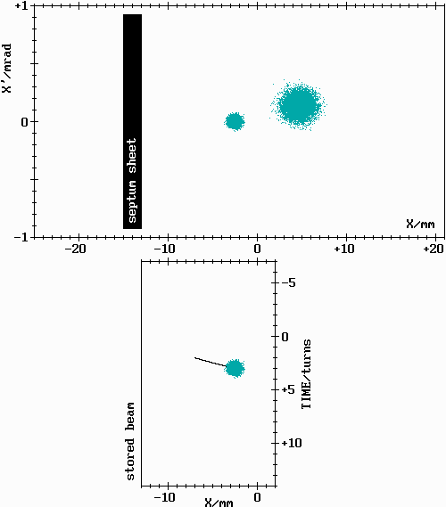
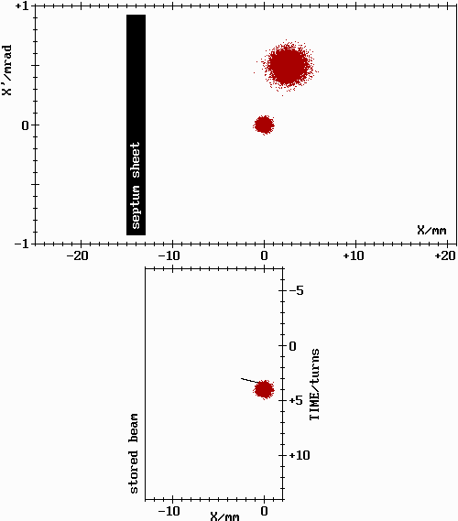
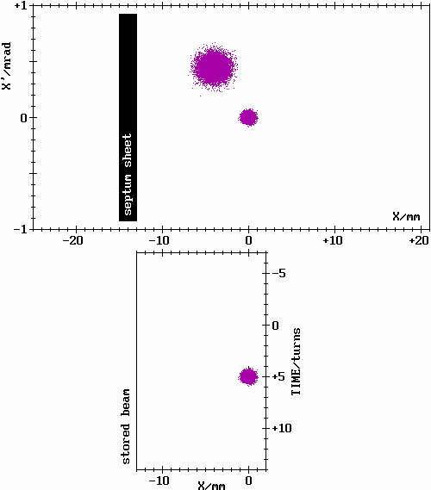
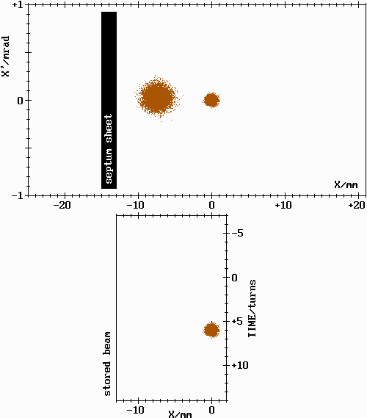
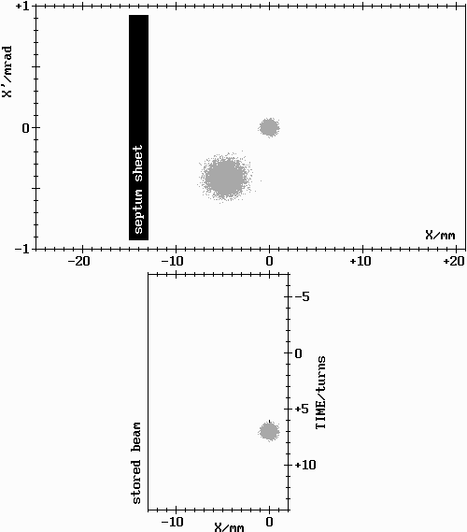
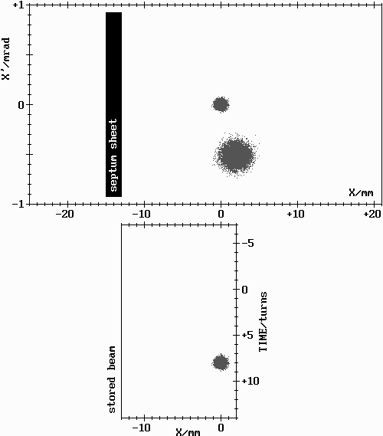
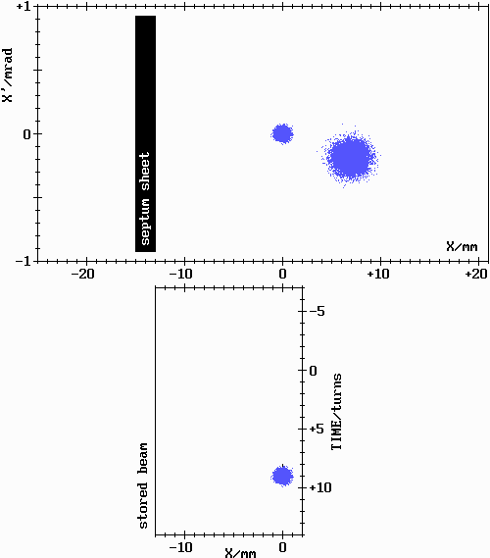
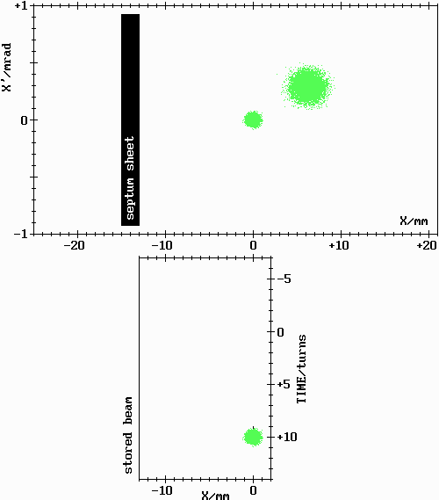
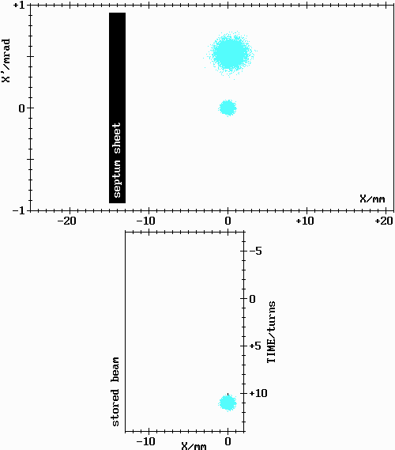
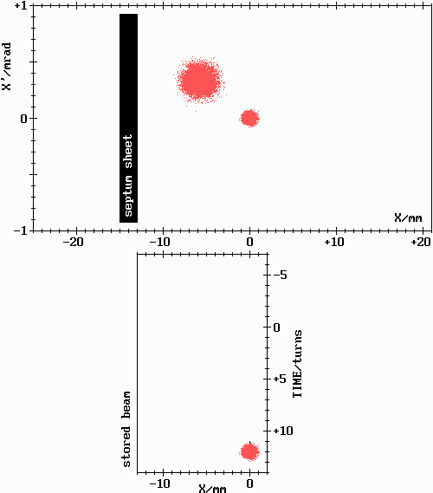
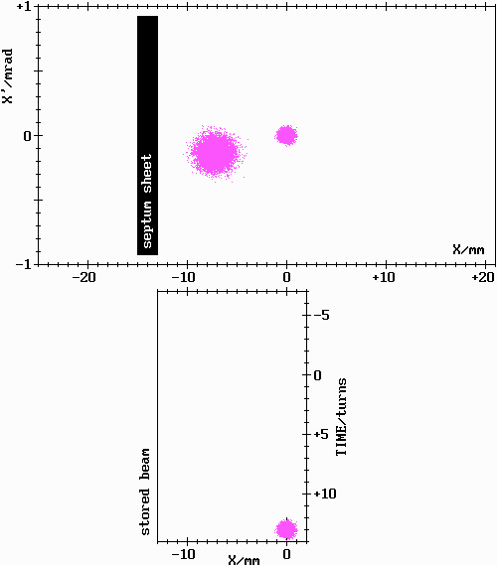
Traditional Injection in Phase Space
flexible – optics independent
ideally, beam motion restricted to injection straight section
critical issue – bump closure
reality: imperfections of septum and kicker magnets
P. Kuske, BESSY, ESLS at Diamond

Slide 7
What‘s Next?
Some Facts about BESSY II
Introduction:
Conventional Injection Scheme
Example BESSY II – Technical Limitations
Critical Issues for Efficient Injection:
Transverse and Longitudinal Match
(Dynamic Aperture – Acceptance of the SR)
(Impact of IDs on Acceptance and Counter Measures)
Overcome Technical Limitations
Give up Symmetry for Higher Injection Efficiency
Limitations –Thickness of the Septum for Ultimate SR
Alternative Single Kicker Injection Schemes
BESSY II Approach
Pulsed Quadrupole or Sextupole KEK Approach
Spring8 Approach
Alternatives to Accumulation, Swap-Out Injection (a la Borland)
Summary

Slide 8
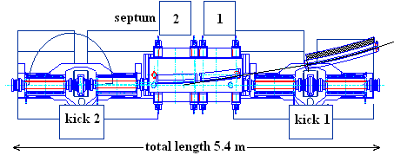
Kicker Magnets Powered in Pairs
source of perturbation (relaxed injection geometry) | orbit distortion in μm with
 | 4 individual kickers | 2 pairs of kickers
rel. amplitude error of 10⁻³ | 370 | 18
timing error of 1 ns | 430 | 22
deviation from half sine wave by 1ns/FW with FW=5.6 μs with constant amplitude | 220 | 11
with constant integral value | 280 | 14
8

Slide 9
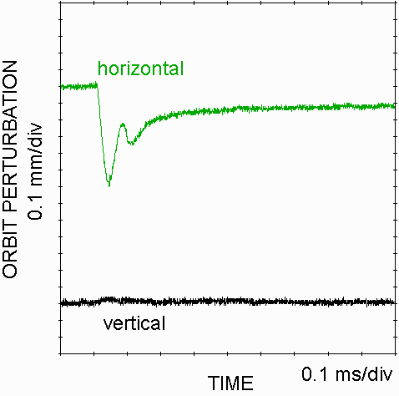
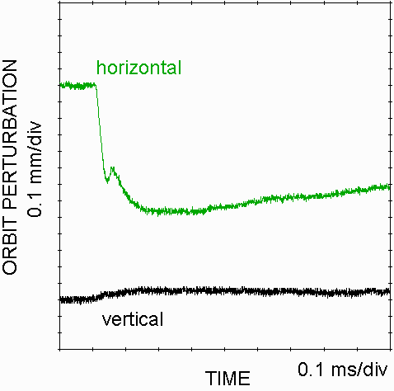
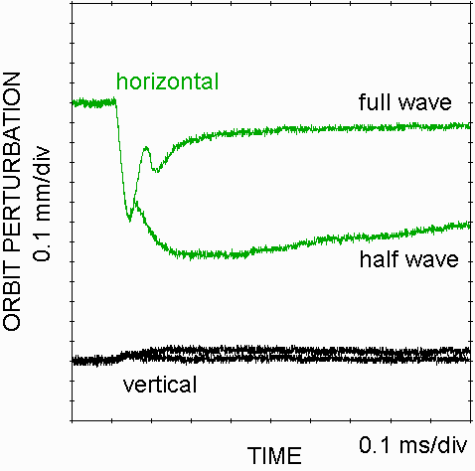
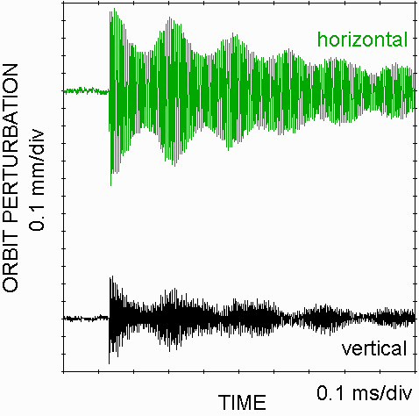
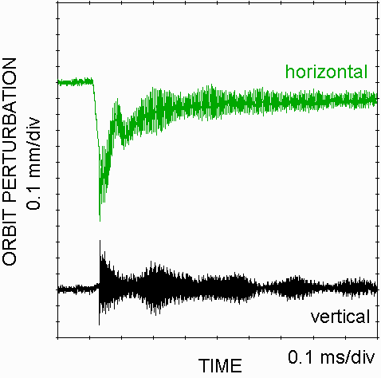
Orbit Perturbations by Pulsed Magnets
impact of pulsed septum magnet
on stored beam
impact of injection kicker magnets
on stored beam
impact of injection kicker and septum magnets on stored beam
O. Dressler, E. Cambas
9

Slide 10
What‘s Next?
Some Facts about BESSY II
Introduction:
Conventional Injection Scheme
Example BESSY II – Technical Limitations
Critical Issues for Efficient Injection:
Transverse and Longitudinal Match
(Dynamic Aperture – Acceptance of the SR)
(Impact of IDs on Acceptance and Counter Measures)
Overcome Technical Limitations
Give up Symmetry for Higher Injection Efficiency
Limitations –Thickness of the Septum for Ultimate SR
Alternative Single Kicker Injection Schemes
BESSY II Approach
Pulsed Quadrupole or Sextupole KEK Approach
Spring8 Approach
Alternatives to Accumulation, Swap-Out Injection (a la Borland)
Summary

Slide 11
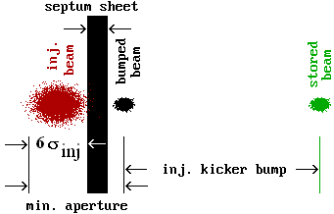
Injection Geometry and Aperture Requirements

Slide 12
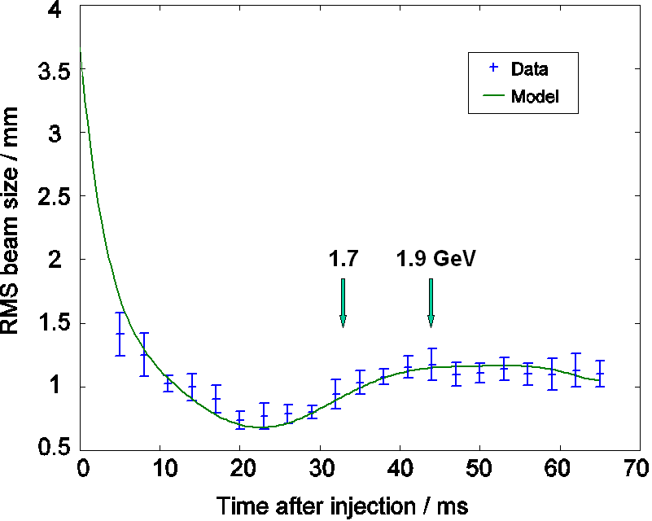
Improve Quality of Injected Beam
Transverse emittance
Measured and calculated beam size in the synchrotron during energy ramp: At extraction the emittance is 40% smaller than expected from radiation equilibrium, adiabatic damping dominates
Additional emittance reduction of 40% by increasing the horizontal tune
Dynamic vertical steering leads to improved x,y-distribution
Particle distribution behind the extraction septum as a function of the vertical beam position
Usual distribution is shown to the very left

Slide 13
Emittance Exchange – Take Advantage of Smaller Vertical Emittance
results of multi particle tracking with time dependent coupling
switched skew quadrupole field
tune switching
time dependent and resonant skew quadrupole field
horizontal and vertical EMITTANCE vs. TIME
C. Carli, et al.,“Emittance Exchange by Crossing a Coupling Resonance“, EPAC 2002

Slide 14
Improve Quality of Injected Beam
Longitudinal emittance and long. mismatch
injected stored beam
energy spread: 5.7 10⁻⁴ 1.0 10⁻³
bunch length: 100 ps 15 ps
after T_{syn}/4 injected beam has an energy spread of
100ps/15ps·5.7 10⁻⁴ = 3.8 10⁻³
at that time the horizontal oscillation amplitudes are still very large and losses can occur
improved with larger RF-voltages and smaller momentum compaction factor
Bunch length measurement of the beam injected into the storage ring and simulation. Red: distribution of particles, black: projections - momentum to the right, longitudinal at the bottom
Longitudinal mismatch challenge for short bunches in SR (low alpha, BII-VSR, …)
Peter Kuske at ELETTRA, 25th of May 2007

Slide 15
What‘s Next?
Some Facts about BESSY II
Introduction:
Conventional Injection Scheme
Example BESSY II – Technical Limitations
Critical Issues for Efficient Injection:
Transverse and Longitudinal Match
(Dynamic Aperture – Acceptance of the SR)
(Impact of IDs on Acceptance and Counter Measures)
Overcome Technical Limitations
Give up Symmetry for Higher Injection Efficiency
Limitations –Thickness of the Septum for Ultimate SR
Alternative Single Kicker Injection Schemes
BESSY II Approach
Pulsed Quadrupole or Sextupole KEK Approach
Spring8 Approach
Alternatives to Accumulation, Swap-Out Injection (a la Borland)
Summary

Slide 16
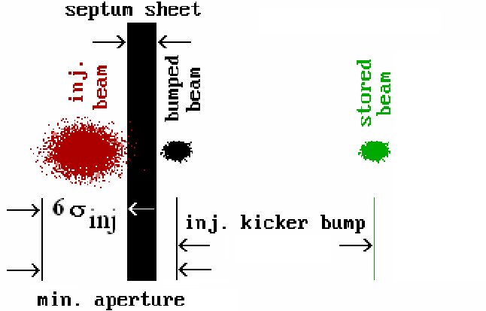
Overcome Technical Limitations Relax Injection Geometry
Septum magnet moved closer to the stored beam
life time not affected, reduced kick strength improves stability
16

Slide 17
Assume Everything Has Been Done
Transverse and longitudinal matching of the injected to the stored beam
Septum, the physical aperture equal to DA
technical limitations of kicker and septa overcome
DA in SR as large as possible – after linear and non-linear optimization
IDs transparent as can be – with passive and active compensation
APPLE II-undulators still reduce the DA (large horizontal ß-function)
What else can we do?
17

Slide 18
What‘s Next?
Some Facts about BESSY II
Introduction:
Conventional Injection Scheme
Example BESSY II – Technical Limitations
Critical Issues for Efficient Injection:
Transverse and Longitudinal Match
(Dynamic Aperture – Acceptance of the SR)
(Impact of IDs on Acceptance and Counter Measures)
Overcome Technical Limitations
Give up Symmetry for Higher Injection Efficiency
Limitations –Thickness of the Septum for Ultimate SR
Alternative Single Kicker Injection Schemes
BESSY II Approach
Pulsed Quadrupole or Sextupole KEK Approach
Spring8 Approach
Alternatives to Accumulation, Swap-Out Injection (a la Borland)
Summary

Slide 19
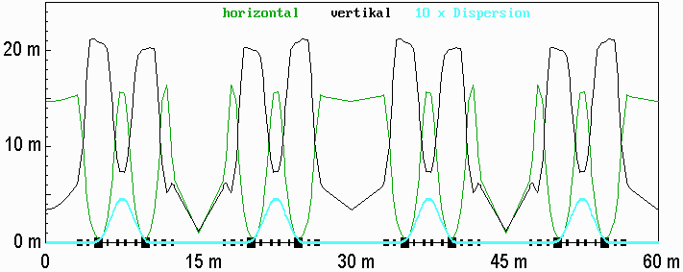
BESSY II Optics Modification
standard optics with strong negative impact of IDs in the doublet straights:

Slide 20
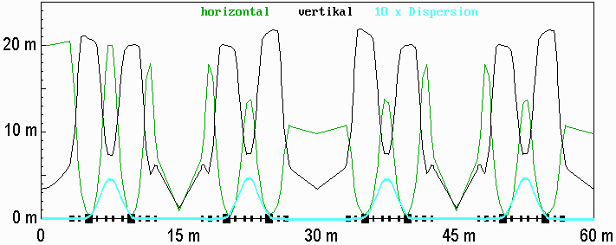
BESSY II Optics Modification
reduce impact of IDs in the doublet straights by smaller horizontal ß-function:
horizontal ß-function 20 m/rad in the injection straight and 10 m/rad elsewhere;
injection efficiency >90 % even with all APPLE II-undulators at smallest gap

Slide 21
What‘s Next?
Some Facts about BESSY II
Introduction:
Conventional Injection Scheme
Example BESSY II – Technical Limitations
Critical Issues for Efficient Injection:
Transverse and Longitudinal Match
(Dynamic Aperture – Acceptance of the SR)
(Impact of IDs on Acceptance and Counter Measures)
Overcome Technical Limitations
Give up Symmetry for Higher Injection Efficiency
Limitations –Thickness of the Septum for Ultimate SR
Alternative Single Kicker Injection Schemes
BESSY II Approach
Pulsed Quadrupole or Sextupole KEK Approach
Spring8 Approach
Alternatives to Accumulation, Swap-Out Injection (a la Borland)
Summary

Slide 22
Limits for Efficient Injection
bring injected and stored beam as close as possible to the septum sheet
make emittance of the injected beam as small as in SR (like SLS, MAXIV, USR@Spring8...)
assume all 3 contributions to the required dynamic aperture, DA, are equal:
thickness of the septum sheet, S: or hor. betafunction:
with typical S ~> 2.5 mm: ß_{x} ~ 35 m/rad for ε_{x} ~ 5. nm·rad
ultimate SR: septum contribution dominant or ß_{x} ~ 3.5 km/rad for ε_{x} ~ 50 pm·rad
at this point 7.5 mm dynamic aperture or acceptance of ~16 nm·rad would do
22

Slide 23
What‘s Next?
Some Facts about BESSY II
Introduction:
Conventional Injection Scheme
Example BESSY II – Technical Limitations
Critical Issues for Efficient Injection:
Transverse and Longitudinal Match
(Dynamic Aperture – Acceptance of the SR)
(Impact of IDs on Acceptance and Counter Measures)
Overcome Technical Limitations
Give up Symmetry for Higher Injection Efficiency
Limitations –Thickness of the Septum for Ultimate SR
Alternative Single Kicker Injection Schemes
BESSY II Approach
Pulsed Quadrupole or Sextupole KEK Approach
Spring8 Approach
Alternatives to Accumulation, Swap-Out Injection (a la Borland)
Summary

Slide 24
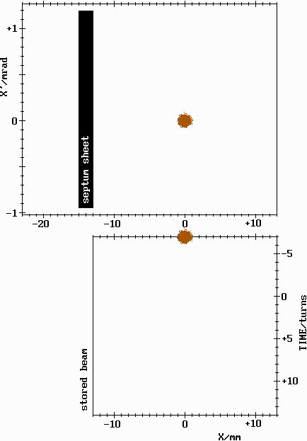
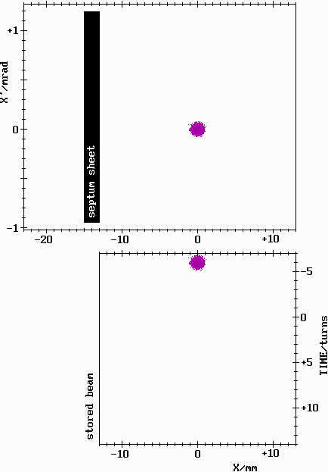
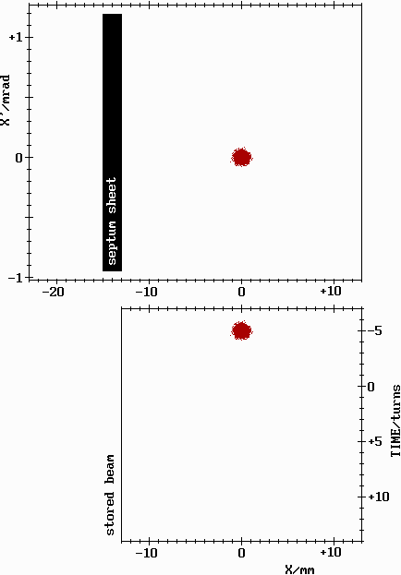
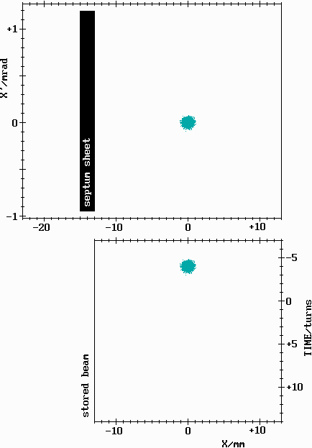
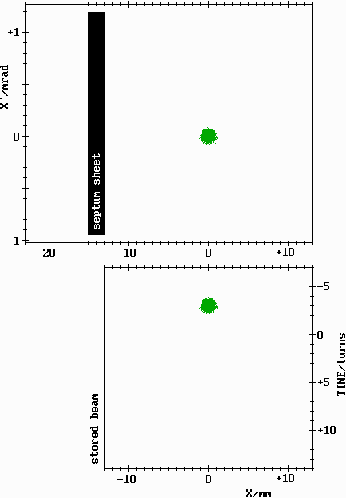
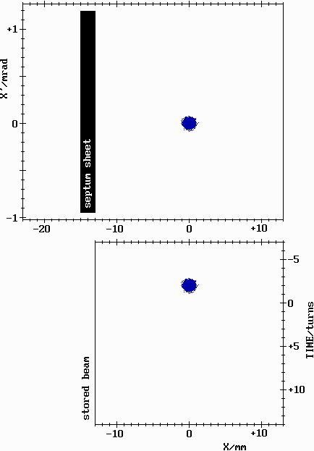
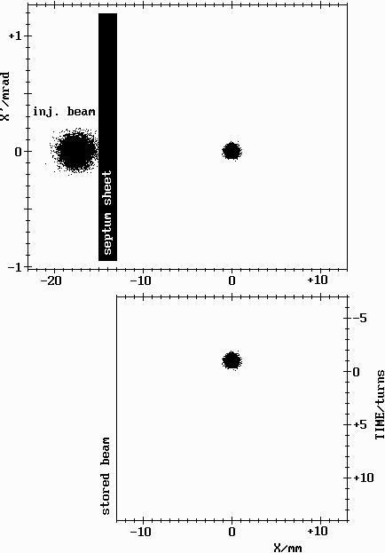
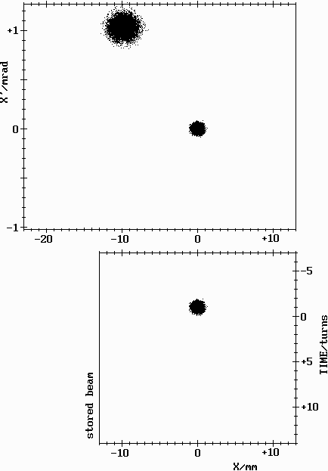
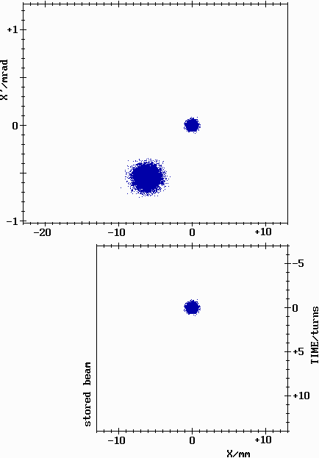
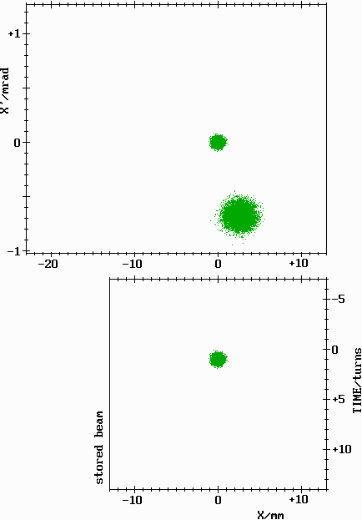
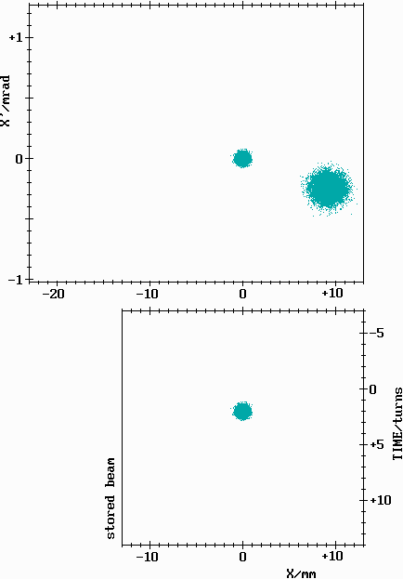
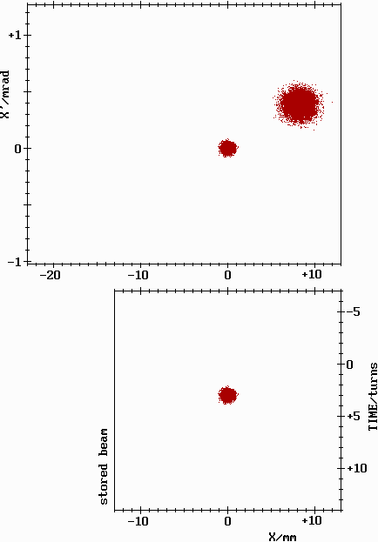
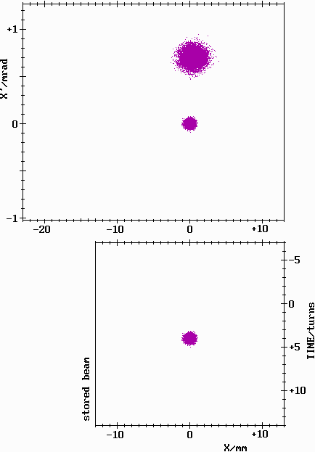
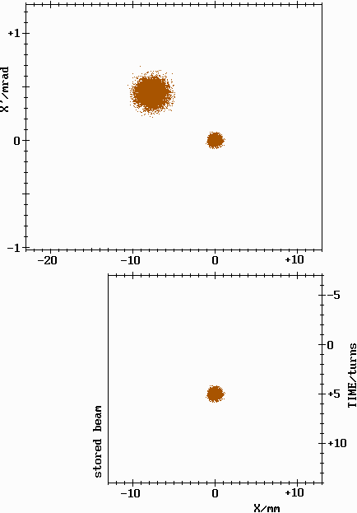
Alternative Single Kicker Injection Scheme
Kentaro Harada’s idea:
use a single (non-linear) kick
~40° phase advance septum - kick
only injected beam is kicked
on-axis field = 0
kick strength ~1 mrad @ x=10mm
Only a dream?
P. Kuske, BESSY, ESLS at Diamond

Slide 26
Pulsed Sextupole Magnet
K. Harada, et al.

Slide 27
What‘s Next?
Some Facts about BESSY II
Introduction:
Conventional Injection Scheme
Example BESSY II – Technical Limitations
Critical Issues for Efficient Injection:
Transverse and Longitudinal Match
(Dynamic Aperture – Acceptance of the SR)
(Impact of IDs on Acceptance and Counter Measures)
Overcome Technical Limitations
Give up Symmetry for Higher Injection Efficiency
Limitations –Thickness of the Septum for Ultimate SR
Alternative Single Kicker Injection Schemes
BESSY II Approach
Pulsed Quadrupole or Sextupole KEK Approach
Spring8 Approach
Alternatives to Accumulation, Swap-Out Injection (a la Borland)
Summary

Slide 28
Our First Prototype Kicker
“4 wire“-design
28
O. Dressler, M. Dirsat, T. Atkinson

Slide 29
Kicker Magnet Design for BESSY II
In-vacuum “stripline”-type design
4 wires with 200A each

Slide 30
Kicker Placement
Suitable locations for the kicker magnet and certain flexibility by choosing injection angle
position of the kicker, upstream of U125
30

Slide 31
Real Injection Studies
4-kicker injection bump optimized for small orbit perturbation
injection efficiency ~ 80 %
single, non-linear injection kicker – not fully optimized:
horizontal < 60 μ
vertical < 15 μ
injection efficiency ~80 % up to 300 mA
31

Slide 32
Performance in the Storage Ring
After the tests the kicker had to be removed
Thermal and Vacuum Problems: Temperature at the outside of the kicker tank increased within 20-30 min to 60°C with I_{mb}=300 mA or I_{sb}=15 mA, along with severe vacuum degradation
Beam Dynamics Issues: Except for vacuum related beam blow-up no coupled bunch instability was observed
Injection Efficiency: was as good as with the 4 kicker injection bump, stored beam was far more stable
32

Slide 33
Details of the Kickermagnet
5 μ thick Ti-coated ceramic
holds the wires and
allows image currents to flow
33

Slide 34
Improved Kicker Design
installed since December 2011
34
O. Dressler, M. Dirsat, H. Rast

Slide 35
Performance - Impact on Stored Beam
Injection efficiency up to 85 % with max. kick ~ 1 mrad
no excessive thermal heating
kick experienced by stored beam vs. beam position inside magnetic structure
unexpected asymmetry
at ~ +1,+1 mm the kick would be ~ 6-7 μrad in both planes*
* 10 μrad at Soleil – P. Labasque, IPAC, 2011

Slide 36
What‘s Next?
Some Facts about BESSY II
Introduction:
Conventional Injection Scheme
Example BESSY II – Technical Limitations
Critical Issues for Efficient Injection:
Transverse and Longitudinal Match
(Dynamic Aperture – Acceptance of the SR)
(Impact of IDs on Acceptance and Counter Measures)
Overcome Technical Limitations
Give up Symmetry for Higher Injection Efficiency
Limitations –Thickness of the Septum for Ultimate SR
Alternative Single Kicker Injection Schemes
BESSY II Approach
Pulsed Quadrupole or Sextupole KEK Approach
Spring8 Approach
Alternatives to Accumulation, Swap-Out Injection (a la Borland)
Summary

Slide 37
KEK Results

Slide 38
KEK Results

Slide 39
What‘s Next?
Some Facts about BESSY II
Introduction:
Conventional Injection Scheme
Example BESSY II – Technical Limitations
Critical Issues for Efficient Injection:
Transverse and Longitudinal Match
(Dynamic Aperture – Acceptance of the SR)
(Impact of IDs on Acceptance and Counter Measures)
Overcome Technical Limitations
Give up Symmetry for Higher Injection Efficiency
Limitations –Thickness of the Septum for Ultimate SR
Alternative Single Kicker Injection Schemes
BESSY II Approach
Pulsed Quadrupole or Sextupole KEK Approach
Spring8 Approach
Alternatives to Accumulation, Swap-Out Injection (a la Borland)
Summary

Slide 40
Other Kicker Developments
see also – kicker development for ILC

Slide 41
Other Kicker Developments

Slide 42
Other Kicker Developments

Slide 43
Other Kicker Developments

Slide 44
What‘s Next?
Some Facts about BESSY II
Introduction:
Conventional Injection Scheme
Example BESSY II – Technical Limitations
Critical Issues for Efficient Injection:
Transverse and Longitudinal Match
(Dynamic Aperture – Acceptance of the SR)
(Impact of IDs on Acceptance and Counter Measures)
Overcome Technical Limitations
Give up Symmetry for Higher Injection Efficiency
Limitations –Thickness of the Septum for Ultimate SR
Alternative Single Kicker Injection Schemes
BESSY II Approach
Pulsed Quadrupole or Sextupole KEK Approach
Spring8 Approach
Alternatives to Accumulation, Swap-Out Injection (a la Borland)
Summary

Slide 48
Summary
Efficient traditional injection and accumulation in SR with small DA is challenging.
Can be mastered if
Injector matches SR requirements
Aperture requirement as small as possible – optics modification
DA is made as large as possible – SR and ID optimization
Injection geometry fits DA – septum defines physical aperture = DA
Technical limitations are overcome
Top-up relevant is a quiet beam
Single non-linear kicker injection scheme shows advantages
Orbit perturbations still too large (KEK and BESSY II)
Best results so far from BESSY II kicker
Injection into ultimate lowest emittance rings could require schemes like swap- out injection (M. Borland, et al.).
Also in this case strong, fast and highly accurate kicker magnets and pulsed PS do need development.

