Slide 1
Dynamics of modulated beams
Operated by Los Alamos National Security, LLC,
for the U.S. Department of Energy
Nikolai Yampolsky
Future Light Sources Workshop
March 8, 2012
Notes:
1
MaRIE = Matter Radiation Interactions and Extremes, a la Ms. Curie

Slide 2
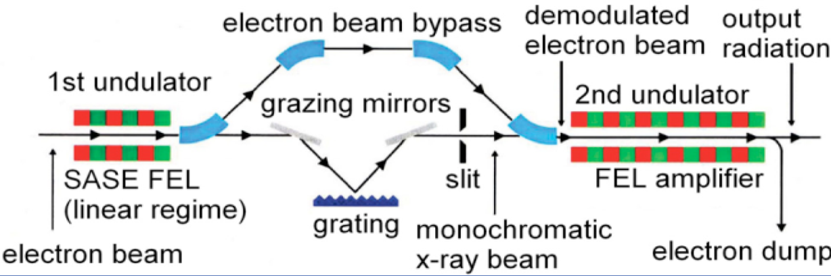
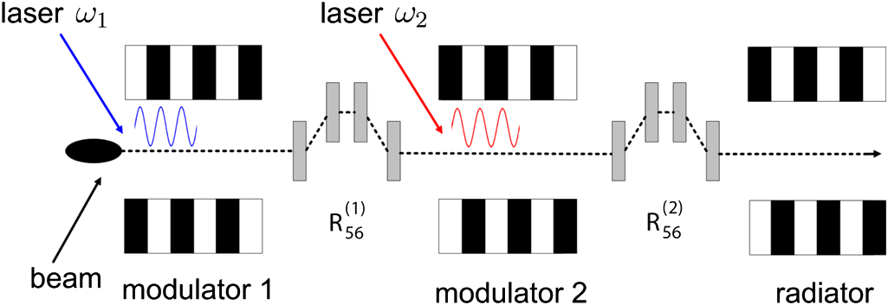
FEL seeding
FEL mode couples electron bunching and radiation. Therefore, FEL can be seeded either by the coherent radiation or by beam bunching at the resonant wavelength.
optical seeding
J. Feldhaus et al.,
Opt. Comm. 140, 341 (1997).
beam seeding
D. Xiang and G. Stupakov,
Phys. Rev. Lett. 12, 030702 (2009).
Notes:
2

Slide 3
Motivation
Objective
Describe beam modulation
Describe dynamics of modulated beams in beamlines
Study different seeding schemes and compare them to each other
Model requirements
Description should quantitative
It should be simple enough
It should be general
Notes:
3

Slide 4
Spectral distribution function
Distribution function
Spectral distribution function
bunching factor
Notes:
4

Slide 5
Qualitative dynamics of spectral distribution
Consider a single harmonic of the distribution function
The phase of modulation depends linearly on the phase space coordinates
In an arbitrary linear beamline the phase space transforms linearly
The phase of transformed distribution function is also a linear function of the phase space coordinates.
That indicates that a single harmonic of the distribution unction remains as a single harmonic under linear transforms.
spectral domain
k_{E}
k_{z}
The topology of the spectral domain remains the same. The entire dynamics should manifest as rotation and reshaping of the beam spectrum
Notes:
5

Slide 6
Vlasov equation
Phase space domain
Spectral domain
Vlasov equation
Spectral Vlasov equation
Characteristic equation (Newton equations)
Characteristic equation
Formal solution (Liouville theorem)
Formal solution
Works only for linear beamlines!!!
Notes:
6

Slide 7
Spectral averages
Phase space domain
Spectral domain
Introduce averaging over distribution function
Introduce averaging over spectral distribution function
The lowest order moments
average position
The lowest order moments
beam matrix
modulation wavevector
Beam matrix transform
bandwidth matrix
Transform of spectral averages
Beam envelope and modulation parameters transform independently from each other!
Notes:
7

Slide 8
Bandwidth matrix as metrics for beam quality
Bandwidth matrix B transforms exactly as inverse beam matrix Σ
In case of Gaussian beam,
Notes:
8

Slide 9
Modulation invariants
Invariants similar to eigen-emittance concept can be introduced for bandwidth matrix
The number of modulation periods under the envelope is conserved
Same for each eigen- phase plane
The relative bandwidth of modulation is conserved in linear beamlines
Same for each eigen- phase plane
Notes:
9

Slide 10
Laser-induced energy modulation
Laser-induced modulation nonlinearly transforms the phase space
Resulting beam spectrum consists of several well separated harmonics
Energy part of spectral distribution is a product of initial spectral distribution and Bessel functions
Spatial part of spectral distribution is a convolution of initial spectral distribution and laser spectrum
For laser pulse with random phase noise
Notes:
10

Slide 11
Diagrams describing seeding schemes
Laser-induced modulation transforms the phase space in z-E plane. Two elements mediate further linear transforms of imposed modulation: chicanes and RF cavities introducing energy chirp
k_{E}
spectral domain
largest modulation amplitude
cavity
chicane
The wavevector of modulation shifts parallel to the axes on the spectral diagram
k_{z}
Notes:
11

Slide 12
High Gain Harmonic Generation (HGHG)
Laser-induced modulation is transformed into bunching through a single chicane. Modulation amplitude is large enough if the modulation is imposed within the spectral energy bandwidth of the envelope
Chicane strength required to transform imposed modulation into bunching
Output bunching bandwidth
Notes:
12

Slide 13
Echo Enabled Harmonic Generation (EEHG)
Scheme consists of two modulators and two chicanes. The first modulation is imposed at low harmonic so that the energy wavenumber lies within the envelope bandwidth. The first chicane transforms this modulation to high values of k_{E} and this modulation serves as an envelope for the secondary modulator (secondary modulation is not suppressed then). The second chine recovers resulting modulation a bunching (same as in HGHG scheme)
Output bunching bandwidth
Notes:
13

Slide 14
Compressed Harmonic Generation (CHG)
RF cavity is used to shift the longitudinal wavenumber of modulation to high values. Since Δk_{z}=αk_{E}⁰ , the chicane is used to bring k_{E} to high values and then perform shift of longitudinal wavenumber.
Parameters of required optics are easy find since it’s linear
Output bunching bandwidth
Notes:
14

Slide 15
Conclusions
It is shown that physics of modulated beams is simple in the spectral domain compared to the phase space domain.
The lowest order moments of the spectral distribution function well characterize modulated beams. That introduces convenient metrics for quantitative analysis of beam modulation.
The entire evolution of modulated beams can be reduced to the transform of its spectral averages. This approach significantly simplifies analysis of beam dynamics.
The simplest cases of FEL seeding schemes are analyzed and the resulting bunching bandwidth is found.
Notes:
15

