Slide 1
J. Teichert, A. Arnold, U. Lehnert, P. Michel, P. Murcek, R. Xiang (HZDR)
R. Barday, T. Kamps, S. Schubert (HZB)
Unwanted Beam Observations
at ELBE
FLS2012 ICFA Workshop on Future Light Sources
March 5-9, 2012, Thomas Jefferson Lab, Newport News, VA

Slide 2
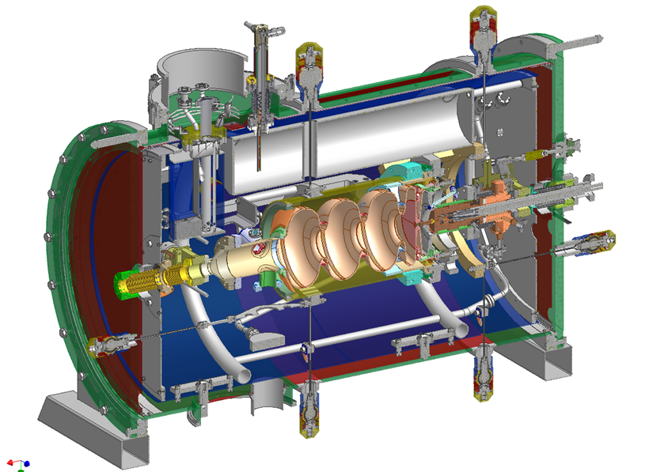
INTRODUCTION – SRF gun for the ELBE CW Accelerator
Application
high peak current operation for CW-IR-FELs with 13 MHz, 80 pC
high bunch charge (1 nC), low rep-rate (<1 MHz) for pulsed neutron and positron beam production (ToF experiments)
low emittance, medium charge (100 pC) with short pulses for THz-radiation and x-rays by inverse Compton backscattering
Design
medium average current:
1 - 2 mA (< 10 mA)
high rep-rate:
500 kHz, 13 MHz and higher
low and high bunch charge:
80 pC - 1 nC
low transverse emittance:
1 - 3 mm mrad
high energy:
≤ 9 MeV, 3½ cells (stand alone)
highly compatible with ELBE cryomodule (LLRF, high power RF, RF couplers, etc.)
LN2-cooled, exchangeable high-QE photo cathode

Slide 3
INTRODUCTION – Unwanted beam
Unwanted beam …particles produced and accelerated with wrong properties
in space and time …
produces beam loss that increases radiation level and activation
(at ELBE permission is 1% beam loss of 1 mA = 10 µA)
causes acute or chronic damage of accelerator components
(experience is <~ 1 µA preventing long-term damage)
produces additional background for users
Superconducting RF Photo electron gun:
Cavity & cathode: dark current, discharges …
Laser: halos from scattered light, energy tails, parasitic pulses …
RF: microphonics, phase and amplitude instabilities …
beam: wake fields, resonant HOM excitation …

Slide 4
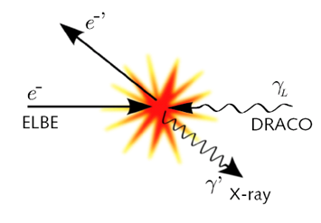
INTRODUCTION – Unwanted beam
Compton backscattering experiment at ELBE with SRF Gun
e-beam: 25 MeV, 10 … 50 pC @ 10 Hz (rep. rate of TW laser)
RF of gun & ELBE modules in CW
nearly the same dark current as in the Fcup near gun
The SRF gun produces a lot of dark current, similar to normal conducting RF photo guns
The dark current has similar properties as the beam. A large fraction was accelerated
and transported to the user station without further losses.

Slide 5
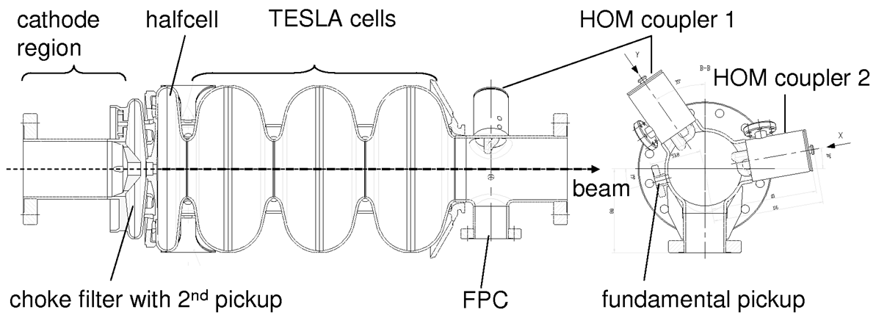
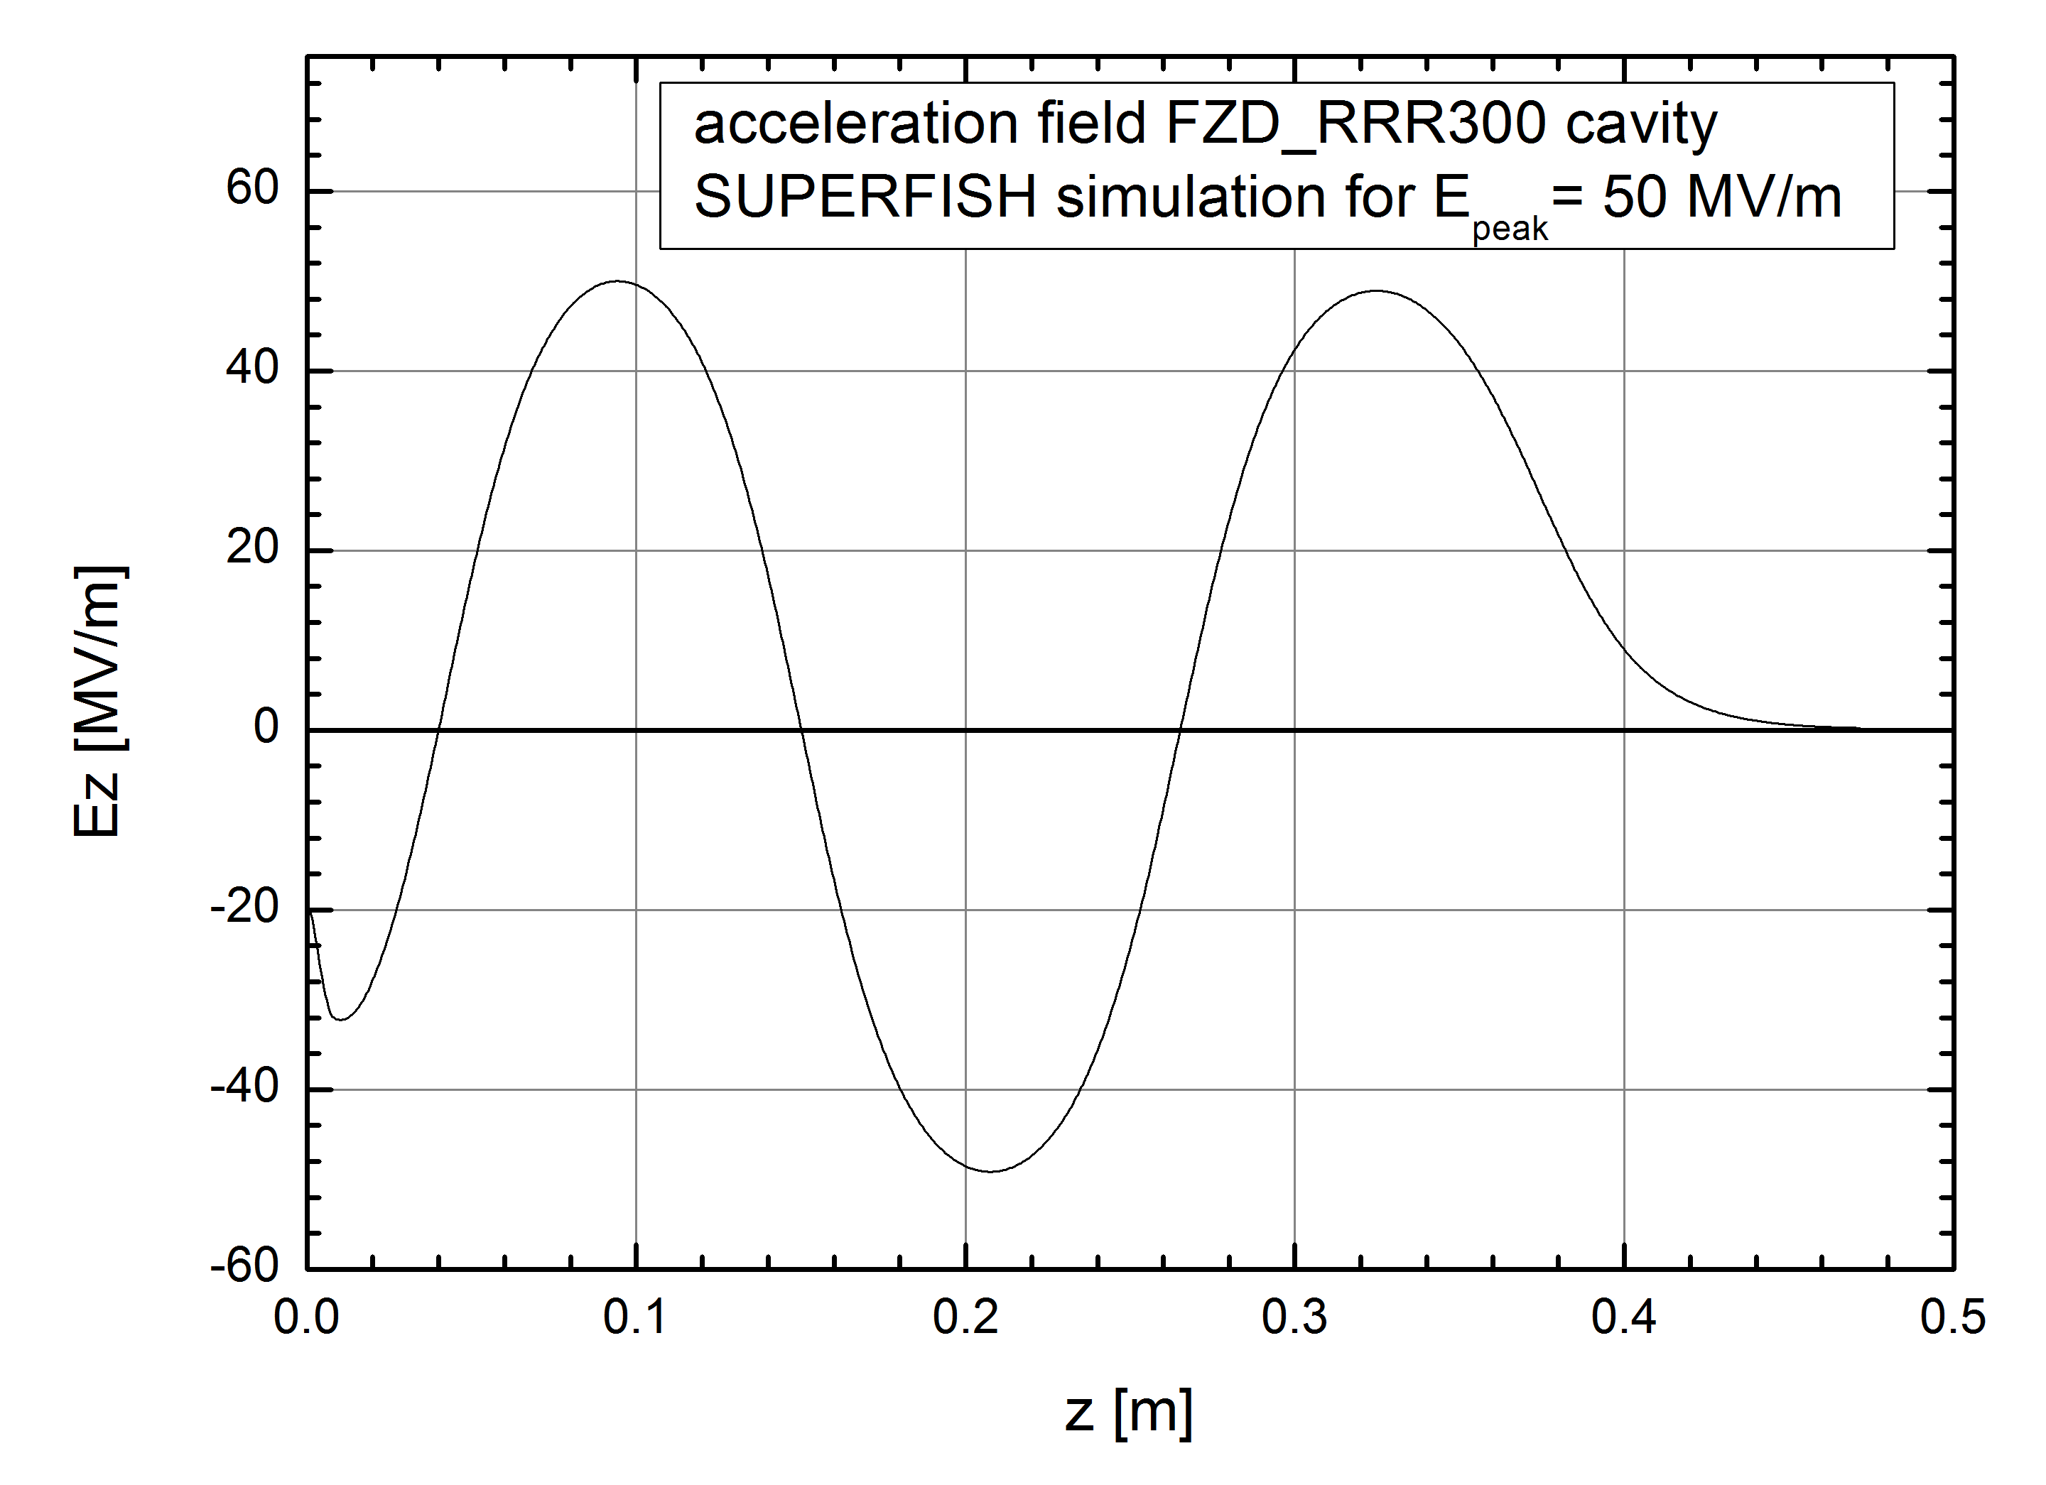
DARK CURRENT – Cavity field
field profile on axis
stored energy U | 32.5 J
quality factor Q₀ | 10¹⁰
dissipated power P_{c} | 25.8 W
maximum beam power P_{B} | 9.4 kW
geometry factor G | 241.9 Ω
accel. voltage V_{acc} accel. gradient E_{acc} | 9.4 MV 18.8 MV/m
R_{a}/Q₀ | 166.6 Ω
E_{peak}/E_{acc} | 2.66
B_{peak}/E_{acc} | 6.1 mT/(MV/m)

Slide 6
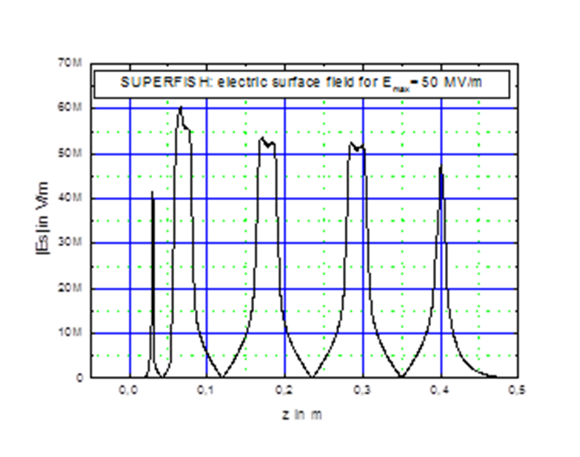
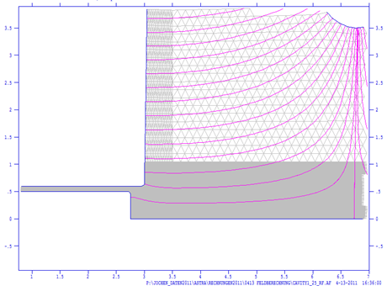
DARK CURRENT – Cavity field
field profile on axis
surface electric field
40% at cathode
110% at iris
gun operation mode | CW | pulsed RF
acceleration gradient | 6.0 MV/m | 8 MV/m
electron kinetic energy | 3 MeV | 4 MeV
peak field on axis | 16.5 MV/m | 21.5 MV/m
peak field at cathode (2.5 mm retracted) | 6.5 MV/m | 8.4 MV/m
cathode field at launch phase (10°) | 1.1 MV/m | 1.5 MV/m
cathode field at 10° and -5 kV bias | 2.2 MV/m | 2.6 MV/m
cathode field at 90° and -5 kV bias | 7.6 MV/m | 9.5 MV/m
80% at edge
Important for emitted dark current:
cathode surface field is ~ 40 % of peak field
field at cathode hole edge is ~ 80 % of peak field
without field enhancement (scratch in our cavity)
cathode
40% at cathode

Slide 7
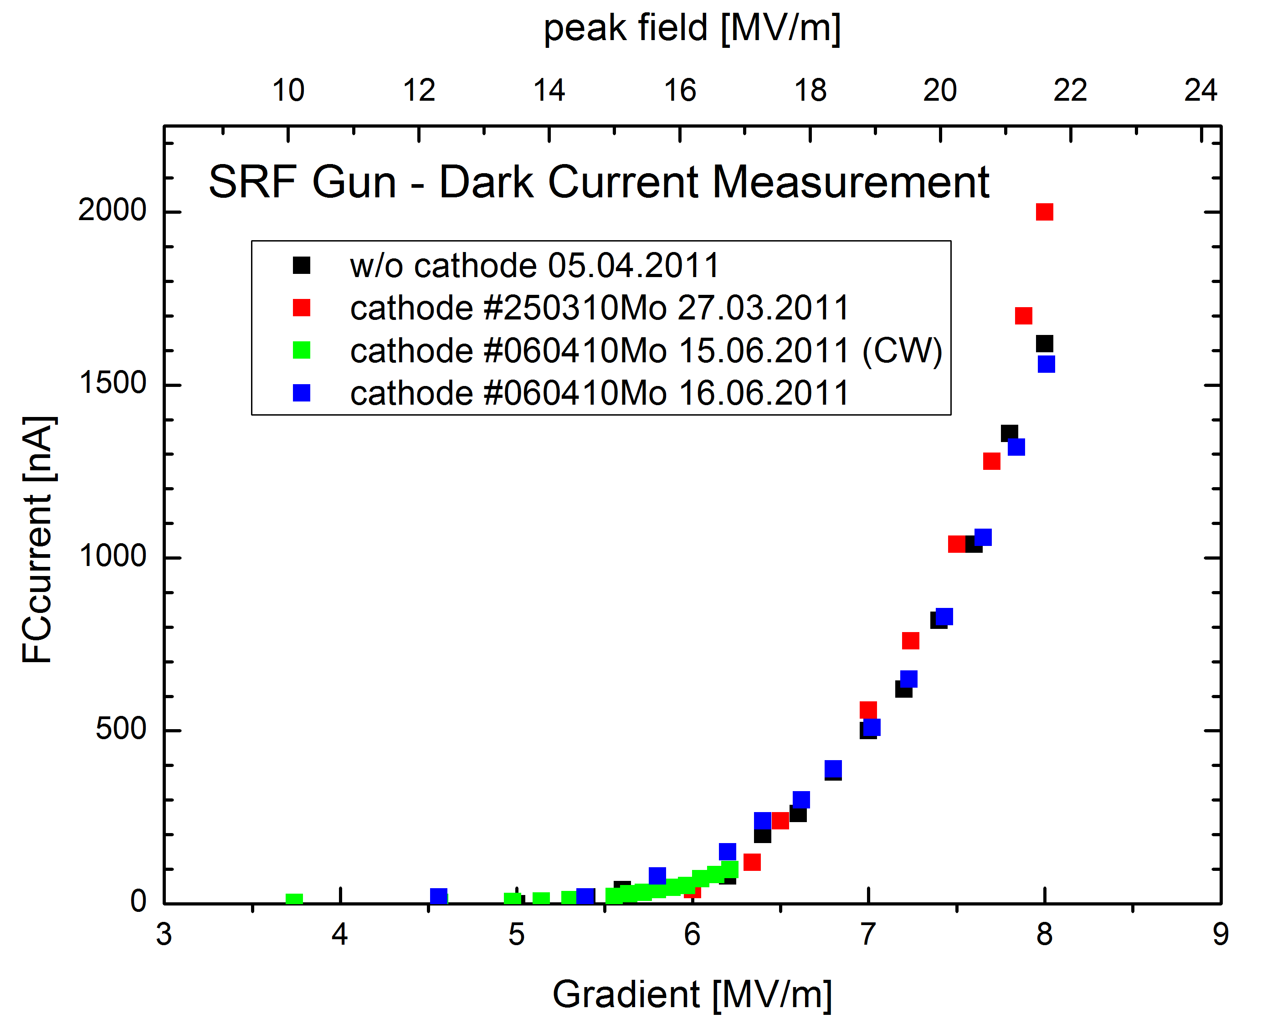
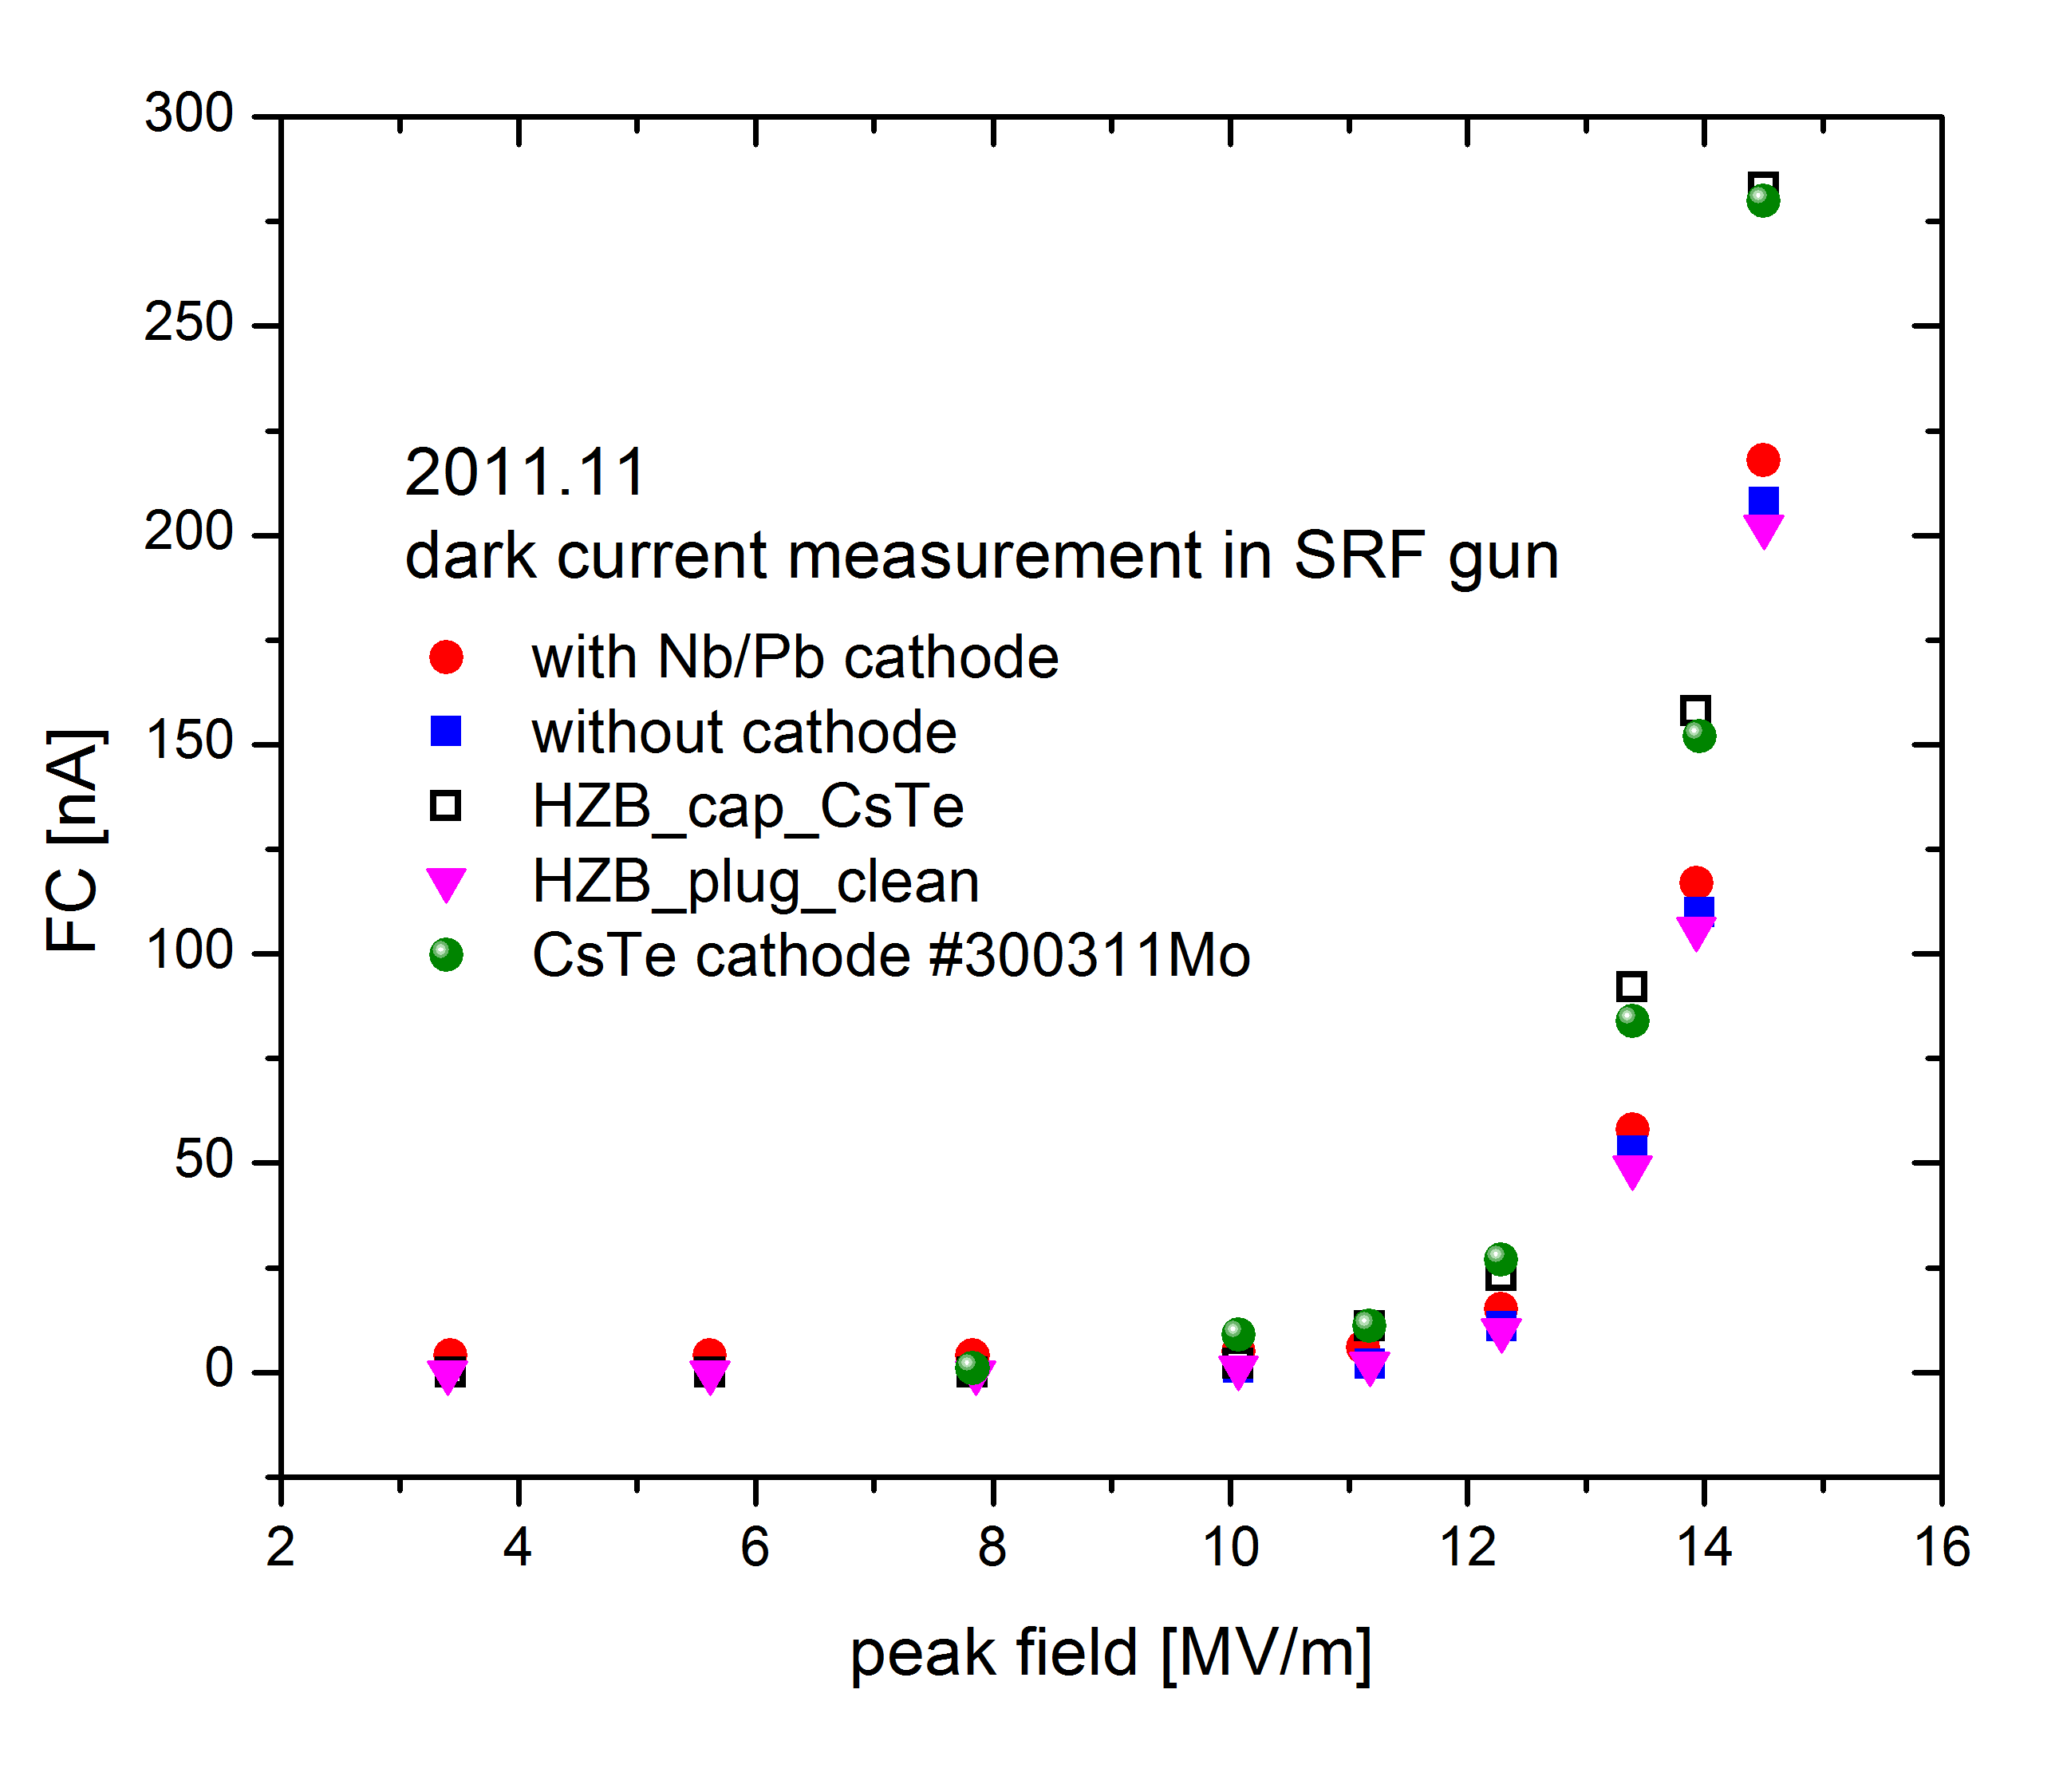
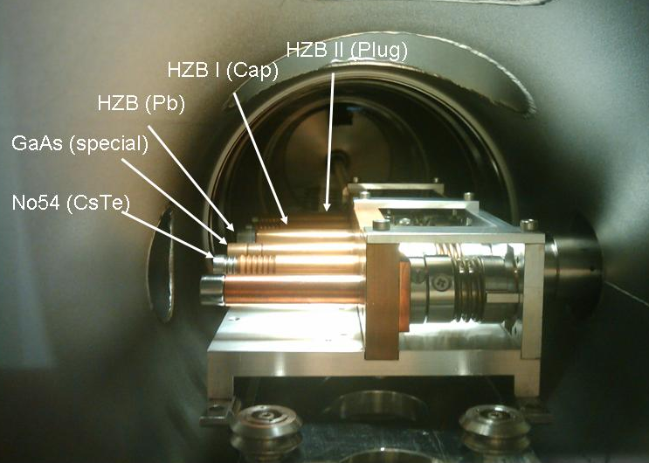
DARK CURRENT – Measurement
Dark current in Faraday cup (~1.5 m from cathode) versus gradient for different cathodes
about 20 % dark current from cathode,
80% from cavity (scratch)
only cathodes with CsTe layer have dark current,
exception: #060410Mo, but without direct comparison

Slide 8
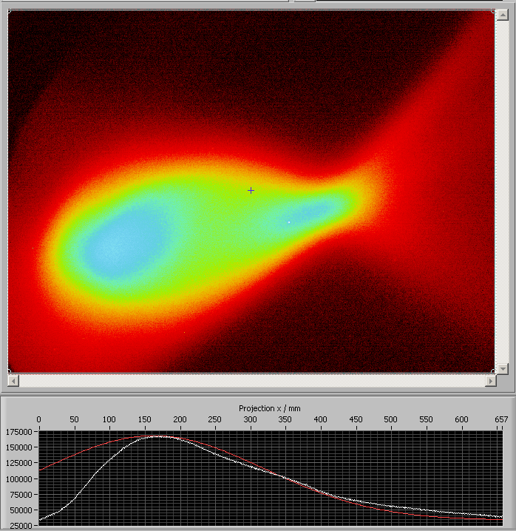
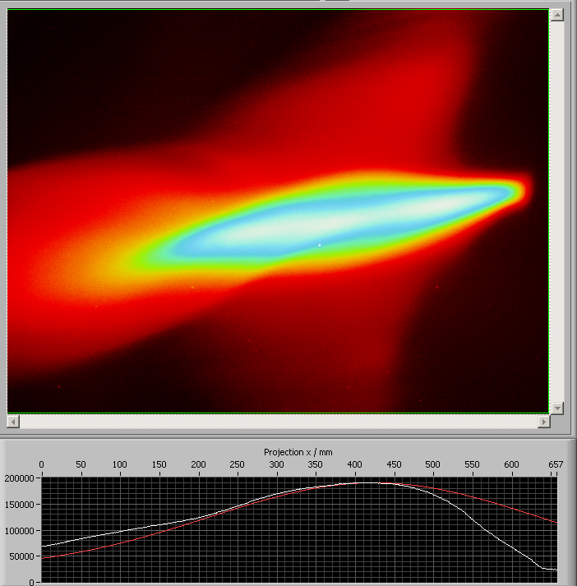
DARK CURRENT – Properties
Measurement of kinetic energy and energy width of dark current and comparison
with low-bunch-charge beam – 180° bending magnet in diagnostic beamline
largest fraction has nearly beam energy (emission from backplane near cathode)
small fraction with lower energy (other high-field iris regions in cavity)
dark current
30 pC beam (E_{kin}= 2.8 MeV)
100 keV
100 keV
parameters:
6 MV/m CW, 5 kV DC bias
120 nA dark current,
1.5 µA @ 50 kHz beam
$$∆E={\overline{E}}_{DC}−E_{kin}≈60 keV$$
$$\frac{∆E}{E_{kin}}≈2 \%$$

Slide 9
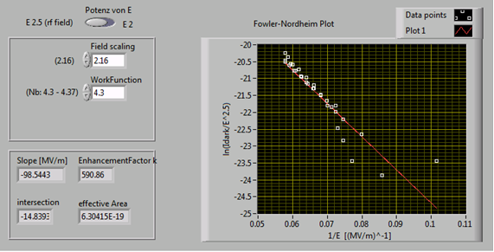
DARK CURRENT – Fowler Nordheim analysis
Fowler Nordheim formula for tunneling (field emission) current:
$$I\left(E\right)=\frac{A_{FN}Aκ^{2}E^{2}}{φ}exp\left(−\frac{B_{FN}φ^{3/2}}{κE}\right)$$
with A_{FN}=1.54 x 10⁶ , B_{FN}=6.83 x 10³ , electric field E in MV/m, work function ϕ in eV,
$κ$is the field enhancement factor, A the emission area. (see book of H. Padamsee, J. Knobloch, T. Hays)
Time averaging for a RF field yields:
(J.W. Wang and G.A. Loew, SLAC-PUB-7684 October 1997)
ϕ = 4.3 eV (Nb)
$κ$= 591
A = 0.63 nm²

Slide 10
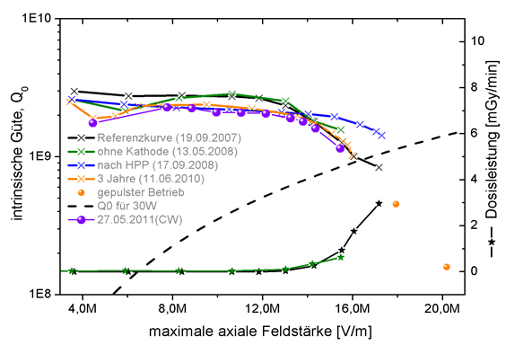
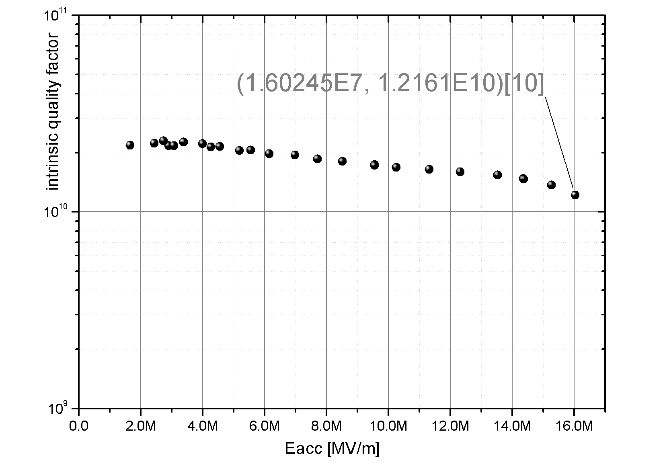
DARK CURRENT – Cavities with higher gradients
existing cavity at ELBE with high field emission
new cavity
Maximum (pulsed):
E_{acc} = 8 MV/m
E_{peak} = 21.5 MV/m
Maximum for operation
E_{acc} = 16 MV/m
E_{peak} = 43 MV/m

Slide 11
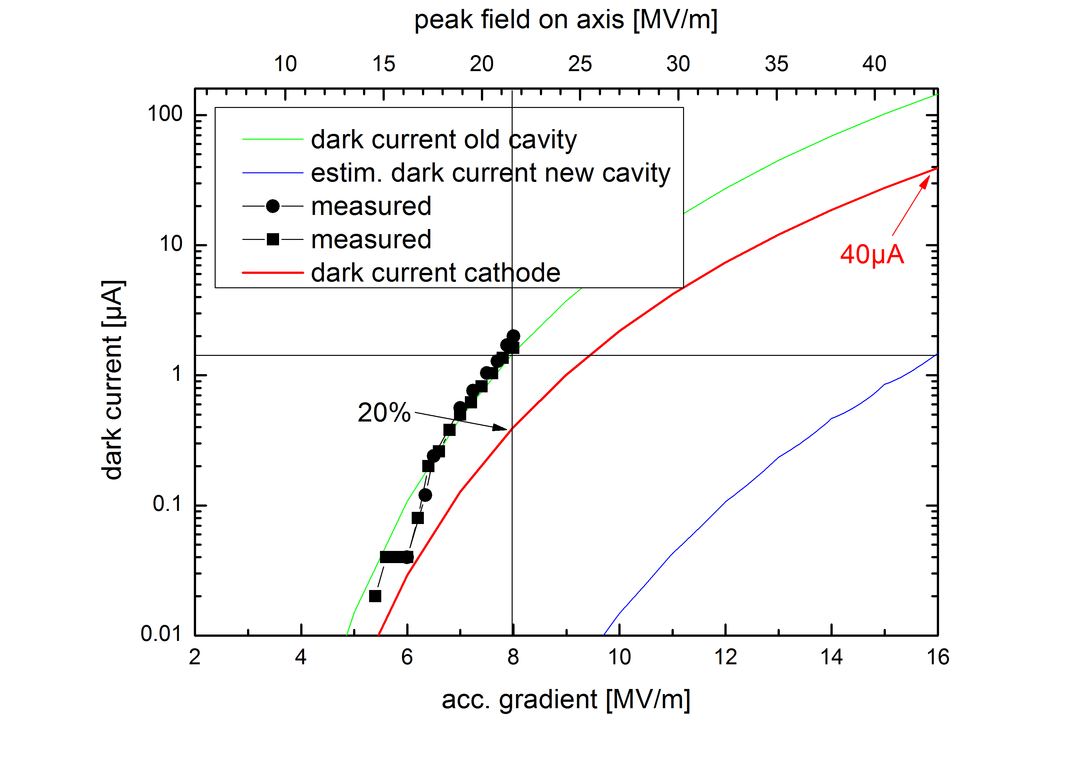
DARK CURRENT – Cavities with higher gradients
Extrapolation of Fowler Nordheim results for new cavity:
New cavity will be operated at the high-field limit of 16 MV/m. Here we
expect the same field emission level as for 8 MV/m for the old cavity (blue curve)
-> smaller field enhancement factor ($κ$= 591)
FN fit for 20 % of current emitted from cathode (ϕ = 4.3 eV for Cs2Te, 40% peak field)
and extrapolation to 16 MV/m (read curve) gives 40 µA cathode dark current

Slide 12
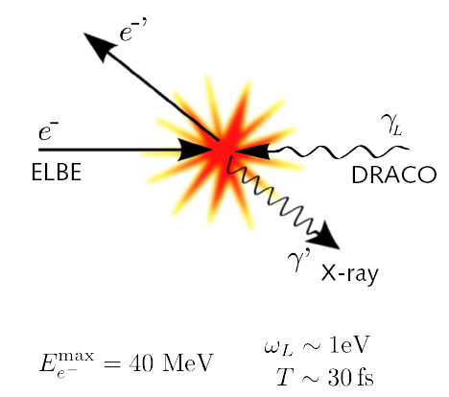
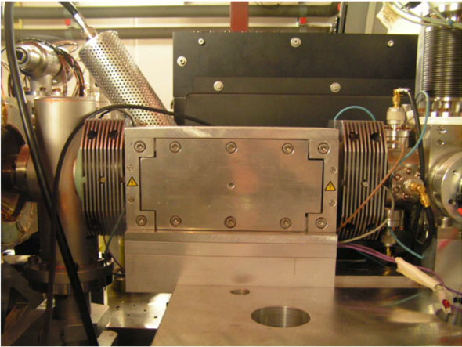
DARK CURRENT – suppression for low rep. rate at ELBE
Compton backscattering experiment
pulsed RF
100 ms
laser
10 ms
bunch 100 pC
Qdark < Qbunch = 100 pC
Q_{dark} =10 ms * 40 µA = 400 nC
suppression factor >10⁴
dark current at 1.3 GHz
10 ms
Adaption of FLASH/DESY RF gun dark current
kicker: 1 MHz sine amplitude, stripeline,
pulsed-mode operation,
Eventually upgrate to CW would allow
application for 500 kHz high-charge mode.
courtesy of
F. Obier/DESY
For higher rep. rates and CW the dark current kicker is a great technical challenge,
at 1.3 GHz CW (BERLinPro ERL) the kicker can not help.

Slide 13
DARK CURRENT – fighting against it sources
assuming an unwanted beam of < 1 µA in CW accelerators with SRF guns
there will be a need for photo cathodes with low dark current
proper handling to prevent dust particles and damage
plug materials and roughness
photo layer properties
- roughness, homogeneity, thickness
- high work function
- crystal size and structure
- multi-layer design
- post-preparation treatment (ions, heating)
- pre-conditioning

Slide 14
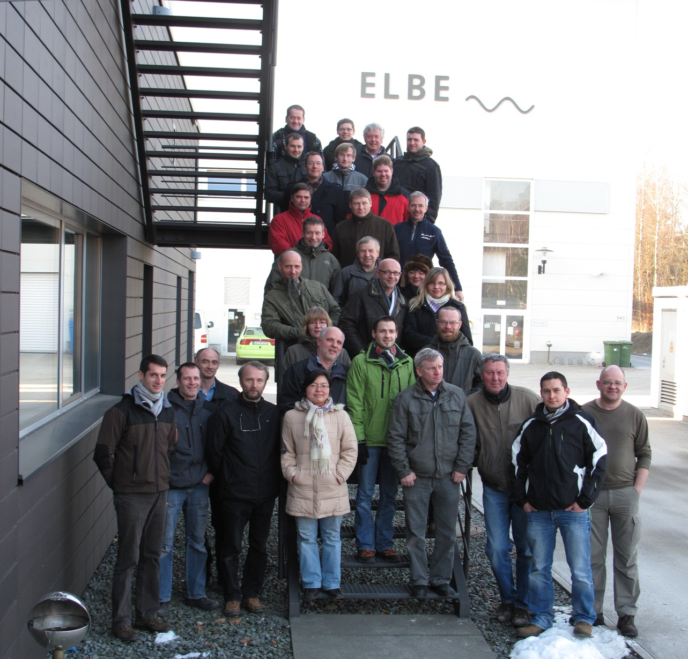
THANK YOU FOR ATTENTION
Acknowledgement
We acknowledge the support of the European Community-Research Infrastructure Activity under the FP7 programme since 2009 (EuCARD, contract number 227579) as well as the support of the German Federal Ministry of Education and Research grant 05 ES4BR1/8.

