Slide 1

Hard X-ray FELs (Overview)
Zhirong Huang
March 6, 2012
FLS2012 Workshop, Jefferson Lab

Slide 2
Outline
Introduction
Seeding and TW
Attosecond pulses
Better beams

Slide 3
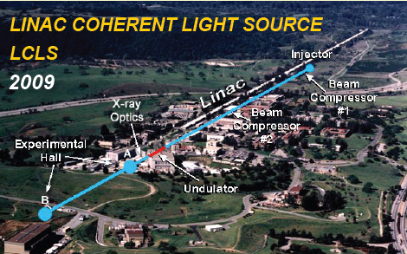
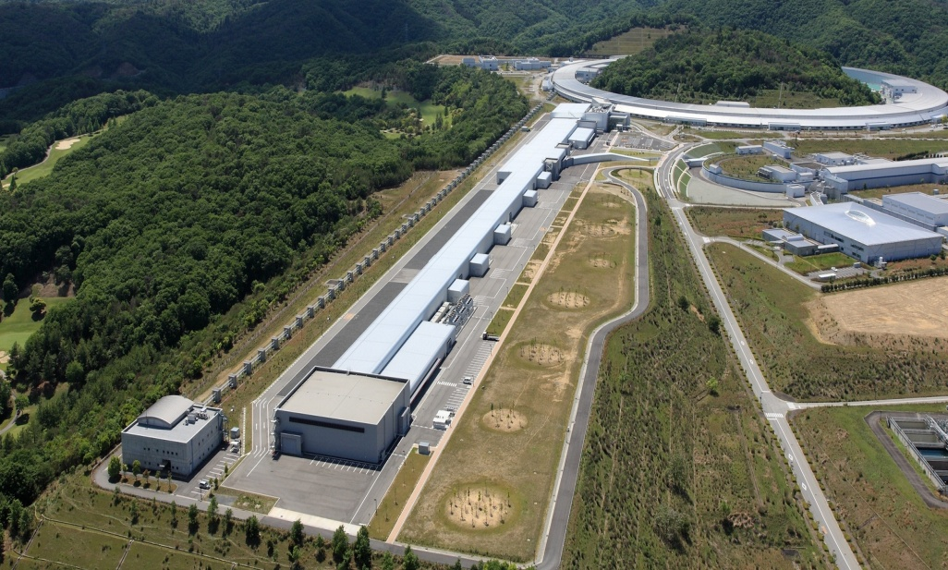
Where are we now (hard x-rays)
SASE wavelength range: 25 – 1.2 Å
Photon energy range: 0.5 - 10 keV
Pulse length (5 - 100 fs FWHM)
Pulse energy up to 4 mJ
~95% accelerator availability
Spring-8 SACLA
2011
SASE Wavelength range: 3 – 0.6 Å
Photon energy range: 4 - 20 keV
Pulse length (10 fs FWHM)
Pulse energy up to 1 mJ
more XFELs to come…

Slide 4



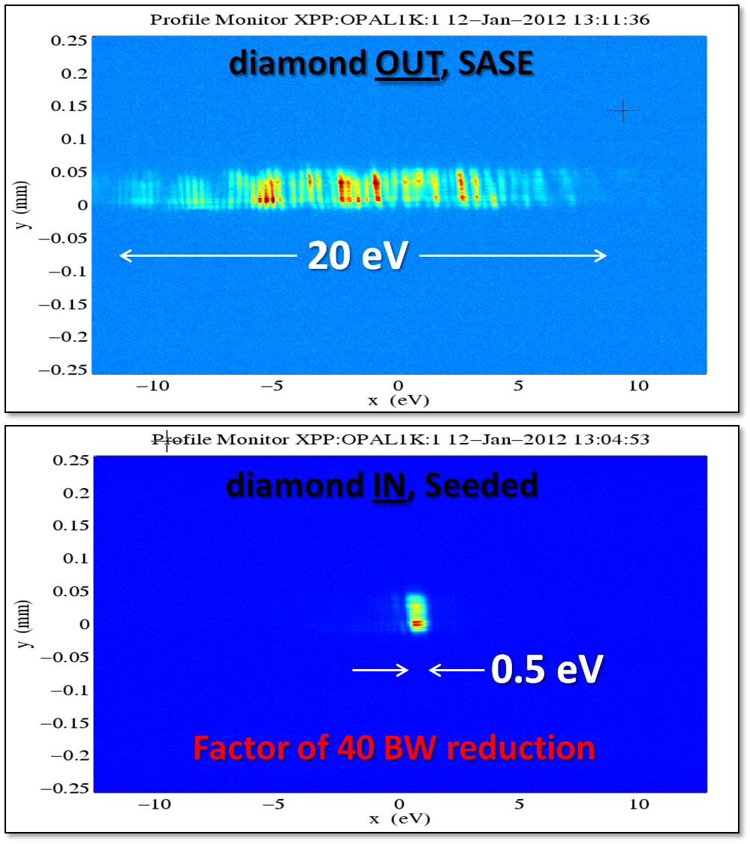
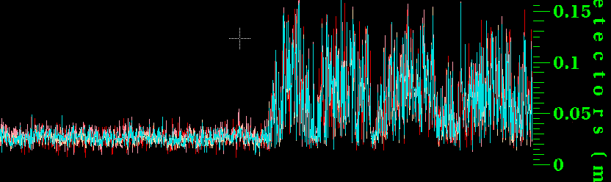
Self-Seeding works!
Single shot SASE and Seeded FEL spectra
Single shot pulse energy from the gas detectors
Pulse energy (mJ)
SASE
Seeded
The mean seeded FEL power is 4 GW with a 2 GW SASE background at 8 keV for 40 pC bunch charge (~10 fs).
Next steps include system optimization of the LCLS undulator beamline including additional undulators which should increase seeded power and reduce intensity fluctuation.
Notes:
TISNCM Troitsk Institute for Superhard and Novel carbon materials
The gas detector plot in upper right hand of the viewgraph shows the pulse by pulse energy in mJ with 40 pC bunch charge. The left side is with no seed and the right is seeded operation.
The peak powers in GW are based on a 10 fs pulse duration: 100 micro joules is then 10 GW peak power.
The SASE and seeded spectra on the left are measured with a Bragg spectrometer with 0.2 eV resolution.
The lineouts below the spectra are on the same vertical and horizontal scales.
The observed spectra at 40 pC are comparable to those shown 0n the slide.

Slide 5
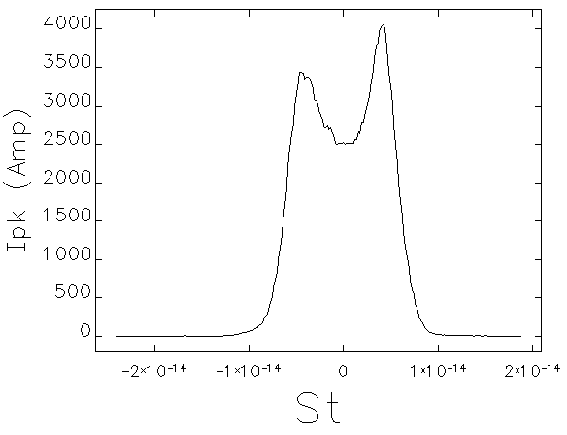
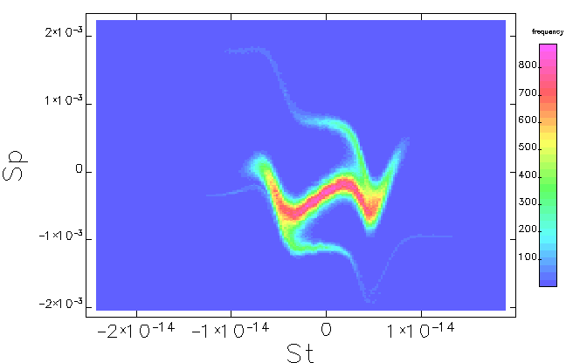
Complicated longitudinal phase space of e-beam
40 pC start-to-end simulations (double-horn with energy chirp)
May not be easy to optimize seeding performance with such beams

Slide 6
Two-bunch HXR Self-seeding
~ 4 m
SASE
U1
U2
Seeded
Si (113)
Si (113)
Any advantage over single bunch scheme?
Probably not in terms of seeding power.
Can seed a longer bunch.
Also can play tricks to use betatron oscillation to suppress the SASE lasing of the second bunch in the first undulator to prevent its energy spread increase due to SASE.
Y. Ding, Z. Huang, R. Ruth, PRSTAB 2010
G.Geloni et al. DESY 10-033 (2010).

Slide 7
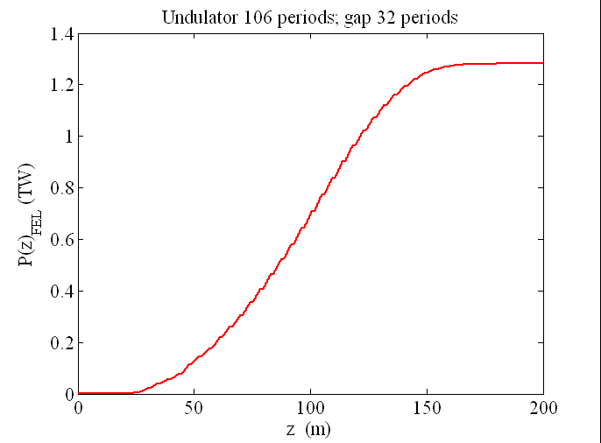
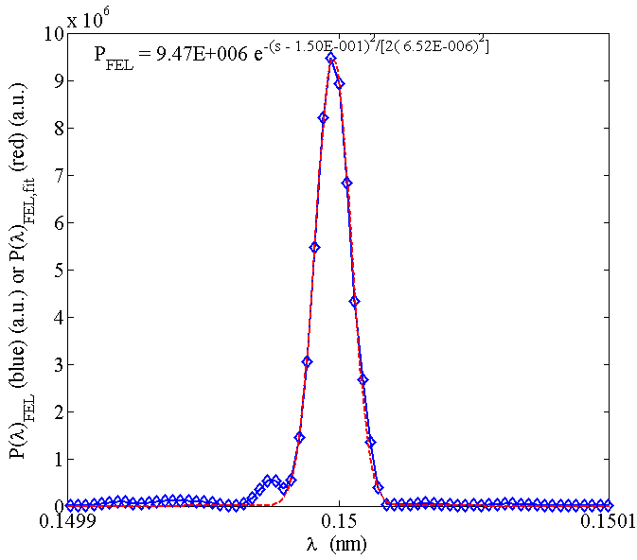
Self-seeding + Tapered undulator ➔ TW FEL
  8.3 keV -- 1.5 Å (13.64 GeV)
  200 m LCLS-II undulator
  LCLS low charge parameters
  Optimized tapering starts at 16 m with 13 % K decreasing to 200 m
1.3 TW over 10 fs
~10¹³ photons
1.0 x 10⁻⁴
FWHMBW
After self-seeding crystal
W. Fawley, J. Frisch, Z. Huang, Y. Jiao, H.-D. Nuhn, C. Pellegrini, S. Reiche, J. Wu (FEL2011)

Slide 8
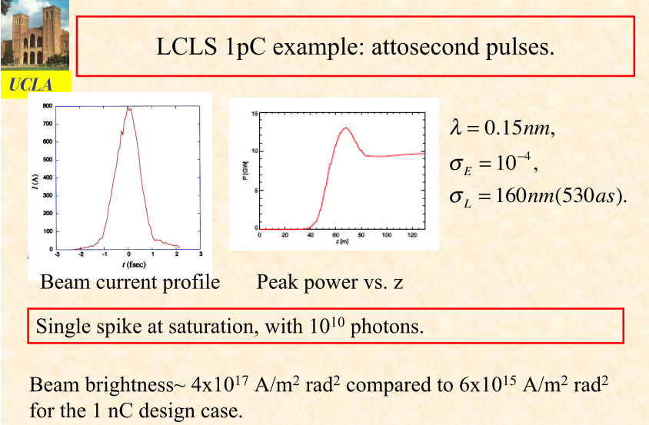
Ultra-low charge for attosecond pulses
C. Pellegrini, S. Reiche, J. Rosenzweig, FLS2010

Slide 9
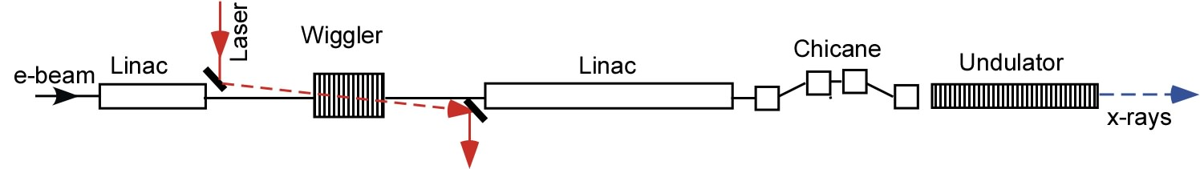
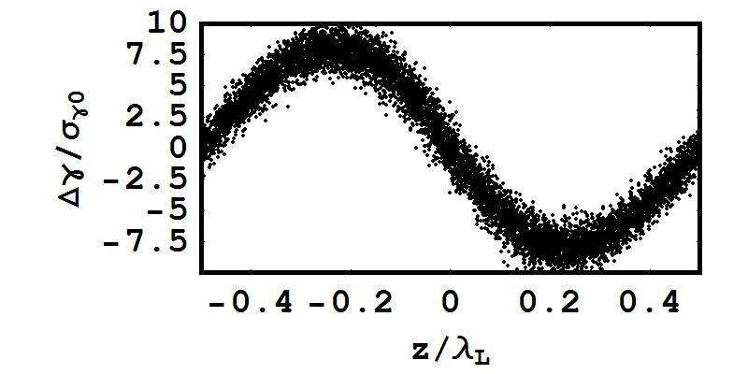
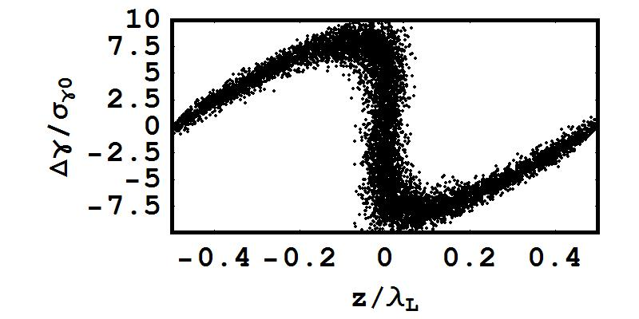
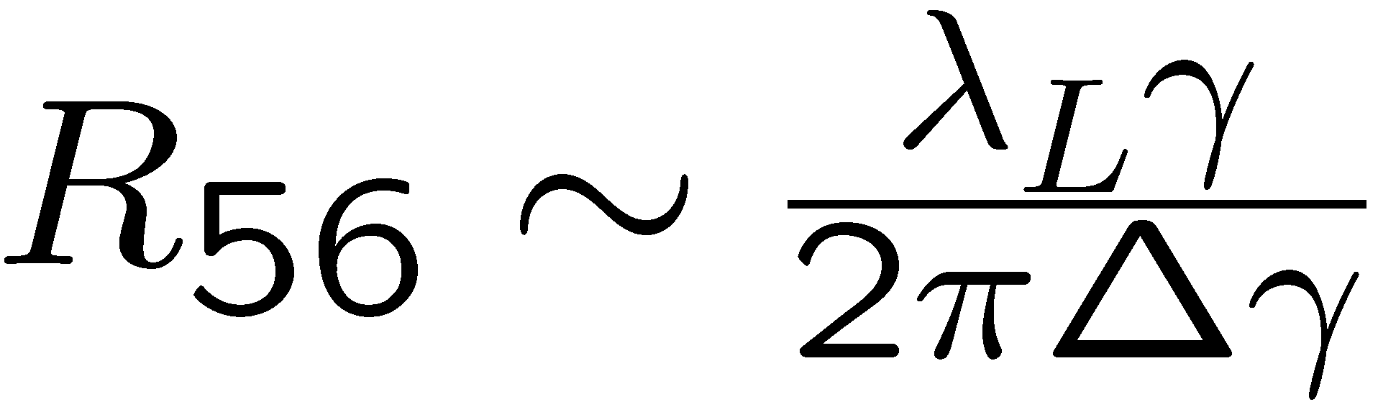
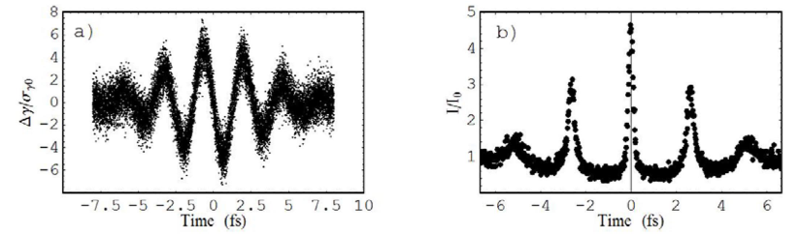
Enhanced SASE
A. Zholents, PRST 2005
30-100 fs pulse
λ_{L}~0.8 to 2.2μm
Modulation
Acceleration
Bunching
E ~ 4.5 GeV
E ~ 14 GeV
One optical cycle
~15 kA
Use a few-cycle laser
Peak current I/I₀

Slide 10
A. Zholents, G. Penn, PRST 2005; Y. Ding et. al., PRST 2009

Slide 11
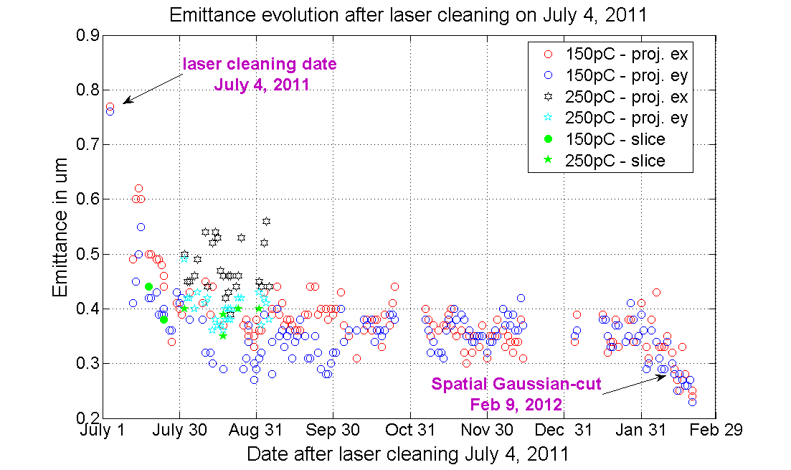
Brighter beams
Recent LCLS injector emittance results
F. Zhou

Slide 12
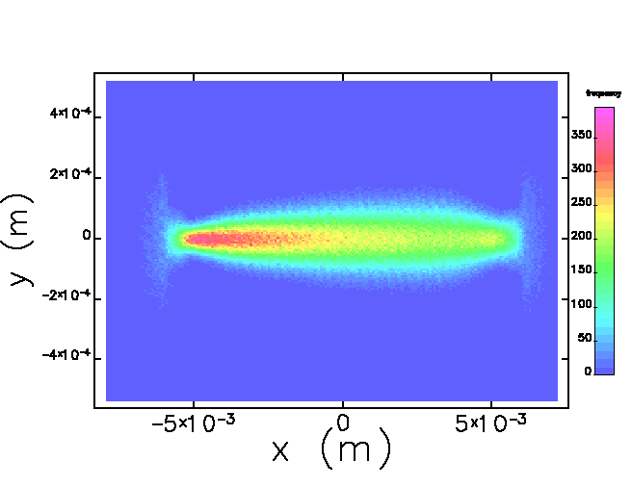
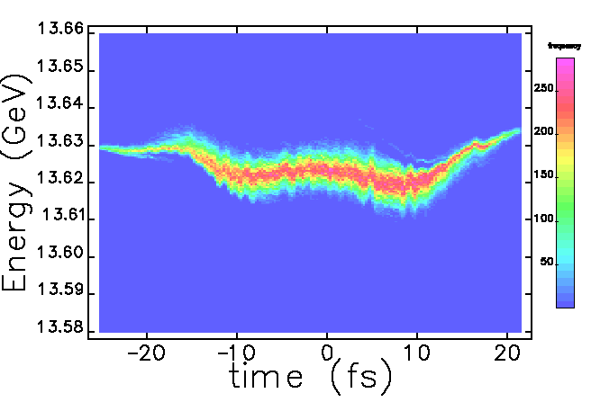
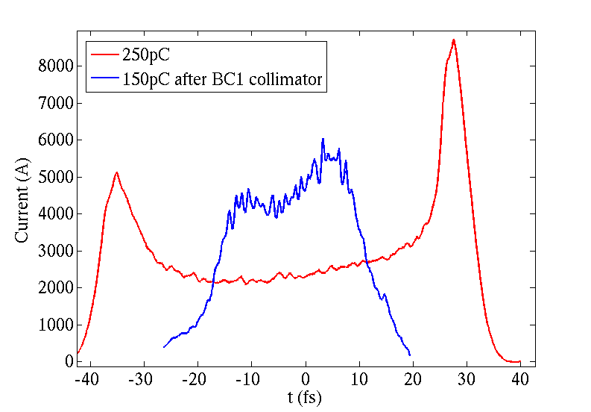
BC1 collimation to remove double-horn*
BC1 collimator: 250--> 150pC
Undulator entrance
Asymmetric collimation , full width=6.4mm, offset dx=1mm.
Without collimation
Collimation,5 kA
(* J. Frisch, Y. Ding )

Slide 13
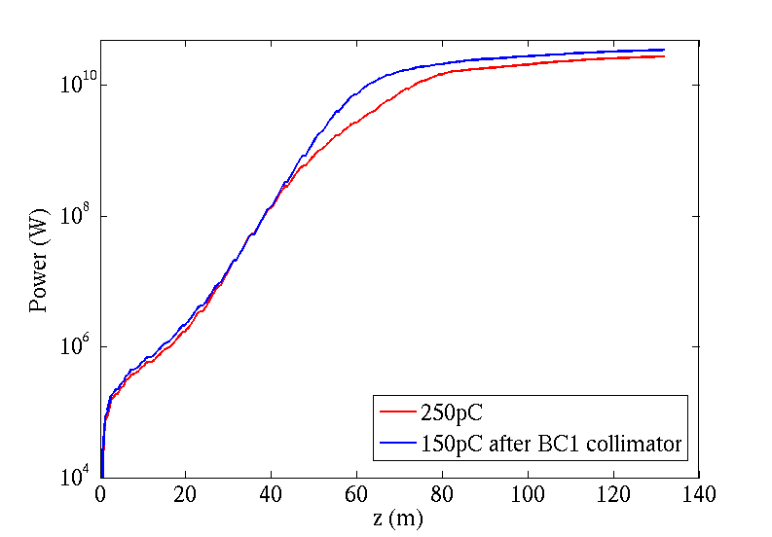
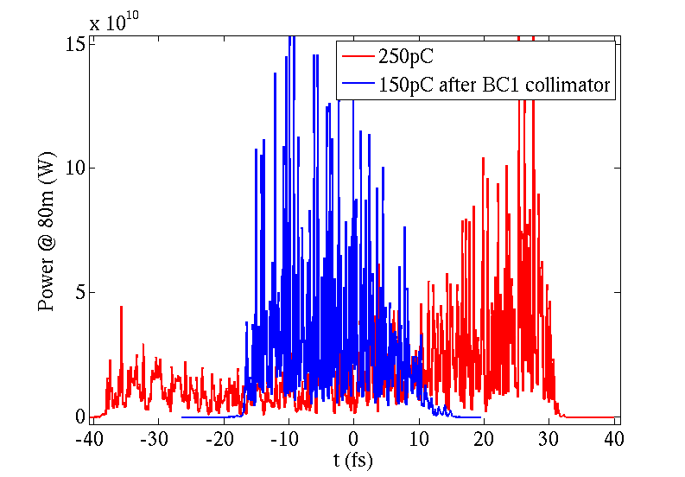
Collimation simulation: FEL at 0.15 nm
Z = 80m
250pC,L2 = -36deg;
BC1 collimator, dx=1mm--> 150pC, L2 = -38deg.
Preliminary collimation experiment showed similar FEL performance (collimator wakefield not an issue)

Slide 14
Chirp control
LCLS uses Linac wakefield to cancel the beam chirp for under-compressed beam and to increase the chirp for overcompressed beam
Chirp control depends on charge, compression setting
SRF does not generate enough wakefield
Would be nice to have an independent chirp control unit
(de-chirper or chirper)

Slide 15
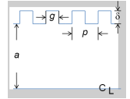
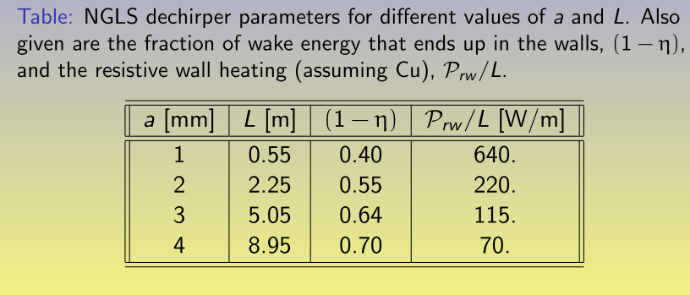
Corrugated waveguide as dechirped and chirper
K. Bane, G. Stupakov
SLAC-PUB-14839

Slide 16
Summary
Hard x-ray FELs are working well and more to come.
Seeding works but challenges remain to reach its full potential.
Many schemes for attosecond pulse generation have been proposed. Needs to understand scientific cases for hard x-ray attosecond pulses.
Understanding cathode issues and optimize injector performance can go a long way in FEL performance
Control of longitudinal phase space is critical for seeding and for special applications (such as wide-bandwidth FELs).

