Slide 1
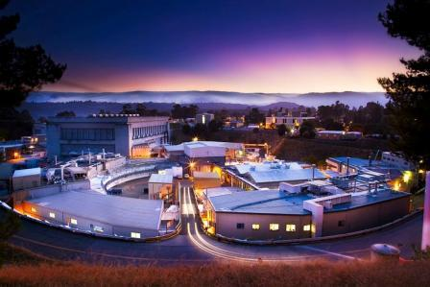
SPEAR3 Lower Emittance & Nonlinear Dynamics
J. Safranek for the SPEAR3 Accelerator Physics Group
SPEAR3 Lower ε_{x}
  X. Huang, Y. Nosochkov, L. Wang
Nonlinear Dynamics Measurements
  X. Huang, J. Corbett, J. Sebek, A. Terebilo
ICFA Future Light Sources Workshop
March 5-9, 2012
March 6, 2012
ICFA Future Light Sources Workshop, J. Safranek
1

Slide 2
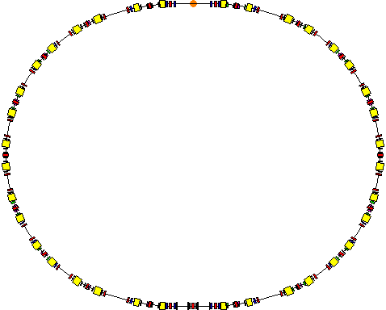
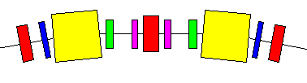
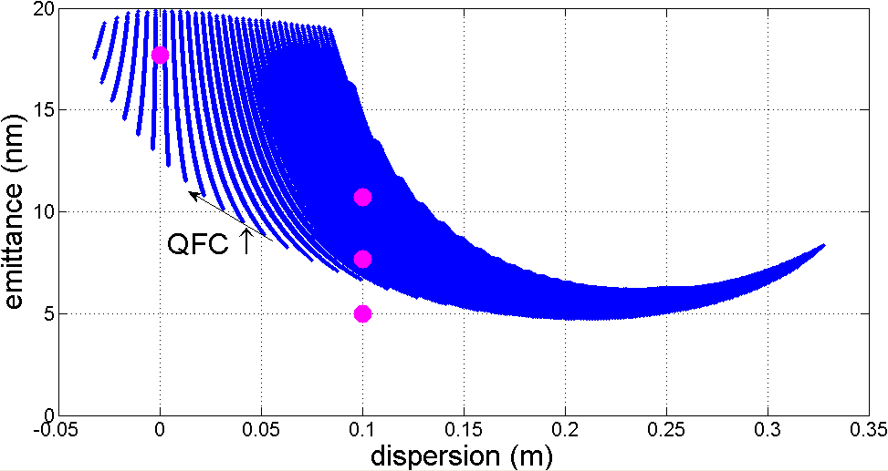
SPEAR3 Potential
Arc cell:
QF
QD
QFC
QD
QF
BEND
BEND
SD
SF
SF
SD
Achromat
Present operations
Tested in AP
Damping wiggler
234 m circumference racetrack
7 standard cells per arc (SF, SD)
4 matching cells (SFM, SDM)
March 6, 2012
2

Slide 3
Emittance Reduction
 | Achromat | Low emittance | “Lower” emittance | Superconducting damping wiggler
 | 2004-2007 | 2007-now | 40% injection | future
ε_{x0} (nm) | 18.0 | 11.2 | 7.68 | ~5.3
ε_{x}, IDs (nm) | 14.6 | 9.6 | 6.76 | 4.9
ε_{x,eff} (nm) | 14.6 | 10.1 | 7.24 | 5.65
η, ID (m) | 0 | 0.1 | 0.1 | 0.1
σ_{E} (permil) | 0.96 | 0.98 | 0.97 | 1.26
ν_{x} | 14.13 | 14.13 | 15.13 | 15.11
x’
x
  Effective emittance, ε_{x,eff} includes η_{x}:
March 6, 2012
ICFA Future Light Sources Workshop, J. Safranek
3
Notes:
Note: can make vertical emittance as small as 5 pm, beyond beamline optics resolution.

Slide 4
Brightness plots (500 mA)
March 6, 2012
ICFA Future Light Sources Workshop, J. Safranek
4
Notes:
Will result in over a factor of 3 in brightness from emittance reduction since SPEAR3 started.
Add a factor of 5 for current + an additional factor from top-off - ~*20 increase in brightness from start of SPEAR3.

Slide 5
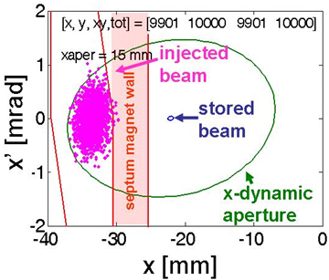
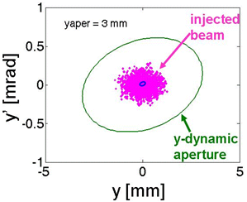
Non-Linear Dynamics
Sextupole magnets
  Correct chromatic focusing errors
  Nonlinearities limit dynamic aperture (maximum stable amplitude)
Require off-energy dynamic aperture for lifetime
Require on-energy dynamic aperture for injection (bigger challenge)
Phase 1 lattice, 40% injection efficiency; dynamic aperture is ~4 mm too small
Reduce injected beam size: remove windows (done); lower booster ε_{x}?
Plan to reduce septum wall from ~6.3 to ~2.5 mm with new in-vacuum septum
5

Slide 6
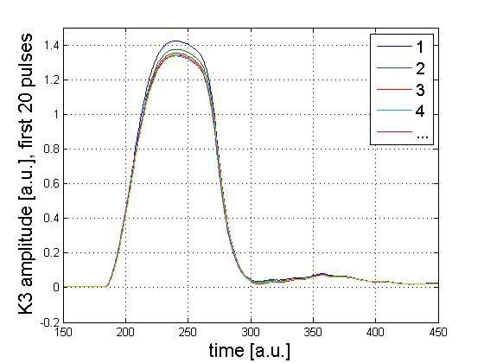
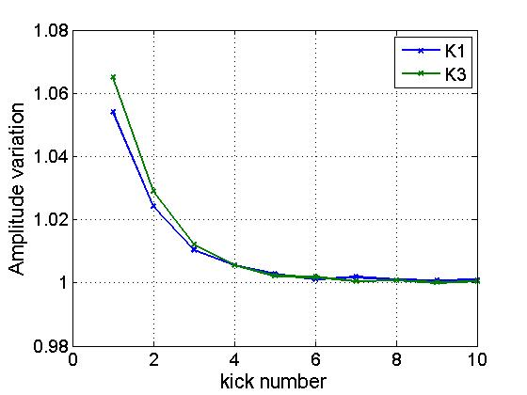
Injection bump issues
First kicks 6% larger
  Requires 1.3 mm more D.A.
  Will be corrected soon
K2 strength insufficient
  Need 8 mm D.C. bump in expt.
  Move septum wall from 25 to 17 mm
  Will reduce kicker bump nonlinearities
Will consider pulsed multipole injection
  This scheme also would benefit from septum upgrade
March 6, 2012
ICFA Future Light Sources Workshop, J. Safranek

Slide 7
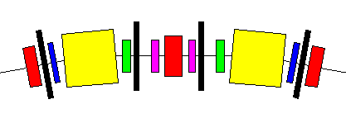
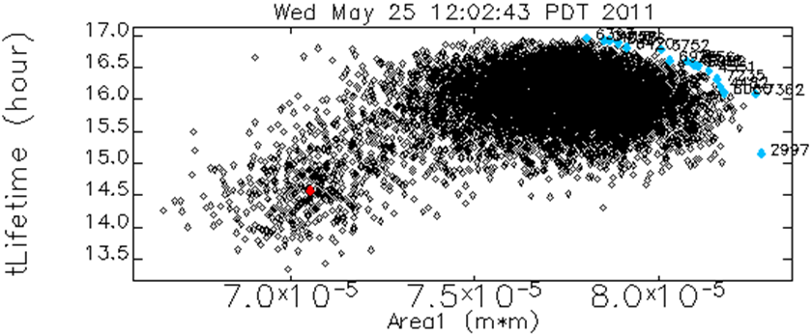
Non-Linear Optics
New sextupole magnets
  Two families
  On steering magnets
Octupole magnets
MOGA elegant tracking, 6.7 nm lattice, with 21 sextupole families
SHA
SHB
SD+OD
SF+OF
start
best results
March 6, 2012
ICFA Future Light Sources Workshop, J. Safranek
7

Slide 8
MOGA codes
Lanfa, elegant
  Objectives:
    Dynamic aperture
    Lifetime
Xiaobiao, new code
  C++ tracking
  MATLAB shell
  Objectives:
    Dynamic aperture
    δ-aperture
    dν_{x,y}/dJ_{x,y}
    Tune diffusion
DA(A.U.)
March 6, 2012
ICFA Future Light Sources Workshop, J. Safranek

Slide 9
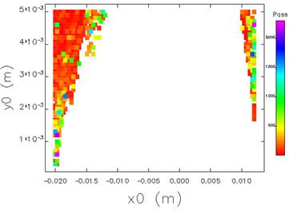
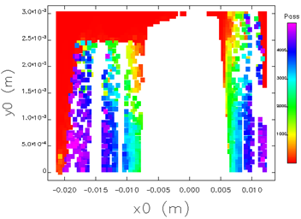
Nonlinear coupling
x-oscillations grow in y
Loss on vertical aperture, 1000s of turns
Track with vertical aperture & many turns
5 mm physical aperture
3 mm physical aperture
2000
4000
turns
turns
0
0
March 6, 2012
ICFA Future Light Sources Workshop, J. Safranek

Slide 10
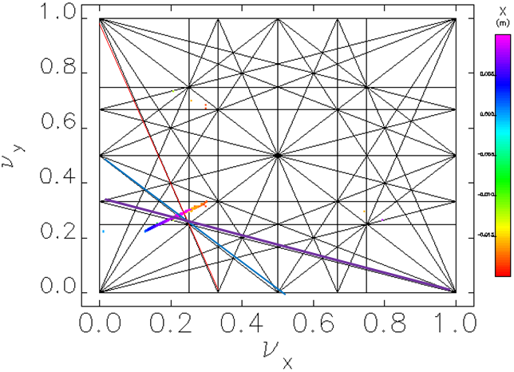
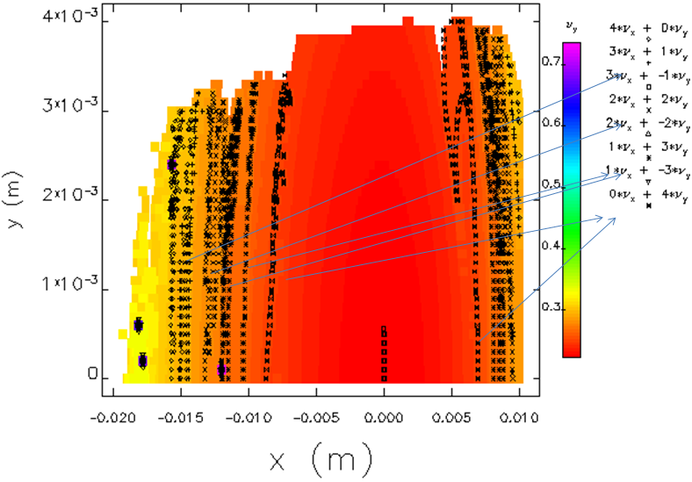
4th order resonances
~3x increase in dν_{x,y}/dε_{x,y}
Larger tune footprint
4ν_{y}, ν_{x}+3ν_{y}, 2ν_{x}+2ν_{y}, 3ν_{x}+ν_{y}
x[mm]
5
0
-5
-10
-15
March 6, 2012
ICFA Future Light Sources Workshop, J. Safranek

Slide 11
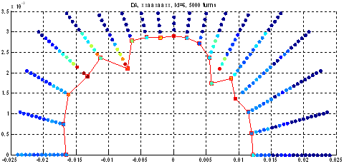
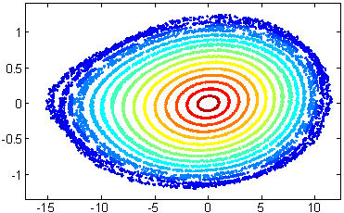
MOGA, 5000 turn tracking, 6.7 nm lattice
‘xxaaxaaxx’ power supply config.
SF/SD strength distribution
Dynamic aperture restored
long straights
septum
y [mm]
xp [mrad]
5000 turn tracking
D.A. = 16 mm
x [mm]
x [mm]
March 6, 2012

Slide 12
5000 turn MOGA tracking Resonance driving terms
MOGA automatically reduces resonances
Need many turns with apertures to “see” resonances
elegant
March 6, 2012

Slide 13
6.1 nm lattice (ν_{x}=15.32, η_{x}=12cm)
Small vertical growth:
y [m]
-12.5 mm dynamic aperture
x [m]
Sextupole distribution:
Crosses 3ν_{x} resonance:

Slide 14
Minimize tunes vs. amplitude
Other MOGA solutions suppress dν_{x,y}/dJ_{x,y}
Marginal dynamic aperture
Interesting to study in real ring
Largest dynamic aperture:
Small dν_{x,y}/dJ_{x,y}:
March 6, 2012

Slide 15
Small tune vs. amplitude
dν_{x}/dJ_{x} = -90,
dν_{x}/dJ_{y} = 400,
dν_{y}/dJ_{y} = 2690
Huge deformation to ellipse
Small tune map:
At septum

Slide 16
Superconducting
Damping Wigglers
One wiggler, 18S
  5.75 Tesla, 3 meters long
Two wigglers
  17S &1S or 8S & 10S
  4.3 Tesla, 2*3.5 meters long
  Hard x-ray beamline, 17S or 10S
  Requires 2 new quadrupoles
Work in progress
  Initial linear optics design
  Working to minimize nonlinearity
  Wiggler fan width
  Exit port acceptance
  Power absorption
beamline 13
18S
or
17S & 1S
or
10S & 8S
March 6, 2012
ICFA Future Light Sources Workshop, J. Safranek
16

Slide 17
Dynamic aperture measurement, (x_{β}, δ)
Present operations lattice.
Horizontal kick and RF frequency scan.
Betx_BPM = 3.46
Betx_septum=9.02
March 6, 2012

Slide 18
Frequency map measurement at SPEAR3
We don’t have a vertical kicker or pinger. So we excite vertical beam resonantly.
Tune driver
RF amplifier
Stripline
Beam
Turn-by- turn BPM
In SWEEP mode: Peak-peak Voltage, stop frequency, sweep span
Horizontal Kicker
Voltage
1. Tune driver, horizontal kicker and turn-by-turn BPM are all triggered by the same 10Hz signal.
2. Delay is set to the tune driver so that the sweep stops when the kicker is fired.
3. 100ms BPM turn-by-turn data is saved.
4. RF driving signal applies to both horizontal and vertical planes through the stripline.
Kicker is fired when the vertical motion is driven to high amplitude. At this moment the driving signal switches to lower frequency. So both horizontal and vertical motion are ‘free’ afterwards.
March 6, 2012
ICFA Future Light Sources Workshop, J. Safranek

Slide 19
Frequency map
measurement at SPEAR3
Oscillation damps down fast when horizontal amplitude gets large.
64 turns in red
March 6, 2012
ICFA Future Light Sources Workshop, J. Safranek

Slide 20
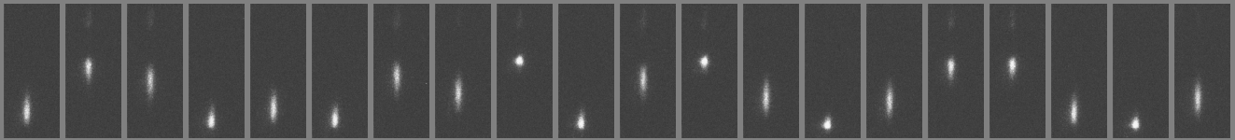
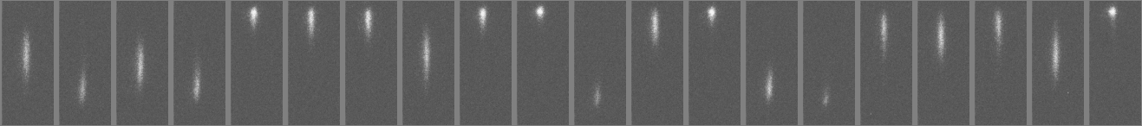
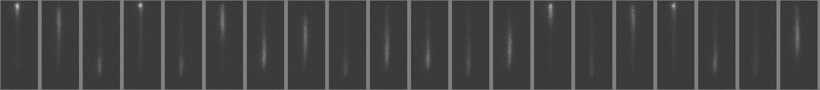
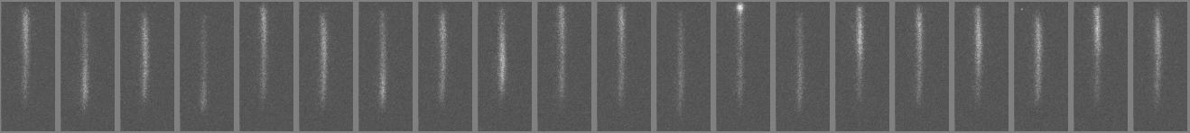
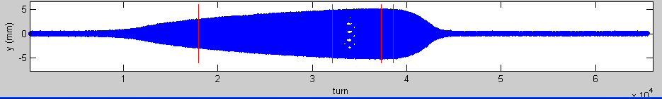
Filamentation
Measurement by J. Corbett and A. Terebilo
on 5/20/2008
Vertical profile on the ramp
14 ms
25 ms
29 ms
30 ms
14 ms
25 ms
29 ms
30ms
Severe filamentation appears in the resonance region.

Slide 21
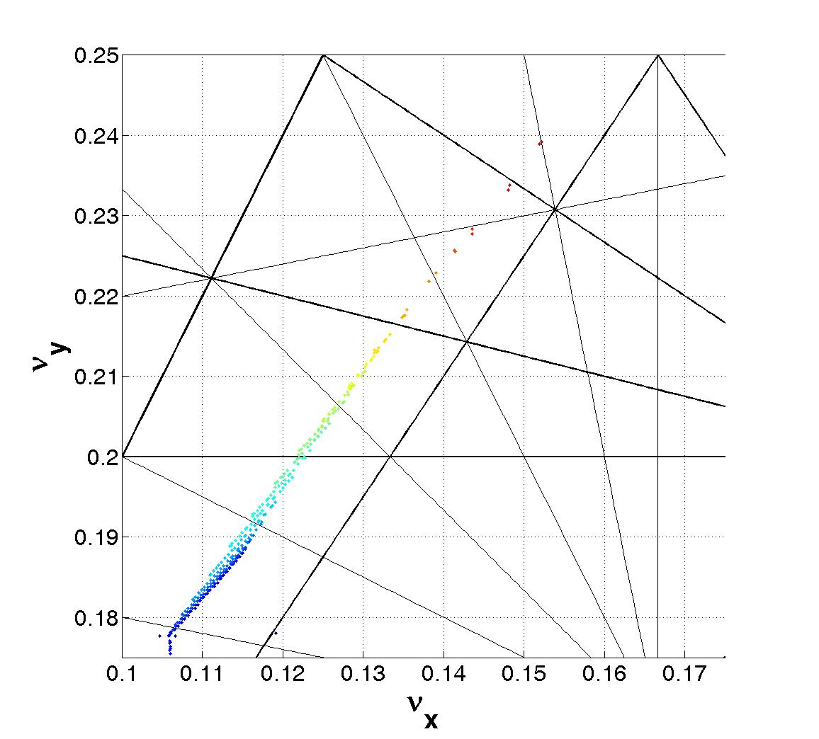
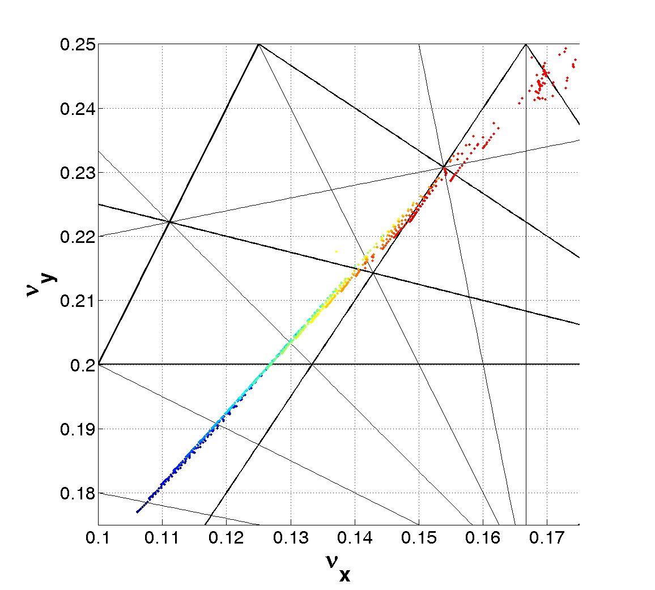
Model vs. measurement
measurement
model
Differences in detuning coefficients:
Map measurement:
4mA/80bunches
64 turns, NAFF
Large error in quadratic vertical chromaticity:
March 6, 2012
ICFA Future Light Sources Workshop, J. Safranek

Slide 22
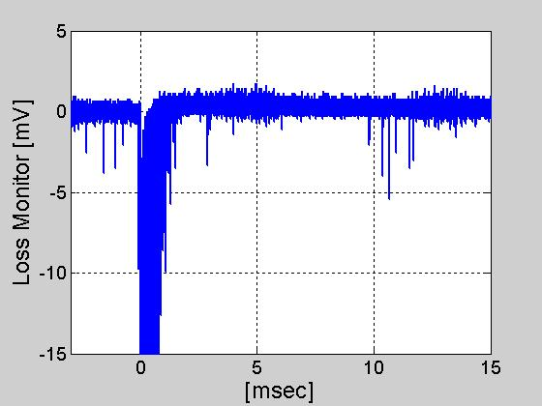
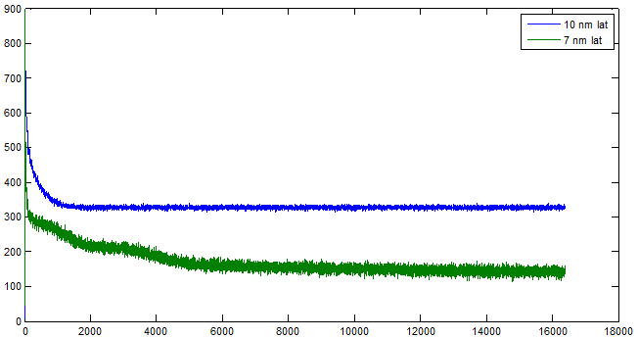
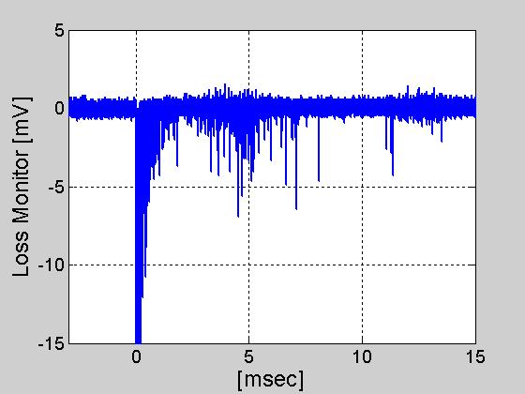
Nonlinear coupling resonant loss measurements
Monitor injected beam losses
Beam loss monitor at small-gap ID
BPM sum signal
10 nm, operations lattice
Injected beam, 16000 turns
BPM sum signal
10 nm operations lattice (x1/2.5)
7 nm lattice
7 nm lattice
5 msec losses
5 msec losses
Turns after injection
March 6, 2012
ICFA Future Light Sources Workshop, J. Safranek

Slide 23
Questions
All sextupoles powered separately?
What’s needed for beam-based nonlinear dynamics control?
  Are pinger magnets necessary?
  How many turn-by-turn BPMs are required?
  BPM noise level requirements?
  Should we have cavity BPM(s)?
Best designs for a vertically bending septum?
Discrepancies between modeling codes?
March 6, 2012
ICFA Future Light Sources Workshop, J. Safranek

