Slide 1
Tolerances for Seeded Free Electron Lasers
J. Wu
March 06, 2012
ICFA-FLS 2012 Workshop
Jefferson Lab, Newport News, VA
Working with T. Raubenheimer, et al.

Slide 2
Outline
Laser imperfection
  Chirp, curvature, and modulation
Electron bunch jitter
  Overall RF jitter, compression jitter
Electron bunch slice properties
  Intrinsic bandwidth
  Harmonic contents
Self-seeding
  Residual energy modulation
  Fresh bunch
Taper optimization
  Genetic Algorithm

Slide 3
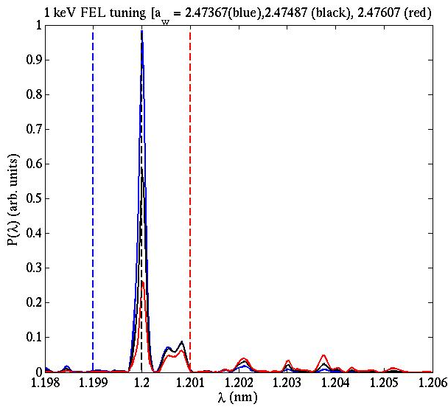
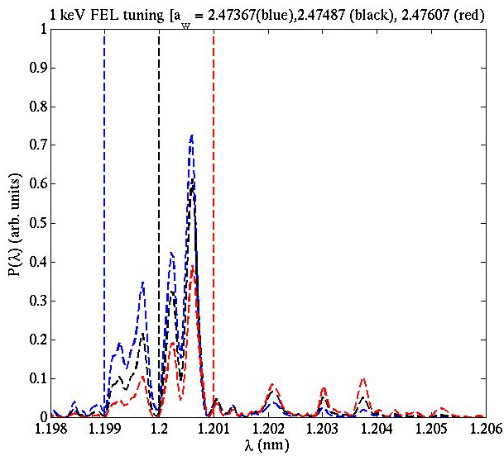
Seed laser
The seed can be imperfect
  Model it with chirp, curvature, and modulations
  Introduce energy jitter or undulator detuning
    Difference between a seed without chirp and with chirp
Electron bunch spectrum dominates

Slide 4
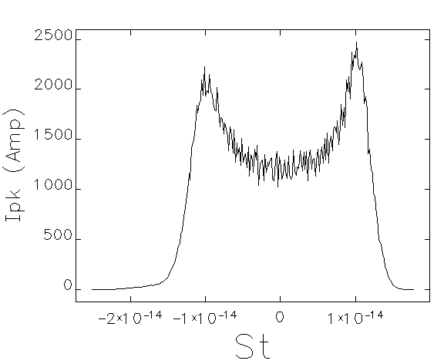
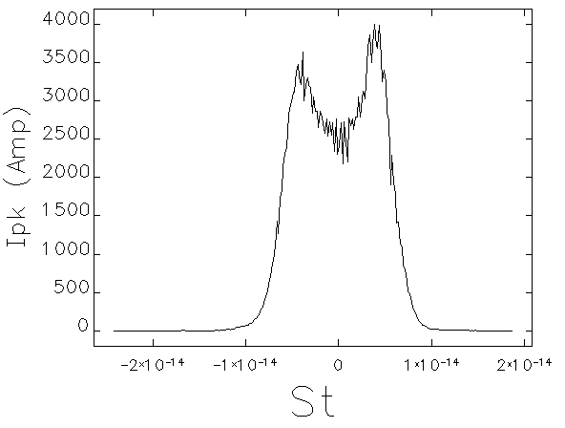
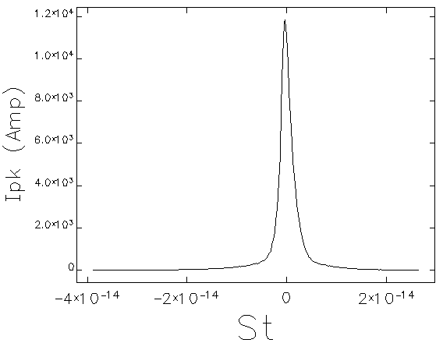
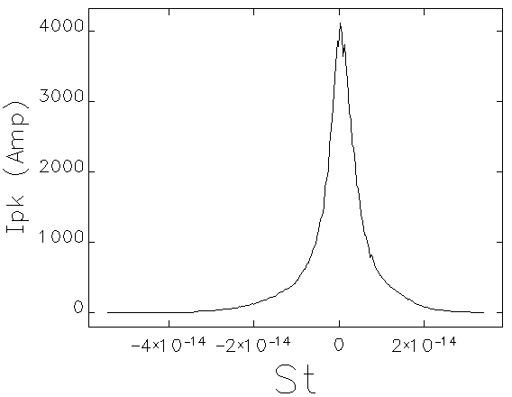
Electron bunch profile
Elegant for LCLS (RF phase jitte)

Slide 5
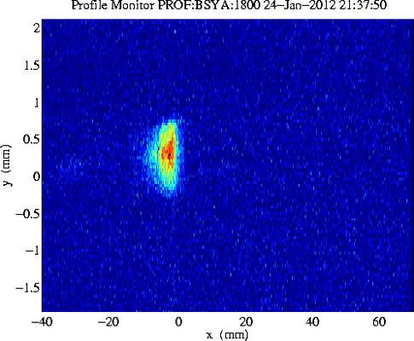
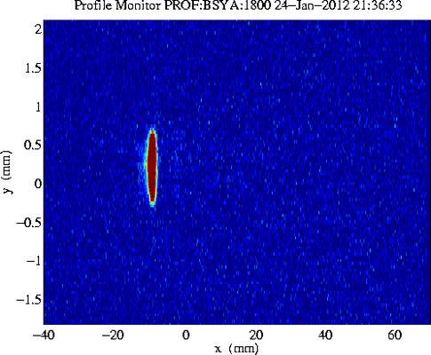
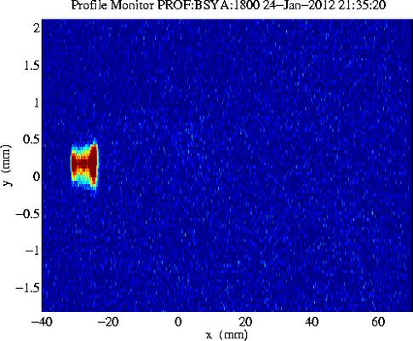
40 pC
Electron profile measured

Slide 6
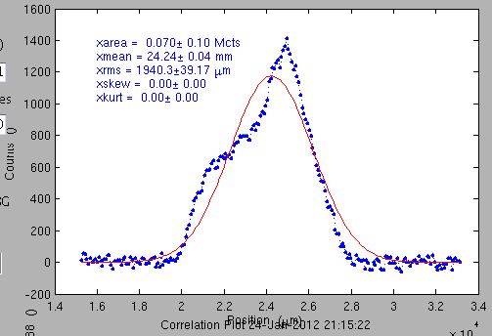
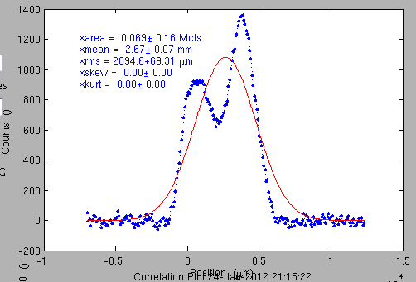
40 pC
Electron profile @ FEL operation point: vary from shot-to-shot

Slide 7
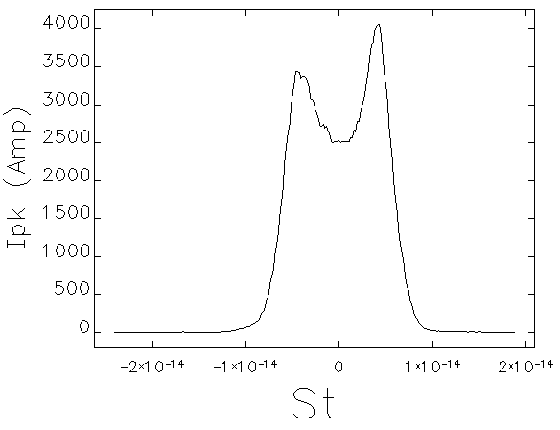
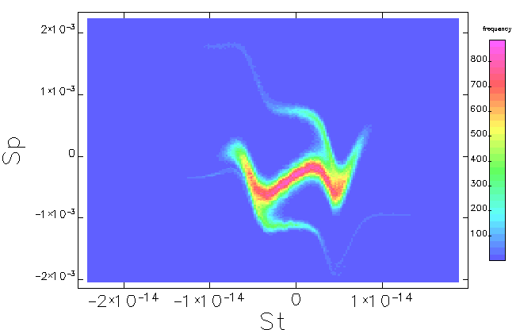
Undercompression: 40 pc
Choose one setup (with energy chirp)

Slide 8
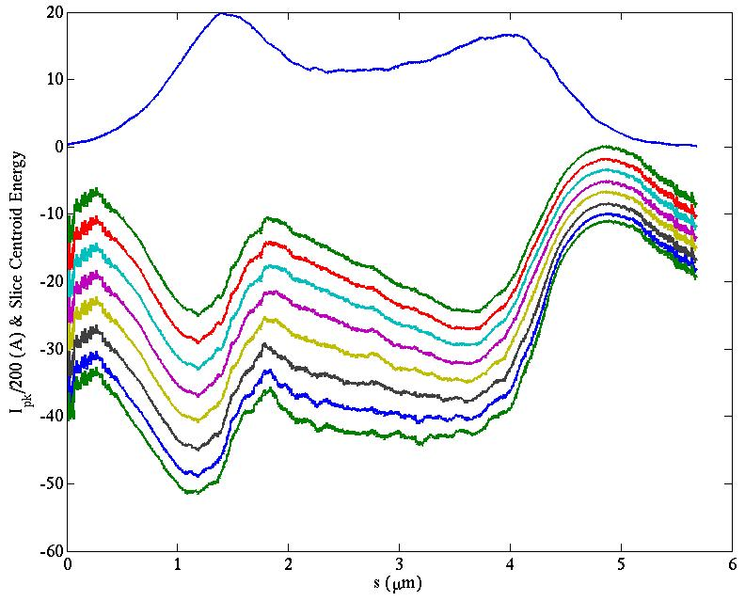
undercompression: energy chirp evolution
Wakefield compensate the chirp
Electron current profile
Electron energy chirp evolution: from top to bottom → electron bunch at 0, 10, 20, 30, 40, 50, 60, and 65.7 m into the second undulator

Slide 9
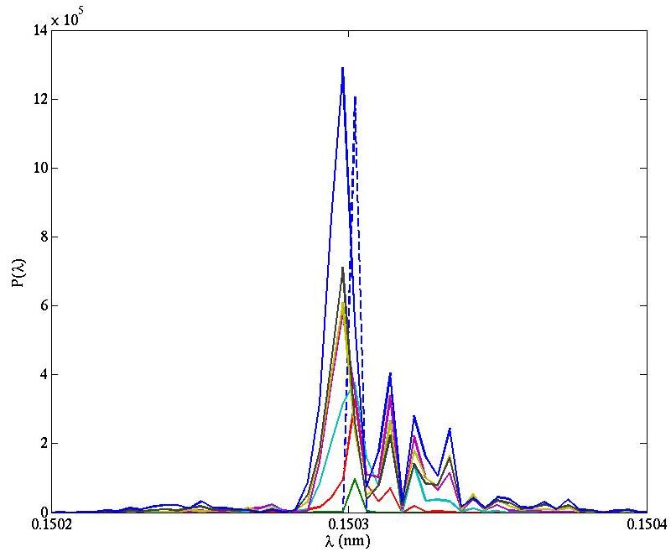
undercompression: FEL wavelength shift
Spectrum also detuned
FEL spectrum evolution: dashed blue curve → seed at undulator entrance
FEL spectrum evolution: green (10 m), red (20 m), cyan (30 m), brown (40 m), yellow (50 m), black (60 m), and blue (65.7 m into the second undulator)

Slide 10
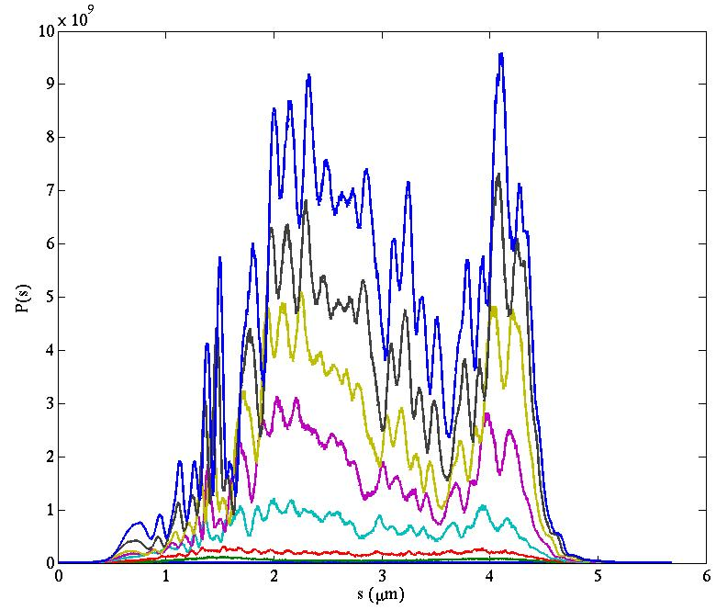
undercompression: slice properties
Different part is lasing differently, slice Gain Length?

Slide 11
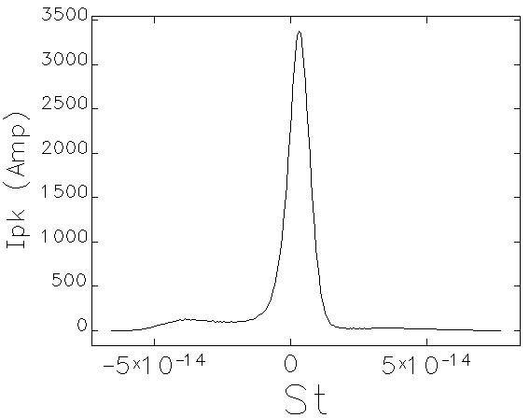
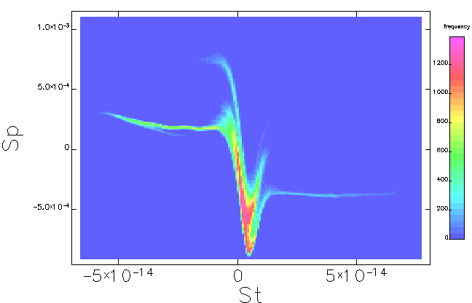
overcompression: 40 pc
Choose another setup (with energy chirp)

Slide 12
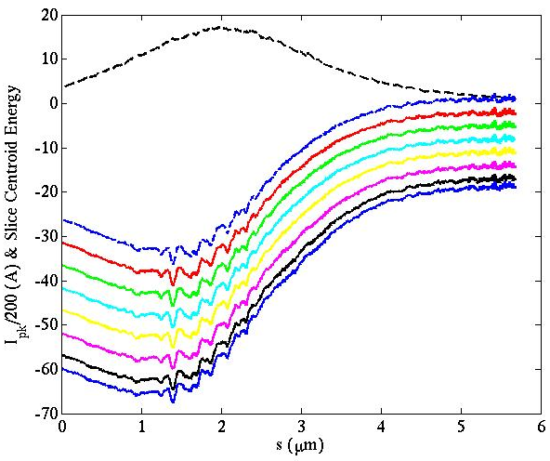
Overcompression: energy chirp evolution
Undulator wakefield is less of a problem
Electron current profile
Electron energy chirp evolution: from top to bottom → electron bunch at 0, 10, 20, 30, 40, 50, 60, and 65.7 m into the second undulator

Slide 13
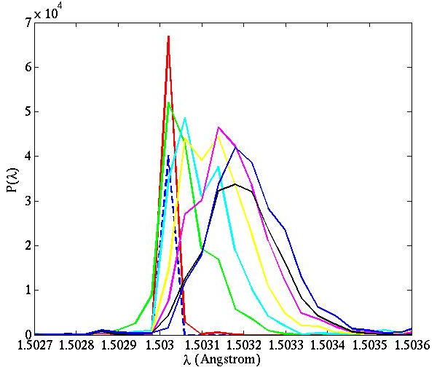
overcompression: FEL wavelength shift
Spectrum also detuned
FEL spectrum evolution: dashed blue curve → seed at undulator entrance
FEL spectrum evolution: green (10 m), red (20 m), cyan (30 m), brown (40 m), yellow (50 m), black (60 m), and blue (65.7 m into the second undulator)

Slide 14
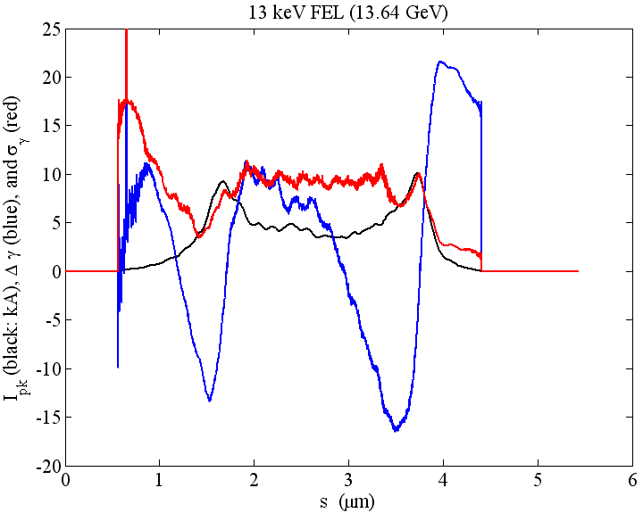
simulation for TW FEL @ LCLS-II
With S-2-E beam: tuning (in simulation) details
Current profile (black)
Centroid energy profile (blue)
Slice energy spread (red)

Slide 15
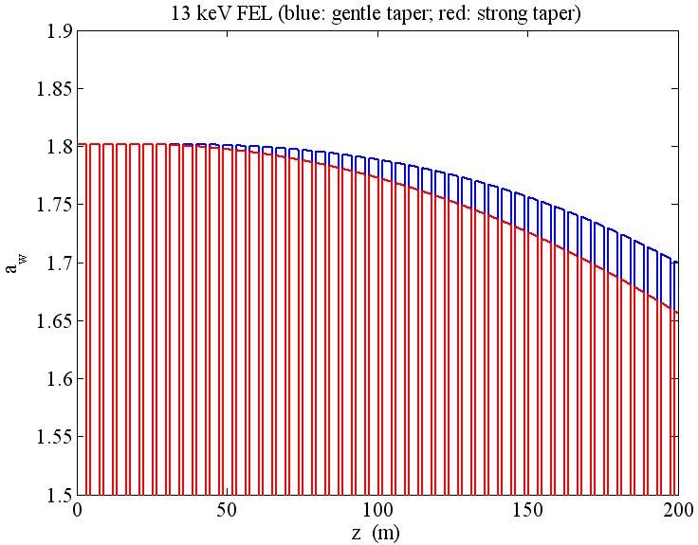
simulation for TW FEL @ LCLS-II
With S-2-E beam: tuning (in simulation) details

Slide 16
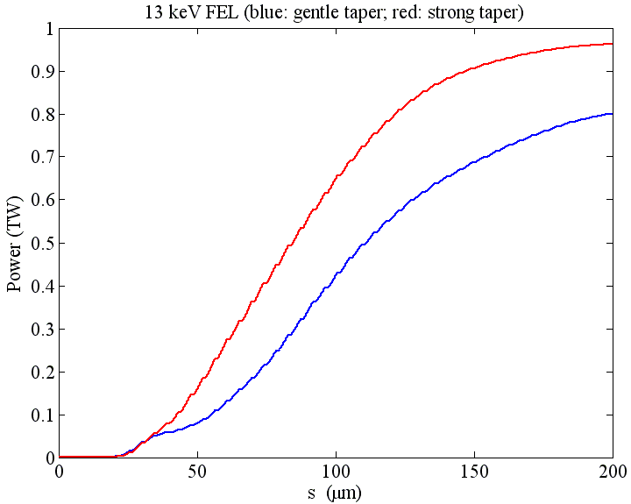
simulation for TW FEL @ LCLS-II
With S-2-E beam: tuning (in simulation) details

Slide 17
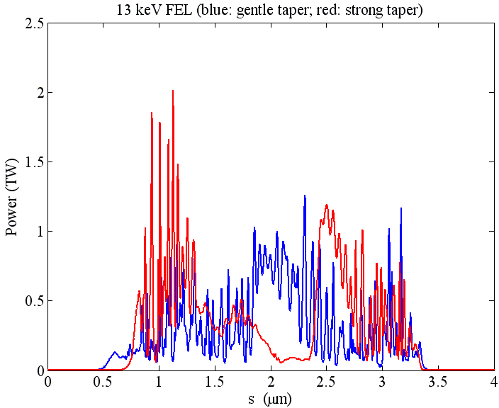
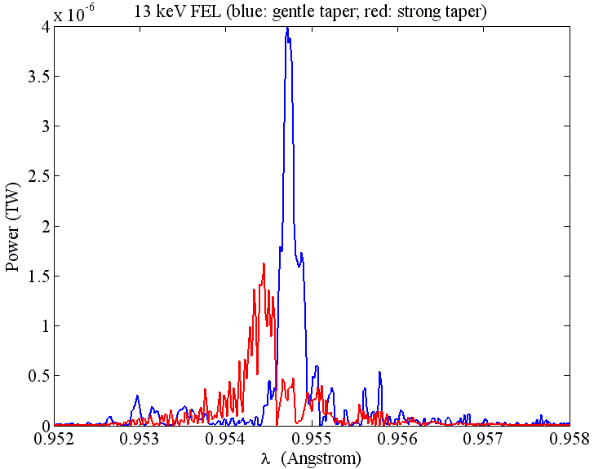
simulation for TW FEL @ LCLS-II
With S-2-E beam: tuning (in simulation) details

Slide 18
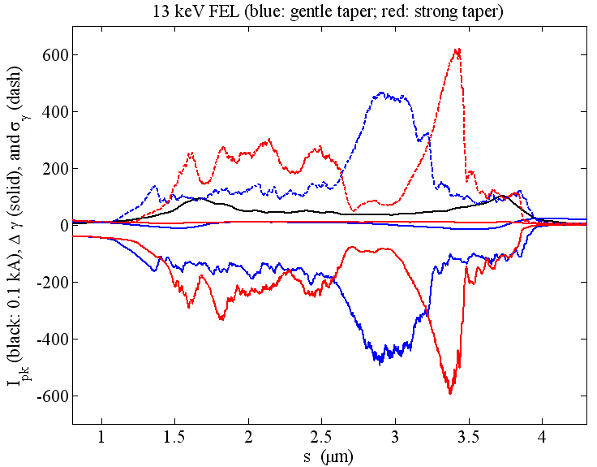
simulation for TW FEL @ LCLS-II
With S-2-E beam: tuning (in simulation) details

Slide 19
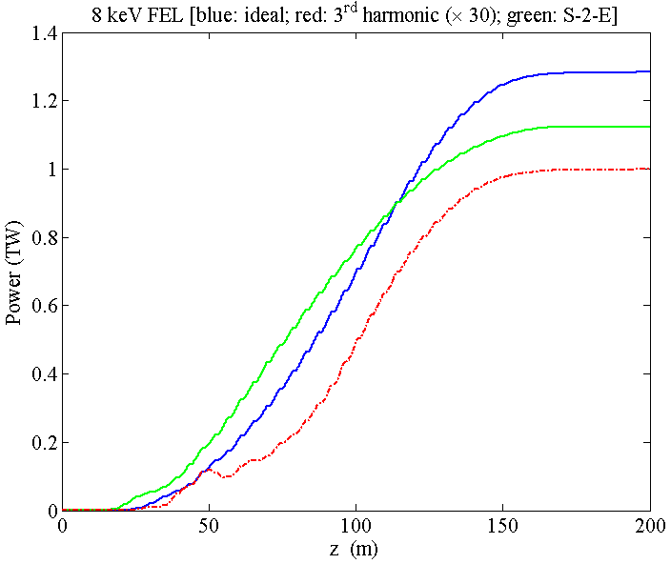
simulation for TW FEL @ LCLS-II
8 keV case
  Harmonic contents
8 keV:
  ideal (blue)
  ideal 3rd harmonic (x 30) (red)
  start-to-end (green)

Slide 20
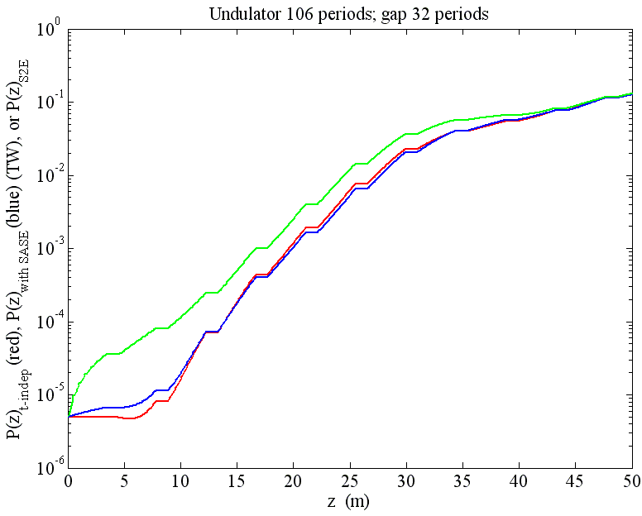
Startup region
After self-seeding chicane, the density bunch factor: 0.1 → 0.008, but also residual energy modulation → enhanced noise
Steady state (red); With SASE (blue);
S-2-E (green)
E. A. Schneidmiller and M. V. Yurkov, PR ST Accel. Beams 13, 110701 (2010).

Slide 21
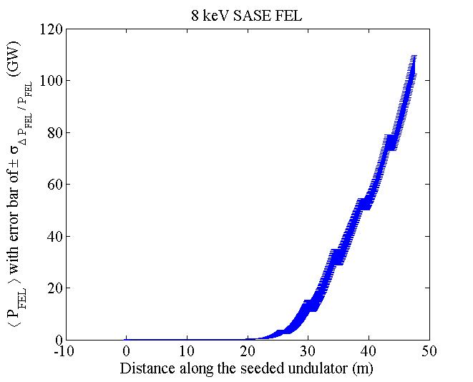
simulation for TW FEL @ LCLS-II
8 keV FEL through a single crystal 0.1 mm thick C(400) with 1.2E-05 (FWHM) bandwidth
The FEL centered @ 1.50205 Å
S-2-E beam, horns lase strongly
SASE

Slide 22
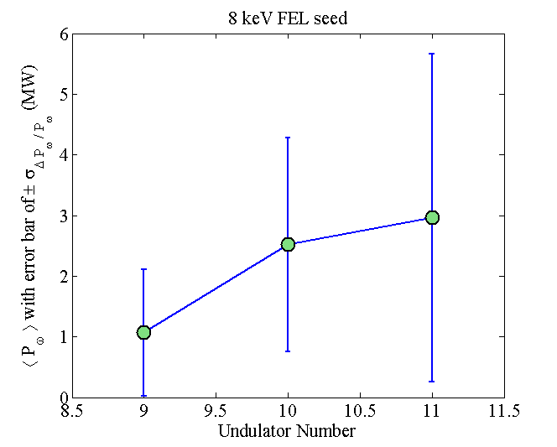
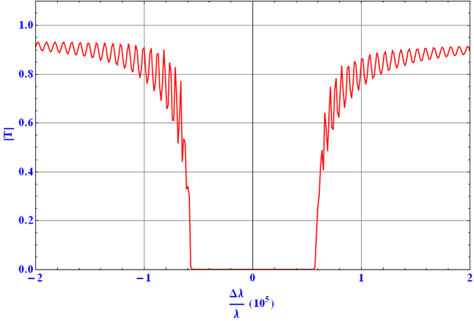
simulation for TW FEL @ LCLS-II
8 keV FEL through a single crystal 0.1 mm thick C(400): 1.2E-05 (FWHM) bandwidth with Bragg angle 57º
The FEL centered @ 1.50205 Å
Seed

Slide 23
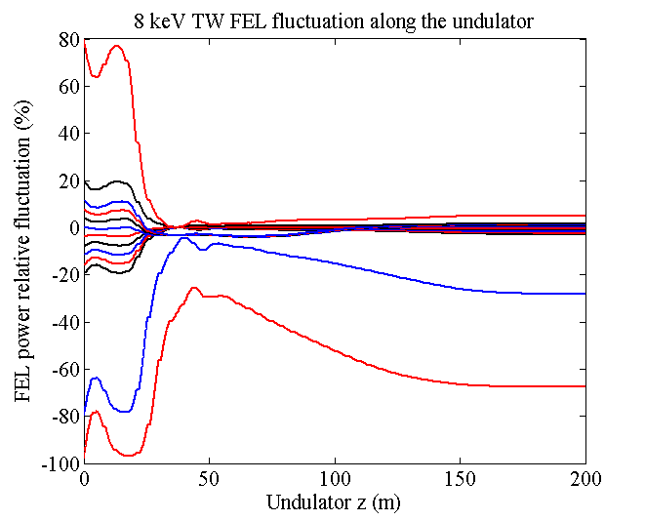
simulation for TW FEL @ LCLS-II
8 keV FEL through an 1.2E-05 (FWHM) bandwidth
The FEL centered @ 1.50205 Å
Seeded TW: Taper profile for 5 MW seed

Slide 24
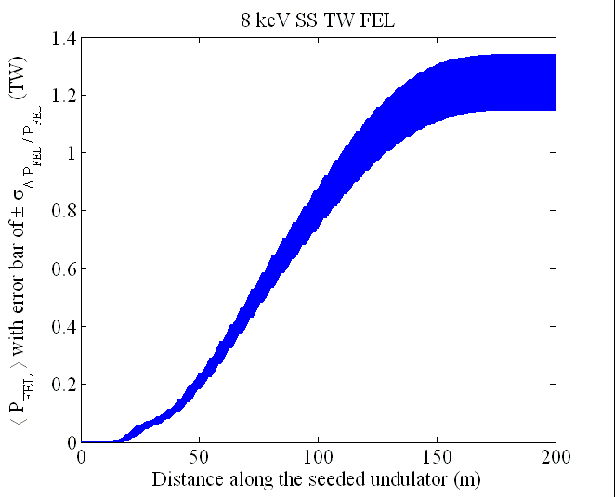
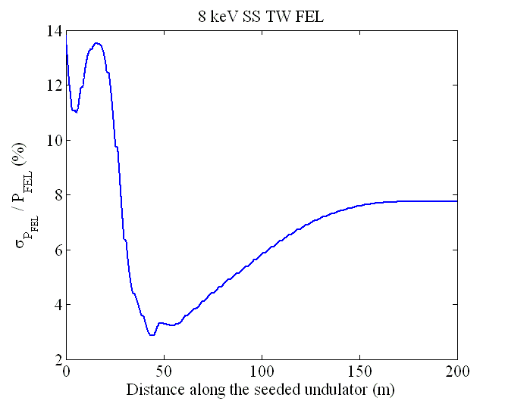
simulation for TW FEL @ LCLS-II
SASE FEL in the seed bandwidth: Gamma-distribution
Seeded TW

Slide 25
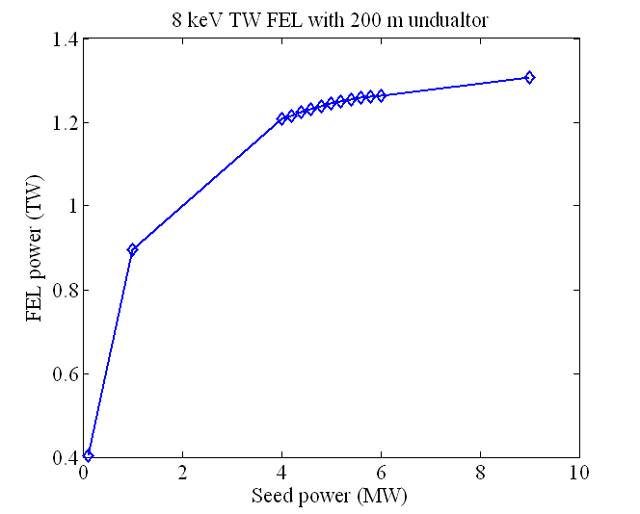
simulation for TW FEL @ LCLS-II
Output power as function of input power

Slide 26
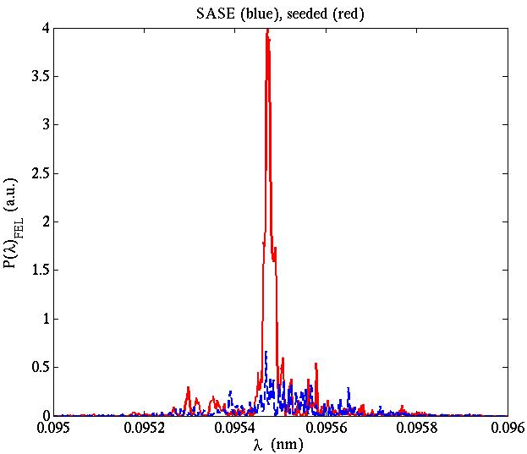
TW FEL SASE and Seeded
TW Seeded FEL has a much narrowed bandwidth
SASE component exists in the TW FEL undulator
Seeded
SASE

Slide 27
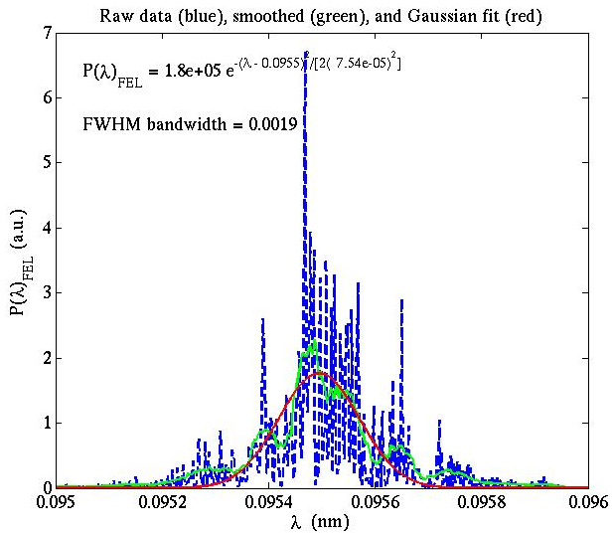
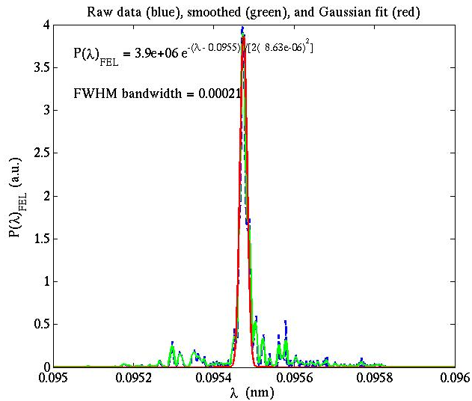
TW FEL SASE and Seeded
SASE and Seeded
SASE 1.9E-03
Seeded 2.1E-04

Slide 28
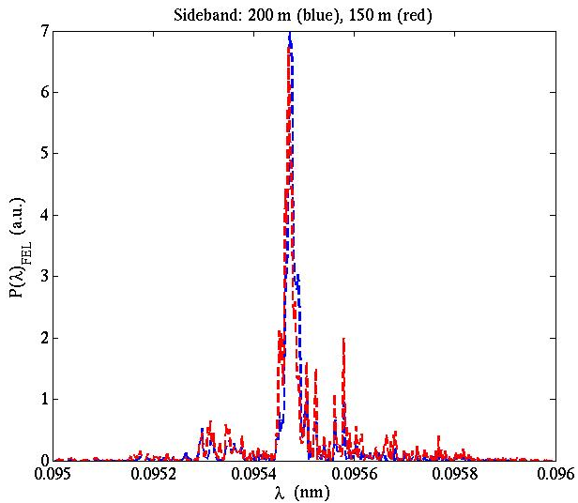
TW FEL sideband
Sideband and reduction of spectrum brightness
Spectrum @ 200 m is timed by 1.8
SASE 1.9E-03

Slide 29
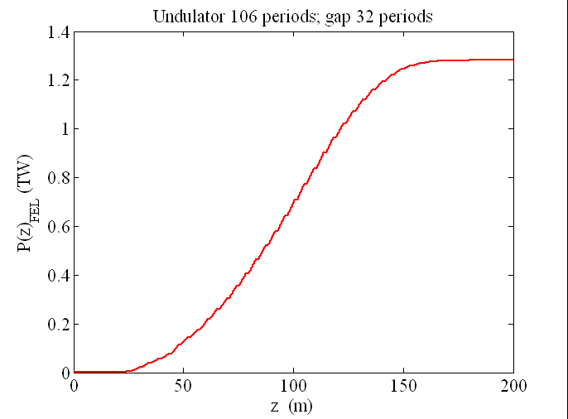
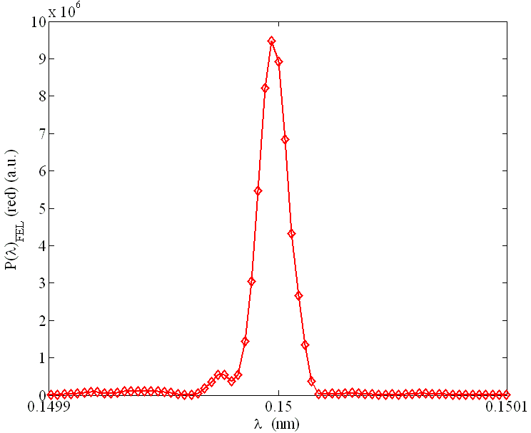
TW FEL @ LCLS-II nominal case
  8.3 keV -- 1.5 Å (13.64 GeV)
  40-pC charge; 4-kA peak current; 10 fs FWHM; 0.3-μm emittance
  Optimized tapering starts at 16 m with 13 % K decreasing from 16 m to 200 m, close to quadratic taper b ~ 2.03
  Und. λ_{w} = 3.2 cm, 3.4 m undulator each section, with 1 m break; average ⟨β_{x,y}⟩ = 20 m
  Longitudinal: close to transform limited
1.3 TW
1.0 x 10⁻⁴
FWHMBW
After self-seeding crystal

Slide 30
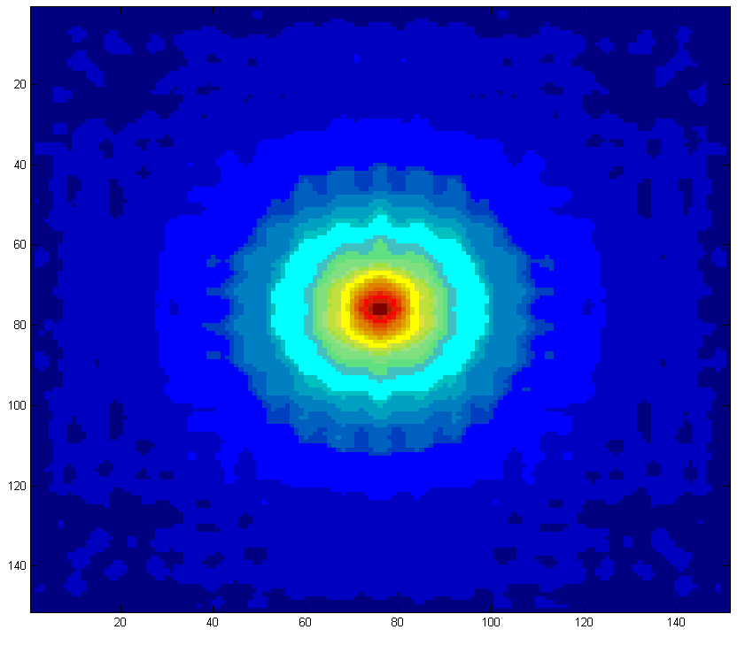
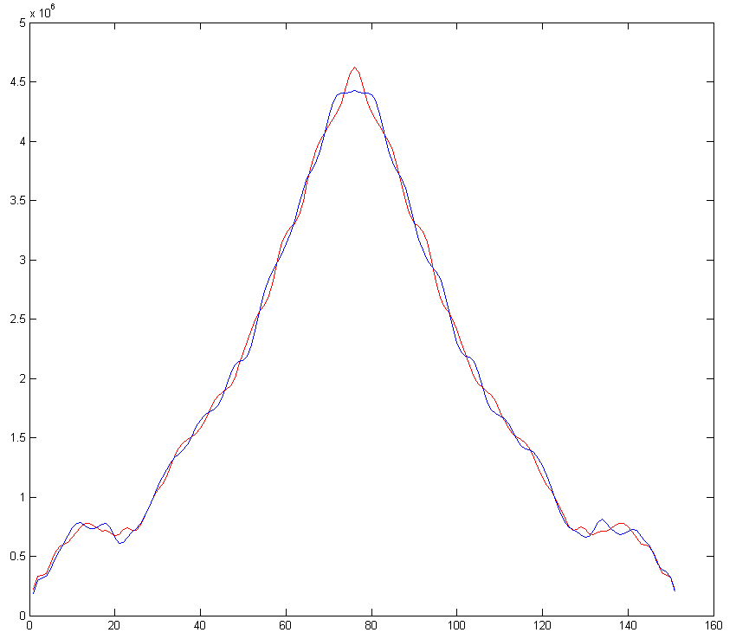
TW FEL @ LCLS-II nominal case
1.5 Å FEL at end of undulator (160 m)
y
E_{y} (red); E_{x} (blue)
5.0E+06 V/m
  ~ 80 % in fundamental Mode
  Transverse: M² ~ 1.3
x
y (red); x (blue)

Slide 31
Taper optimization
Give the above mentioned details, it is urgent to have an optimization tool to include as much physics as possible
  A Grid Scan based optimization (Y. Jiao’s talk) with 8 variables
  A Genetic Algorithm (GA) is adopted (Xiaobiao Huang, et al.) to attack much higher dimensional optimization

Slide 32
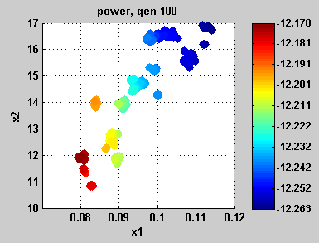
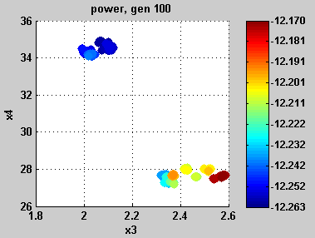
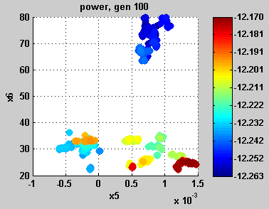
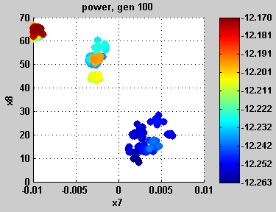
The basic 8 variable model with 7 phase shifts (0115b)
Introduce phase shifts in gaps following undulators 5 to 11.
parameter | low | high | delta | best
a | 0.01 | 0.3 | 0.001 | 0.114
z0 | 10 | 40 | 0.2 | 16.8
b | 1.1 | 3.3 | 0.01 | 2.072
K0 | 20 | 40 | 0.1 | 34.9
r1 | -0.005 | 0.005 | 0.00005 | 0.0008
z1 | 20 | 80 | 0.2 | 74.3
r2 | -0.01 | 0.01 | 0.00005 | 0.0022
z2-z1 | 0 | 70 | 0.2 | 9.3
Courtesy of Xiaobiao Huang
(a, z0)
(b, K₀)
(r1, z1)
(r2, z2-z1)

Slide 33
Summary
A detailed tolerance study for a seeded FEL, in particular, for reaching TW is on-going
  Here we try to bring out the issues, but not a TABLE
In general, a seeded FEL tolerance on the seed properties, the RF jitter, the details of the current profile coupled to the collective effects, taper tolerance, etc. are much more demanding
In collaboration with Y. Jiao, X. Huang, Y. Cai, A.W. Chao, Y. Ding, P. Emma (LBL), W.M. Fawley, Y. Feng, J. Frisch, J. Hastings, Z. Huang, H.-D. Nuhn, A. Mandlekar, C. Pellegrini, G. Penn (LBL), T.O. Raubenheimer, S. Reiche (PSI), M. Rowen, S. Spampinati, J. Welch, G. Yu…

