Slide 1
Perspectives of SRF gun development for BERLinPro T. Kamps (HZB)

Slide 2
The goal is to develop a photoinjector with characteristics within the parameter envelope of an ERL for a lightsource
generate a low emittance (1 mm mrad)
high current beam (100 mA)
accelerate/ de-accelerate
to / from 50 MeV
(energy recovery,
HOM losses, Beam Break Up)
accelerate the beam
up to 6.5 MeV (handle 650 MW)
beam dump
gun
booster
linear accelerator
transport through merger
without deterioration
of beam quality
manipulate the beam
(pulse compression)
recirculate the used beam (energy spread, emittance)
back to linac, control of beam loss
25m
max. beam energy | 50 MeV
max. current | 100 mA
nominal bunch charge | 77 pC
max. rep. rate | 1.3 GHz
normalized emittance | < 1mm mrad

Slide 3
Approach the goals for BERLinPro in stages, tackling issues concerning beam, brightness and current
 | Gun0 (HoBiCaT) | Gun1 | Gun2
Goal | Beam Demonstration (First beam April 2011) | High brightness R&D gun (2014) | High average current production gun (2015)
Cathode material | Pb (SC) | CsK₂Sb (NC)
Cathode QE_{max} | 1*10^-4@258 nm* | 1*10^-2@532 nm
Drive laser wavelength | 258 nm | 532 nm
Drive laser pulse length and shape | 2.5 ps fwhm Gaussian | ≤ 20 ps fwhm Gaussian | ≤ 20 ps fwhm Gaussian/Flat-top
Repetition rate | 8 kHz | 54 MHz/25 Hz | 1.3 GHz
Electric peak field in cavity | 20 MV/m* | ≥ 10 MV/m
Operation launch field on cathode | 5 MV/m* | ≥ 10 MV/m
Electron exit energy | 1.8 MeV* | ≥ 1.5 MeV
Bunch charge | 6 pC* | 77 pC
Electron pulse length | 2…4 ps rms^{*o} | ≤ 10 ps rms
Average current | 50 nA* | 4 mA/40 µA | 100 mA
Normalized emittance | 2 mm mrad* | 1 mm mrad
*Preliminary data / results,
º value represents emission time
T. Kamps et al, PRST-AB IPAC 2011 Edition, in preparation,
A. Neumann et al., PRST-AB IPAC 2011 Edition, in preparation
R. Barday et al., Proc. of PSTP 2011, in preparation
J. Völker, Master thesis, HU Berlin

Slide 4
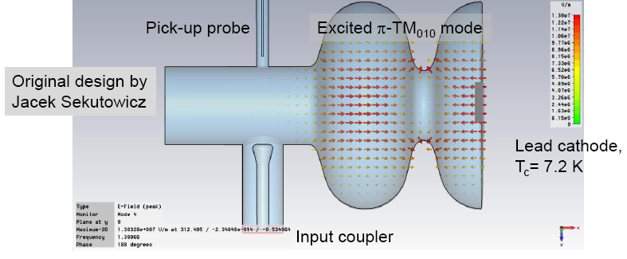
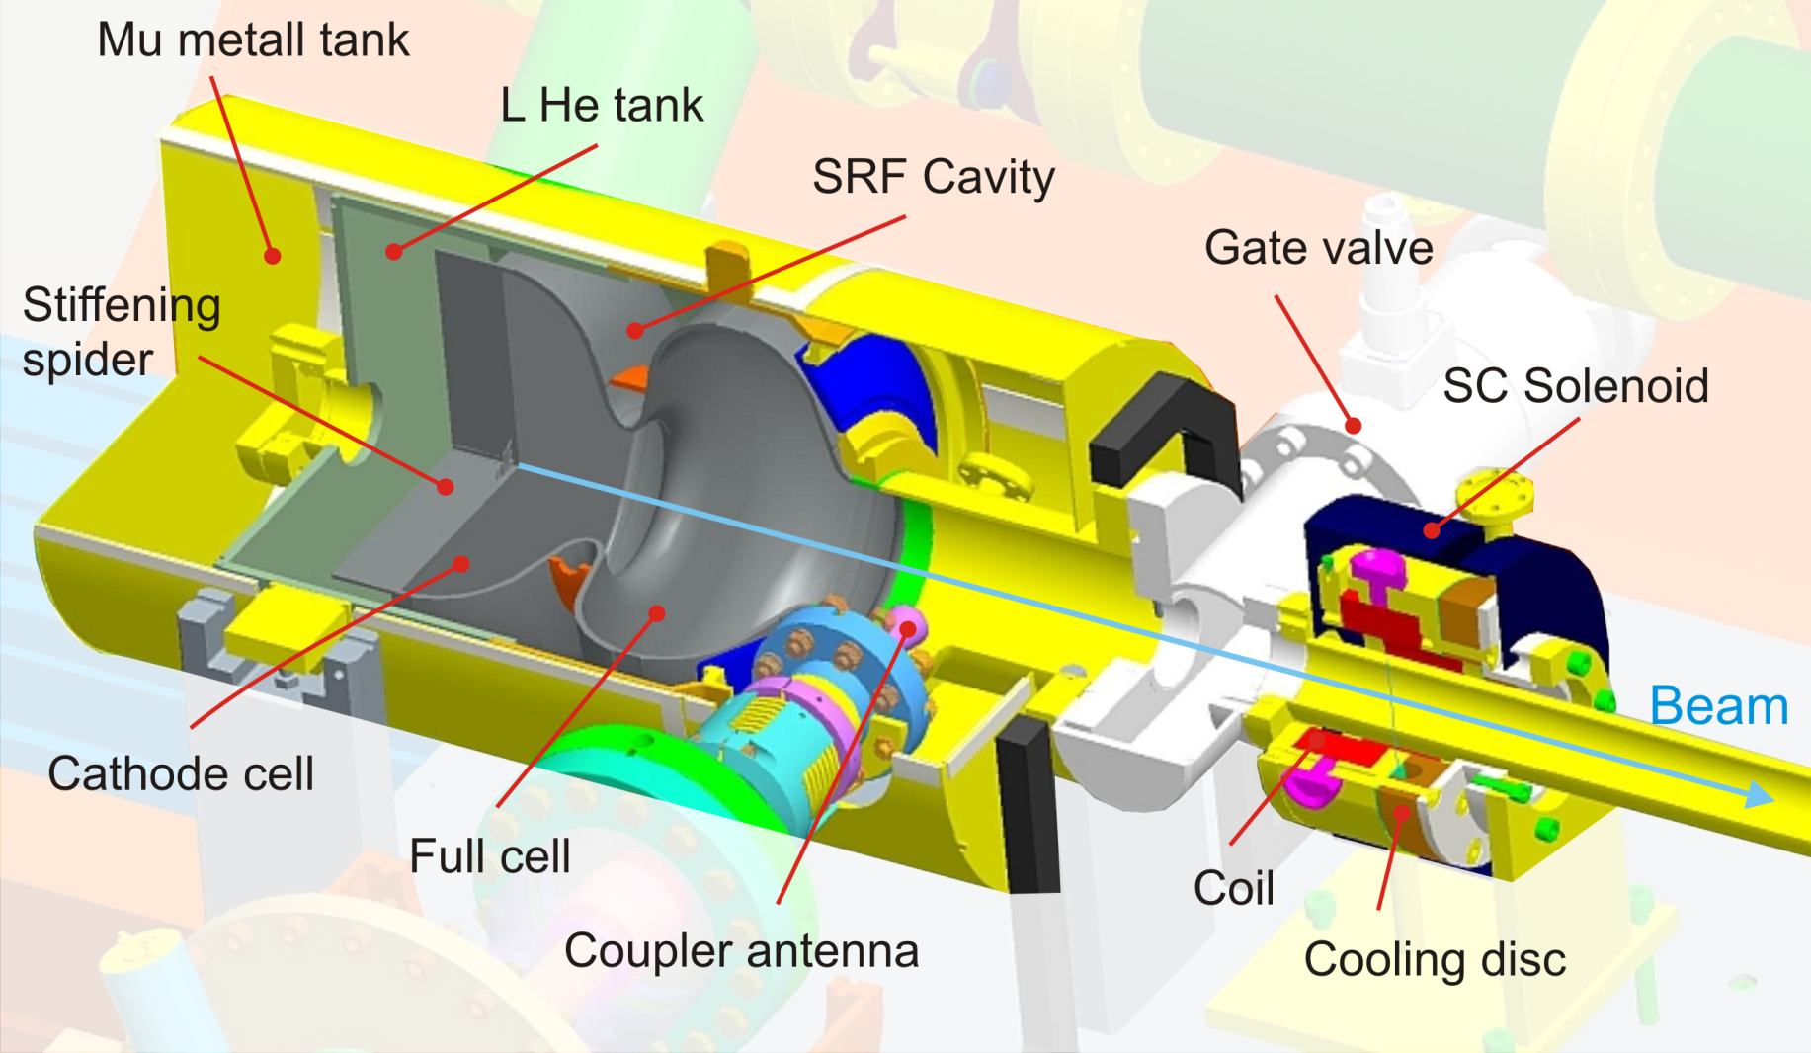
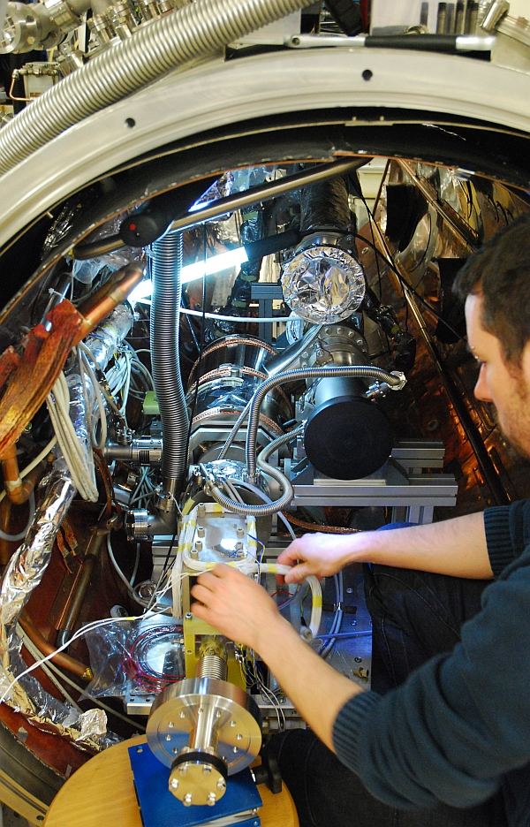
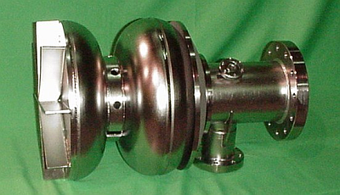
Gun0: Insert cold mass with cavity and solenoid into existing cryomodule of HoBiCaT, add drive laser and diagnostics
1.3 GHz, 1.6 cell, optimized to have peak field on metal at cathode location
Solenoid sits close to cavity. Both cavity and solenoid are shielded. No performance degradation with respect to Q of cavity found, OK.

Slide 5
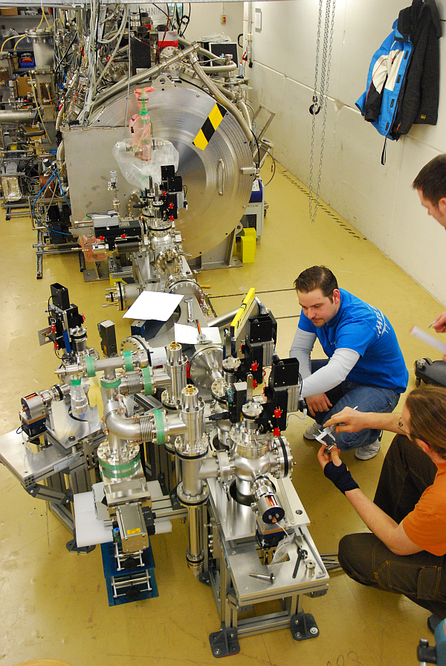
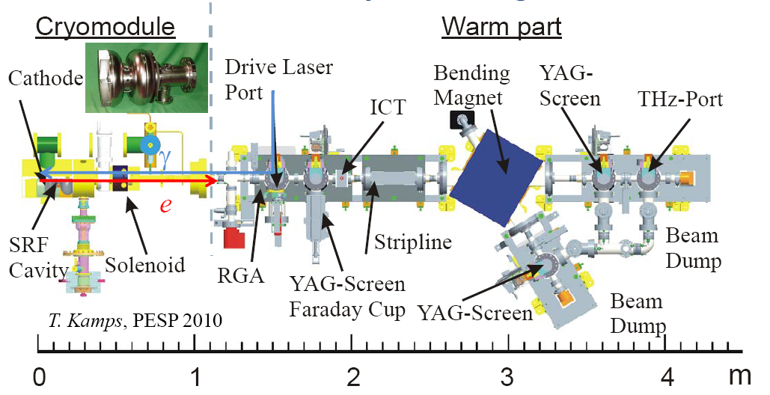
Compact diagnostics beamline
R. Barday, T. Kamps et al., Proc. of DIPAC 2011

Slide 6
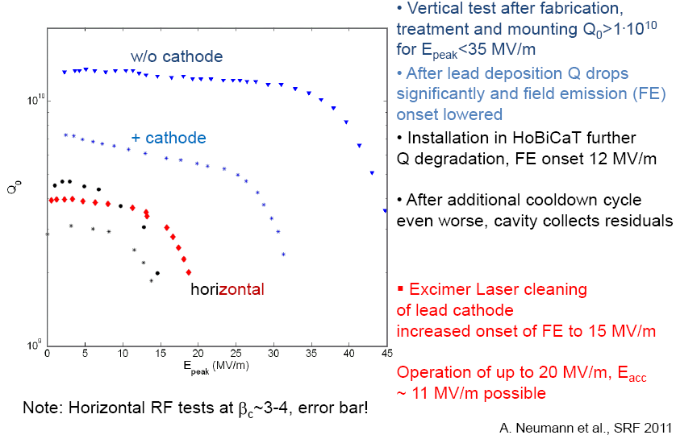
Gun0: Cavity results from VTA at JLAB and HoBiCaT at HZB

Slide 7
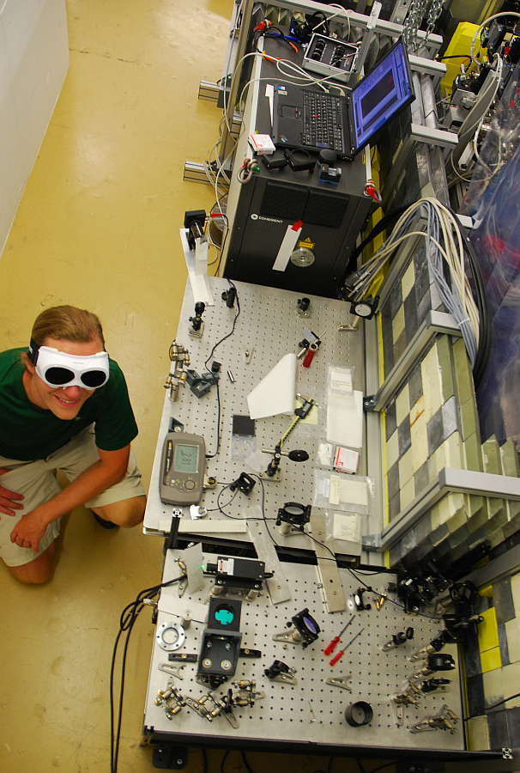
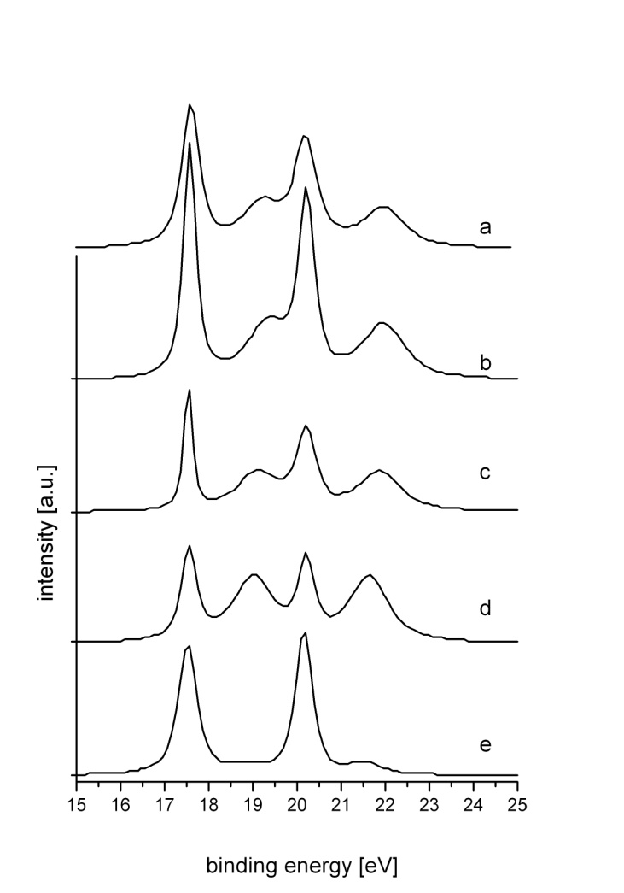
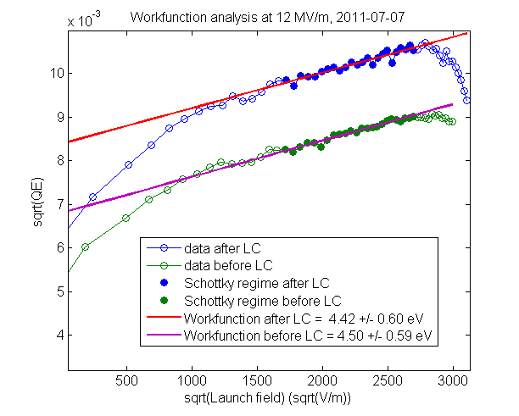
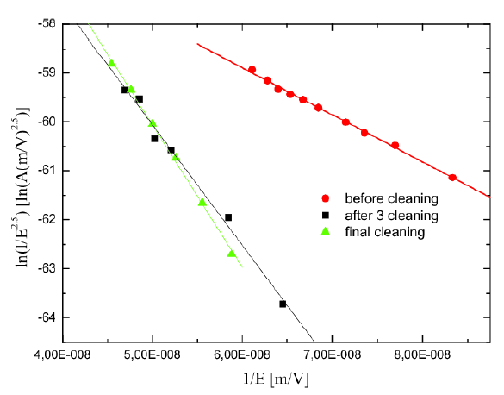
Gun0: Laser cleaning in-situ with real cathode and with witness cathode at XPS
Lasercleaning at XPS beamline
S. Schubert et al., at IPAC 2012
Laser cleaning required to control state of the cathode surface, as contaminants increase workfunction and lower QE
We laser cleaned the Pb cathode film SC state with KrF excimer laser at 248 nm with 0.045 mJ/mm² to 0.23 mJ/mm². Fired 300.000 shots in 10 min for each round , in total seven rounds.
Found that lasercleaning improves QE, lowers workfunction and moves dark current onset to higher gradients

Slide 8
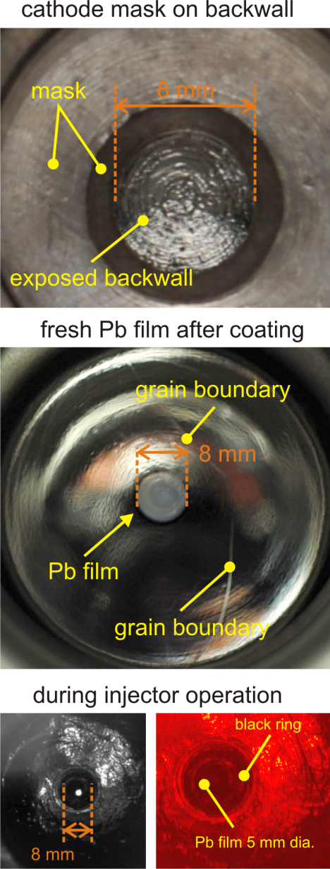
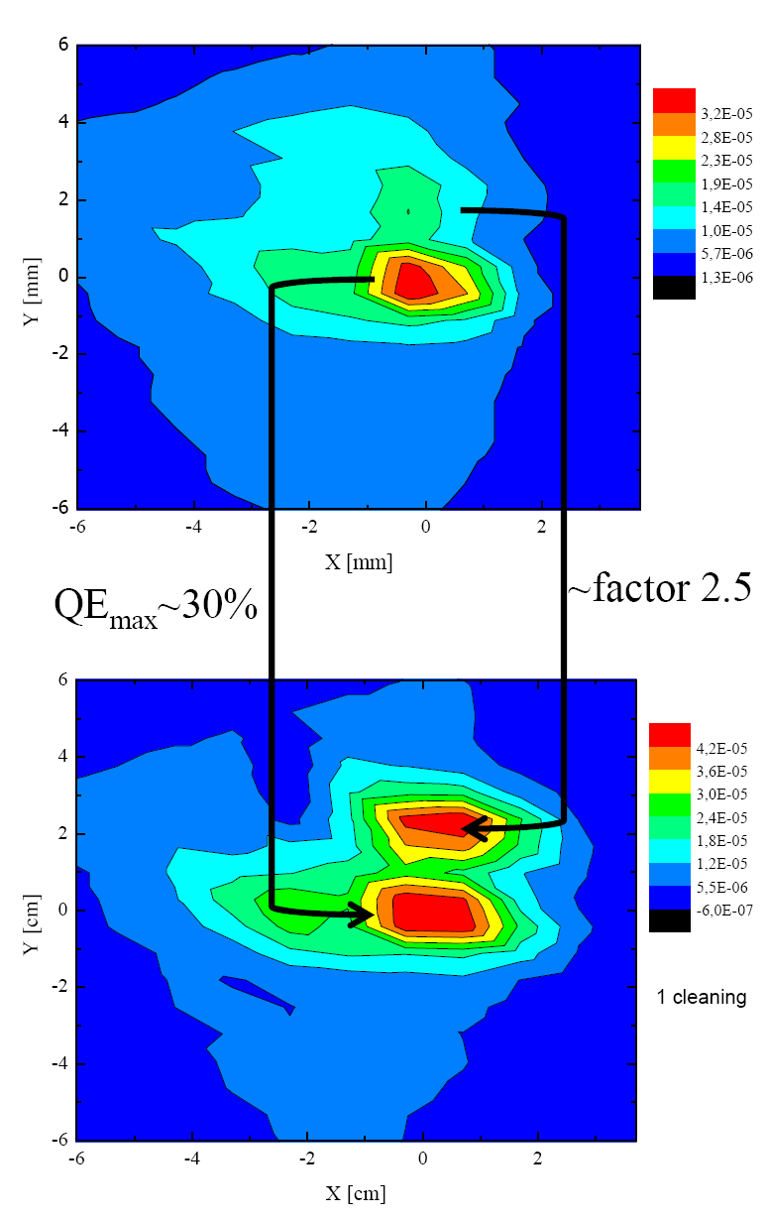
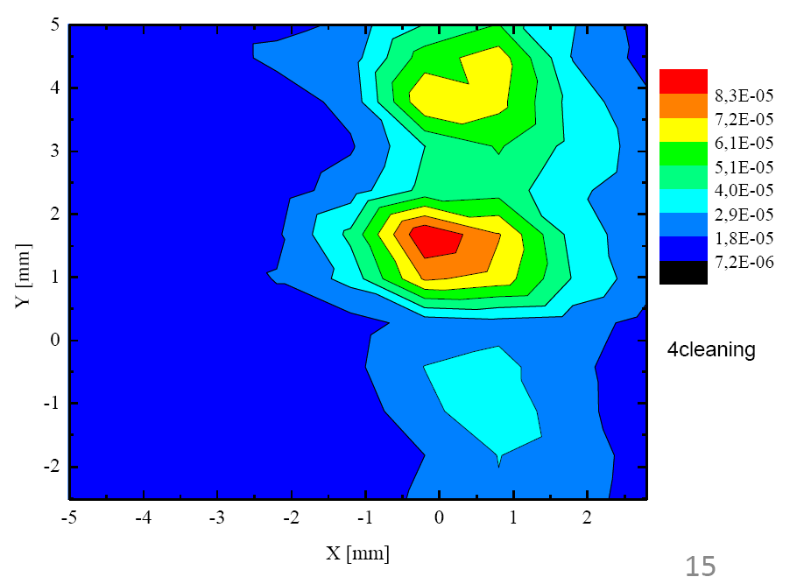
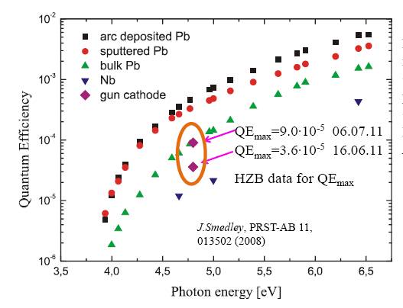
Gun0: Improvement of QE after four rounds of laser cleaning
pre
cleaning
after
4th round
after
1st round
R. Barday et al., Proc. of PSTP 2011

Slide 9
The focus is now moving from Gun0 to Gun1. Main goal is to run at macropulse current of 4mA from high QE cathode
Gun0
One more run from May to August 2012.
New cavity with tuner and improved Pb coating procedure.
Test of new beam instrumentation.
Gun1
Setup of cathode preparation lab.
Kick off cryomodule design.
Iterate on gun cavity.
Test and improve cathode plug.
Start planning setup of Gunlab.

Slide 10
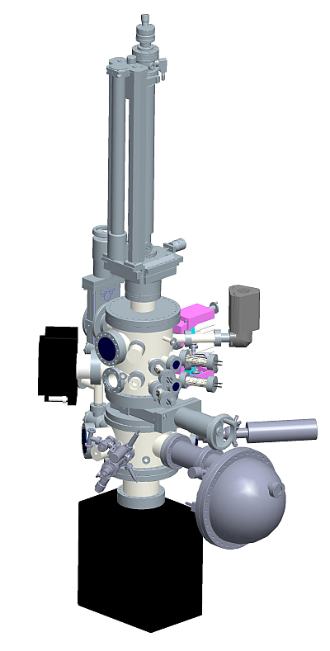
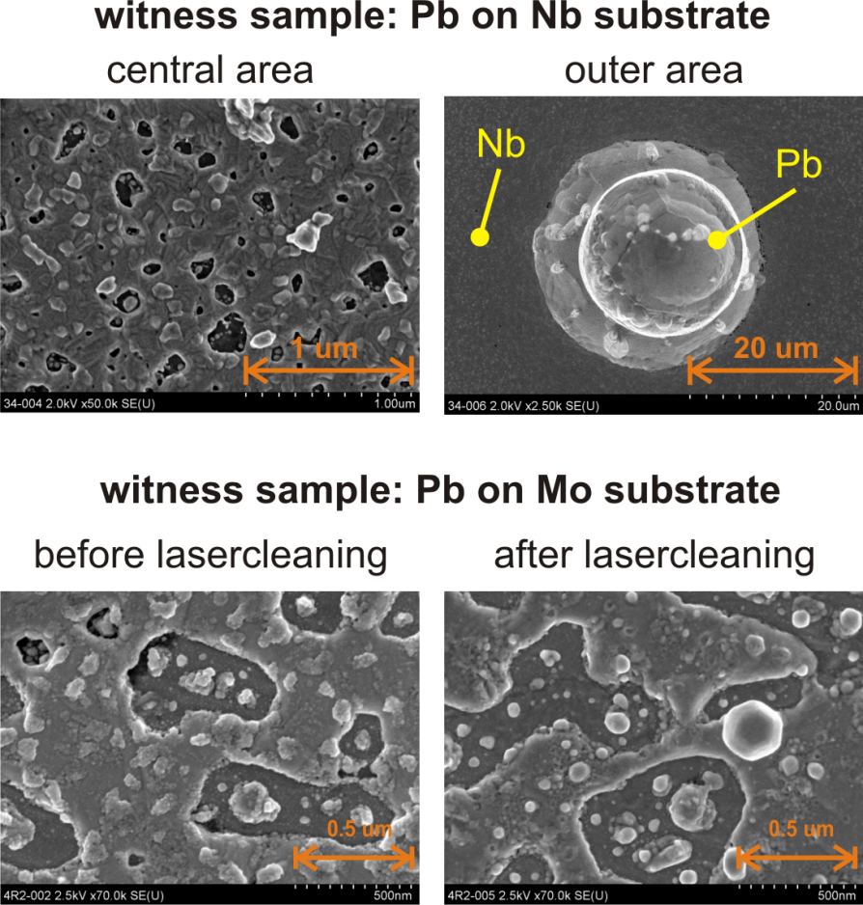
Gun1: Setup of cathode preparation lab and evaluation of surface science methods
Started to work on the Nb/Pb system to evaluate tools for substrate and surface analysis
EDX/SEM (at FHI) for surface topography and composition. Found Pb droplets → potential field-emitters
White light interferometry (at HZB) for surface roughness inspection
ARPES/XPS (at HZB/Bessy II) for chemistry of surface → understanding of mechanism behind lasercleaning
Work on the high current cathode started, order for preparation chamber complete
Goal is to setup chamber and start preparation of cathodes this year
Transfer and
transportation
Evaporation
sources
Mass spectrometer
X-ray tube
Ion gun
Ion and electron
Energy analyser

Slide 11
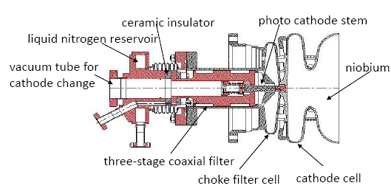
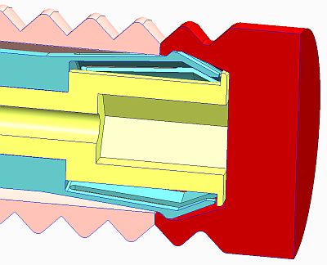
Gun1: Plug design. Have a compact plug to ease handling of cathodes in preparation and characterization systems.
Based on HZDR/ELBE design. Compatible with inserts for HZDR and U Wisconsin SRF guns.
Divide cap and stem, keep cap length < 10 mm.
After some iterations we have a mark1 design which was tested successfully at HZDR/ELBE SRF gun.
Mark1: Spring presses cap against base.
Next step: Model RF and thermal properties with MWS and ANSYS
mark1 -> HZB cap

Slide 12
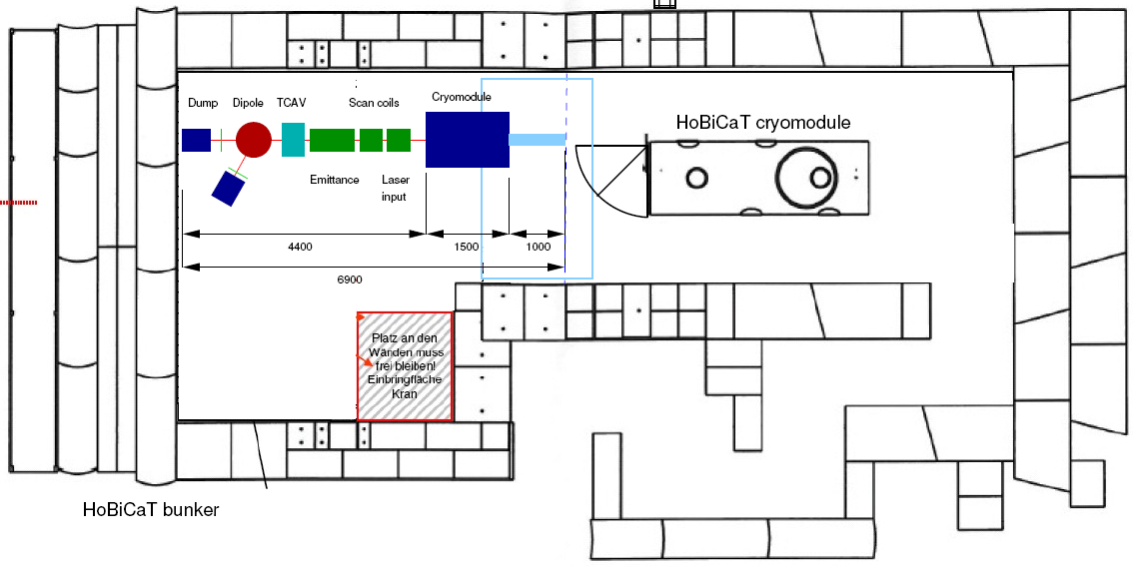
Gun1 (and later Gun2) will be commissioned above ground inside HoBiCaT bunker and new cryomodule → Gunlab
Study cathode/cavity interface and cathode lifetime issues, 6D phase space brightness and RF control of cavitiy.
Longer pulses and emittance compensation → slice diagnostics,
develop transverse RF deflector with TU Dortmund (Verbundforschung)

Slide 13
work done by T. Kamps, W. Anders, R. Barday, D. Böhlick, A. Frahm, M. Dirsat, F. Hoffmann A. Jankowiak, S. Klauke, J. Knobloch, O. Kugeler, J. Rudolph, A. Matveenko, A. Neumann, T. Quast, M. Schenk, M. Schuster, S. Schubert, J. Völker, P. Kneisel (JLAB), R. Nietubyc (NCBJ), J. Sekutowicz (DESY), J. Smedley (BNL), J. Teichert, P. Murcek, R. Xiang, A. Arnold (HZDR), V. Volkov (BINP), I. Will (MBI), T. Weis, A. Ferrarotto (TU Dortmund) supported by the Accelerator Physics and SRF institutes and Experimental Support groups at HZB. the Pb cathode work is supported by EuCARD. the TCAV work is supported by BMBF.

