Slide 1
Progress in CW-Timing Distribution for Future Light Sources
Russell Wilcox, Gang Huang,
Larry Doolittle, John Byrd
ICFA Workshop on Future light sources
March 7,2012

Slide 2
Outline
How the CW/RF system works
Timing requirements for NGLS
CW systems running and developing
Conclusions

Slide 3
One timing channel
Laser or klystron
receiver
transmitter
RF phase
detect,
correct
CW
laser
AM
d₂
FRM
fiber 1
FS
FRM
0.01C
Rb
lock
ω_{RF}
0.01C
optical
delay
sensing
fiber 2
ω_{FS}
d₁
Note: this is a synchronizer/controller, not just an RF clock delivery system
When controlling a low noise VCO, it contributes <10fs RMS (200m, 20 hours to 2kHz [loop BW])

Slide 4
Information flow in the receiver
signal
calibration
sig - ref
phase
shifter,
VCO
or
laser
transmission
fiber
reference
calibration
PI
error
FS
reference
interferometer
group/phase
factor
light
PI
phase information
optical
delay
correction
RF
delay
correction
All implemented digitally on an FPGA
Phase sensitivity <0.01º, thus 10fs for 3GHz

Slide 5
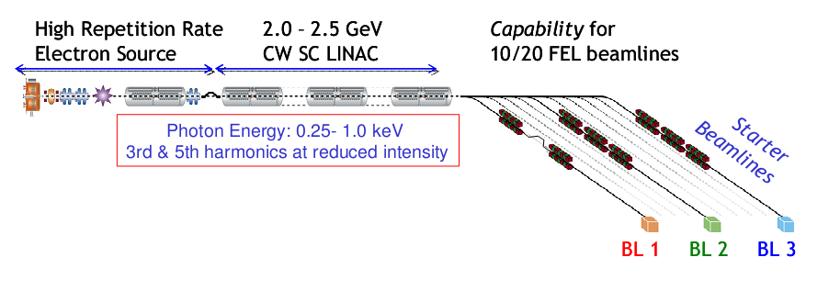
Next Generation Light Source
High repetition rate electron source
CW SC linac
Output photon properties
  100kHz FEL (seed and experiment lasers, diagnostics)
  Wavelength: 1 to 4nm
  Pulse width 200fs to 200as

Slide 6
Jitter Tolerances Estimated (CD0 Design)
L0
ϕ = ?
I_{pk} = 60 A
L1
ϕ = −28°
I_{pk} = 120 A
Lh
ϕ = 180°
L2
ϕ = −31°
I_{pk} = ?
L3
ϕ = +18°
I_{pk} = 600 A
CM1
CM2
3.9
CM3
CM9
CM10
CM30
GUN
1 MeV
Heater
70 MeV
R₅₆ = 4 mm
BC1
168 MeV
R₅₆ = 75 mm
BC2
640 MeV
R₅₆ = 48 mm
SPRDR
2.4 GeV
R₅₆ = 0
670 m
Gun Timing: 0.1ps
Bunch Charge: 2.0%
to spreader end
CD0 Jitter Tols:
1.8 GeV,
300 pC,
One BC only,
Gaussian input,
70-MeV start
“10/25/11” better?
L0 RF Phase: 0.050°
L1 RF Phase: 0.010°
Lh RF Phase: 0.100°
L2 RF Phase: 0.010°
L3 RF Phase: 0.010°
L0 RF Voltage 0.010%
L1 RF Voltage 0.010%
Lh RF Voltage 0.010%
L2 RF Voltage 0.010%
L3 RF Voltage 0.010%
Heater R₅₆: 1%
BC1 R₅₆: 0.005%
SPRDR 10fs

Slide 7
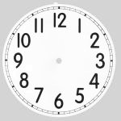
RF Control – 0.01%,0.01 deg at 1.3 GHz
Beam-based Feedback
Optical synchronization between arrival time and user lasers- ~1 fsec
Stabilized clock reference distribution - <10 fsec
GUN
1 MeV
Heater
70 MeV
BC2
640 MeV
L0
L1
Lh
BC1
168 MeV
L2
L3
SPREADER
2.4 GeV
BAT
CM1
CM2
3.9
CM3
CM9
CM10
CM30
ΔE
ΔE
Δσ_{τ}
Δσ_{τ}
ΔE_{τ}
Δt
User laser
SP
SP
SP
Master
NGLS timing system overall

Slide 8
High reprate enables better sync
Faster “beam-based” feedback
  Error terms are correctable up to ~100kHz with 1 MHz sampling
Faster averaging for slow but precise drift
  Keep as precision for long term

Slide 9
An integrated timing approach
modulator
FEL
experiment
power
amplifier
seed lasers
experiment
lasers
modelocked
oscillator
clock transmitter
TX
Control lasers to minimize high frequency jitter
Use final cross-correlator to correct for FEL and thermal slow drift

Slide 10
X-ray/optical cross-correlator example
Optically streaked photoelectron spectra
  From A. R. Maier, FEL 2011
  New J. Phys 13, 093024 (2011) (similar, longer pulse)
Runs next to experiment, but with special laser

Slide 11
Existing and developing CW systems
  Existing FERMI@ELETTRA LLRF system
  Existing LCLS user laser timing
  Developing SPX SCRF and user laser timing
  Developing 1fs sync in lab

Slide 12
Fermi@Elettra RF timing configuration
11 links now used (?), 32 possible
  Separate 3GHz system being replaced channel by channel

Slide 13
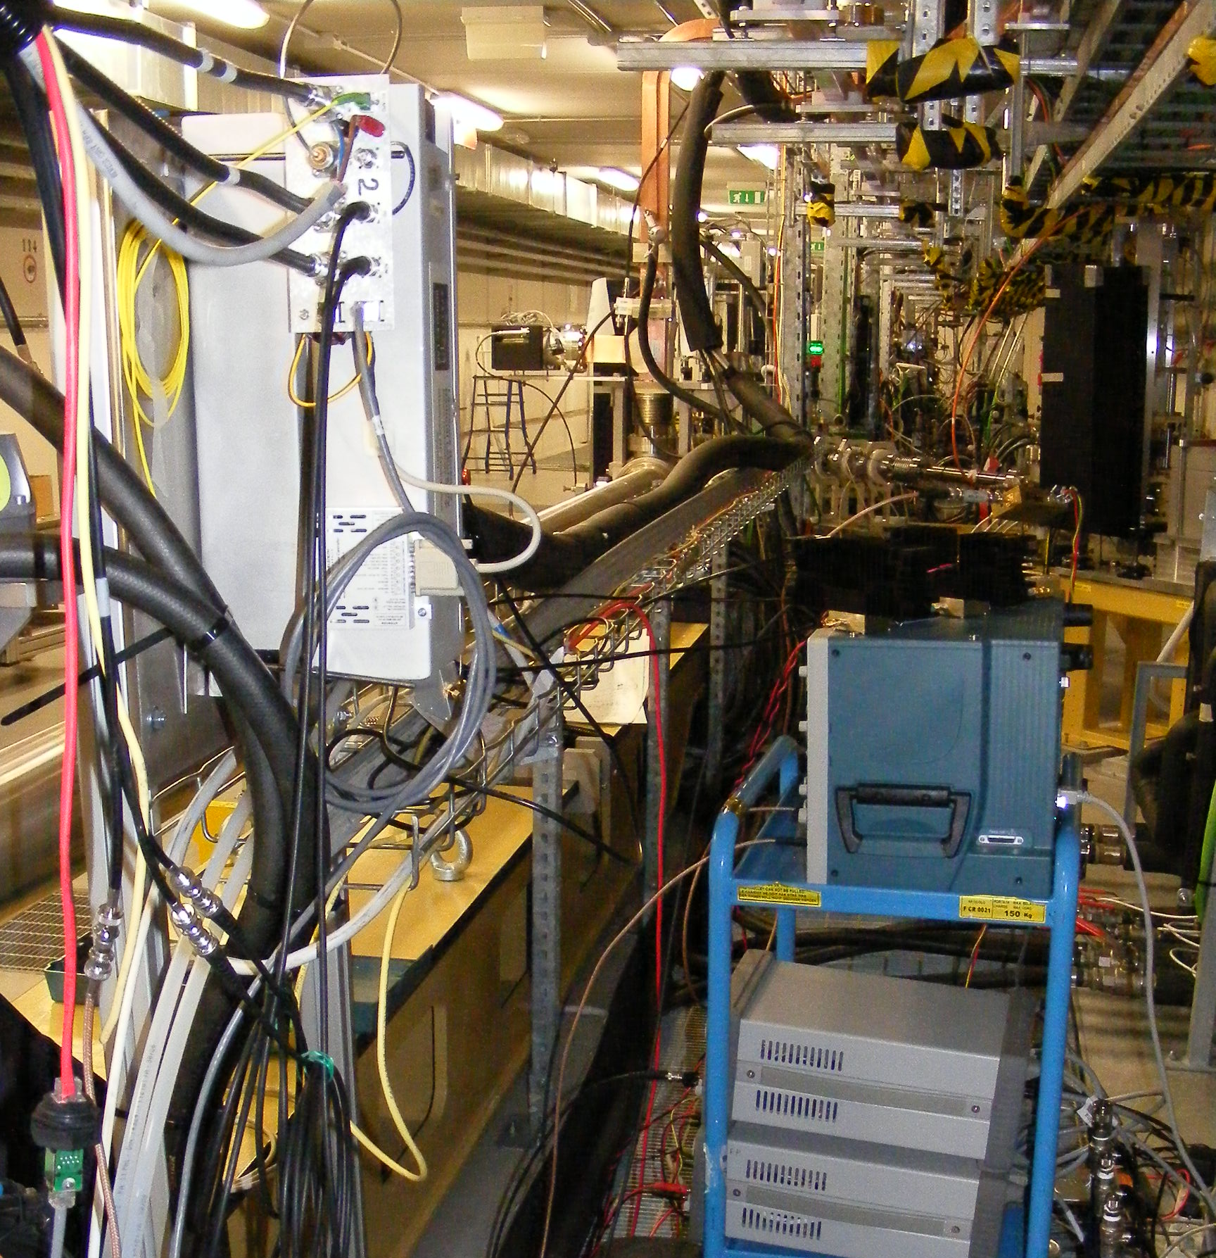
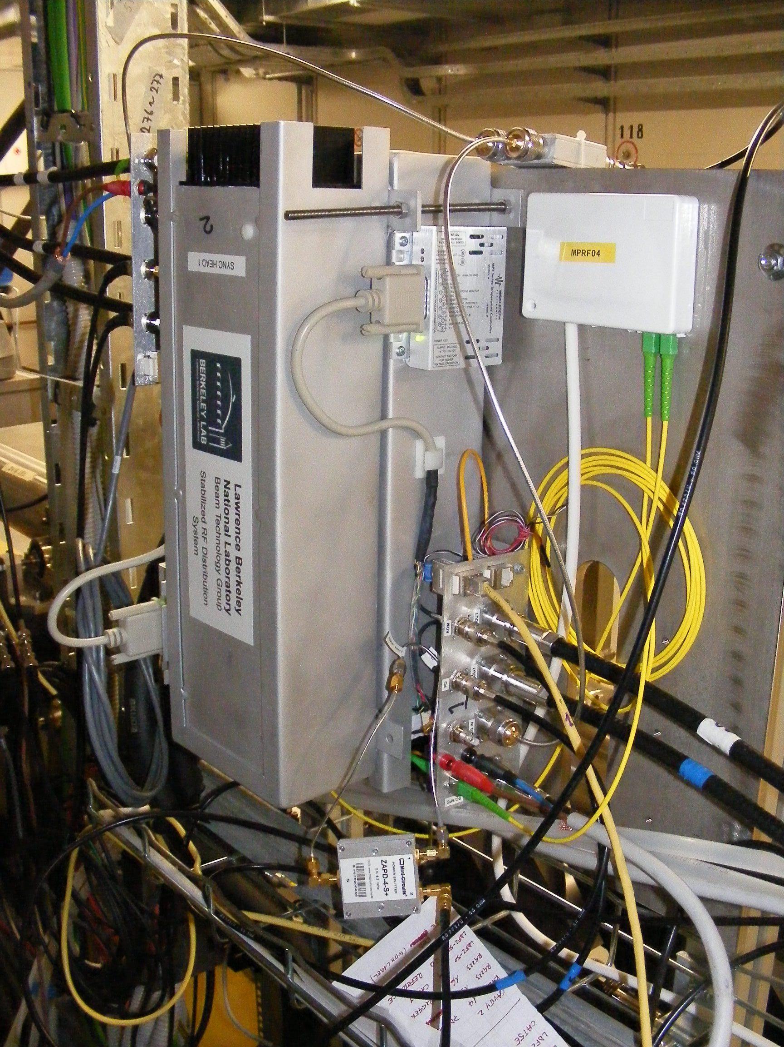
The Fermi transmitter is compact
Transmitter rack
Sync head In
accelerator
tunnel
sender

Slide 14
Fermi@Elettra results
Initial out-of-loop test showed 87fs RMS for controlling cavity
Final arrival time jitter due to many sync channels, may average
Electron bunch arrival time measurement
Drive KLY3 unstable
Mario. Ferianis, FEL 2011
All-optical femtosecond timing system
for the Fermi@Elettra FEL

Slide 15
LCLS laser timing configuration
linac
undulator
bunch
arrival
monitor
AMO
SXR
XPP
CXI
MEC
laser
laser
laser
laser
laser
NEH
laser
room
timing
TX
System has 16 channel capability, 6 used
Typical 300m fibers, 10ps correction (thermal)

Slide 16
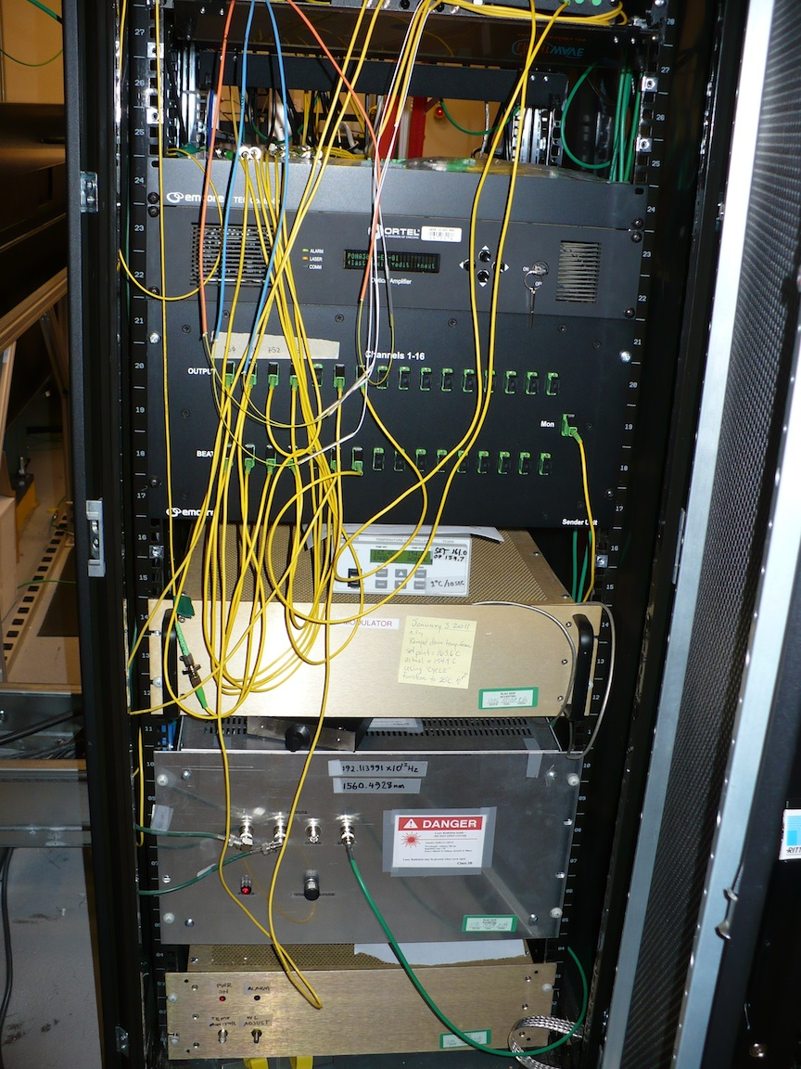
16 channel transmitter fits in a rack
Amplifier and splitter (“sender”)
Modulator
Wavelength locker
CW laser
Transmitter is simple
  All smarts are in RX
“Sender” has only EDFA, local ref arms

Slide 17
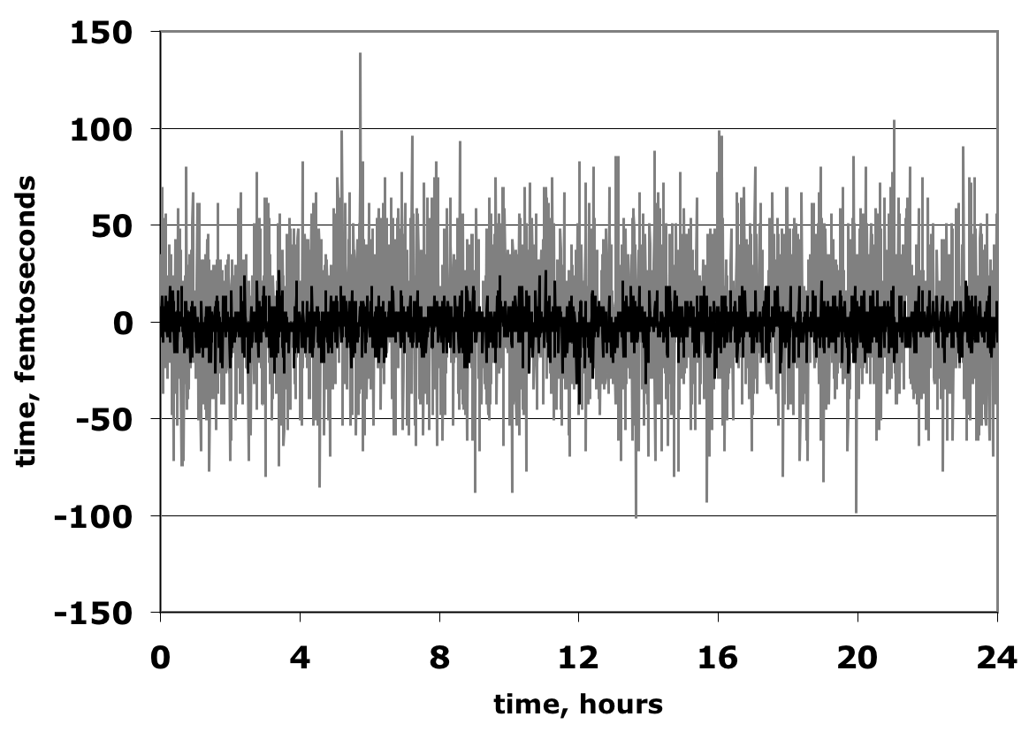
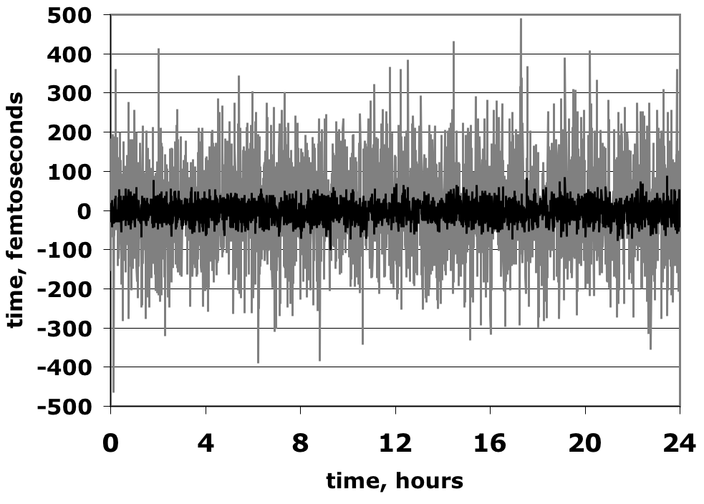
In-loop LCLS jitter
Phase shifter loop (reference)
Laser loop (to experiment)
125kHz BW (gray): 31fs RMS
1kHz BW (black): 8fs RMS
125kHz BW (gray): 120fs RMS
1kHz BW (black): 25fs RMS
When controlling a nice RF phase shifter, performance is better than with lasers
In-loop laser jitter a good indication of experimental jitter

Slide 18
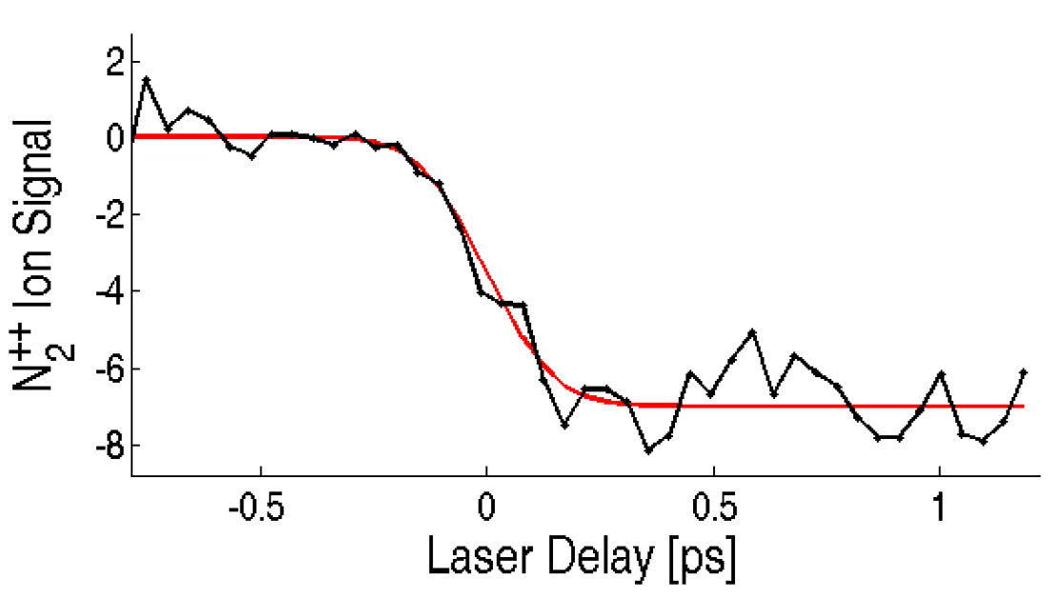
LCLS experimental (out-of-loop) jitter
Optically streaked photoelectrons from Ne
Ionization of N2
60fs RMS
120fs RMS
J. M. Glownia et al, Opt. Exp. 18, 17620 (2011)
delay, fs
Andreas Maier, at SLAC Oct. 2011,
also New J. Phys. 13, 093024 (2011)
Variability probably due to readjustment of laser

Slide 19
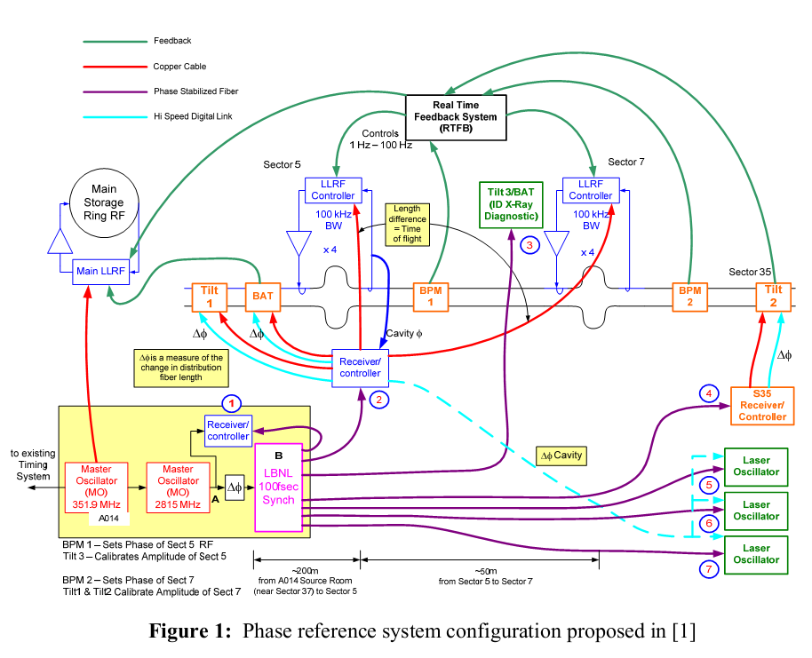
SPX at APS proposed configuration
F. Lenkszus, “Phase Reference Distribution for SPX – Notes for Discussion”, APS Internal
Note, Jan 2011.

Slide 20
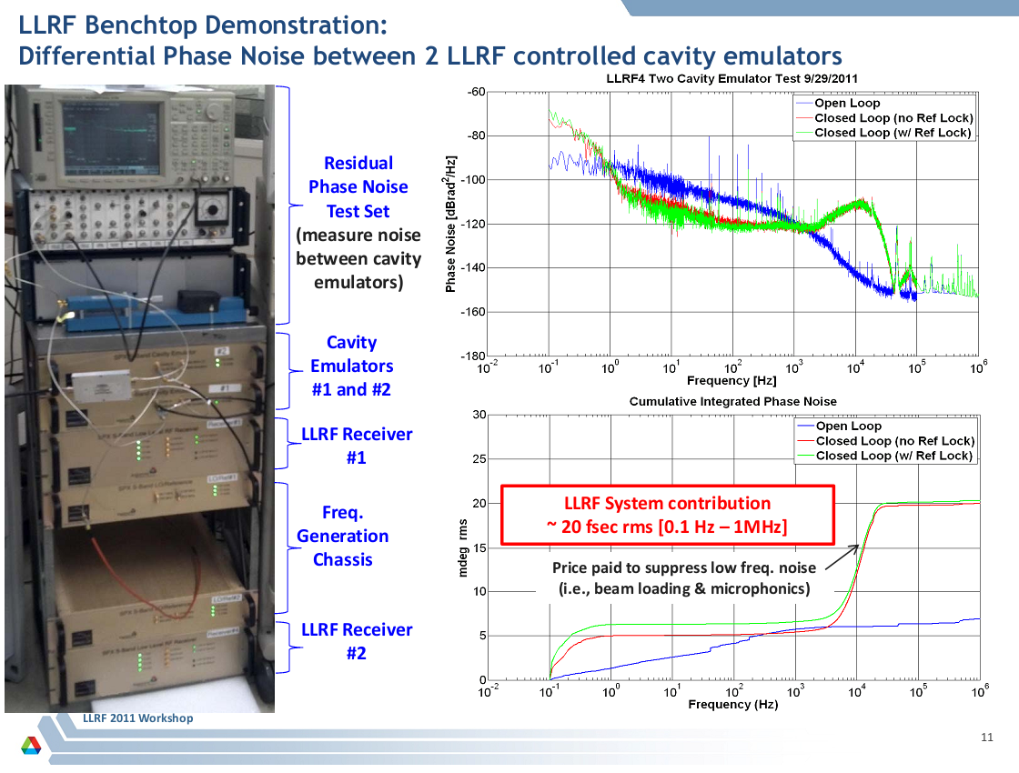
Current SPX LLRF system results

Slide 21
Some conclusions from experience
Failures, out-of-spec performance due to ancillary systems
A good interface is essential
Most jitter due to laser (LCLS)

Slide 22
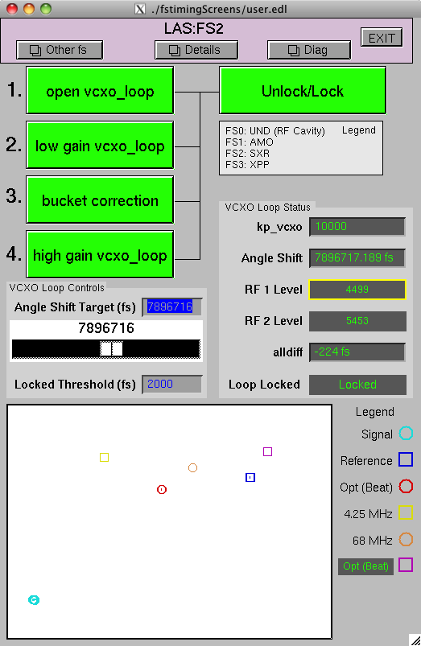
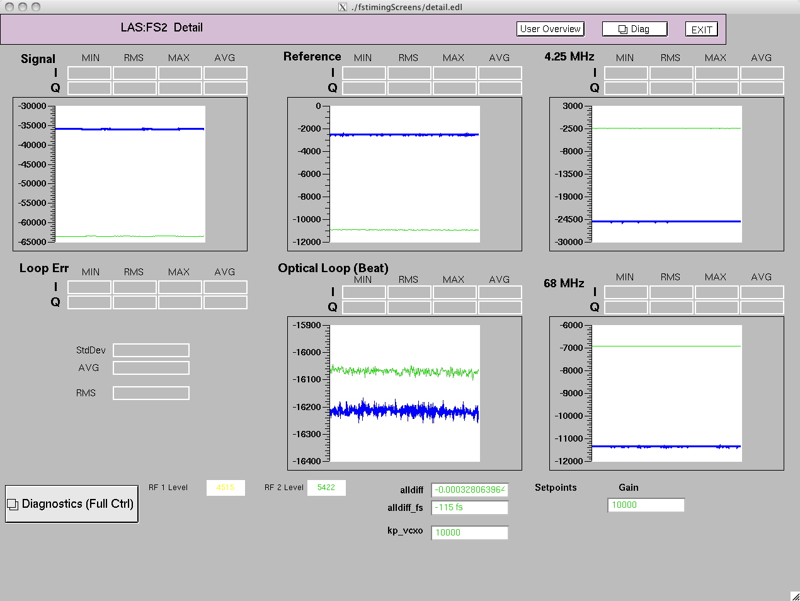
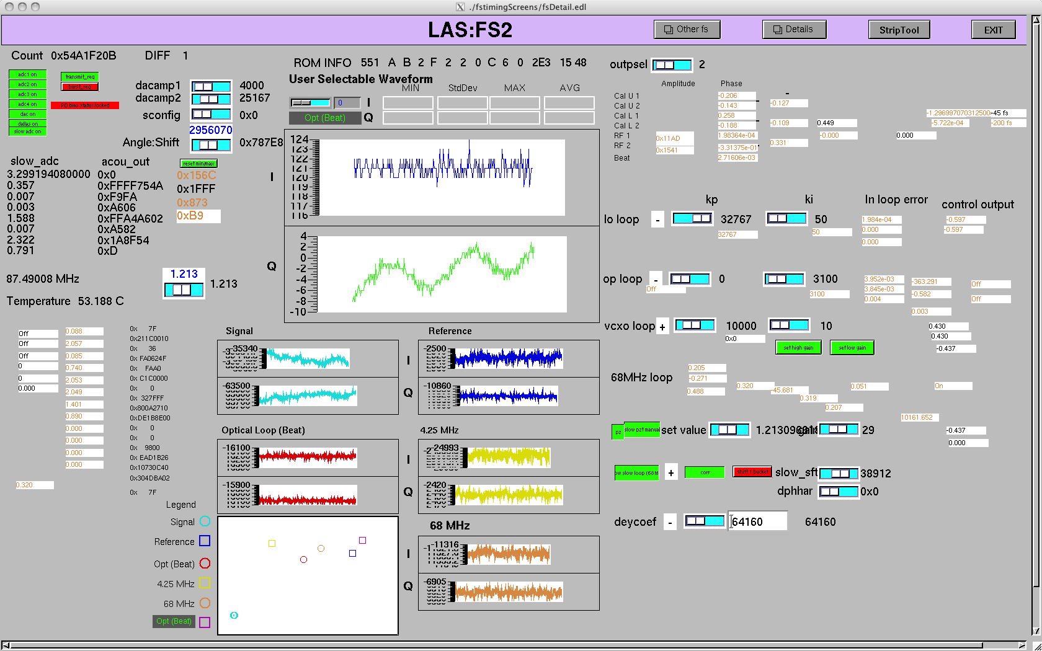
LCLS user and maintenance interfaces
Prevent failures due to operator error
Enable quick parameter check for maintenance

Slide 23
Our laser jitter studies at LCLS
free run
locked
reference
Single side band phase noise measurement
At the ~2kHz resonance, gain <1 to avoid oscillation
This limits noise suppression at lower frequencies
  Where most of the jitter comes from
Look for mechanical resonances, acoustic noise

Slide 24
Our laser jitter studies at LBNL
Modelocked fiber laser tuned with piezo mirror
Laser control loop pinged with step
Transfer function analyzed
Compensation added to loop gain
This should allow for higher gain, lower noise

Slide 25
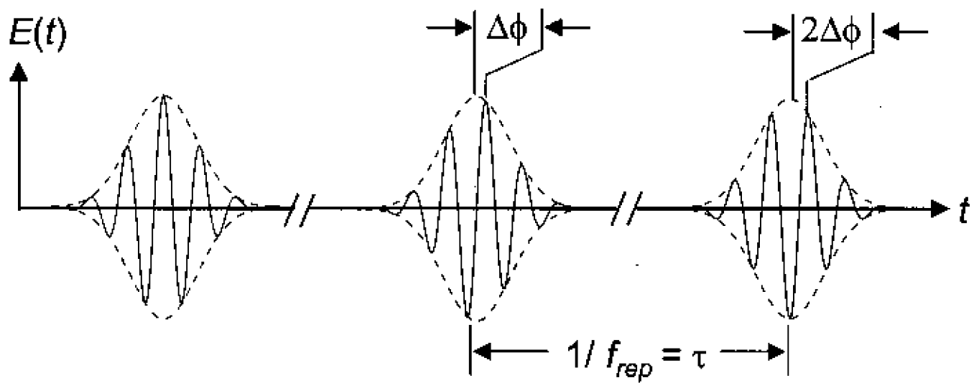
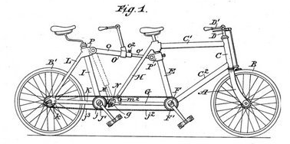
Syncing CEP-stable laser to carrier
comb1
line
picker
line
TX
line
RX
hetero-
dyne
comb2
reprate
Envelope is locked to carrier, transmit single frequency, beat with carrier to get error signal
  Wilcox et al, J. Modern Opt. 58, 1460 (2011)
Like chain and sprockets
We are using the full optical bandwidth

Slide 26
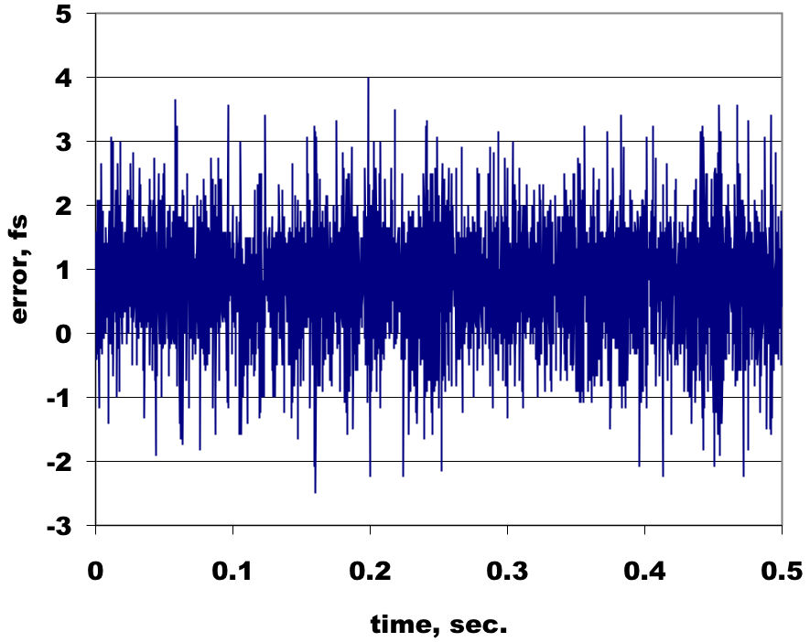
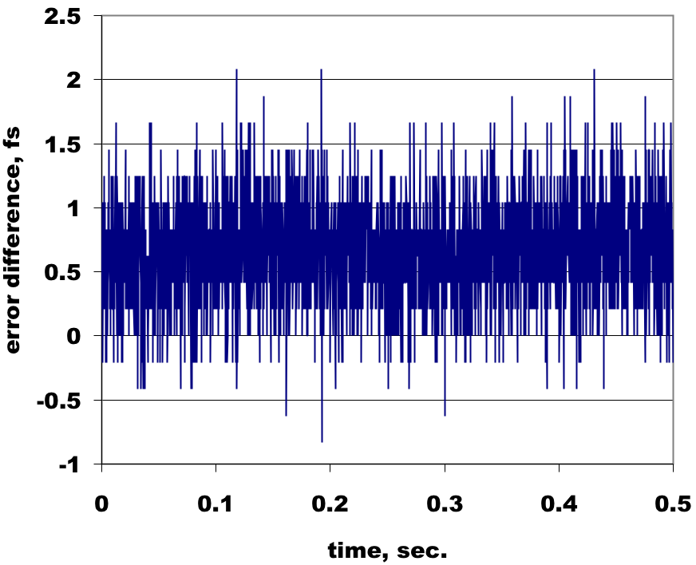
Line picker/transmission experiment
stability B
ML
+FS
÷5
interferometer
controller
stability A
-FS
PI amp
VCO
0.95fs RMS
(picking)
100m
CW
FS
1550nm fiber lasers
No attempt to stabilize long term
Transmission = 0.41fs RMS
(B-A)

Slide 27
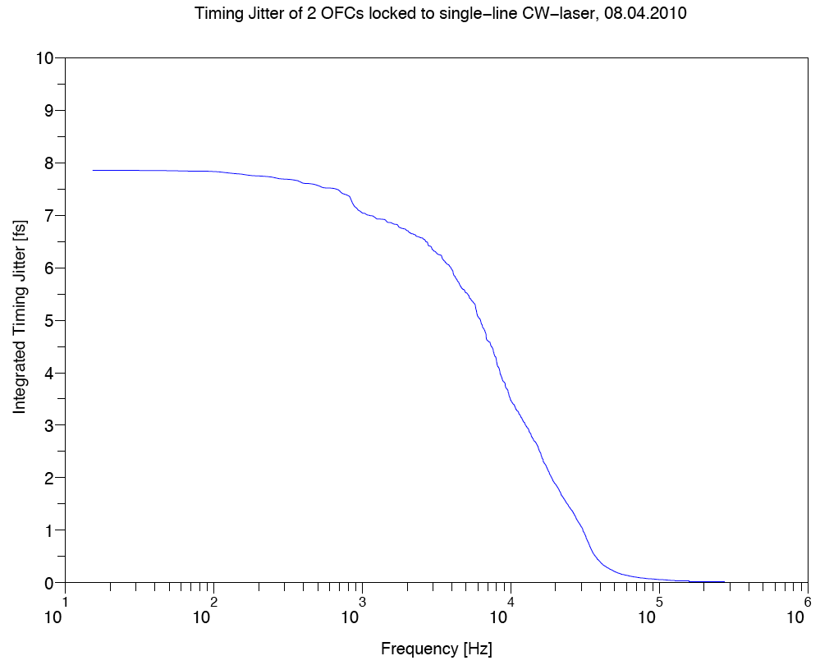
Laser sync experiment with Menlo
Experiment done at Menlo Systems:
<8fs integrated jitter
hetero-
dyne
comb1
EO modulator BW
CW
reprate
control
cross-correlator
comb2
hetero-
dyne
current piezo BW
Erbium doped fiber laser used here
By adding an EO phase modulator in the cavity, control BW can increase, cut jitter to ~1fs
Previous experiments (e.g. Opt. Lett. 28, 663 (2003)) have shown ~1fs jitter with similar schemes, Ti/Sapphire laser used here

Slide 28
Interferometer noise is small
Length sensor for our 3GHz system
Can track 10ns time shift within bandwidth
  Impervious to all but fast, hard shocks to fiber
1.4fs, unlocked
52as, locked

Slide 29
Conclusions
We currently have two timing systems in operation in FEL facilities, and another in development for a storage ring
Using operational experience, we are both improving the existing systems and designing the next one for the NGLS
To meet new NGLS requirements, we are developing a ~1fs laser sync system

