Slide 1

Radiation Monitoring at the
Undulator System
Heinz-Dieter Nuhn – LCLS Undulator Group Leader
Presented at
Wednesday, March 7, 2012

Slide 2
LCLS Undulator Radiation Damage
Magnet Damage Experiment T-493 at SLAC
LCLS TLD Radiation Dose Monitoring
LCLS Undulator Damage Monitoring

Slide 3
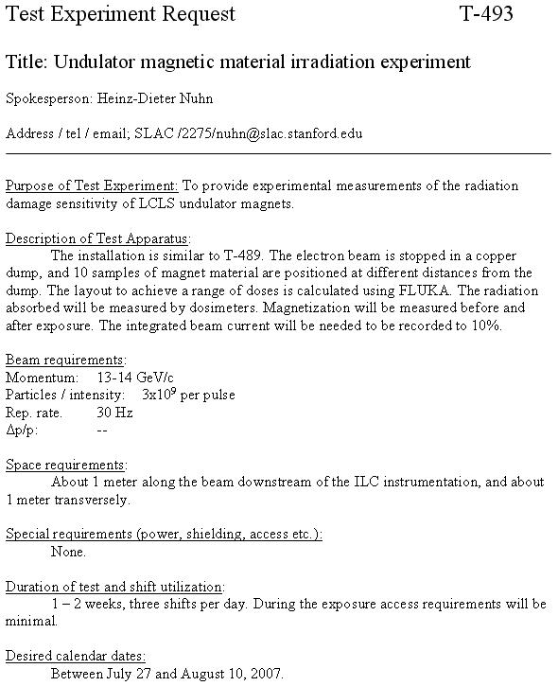
LCLS Undulator Irradiation Experiment (T-493)
The LCLS electron beam is stopped in a copper dump, and 9 samples of magnet material are positioned at different distances from the dump.
The layout to get a range of doses is calculated with FLUKA.
The absorbed radiation will be measured by dosimeters.
Magnetization will be measured before and after exposure.
The integrated beam current will need to be recorded to 10% accuracy.
July/August 2007

Slide 4
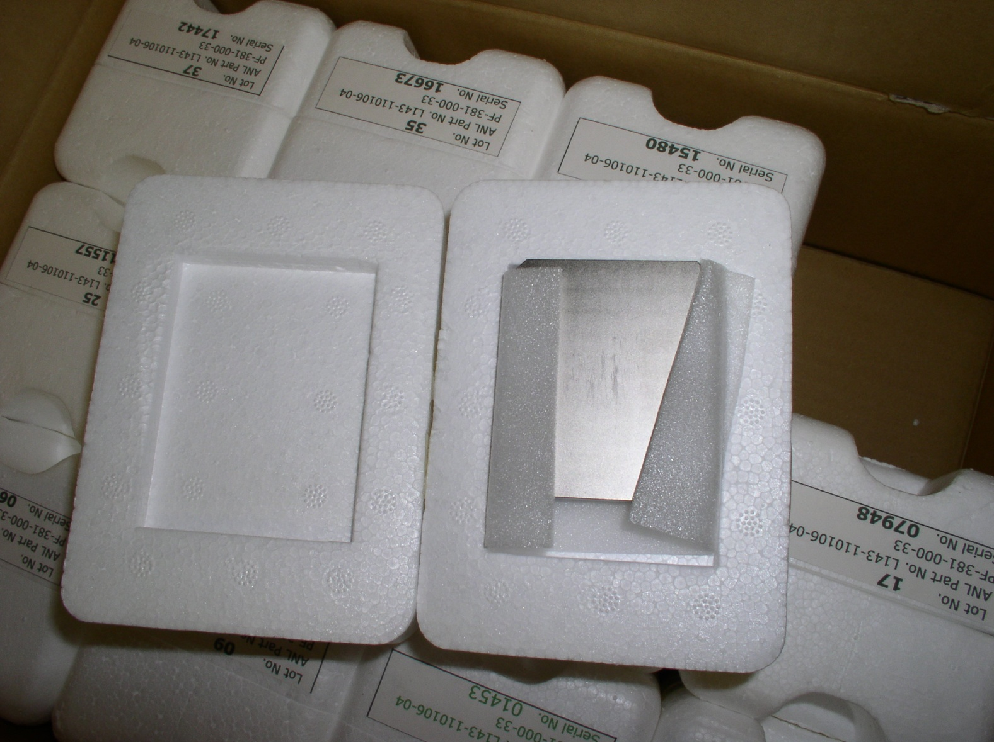
Use 12 Spare LCLS Undulator Magnet Blocks
Material: Ne₂Fe₁₄B
Manufacturer: Shin-Etsu
Type: N32SH
B_{r}: 1.23-1.29 T
H_{ci}: 21 kOe
H_{cb}: 11.6 kOe
Block Thickness: 9 mm
Block Height: 56.5 mm
Block Width: 66 mm
Material Density: 7.4 g/cm³
Block Volume: 33.6 cm³
Block Mass: 248.4 g
Curie Point: 310 °C
Photo courtesy of S. Anderson

Slide 5
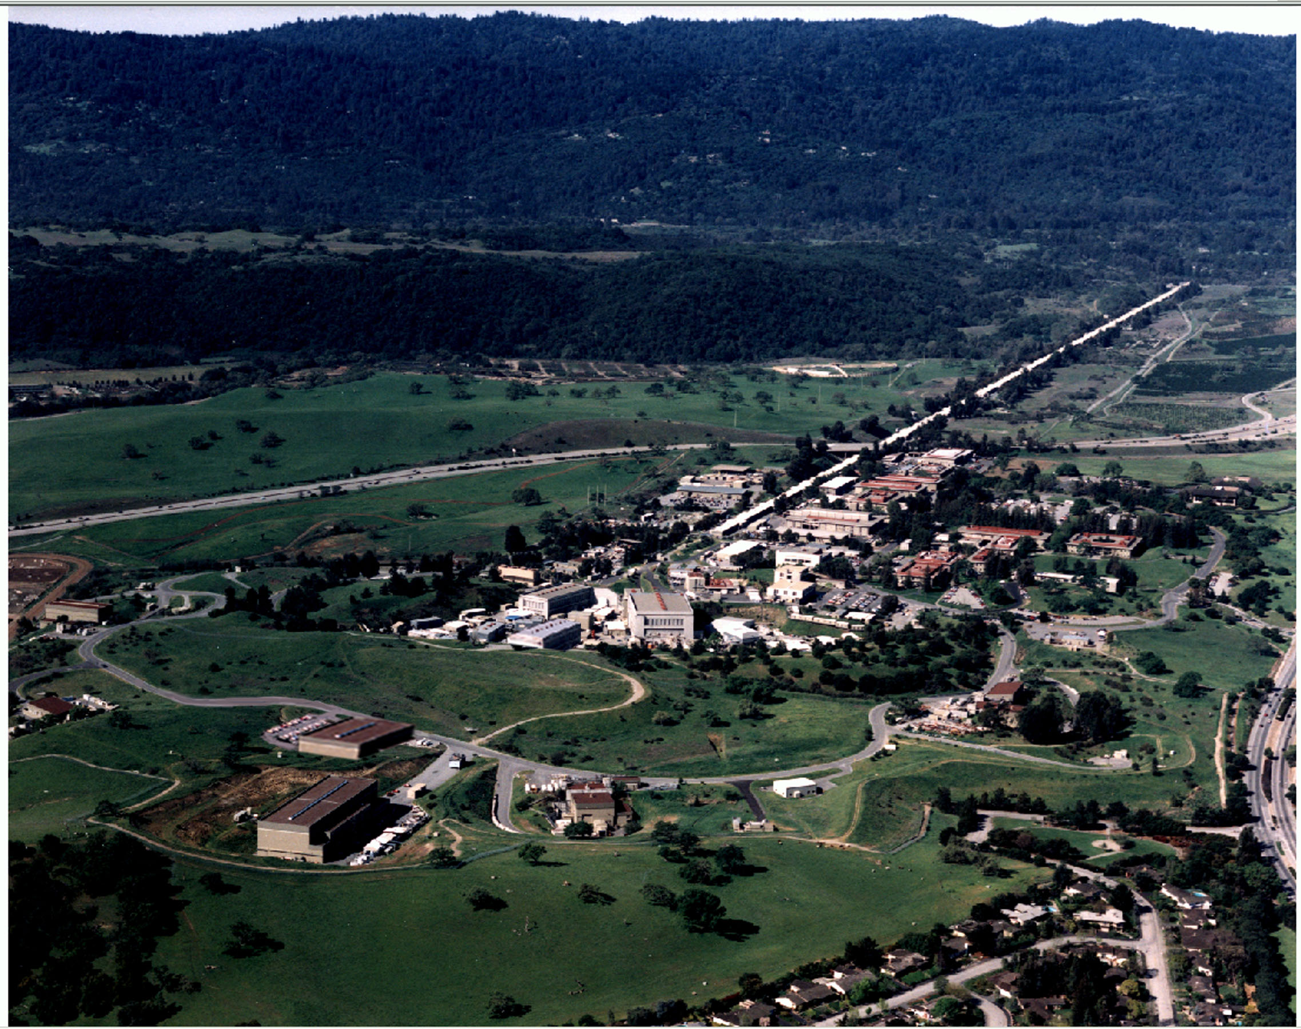
Linac Coherent Light Source
SLAC LINAC
Injector
T-493
Endstation A
Undulator Tunnel
Near Hall
Far Hall

Slide 6
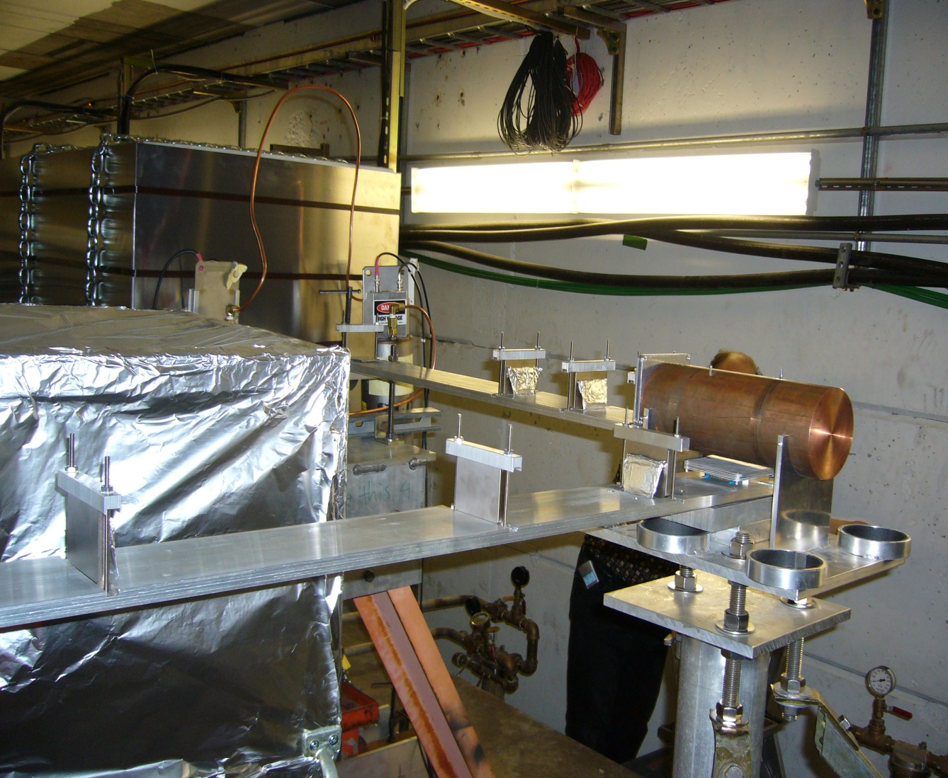
T-493 Components installed in ESA Beamline
ESA Beamline with copper cylinder and magnet blocks.
BEAM
Photo courtesy of J. Bauer

Slide 7
Magnet Block Assembly (Top View)
Top View
M9
Magnet Blocks
M8
4 Magnet blocks in forward direction
5 Magnet blocks in transverse direction
M7
Copper Cylinder
Heat Shield
M6
r
Beam Direction
z
M5
M1
M2
M3
M4

Slide 8
Magnet Block Assembly (View in Beam Directions)
Copper Cylinder
View in Beam Direction
M9
M8
M7
M1-M4
M6
y
M5
r
Heat Shield
Magnet Blocks

Slide 9
Magnet Block Utilization
The magnetic moments of all twelve blocks have been measured.
Nine blocks were mounted next to the beam and have been irradiated.
Three blocks have been kept in the magnet measurement lab as reference.
j | Serial No. | r | z
 |  | [cm] | [cm]
1 | 06950 | 0 | 27
2 | 17442 | 0 | 40
3 | 04222 | 0 | 55
4 | 11557 | 0 | 101
5 | 10898 | 7 | 12
6 | 08716 | 24.9 | 12
7 | 01453 | 50.4 | 12
8 | 00659 | 88.4 | 12
9 | 07948 | 149.4 | 12
10 | 14744 | - | - | reference
11 | 15480 | - | - | reference
12 | 16673 | - | - | reference

Slide 10
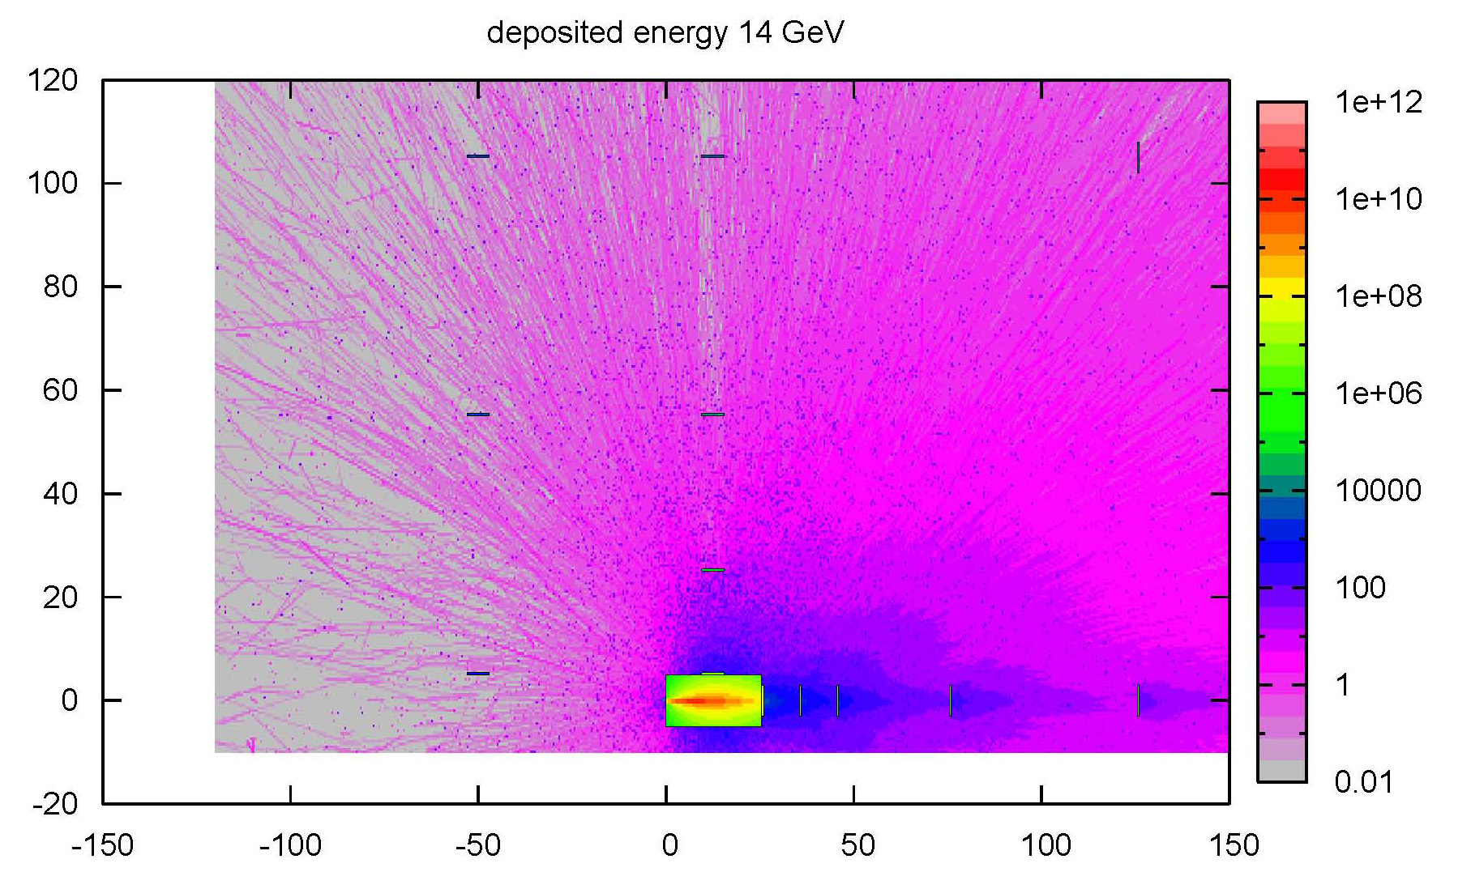
Predicted Deposited Power [Gy g/cm³] after receiving 57 Pe
Magnet Block Locations in Simulation.
NOT identical to mounting location
FLUKA Simulations by J. Bauer

Slide 11
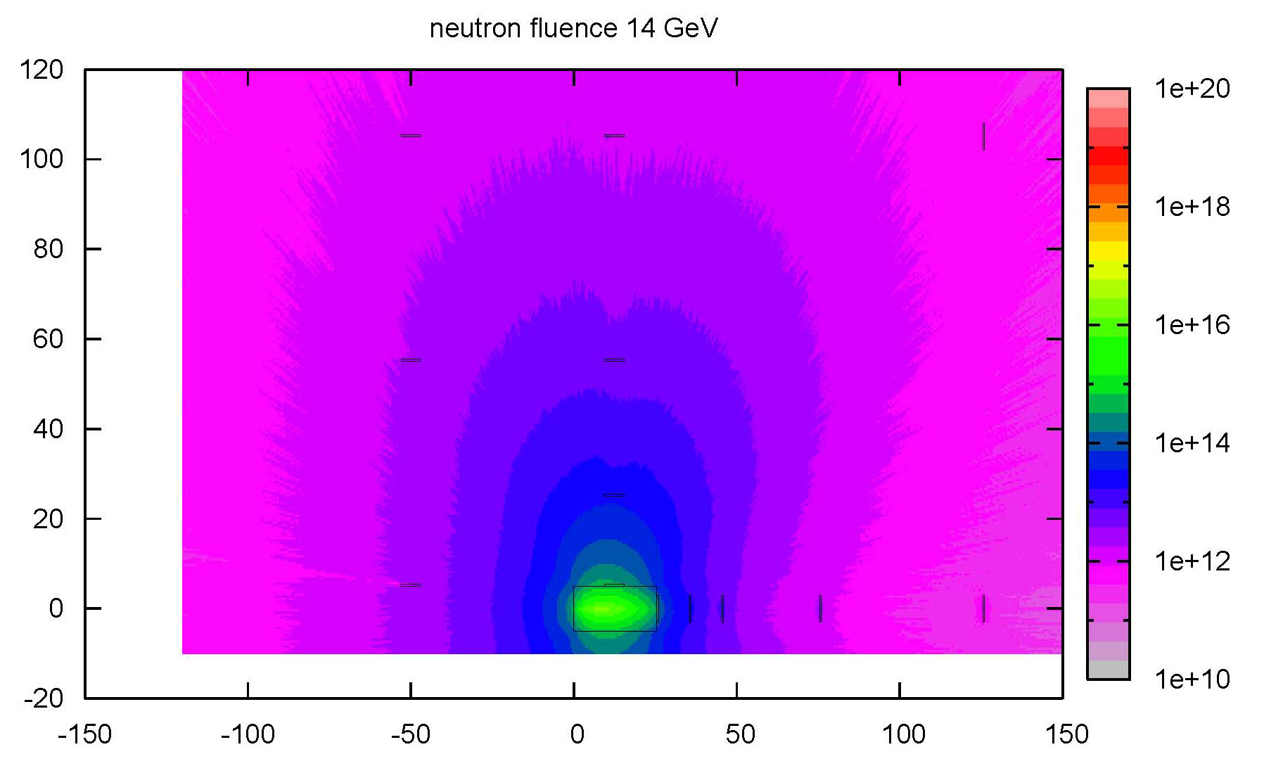
Predicted Neutron Fluence [n/cm2] after receiving 57 Pe
cm
Magnet Block Locations in Simulation.
NOT identical to mounting location
cm
FLUKA Simulations by J. Bauer

Slide 12
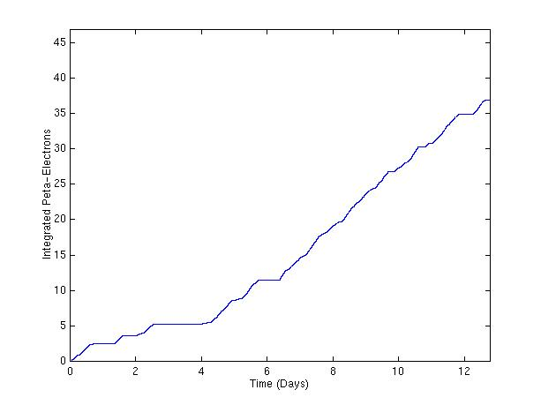
Number of Electrons Delivered to Copper Block
Integrated electron number in units of 10¹⁵ electrons (Peta-Electrons)
Magnet Irradiation Experiment T-493 ran for 38 shifts from 7/27-8/09/2007

Slide 13
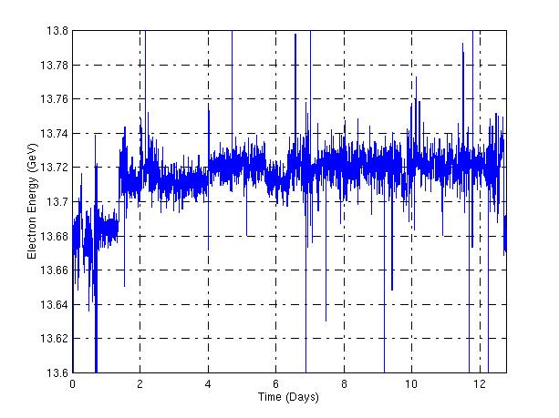
Measured Electron Energy

Slide 14
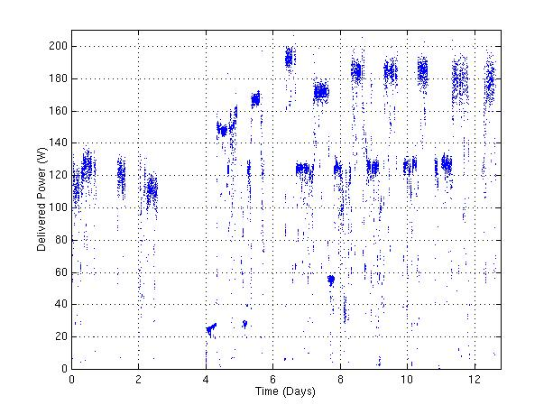
Delivered Power
Delivered power levels alternated between about 125 W during Day and Swing Shifts and 185 W during Owl Shifts.
During Day and Swing Shifts the experiment ran parasitically with LCLS commissioning.

Slide 15
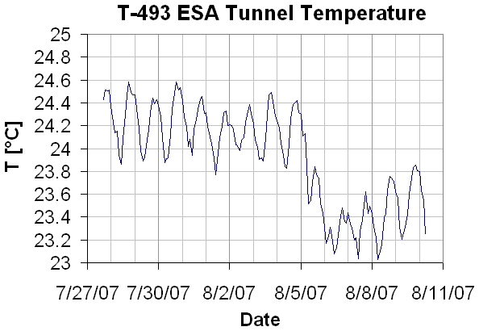
Tunnel Temperature Profile
The temperature in the ESA tunnel stayed between 23-24.6°C during the entire 12-day data collection period.
The plot shows diurnal cycle fluctuations. Energy deposited in the blocks was insufficient for significant average temperature increase.

Slide 16
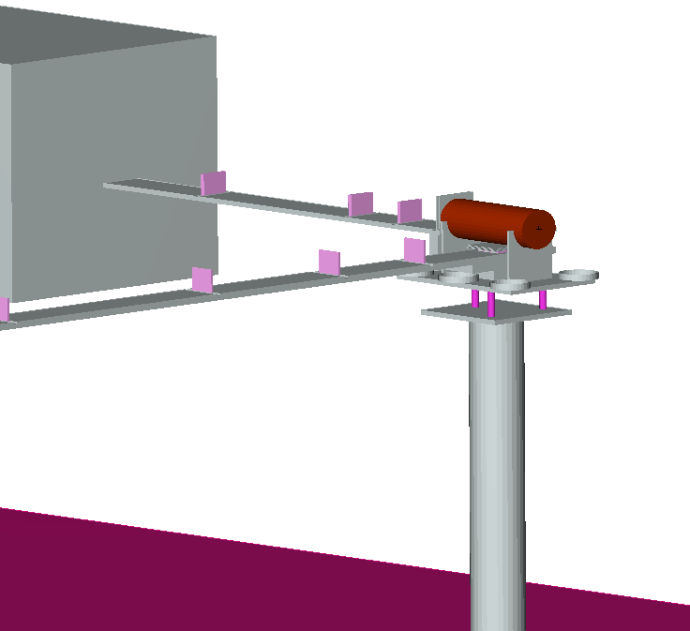

Detailed FLUKA model of the experiment
13.7 GeV electron beam impinging on the copper dump
Computation of total dose, electromagnetic dose, neutron energy spectra
Quantity scored using a binning identical to the one used for the mapping of the magnetization loss
M4
M3
M2
M1
Beam
M6
M5
M8
M7
M9
Courtesy of J. Vollaire

Slide 17
Integrated Dose Calculation
 | r | z | Dose | Dose | non EM Dose | Neutron Fluence | Demag. | Demag/Dose | Demag/Flu
 | [cm] | [cm] | [kJ] | [kGy] | [J] | [10¹³ cm⁻²] | [%] | [%/kJ] | [%/(10¹³ cm⁻²)]
Mag1 | 0 | 27 | 163 | 658 | 114 | 6.27 | 9.675 | 0.0592 | 1.54
Mag2 | 0 | 40 | 56.6 | 228 | 46.9 | 1.29 | 2.804 | 0.0495 | 2.17
Mag3 | 0 | 56 | 26.8 | 108 | 24.6 | 0.529 | 1.166 | 0.0435 | 2.20
Mag4 | 0 | 101 | 7.29 | 29.4 | 9.55 | 0.205 | 0.386 | 0.0529 | 1.88
Mag5 | 7 | 12 |  |  |  |  | 4.889
Mag6 | 24.9 | 12 |  |  |  |  | 0.329
Mag7 | 50.4 | 12 |  |  |  |  | 0.013
Mag8 | 88.4 | 12 |  |  |  |  | -0.003
Mag9 | 149 | 12 |  |  |  |  | -0.023
Dump |  |  | 76,600

Slide 18
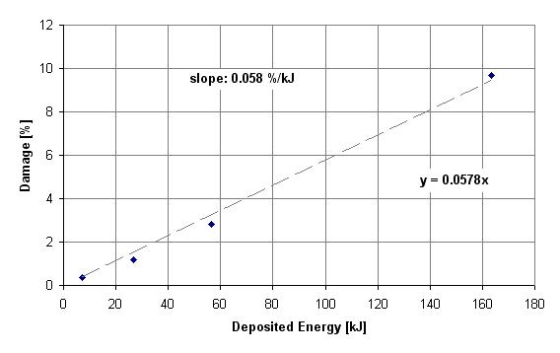
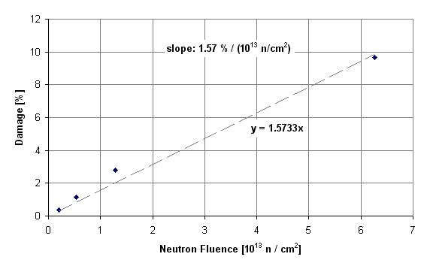
Damage Gradients
M1
M1
M2
M2
M4
M3
M4
M3
Threshold Estimates for 0.01 % Damage
Source | Deposited Energy | Dose | Dose | Neutron Fluence
T-493 | 0.17 kJ | 0.70 kGy | 0.070 MRad | 0.64×10¹¹ n/cm²
Threshold Estimates for 1 % Damage
Source | Deposited Energy | Dose | Dose | Neutron Fluence
T-493 | 17 MJ | 70 kGy | 7 MRad | 6.4×10¹² n/cm²
FLASH Experimental Result: 20 kGy cause 1% Damage

Slide 19
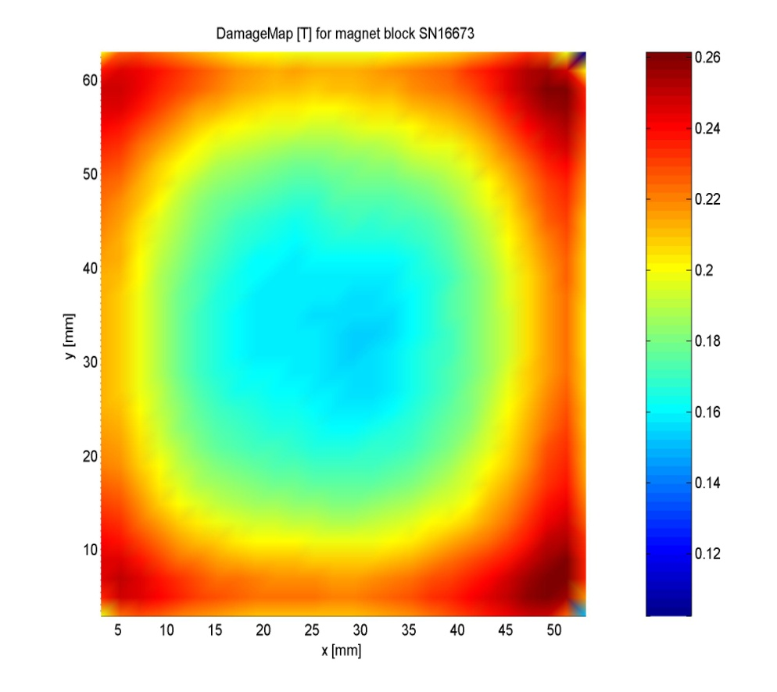
Field Map Measurements
Grid Size: 26 x 31 Points = 806 Points; Point Spacing: 2 mm; Method: Hall Probe
Reference Magnet SN16673

Slide 20
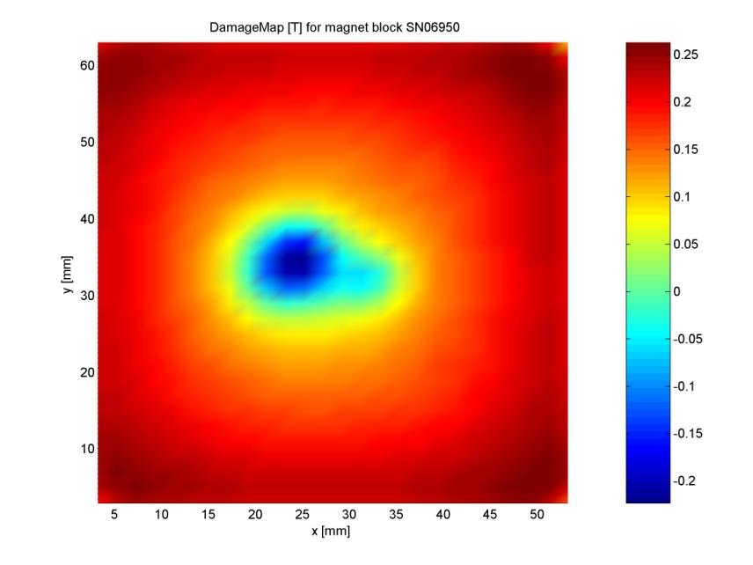
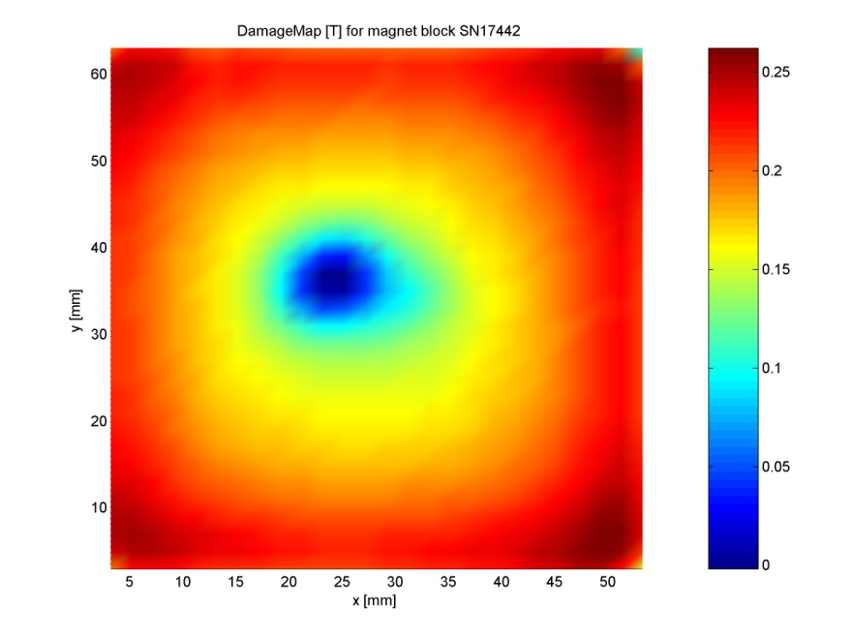
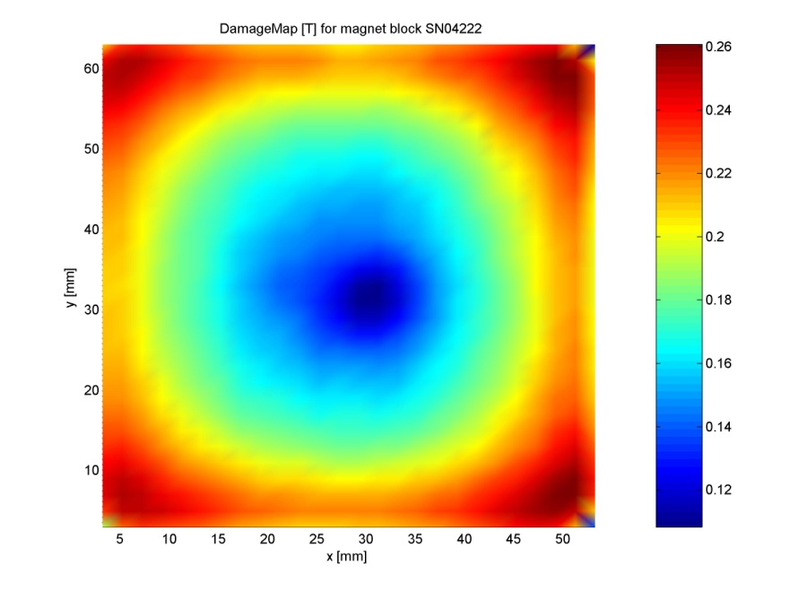
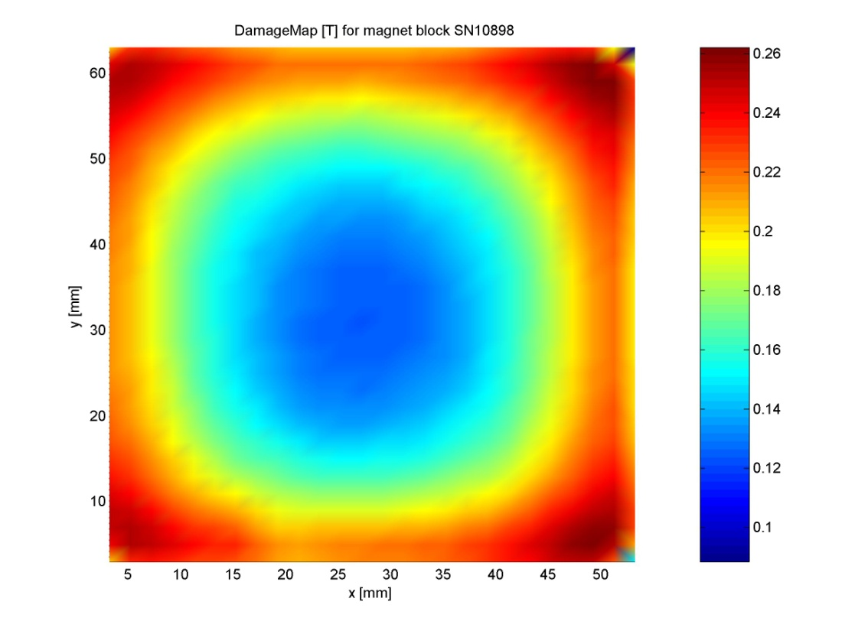
Field Map Measurements for M1
M1
M2
M3
M5

Slide 21
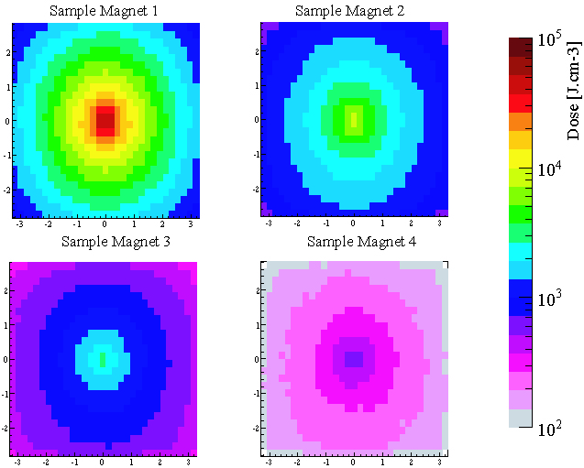
Dose Mapping for the 4 Downstream Samples
Courtesy of J. Vollaire

Slide 22
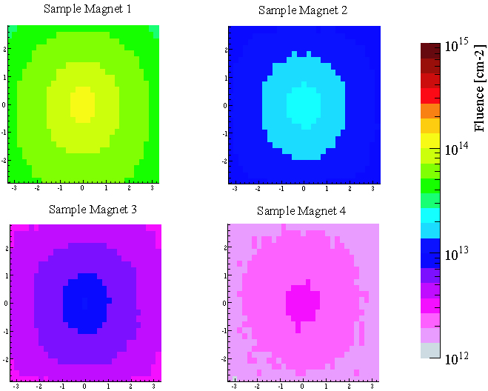
Neutron Fluence Mapping for the 4 Downstream Samples
Courtesy of J. Vollaire

Slide 23
TLD Monitoring Results Jan 2009
Before Installation of First Undulator On Girder
[Rad]
On Top of
Slide Motor 1
Outside of Undulator
Storage Box
Evidence for Beam
Loss Event

Slide 24
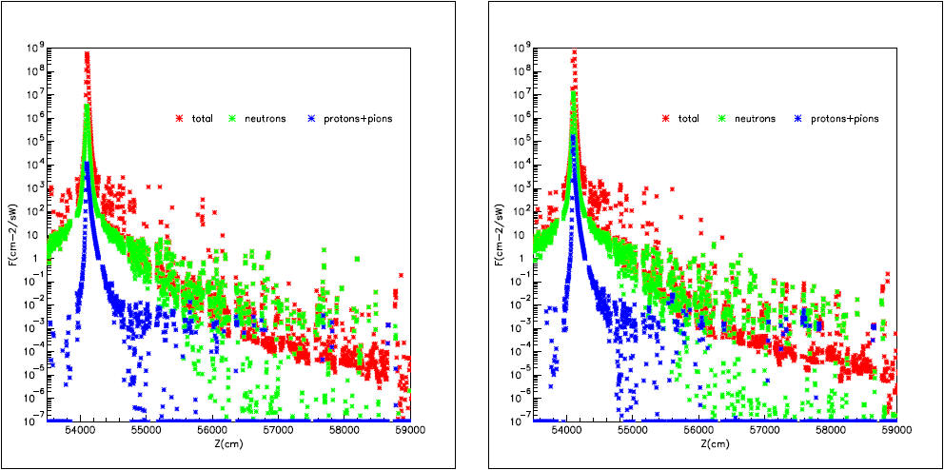
Top Chamber Hit (Z=540.89 m; y’ = 465 µrad)
FLUKA SIMULATIONS
Fluences in Top Magnets
Fluences in Bottom Magnets
Courtesy of Mario Santana

Slide 25
LCLS Undulator Rad. Protection and Monitoring
Phase space reduction (6D) of the linac beam using collimation system
RFBPM based trajectory monitoring keeps beam center within 1-mm radius relative to chamber center
Beam Loss monitors catch unexpected radiation events, quickly
TLD program monitors long-time exposure
Periodic undulator measurements for early damage detection
No further beam losses observed

Slide 26
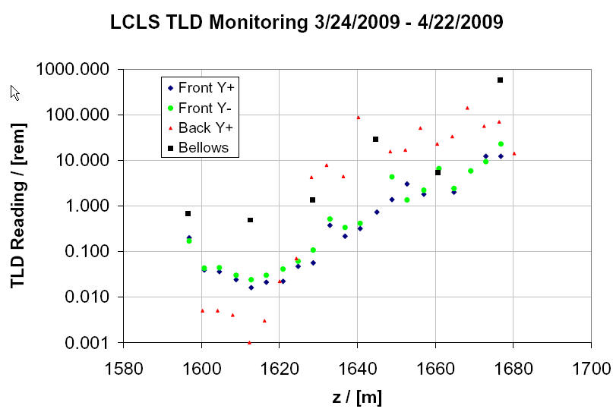
Dose During Initial FEL Operation
[rad]
e-folding length 8.7 m
Girders 13-33
Increased TLD Readings are predominantly low energy synchrotron radiation, not to cause significant magnet damage

Slide 27
Damage Mechanisms
Damage is expected to be caused by neutrons and hadrons that are predominantly generated inside the magnet blocks, themselves, from high energy (MeV) photons.
See for instance
Asano et al., “Analyses of the factors for the demagnetization of permanent magnets caused by high-energy electron irradiation.” J. Synchrotron Rad. (2009) 16, 317-324
Since neutrons and hadrons are not detectable outside of the magnets, radiation monitoring focuses on high energy photons.

Slide 28
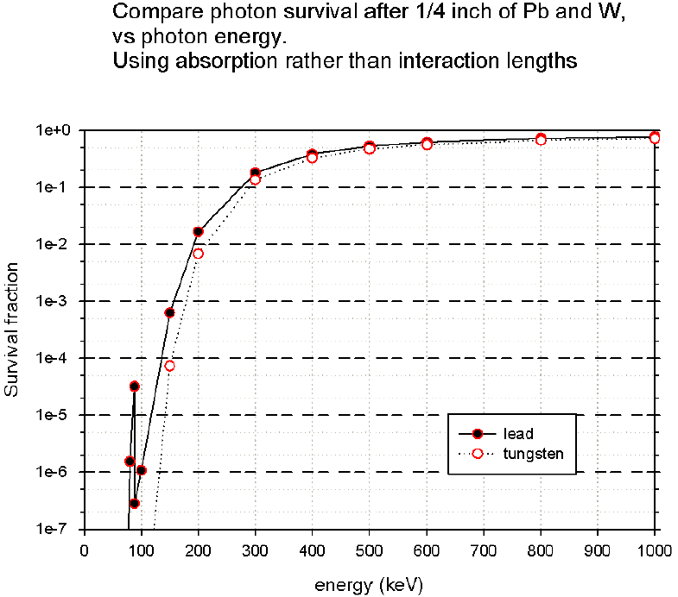
Use Pb to Filter Low Energy SR Component
Actually used: 1.6 mm

Slide 29
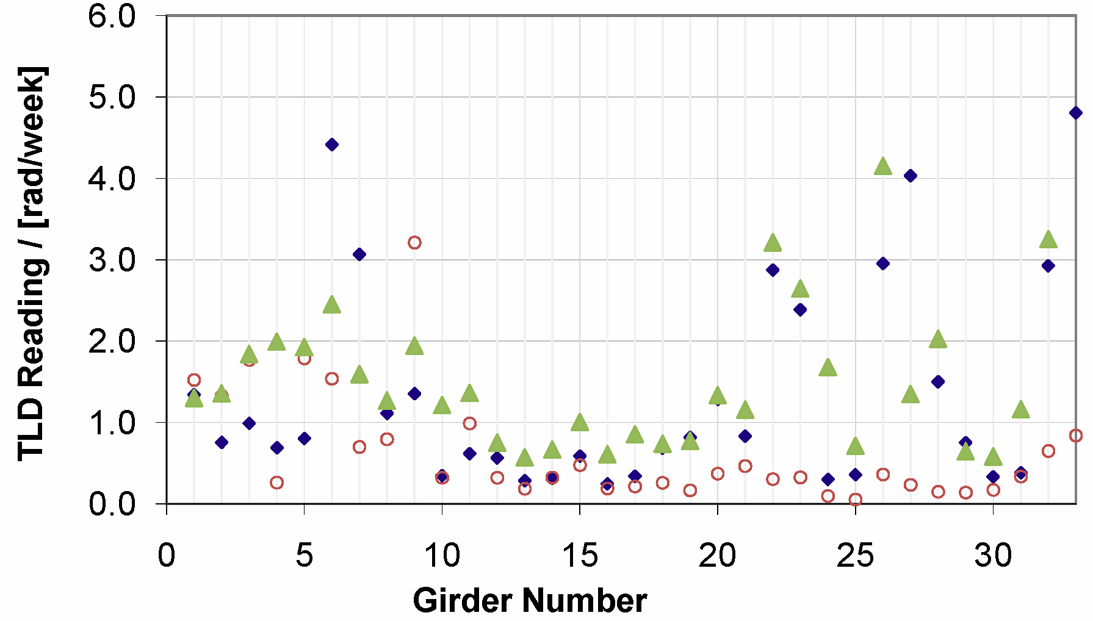
2010 Girder Radiation Monitoring
3/16/2010 – 5/26/2010
5/26/2010 – 9/24/2010
9/24/2010 – 1/19/2011
Thermo-Luminescent Dosimeters
Each TLD mounted in 1.6-mm thick Pb-casing to suppress photons below ~200 keV
External neutron doses are very small: (U01: 0.04-0.05 rad/week; U33: ~0 rad/week)
LCLS radiation level control works well.

Slide 30
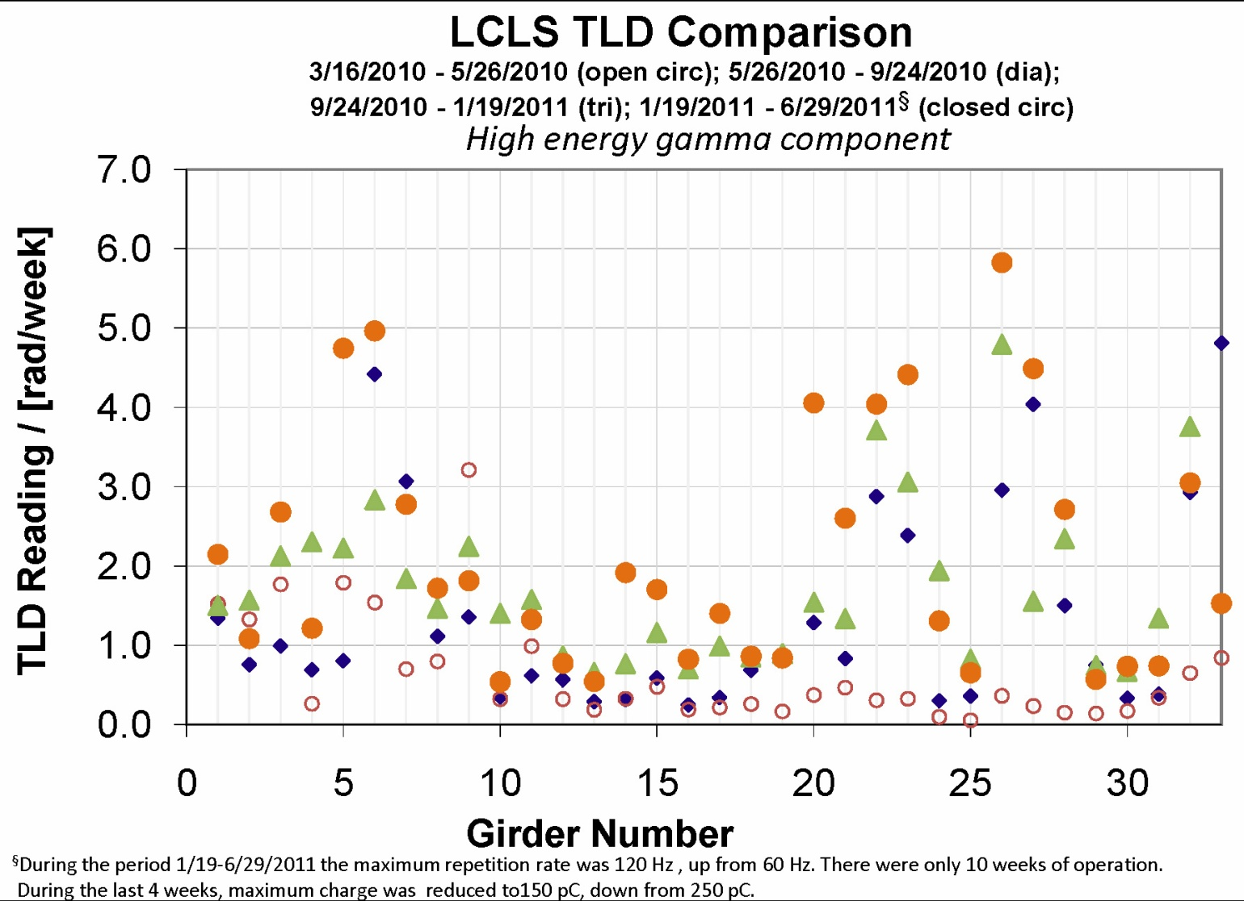
2011 Repetition Rate increased to 120 Hz
3/16/2010 – 5/26/2010
5/26/2010 – 9/24/2010
9/24/2010 – 1/19/2011
1/19/2011 – 6/29/2011
Thermo-Luminescent Dosimeters
Each TLD mounted in 1.6-mm thick Pb-casing to suppress photons below ~200 keV
External neutron doses are very small: (U01: 0.04-0.05 rad/week; U33: ~0 rad/week)
LCLS radiation level control works well.

Slide 31
SN32 Radiation Damage Check
Parameter | Jan 09 | May 10 | Difference | Tolerance
Installed in Slot |  | 30
Beam Time [Months] |  | 10
1st B_{y} Integral [µTm] | -18 | -12 | +6 | ±40
2nd B_{y} Integral [µTm²] | -2 | +10 | +12 | ±50
1st B_{x} Integral [µTm] | +18 | +5 | -13 | ±40
2nd B_{x} Integral [µTm²] | -11 | -5 | +6 | ±50
RMS Phase Shake | 4.2 | 4.2 | 0.0 | 10° Xray
Cell Phase Error | +2.2 | +2.1 | -0.1 | ±10° Xray
K_{eff} (goal 3.48670) (at the same X and 20.00° C) ΔK/K | 3.48668 -0.6×10⁻⁵ | 3.48660 -2.9×10⁻⁵ | -0.00008 -2.3×10⁻⁵ | 0.00052 (rms) 15×10⁻⁵ (rms)
NO SIGNIFICANT CHANGE IN FIELD PROPERTIES

Slide 32
SN02 Radiation Damage Check
Parameter | Jun 09 | Oct 10 | Difference | Tolerance
Installed in Slot |  | 1
Beam Time [Months] |  | 12
1st B_{y} Integral [µTm] | -5 | -5 | 0 | ±40
2nd B_{y} Integral [µTm²] | -6 | -24 | -18 | ±50
1st B_{x} Integral [µTm] | -4 | -10 | -6 | ±40
2nd B_{x} Integral [µTm²] | -3 | +10 | +13 | ±50
RMS Phase Shake | 2.4 | 2.2 | -0.2 | 10° Xray
Cell Phase Error | -3.3 | -4.5 | -1.2 | ±10° Xray
K_{eff} (goal 3.50000) (at the same X and 20.00° C) ΔK/K | 3.50003 +0.9×10⁻⁵ | 3.50008 +2.3×10⁻⁵ | +0.00005 +1.4×10⁻⁵ | 0.00052 (rms) 15×10⁻⁵ (rms)
NO SIGNIFICANT CHANGE IN FIELD PROPERTIES

Slide 33
SN16 Radiation Damage Check
Parameter | May 09 | Jul 11 | Difference | Tolerance
Installed in Slot |  | 16
Beam Time [Months] |  | 20
1st B_{y} Integral [µTm] | -4 | -5 | -1 | ±40
2nd B_{y} Integral [µTm²] | -4 | -15 | -11 | ±50
1st B_{x} Integral [µTm] | +5 | +17 | +12 | ±40
2nd B_{x} Integral [µTm²] | -10 | -6 | +4 | ±50
RMS Phase Shake | 3.5 | 3.5 | 0.0 | 10° Xray
Cell Phase Error | +4.3 | +4.0 | -0.3 | ±10° Xray
K_{eff} (goal 3.49310) (at the same X and 20.00° C) ΔK/K | 3.49302 -2.3×10⁻⁵ | 3.49308 -0.5×10⁻⁵ | +0.00006 +1.8×10⁻⁵ | 0.00052 (rms) 15×10⁻⁵ (rms)
NO SIGNIFICANT CHANGE IN FIELD PROPERTIES

Slide 34
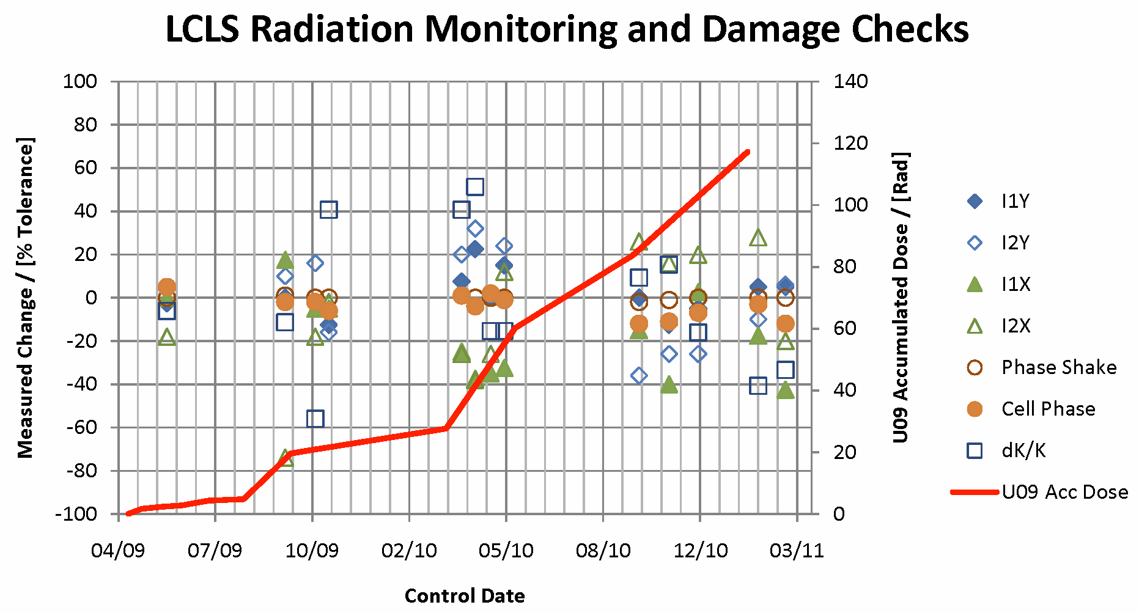
Changes in Undulator Properties After Beam Operation

Slide 35
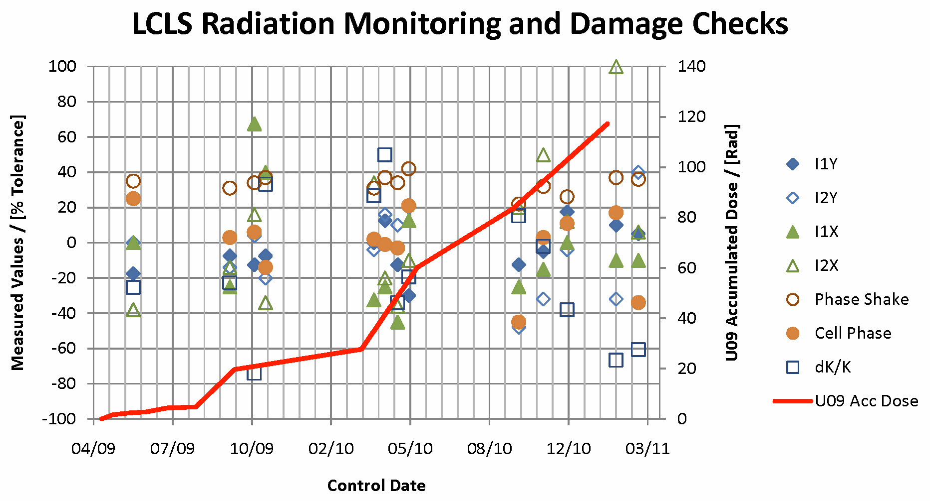
Undulator Properties After Beam Operation

Slide 36
Live Time Estimates
At LCLS, rms tolerance for ΔK_{eff} /K_{eff} is 2.4×10⁻⁴.
Measured radiation levels at 120 Hz are about 5 rad/week or less.
Estimated equivalent dose required for a block demagnetization of 10⁻⁴ is about 70 krad. (This level should still would not affect undulator performance)
These 2 numbers give an optimistic lifetime estimate of 14,000 weeks or more than 100 years.
For NGLS, K tolerances might be similar to those of LCLS but the repetition rate is 8300 times larger (,i.e. 1 MHz) and the undulator gaps are smaller.
Using the same numbers as above (,i.e., ignoring the gap reduction), we get an estimated time of 1.7 weeks, which sounds quite serious.
In this case, knowing details of the radiation fields and damage patterns is much more important.
In-vacuum undulators might provide lower vacuum pressure (<0.2 µTorr), which will reduced Bremsstrahlung.
Demagnetization levels 10⁻⁴ are too conservative, much larger magnet damage amplitudes are likely to be acceptable depending on the patterns at which damage occurs.

Slide 37
Final Remarks
A figure of merit for radiation damage was established experimentally by exposing spare LCLS Nd₂Fe₁₄B permanent magnet pieces to a well defined radiation pattern and using FLUKA simulations to connect damage levels with exposure amplitudes.
Damage is expected to be caused by neutrons and hadrons that are predominantly generated inside the magnet blocks, themselves, from high energy photons.
Radiation monitoring focuses on high energy photons outside the magnets.
A rough correlation factor have been established.
At LCLS, undulator radiation protection is achieved through a collimator system and through the machine protection system.
Based on the measured radiation levels, measurable damage is not expected for many years even at 120 Hz repetition rate.
Undulators are re-measured on an on-going bases. No damage detected so far.
Due to much higher projected repetition rates radiation damage is expected to be a much more severe problem for NGLS.

Slide 38
End of Presentation

