Slide 1
Intrabeam Scattering, Impedance, and Instabilities in Ultimate Storage Rings
Karl Bane
FLS2012 Workshop
7 March 2012

Slide 2
Outline of Talk
Longitudinal microwave instability
--Coherent synchrotron radiation (CSR)
--Impedance scaling for small angle transitions
--Impedance budget
--Pseudo-Green function wake
Other instabilities
Intra-beam scattering (IBS)
Touschek lifetime
Conclusions
As specific example illustrating the above topics I will use cases of PEP-X, a
study effort of a group led by Y. Cai

Slide 3
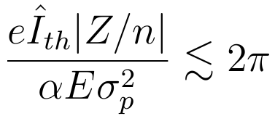
Introduction
An “ultimate storage ring” is a term used to describe a ring with diffraction limited emittances at 1 angstrom wavelength
Two 4.5 GeV versions have been designed for the PEP tunnel:
A: 2010 (SLAC-PUB-13999), ε_{x}= 165 pm, ε_{y}= 8 pm, I= 1.5 A, lattice TME + DBA
“baseline”
B: 2012 (SLAC-PUB-14785), ε_{x}= 12 pm, ε_{y}= 12 pm, I= 0.2 A, lattice 7BA
“ultimate”
Since I for Design A is so much larger, will discuss instability calculations for A
(e.g. Boussard criterion for threshold to microwave instability: )
But will apply IBS and Touschek calculations for (the recently developed) Case B.

Slide 4
Selected Parameters for PEP-X
Parameter | A | B | Units
Energy, E | 4.5 | 4.5 | GeV
Circumference, C | 2199 | 2199 | m
Average current, I | 1.5 | 0.2 | A
Bunch population, N_{b} | 2.18 | 0.28 | 10¹⁰
Number of bunches, M | 3154 | 3300
Rel. rms energy spread, σ_{p} | 1.14 | 1.2 | 10⁻³
Rms bunch length, σ_{z} | 3.0 | 3.0 | mm
Nominal emittance, ε₀ | 85.7 | 11.0 | pm
Momentum compaction, α | 5.8 | 5.0 | 10⁻⁵
Synchrotron tune, ν_{s} | 7.7 | 6.9 | 10⁻³
Horiz. rad. damping time, τ_{x} | 13.5 | 19. | ms
Long. rad. damping time, τ_{p} | 7.2 | 12. | ms
Note that the nominal horizontal emittance ε_{x0}= ε₀/(1+κ), with κ the x-y coupling parameter

Slide 5
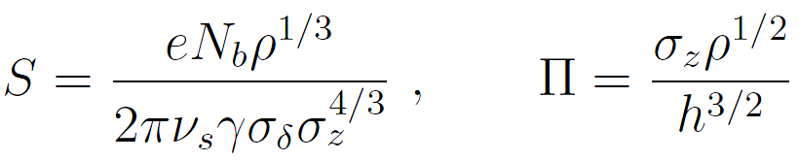
Microwave Instability Due to Shielded CSR
(K. Bane, Y. Cai, G. Stupakov, PRST-AB, 2010)
height 2h
ρ
test
v =c
driving
Wake of particles moving at speed c, on circle of radius ρ, between two metallic plates located at y= ±h was found by J. Murphy, et al.
For a bunch, the normalized threshold current S is a function of normalized shielding parameter Π, with

Slide 6
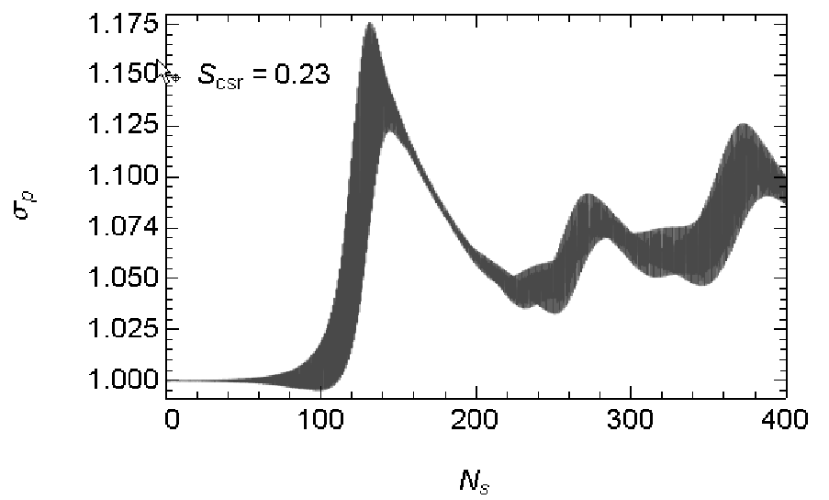
We have performed Vlasov-Fokker-Planck simulations (a la R. Warnock and J. Ellison, SLAC-PUB-8404, 2000) for the shielded CSR wake to find threshold as function of Π.
Example simulation result, showing σ_{p}/σ_{p0} vs. number of synchrotron periods N_{s}. This example is above threshold.

Slide 7
Result:
For the CSR wake, threshold values of current S vs. shielding parameter Π. The dashed curve is S_{th}= 0.50 + 0.12 Π.
For PEP-X, vacuum chamber is elliptical with axes (20.0, 12.5) mm and bending radius ρ= 100.8 m => Π= 22.7 and I_{th}= 3.6 A, far above design I.

Slide 8
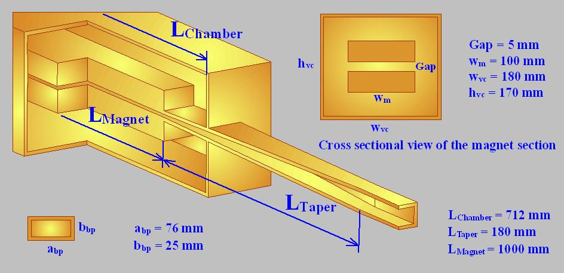
Impedance Scaling for
Small Angle Tapers
From “Impedance calculation for the NSLSII storage ring,” A. Blednykh
With the insertion gap becoming ever smaller, the insertion region becomes a dominating part of the ring impedance
Insertion transitions tend to be long, gradually tapered, and 3D => it is very challenging to obtain the wakefield for a short bunch
Impedance scaling of small angle tapers

Slide 9
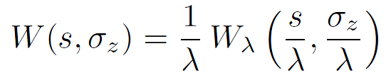
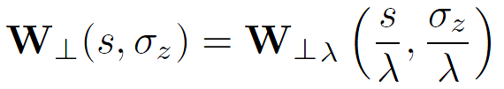
Impedance Scaling for Small Angle Transitions
(G. Stupakov, K. Bane, I. Zagorodnov, PRST-AB, 2011)
At high frequencies, envelope equation for fields satisfies parabolic equation
For small angle transitions, the parabolic equation is valid for all frequencies
As a consequence the wakes of such a transition is approx. related to that of the transition but scaled in the z direction by factor λ as:
Sketch of a small angle transition (left), and the scaled one with λ= ½ (right)
For 2D time-domain calculation this implies reduction in required computer resources of λ³, for 3D of λ⁴
full scale
λ= 1/2

Slide 10
We test the scaling using ECHO, I. Zagorodnov’s time-domain wakefield solving program.
Longitudinal (left) and transverse (right) wake of Gaussian bunch passing through a 2D small-angle transition to a long central pipe and back again. The radius of the beam pipe is 48 mm, of the central pipe is 7.5 mm, the taper angle is 5.8 deg, and σ_{z}= 0.5 mm. The full calculation is in blue, the scaled result in red; the nominal bunch shape is in black.

Slide 11
A 3D Example
(b)
(a)
A 3D symmetric, small-angle transition (of which one taper is shown in cut-view) with a long interior pipe (a); the longitudinal (b) and dipole (c) wake. Exterior pipes are 30 mm x 30 mm (x by y), interior pipe is 30 mm x 15 mm, the taper angle is 3 deg, and σ_{z}= 0.5 mm. The full calculation is in blue, the scaled result in red; the nominal bunch shape is in black.
(c)

Slide 12
Longitudinal Impedance Calculations for PEP-X
For PEP-X, without an actual vacuum chamber design available, we developed a straw man design, inspired by objects in other machines, such as PEP-II
Sources include: RF cavities, BPM’s, wiggler transitions, undulator transitions, resistive wall, coherent synchrotron radiation (CSR)
For the microwave instability, generate:
(i) a pseudo-Green function wake representing the ring—to be used in simulations (σ_{z}= .5 mm; nominal is 3 mm) and reaching to 60 mm behind the bunch
(ii) an impedance budget—to assess relative importance of contributors
People involved in 3D code development and impedance calculation include L.-Q. Lee, C.-K. Ng, L. Wang, L. Xiao

Slide 13
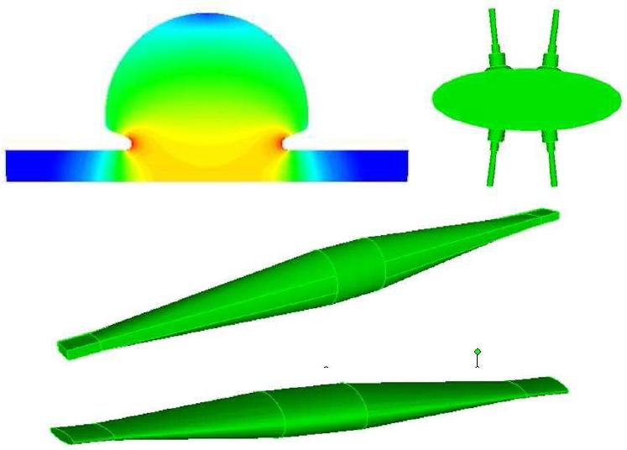
Selected PEP-X Impedance Sources
RF
cavity
BPM
Pair of wiggler transitions
Pair of undulator transitions
Selected impedance objects included in our straw man PEP-X design. Note: the fundamental mode fields are shown in the RF cavity.

Slide 14
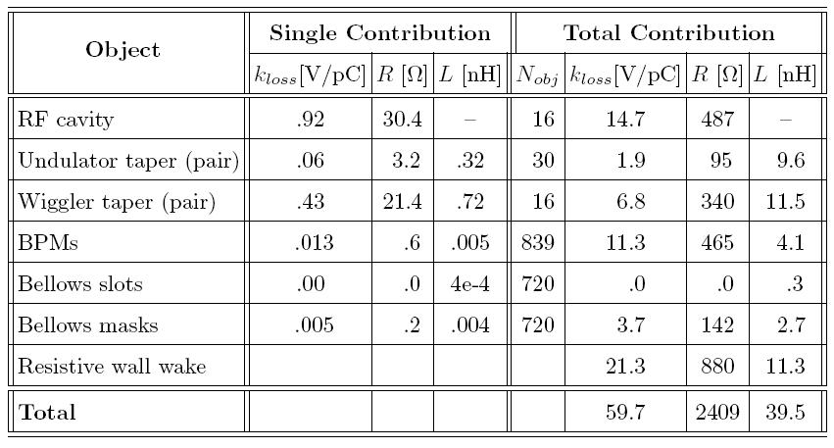
Impedance Budget
Impedance budget for PEP-X, giving the loss factor, and the effective resistance and inductance of the various objects in the ring. The results are at nominal bunch length σ_{z}= 3 mm.

Slide 15
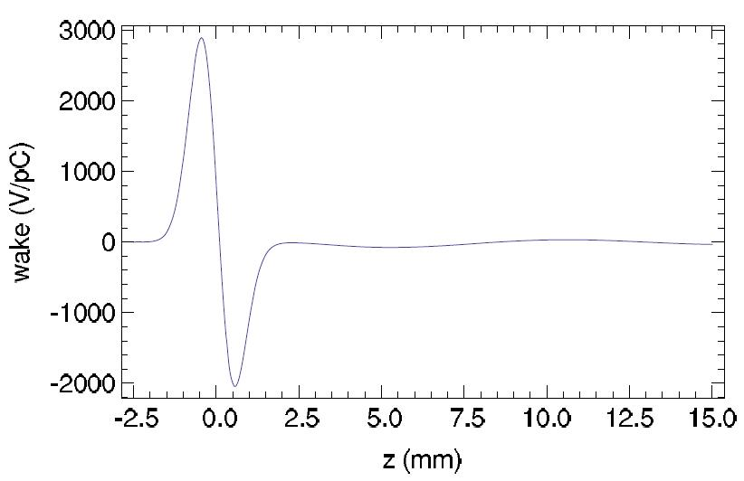
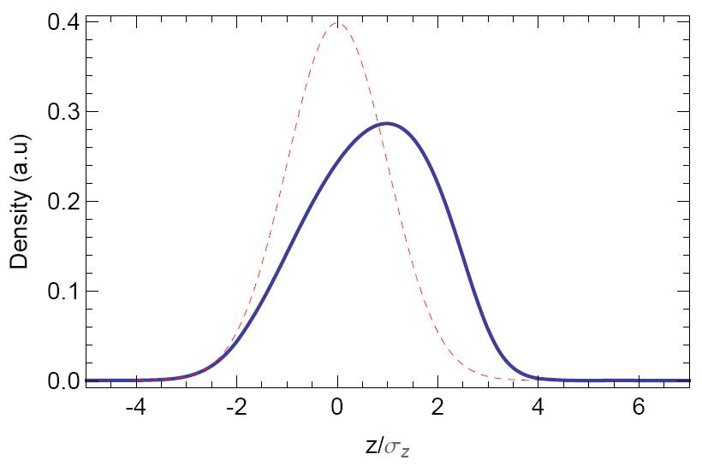
Pseudo-Green Function Wake
Pseudo-Green function wake representing the PEP-X ring: wake of a σ_{z}= .5 mm bunch
Haissinski solution, giving the steady-state bunch shape. Bunch length is 25% above nominal length.
(G. Stupakov)
Front

Slide 16
Instabilities in PEP-X (Baseline, I= 1.5 A)
G. Stupakov, L. Wang
Microwave:
Can cause σ_{p}, σ_{z} to increase, saw-tooth instability, heating. With PEP-X impedance we find 25% σ_{z} increase (potential well distortion) but no threshold until I> 8 A
Transverse Single Bunch:
Can cause beam to be lost. When including only the resistive wall impedance (dominant in the insertion devices), the threshold is 1.5 times the nominal current. Other impedance objects will reduce this value.
Since transverse resistive wall wake ∝a⁻³, (a is aperture) this is a serious limitation to reducing the aperture of the insertions.
Multibunch Transverse:
Including only the resistive wall wake, which often dominates the multibunch transverse instability, the calculation yields a growth time of .14 ms, or 19 turns. Good feedback is needed.
Fast Ion:
Multi-particle tracking shows that the instability is strong, though with a compromise between vacuum level and bunch gap size, the growth rate can be kept to a level that are manageable with feedback.

Slide 17
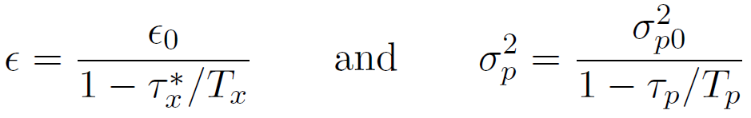
Intra-Beam Scattering (IBS) for Ultimate PEP-X
(Thanks to A. Xiao, M. Borland, K. Kubo)
IBS describes multiple Coulomb scattering that leads to an increase in all bunch dimensions and in energy spread
Assume coupling dominated (η_{y} is negligible and can be ignored): ε_{y}= κε_{x}
Steady-state IBS emittance and energy spread:
where sum emittance ε= ε_{x}+ε_{y}, and ε_{x} = ε/(1+κ); subscript 0 indicates zero current values; τ_{x}*= τ_{x}/(1+κτ_{x}/τ_{y})
Local IBS growth rates δ(1/T_{x}), δ(1/T_{p}), are functions of beam and lattice parameters; their average around the ring are the growth rates 1/T_{x}, 1/T_{p}
We follow the Bjorken-Mtingwa (BM) formulation of 1/T_{x}, 1/T_{p}; solution involves (i) an integration at every lattice element, (ii) averaging around the ring, (iii) solving the above two equations simultaneously
Due to small impact parameter events, the tails of distributions are not Gaussian; Coulomb log reflects this; for PEP-X, (log)≈ 11

Slide 18
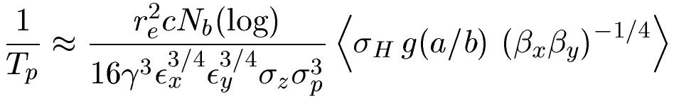
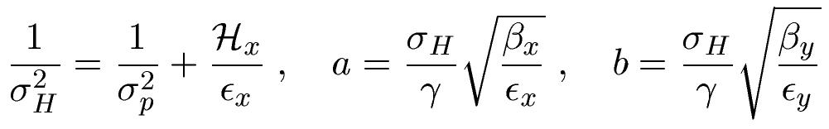

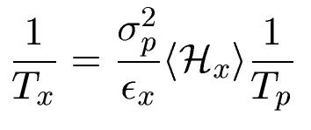
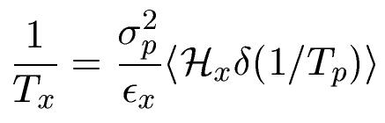
Simplified Model of IBS
(K. Bane, EPAC02)
Longitudinal growth rate:
Transverse growth rate:
Valid for a, b<< 1, “high energy approximation”
= <δ(1/T_{p})>

Slide 19
Solution for PEP-X
For PEP-X consider round beam, κ= 1
Table. Steady-state beam properties in PEP-X at zero current and nominal current. Results were obtained using the Bjorken-Mtingwa (B-M) formalism.
Note: almost no growth in p or z
In nominal configuration T_{x}⁻¹= 52. s⁻¹, T_{p}⁻¹= 7.4 s⁻¹ (simplified model gets
T_{x}⁻¹= 53.7 s⁻¹, T_{p}⁻¹= 8.9 s⁻¹ )
I [mA] | ε_{x} [pm] | ε_{y} [pm] | σ_{p} [10⁻³] | σ_{z} [mm]
0 | 5.5 | 5.5 | 1.20 | 3.0
200 | 11.5 | 11.5 | 1.25 | 3.1

Slide 20
Checked results with SAD, an optics program that treats coupling without simplifying assumptions (i.e. solves for true emittance invariants), and that can also solve the B-M IBS equations. (K. Kubo)
Procedure:
1 In dispersive-free region of PEP-X:
(i) adjust quad strengths to bring tunes close together,
(ii) randomly rotate 400 quads by small amount, with scale factor adjusted to give ε_{x}≈ ε_{y}
2 Perform IBS calculations
3 Repeat for 10 seeds
Result: steady-state ε_{x}≈ ε_{y}≈ 11 pm, with variation of few percent for the different seeds

Slide 21
Accumulated IBS Growth Rates
Accumulated growth rates in p, x;
H_{x} optics function

Slide 22
Correlation between H_{x} and δ(1/T_{p}) in PEP-X
Arc
Straight
δT_{p}⁻¹ [s⁻¹]
80H_{x} [mm]
H_{x} and δ(1/T_{p}) over one arc and one straight of PEP-X
Note the anti-correlation of the two functions in arc
With no correlation but “same” lattice parameters, 1/T_{x} would be twice as large

Slide 23
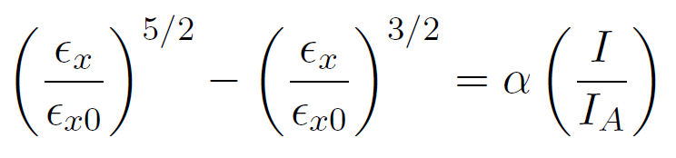
Emittance Dependence on Current
With T_{p}⁻¹ small, from simplified model can show that steady-state emittances can be approximated by
with I_{A}= 17 kA and α a constant
analytical formula
Steady-state emittances as function of bunch current in PEP-X. The dashed curve gives the analytical approximation.

Slide 24
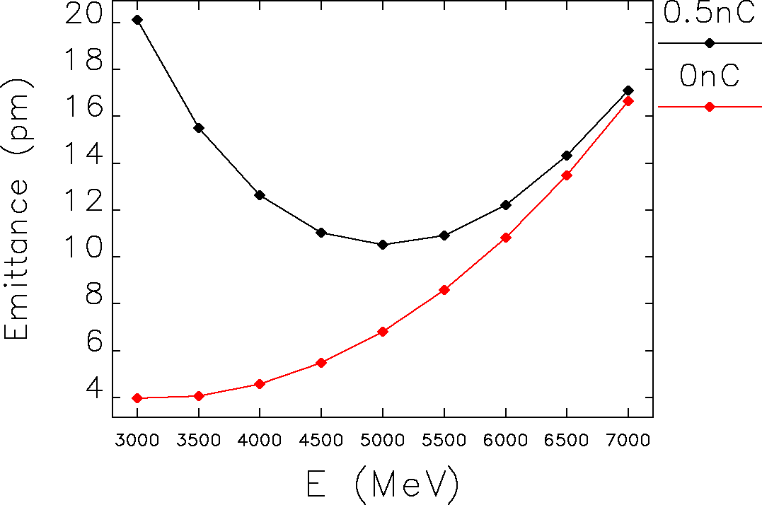
Dependence on Energy
(M. Borland)
Emittance ε_{x}= ε_{y} vs. energy for a round beam at nominal current (black) and at zero current (red).

Slide 25
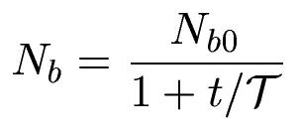
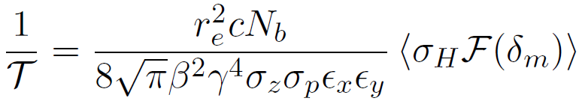
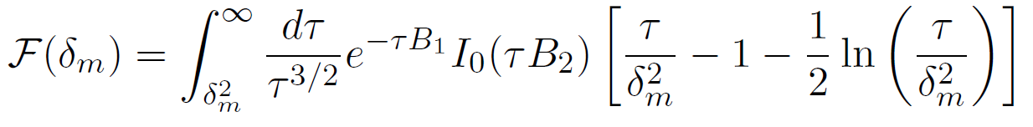
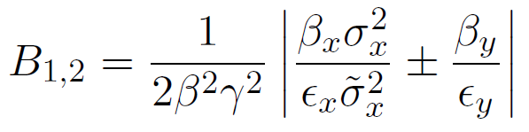
Touschek Lifetime for Ultimate PEP-X
Touschek effect concerns large, single Coulomb scattering events where energy transfer from transverse to longitudinal leads to immediate particle loss
Number of particles in bunch decays as:
Can’t use usual (flat beam) formula of Brueck
Use general formula due to Piwinski. Inverse of Touschek lifetime:
B₁~ β_{x,y}/ε_{x,y}=> where σ_{x,y} is large, 1/T is small because of exp(−τB₁) factor in integral. This factor is also reason 1/T becomes small at very small ε_{x,y.}

Slide 26
Momentum Acceptance in PEP-X
(Min-Huey Wang)
Momentum acceptance due to linear optics for PEP-X. The average value is δ_{m}= ±2.8%.

Slide 27
Touschek Lifetime Results
Result for the IBS-determined steady-state beam sizes is: T= 11 hrs
Accumulation around the ring of the Touschek growth rate in PEP-X. The growth is significant only in the arcs, where σ_{x,y} are small.

Slide 28
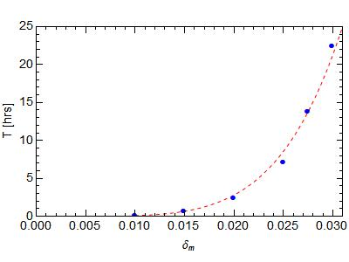
Dependence on Momentum Acceptance
Touschek lifetime T vs. (global) momentum acceptance parameter, δ_{m} (blue symbols). The dashed curve gives the fit: T= 0.088(δ_{m}/0.01)⁵ hrs.

Slide 29
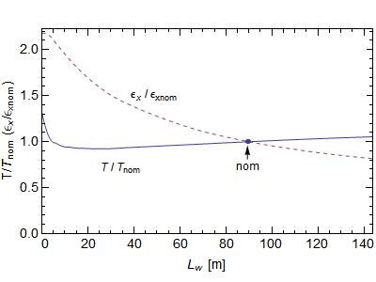
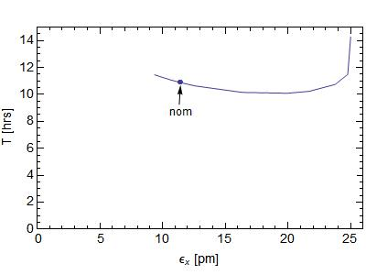
Touschek Lifetime vs Emittance
As the length of wiggler L_{w} increases, the emittance decreases. In PEP-X design L_{w}= 90 m, ε_{xnom}= 11 pm (including IBS), T_{nom}= 11 hrs
Emittance ε_{x} (= ε_{y}) and Touschek lifetime T vs wiggler length L_{w} (left plot), and T vs ε_{x} (right). These are results of self-consistent calculations including IBS.

Slide 30
Conclusions
In ultimate storage rings, such as the latest version of PEP-X, impedance effects tend not to be important since the current is quite low (200 mA)
IBS sets the limit of current that can be stored in an ultimate ring. In PEP-X with round beams, IBS doubles the emittance to 11 pm at the design current of 200 mA
The Touschek lifetime in ultimate PEP-X is quite large, 11 hrs, but it is a very sensitive function of the momentum acceptance
How to run a machine with a round beam needs serious study. E.g. using vertical dispersion may be preferable to coupling. The choice will affect the IBS and Touschek effect
In the higher current version of PEP-X (baseline, 2010, I= 1.5 mA), the transverse single and multi-bunch instabilities can become an issue, with the small-gap insertion devices becoming dominant contributors to the (transverse) ring impedance

